Slide 1
group project 2
karen

Slide 2
Introduction of dataset

Slide 3
Question to be explored
Imagine you have been asked by a film producer to investigate the following question of interest:
Which properties of films influence whether they are rated by IMDB as greater than 7 or not?
You should conduct an analysis to answer your question using a Generalised Linear Model (GLM). Following your analyses, you should then summarise your results in the form of a presentation.

Slide 4
Introduction of dataset

Slide 5
Explain each variables
film.id – The unique identifier for the film
year – Year of release of the film in cinemas
length – Duration (in minutes)
budget – Budget for the films production (in $1000000s)
votes – Number of positive votes received by viewers
genre – Genre of the film
rating – IMDB rating from 0-10

Slide 6
Data processing
Create a column to separate the rating: >7(1), <=7(0)

Slide 7
year | length | budget | votes | genre | rating.large7
2003 | 75 | 10.9 | 17 | Action | 0
2004 | 120 | 19.6 | 21 | Documentary | 1
1941 | 78 | 11.7 | 14 | Action | 0
1959 | 106 | 12.0 | 14 | Drama | 0
1917 | 70 | 14.8 | 9 | Drama | 0
1934 | 64 | 11.6 | 8 | Drama | 0
2003 | 91 | 12.6 | 182 | Comedy | 0
1988 | 101 | 10.1 | 274 | Action | 0
1981 | 78 | 14.2 | 61 | Action | 0
1935 | 7 | 6.6 | 10 | Animation | 1

Slide 8
Exploratory data analysis

Slide 9
The distribution of rating.large7 by genre
## `summarise()` has grouped output by 'genre'. You can override using the `.groups` argument.

Slide 10
genre | rating.large7 | n
Action | 0 | 563
Action | 1 | 117
Animation | 0 | 49
Animation | 1 | 111
Comedy | 0 | 224
Comedy | 1 | 325
Documentary | 0 | 11
Documentary | 1 | 121
Drama | 0 | 620
Drama | 1 | 34
Romance | 0 | 15
Short | 0 | 1
Short | 1 | 104

Slide 11
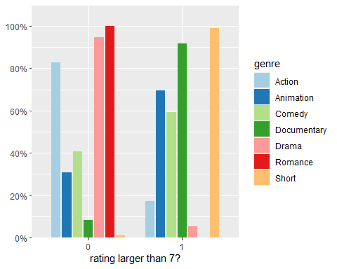

Slide 12
rating.large7 | Action | Animation | Comedy | Documentary | Drama | Romance | Short
0 | 38.0% (563) | 3.3% (49) | 15.1% (224) | 0.7% (11) | 41.8% (620) | 1.0% (15) | 0.1% (1)
1 | 14.4% (117) | 13.7% (111) | 40.0% (325) | 14.9% (121) | 4.2% (34) | 0.0% (0) | 12.8% (104)

Slide 13
The distribution of rating.large7 by other numerical variables

Slide 14
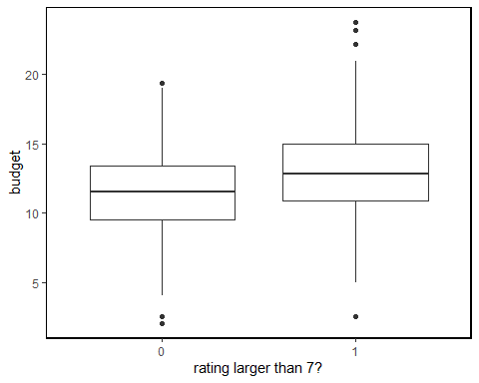
budget

Slide 15
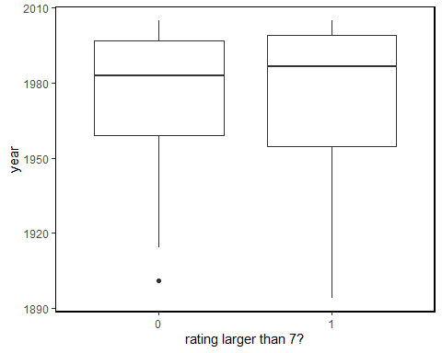
year

Slide 16
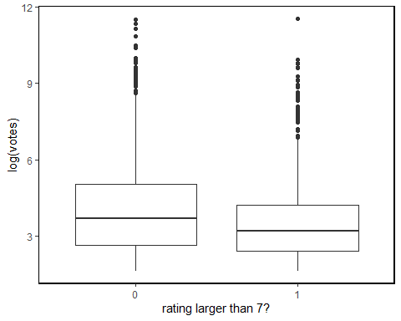
votes

Slide 17
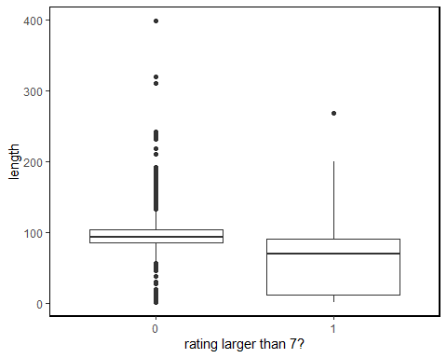
length

Slide 18
Formal data analysis

Slide 19
Take log transformation of variable “vote” because the scale is not linear.

Slide 20
Formal data analysis

Slide 21
Stepwise Slection: choosing which variables need to be removed.
Since Model with “year” removed has lowest AIC=1303.21 and deviance D=1283.2 we will go ahead and compared the three link function in our model
## Start: AIC=1304.73 ## rating.large7 ~ length + budget + genre + log.votes + year ## ## Df Deviance AIC ## - year 1 1283.2 1303.2 ## <none> 1282.7 1304.7 ## - log.votes 1 1293.0 1313.0 ## - length 1 1595.2 1615.2 ## - budget 1 1658.2 1678.2 ## - genre 6 2101.0 2111.0 ## ## Step: AIC=1303.21 ## rating.large7 ~ length + budget + genre + log.votes ## ## Df Deviance AIC ## <none> 1283.2 1303.2 ## + year 1 1282.7 1304.7 ## - log.votes 1 1294.3 1312.3 ## - length 1 1602.0 1620.0 ## - budget 1 1659.2 1677.2 ## - genre 6 2118.6 2126.6
## ## Call: ## glm(formula = rating.large7 ~ length + budget + genre + log.votes, ## family = binomial(link = "logit"), data = film) ## ## Deviance Residuals: ## Min 1Q Median 3Q Max ## -3.7981 -0.3973 -0.1132 0.2672 4.3137 ## ## Coefficients: ## Estimate Std. Error z value Pr(>|z|) ## (Intercept) -3.902725 0.454750 -8.582 < 2e-16 *** ## length -0.054295 0.003818 -14.220 < 2e-16 *** ## budget 0.499131 0.031641 15.775 < 2e-16 *** ## genreAnimation -0.335711 0.346575 -0.969 0.332719 ## genreComedy 2.677837 0.184023 14.552 < 2e-16 *** ## genreDocumentary 4.908172 0.414732 11.835 < 2e-16 *** ## genreDrama -2.081558 0.259941 -8.008 1.17e-15 *** ## genreRomance -14.705910 513.365991 -0.029 0.977147 ## genreShort 4.192245 1.051548 3.987 6.70e-05 *** ## log.votes 0.139433 0.041932 3.325 0.000884 *** ## --- ## Signif. codes: 0 '***' 0.001 '**' 0.01 '*' 0.05 '.' 0.1 ' ' 1 ## ## (Dispersion parameter for binomial family taken to be 1) ## ## Null deviance: 2982.5 on 2294 degrees of freedom ## Residual deviance: 1283.2 on 2285 degrees of freedom ## AIC: 1303.2 ## ## Number of Fisher Scoring iterations: 15

Slide 22
Formal data analysis

Slide 23
Comparing different link functions
The AIC and BIC in model1 is the smallest, and the Pseudo-R² is the largest. Hence we choose ‘logit’ link function to fit our model
Model 1: logit link

Slide 24
 | Estimate | Std. Error | z value | Pr(>|z|)
(Intercept) | -3.9027252 | 0.4547502 | -8.5821288 | 0.0000000
length | -0.0542952 | 0.0038184 | -14.2195171 | 0.0000000
budget | 0.4991309 | 0.0316411 | 15.7747597 | 0.0000000
log.votes | 0.1394325 | 0.0419324 | 3.3251739 | 0.0008836
genreAnimation | -0.3357107 | 0.3465752 | -0.9686518 | 0.3327189
genreComedy | 2.6778375 | 0.1840227 | 14.5516666 | 0.0000000
genreDocumentary | 4.9081723 | 0.4147323 | 11.8345565 | 0.0000000
genreDrama | -2.0815583 | 0.2599412 | -8.0078036 | 0.0000000
genreRomance | -14.7059096 | 513.3659914 | -0.0286461 | 0.9771469
genreShort | 4.1922446 | 1.0515476 | 3.9867379 | 0.0000670

Slide 25
Model 2: probit link
## Warning: glm.fit: fitted probabilities numerically 0 or 1 occurred

Slide 26
 | Estimate | Std. Error | z value | Pr(>|z|)
(Intercept) | -2.2580098 | 0.2400473 | -9.4065197 | 0.0000000
length | -0.0270367 | 0.0019004 | -14.2266271 | 0.0000000
budget | 0.2651683 | 0.0161181 | 16.4516088 | 0.0000000
log.votes | 0.0741528 | 0.0229369 | 3.2328987 | 0.0012254
genreAnimation | 0.0114378 | 0.1850186 | 0.0618195 | 0.9507066
genreComedy | 1.4366364 | 0.0972245 | 14.7764884 | 0.0000000
genreDocumentary | 2.6788268 | 0.2089662 | 12.8194241 | 0.0000000
genreDrama | -1.1254739 | 0.1323994 | -8.5005985 | 0.0000000
genreRomance | -4.7946239 | 76.3841715 | -0.0627699 | 0.9499498
genreShort | 2.3095760 | 0.4487067 | 5.1471839 | 0.0000003

Slide 27
Model 3: complementary log-log link
## Warning: glm.fit: algorithm did not converge
## Warning: glm.fit: fitted probabilities numerically 0 or 1 occurred

Slide 28
 | Estimate | Std. Error | z value | Pr(>|z|)
(Intercept) | -3.0603647 | 2.770069e-01 | -11.047973 | 0.0000000
length | -0.0261264 | 2.017800e-03 | -12.948013 | 0.0000000
budget | 0.2727197 | 1.770050e-02 | 15.407474 | 0.0000000
log.votes | 0.0631261 | 2.702300e-02 | 2.336017 | 0.0194904
genreAnimation | 0.2913751 | 2.000395e-01 | 1.456588 | 0.1452302
genreComedy | 1.6175171 | 1.180506e-01 | 13.701901 | 0.0000000
genreDocumentary | 2.8208752 | 1.889471e-01 | 14.929446 | 0.0000000
genreDrama | -1.4234838 | 1.920719e-01 | -7.411201 | 0.0000000
genreRomance | -24.4586756 | 7.992165e+04 | -0.000306 | 0.9997558
genreShort | 2.3520773 | 3.407617e-01 | 6.902411 | 0.0000000

Slide 29
Model | link function | AIC | BIC
model1 | $g(p_{i})=log(\frac{p_{i}}{1−p_{i}})$ | 1303.21 | 1360.6
model2 | $g(p_{i})=ϕ^{−1}(pi),p_{i}=ϕ(\frac{x_{i}−μ}{σ})$ | 1328.18 | 1385.57
model3 | $g(p_{i})=log[−log(1−p_{i})]$ | 1402.13 | 1459.51

Slide 30
final model
$$log(\frac{p_{(rating.large7=1)}}{1−p_{(rating.large7=1)}})=−3.9+−0.05length_{i}+0.5*budget_{i}+0.14*log(votes_{i})+−0.34*I_{(}genre=Animation)+2.68*I_{(}genre=Comedy)+4.91*I_{(}genre=Documentary)+4.91*I_{(}genre=Drama)+4.91*I_{(}genre=Romance)+4.91*I_{(}genre=Short)$$
$$I_{(genre=Animation)}=\left\{\begin{matrix}1,genre=Animation \\ 0,otherwise\end{matrix}\right.,$$
$$I_{(genre=Comedy)}=\left\{\begin{matrix}1,genre=Comedy \\ 0,otherwise\end{matrix}\right.,$$
$$I_{(genre=Documentary)}=\left\{\begin{matrix}1,genre=Documentary \\ 0,otherwise\end{matrix}\right.,$$
$$I_{(genre=Drama)}=\left\{\begin{matrix}1,genre=Drama \\ 0,otherwise\end{matrix}\right.,$$
$$I_{(genre=Romance)}=\left\{\begin{matrix}1,genre=Romance \\ 0,otherwise\end{matrix}\right.,$$
$$I_{(genre=Short)}=\left\{\begin{matrix}1,genre=Short \\ 0,otherwise\end{matrix}\right..$$

Slide 31
Residual Deviance
$$D_{0}−D_{1}=2982.47−1283.21=1699.26>χ^{2}(0.95,9)=16.9189776$$
We reject H0, and we can say that the model1 fits the data better than Null model.
## [1] 1699.256
## [1] 16.91898

Slide 32
Deviance
To assess the adequacy of the model1 compared to the full/saturated model
The deviance of model1 is $D=1283.21>χ^{2}(0.95,2)=5.9914645$
So we can conclude that there is no evidence of lack of fit for the model1.
## [1] 3.841459

Slide 33
Odds ratios of model1
We interpret the odds ratios as follows: for the increase in the film’s length, the odds of rating bigger than 7 decrease; for the increase in the film’s budget, the odds of rating bigger than 7 increase; for the increase in the film’s votes, the odds of rating bigger than 7 increase; Animation’s odds of survival were 0.71 times those of Action, Comedy’s odds of survival were 14.55 times those of Action, Documentary’s odds of survival were 135.39 times those of Action, Drama’s odds of survival were 0.12 times those of Action, Short’s odds of survival were 66.17 times those of Action.
## Scale for 'y' is already present. Adding another scale for 'y', which will ## replace the existing scale.
## Warning: Transformation introduced infinite values in continuous y-axis
## Warning: Removed 1 rows containing missing values (geom_point).
## Warning: Removed 1 rows containing missing values (geom_text).

Slide 34
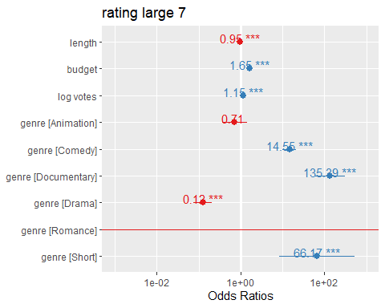

Slide 35
Prediction

Slide 36
length
## Data were 'prettified'. Consider using `terms="length [all]"` to get smooth plots.

Slide 37
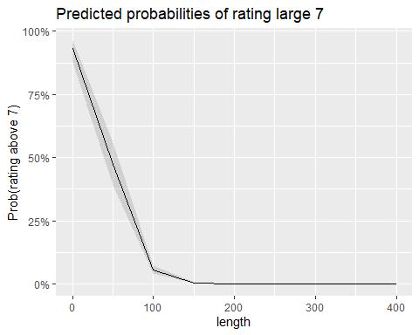

Slide 38
## log.votes
## Data were 'prettified'. Consider using `terms="log.votes [all]"` to get smooth plots.

Slide 39
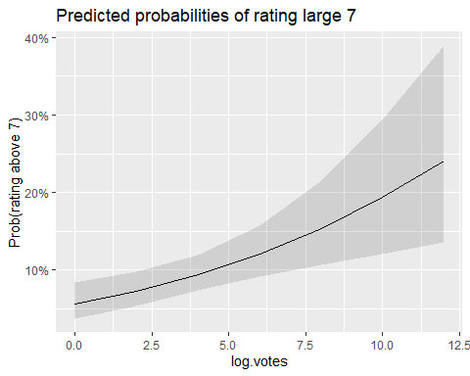

Slide 40
budget
## Data were 'prettified'. Consider using `terms="budget [all]"` to get smooth plots.

Slide 41
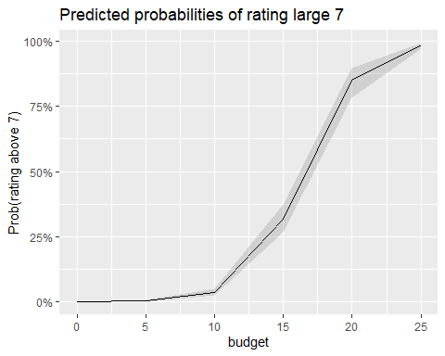

Slide 42
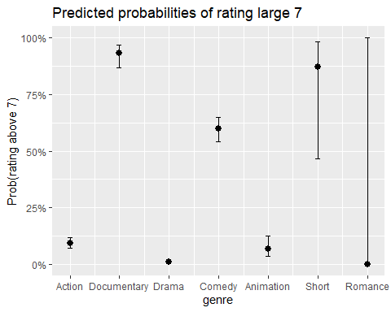
genre

Slide 43
Model checking and diagnostics

Slide 44
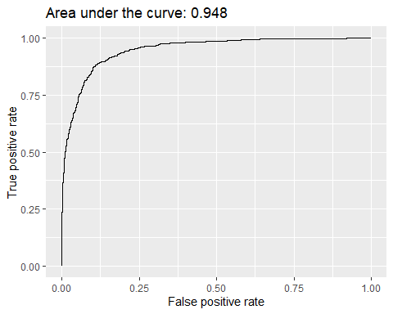
ROC curve and AUC

Slide 45
The area under Curve (AUC) = 0.948 indicated that model 1 is very good at predicting the films rating greater than 7 given all predictor variables.

Slide 46
Hosmer-Lemeshow goodness of fit test
$H_{0}:$ Model1 fits the data well
$H_{1}:$ Model1 is not a good fit for the data
## Warning in HLTest(model1, g = 6): Some expected counts are less than 5. Use ## smaller number of groups
## ## Hosmer and Lemeshow goodness-of-fit test with 6 bins ## ## data: model1 ## X2 = 5.4773, df = 4, p-value = 0.2417
The large p-value = 0.2417 indicates no lack of fit for the model1 and we fail to reject $H_{0}$.

