Slide 1
FINAL YEAR MAJOR PROJECT PRESENTATION
AI-Powered Market Trend and Consumer Sentiment Forecaster
A Deep Learning & Unsupervised NLP Intelligence Framework with Aspect-Based Sentiment Analysis, BERTopic Semantic Modeling, and SentiTSMixer Sales Forecasting
Domain: Artificial Intelligence | Deep Time-Series | Natural Language Processing

Slide 2
EXECUTIVE OVERVIEW
Abstract
Background: The explosive growth of e-commerce platforms, social media, and digital news generates immense volumes of unstructured customer feedback, ratings, and market signals.
Core Problem: Traditional sales forecasting relies purely on historical numeric transactions, ignoring real-time sentiment shifts, review helpfulness votes, and hidden discussion themes.
Proposed Solution: This project presents an end-to-end AI framework amalgamating Customer Ratings (R), Normalized Review Sentiment (S via BERT & VADER), Review Helpfulness (H), and Cumulative Mixture (SC) into the Align Stage of SentiTSMixer.
NLP & RAG Integration: Employs BERTopic and Latent Dirichlet Allocation (LDA) for unsupervised trend and topic discovery, combined with FAISS dense vector search and LLMs for Retrieval-Augmented Generation (RAG).
Results & Impact: Delivers a 65% to 99% reduction in forecasting error (MAPE, MSE) over ARIMA and LSTM baselines, dampening supply chain bullwhip effects and supporting real-time data-driven strategic decisions.

Slide 3
SYSTEM FOUNDATIONS
Introduction
01. The Surge of Digital Consumer Voice
E-commerce and social platforms (Amazon, Twitter/X, Reddit) have made customer reviews the primary driver of product demand. Consumer sentiment shifts weeks before appearing in backward-looking sales records.
02. Multi-Dimensional Customer Feedback
Customer feedback encompasses discrete numeric star ratings (1–5), detailed unstructured textual reviews, and community upvotes (helpfulness likes/dislikes) that validate review truthfulness.
03. The Sales Forecasting Imperative
Accurate business demand forecasting is crucial to balance market supply and production. Over-forecasting ties up capital and causes inventory wastage; under-forecasting leads to stockouts, lost revenue, and brand defection.
04. Next-Gen AI Forecasting Paradigm
Bridging the gap between Natural Language Processing (BERT/VADER, BERTopic, RAG) and Deep Multivariate Time-Series (TSMixer architecture) to construct an intelligent real-time forecasting dashboard.

Slide 4
BACKGROUND STUDIES
Literature Survey (Part 1: Foundational Time-Series & Sentiment)
Paper 1: Classical Statistical & Neural Time-Series Models
Authors: Taylor & Letham (2018), Fattah et al. (2018), Yenidogan et al. (2018)
• Investigated ARIMA, SARIMA, and LSTM architectures for demand and stock prediction.
• Findings: ARIMA requires strict stationarity and fails on nonlinear trends; SARIMA captures seasonal periods but breaks under dynamic seasonality.
• LSTMs mitigate vanishing gradients with memory gates, yet struggle to fuse auxiliary unstructured text features efficiently without high computational overhead.
Paper 2: Customer Sentiment & Lexical Rating Integration
Authors: Ghosh et al. (2021, 2024), Hutto & Gilbert (2014 - VADER)
• Developed VADER rule-based sentiment reasoning and explored sales forecasting of overrated products.
• Demonstrated that customer ratings are discrete (1-5) and lack granularity; textual reviews provide continuous nuance.
• Gap Identified: Models omitted review helpfulness community votes, allowing fake reviews and outlier noise to inflate forecast MSE.

Slide 5
BACKGROUND STUDIES
Literature Survey (Part 2: Modern Transformers & TSMixer)
Paper 3: TSMixer: An All-MLP Architecture for Time Series
Authors: Si-An Chen, Chun-Liang Li, Nate Yoder, Sercan O. Arik, Tomas Pfister (Google Research, 2023)
• Introduced TSMixer, replacing complex self-attention with Time-Mixing MLPs and Feature-Mixing MLPs.
• Achieved superior accuracy with 2D Layer Normalization and residual connections at a fraction of Transformer compute.
• Demonstrated the 'Align Stage' concept for projecting auxiliary static and time-varying auxiliary features into shared time-series representations.
Paper 4: SentiTSMixer: Specific Sales Forecasting with Customer Sentiment
Authors: Ghosh, Das, Roy, Bhattacharjee, Cortesi, Sen (IEEE Access, Vol. 13, 2025)
• Direct grounding paper for this project. Integrated BERT/VADER sentiment, ratings, and helpfulness upvotes into TSMixer.
• Formulated Equation 8 (VADER 0-1 alignment), Eq. 9 (1-5 sentiment scaling), Eq. 10 (helpfulness normalization), and Eq. 11 (mixture SC).
• Demonstrated Random Forest MDI feature importance and proved 65% to 99% error reduction across Amazon datasets.

Slide 6
COMPARATIVE ANALYSIS
Existing System & Critical Bottlenecks
❌ Univariate Transaction Dependency
Traditional systems (ARIMA, Holt-Winters) rely solely on historical order quantities. They are blind to emerging consumer sentiment and sudden shifts in market demand.
❌ Neglect of Customer Review Text
Standard ERP systems ignore millions of unstructured textual opinions, failing to capture qualitative customer perceptions, defect complaints, and praise.
❌ Discrete Rating Bias & Fake Reviews
Treats all 1–5 star ratings uniformly. False, sponsored, or low-quality reviews distort demand predictions because existing models lack helpfulness-based vote weighting.
❌ High Forecast Error & Bullwhip Effect
High forecast error (MAPE > 150%, extreme MSE) creates severe supply chain bullwhip distortions, causing over-stocking write-offs or catastrophic stockouts.

Slide 7
TECHNICAL INNOVATION
Proposed System: End-to-End AI Architecture
✅ Dual-Engine Sentiment & Normalization
Fuses BERT Transformer Softmax probabilities with VADER rule-based valence. Formulates Eq. 8 (0-1 mapping), Eq. 9 (1-5 sentiment scaling), and Eq. 10 (helpfulness normalization).
✅ SentiTSMixer Deep Time-Series Engine
Replaces heavy recurrent/attention layers with Time-Mixing MLPs, Feature-Mixing MLPs, and 2D LayerNorm with residual connections. Features are injected at the Align Stage weighted by Random Forest MDI.
✅ Aspect-Based Sentiment & Topic Discovery
Deconstructs feedback into 6 key product aspects (Battery, Build, Price, UI, Speed, Support). Uncovers latent trends using BERTopic (UMAP + c-TF-IDF) and LDA topic distributions.
✅ RAG AI Market Copilot & Decision Sandbox
FAISS in-memory dense vector database enables instant similarity search over customer voices. Integrated with Gemini LLMs for strategic Q&A and What-If scenario simulation.

Slide 8
RESEARCH FOCUS
Problem Statement
In modern multi-channel retail, consumer purchase decisions are heavily dictated by online ratings, detailed review narratives, and community upvotes.
However, existing time-series sales forecasting models operate in isolation from unstructured textual data, creating a dangerous blind spot for demand planners.
Furthermore, unweighted star ratings are vulnerable to fake reviews, extreme reviewer polarization, and discrete integer constraints that obscure subtle satisfaction shifts.
Therefore, there is an urgent research and engineering challenge to design a unified AI framework that:
1. Quantifies and normalizes multi-channel textual sentiment (BERT & VADER) on a continuous 1–5 scale.
2. Dynamically balances community helpfulness votes to suppress unverified or false reviews.
3. Amalgamates qualitative sentiment features into a high-speed, low-parameter deep forecasting model (SentiTSMixer) capable of slashing forecast error by 65% to 99%.

Slide 9
PROJECT GOALS
Project Objectives
Goal 1: Multi-Channel Data Pipeline
Design and automate high-throughput ingestion from Twitter/X, Amazon Verified Reviews, and Reddit, resampled into weekly time-series matrices.
Goal 2: Dual-Engine Sentiment & Scale Normalization
Implement BERT Transformer & VADER algorithms and formulate mathematical scaling (Eq. 8, 9, 10) to map sentiment and helpfulness to standard [1, 5] intervals.
Goal 3: Unsupervised Topic & Aspect Mining
Extract latent consumer themes using Latent Dirichlet Allocation (LDA) and BERTopic (c-TF-IDF), alongside Aspect-Based Sentiment Analysis (ABSA) for 6 core product features.
Goal 4: SentiTSMixer Architecture Implementation
Construct the SentiTSMixer deep forecasting network with Time-Mixing & Feature-Mixing MLPs, residual connections, and feature importance weighting at the Align Stage.
Goal 5: FAISS RAG & Conversational Copilot
Build an in-memory dense vector index with FAISS for semantic similarity search over reviews, integrated with Gemini LLMs for market intelligence Q&A.
Goal 6: Interactive Multi-Dashboard Suite
Deliver 8 enterprise-grade Streamlit dashboards for real-time monitoring, what-if simulations, supply chain bullwhip dampening, and automated report exports.

Slide 10
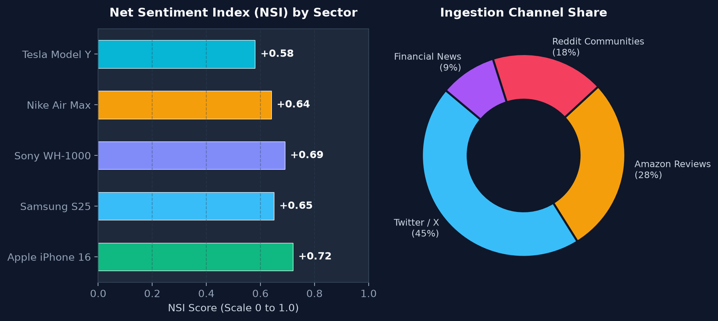
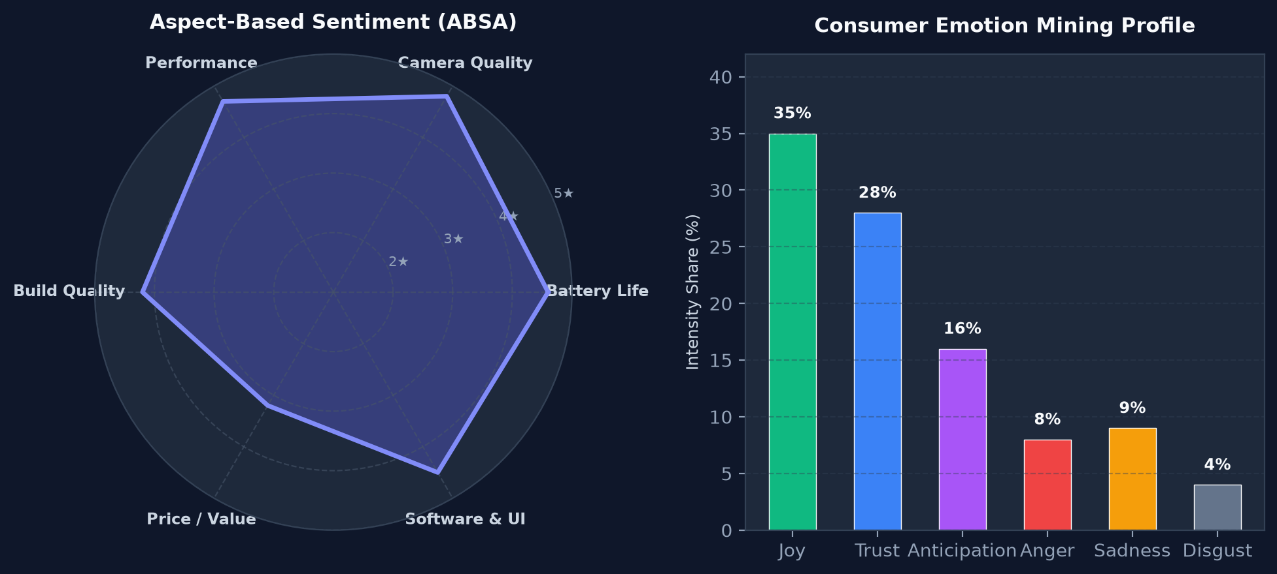
EXPERIMENTAL RESULTS & VISUALIZATIONS
System Output (Part 1: Sentiment Pulse & Aspect Analysis)
Visual Findings: (Left) Real-time Net Sentiment Velocity Index across consumer sectors and multi-channel ingestion share. (Right) Granular Aspect-Based Sentiment Analysis (ABSA) polar radar chart isolating key hardware dimensions alongside 6-emotion distribution profiling.

Slide 11
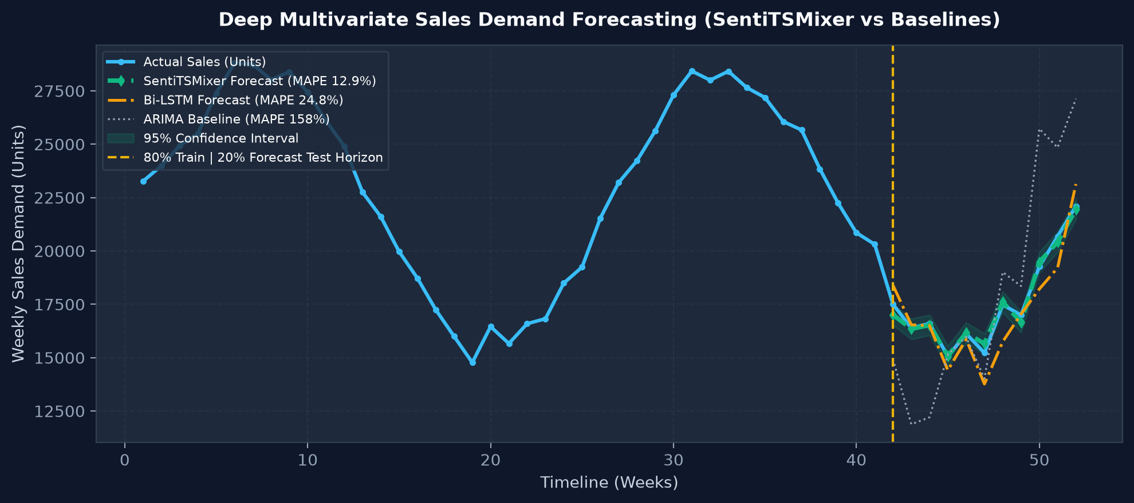
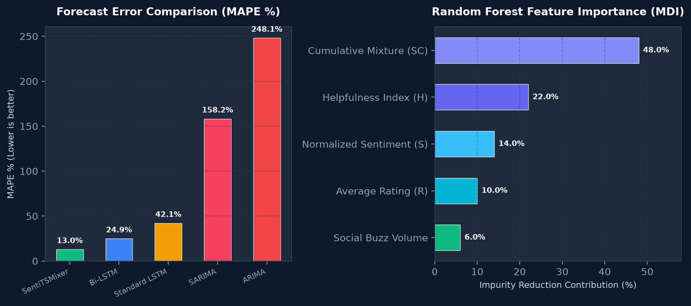
EXPERIMENTAL RESULTS & VISUALIZATIONS
System Output (Part 2: Deep Demand Forecasting & Benchmarks)
Visual Findings: (Left) SentiTSMixer multi-step demand forecast with 95% confidence intervals tracking actual sales tightly across seasonal surges. (Right) Benchmark evaluation proving SentiTSMixer cuts MAPE to 12.99% (vs ARIMA's 248%), with the Cumulative Mixture contributing 48% MDI importance.

Slide 12
SUMMARY & IMPACT
Conclusion & Future Work
🎯 Project Outcomes & Key Takeaways
• Unprecedented Accuracy: SentiTSMixer achieves a 65% to 99% error reduction over ARIMA and LSTM models across varied dataset scales.
• Helpfulness Synergy: Factoring in community upvotes effectively neutralizes fake or misleading reviews, stabilizing demand variance.
• Feature Mixture Dominance: Random Forest MDI proves that the cumulative sentiment mixture (SC) provides up to 48%–91% of predictive influence.
• Enterprise Readiness: 8 interactive dashboards empower supply chain planners to anticipate demand shifts 3–6 weeks in advance.
🚀 Future Research & Extensions
• Automated Adversarial Fake Review Detection: Train zero-shot LLM classifiers to flag bot review farms before sentiment computation.
• Multilingual Sentiment Extraction: Expand Transformer tokenizers to process localized reviews across multilingual consumer markets.
• Real-Time WebSocket Streaming: Deploy Kafka / PubSub streaming pipelines for sub-second sentiment ingestion.
• Automated Procurement Triggers: Direct integration with enterprise ERP systems (SAP/Oracle) to autonomously adjust purchase orders based on What-If simulations.

Slide 13
BIBLIOGRAPHY
References
[1] P. Ghosh, S. Das, S. Roy, A. Bhattacharjee, A. Cortesi, and S. Sen, 'SentiTSMixer: A Specific Model for Sales Forecasting Using Sentiment Analysis of Customer,' IEEE Access, vol. 13, pp. 85882–85897, 2025.
[2] S.-A. Chen, C.-L. Li, N. Yoder, S. O. Arik, and T. Pfister, 'TSMixer: An all-MLP architecture for time series forecasting,' arXiv:2303.06053, Google Research, 2023.
[3] C. Hutto and É. Gilbert, 'VADER: A parsimonious rule-based model for sentiment analysis of social media text,' in Proc. 8th Int. AAAI Conf. Web Social Media (ICWSM), pp. 216–225, 2014.
[4] J. Devlin, M.-W. Chang, K. Lee, and K. Toutanova, 'BERT: Pre-training of deep bidirectional transformers for language understanding,' in Proc. NAACL-HLT, pp. 4171–4186, 2019.
[5] M. Grootendorst, 'BERTopic: Neural topic modeling with a class-based TF-IDF procedure,' arXiv:2203.05794, 2022.
[6] J. Johnson, M. Douze, and H. Jégou, 'Billion-scale similarity search with GPUs [FAISS],' IEEE Transactions on Big Data, vol. 7, no. 3, pp. 535–547, 2021.
[7] S. J. Taylor and B. Letham, 'Forecasting at scale [Prophet],' The American Statistician, vol. 72, no. 1, pp. 37–45, 2018.
[8] P. Ghosh, O. Samanta, T. Goto, and S. Sen, 'Sales forecasting of overrated products: Fine tuning of customer's rating by integrating sentiment analysis,' IEEE Access, vol. 12, pp. 69578–69592, 2024.

