Slide 1
SMART PEER COMPANION
Individual
Contribution
01
RESEARCH
02
UML
From research to backend foundations
03
ARCHITECTURE
04
BACKEND
Hein Myat Thu · Backend Architecture

Slide 2
CONTRIBUTION JOURNEY
02
My contribution connected evidence to implementation
Each stage produced an asset the team could use in the next stage.
1
2
3
4
Research
Model
Architect
Implement
Literature reviews and survey participation
Nine owned UML diagrams across four views
Clean boundaries and one-VM deployment
Backend skeleton, APIs, and documentation
Outcome
A traceable backend plan: why the feature exists → how it behaves → where it belongs → how it can run.
SMART PEER COMPANION · INDIVIDUAL CONTRIBUTION

Slide 3
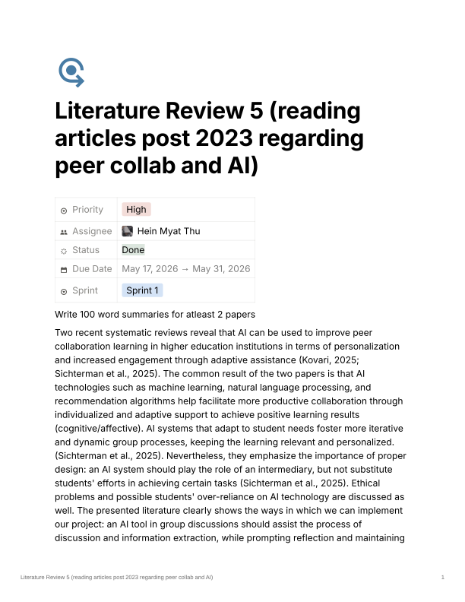
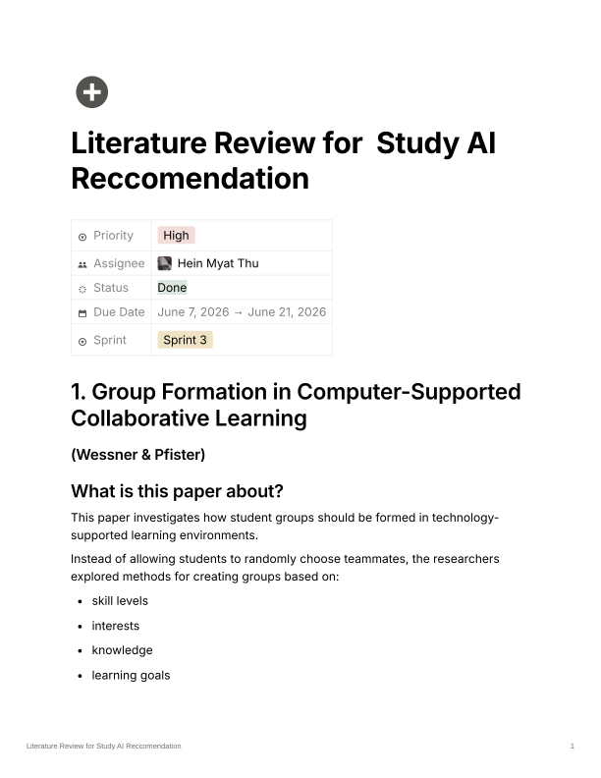
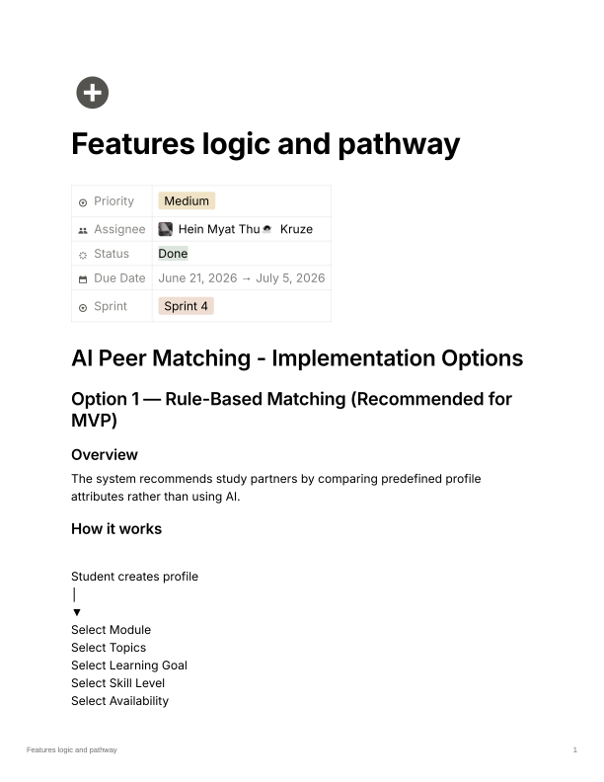
ACADEMIC CONTRIBUTION
03
Research reduced uncertainty before development
Three assigned reviews turned broad sponsor questions into practical product choices.
SPRINT 1
SPRINT 3
SPRINT 4
AI-supported collaboration
Peer recommendation
Feature pathway
AI should scaffold reflection and peer work—not replace student effort.
Match using interests, notes, learning goals, and study topics.
Start with transparent rules; evolve toward hybrid AI ranking.
Also contributed with the team leader to survey creation and data collection.
SMART PEER COMPANION · INDIVIDUAL CONTRIBUTION

Slide 4
SYSTEM MODELLING
04
I owned nine UML views of the backend
Together, the diagrams describe workflow, interaction, data structure, and module boundaries.
01
Activity
04
Sequence
Figure 5
Figures 11, 12, 16, 17
Upload learning material and AI processing
Authentication · PDF/RAG · AI question · Facilitator
03
Class
01
Component
Figures 19, 20, 25
Figure 28
Users · Collaboration · Backend services
Collaboration module and its dependencies
SMART PEER COMPANION · INDIVIDUAL CONTRIBUTION

Slide 5
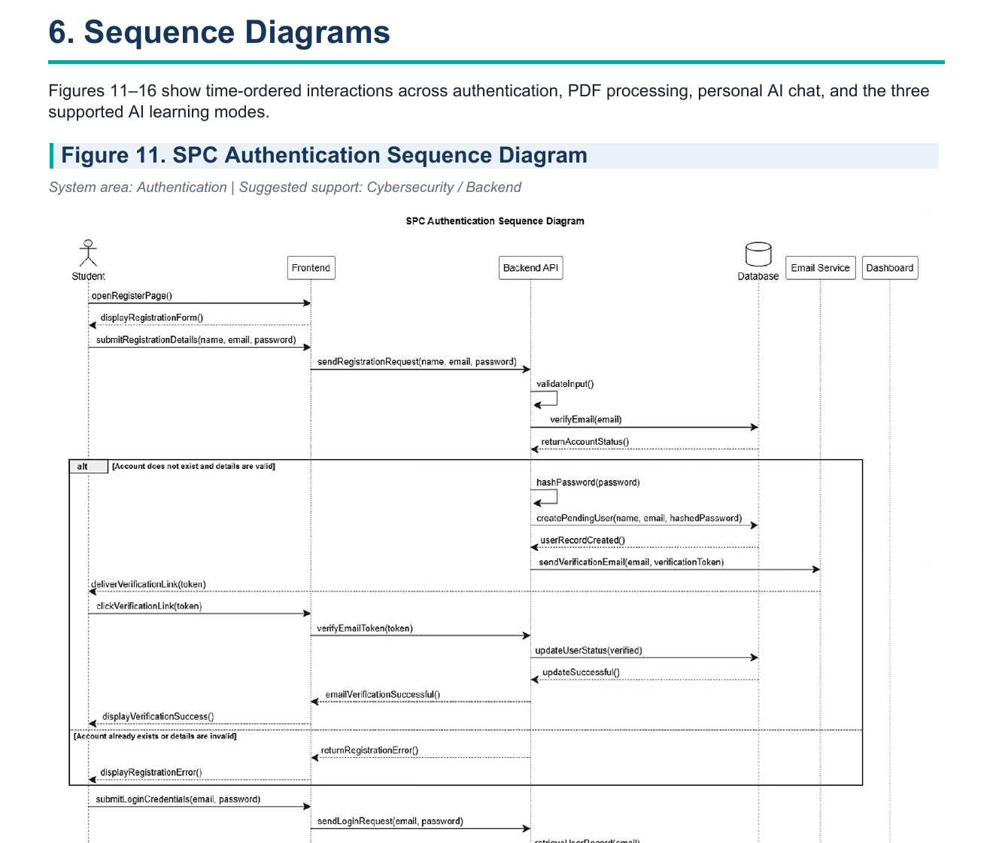
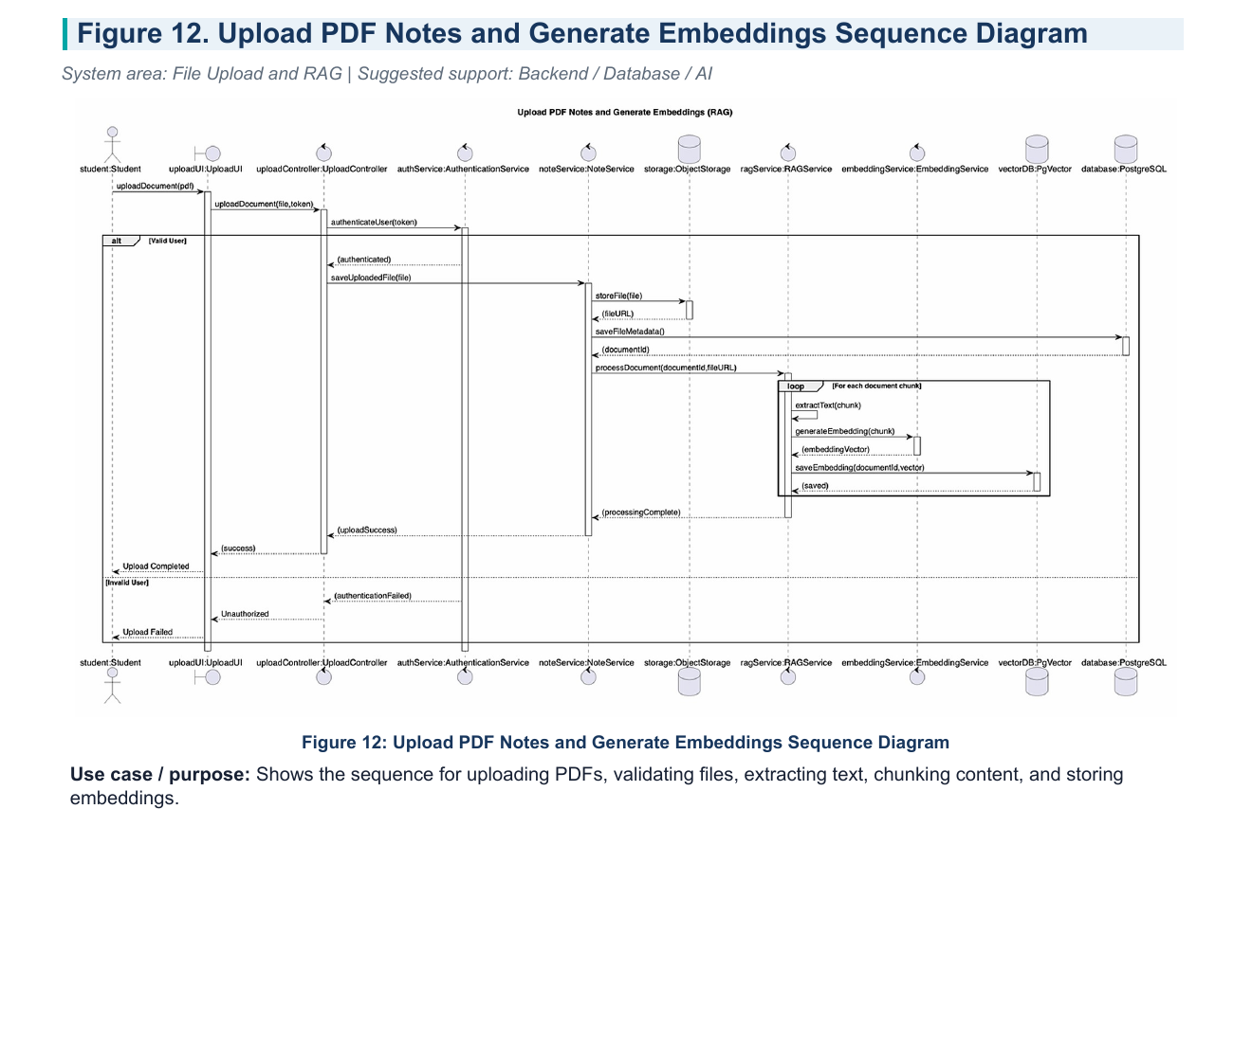
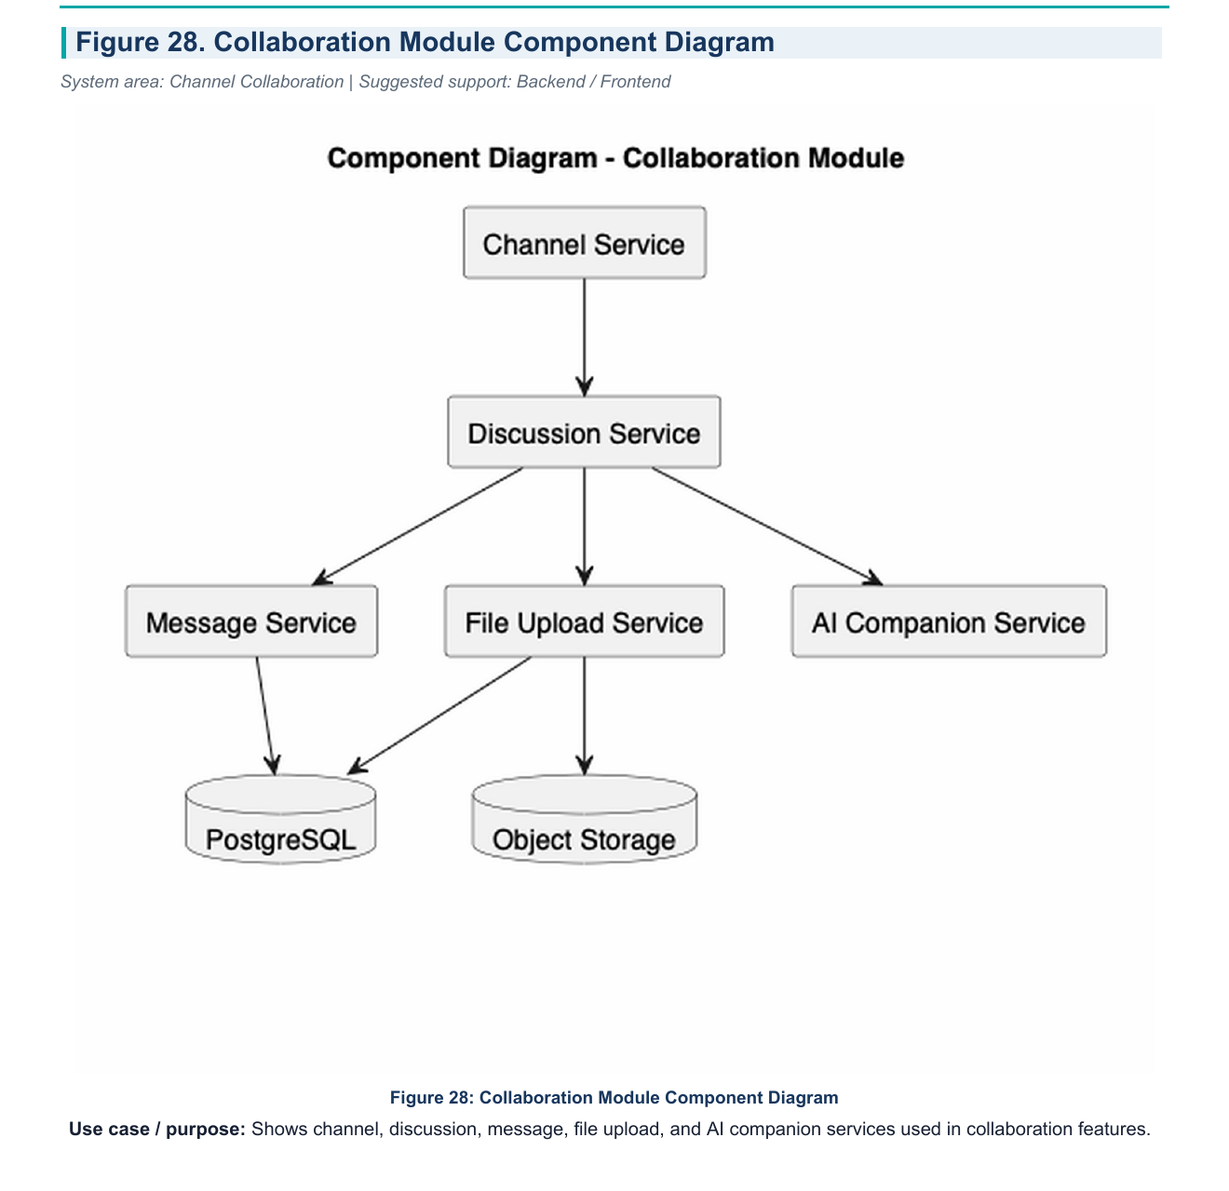
SELECTED EVIDENCE
05
The UML links user actions to backend responsibility
FIGURE 11
FIGURE 12
FIGURE 28
Authentication
PDF + embeddings
Collaboration
Credentials → verification → session
Validate → store → chunk → embed
Channels, discussion, files, and AI
SMART PEER COMPANION · INDIVIDUAL CONTRIBUTION

Slide 6
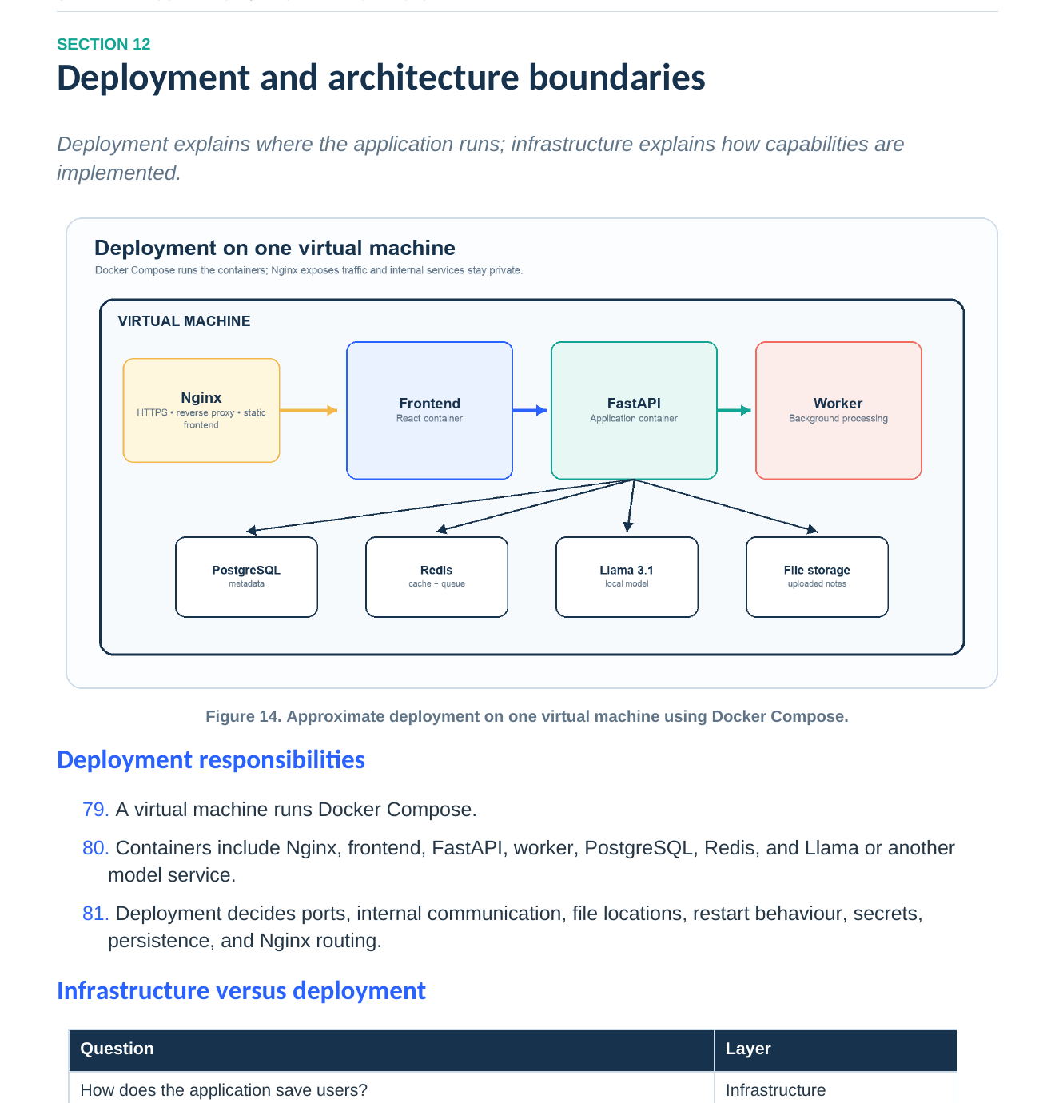
BACKEND ARCHITECTURE
06
The sponsor’s one-VM decision shaped the architecture
SPONSOR-ALIGNED CONSTRAINT
One virtual machine.
Clear service boundaries.
I adapted the design so the system could be deployed now without losing a path to scale later.
Clean Architecture
Presentation → application → domain → infrastructure
Container coordination
Web, API, workers, data, cache, and AI services
AI as a backend concern
Orchestration, memory, prompting, models, and RAG
SMART PEER COMPANION · INDIVIDUAL CONTRIBUTION

Slide 7
LIVE WALKTHROUGH
Open the interactive
architecture book
Follow the backend from high-level architecture to modules, AI processing, request flows, and deployment.
Open Figma architecture →
01 High level 02 Folder structure 03 AI & RAG 04 Request flows 05 Deployment

Slide 8
IMPLEMENTATION FOUNDATION
08
I translated the architecture into a backend skeleton
BACKEND /
REPEATABLE MODULE PATTERN
app/
├── api/
├── domains/
│ ├── auth/
│ ├── users/
│ ├── notes/
│ └── study_groups/
├── ai/
│ ├── engine/
│ └── rag/
├── workers/
└── main.py
tests/ docker/ scripts/
Domains keep their own boundaries
Each domain follows the same structure:
presentation
routes and API contracts
application
use cases and orchestration
domain
business rules and entities
infrastructure
database and external adapters
One structure · repeatable across every business domain
SMART PEER COMPANION · INDIVIDUAL CONTRIBUTION

Slide 9
BACKEND DEMONSTRATION
09
The skeleton makes APIs testable and self-documenting
router.py
FASTAPI ROUTER
Generated API contract
LIVE DEMO
FastAPI · OpenAPI
Show the path
from code to API
from fastapi import APIRouter, Depends
router = APIRouter(prefix="/users")
@router.get("/me")
async def get_current_user(
service = Depends(get_user_service)
):
return await service.get_current_user()
GET
/health
200
GET
/users/me
200
1
Run the backend
POST
/notes
201
2
Open /docs
Interactive documentation
3
Call an endpoint
Swagger /docs
ReDoc /redoc
4
Show /redoc
router → service → DTO
Visible · testable · shareable
FastAPI automatically keeps the API contract visible to the whole team.
SMART PEER COMPANION · INDIVIDUAL CONTRIBUTION

Slide 10
CONTRIBUTION SUMMARY
I created continuity from
research to implementation.
01
02
03
Evidence-informed choices
Shared system language
Executable backend baseline
Research and survey participation reduced uncertainty.
Nine UML diagrams made behaviour and ownership visible.
Architecture, folder structure, APIs, and documentation.
Next: integrate remaining domains and complete the end-to-end AI/RAG flow.
Thank you

