Slide 1



INDIVIDUAL CONTRIBUTION
Smart Peer Companion
Krish Longwani (C3549511) | Project Manager & AI Technical Lead
COMP3851A: Computing and Information Sciences WIL

Slide 2

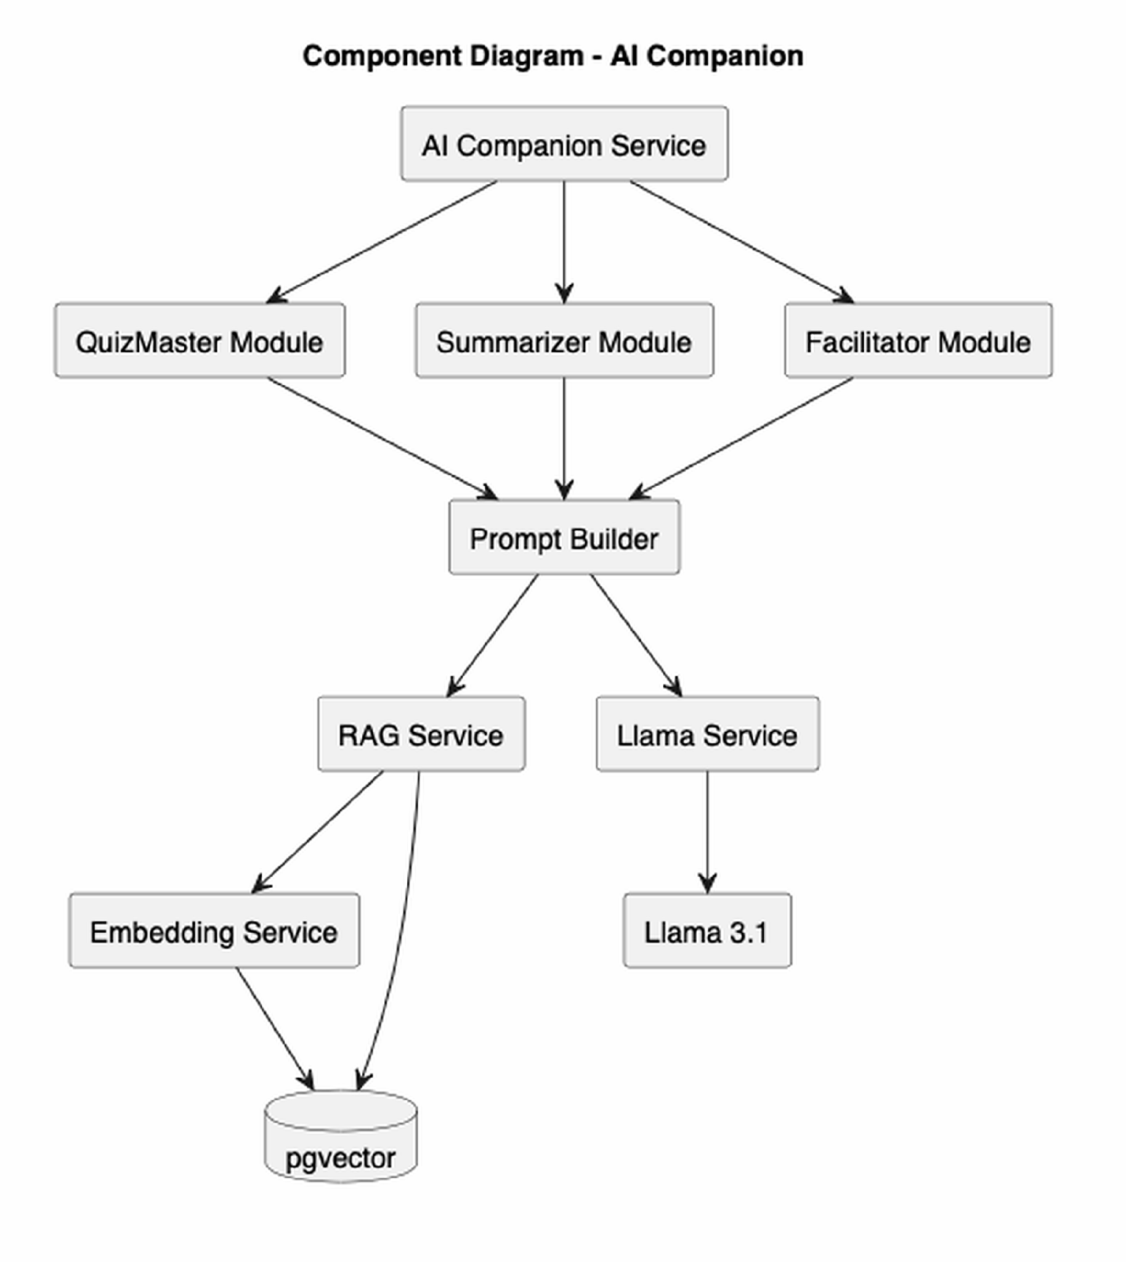

02 / ARCHITECTURE
Architectural Leadership: Directing the AI Infrastructure
Technical Strategy: Defined the key architecture that governs the platform’s Artificial Intelligence and Retrieval-Augmented Generation (RAG) backend.
Localized Large Language Model (LLM): Developed a self-contained Llama 3.1 setup in order to be independent of commercial APIs and preserve student data sovereignty.
Privacy-Based Infrastructure: Converted strict academic requirements for privacy compliance into security infrastructure.
System Architecture Diagram

Slide 3
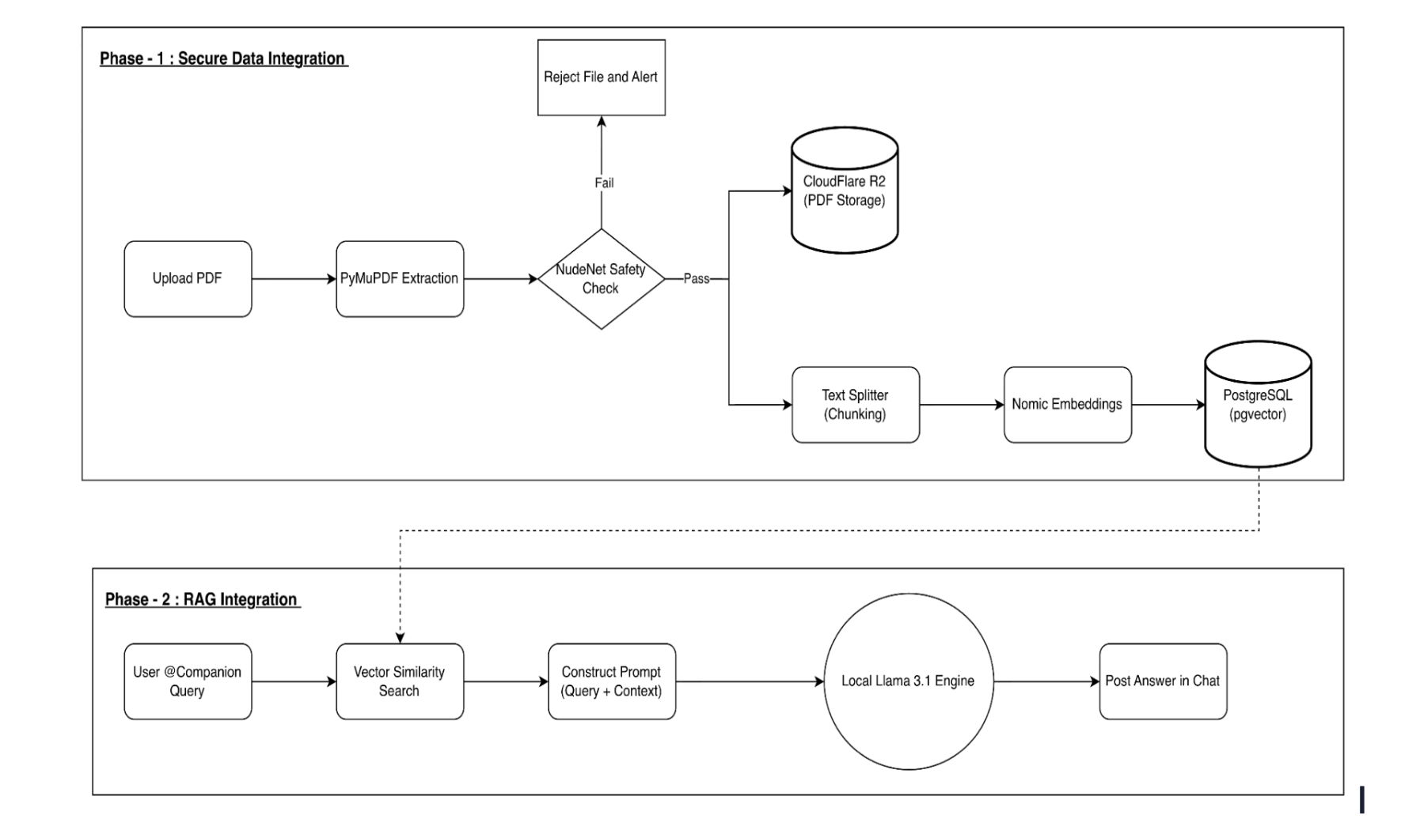
03 / BLUEPRINTING
Technical Blueprinting: Defining the System Logic
End-to-End RAG Integration: Systematically mapped out the secure, multi-stage process of ingesting raw course PDFs and storing them in a vectorized database.
Event-Driven Conversation: Specified WebSocket event loops for isolating intensive AI processing and thus maintaining instant messaging responsiveness of peer-to-peer conversation.
Object-Oriented Approach: Designed the RAG Class Diagram in order to impose a hard separation between document parsing, text chunking, and LLM inference, grouping them into microservices.
End-to-End RAG Integration Pipeline Diagram

Slide 4
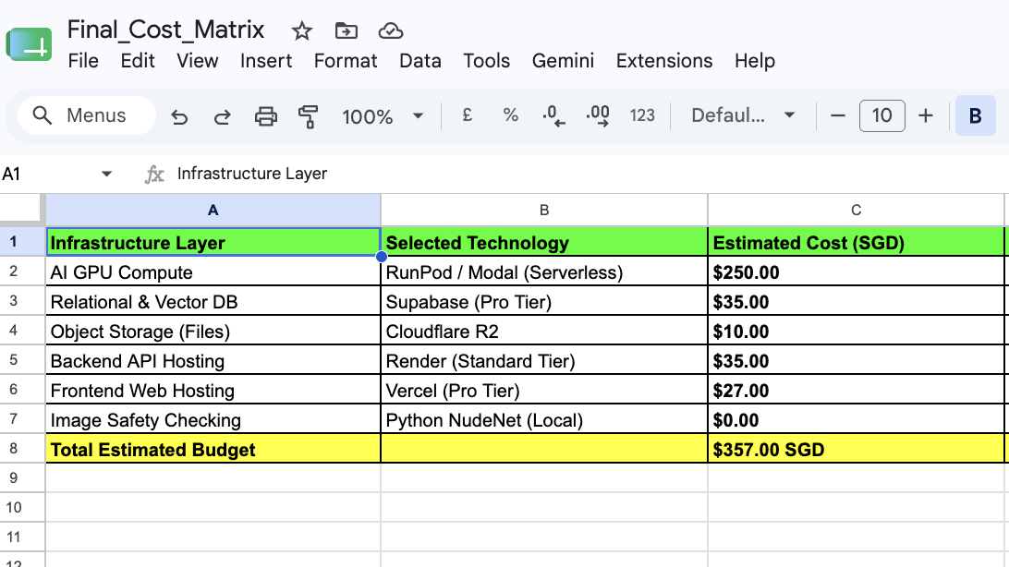
04 / COMPLIANCE
Strategic Pivots & Compliance: Risk & Hardware Constraints
Infrastructure Optimization: Identified cloud processing performance bottlenecks and set the minimum NVIDIA GPU constraints (16 GB VRAM) to enable feasible local deployment.
Budgeting: Developed the Budget Matrix for the project to gauge the financial feasibility of self-hosting vs. ongoing commercial API costs.
AI Ethical Constraints: Authored the project’s Risk Matrix and specified the "Facilitator Mode" business rules in order to avoid answering directly.
Budget Matrix

Slide 5
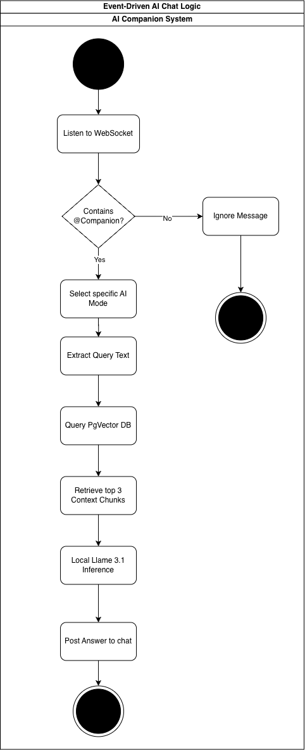
05 / INTEGRATION
Cross-Functional Integration: Seamless API & Database Alignment
Technical Interface : Served as the bridge between AI logic and the primary backend to synchronize microservices with the FastAPI routing system.
Alignment with Database: Worked with database management to map vector embedding requirements directly into PostgreSQL/pgvector Entity-Relationship diagram.
Workflow Coordination: Ensured that frontend/backend/database developers have the required AI conditions in place to proceed with their tasks.
Component Diagram

Slide 6
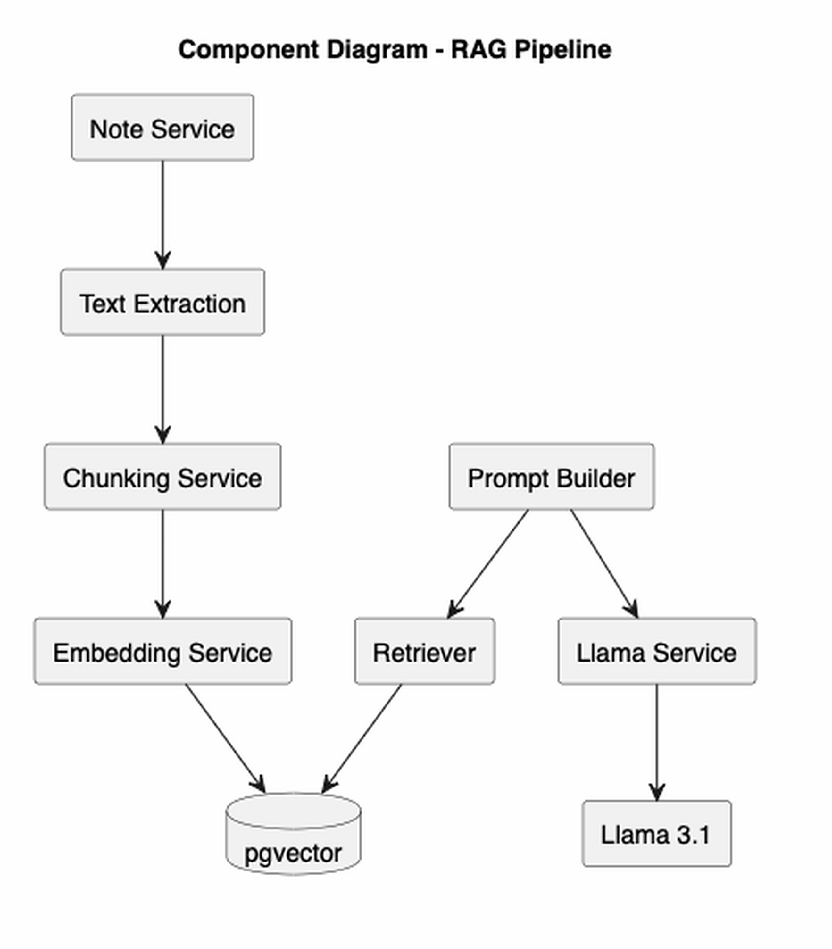
06 / LEARNING
Self-Directed Learning: From Relational to Vector Data
Efficient Data Retrieval: Independently researched and learned about Nomic embeddings to devise a smart RAG architecture and pgvector similarity search optimization.
Algorithm Development: Employed the knowledge of programming fundamentals in Python, C, and SQL to develop robust data ingestion pipelines and sophisticated text-chunking workflows from scratch.
Future Scaling: Reoriented efforts towards orchestrating a local LLM to improve token streaming and meet the 3-second non-functional response requirement for next trimester.

Slide 7
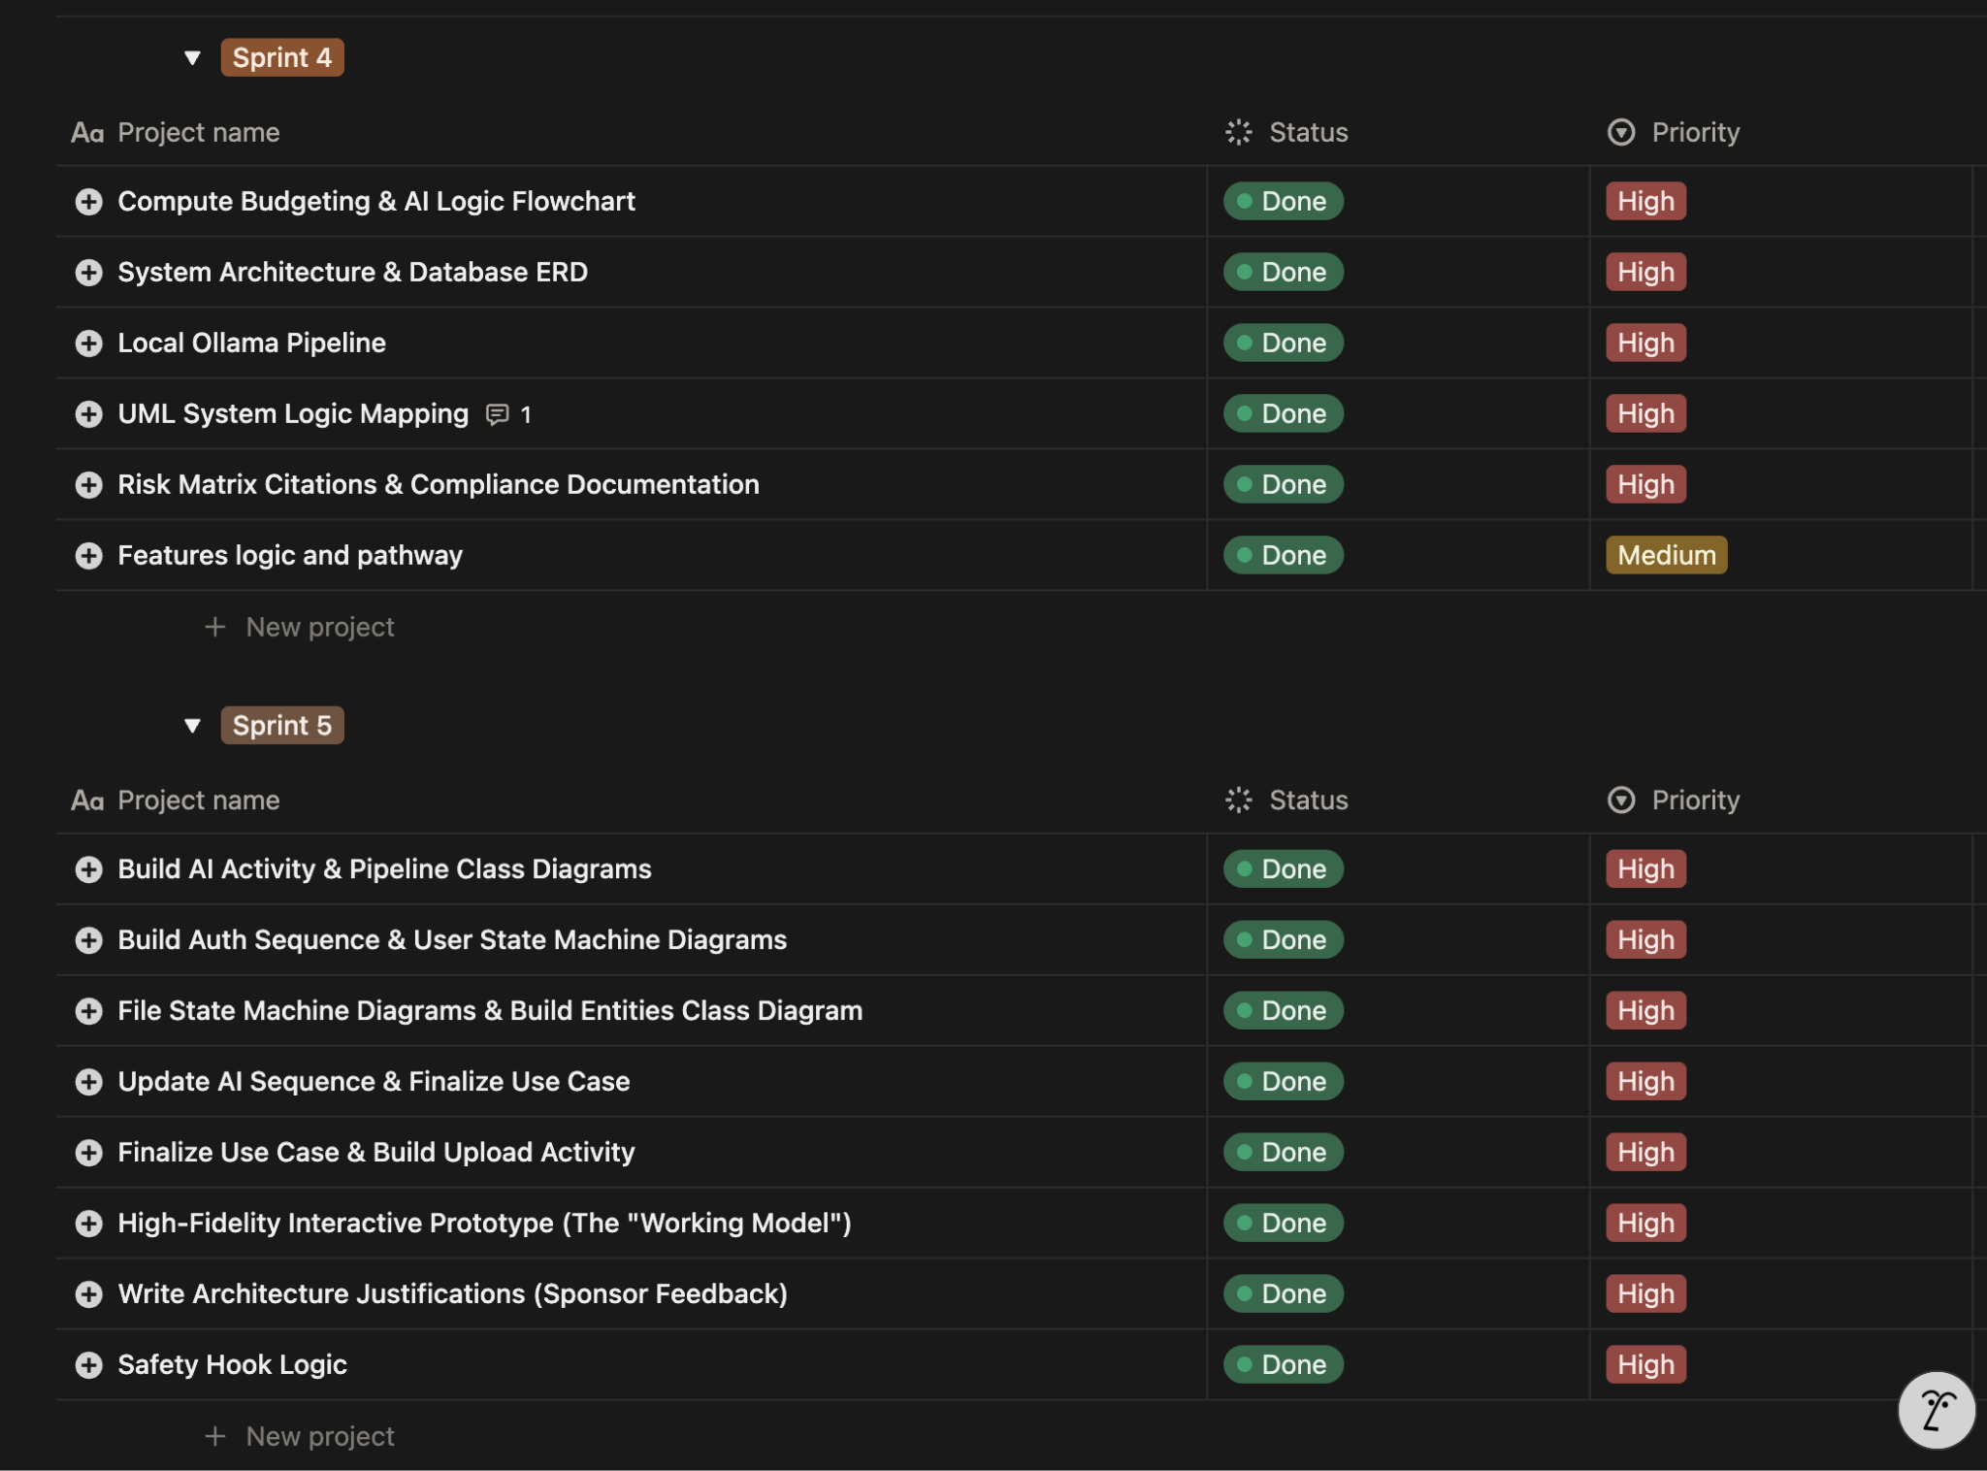
07 / DELIVERY
Agile Project Management: Leading Execution & Delivery
Sprint Management: Managed sprints in Notion, breaking down large AI architectural requirements into actionable developer tasks.
Role Clarification: Specified technical roles explicitly in order to prevent overlap and enable high-speed work without conflicts.
Task Proactivity: Provided comprehensive technical documentation and UML diagrams well ahead of deadline to enable final reporting.
Notion Sprint Screenshot

