Slide 1


AI-ASSISTED PEER COLLABORATION PLATFORM
Smart Peer Companion
SPC
Where AI facilitates learning — instead of replacing it.
Team 1 | University of Newcastle | COMP3851A : Computing and Information Sciences WIL
PRESENTERS
· Krish Longwani - C3549511 (PM)
· Elizabeth Flores - C3546059 (DPM)
· Hein Myat Thu - C3552370
· Kaung Sett Paing Tun - C3546060
· Daniil Berezovik - C3543315

Slide 2

01 — THE PROBLEM
The AI Isolation Problem
ALONE
Generative AI tools hand students instant answers — quietly bypassing critical thinking, peer discussion, and the friction where real learning happens.

Slide 3


02 — THE GAP IN THE MARKET
The Missing Link
Generic Group Chats
Solitary AI Bots
SPC
Peer collaboration, but no intelligence. Just noisy threads with zero guided learning.
Instant answers, but no peers. Learning happens in isolation with no shared context.
The missing middle ground: collaborative, AI-guided learning in one shared space.

Slide 4

03 — OUR SOLUTION
The Smart Peer Companion
AI AS FACILITATOR
A walled-garden study platform where AI acts as a Facilitator — not an answer key.
Guides discussion
Asks questions
Summarizes learning
Never just hands over answers
Public & private study channels
Secure file uploads for course material
Targeted AI modes for guided learning

Slide 5
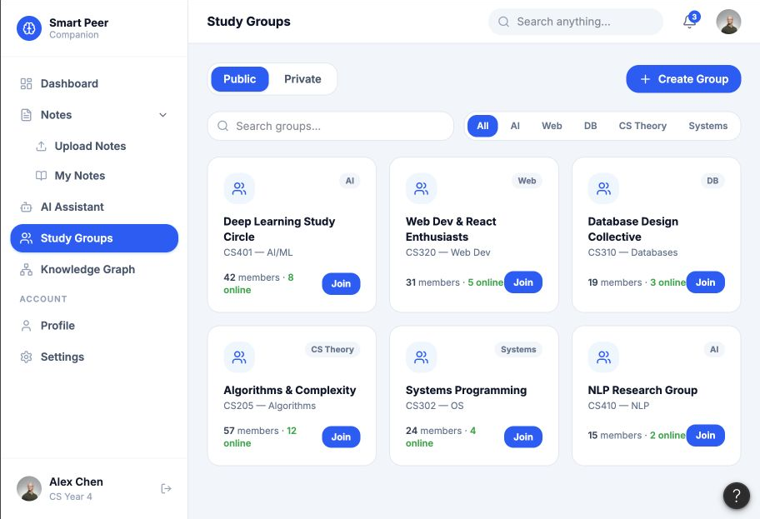
04 — THE STUDY HUB
The Study Hub
A clean, intuitive UI giving students centralized access to study groups, private chats, and uploaded learning materials — all from a single hub.

Slide 6
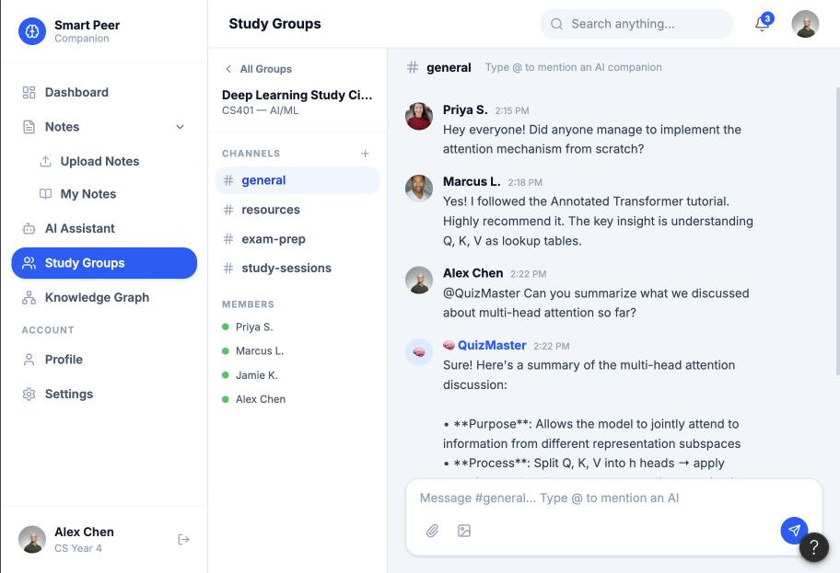
05 — COLLABORATIVE STUDY CHANNELS
Peer-to-Peer Workspaces
Real-time messaging designed for active student discussion, file sharing, and peer review.
Live threaded discussion
Drag-and-drop file sharing
Structured peer review

Slide 7
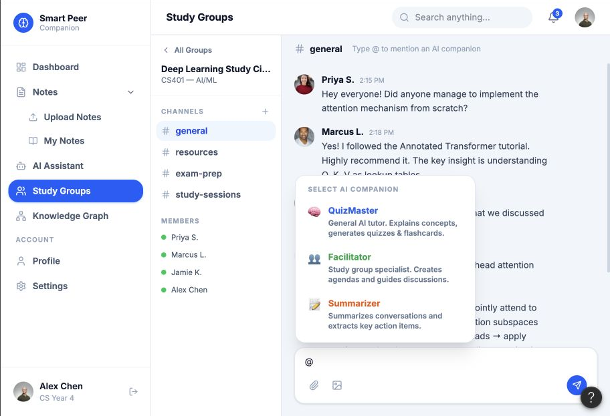
06 — INVOKING THE AI FACILITATOR
On-Demand Intelligence
The AI stays passive until summoned — preventing over-reliance and encouraging human-first problem solving.
Type @ → choose a role

Slide 8
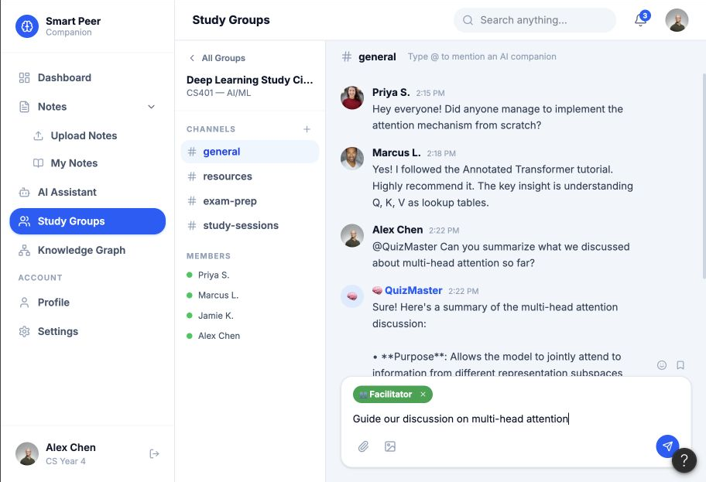
07 — THE USER EXPERIENCE
Guided Learning
Toggle the AI into a specific mode to fit the learning goal.
@Companion modes:
QuizMaster : Generates practice tests to check understanding and reinforce recall.
Summarizer : Synthesizes notes and readings into clear, concise summaries.
Facilitator : Leads Socratic debate, prompting deeper reasoning instead of giving answers.

Slide 9


08 — THE AI ENGINE · COMPETITIVE ADVANTAGE
100%
ZERO RECURRING API COSTS
Predictable, sustainable infrastructure at scale.
Localized AI
TOTAL DATA SOVEREIGNTY
No commercial APIs. SPC runs a localized Llama 3.1 model on a GPU-enabled VM.
Student data never leaves our infrastructure.

Slide 10


09 — THE RAG PIPELINE
Hallucination-Free AI
Retrieval-Augmented Generation reads only authorized, uploaded course materials.
01 UPLOAD
02 EMBED
03 RETRIEVE
04 GENERATE
Course materials ingested securely.
Nomic Embeddings + pgvector index.
Relevant context pulled per query.
Accurate, source-grounded answers.

Slide 11
10 — THE AI LOGIC ENGINE
Event-Driven Processing
MESSAGE ROUTING
Incoming message
Event router
WebSocket event
standard or @Companion?
Server-side WebSocket listeners isolate standard messages from AI queries, ensuring secure and efficient inference routing.
Persist + broadcast
AI orchestrator
fast path for peer chat
authorized context only
Human conversation stays instant. AI processing is invoked only when requested.

Slide 12
11 — RAG CLASS ARCHITECTURE
Object-Oriented AI
INGESTION
Loader
Parser
Chunker
pgvector
PDF / notes
clean text
learning units
index
Modular, scalable backend design separating document parsing, text chunking, vector storage, and LLM inference.
QUESTION
Retriever
Context builder
Prompt manager
relevant chunks
authorized only
mode + guardrails
Document parsing
Text chunking
Vector storage
LLM inference
Each class has one job — easier to test, replace, and scale.

Slide 13
12 — SYSTEM ARCHITECTURE
Deployable Today. Ready to Scale.
Containerized services on one virtual machine — simple to operate now, cleanly separated for future growth.
ONE VIRTUAL MACHINE · DOCKER COMPOSE
Nginx
React
FastAPI
Worker
HTTPS · reverse proxy
student + admin portals
REST + WebSocket
embedding · quiz · notify
PostgreSQL + pgvector
Redis
Llama 3.1
state + semantic index
cache + queue
local model service

Slide 14


13 — SECURITY & COMPLIANCE
Built for Academic Integrity
Safety Hooks
Stateless Auth
Context Isolation
NudeNet screening scans every image upload to keep channels safe.
JWT session authentication for secure, scalable identity.
Strict RAG isolation prevents data bleed between private groups.

Slide 15
14 — DATA BACKBONE
Scalable State Management
A robust PostgreSQL relational database handling complex user memberships, attachments, and chat states.
STATE RELATIONSHIPS
User
Membership
Channel
identity
role + permission
public / private
Users & memberships
Channels & permissions
Attachments & chat state
Message
Attachment
chat state
file + ownership
One source of truth for permissions, collaboration, and AI context.

Slide 16
15 — ARCHITECTURE IN ACTION
One Request. Clear Responsibilities.
From a student action to a grounded AI response — every step is isolated, testable, and observable.
Student UI
FastAPI router
Domain service
Worker / RAG
Data + model
Grounded response
upload or question
validate + authorize
business rules
background + retrieval
PostgreSQL · Llama
streamed to user
Clear ownership
Safe background work
Local, auditable data
Routers, domains, workers and AI components each have one responsibility.
Long-running embedding and generation never block live collaboration.
Permissions and context stay inside the project’s controlled infrastructure.

Slide 17
16 — THE RELATIONAL BACKBONE
Complex Data Lifecycles
LIFECYCLE, NOT JUST TABLES
User joins
Membership
Collaborate
identity
role
group + channel
An advanced PostgreSQL schema mapping user permissions, channel memberships, and persistent state management.
Persist state
Process safely
Audit + notify
message + file
worker + RAG
history
Permissions follow the data from creation to AI processing.

Slide 18
17 — SAFE ATTACHMENT PIPELINE
Every Upload Has a Lifecycle
CONTROLLED FROM UPLOAD TO RETRIEVAL
Upload
Quarantine
Safety scan
received
isolated
validate
Files remain quarantined until validation and safety checks are complete — only approved content reaches channels and the AI knowledge base.
Approve
Chunk + embed
Indexed
persist
worker + pgvector
authorized
Unsafe or unapproved content never enters shared channels or AI context.

Slide 19





18 — PROJECT EXECUTION
5 Sprints to Success
Strict Agile methodology — from research to high-fidelity prototype in one trimester.
Sprint 1
Sprint 2
Sprint 3
Sprint 4
Sprint 5
Literature review, campus student surveys, persona creation & requirements scoping.
Database schema design, FastAPI backend setup & local Llama 3.1 VM provisioning.
pgvector RAG pipeline build, Nomic embedding integration & core microservices API routes.
React frontend development, workspace UI, WebSocket setup & NudeNet safety integration.
End-to-end integration, focus group user acceptance testing & high-fidelity release.

Slide 20
19 — CONCLUSION
The Future of Collaborative Education
SPC proves AI doesn't have to replace peer learning — it can facilitate it.

