Slide 1
K00223367 Damien McManus
Assignment 2
Me, Myself & I

Slide 2
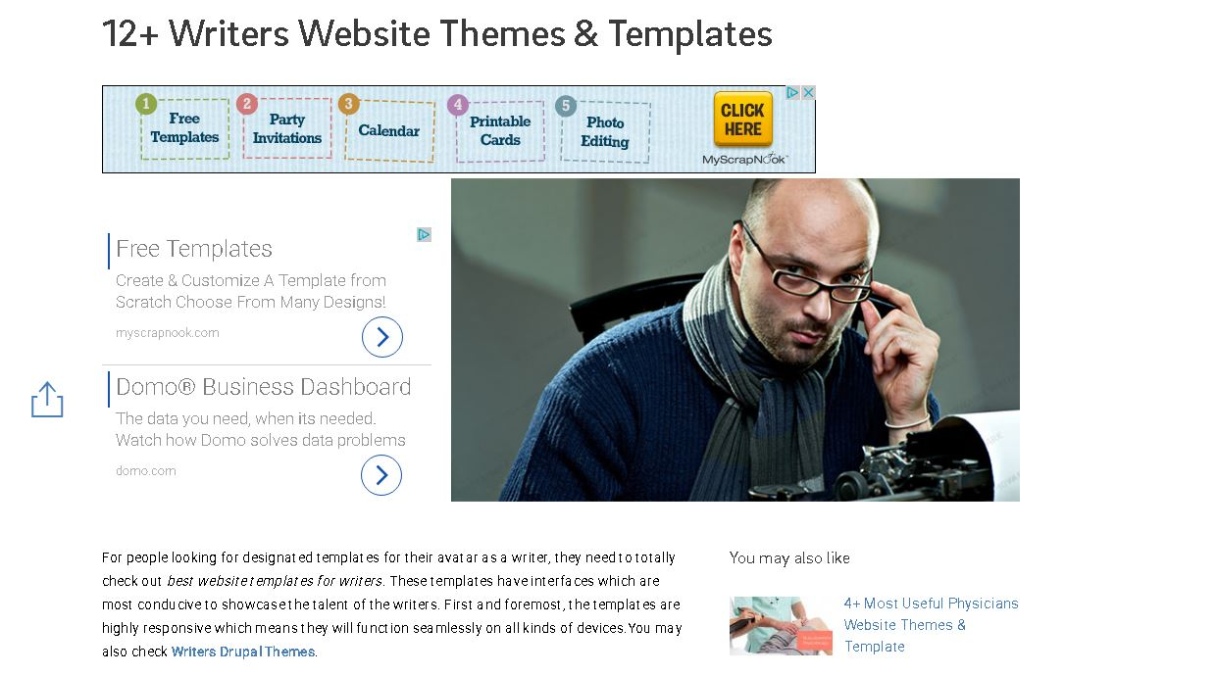

Slide 3




Colours

Slide 4
Accessibility

Slide 5
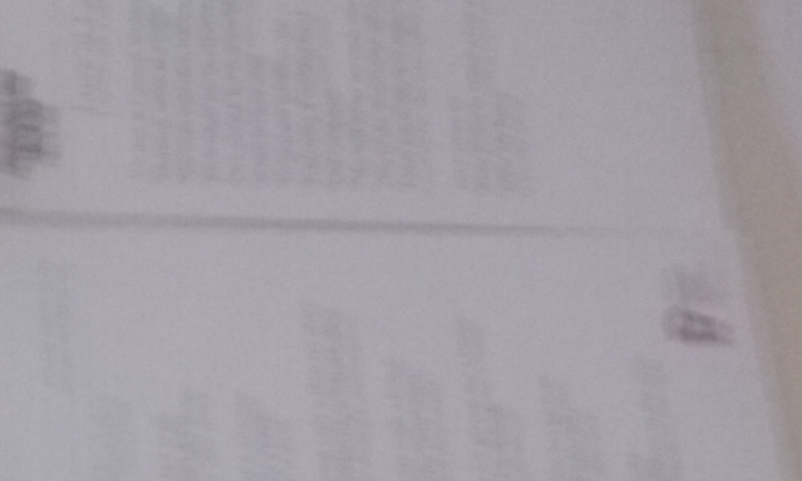
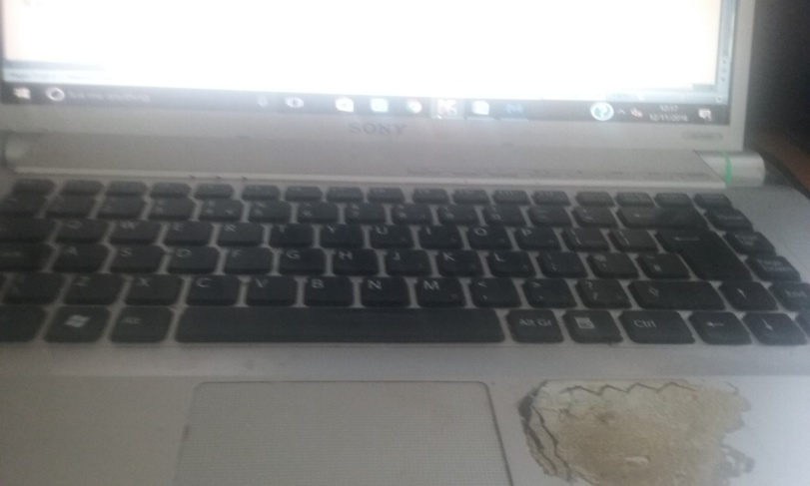

Photos

Slide 6
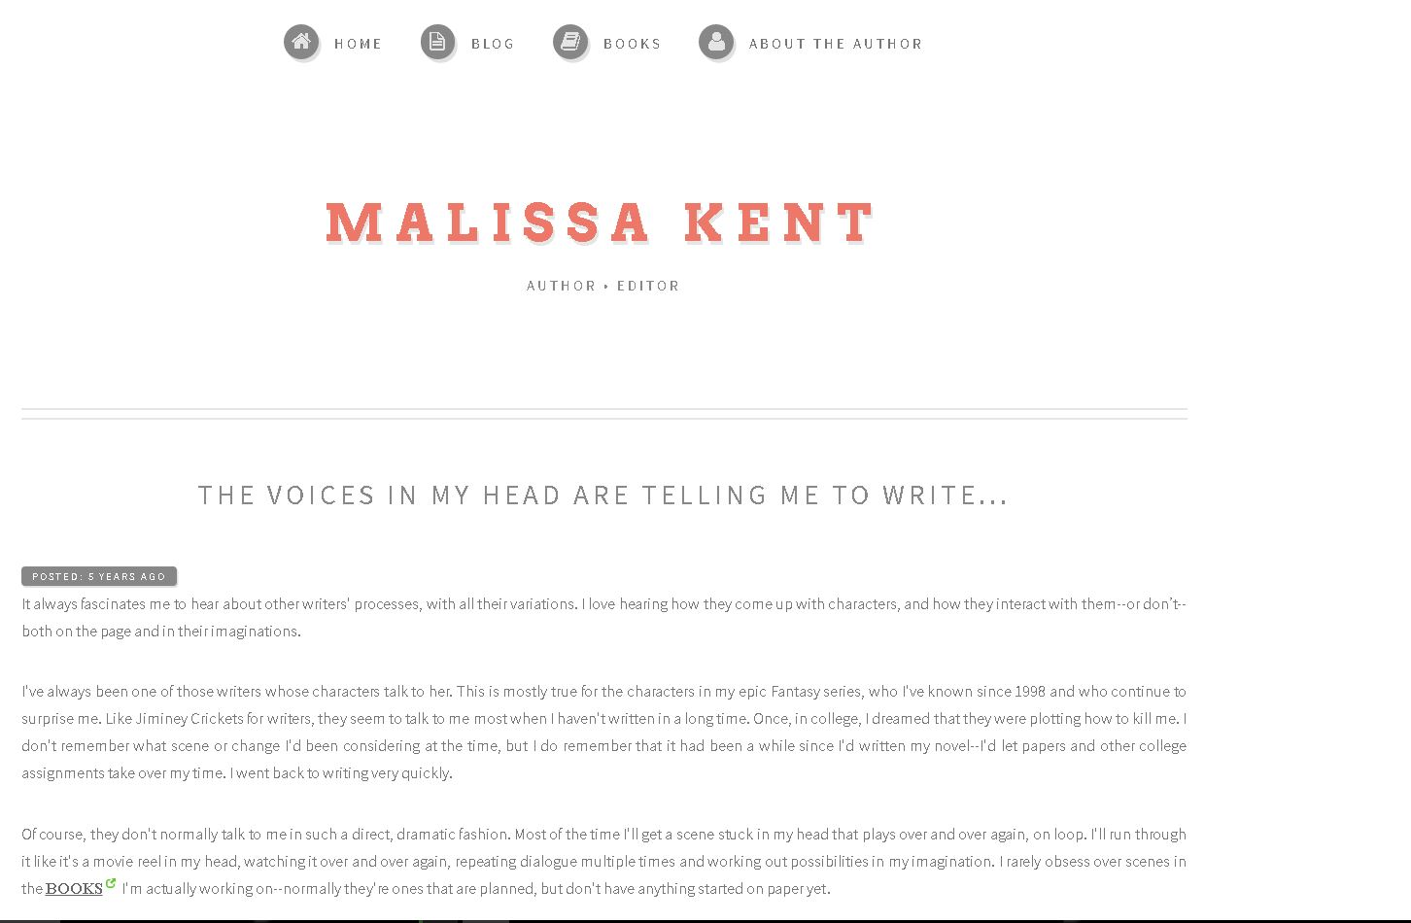
Another Design

Slide 7
Blogs
https://www.blogger.com/blogger.g?blogID=3863765846488976680#allposts

Slide 8
The End
or is it...

