Slide 1
Search Engine Optimization
*
Notes:
*

Slide 2
Presentation Overview
Search Engine Basics
What is SEO?
Need of SEO
How to Conduct Keyword Research
Page Ranking
How page Ranking Done
Advantages and Disadvantages
Conclusion
References
*
Notes:
*

Slide 3
Search Engine Basics
Search engines are programs that search documents for specified keywords and returns a list of the documents where the keywords were found.
Some of the popular Search Engine are Google,Bing,Ask,Bing,Baidu,e.t.c
*
Notes:
*

Slide 4
Search Engines
Search Engine Functions:
Web Crawling
Indexing
Ranking and Serving Results
*
Notes:
*

Slide 5
Types of Search Engine
Search Engine are categorised in two categories based on their result gathering-
Crawler-Based Search Engines
Human-Powered Directories
*
Notes:
*

Slide 6
Search Engine Basics
Crawler-Based Search Engines
These Search Engine create their listings automatically by “crawling” as in a “web spider”
Human-Powered Directories
A human-powered directory, such as the Open Directory, depends on humans for its listings.
*
Notes:
*

Slide 7
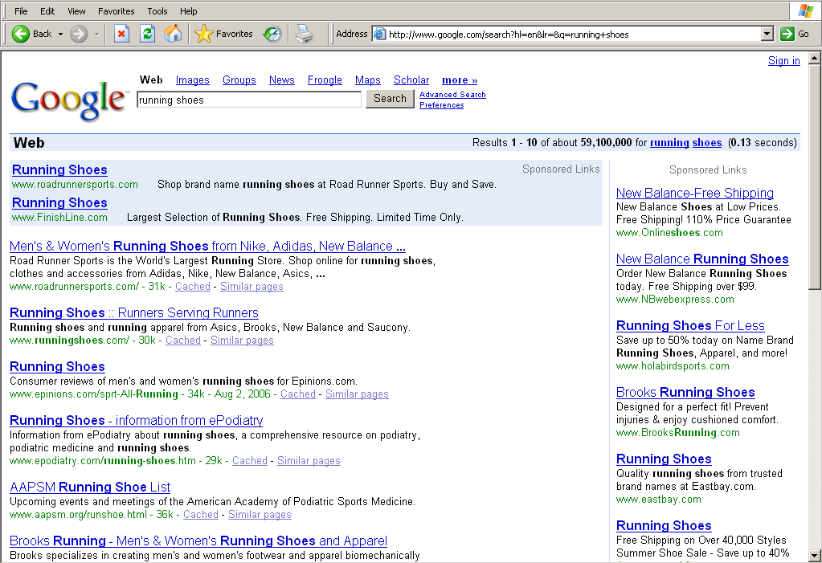
Search Engine Results Pages
Paid Placement
Results
Organic
Results
*
Notes:
*

Slide 8
What is SEO?
Search engine optimization (SEO) is the process of improving the visibility of a website or a web page in search engines via the "natural," or un-paid ("organic" or "algorithmic"), search results.
*
Notes:
*

Slide 9
SEO may target different kinds of search, including image search, local search, video search, academic search, news search and industry-specific vertical search engines.
*

Slide 10
Need of SEO
If your site cannot be found by search engines then your content cannot be put into their database
Your site is “unfindable”
*
Notes:
*

Slide 11
The majority of web traffic (64%) is driven by the major commercial search engines - Yahoo!, MSN, Google & AskJeeves
*

Slide 12
How to Conduct Keyword Research
Brainstorming
Surveying Customers
Applying Data from KW Research Tools
Term Selection
Performance Testing and Analytics
*
Notes:
*

Slide 13
Page Ranking
The ranking is the basic criteria by which organic Search Engines index and then retrieve documents.
*
Notes:
*

Slide 14
How page Ranking Done
An organic search engine software spider is a piece of software that acts like an electronic librarian who cuts out the content pages of every book of library in the world sorts them into a extremely large master index.
The basic principal is that the index is made from the actual content of site.
*
Notes:
*

Slide 15
Key Concepts
Web site appears in the returned matches depends on 5 factors:
-Which Keywords the user entered
-Your web page Keyword Density for these keywords
-Your web page Keyword Prominence (page location) for these keywords
-Your Link Popularity – the number of other sites that link to you
-Your link and keyword Relevancy
-And much much more!
*
Notes:
*

Slide 16
ADVANTAGES OF SEO
Perspective (Global / Regional)
Targeted Traffic
Increase Visibility
High ROI (Return on Investment)
Long term positioning
Cost-effective
Flexibility
*

Slide 17
DISADVANTAGES OF SEO
You may be prevented from competing on a level playing field, because competitors and even affiliates may use less ethical black hat SEO techniques.
As a consequence, the biggest disadvantage of SEO is a lack of control. You are subject to changes in the algorithm.
In competitive sectors it may be very difficult to get listed in the top few results for competitive phrases
*

Slide 18
Conclusion
Unique Content
Link Friendly Formatting
Avoid Black Hat SEO
Content relevant keywords
Market Awareness
Unique HTML page title for every landing page
*
Notes:
*

Slide 19
SEO Links
http://www.bruceclay.com/blog/seo-checklist/
https://moz.com/beginners-guide-to-seo/
http://www.tutorialspoint.com/seo/index.htm
http://backlinko.com/seo-techniques
http://www.shoutmeloud.com/on-page-seo.html

