Slide 1
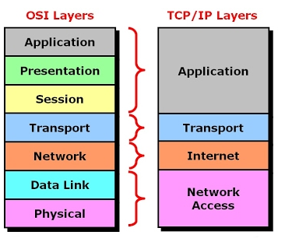
Networking Fundamentals OSI and TCP/IP models
James.Fennell@lit.ie

Slide 2
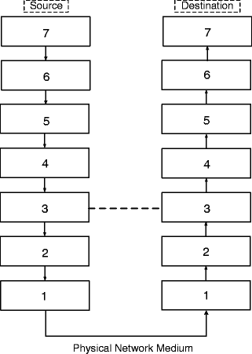
Layering of Networks
Most networks are organised as a series of layers or levels
At the lowest layer physical communication takes place
At higher layers virtual communication happens
The protocol in one layer prepares the data for the next
The data gets passed down through the layers until it is ready for the physical network

Slide 3
Why Layers?
Design is less complex because any problem is broken down into separate components
One huge program that performs all functions would be inflexible
Improvements to one module should have no knock-on effects on the rest of the system (encapsulation)
Programmers write network software to well defined APIs

Slide 4
7 Layer OSI Reference Model
During the 1980s, each manufacturer had their own network architectures and protocols
The OSI (Open Systems Interconnection) 7-layer reference model was devised by the International Organisation for Standardisation (ISO)
In terms of implementation OSI was a failure but the principles are still fundamental to modern Network Protocols
Notes:
During the 1980s, different computer manufacturers had their own network architectures and protocols.
This situation often made it difficult to network together computers made by different manufacturers

Slide 5
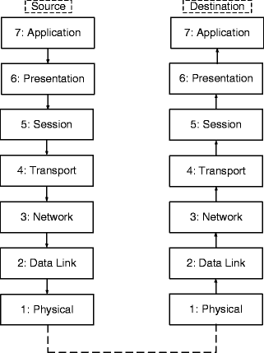
OSI 7-Layer Reference Model
The aim of OSI was to devise an architecture containing standard protocol layers that all vendors would use
This would result in complete interoperability between all network devices and network software.
New and existing protocols were incorporated into the model.
Some OSI protocols are still in use. E.g. (IS–IS)

Slide 6
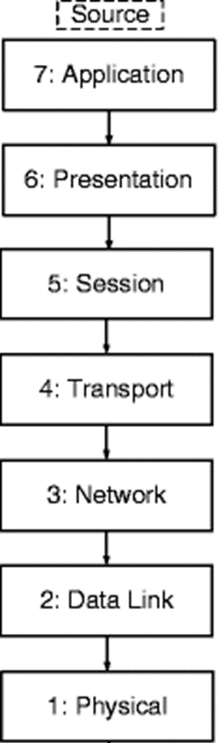
Physical Layer
The physical layer is concerned with the transmission of bit patterns over a communications channel.
It is responsible for how the binary 0s and 1s are represented, for example, what voltage levels are used.
It is also concerned with the control signals to set up and tear down connections.
Connectors and pin assignments are also specified by the physical layer. EIA/TIA-232 (or RS232-C) is an example of a physical-layer protocol

Slide 7
Data Link Layer
The data-link layer handles the errors that result from the physical transmission media.
In this layer, the raw bit patterns from the physical layer are organised into frames.
These frames are acknowledged by the destination if they are received correctly.
The data-link layer also performs flow control.
HDLC (High Level Data Link Control) is a typical data-link protocol.

Slide 8
Network Layer
The network layer is concerned with the routing of packets across a network.
The message from the source is split up into packets, and sent to the destination.
The network layer is concerned with addressing
Internet Protocol (IP) is an example of a network layer protocol.

Slide 9
Transport Layer
The transport layer is responsible for end-to-end connections between hosts
This layer masks the characteristics of the underlying network, which may change with advances in technology.
Transmission Control Protocol (TCP) is the most important example of a transport-layer protocol.

Slide 10
Session Layer
The session layer deals with the establishment, maintenance and termination of sessions between two users
This is similar to logging in and out of a time-sharing computer system but over a network rather than from a directly connected termina.
Security precautions, such as authentication of users by password, belong in this layer

Slide 11
Presentation Layer
The presentation layer deals with data formatting, data compression and data encryption
The presentation layer performs data compression and encryption

Slide 12
Application Layer
The application layer contains a number of protocols that users need to be able to communicate over a network.
Examples
HTTP (HyperText Transfer Protocol), which is used to transfer pages on the World Wide Web
SMTP (Simple Mail Transfer Protocol) used in email
FTP (File Transfer Protocol) used for downloads

Slide 13
Encapsulation
Data cannot be sent over a network until it has been encapsulated
packaged up into a suitable form to be transmitted over the network
During encapsulation the data has protocol information added to it as it is passed down through the OSI layers.
This protocol information consists of headers (address information), trailers (for error control) and other items.

Slide 14
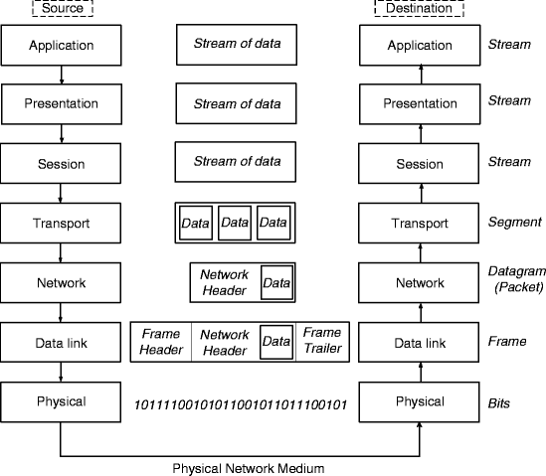
Encapsulation
Build Data – write message, add image etc.
Convert data into Segments for transport
Put data into a Packet which will include a header containing the addresses of the source and destination
Add the packet to a Frame
Convert frame to Bit Pattern
Notes:
A frame contains a packet it includes device’s MAC address while a packet includes device’s IP address.
Frames are removed and a new frame applied at the source and gateway router

Slide 15
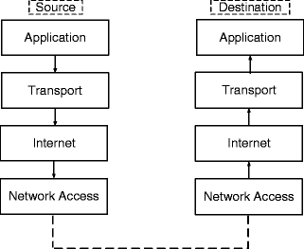
TCP/IP Model
TCP/IP protocol was developed by the US Department of Defence (DOD)
a robust communication system that would still function even if it were partially destroyed in a war
The model has four layers
Application
Transport
Internet
Network Access
The TCP/IP application layer is NOT the same as the OSI’s

Slide 16
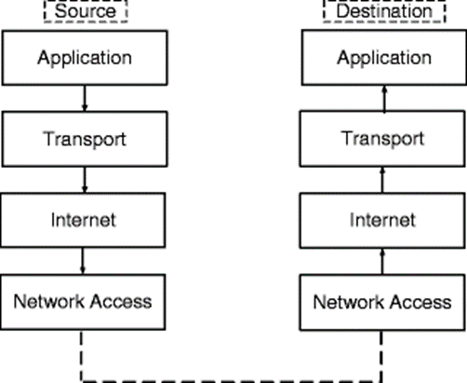
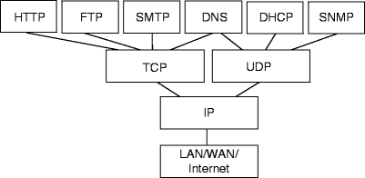
TCP/IP Model - Protocols
Application Layer
Hyper Text Transfer Protocol, File Transfer Protocol, Simple Mail Transfer Protocol, Domain Name System, Dynamic Host Configuration, Simple Network Management Protocol
Transport Layer
Transmission Control Protocol, User Datagram Protocol
Internet
Internet Protocol
Sole Protocol – allows universal communication between machines

Slide 17
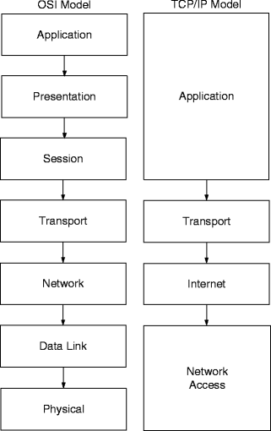
OSI vs TCP/IP
Transport and Internet layers are similar to the OSI transport and network layers
The TCP/IP application layer performs the functions of the OSI application, presentation and session layers combined.
TCP/IP network access layer performs the functions of the OSI data link and physical layers
The OSI model is used to classify protocols, but few of its protocols are used to any great extent
TCP/IP protocols are very heavily used

Slide 18
Networking Standards
Networking Standards ensure that hardware and software from different vendors can work together
We can classify standards into three categories:
Formal Standards
developed by an official body, for example, the OSI 7-layer model and TCP/IP
Proprietary Standards
devised by one vendor for use with the company’s products
De Facto Standards
those supported by more than one vendor but which have no official standing
Notes:
Proprietary standard example:
is the now defunct Digital Equipment Corporati.
Defacto Standard: example
the AT command set for modems. This was devised by the Hayes modem company (a proprietary standard initially) but was then taken up by every other modem manufacturer.on’s DECnet, which worked only with DEC’s products

Slide 19
Networking Standards Bodies
The Institute of Electrical and Electronics Engineers (IEEE)
produces standards for electrical engineering, computers and control technology. It is responsible for the 802.3/Ethernet standards, among others (http://www.ieee.org)
The Internet Engineering Task Force (IETF)
is concerned with the Internet architecture and the operation of the Internet (http://www.ietf.org). Among other standards, it is responsible for the TCP/IP protocols
International Organisation for Standardisation
(http://www.iso.org), which devised the OSI 7-layer model. ISO is a network of many national standards institutes, including the British Standards Institution (BSI) and ANSI.
Notes:
There are many standards bodies that issue formal standards relevant to computer networking and telecommunications.

Slide 20
Networking Standards Bodies
The European Telecommunications Standards Institute (ETSI)
is an independent, non-profit organisation which produces telecommunications standards (http://www.etsi.org)
The World Wide Web Consortium (W3C)
develops specifications and software for the World Wide Web (http://www.w3.org). HTML (see Sect. 7.3.1) and Extensible Markup Language (XML) are specified by W3C.
Notes:
There are many standards bodies that issue formal standards relevant to computer networking and telecommunications.

Slide 21


