Slide 1


SOCIETY OF AMATEUR RADIO ASTRONOMERS • 2026 CONFERENCE
Lowering the Barrier
to Radio Astronomy
First pulsar detections with the new DSES Spectrum Analyzer software —
60-foot dish, Haswell, Colorado
Richard M. Hambly (K0GD) • Deep Space Exploration Society
Notes:
Title. One sentence framing: this is the story of a deliberate experiment — can we make pulsar observing something any motivated DSES member can do, not just our two experts? Field session July 11, 2026 at the Haswell, Colorado 60-foot dish; results verified over the following two days.

Slide 2

FOR THE SARA PROGRAM
Abstract
For years, pulsar observing at the Deep Space Exploration Society has rested on a professional toolchain — PRESTO and TEMPO built from source, custom GNU Radio flowgraphs, SIGPROC utilities, and companion analysis tools — with a learning curve steep enough that only two members could take an observation from dish to detection. This talk describes a deliberate experiment in lowering that barrier.
DSES developed the “Spectrum Analyzer”, a cross-platform application that consolidates the on-site workflow — planning the observation, choosing clean frequencies, verifying the RF path, and recording analysis-ready SIGPROC filterbank data — into a single, easy-to-use package driving an Ettus USRP B210 software-defined radio.
On July 11, 2026, a three-member team, none of them pulsar-processing experts, put the premise to the test at the Society’s 60-foot dish in Haswell, Colorado. B0329+54 was ultimately detected at 28 sigma — a figure that grew from 20 when peer review of the trip report exposed, and repaired, a subtle recording-timebase defect — and B0950+08 produced a strong ~9-sigma candidate whose best-fit period and dispersion land on the catalog values.
Field feedback drove two software releases within a week, and a documented upgrade queue — from a built-in pulsar visibility planner to one-click post-recording analysis — now charts the path to training a new generation of DSES observers on a far gentler learning curve.
SPEAKER
Richard M. Hambly, K0GD
SOCIETY
Deep Space Exploration Society (DSES), Colorado
INSTRUMENT
60-ft dish + Ettus USRP B210 SDR
SOFTWARE
DSES Spectrum Analyzer + PRESTO
KEYWORDS
pulsars • SDR • filterbank • accessibility
Lowering the Barrier to Radio Astronomy • DSES • SARA 2026
Notes:
This abstract is what goes to the SARA meeting planner. Read silently in rehearsal, skip live — or show for a beat while introducing the talk.

Slide 3
THE PROBLEM
Pulsar observing had become an experts-only craft
For years, the Society’s results rested on two members — Dr. Richard Russel (AC0UB) and Dan Layne (AD0CY) — and the professional toolchain they mastered:
PRESTO v5 + TEMPO1 + TEMPO2
RIPTIDE
GNU Radio
100s
built from source; hand-edited observatory and clock files
a second, independent pulsar-search code (fast-folding)
custom filterbank flowgraphs driving the B210
of pages of DSES training material for this stack
SIGPROC
blimpy / watutil
PINT
filterbank-format utilities
Breakthrough Listen RFI and saturation checks
high-precision pulsar timing in Python
2
ATNF pulsar catalogue
Murmur + Best Profile Analyzer
Stellarium + experience
ephemeris data (.par) for every fold
I0NAA planning/analysis tools — run under Wine
above all, knowing how the pieces fit together
members who could run an observation end to end
First-rate results — but a learning curve that kept everyone else watching.
PSRCHIVE — the professional community’s archiving & timing suite, in common use — beyond even our experts’ stack
Lowering the Barrier to Radio Astronomy • DSES • SARA 2026
Notes:
Credit where due: this toolchain produces first-rate, professional results, and Rich and Dan built DSES's pulsar program on it. The point is not that the tools are bad — it's that the barrier to entry kept hands-on observing limited to two people. Hundreds of pages of training material is a real number — this tool list is straight from the DSES pulsar training guide's system-configuration table. The grayed row is the kicker: the professional world in common use runs even deeper — PSRCHIVE is a whole additional suite our two experts didn't even need.

Slide 4
THE ANSWER
The new stack — much simpler
The same observation today takes two pieces:
2
ACQUISITION — ON SITE
ANALYSIS — ANY MACHINE
DSES Spectrum Analyzer
PRESTO v6.0.0 + TEMPO2
pieces in the whole chain — acquisition and analysis
plan, survey, verify, record — one application on one laptop (Windows / macOS / Linux)
the professional analysis suite, installed by one DSES build script — v6 barycenters in-process, so classic TEMPO is no longer needed
1
build script installs the analysis stack, per platform
Same professional-quality results — on a far gentler learning curve.
That’s the whole list — no Wine, no custom flowgraphs, no hand-edited configuration files
Lowering the Barrier to Radio Astronomy • DSES • SARA 2026
Notes:
Deliberate contrast with the previous slide: the wall of chips collapses to two. On site, the Spectrum Analyzer does everything the observer needs; at home (or in the field), PRESTO v6 plus TEMPO2 does the analysis. PRESTO v6 dropped the classic-TEMPO dependency — barycentering is in-process and polycos come from TEMPO2 — and both installations are captured as re-runnable build scripts in the Society's repository (WSL on Windows, macOS).

Slide 5
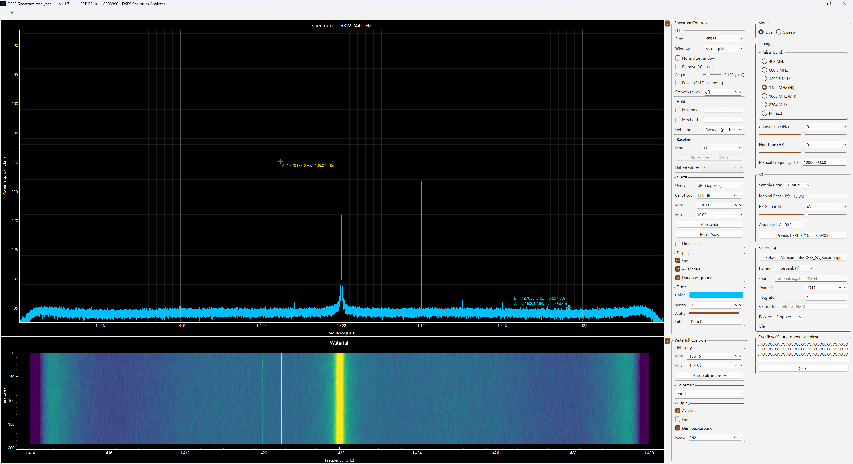
THE ANSWER
DSES Spectrum Analyzer V1.1.7
Lowering the Barrier to Radio Astronomy • DSES • SARA 2026
Notes:
Deliberate contrast with the previous slide: the wall of chips collapses to two. On site, the Spectrum Analyzer does everything the observer needs; at home (or in the field), PRESTO v6 plus TEMPO2 does the analysis. PRESTO v6 dropped the classic-TEMPO dependency — barycentering is in-process and polycos come from TEMPO2 — and both installations are captured as re-runnable build scripts in the Society's repository (WSL on Windows, macOS).

Slide 6
THE INSTRUMENT
One instrument instead of a toolchain
The DSES Spectrum Analyzer — a cross-platform application written within the Society. Born as an RFI-survey instrument for the Haswell site, it has grown into a radio-astronomy data-acquisition system.
1
Plan — live altitude/azimuth for catalog pulsars, computed from the site
2
Survey — real-time spectrum and waterfall; wide-band Sweep mode for RFI surveys
DSES Spectrum Analyzer
Verify — confirm the RF path is alive and clean before committing to a recording
drives the Ettus USRP B210
and other SDRs
3
4
Record — industry-standard SIGPROC .fil files — source name and RA/Dec stamped in the header
v1.1.7 — released July 18, 2026
5
Update — built-in updater keeps observatory and member machines on the released baseline
Windows • macOS • Linux (incl. Raspberry Pi 5 field box)
Lowering the Barrier to Radio Astronomy • DSES • SARA 2026
Notes:
Everything the observer does on site — plan, survey, verify, record — in one package. The analysis side (PRESTO) stays the professional standard; the acquisition side no longer requires it to be assembled by hand. Distribution is from the Society's server with a built-in update checker.

Slide 7
THE EXPERIMENT — JULY 11, 2026
Put non-experts in front of the dish
The question: can members who are not pulsar-processing experts plan an observation, capture pulsar data, and process it into professional-quality reports?
RU
Ray Uberecken
AH
Anne Haney
RH
Richard Hambly
AA0L
W0ZDW
K0GD
60-ft dish
Ettus USRP B210
Spectrum Analyzer
DSES site, Haswell, Colorado
software-defined radio receiver
one laptop — planning, RF checks, recording
Lowering the Barrier to Radio Astronomy • DSES • SARA 2026
Notes:
The Society's first live pulsar session using its own software. Team of three; none are pulsar-processing experts in the sense of the previous slide. Everything on site ran through the Spectrum Analyzer on one laptop driving the B210 at the 60-foot dish.

Slide 8
THE DATA
Two pulsars recorded live to filterbank
20 MHz
256
204.8 µs
32-bit
bandwidth, centered on 420 MHz
frequency channels
time resolution
samples — SIGPROC .fil
Target | Start (MDT) | Duration | Data volume | Why this target
B0329+54 | 14:17 | 36.6 min | 11.0 GB | Brightest northern pulsar — the standard reference source
B0950+08 | 15:12 | 22.2 min | 6.7 GB | Bright, low-dispersion; transiting at ~59° altitude during the session
Targets were chosen live — the software computed current altitude/azimuth for the catalog pulsars from the Haswell site. Most southern sources never rise there, which made the transiting B0950+08 the natural second pick.
Lowering the Barrier to Radio Astronomy • DSES • SARA 2026
Notes:
Same geometry for both recordings: 20 MHz at 420 MHz, 256 channels, 204.8 microsecond sampling, 32-bit — written directly as SIGPROC filterbank, the format PRESTO consumes. Nearly 18 GB across the two targets.

Slide 9
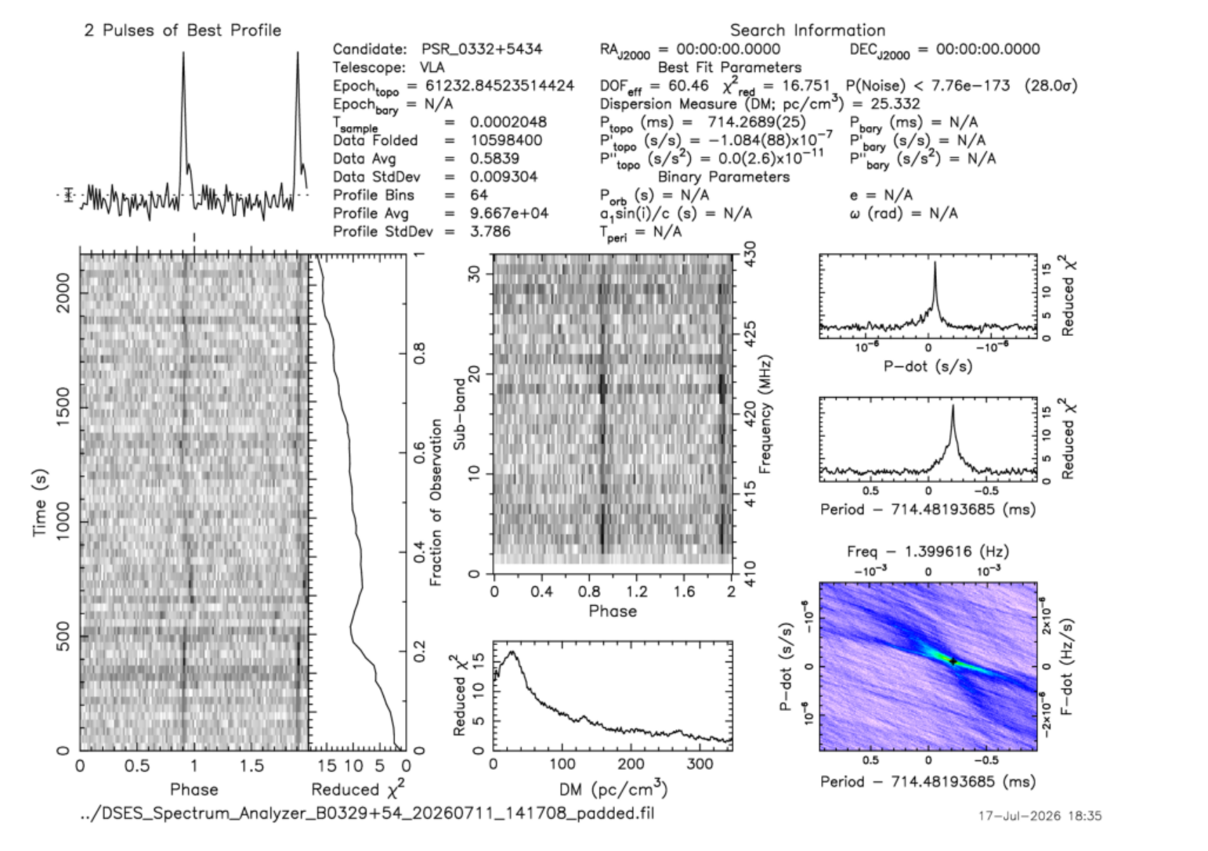
RESULTS
B0329+54 — a textbook detection
28.0 σ
probability the signal is noise: < 8×10⁻¹⁷³
Textbook single-peaked profile at the catalog period of 714.5 ms, coherent across the full 36.6 minutes
Detection peaks at dispersion measure ≈ 25 — catalog value 26.8 — and falls off toward zero
In the field it stood at ~20 σ; RFI cleanup and one timebase repair recovered the rest — that story is the next slide
Gap-bridged, RFI-cleaned ephemeris fold — the full 36.6-minute integration (2026-07-17 re-analysis)
Lowering the Barrier to Radio Astronomy • DSES • SARA 2026
Notes:
Walk the figure: single clean pulse top-left, single vertical track in phase-vs-time, DM curve peaking near catalog. The number's history: ~19.9-20.6 sigma across the original fold types as reported in the field; RFI mask + zap took it to 22.4; bridging a 0.558-second dropped-sample gap recovered full coherence at 28.0 sigma with DM back at 25.3. Chi-squared_red 16.75.

Slide 10
PEER REVIEW
One review comment was worth 5.6 σ
1
2
3
4
The comment
The forensics
The culprit
The repair
Dan Layne (AD0CY), reviewing the trip report: the fold shows a phase drift it shouldn’t have
A rigid no-search ephemeris fold: smooth 1.2-rotation drift plus one +0.22-rotation step — parts in 10⁴, five orders beyond any physics. Our clock, not the sky
USB sample drops during recording silently shorten the .fil’s sample-count clock — the app showed overflows live but didn’t count or log them
0.558 s of noise padded at the step: 22.4 σ → 28.0 σ, single textbook profile, DM back at 25.3 — diagnosis confirmed by repair
Return on criticism. Overflow logging and automatic gap-padding are now queued on the roadmap — future recordings keep an honest clock.
Lowering the Barrier to Radio Astronomy • DSES • SARA 2026
Notes:
The drift function was mapped directly: 22 consecutive 100-second fixed-period folds, each window's phase measured by cross-correlation — a smooth accelerating drip plus one discrete +0.219-rotation step at t ≈ 550 s. The pad is 0.025% of the data, a copy of the preceding real noise — no synthetic signal; it only restores the time axis. The 5.6-sigma jump is the coherence recovered when the two segments finally add in phase. Caveat: the padded file is for detection and profile work, not absolute timing. Full analysis in the refined fold PDFs beside the recordings.

Slide 11
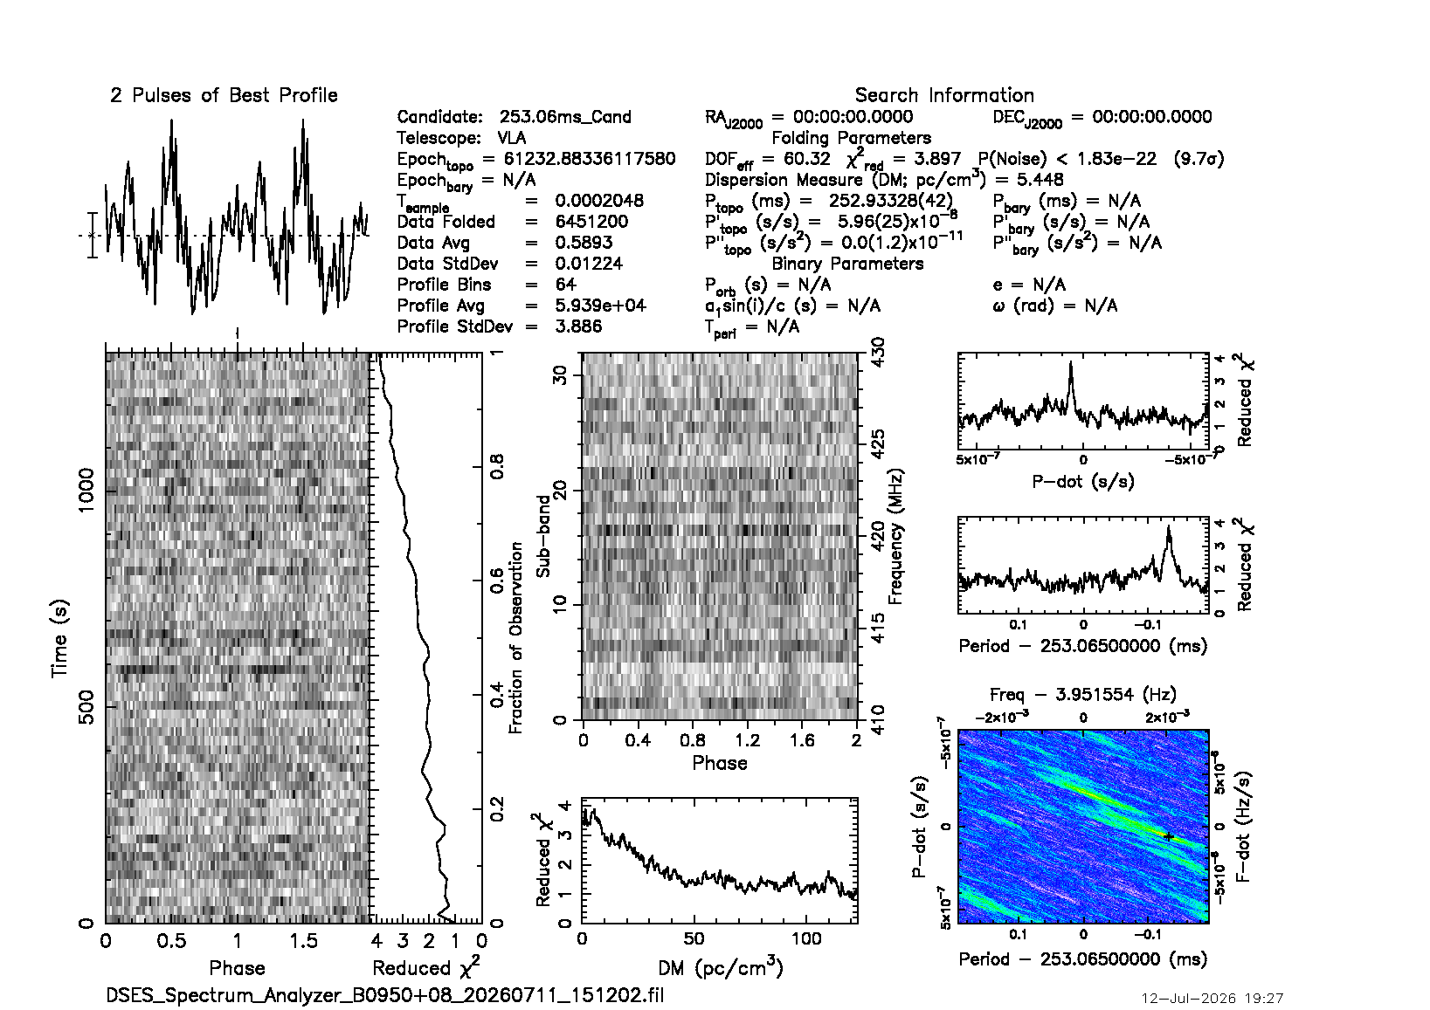
RESULTS
B0950+08 — a strong candidate, honestly framed
~9 σ
after cleanup, the best fit lands on the catalog values
Clear peak at the pulsar’s 253 ms period when folded at the known ephemeris (~9.7 σ as recorded)
With RFI masked and the timebase repaired, the search converges on P = 253.05 ms and DM ≈ 2.9 — the catalog values — exactly how a real detection behaves
But it is noise-limited: at 20 MHz bandwidth DM 2.97 is indistinguishable from zero, and ~9 σ leaves no room for decisive sub-tests — a strong candidate, not yet a publishable detection
The remaining gains are observational: a 90-minute track (≈20 σ), several sessions to catch scintillation maxima, wider bandwidth
Fold at the known 253 ms period — 22.2-minute observation
Lowering the Barrier to Radio Astronomy • DSES • SARA 2026
Notes:
Honesty is the credibility of the whole talk: the 2026-07-17 re-analysis applied the full B0329+54 cleanup — the significance stays ~9 sigma (noise-limited, not artifact-limited), but the best-fit parameters walk onto the catalog values for the first time. A predictive split-half coherence test came out consistent (~2 sigma) but not decisive — at 9 sigma total, subdividing runs out of signal. Processing gains are exhausted; the re-observation plan is on the roadmap: record after the timebase fix ships, 90+ minutes, multiple sessions for scintillation.

Slide 12
VERIFICATION
Real — and independently reproducible
Dispersion: the celestial fingerprint
Two platforms, two toolchains, one answer
Interstellar plasma delays lower frequencies — a sweep imposed by light-years of travel
Detection strength peaks at the catalog dispersion measure and falls toward zero
Terrestrial interference shows no dispersion at all
One curve separates a genuine pulsar from RFI
macOS — PRESTO v5.0.2, re-run on v6.0.0
Windows — PRESTO v6.0.0 under WSL (a new DSES capability)
Identical fold commands, independently built stacks
B0329+54 probability-of-noise
4.49×10⁻⁹⁰ Windows 4.5×10⁻⁹⁰ macOS
Every fold now produces a standardized PDF diagnostic stored beside the recording — validation minutes after capture, on whichever machine is at hand.
Lowering the Barrier to Radio Astronomy • DSES • SARA 2026
Notes:
Two independent arguments. Physics: the dispersion curve is the fingerprint — RFI doesn't have one. Engineering: the same recordings re-analyzed on separately compiled PRESTO builds on two operating systems agree to three significant figures.

Slide 13
FIELD ENGINEERING
The case of the headless Raspberry Pi
1
2
3
4
Symptoms
Diagnosis
Root cause
Fix — in v1.1.6
Dropdown menus dead, Help menu blank, window opens tiny in a corner — on the field box, mid-session
Remote SSH into the site over Tailscale — while the trip continued
No monitor attached: the graphics system reports a 0×0-pixel screen, collapsing every popup and confusing window placement
Launcher synthesizes a virtual monitor when none is connected; the app refuses to reposition windows against an empty screen
Not an application bug. A display-configuration condition that had silently affected every prior software version — found because real hardware was running at a real site.
Lowering the Barrier to Radio Astronomy • DSES • SARA 2026
Notes:
Crowd-pleaser story: the field box (Raspberry Pi 5, viewed over remote desktop) had 'broken' menus. Every symptom traced to one condition — headless operation yields a zero-by-zero screen. The fix shipped in v1.1.6 and the box was verified running it. Moral for any club running remote gear.

Slide 14
SHIPPED
Field wish-list → v1.1.6 in two days
Spectrum Analyzer v1.1.6 — cut and published July 12, one day after the observing session:
Sweep mode
Recording, finished
Headless fixes
Stepped wide-spectrum scan for RFI surveys beyond the radio’s instantaneous bandwidth — retunes across a range (e.g. 100–1000 MHz) and stitches one wide trace, with cross-pass max-hold.
Source name stamped into the filename and the .fil header — with RA/Dec derived from the pulsar designation. Red REC indicator, elapsed time, timed auto-stop. July 11’s files had to be renamed and patched by hand; never again.
The virtual-monitor launcher and empty-screen safeguards from the previous slide, plus updated documentation and operating guide.
Epilogue: one day after release, the field box caught a packaging defect desktop testing had missed — Windows line endings in the Unix launcher script. Rebuilt and republished within hours, with two independent build-pipeline safeguards added. Real installations in the field earn their keep.
Lowering the Barrier to Radio Astronomy • DSES • SARA 2026
Notes:
Everything the field session asked for shipped within two days, and every machine — including the field box — converged on the release through the built-in updater. The line-endings epilogue is worth telling: the first Windows-built archive broke Unix launches; the field box exposed it within a day.

Slide 15
SHIPPED, AGAIN
v1.1.7 six days later — the display was hiding signals
1
2
3
4
The report
The root cause
The fix
The result
Ray (AA0L): on the same hardware, other SDR software shows weak signals ours doesn’t
The display FFT examined only the newest FFT-length of samples each screen tick — about 0.3% of the stream at 20 MS/s. The other 99.7% never reached the screen
Welch-average every sample between screen updates; true per-block peak/min hold detectors; an adaptive CPU budget so slower machines shed coverage gracefully
A razor-flat noise floor with sub-dB scatter — weak signals stand clear. Verified live on the B210; released July 18
Recordings were never affected — the filterbank path always processed every sample; this was display-only. Two field reports, two releases, seven days.
Lowering the Barrier to Radio Astronomy • DSES • SARA 2026
Notes:
The noise-floor scatter dropped ~34x (≈ sqrt of the averaging depth); max hold is now a true per-block peak detector, so a 51-microsecond burst reads at full amplitude instead of -27 dB. One release note worth mentioning: the default average is now linear power, so the displayed floor reads about +2.5 dB versus older versions — the old dB-domain average was biased low; the new number is the honest one. Verified live on the B210 at 1422 MHz with three weak narrowband test signals.

Slide 16
THE ROAD AHEAD
A documented upgrade queue
Pulsar visibility planner
One-click post-processing
8
“what’s up now?” — pulsars above the horizon with az/el, flux, and time left; a pick fills the recording Source field
“is it good?” — automatic RFI mask + catalog fold when a recording ends; sigma/DM results card and a plain verdict
features specified and committed to the Society’s shared roadmap
Quick-look during recording
Timebase integrity
a draft fold on a snapshot of the data so far — without interrupting a multi-hour capture
count and log overflows; automatic gap-padding keeps the .fil clock honest — the peer-review finding, fixed at the source
≈20 σ
Self-contained fold PDFs
Audio demodulators for RFI ID
commands, results table, and plain-language verdict inside every chart PDF — nothing to chase down later
click a signal and listen — AM/NFM/WFM/SSB/CW; an AI mode-classifier to follow
expected from a 90-minute B0950+08 re-observation once the timebase fix ships
System-1 steering integration
ezRA drift-scan format
Plus a site-computer upgrade to multi-core x86-64 — enabling PRESTO post-processing right at the dish.
pick a pulsar in the app and the dish knows where to point — awaiting the steering team’s API
record ezCol-compatible files for the open-source hydrogen-line drift-scan suite
Training the radio-astronomy interest group starts on this baseline — a roster of members is signed up.
Lowering the Barrier to Radio Astronomy • DSES • SARA 2026
Notes:
This is not a wish list — every item is specified in the repository's shared ROADMAP.md with design notes. The queue turns the remaining expertise into software: the planner replaces the Murmur/Stellarium planning step, one-click post-processing replaces the hand-run PRESTO pipeline for the common case, and timebase integrity fixes the defect peer review found. Science queue alongside: the B0950+08 campaign, and repeated B0329+54 sessions toward timing-grade data.

Slide 17
WHAT WE PROVED AT HASWELL
Non-experts detected B0329+54 at 28 σ — plus a strong second candidate — with software the Society wrote, controls, and can teach.
1
The whole data path — antenna → SDR → filterbank → PRESTO — is validated end to end, reproduced across platforms, and hardened by peer review.
2
The barrier is now a slope: two releases shipped from field feedback in a week, and the upgrade queue is written down.
3
Standing on the work of Dr. Richard Russel (AC0UB) and Dan Layne (AD0CY) — whose review of the report made the headline number stronger.
Field team: Ray Uberecken (AA0L), Anne Haney (W0ZDW), Richard Hambly (K0GD).
Development, field diagnosis, and data processing accelerated by AI-assisted engineering (Claude Code).
Richard M. Hambly (K0GD) • rick@cnssys.com • https://dses.science
Notes:
Close on the mission, not the software: this was about opening real radio astronomy to more members. Thanks: Rich and Dan built the program this stands on; the field team; and the report notes the role of AI-assisted engineering across three platforms. Questions.

