Slide 1
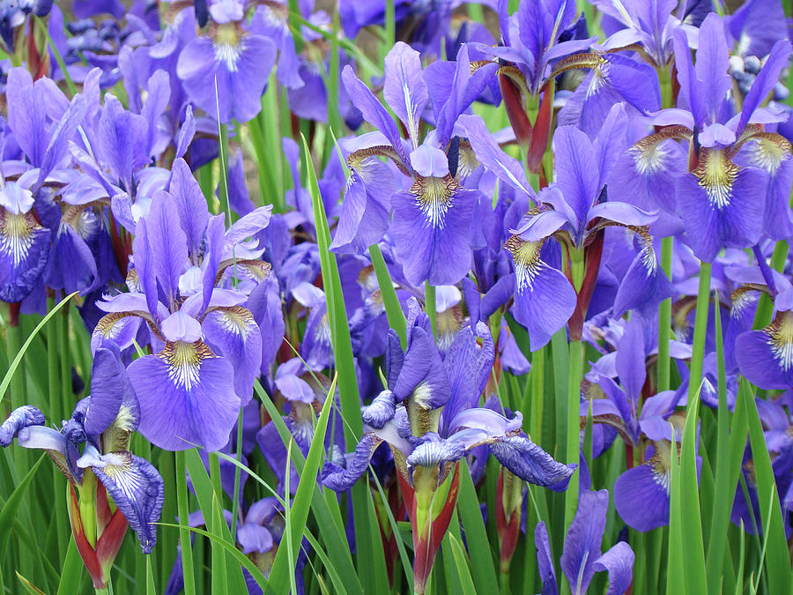
Iris Dataset
Classification via Unsupervised learning

Slide 2
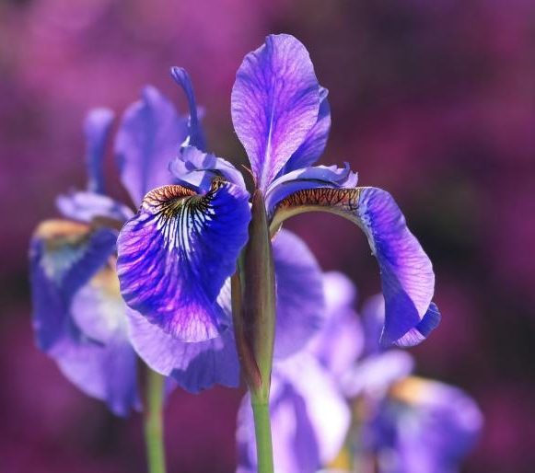
Presentation Outline
Data Exploration
Model Selection
Conclusion

Slide 3
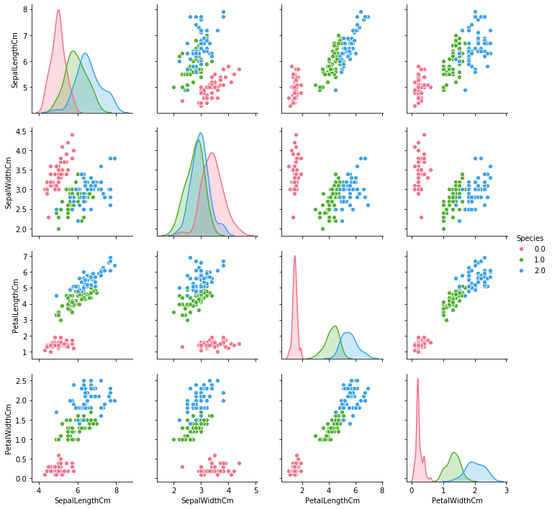
Visualization : Pair Plot
3 species :
Iris Setosa
Iris Versicolor
Iris Virginica
4 features :
Sepal Length Cm
Sepal Width Cm
Petal Length Cm
Petal Width Cm

Slide 4
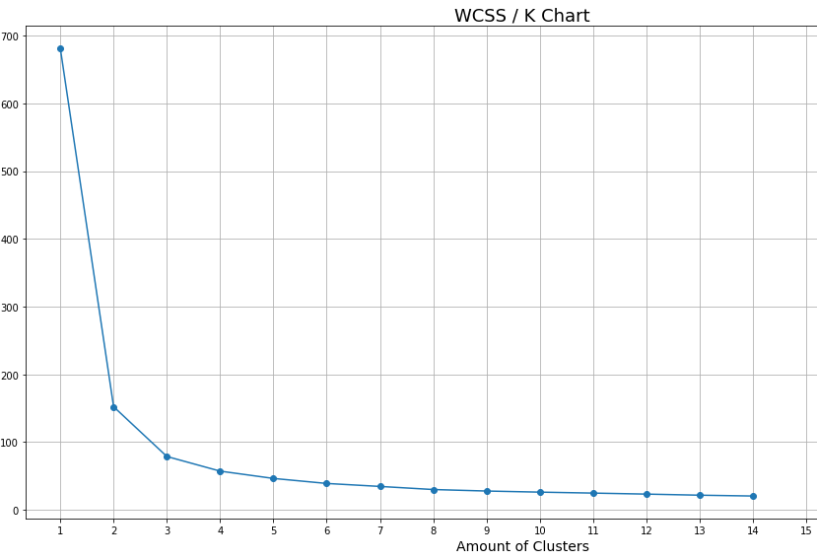
Model 1 : Kmeans Clustering
K selection for kmeans
Elbow Graph to determine the number of clusters
K could be either 2, 3 or 4

Slide 5
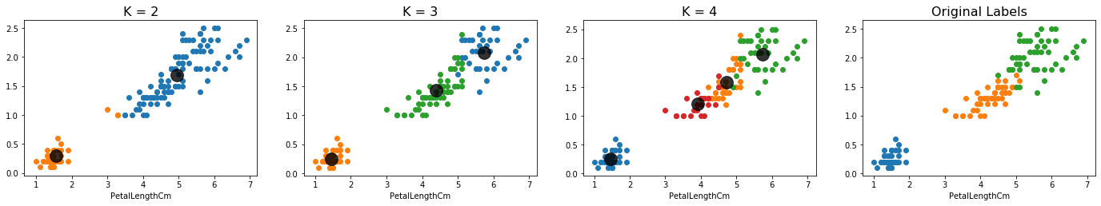
Visualization : Scatter Plot (Kmeans)

Slide 6
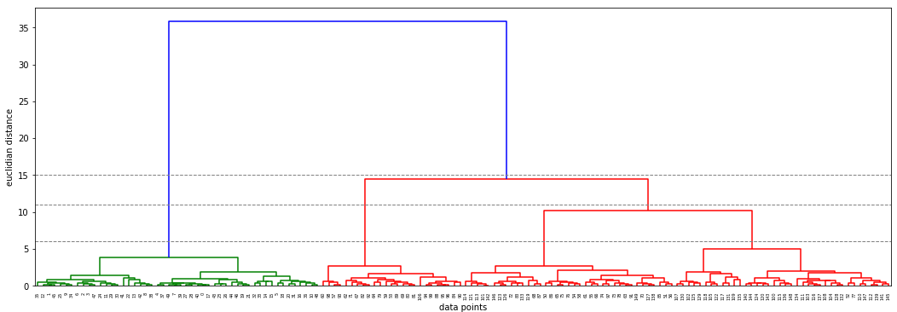
Model 2 : Hierarchical Agglomerative Clustering
K selection for Hierarchical Clustering using Dendrogram to determine the number of clusters
K could be either 2, 3 or 4

Slide 7
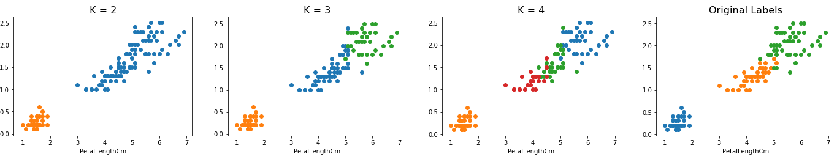
Visualization : Scatter Plot (Hierarchical Agglomerative Clustering)

Slide 8
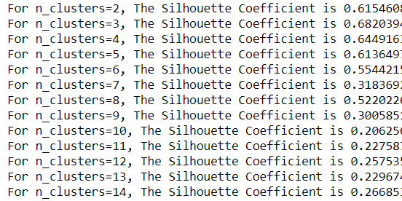
Model 3 : Gaussian Mixture Clustering
K selection for Gaussian Mixture
Silhouette Score to determine the number of clusters
K could be either 3 or 4

Slide 9
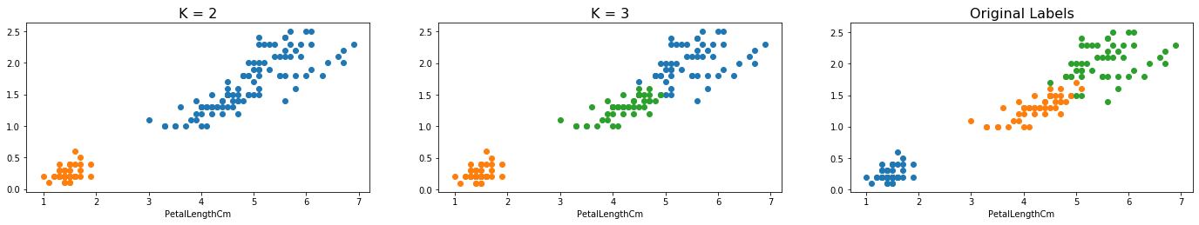
Visualization : Scatter Plot (Gaussian Mixture Model Clustering)

Slide 10
Conclusion
Made used of 3 models to find the ideal number of cluster
Kmeans + Elbow Graph
Hierarchical Clustering + Dendrogram
Gaussian Mixture + Silhouette Score
All model found it easier to classify Iris Setosa compare to:
Iris Versicolor
Iris Virginica
Overall best model in classification:
Is a tie between Hierarchical & Gaussian Mixture

