Slide 1
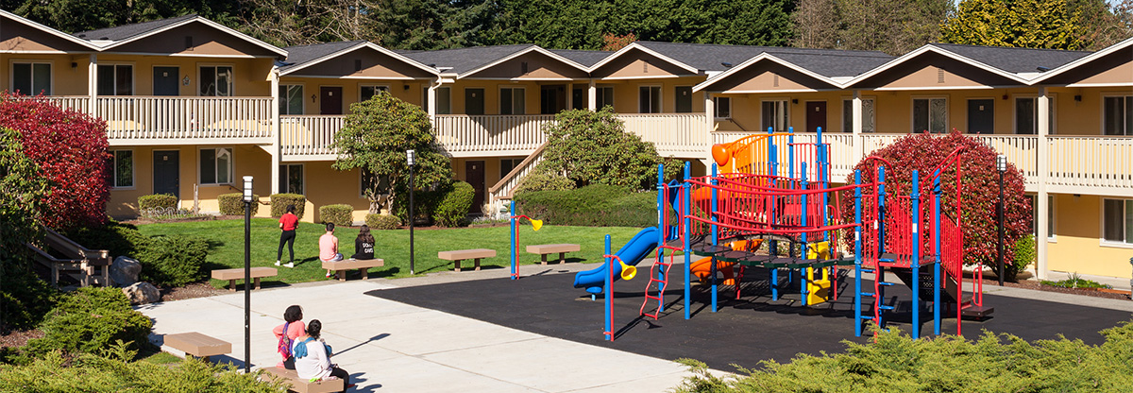
King County Housing
Predicting house pricing via regression

Slide 2

Presentation Outline
Data Exploration
Features
Model Selection
Conclusion

Slide 3
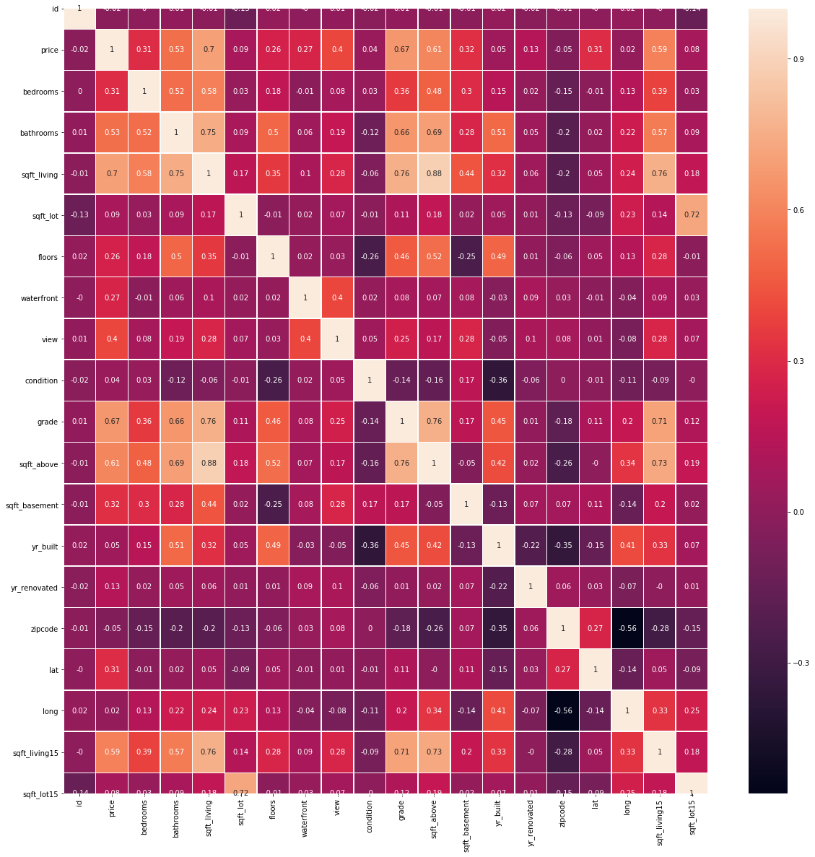
Visualization : Plotting pair wise correlation
Look for correlation between attributes and target
Look for abnormal correlation between attributes

Slide 4
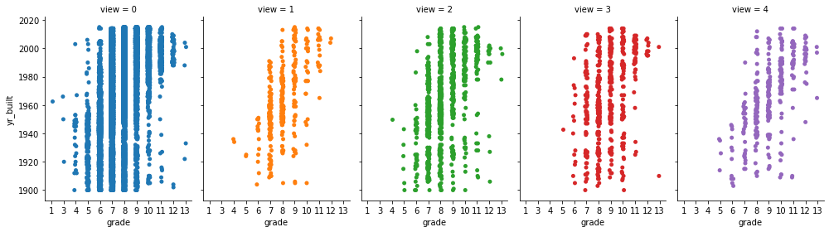
Visualization : Scatter Plot (1/2)
Determine the relation between the view, grade and year built.
Newer houses have better grades but we can not say much about the change in the view.

Slide 5
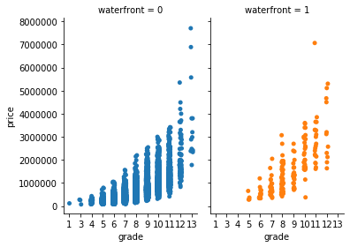
Visualization : Scatter Plot (2/2)
Plotting the correlation between waterfront in relation of grade and price.
↑ grade = ↑ price but have nothing to do with owing a waterfront (one hot)

Slide 6
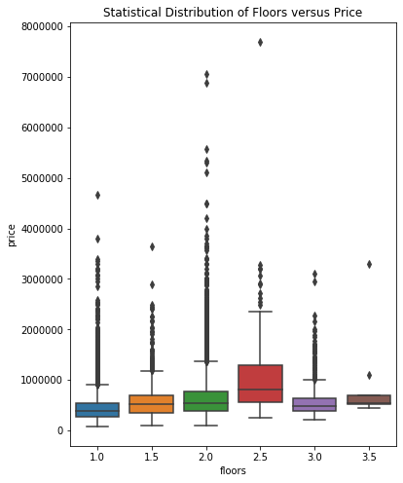
Before : Outliners
Grey diamonds indicate datapoints that deviate 3 times the standard deviation
Following Three Sigma Rule
this only accounts for .3% of data

Slide 7
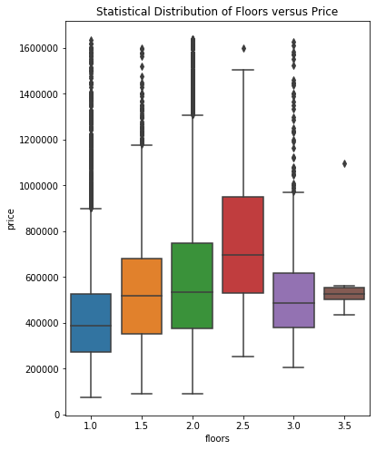
After : Outliners
Scipy’s zscore()
Numpy’s abs()
Identify and remove the outliers in price.

Slide 8
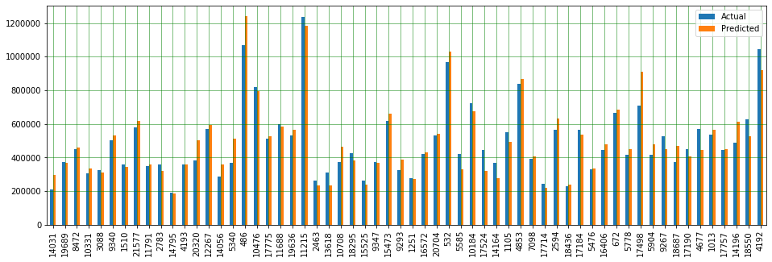
Gradient Boosting Regressor
Using the 80/20 split I trained my model using the training data provided …
Albeit a little greedy but fastest to get the job done. Basic tuning was done to ensure consistency …

Slide 9
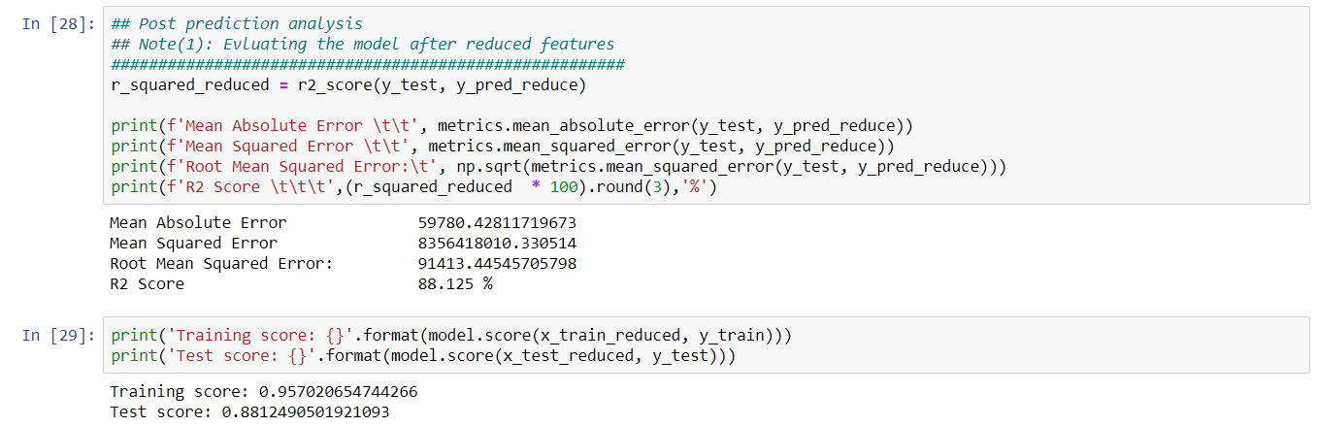
Evaluation (1/2)

Slide 10
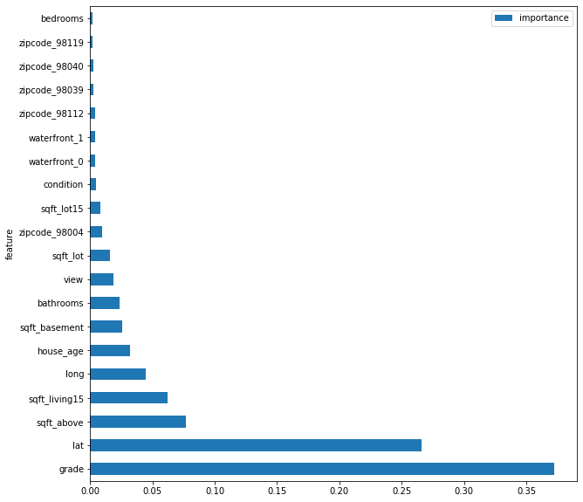
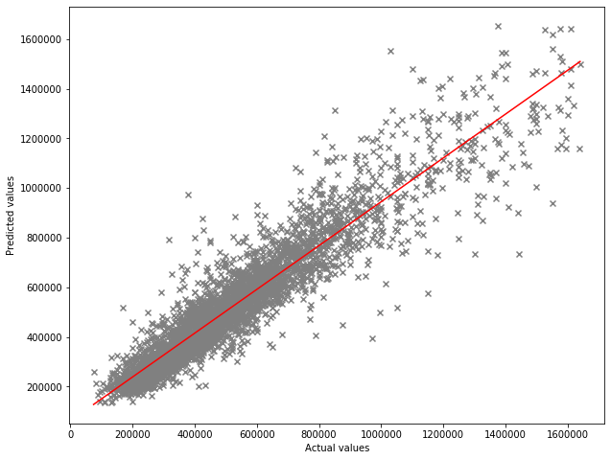
Evaluation (2/2)

