Slide 1

Voice-Controlled Maze Game SCBIO Final Project 2026
Kewan Marboeuf
Michael Vogt
Tizian Quinque
Luca Delli Castelli
Sistemas Complexos Bioinspirados (SCIBIO)
Lecturer: Fernando Escobar Ropero

Slide 2
Outline
Motivation
Task Division
Introduction to Vosk Speech Recognition
Code Implementation
Voice Control
Game Integration
Demonstration
Conclusion

Slide 3
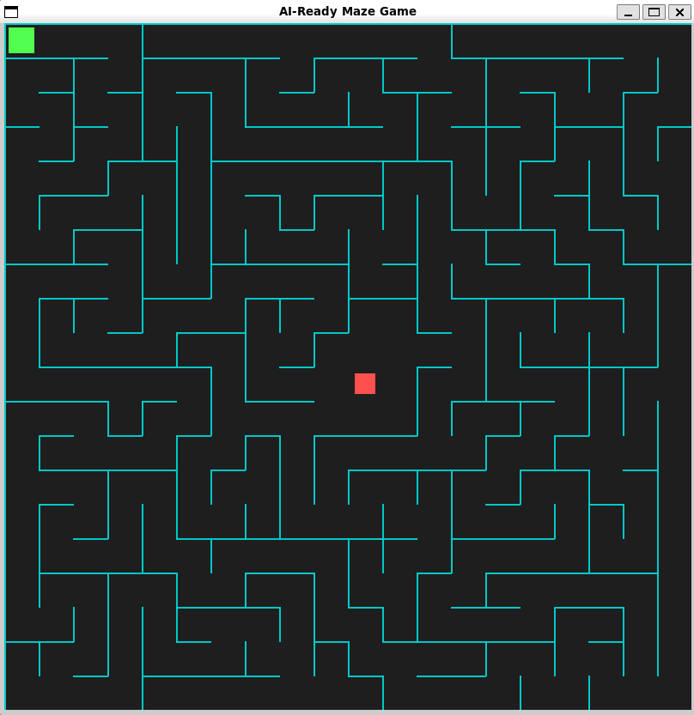
Motivation
Why voice control?
Human-computer interaction
Lightweight alternative to vision systems
No large training dataset required
Project Goal
Maze game controlled by voice
Combination of:
Speech Recognition
Game Development
Real-time interaction
→ Recognize: “up”, “down”, “left”, “right”, “exit”

Slide 4
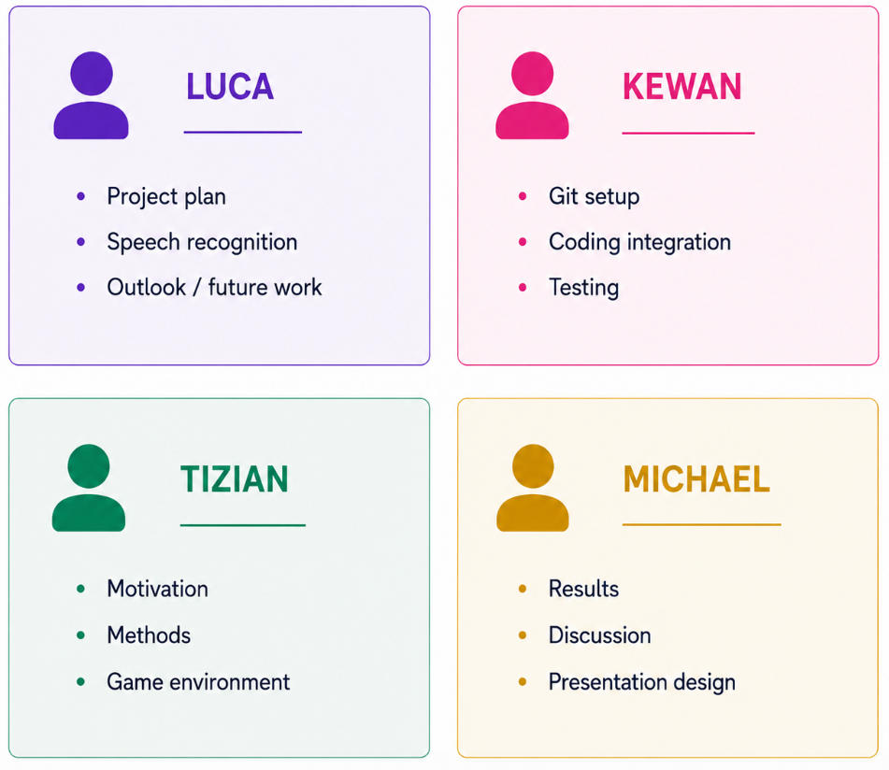
Task Division

Slide 5
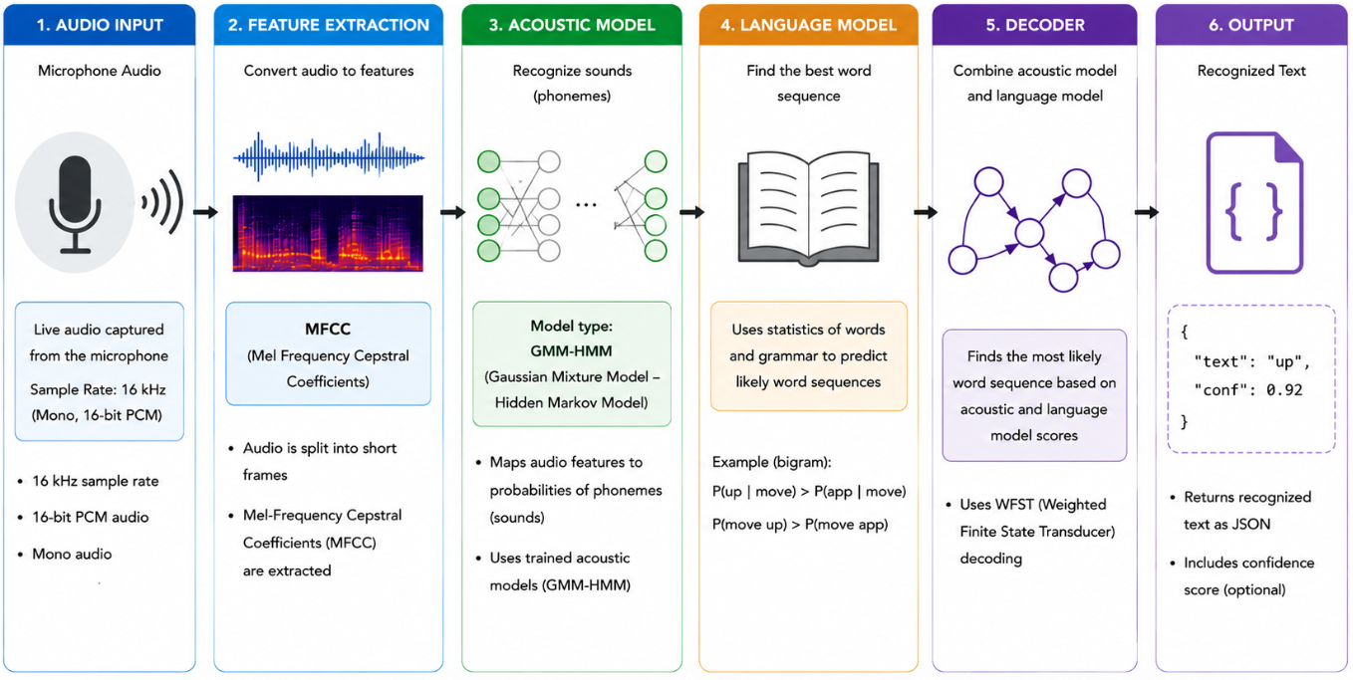
Intoduction to Vosk
Notes:
First, we introduce speech recognition using Vosk and Kaldi. The input is a raw audio signal, which is converted into MFCC features (Mel-Frequency Cepstral Coefficients). These features represent important speech frequencies based on how humans perceive sound.
Vosk and Kaldi mainly use two models. First, the acoustic model maps these audio features to possible speech sounds. In this pipeline, a GMM-HMM based acoustic model is used. Gaussian Mixture Models, or GMMs, are used to model the probability of speech sounds, while Hidden Markov Models, or HMMs, model how speech changes over time.
Then, the language model predicts the most likely word sequence using word probabilities and grammar statistics. Finally, the decoder combines the acoustic model scores and the language model scores to determine the most probable sentence or command.
In our project, we extract commands like ‘up’, ‘down’, ‘left’, ‘right’, and ‘exit’ to control the maze game
https://www.researchgate.net/publication/228828379_The_Kaldi_speech_recognition_toolkit

Slide 6
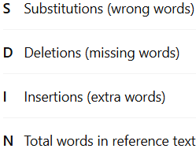

Implementation of Voice Control
Why did we choose Vosk?
Pretrained model → Transfer Learning
Real-time speech recognition
Works offline
WER of 9,85 – 10,38, BUT Accuracy depends on:
Microphone quality
Background noise
Pronunciation / accent
Notes:
https://www.researchgate.net/publication/228828379_The_Kaldi_speech_recognition_toolkit
https://alphacephei.com/vosk/models
In zwei test zwsichen 9.85 und 10.38 WER 9.85 (librispeech test-clean) 10.38 (tedlium)

Slide 7
Game integration
Recursive backtracking maze generation
1- Initialize maze with walls everywhere
2- Do a depth first search while removing the walls between neighbours

Slide 8
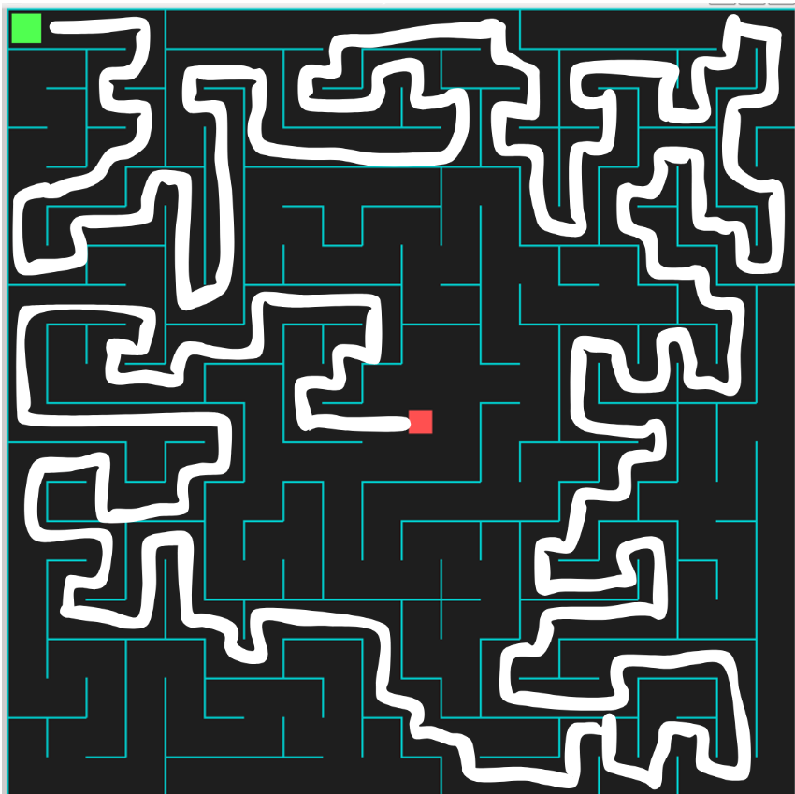
Game integration
Pipeline
speech
text
direction

Slide 9
Gameplay DEMO

Slide 10
Conclusion
Successful proof of concept
Speech as lightweight interface
Real-time control works
Reliable command recognition
HOWEVER: Problems with accents and background noises

