Slide 1
MARL: A Multi-Agent Reinforcement Learning Framework for Buffer Management in Multi-Tenant Cloud Databases
Xin Huang, Yu-Ang Zhang, Hongtao Wang, Peiquan Jin
University of Science and Technology of China (USTC)
IEEE ICDCS 2026 — Industrial Event
Notes:
Good morning everyone. Today I am delighted to present our work, MARL, a Multi-Agent Reinforcement Learning framework for buffer management in multi-tenant cloud databases. This is a joint work at the University of Science and Technology of China, published at the IEEE ICDCS 2026 Industrial Event. In modern cloud DBaaS platforms, multiple tenants share the same physical resources, and dynamically managing the shared buffer pool is a critical yet challenging problem. Our MARL framework addresses this by modeling each tenant as an independent reinforcement learning agent that learns to adjust its buffer allocation in a cooperative manner.

Slide 2
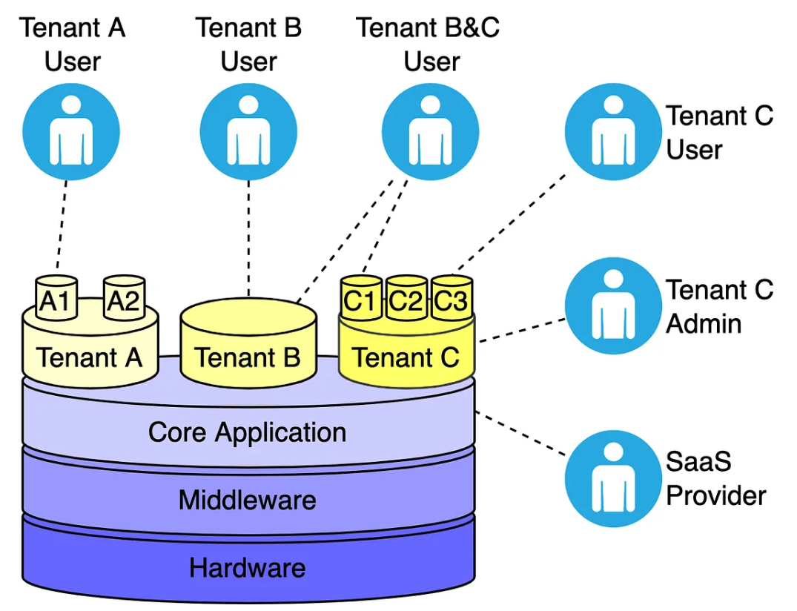




Background
Database-as-a-Service (DBaaS) has become a foundational enterprise infrastructure.
Modern DBaaS rely heavily on multi-tenancy to maximize physical hardware utilization.
Providers face a critical trade-off: satisfying tenants' strict Service Level Agreements (SLAs) while minimizing operational overhead.
Notes:
Let me begin with the background. Over the past decade, relational Database-as-a-Service has been widely adopted by enterprises. Major providers such as Amazon Aurora, Azure SQL Database, and Google Cloud SQL all rely on multi-tenancy to maximize hardware utilization and reduce operational costs.
In a multi-tenant model, multiple databases from different customers share the same physical data center resources. Providers face a key trade-off: they need to satisfy tenants' performance guarantees defined by Service Level Agreements, or SLAs, while minimizing the physical resources consumed.

Slide 3
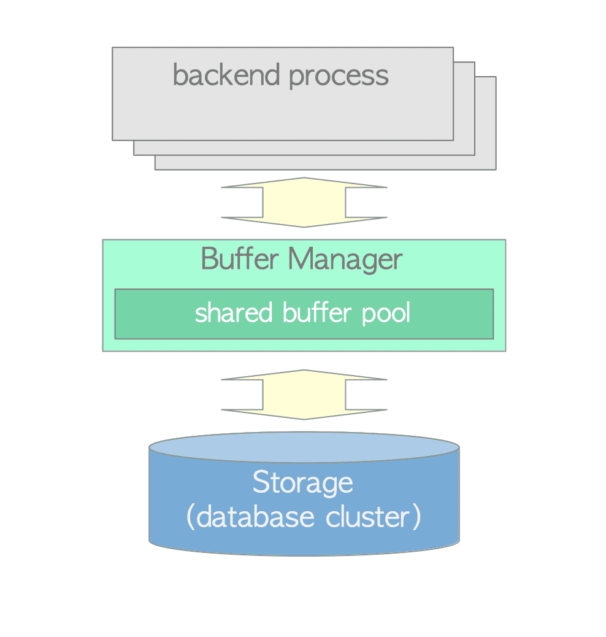
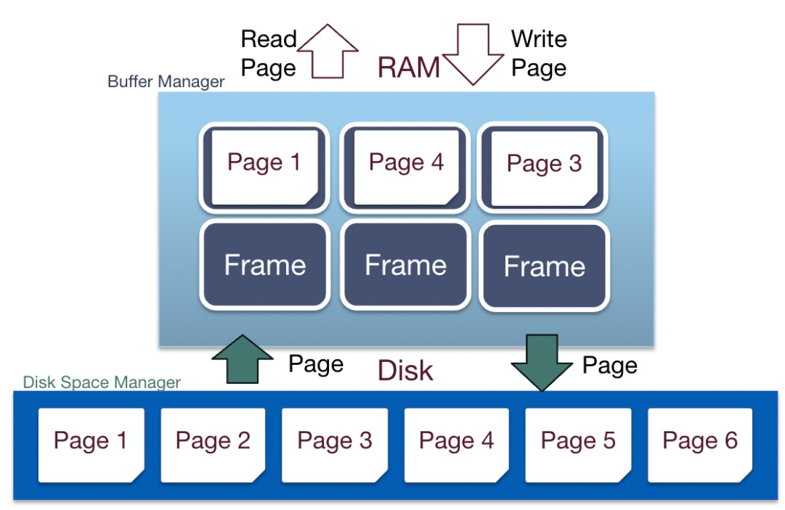
Background
The buffer pool is a critical database component that caches frequently used pages, directly dictating transaction efficiency.
In cloud-native DBaaS architectures, buffer misses trigger remote storage calls over the network, introducing massive high-latency overhead.
Challenge: How can we dynamically manage a shared buffer pool among unpredictable, volatile multi-tenant workloads to satisfy tenants’ SLA?
Notes:
Now, why is the buffer pool so important? The buffer pool is a critical database component that caches frequently accessed pages, thereby reducing expensive disk I/O. In cloud-native DBaaS architectures, this is even more crucial, because buffer misses trigger remote storage access over the network, introducing orders-of-magnitude higher latency compared to local disk access. This brings us to the core challenge: how can we dynamically manage a shared buffer pool among unpredictable and volatile multi-tenant workloads, while satisfying each tenant's SLA? Traditional approaches fall short, and that is exactly the problem our MARL framework addresses using multi-agent reinforcement learning.

Slide 4
Limitations of Existing Approaches
Traditional & ML-Based Replacement (LRU, ARC, LeCaR, LRB)
No tenant-level buffer isolation.
Severe noisy-neighbor interference under co-located workloads.
Static Partitioning Mechanisms
Isolation by pre-defined sizes or priorities.
No runtime agility; significant resource waste.
Heuristic Approaches (SAM)
Rely on hand-crafted heuristic-based rules.
Frequently converge to sub-optimal configurations.
Lack of SLA Consideration
Human Heuristic-Based
Our Approach (MARL): SLA-Aware & Learning-Based Adjustment
Notes:
Before introducing MARL, let me review the limitations of existing approaches.
They fall into three categories. First, traditional and ML-based replacement policies such as LRU, ARC, LeCaR, and LRB manage all pages in a single global pool without tenant-level isolation, which means they cannot directly address the multi-tenant buffer management problem.
Second, static partitioning ensures isolation by pre-allocating buffer based on promised sizes, but it leads to significant resource waste when workloads change, since idle buffers cannot be reclaimed by other tenants.
Third, heuristic approaches like SAM employ stability-aware heuristic control for multi-tenant embedded databases. However, SAM relies on hand-crafted rules rather than learned policies, which limits resource utilization under highly dynamic workloads.
Motivated by shortcomings of existing methods, our approach enhance performance through a SLA-driven and learning-based framework

Slide 5
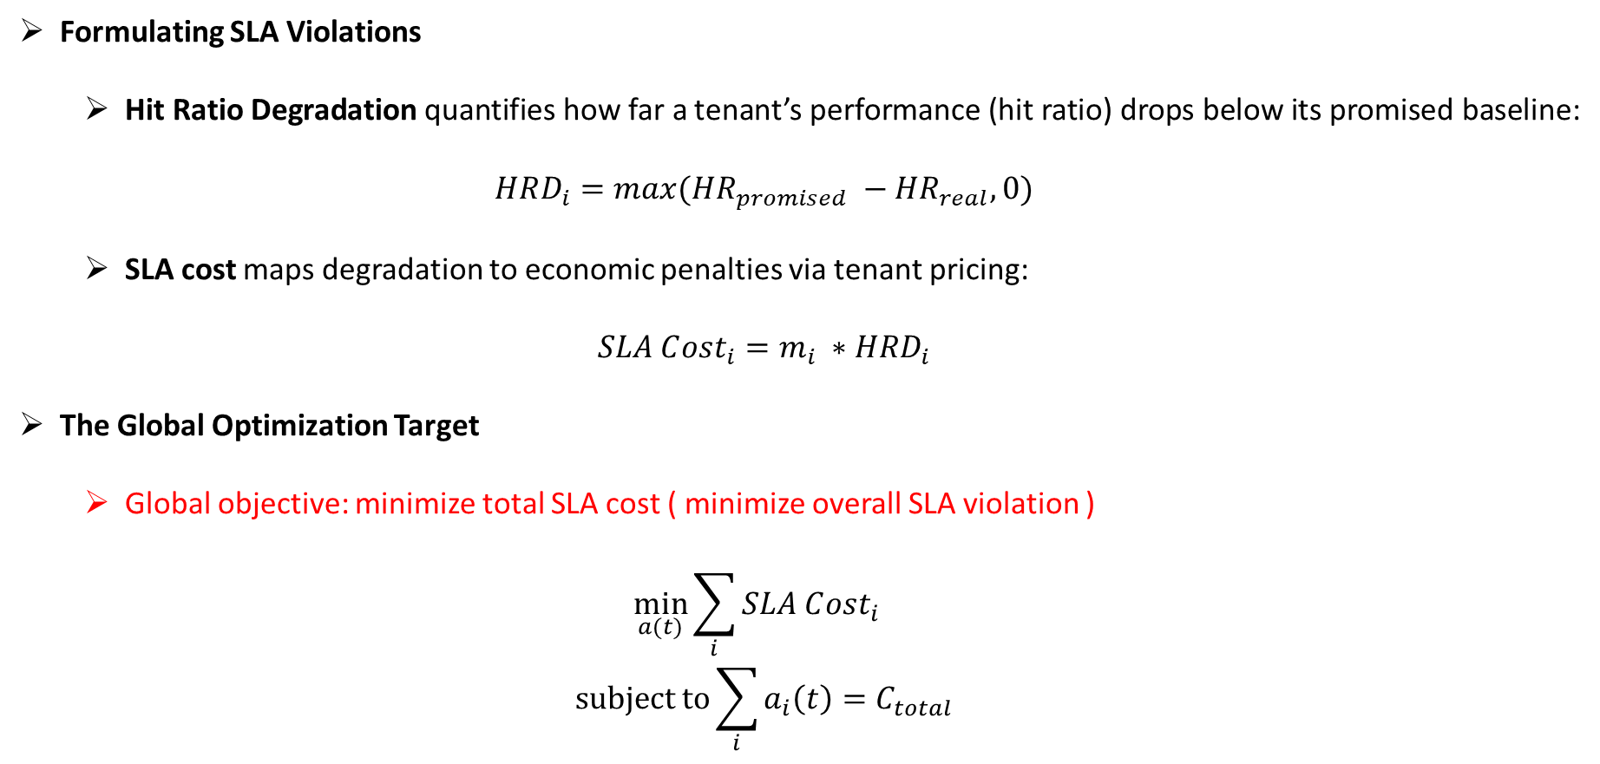
SLA-Aware Cost Model
Formulating SLA Violations
Hit Ratio Degradation quantifies how far a tenant’s performance (hit ratio) drops below its promised baseline:
$$HRD_{i}=max({HR}_{promised} −{HR}_{real}, 0)$$
SLA cost maps degradation to economic penalties via tenant pricing:
$$SLA C{ost}_{i}=m_{i} ∗HRD_{i}$$
The Global Optimization Target
Global objective: minimize total SLA cost ( minimize overall SLA violation )
$$\min_{a(t)}{\sum_{i}{SLA C{ost}_{i}}}$$
$$subject to\sum_{i}{a_{i}\left(t\right)=C_{total}}$$
Notes:
At the core of MARL is an SLA-aware cost model that directly guides the optimization.
We first define a baseline hit ratio, HR promised, which represents the expected performance when a tenant is statically allocated its promised buffer capacity. The Hit Ratio Degradation, or HRD, measures how far the actual hit ratio falls below this baseline, formulated as the maximum of the difference and zero.
The SLA cost for each tenant is then defined as the product of the tenant's SLA price, m-i, and their HRD. Here, m-i reflects the economic importance of that tenant's service guarantee.
Our global optimization objective is to minimize the total SLA cost across all tenants. This cost model is what distinguishes MARL from prior work: it enables the system to prioritize buffer allocation based on economic impact rather than just raw hit ratios.

Slide 6
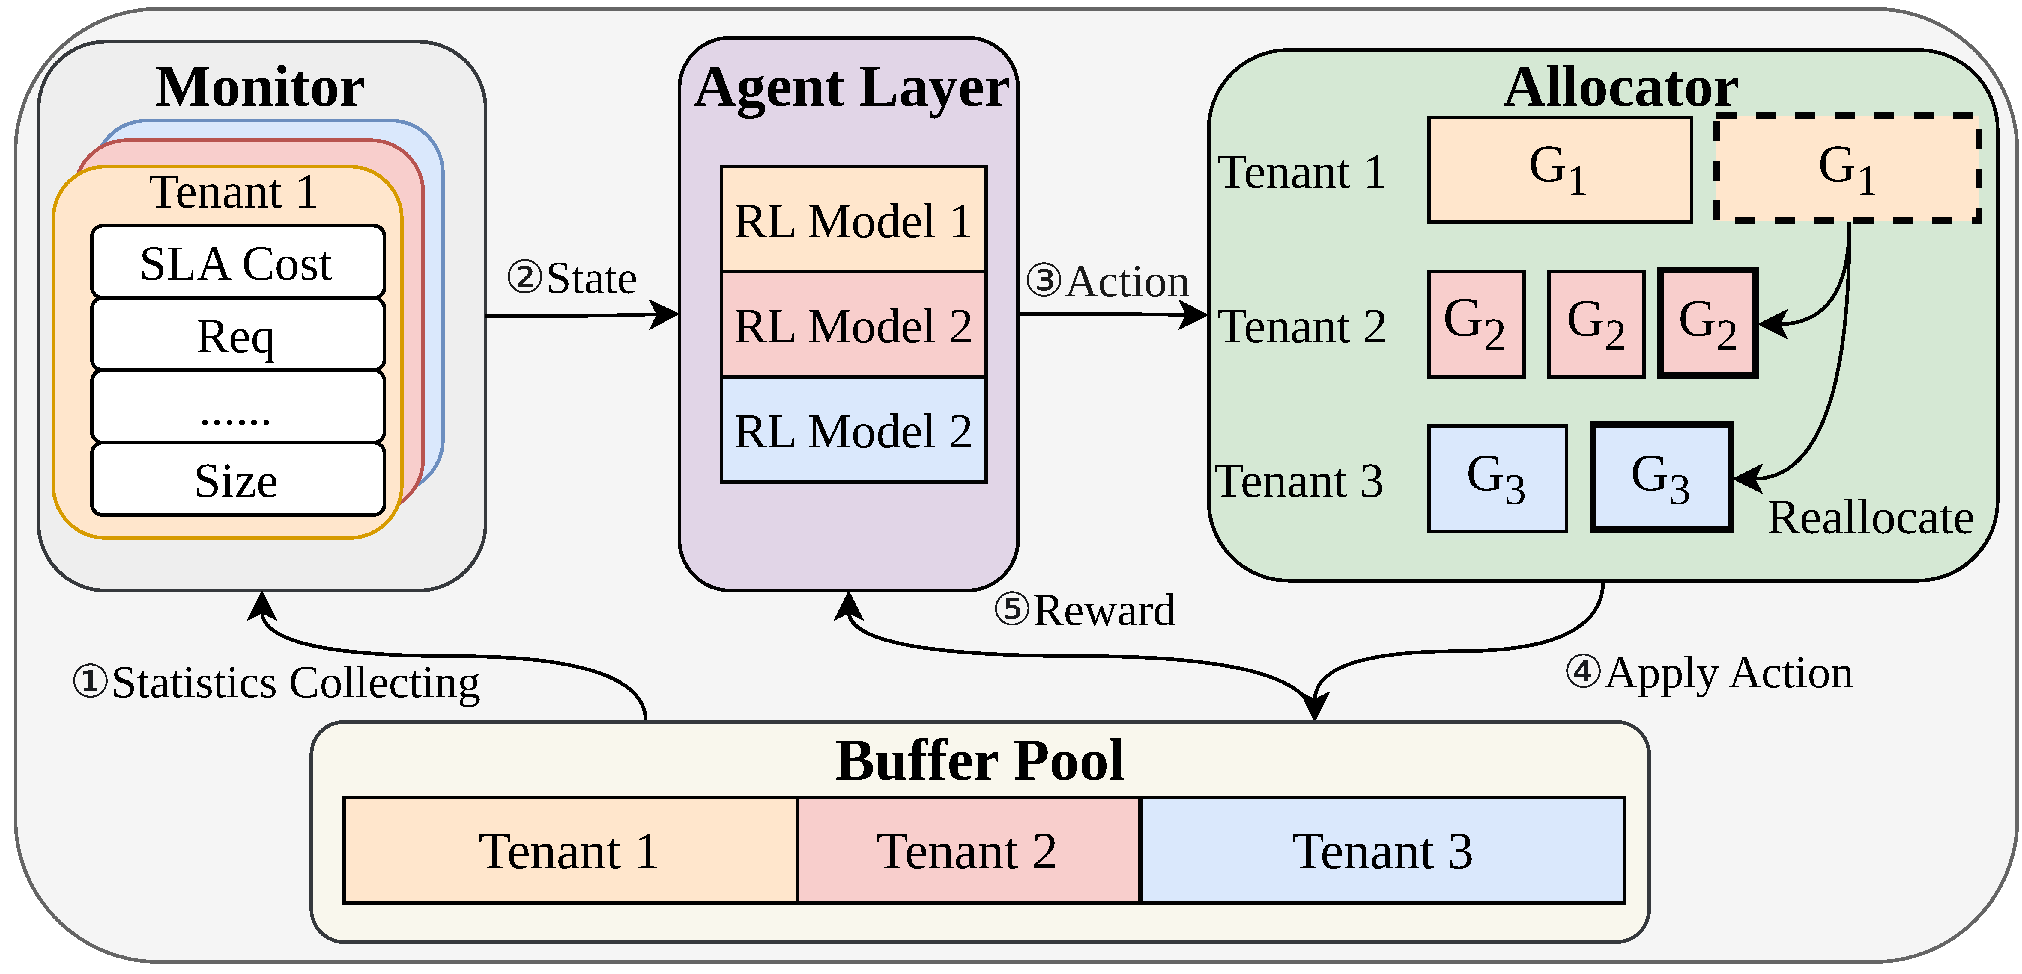
MARL: System Architecture
1
Monitor
2
Agent Layer
3
Allocator
Collects runtime stats per tenant
• SLA cost, buffer sizes, etc.
• Aggregated over fixed interval
• Normalized → RL state
Each tenant = independent RL agent
• Observes own state
• Actions: Grow or Shrink
Aggregates all agent actions
• Collects released buffer (Shrink)
• Redistributes to Grow agents
• Generates reallocation action
Notes:
Now let me walk you through the overall architecture of MARL, which consists of three main components.
First, the Monitor continuously collects runtime statistics for each tenant from the database system, including the SLA cost, actual and promised buffer sizes, and request traffic intensity. These metrics are aggregated over a fixed control interval and normalized to construct the state representation for each RL agent. By providing both tenant-level and system-wide statistics, the Monitor enables agents to reason about their local performance in the context of global conditions.
Second, the Agent Layer models each tenant as an independent RL agent that observes its own state and decides whether to Grow or Shrink its buffer allocation. All agents maintain separate observations and actions.
Third, the Allocator aggregates all agents' actions, collects the buffer space released by tenants who choose Shrink, and redistributes it to those requesting Grow through a matching process.

Slide 7
RL Agent Design
State
Actions
Reward
Avg SLAₜ / SLAᵢₜ: System-wide & per-tenant SLA cost
Avg RPₜ / RPᵢₜ: Ratio of promised vs actual buffer
Sizeᵢₜ: Tenant's buffer proportion
Reqᵢₜ: Tenant's request proportion
Tenant-level & System-wide Statistics
Grow: Request additional buffer
Shrink: Release allocated buffer
Adjustment unit Gᵢ:
A = Σ Actual Buffer / Σ Promised Buffer Gᵢ = A × Promisedᵢ × 3%
Prevents aggressive/negligible changes
Rewardᵢ = S1 + S2
S1: Self SLA Reduction:
- ΔSLA Costᵢ
S2: Contribution to other tenants:
- ΣRⱼ · ΔSLA Costⱼ
Minimizes overall SLA cost
Notes:
Let me now detail the RL agent design.
The state representation is six-dimensional, integrating both tenant-specific and system-wide metrics. Specifically, it includes the average and per-tenant SLA cost, the average and per-tenant ratio of promised to actual buffer size, the tenant's proportion of total buffer size, and its proportion of buffer requests. This design enables each agent to assess its local situation while being aware of global system conditions.
The action space is binary: each agent chooses either Grow or Shrink at each decision epoch. The adjustment granularity G-i is defined as the system-wide actual-to-promised buffer ratio, times the tenant's promised buffer size, times three percent. This scaling prevents both aggressive and negligible buffer changes.
Now, the reward function is key to our cooperative design. When a tenant chooses to Shrink, its released buffer is distributed to other tenants. The reward for that tenant accounts for both its own SLA cost change and the weighted contribution to other tenants' SLA cost improvements, where R-j represents the proportion of resources tenant j received from tenant i.
This design encourages agents to release buffer when doing so significantly benefits others without severely hurting their own performance.

Slide 8
Buffer Reallocation Process
Agent
Layer
Phase 1 — Partition
Phase 2 — Matching
Partition tenants by their actions
Shrink tenants → Shrink queue
Grow tanants → Grow queue
Transfer Δ from shrinker i → grower j
Pop satisfied tenants from queues
Stop when shrinker’s buffer is exhausted
Actions
Phase 4 — Reward Update
Phase 3 — Reallocation
The reward will be calculated and sent back to agent layer to update the model
Send reallocation action to database background thread
Adjust buffer size based on reallocation actions
Reward
Notes:
Next, I will explain the buffer reallocation process executed by the Allocator, which operates in four main phases.
In Phase 1, Partition, we first compute the adjustment granularity G-i for each tenant based on the formula we just discussed. Then, tenants who choose Shrink are placed into a shrink queue with their available buffer tracked, while tenants who choose Grow are placed into a grow queue with their needed buffer tracked.
In Phase 2, Matching, we iteratively pair shrinkers with growers. In each iteration, we transfer the minimum of the needed versus available buffer from a shrinker to a grower, and pop satisfied or exhausted tenants from their respective queues. This continues until either queue is empty. During training, the matching order is randomized for exploration fairness; in production, this can be readily adapted to a priority-based queue with high-priority tenants served first.
In Phase 3, After getting the reallocation action , the results are sent to the database background thread for execution
In Phase 4, the reward is computed and fed back to Agent Layer to update the RL model.

Slide 9
Implementation Details
Platform:
We implemented MARL in the open-source relational database OpenGauss 5.1.0. A dedicated background thread is created to periodically collect tenant metrics and transmits state information to the RL agent via shared memory, and will adjust the buffer size of each tenant after receiving the reallocation plan
RL Algorithm:
We develop our RL model based on Proximal Policy Optimization (PPO)
Training:
The model is pre-trained for 4 hours offline in a Python simulator before deployment; inference task is evenly distributed across 4 CPU cores.
Parameter:
The reward coefficient is set to 0.3. Hidden layer size is [50, 50]. With a learning rate of 10^-4, the discount factor is 0.9. We train it for 1024 iterations with a batch size of 32.
Notes:
Now let me describe the implementation details. We implemented MARL in OpenGauss 5.1.0, a production-grade open-source relational database. Tenants are identified by the database name specified in each access request. A dedicated background thread periodically collects tenant metrics and transmits state information to the RL agent via shared memory. Once the Allocator computes the reallocation plan, the results are sent back via shared memory to the background thread, which then resizes the corresponding tenants' buffer pools. Importantly, this entire adjustment process, including RL inference and fine-tuning, operates completely off the critical path of buffer requests, adding zero latency to database operations. We develop our RL model based on Proximal Policy Optimization, or PPO, which performs periodic policy updates to ensure stable and efficient learning. The reward coefficient beta is set to 0.3, with hidden layers of size 50 by 50, a learning rate of 10 to the minus 4, and a discount factor of 0.9. The model is pre-trained for 4 hours offline in a Python simulator before deployment.

Slide 10
Experimental Setup
Hardware
Intel Xeon Gold 6348 (28 cores, 2.6 GHz)
Workload Configuration (8 tenants)
SLA:
High-prior tenants (4 tenants): SLA Price=2, Promised Buffer Size = 10% DB size
Low-prior tenants (4 tenants): SLA Price=1, Promised Buffer Size = 5% DB size
Database:
Each tenant has a DB of 2M * 1 KB records (~2 GB total), generated by YCSB
Total Buffer size = 25%/50%/75% of Total Promised Buffer Size
Access Pattern:
Mixture of 4 access patterns: Scan/Latest/Zipfian/Uniform
Competitors
Shared (global ClockSweep) · Static (proportional to promised) · SAM (state-of-the-art heuristic)
Metrics
SLA Cost / Buffer Miss Ratio / Throughput / Average & P99 Latency
Notes:
Let me now describe our experimental setup. All experiments are conducted on a server equipped with an Intel Xeon Gold 6348 CPU with 28 cores at 2.6 gigahertz, 256 gigabytes of DDR4 memory, and a Western Digital NVMe SSD, running Ubuntu 22.04.
The workload is generated by YCSB, comprising 8 tenants. Half of the tenants are high-priority with an SLA price of 2 and a promised buffer size of 10 percent of the database size; the other half are low-priority with an SLA price of 1 and a promised buffer size of 5 percent.
Each tenant maintains 2 million records, each 1 kilobyte in size, yielding a database of approximately 2 gigabytes. We test four access patterns: scan, latest, zipfian, and uniform. To maximize workload diversity, the execution sequence of these patterns differs across tenants with the same SLA price. The actual buffer size defaults to 50 percent of the total promised buffer size.
We compare MARL against three baselines: Shared, which uses a single global buffer pool; Static, which allocates proportionally to promised sizes; and SAM, a state-of-the-art stability-aware heuristic. OpenGauss's default ClockSweep algorithm is used as the buffer replacement scheme. Our metrics include SLA cost, buffer miss ratio, throughput, and average and P99 latency.

Slide 11
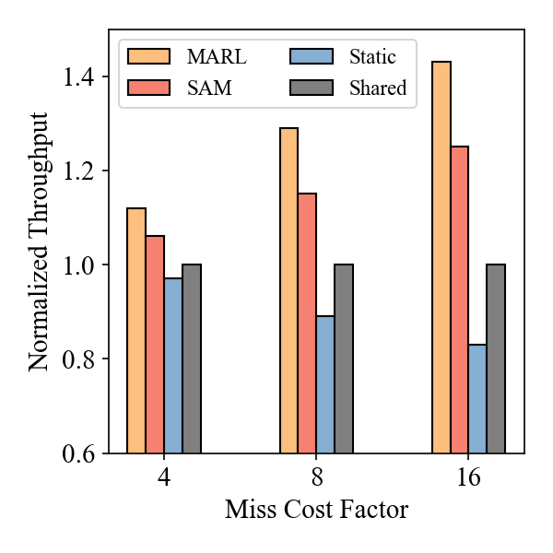
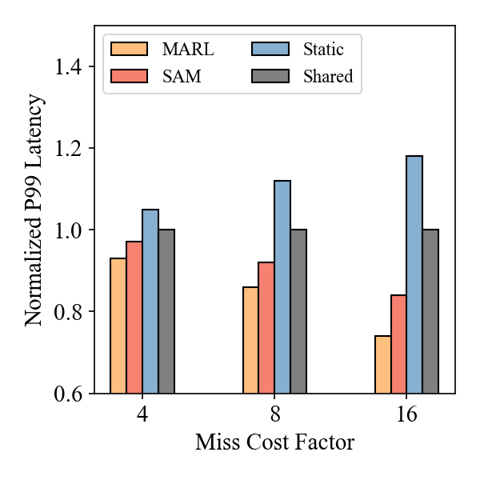
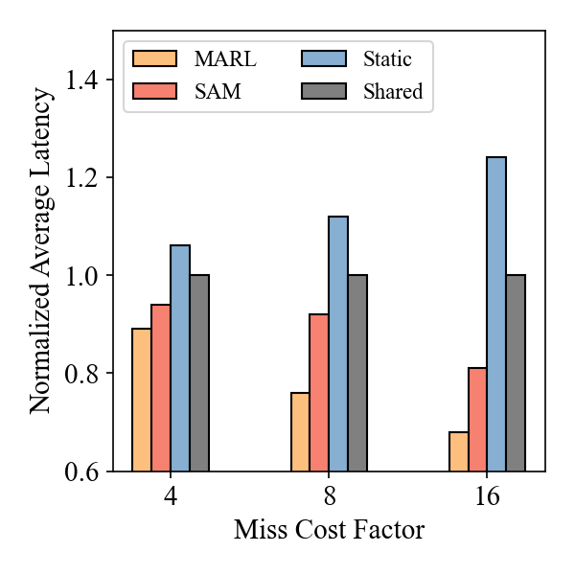
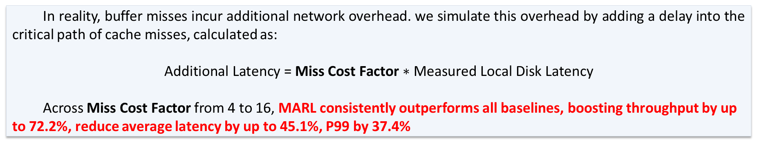
Throughput & Latency
In reality, buffer misses incur additional network overhead. we simulate this overhead by adding a delay into the critical path of cache misses, calculated as:
$$\text{Additional} \text{Latency}\text{ = }\text{Miss} \text{Cost} \text{Factor}\text{ ∗ }\text{Measured} \text{Local} \text{Disk} \text{Latency}$$
Across $\text{Miss} \text{Cost} \text{Factor}$ from 4 to 16, MARL consistently outperforms all baselines, boosting throughput by up to 72.2%, reduce average latency by up to 45.1%, P99 by 37.4%
Notes:
This slide presents our throughput and latency results under different miss cost factors. In real-world cloud database systems, cache misses incur additional network access overhead, making them orders of magnitude slower than local disk accesses. To simulate this, we add a delay to the critical path of cache misses, calculated as the measured local disk latency multiplied by a miss cost factor.
MARL consistently outperforms all baselines, and importantly, the performance gap widens substantially as the factor increases. At factor 4, MARL improves throughput by 5.1 to 15.4 percent compared to the three baselines, while reducing average latency by 6.4 to 17.3 percent. At factor 8, throughput gains reach 12.2 to 44.1 percent, with average latency reduced by 17.3 to 32.2 percent. At factor 16, MARL achieves remarkable throughput gains of 17.0 to 72.2 percent, and reduces average latency by up to 45.1 percent and P99 latency by up to 37.4 percent.

Slide 12
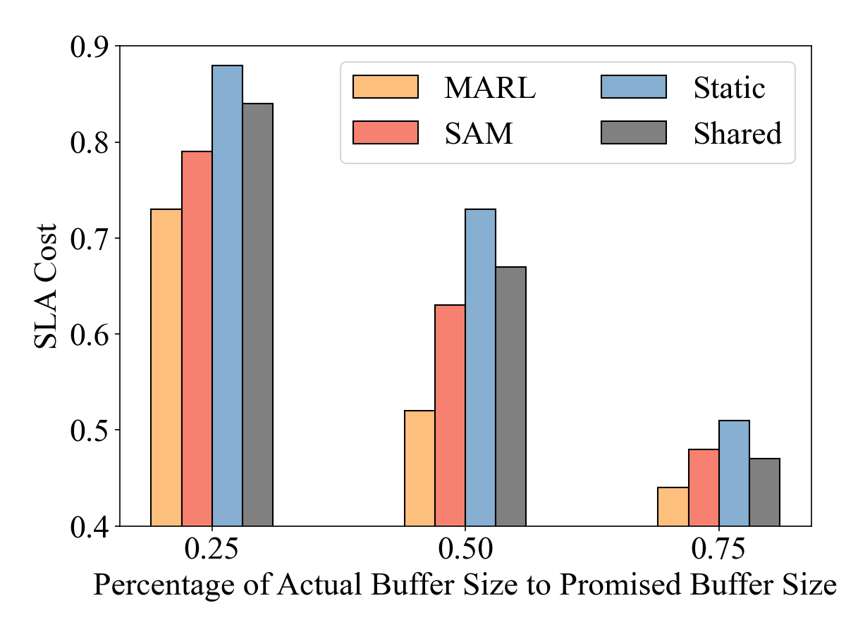
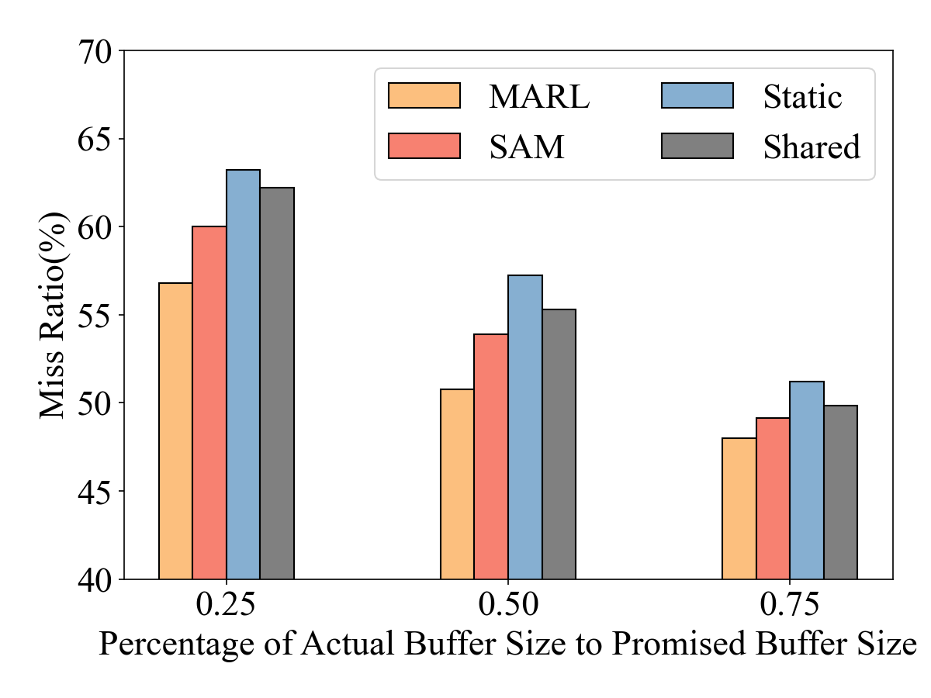
Miss Ratio & SLA Cost
MARL consistently achieves the lowest miss ratio and SLA cost across varying buffer pool sizes. Compared to SAM, Static, and Shared, MARL reduces the average miss ratio by 5.8%, 11.7%, and 9.7%, and the average SLA cost by 15.4%, 26.3%, and 20.1%, respectively.
Notes:
Now let us look at miss ratio and SLA cost across varying buffer pool sizes. MARL consistently achieves the lowest miss ratio and SLA cost. Compared to SAM, Static, and Shared, MARL reduces the average miss ratio by 5.8 percent, 11.7 percent, and 9.7 percent, respectively. For SLA cost, the reductions are even more significant: 15.4 percent over SAM, 26.3 percent versus Static, and 20.1 percent versus Shared.
Why does MARL outperform? Static fails to dynamically redistribute buffer resources among tenants, resulting in significant resource waste when some tenants are idle. Shared suffers from inter-tenant interference due to insufficient isolation for tenants with low buffer utility. SAM adapts dynamically, but its conservative heuristic strategy and lack of a direct SLA-optimization objective prevent it from matching MARL's performance under highly dynamic workloads. MARL avoids all three pitfalls through its SLA-aware multi-agent coordination mechanism.

Slide 13
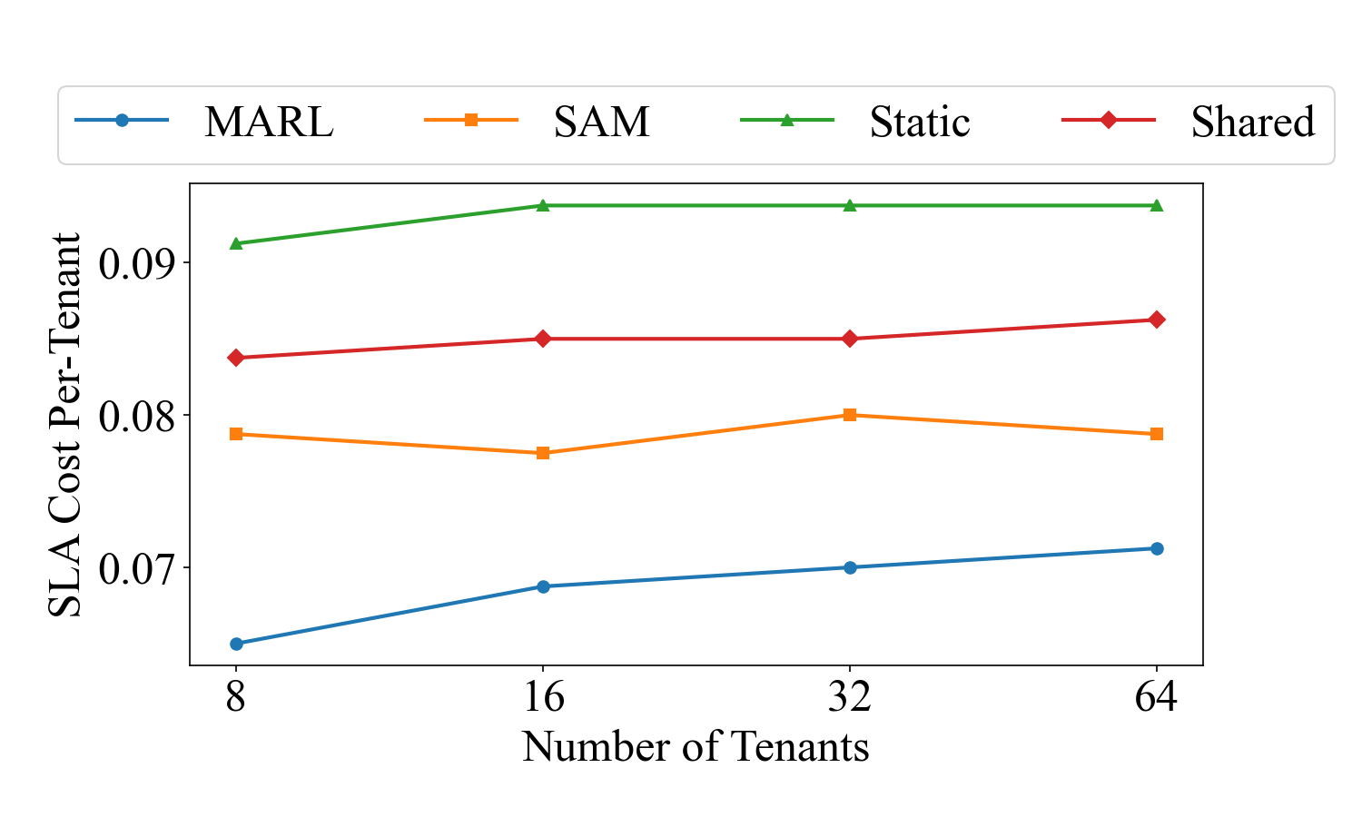
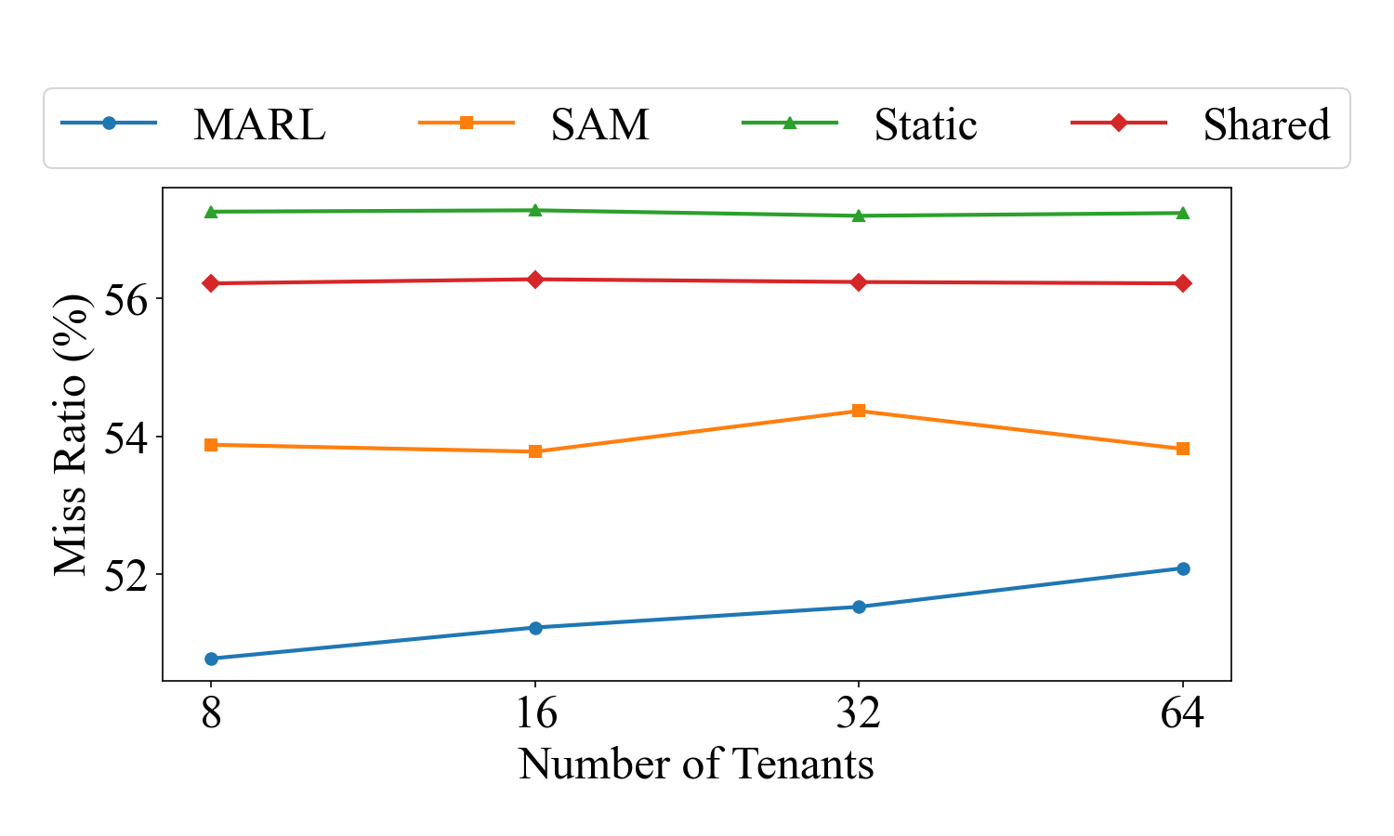
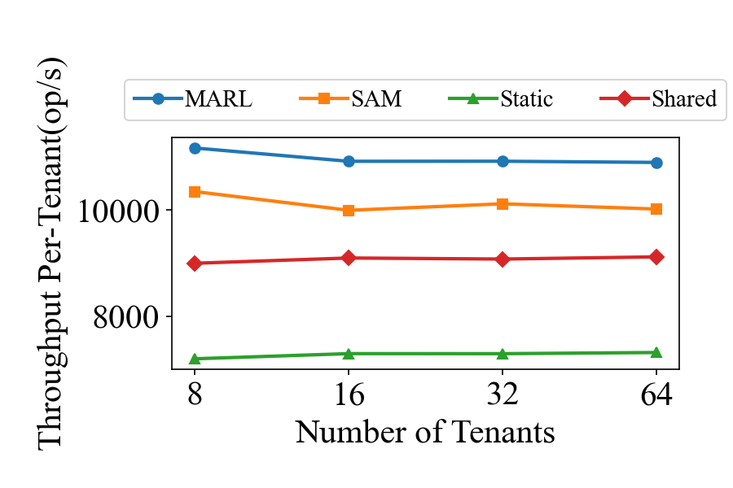
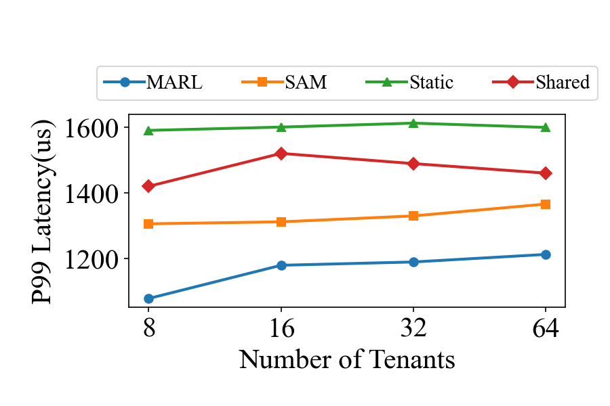
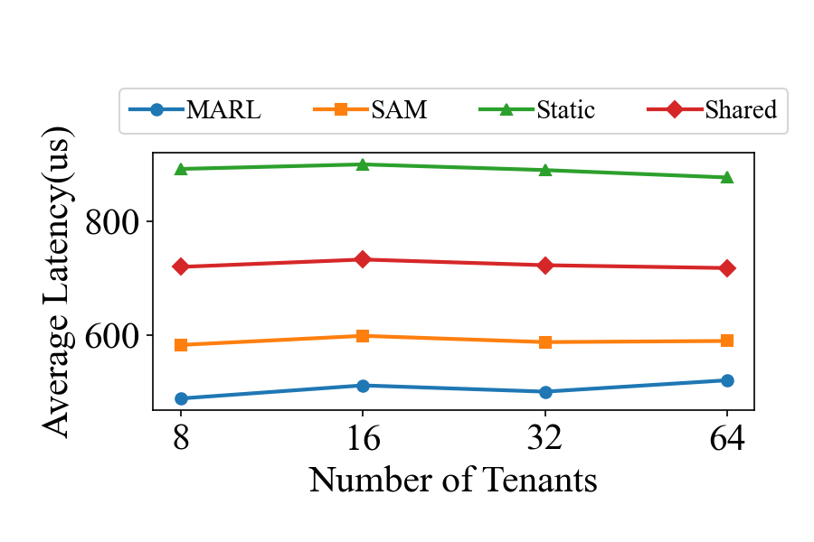
Scalability
We scale 8-tenant workload proportionally with buffer pool, up to 64 tenants
Variation of per-tenant performance: 3%~8%
MARL outperforms SAM, Static, and Shared at every tested scale
Notes:
To evaluate scalability, we proportionally replicate the 8-tenant workload to 16, 32, and 64 tenants, while scaling the buffer pool size accordingly.
The results demonstrate strong performance stability. As shown in the figures, miss ratio, throughput, and average latency variations across all scales remain within 3 percent. Per-tenant SLA cost and P99 latency show minor variations of 7 to 8 percent.
Crucially, MARL maintains a significant and stable advantage over all competitors at every tested scale. This confirms that the multi-agent approach scales effectively without performance degradation as the number of tenants grows, which is essential for practical deployment in large-scale cloud environments.

Slide 14
Overhead
Pre-training
Inference
Fine-tuning
4 hours offline in Python simulator
0.9 ms per iteration (5s) per model
Inference off critical path
SLA measurement: 0 overhead
Evenly distributed across 4 CPU cores
20.3 ms every 10 iterations
Fine-tuning off critical path
Negligible runtime impact
MARL is lightweight and introduces minimal overhead
Notes:
A key practical advantage of MARL is its minimal runtime overhead. Pre-training takes 4 hours offline in a Python simulator with 1024 iterations and a batch size of 32, which is a one-time cost. During deployment, RL inference takes only 0.9 milliseconds per 5-second time window per model. Fine-tuning incurs 20.3 milliseconds every 10 time windows, or every 50 seconds. Both inference and fine-tuning operate entirely off the critical path of buffer requests. SLA measurement is similarly lightweight, since it only involves metadata adjustments. Evaluations under 64 concurrent accesses to a single tenant confirm that SLA measurement has no observable impact on system performance.
All inference tasks are evenly distributed across 4 CPU cores.

Slide 15
Conclusion & Future Work
Contributions
MARL framework for multi-tenant buffer management
SLA-aware cost model: hit ratios to economic penalties
Implementation in OpenGauss, up to 26.3% SLA cost reduction, 72.2% throughput improvement
Future Work
Multi-dimensional resource coordination (CPU, I/O, network)
Decentralized agent communication with state embedding exchange
Proactive resource negotiation among tenants
Broader workload types and cloud deployment scenarios
Notes:
To summarize, this paper makes three key contributions.
First, we propose MARL, a multi-agent reinforcement learning framework for multi-tenant buffer management, where each tenant is modeled as an independent agent that executes Grow or Shrink actions.
Second, we design an SLA-aware cost model that translates hit ratio degradation into economic penalties, and build a multi-agent cooperation mechanism on top of it. Agents learn to release buffer space when doing so significantly reduces the global SLA cost without causing unacceptable local performance penalties, leveraging PPO for stable and efficient learning.
Third, we implement MARL in OpenGauss, a production-ready open-source database engine, with all RL inference and fine-tuning completely off the critical path. Extensive experiments show that MARL achieves up to 26.3 percent SLA cost reduction and 72.2 percent throughput improvement over state-of-the-art methods.
For future work, we plan to extend optimization to multi-dimensional resource coordination including CPU, I/O, and network bandwidth, explore decentralized agent communication with state embedding exchange, and evaluate broader workload types and cloud deployment scenarios.

Slide 16
Thank You!
Q & A
Notes:
Thank you for your attention.

