Slide 1
Delta-SASA-GNN: Weakly Supervised Protein-Protein Interface Prediction
Delta-SASA weak labels | ESM-2 residue embeddings | Structure-aware GCN
Presenter: Adonis
Computational Biology Course Project

Slide 2
CONTENTS
Presentation Outline
01
Research Background
02
Research Motivation
PPI interfaces, SASA, and biological relevance
Why weak supervision and multi-modal features are needed
03
Existing Methods and Challenges
04
Our Method
From feature engineering to graph and language models
Weak supervision + multi-modal fusion + graph learning
05
Experiments and Ablation
06
Summary
Feature ablation and threshold sensitivity
Key takeaways and future directions
2 / 25

Slide 3
01 - Research Background
Protein-protein interfaces are functional molecular surfaces
Protein-Protein Interaction (PPI) Interfaces
Interface formation
Residues that form binding surfaces between protein chains
Many cellular processes depend on selective contacts between proteins. Interface residues are often enriched on exposed surface regions and become partly buried after complex formation.
Biological function
Signal transduction, regulation, immune recognition
Biomedical relevance
Drug targets, mutation effects, disease mechanisms
Computational task
Predict interface residues before costly experiments
Exposed residue
Partner chain approaches
Surface burial indicates possible interface participation
3 / 25

Slide 4
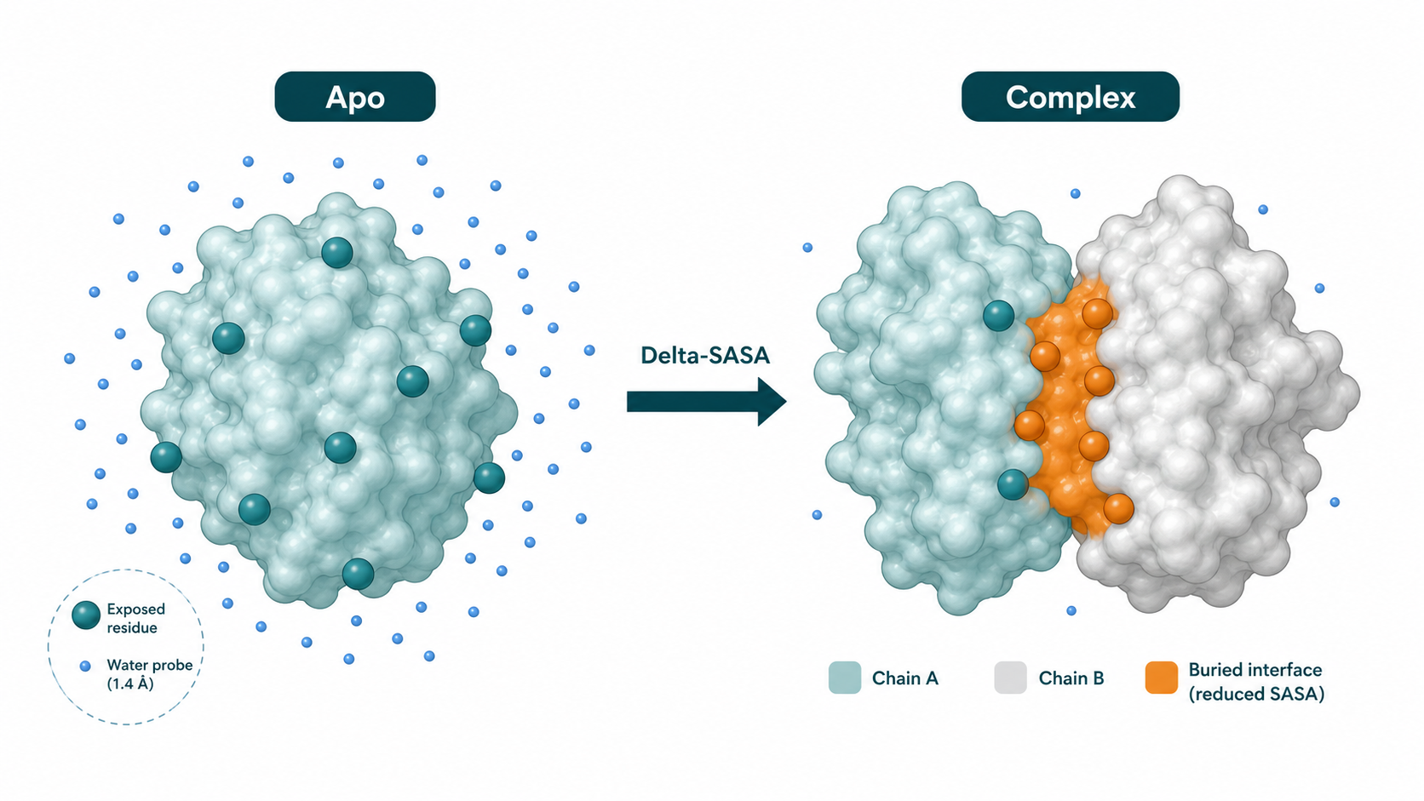
01 - Research Background
SASA links surface geometry to interface formation
01
Solvent exposure
SASA quantifies how much of a residue is accessible to a water probe. It turns a 3D surface concept into a measurable residue-level signal.
02
Interface burial
When two chains bind, interface residues lose solvent accessibility. The change is commonly described as buried surface area or ΔSASA.
03
A large ΔSASA can be used to generate interpretable pseudo-labels for interface residues, connecting physical rules with machine learning.
Weak labels
4 / 25

Slide 5
02 - Research Motivation
Why not stop at a standalone SASA calculator?
01
02
03
Sparse labels
Limited features
Missing topology
High-quality residue-level interface labels require complex structures or experiments. This limits fully supervised model training.
A single SASA value is interpretable but low-dimensional. It cannot capture sequence context, residue chemistry, or local 3D neighborhoods.
Protein structures are graphs in 3D space. Sequence-only models may miss spatial neighbors that are far apart along the chain.
5 / 25

Slide 6
02 - Research Motivation
Our project turns SASA into a learning-oriented pipeline
01
02
03
Physical Rule
Weak Supervision
Learned Prediction
Apo SASA - Holo SASA
reveals buried surface
Delta-SASA threshold
creates residue labels
ESM-2 + geometry + graph
predicts interface sites
Motivation: use an interpretable surface-burial signal to train a lightweight, reproducible interface predictor.
6 / 25

Slide 7
03 - Existing Methods
A broad landscape: from hand-crafted features to learned structure models
The field moves from interpretable hand-crafted exposure signals toward learned sequence and 3D structural representations.
1970s-
2000s
2020s
2021-
Recent
SASA / ASA
Feature ML
PLM Features
Graph Models
Equivariant 3D
Exposure as a
biophysical descriptor
SASA, conservation,
chemistry + classifiers
ESM-like embeddings
capture residue context
Residue contacts become
a node-classification graph
Geometry-aware models
respect spatial symmetry
7 / 25

Slide 8
03 - Existing Methods
What each family contributes
Method family
Representative idea
Strength
Limitation
SASA-based
Lee-Richards, Shrake-Rupley,
FreeSASA
Interpretable physical
exposure signal
Not predictive
alone
ML / PLM
ISIS, SPPIDER, PSIVER,
DeepPPISP, ESM-2
Scalable sequence
representation
Weak explicit
3D topology
Graph / 3D
GraphPPIS, EquiPPIS,
recent EGNN methods
Uses spatial
neighborhoods
Higher data and
engineering cost
Positioning: our project combines the interpretability of SASA with PLM features and lightweight graph learning.
8 / 25

Slide 9
03 - Challenges
Open challenges naturally define our project value
Open challenge
How this project responds
1
Label noise
Threshold analysis
Delta-SASA labels depend on threshold choice
Report sensitivity and prevent Delta-SASA leakage
2
Class imbalance
Better metrics
Interface residues are much rarer than surface residues
Use F1, AUPRC, precision and recall, not accuracy only
3
Fair comparison
Conservative claim
Datasets and interface definitions vary across papers
Emphasize a clear reproducible pipeline, not SOTA claims
9 / 25

Slide 10
04 · Our Method
Pipeline
STEP 1
STEP 2
STEP 3
STEP 4
STEP 5
Data Input
Self-developed SASA
ΔSASA Weak Supervison
Multi-modal Features
GCN Prediction
PDB Apo + Holo
Geometric Calculation Engine
Automatic Pseudo-label Generation
ESM-2 + SASA
Node Binary Classification
Core Innovation
INNOVATION 1
INNOVATION 2
INNOVATION 3
Physical Rules → Supervisory Signals
Multi-modal Feature Fusion
Graph Deep Learning Closed Loop
Translating the classic SASA difference rule into a weak-supervision pseudo-label generator for machine learning.
Horizontal concatenation of evolutionary semantics (ESM-2) and explicit geometric exposure (SASA).
GCN aggregates spatial neighborhoods on 3D residue graphs to achieve structure-aware prediction.
10 / 25

Slide 11
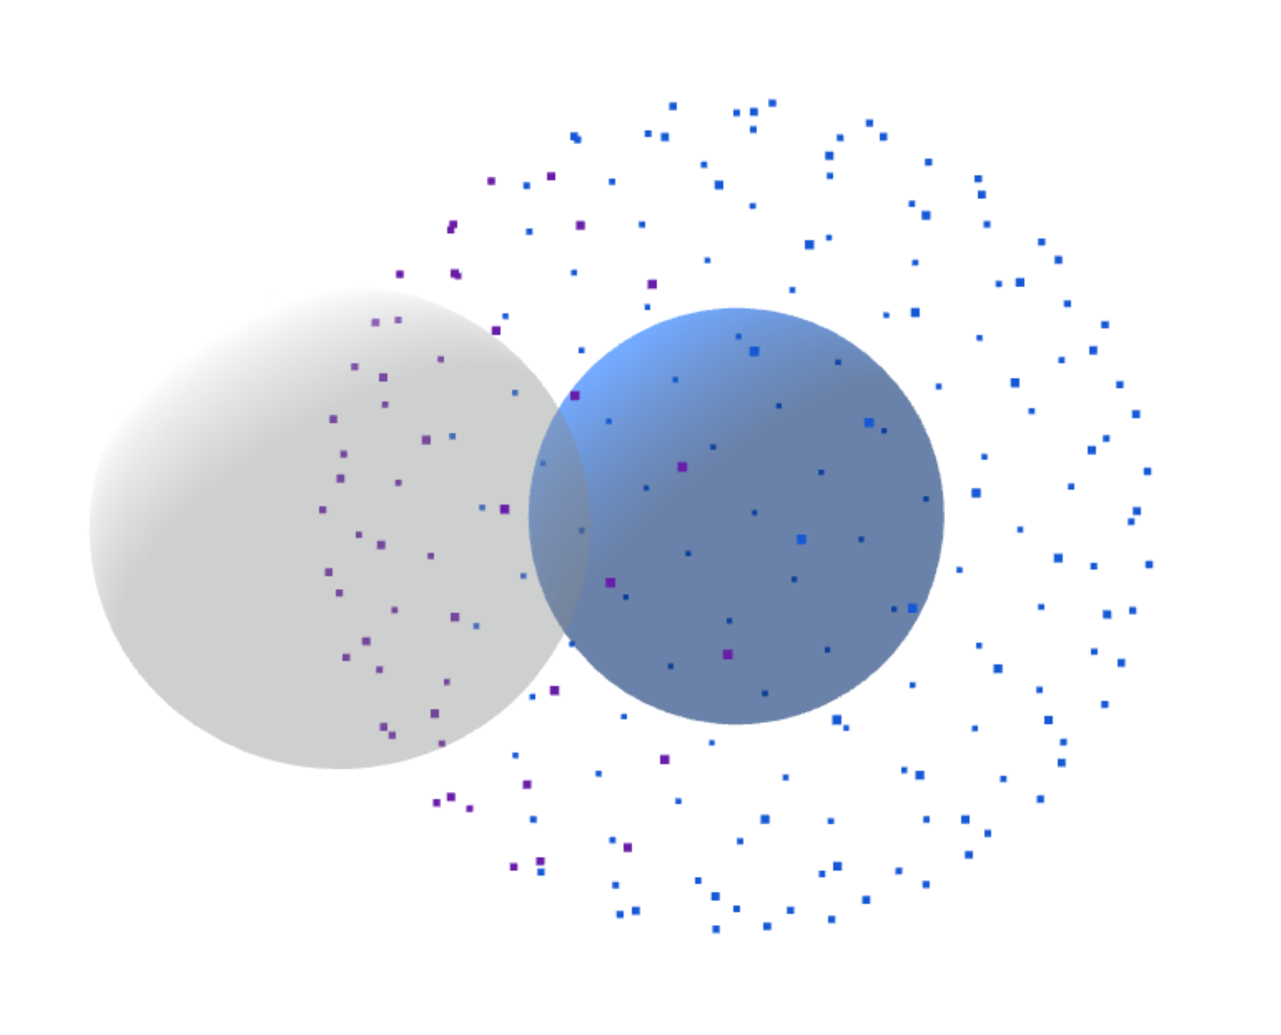
04.1 · Self-developed SASA
Engineering Implementation of the Self-developed SASA Calculator
Core Principle: Shrake-Rupley Algorithm
Expands the atomic van der Waals radius by the radius of a water molecule probe (1.4Å) to generate a spherical point cloud.
Computational Logic: Neighborhood Traversal
H
Traverses adjacent atoms. If a probe point is not occluded by neighboring atoms, it is considered "solvent-accessible".
Output
Precise exposed surface area for each amino acid residue (Unit: Å²).
11 / 25

Slide 12
04.1 · Self-developed SASA
Algorithm Validation and Reliability Analysis
Rigorous bidirectional cross-validation of the in-house developed algorithm against FreeSASA, an industry benchmark tool, was conducted to establish absolute data reliability.
0.55%
Relative Error of Total Area for Single Sample (2iww_H)
0.9935
Pearson R for Residue-Level Distribution Trend
Under single-sample extreme testing, the in-house algorithm exhibits astonishing stability, with the error approaching zero.
In batch validation (10 sets of complexes), systemic error is strictly controlled within 1.5%, proving that spatial topological representation capability fully meets the standard.
12 / 25

Slide 13
04.2 · ΔSASA Weak Labeling
From validated SASA to residue-level weak labels
Chain-level workflow
Stepwise computation
PDB complex
target chain + partner chain(s)
Chain splitting
select target and occluding partner
Apo SASA
target chain alone
Holo SASA
target + partner for occlusion
Target residues are labeled by exposure loss after complex formation.
ΔSASA label
residue-level pseudo-label output
ΔSASA_i = SASA_apo,i − SASA_holo,i
Large exposure loss indicates likely interface participation.
13 / 25

Slide 14
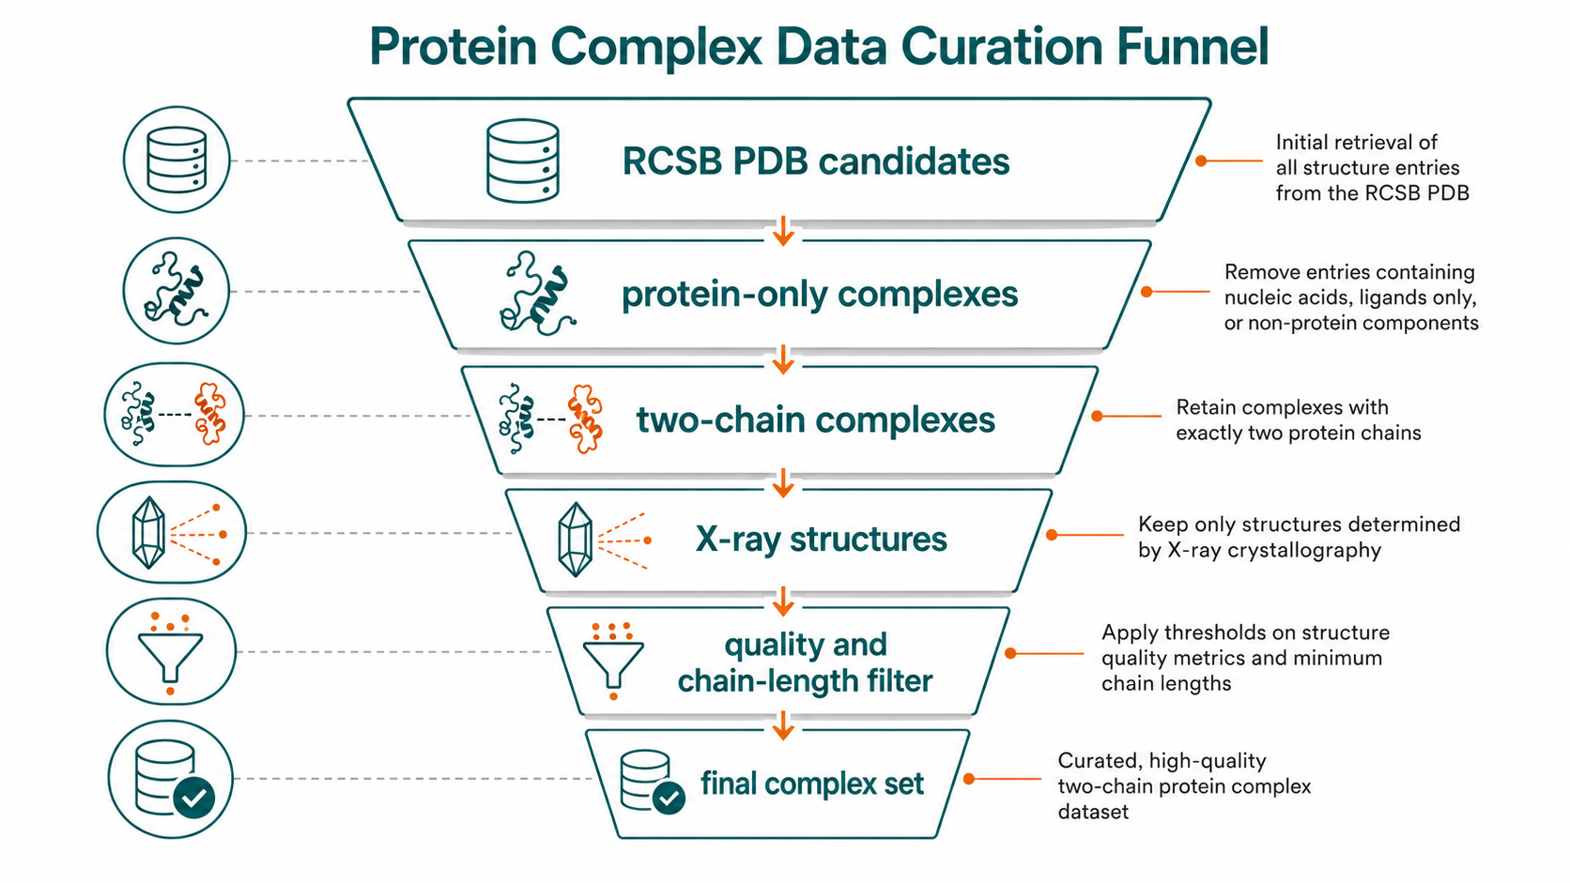
04.2 · Data Curation
Collecting usable protein complex structures
We first build a clean structure set before generating ΔSASA labels.
Candidate PDB complexes
RCSB PDB query
01
Source
Protein-only assemblies
remove nucleic-acid / ligand-only cases
Protein complex structures are collected from RCSB PDB.
Two-chain complex
target chain + partner chain
02
Filtering
Quality control
X-ray, resolution <= 3.0 Å, chain length >= 20
Protein-only, two-chain, X-ray structures with acceptable resolution.
Complex manifest
PDB ID, chain IDs, residue counts, file path
03
Manifest
Each retained complex records chain IDs, residue counts, and file paths.
14 / 25

Slide 15
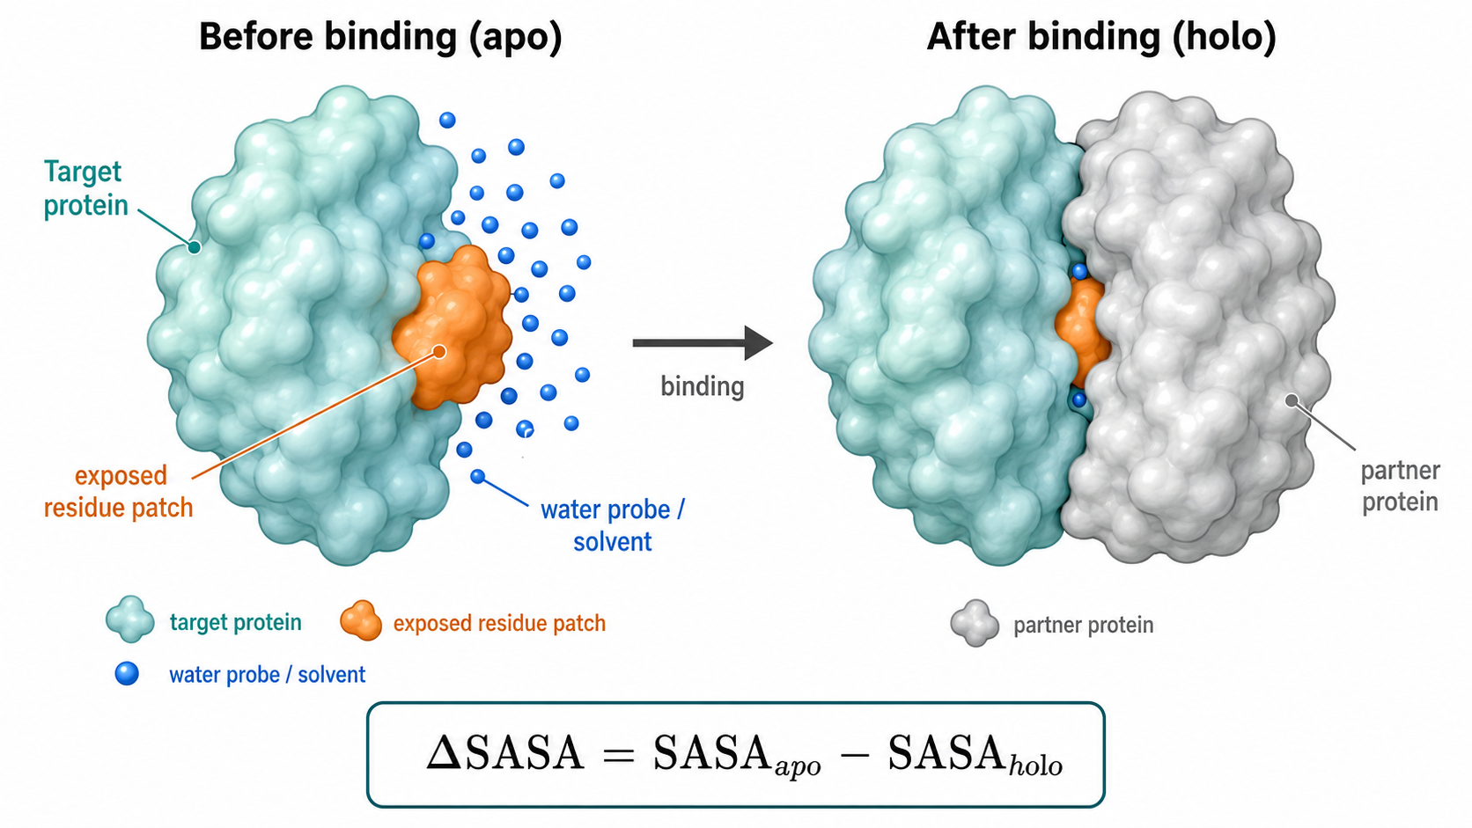
04.2 · Apo / Holo SASA
Computing exposure before and after binding
The partner chain is used as an occluding context, while only target-chain residues are labeled.
Apo SASA
Holo SASA
Computation rules
Target chain only
Target + partner context
Apo state
SASA_apo,i measures exposed area before partner-chain occlusion.
SASA_holo,i is computed with partner atoms blocking accessible points.
Keep the target chain only; compute per-residue SASA_apo.
Holo state
ΔSASA_i = SASA_apo,i − SASA_holo,i
Use target + partner chains for occlusion; still count target residues only.
Only target-chain residues enter the final label table.
Residue matching
Align by chain ID, residue ID, insertion code, and residue name.
15 / 25

Slide 16
04.2 · Label Construction
Turning surface burial into weak supervision
01
ΔSASA formula
For each target residue, ΔSASA is computed as SASA_apo minus SASA_holo.
02
Thresholded labels
A residue is labeled positive when ΔSASA exceeds a selected threshold, such as 0.5, 1.0, 2.0, or 5.0 Å².
03
Leakage control
ΔSASA is used to generate labels or confidence weights, not as an ordinary input feature for the predictor.
This keeps the weak-label source separate from downstream model features.
16 / 25

Slide 17
04.3 · Module 3 Overview
From weak labels to leakage-controlled EGNN
STEP 1
STEP 2
STEP 3
STEP 4
STEP 5
Weak labels
ESM-2 650M
Strict features
EGNN
Prediction
Delta-SASA threshold
1280-D embeddings
No SASA inputs
3D residue graph
Residue probability
Core design rule: Delta-SASA is the label source, not a shortcut feature.
The deployable model learns sequence and geometry while keeping weak-label construction separate from prediction.
17 / 25

Slide 18
04.3 · Leakage-Controlled Features
Separating label construction from deployable inputs
STRICT PRIMARY
DEPLOYABLE
WEAK-LABEL SOURCE
ESM + geometry
Delta-SASA
1280-D ESM-2 embeddings · Backbone dihedrals · HSE + hydrophobicity · 3D coordinates
SASA_apo - SASA_holo
Used to generate weak interface labels at a 2.0 A^2 threshold.
DIAGNOSTIC ONLY
DO NOT DEPLOY
Holo-aware inputs
Adding SASA_holo strongly raises scores because it is close to the label definition. Do not report as deployment performance.
Strict model: 1287 scalar node features. Delta-SASA, SASA_holo and SASA_apo are excluded.
18 / 25

Slide 19
04.4 · Residue Representation
ESM-2 650M semantics meet local structural geometry
ESM-2 embedding
1280
Evolutionary and sequence context
STRICT NODE INPUT
Dihedral encoding
4
sin(phi), cos(phi), sin(psi), cos(psi)
1287
scalar features
per residue
Half-sphere exposure
2
Local neighborhood orientation
Hydrophobicity
1
Residue physicochemical tendency
Coordinates are used by the graph, not counted in the scalar vector.
19 / 25

Slide 20
04.4 · EGNN Spatial Modeling
Reasoning over a 3D residue graph
01
02
03
GRAPH
MESSAGE PASSING
OUTPUT
Residue nodes
Equivariant updates
Interface probability
One node per target-chain residue. Edges connect C-alpha atoms within an 8 A cutoff.
Messages depend on residue states and normalized pairwise distances. Coordinate updates respect spatial symmetry.
Three EGNN layers aggregate local context. An MLP head outputs residue-level interface probabilities.
Translation, rotation and reflection symmetry are preserved by construction.
20 / 25

Slide 21
05 · Experiments and Ablation
Leakage audit changes the interpretation of the result
TEST F1
apo-SASA rank
0.3317
MLP / ESM-only
0.6290
+0.1203
GCN / ESM + geometry
0.5961
apparent gain after
adding holo SASA
This is leakage evidence,
not a deployable improvement.
EGNN / ESM + geometry
0.7745
EGNN / apo + ESM + geometry
0.7787
EGNN / apo+holo + ESM + geometry
0.8948
Primary result: strict EGNN reaches F1 = 0.7745, AUROC = 0.9322 and AUPRC = 0.8421.
21 / 25

Slide 22
05 · External Benchmarks
Strict evaluation exposes a real generalization gap
Dataset
Role
Model
F1
AUROC
AUPRC
Dset_186-local
Strict primary
EGNN
0.3529
0.7277
0.3050
PDBtest_315-local
Strict primary
EGNN
0.3040
0.6799
0.2675
PDBtest_315-local
Diagnostic
Holo EGNN
0.6761
0.8946
0.7408
PDBtest_315-local
Diagnostic
Cross-chain
0.6816
0.8983
0.6906
Strict external scores are substantially lower than internal scores. The current package is a reproducible baseline, not a state-of-the-art claim.
22 / 25

Slide 23
05 · Cross-chain Analysis
A useful analysis module, not a stable core improvement
WHAT IT ADDS
Partner-chain attention
WHAT WE OBSERVE
Metric trade-off
Target residues attend to partner-chain C-alpha positions using distance-weighted context.
Holo-aware PDBtest_315-local
Recall
0.6252 → 0.6629
▲
HOW WE CLAIM IT
F1
0.6761 → 0.6816
▲
Conservative framing
AUPRC
0.7408 → 0.6906
▼
Cross-chain attention is retained for analysis. Its benefits are benchmark-dependent and not consistently positive.
Next step: retrain cross-chain variants under strict no-SASA inputs and matched manifests.
23 / 25

Slide 24
06 · Summary
What module 3 adds to the complete project
01 · METHOD Closed-loop pipeline
Self-developed SASA
Delta-SASA weak labels
ESM-2 650M + geometry
EGNN prediction
02 · RIGOR
03 · DELIVERY
Leakage-controlled study
Reproducible package
✓ Strict no-SASA primary model ✓ Apo-only ablation
✓ Holo-aware diagnostics ✓ External local benchmarks
✓ Tracked checkpoint ✓ Prediction CSV exports
✓ Automated tests ✓ Windows GBK compatibility
Takeaway: the engineering pipeline is complete; the next research priority is strict external generalization.
24 / 25

Slide 25
Thank You
Questions and Discussion
iA weakly supervised PPIS system built on self-developed SASA and ESM-2

