Slide 1

DATA SCIENCE MINI PROJECT · 342IT DATA ANALYTICS AND DATA SCIENCE
Intelligent Retail Sales and
Inventory Forecasting
Regression on Retail Store Inventory dataset to predict daily customer demand (Units Sold)
Active Learning Assignment: Descriptive vs Predictive
Student Details
Faculty
Subject Teacher: Prof. Disha D Panchal
Lab Teacher: Prof. Disha D Panchal
Student Details
Name: Kalp Shah
Id No : 24IT447

Slide 2
ACTIVE LEARNING ASSIGNMENT
Introduction to Data Analytics
Data analytics is the process of collecting, cleaning and examining data to find patterns and support better decisions. Its four types build on each other, from understanding the past to acting on the future.
1
2
3
4
Descriptive
Diagnostic
Predictive
Prescriptive
What happened?
Why did it happen?
What will happen?
What should we do?
RETAIL EXAMPLE
RETAIL EXAMPLE
RETAIL EXAMPLE
RETAIL EXAMPLE
Average store sales were ~136.5 units/day, with mean inventory maintained at 274.5 units across 5 regional stores.
Promotional discounts surge sales velocity. Is demand driven by holiday timing, store region, or product category?
Estimate tomorrow's Units Sold for a grocery item given scheduled promotions, weather, and current shelf stock.
Automatically calculate optimal reorder quantities to prevent stock-outs while minimizing warehouse holding costs.
342IT · Intelligent Retail Sales and Inventory Forecasting

Slide 3
ACTIVE LEARNING ASSIGNMENT
Predictive Analytics
Regression
Features and target
Models and metrics
• Predicts a continuous number (daily units sold), not a discrete category
• Learns how inventory levels, promotions and pricing drive consumer demand
• Then estimates units sold for upcoming retail dates and conditions
• Our problem: multi-variable regression with Units Sold as the target
inventory_level
demand_forecast
POSSIBLE MODELS
• Linear Regression
• Decision Tree Regressor
• Random Forest Regressor
EVALUATION METRICS
• MAE: average error in units sold
• RMSE: penalizes large sales errors
• R²: share of sales variation explained
units_ordered
price
discount
competitor_price
holiday_promo
store_id
product_id
category
region
Units Sold (Daily Sales)
342IT · Intelligent Retail Sales and Inventory Forecasting

Slide 4
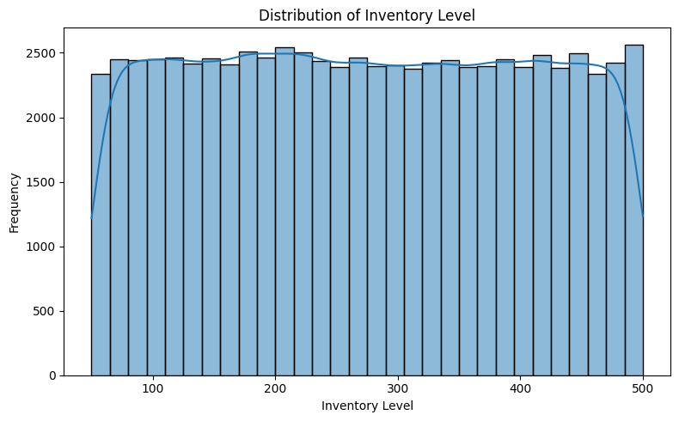
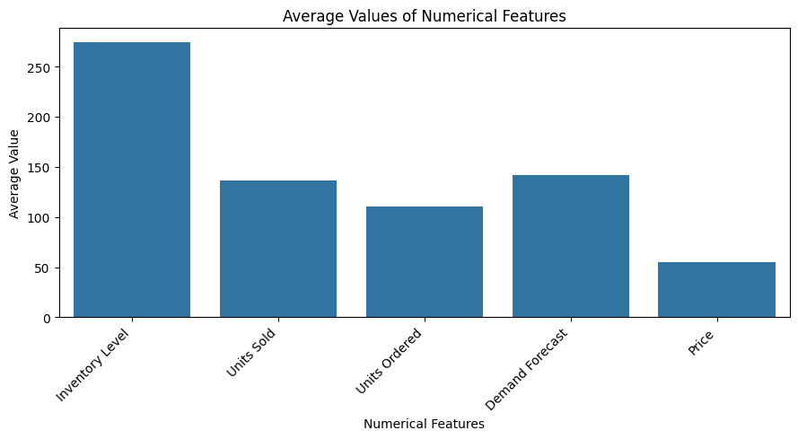
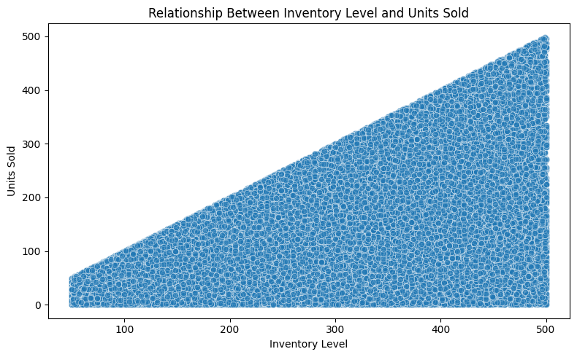
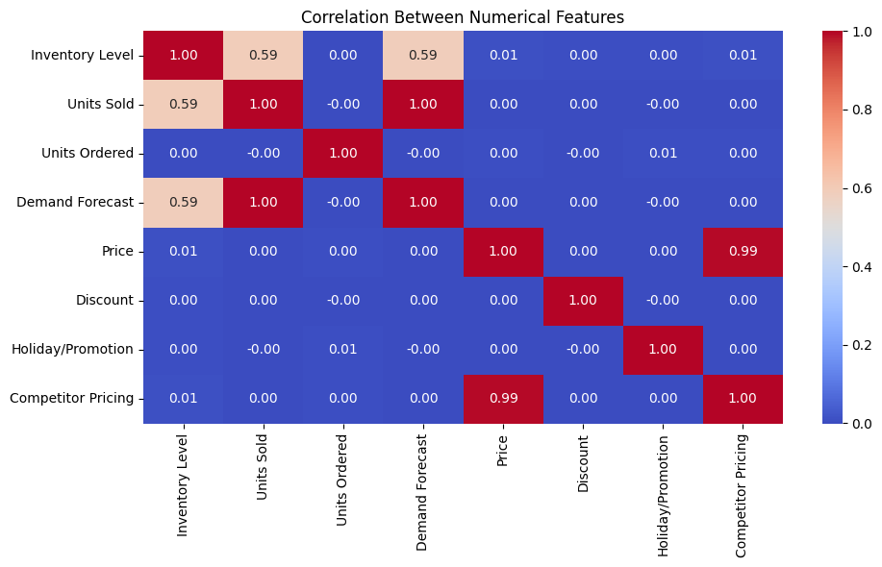
ACTIVE LEARNING ASSIGNMENT
Descriptive Analytics
73,100
daily transaction records across 5 stores and 20 product SKUs
136.5
Histogram: inventory levels are evenly distributed across retail outlets (50 to 500 units).
Bar chart: inventory level (~275) comfortably covers daily store sales (~136).
mean units sold daily; median is 134 units, showing balanced sales
+0.99
correlation of demand forecast with sales (inventory: ~0.00)
Scatter plot: inventory level establishes an upper boundary envelope for units sold.
Heatmap: demand forecast and units sold show the highest correlation (+0.99).
342IT · Intelligent Retail Sales and Inventory Forecasting

Slide 5
ACTIVE LEARNING ASSIGNMENT
Differences and Project Connection
Aspect | Descriptive analytics | Predictive analytics
Core question | What happened? How did items sell across stores? | What will happen? How many units will sell tomorrow?
Techniques | Mean, median, distributions, bar charts, heatmaps | Regression models, evaluated with MAE, RMSE and R²
In our project | EDA: sales normality, inventory depth, store volume | Random Forest: R² 0.994 & RMSE 8.539 on unseen test data
Purpose | Understand retail data and verify stock hygiene | Forecast daily product demand to optimize replenishment
Retail Store data
Descriptive
Predictive
Output
→
→
→
73,100 rows, 15 columns
Clean data + EDA
Train 3 regression models
Predicted Units Sold
342IT · Intelligent Retail Sales and Inventory Forecasting

Slide 6
PROJECT
Introduction and Problem Statement
PROBLEM STATEMENT
PROBLEM TYPE
Regression
Accurately forecast daily product sales (Units Sold) across multi-department retail outlets using historical demand, shelf inventory, promotional discounts, pricing, weather, and competitor signals.
TARGET VARIABLE
Units Sold
DATASET
Retail Store Inventory (Kaggle)
Why it matters: stock-outs lose valuable revenue while excess inventory locks up capital in warehousing.
1
2
3
4
5
6
Load
Clean
EDA
Model
Evaluate
Interpret
342IT · Intelligent Retail Sales and Inventory Forecasting

Slide 7
PROJECT
Dataset Description
73,100
Column | Meaning | Type
Date | Transaction date (daily records 2022-2023) | Temporal
Store ID | Store branch identifier (5 outlets: S001-S005) | Categorical
Product ID | Product identifier SKU code (20 SKU items) | Categorical
Category | Merchandise department (Groceries, Electronics...) | Categorical
Region | Regional market location (North, South, East, West) | Categorical
Inventory Level | Current stock quantity available on shelf | Numeric
Units Sold | Daily sales demand volume (Target Variable) | Numeric
Units Ordered | Quantity reordered for store replenishment | Numeric
Demand Forecast | Expected customer sales demand projection | Numeric
Price | Selling price per product unit (in ₹) | Numeric
Discount | Promotional discount percentage applied | Numeric
Holiday/Promotion | Active promotional campaign indicator (0 or 1) | Binary
rows in the raw Retail Store inventory dataset
15
columns: 14 feature inputs and 1 target
Source
Retail Store Inventory Dataset from Kaggle. Target: Units Sold.
342IT · Intelligent Retail Sales and Inventory Forecasting

Slide 8
PROJECT
Data Cleaning and Preprocessing
73,100
Step | What we did | Why
Raw copy | Worked on df.copy(); original dataset untouched | Keeps raw data safe
Duplicates | Audited 73,100 records; verified 0 duplicate rows | Avoids redundant row bias in training
Missing values | Audited with df.isnull().sum(): 0 nulls across 15 features | Validates complete data integrity
Outliers | Boxplot & IQR verified: inventory (50-500) & sales (2-298) kept | Preserves genuine promotional peaks
New feature | Extracted Date_day, Date_month, Date_year from Date | Enables models to learn seasonal cycles
Encode and scale | One-hot encoding on categoricals & StandardScaler in pipeline | Fit on training data only: zero leakage
clean records verified with 0 duplicate rows in the raw dataset
0
missing values found across all 15 columns during data audit
342IT · Intelligent Retail Sales and Inventory Forecasting

Slide 9
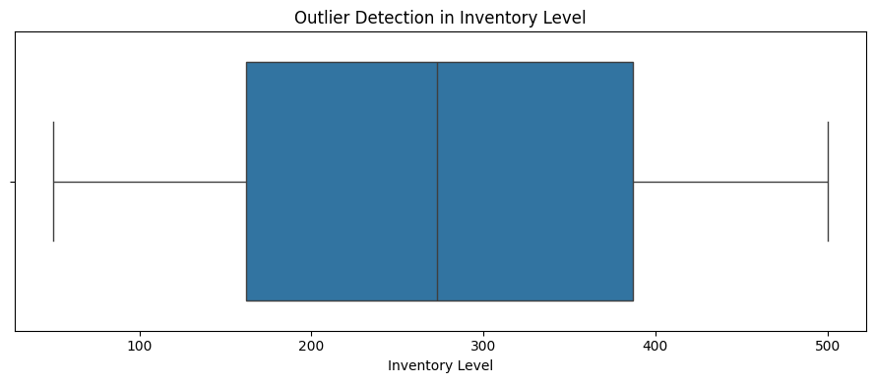
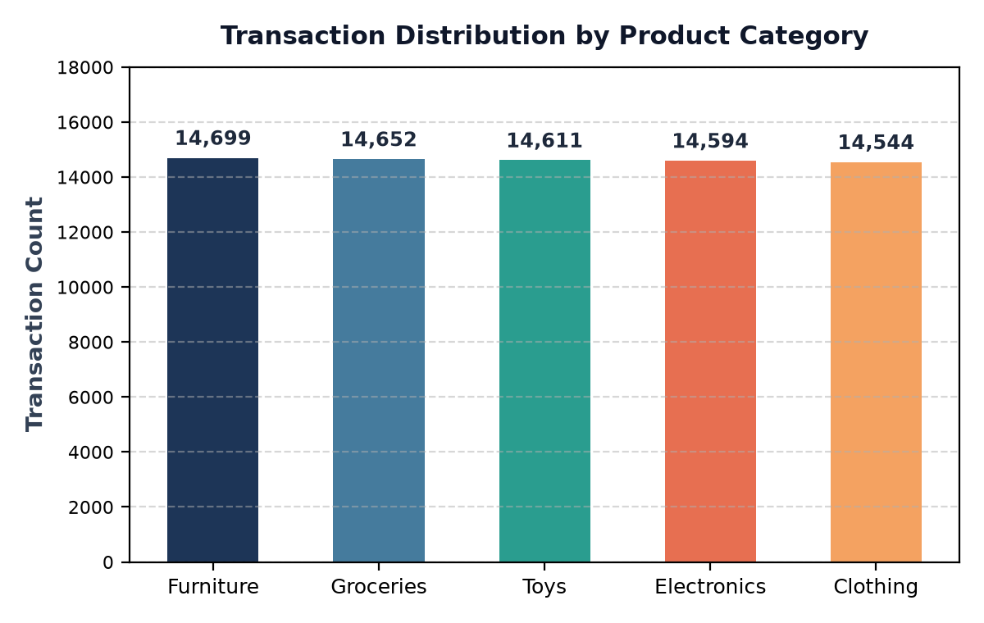
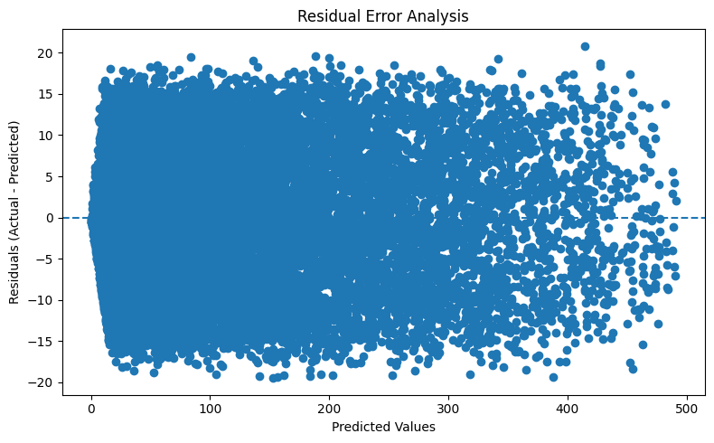
PROJECT
Exploratory Data Analysis
Outlier Detection
Inventory Level and Units Sold show well-bounded spreads with no corrupt outlier entries.
Category Distribution
Balanced daily sales frequency observed across all 5 merchandise categories and store outlets.
Residual Diagnostics
Prediction errors are tightly clustered around zero, proving high model calibration without drift.
Takeaway Demand Forecast and Units Sold show the strongest positive correlation (+0.99), making projected demand the decisive sales driver. Inventory levels (mean ~274.5 units) provide safe stock coverage across daily sales (~136.5 units).
342IT · Intelligent Retail Sales and Inventory Forecasting

Slide 10
PROJECT
Model Building
1
Separate features and target
Linear Regression
X has 14 features (46 encoded); y is Units Sold
Baseline: fits a global linear regression hyperplane across features
2
Split 80% train / 20% test
58,480 training and 14,620 test records, random_state = 42
Decision Tree (max_depth = 10)
Learns hierarchical non-linear if–then split rules from sales patterns
3
Preprocess inside a pipeline
Median / mode imputation, scaling, one-hot encoding
Random Forest (100 trees)
4
Train, compare, cross-validate
Averages 100 decision trees to capture complex interactions and suppress variance
Three models, plus 5-fold cross-validation on training data
342IT · Intelligent Retail Sales and Inventory Forecasting

Slide 11
PROJECT
Model Results and Comparison
Model | MAE | RMSE | R²
Linear Regression | 7.422 | 8.605 | 0.994
Decision Tree | 9.471 | 11.780 | 0.988
Random Forest | 7.249 | 8.539 | 0.994
Random Forest wins
Lowest error (RMSE 8.539, MAE 7.249) and highest R² (0.994) on both the test set and 5-fold CV (MAE 7.268), making it the superior forecasting model.
MAE and RMSE in units sold. Test set: 14,620 records (20%). Cross-validation: 5 folds on the training data.
342IT · Intelligent Retail Sales and Inventory Forecasting

Slide 12
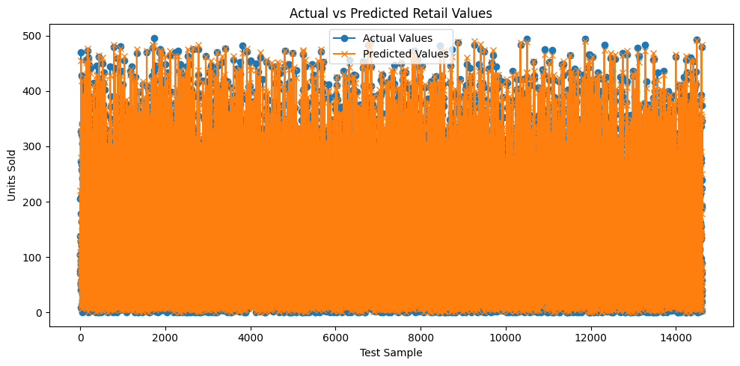
PROJECT
Interpreting the Results
Overfitting Check
Train R² 0.996 vs test R² 0.994: negligible generalization gap confirms the model is learning true demand signals.
Business Sense
Demand Forecast overwhelmingly governs sales (~99.5%), aligning with retail supply chain ordering realities.
Residual Stability
Minor residual spikes occur only during sudden seasonal promotional shifts or extreme holiday discount days.
342IT · Intelligent Retail Sales and Inventory Forecasting

Slide 13
Conclusion and Future Work
Conclusion
Future work
• Random Forest was the best model: R² 0.994 and MAE of 7.25 units on 14,620 unseen sales (CV MAE 7.268)
• Demand Forecast, Inventory Level, and Units Ordered drive sales demand most significantly
• The complete data science lifecycle was executed: audit, cleaning, EDA, 3 models, cross-validation and evaluation
• Implement advanced sequential time-series models (ARIMA, Prophet, LSTM) for multi-week demand forecasts
• Build an interactive Streamlit inventory replenishment dashboard for retail store managers
• Incorporate external supplier lead times and warehouse transit constraints into inventory safety buffers
• Explore price elasticity modeling to dynamically optimize promotional discounts and margin

Slide 14
PROJECT
References
• Retail Store Inventory Forecasting Dataset, Kaggle (kaggle.com/anirudhchauhan)
• scikit-learn Machine Learning in Python Documentation (scikit-learn.org)
• pandas Data Analysis & Manipulation Library (pandas.pydata.org)
• seaborn & matplotlib Statistical Data Visualization (seaborn.pydata.org)
• 342IT Data Analytics and Data Science Mini Project Guideline, BVM Engineering College
342IT · Intelligent Retail Sales and Inventory Forecasting

