Slide 1
JAVA COURSEWORK · CONSOLE APPLICATION
Console Clinic
Appointment System
Scheduling rules, pricing strategies, waiting lists and JSON persistence in one Java 17 console application.
Onah Debeiwu Chrysanctus — Student1639236
Okeke Chiemerie Miracle — Student1647235
Okonkwo Samuel chiemerie — Student1627019
Java development · Mr Kamsi · 20th November 2026
Notes:
Introduce yourself and the project in one sentence: a console clinic appointment system that enforces every booking rule, prices appointments with strategies, offers cancelled slots to a waiting list and keeps all data in JSON. Mention the stack: Java 17, Maven, Gson only.

Slide 2
OVERVIEW
What this presentation covers
From the paper-diary problem to a verified, rule-enforcing system
01
The problem
02
Architecture & domain
Why phone-and-paper booking breaks at scale
Layers, packages, users, appointment types
03
Scheduling & booking
04
Pricing & waiting list
15-minute grid, 12 checks, lifecycle
Strategies, late fees, FIFO offers
05
Data, concurrency & CLI
06
Verification & demo
Atomic JSON, one lock, role-filtered commands
40 checks, scripted sessions, restart
Console Clinic Appointment System
02
Notes:
Walk through the six parts. Emphasise that the presentation follows the project's story: problem, design, the two hardest subsystems (scheduling and booking), the supporting subsystems, and the evidence that it works.

Slide 3
MOTIVATION
The paper diary does not scale
1
Double bookings
2
Wasted slots
Six recurring
problems,
one system.
Two patients, one doctor, overlapping slots
Cancellations stay empty, nobody calls the next patient
3
No-shows
4
Inconsistent charges
Repeated absences are not tracked or penalised
Insurance, seniors and walk-ins billed differently
The system enforces the rules,
not the receptionist.
5
Poor visibility
6
Scattered history
No clean daily schedule or utilisation view
Visit notes live in separate files
Console Clinic Appointment System
03
Notes:
Tell the story from the brief: a growing clinic with a shared diary. Each card is a problem the system solves. The punchline is that rules must be enforced by software, not by the person at the desk, because that is where the inconsistency comes from.

Slide 4
SOLUTION
One console, three roles, every rule automated
Typed commands instead of numbered menus - the CLI only parses, renders and enforces roles
RECEPTIONIST
DOCTOR
PATIENT
▪ Register patients and doctors
▪ Book, move and cancel appointments
▪ Check in, mark no-shows, unblock
▪ Daily schedule, utilisation, revenue
▪ See today's schedule
▪ Complete checked-in visits
▪ Add notes, diagnosis, prescriptions
▪ Read history of treated patients
▪ Book, reschedule, cancel own slots
▪ Join the waiting list
▪ Accept an offered slot
▪ View own history and inbox
31 commands
4 reports
JSON files
salted passwords
40 self-checks
no database
Console Clinic Appointment System
04
Notes:
The same data and the same rules are exposed differently to each role. Patients can only touch their own appointments, doctors only their own visits, receptionists manage the diary. Role filtering happens in the command registry and is re-checked inside services.

Slide 5
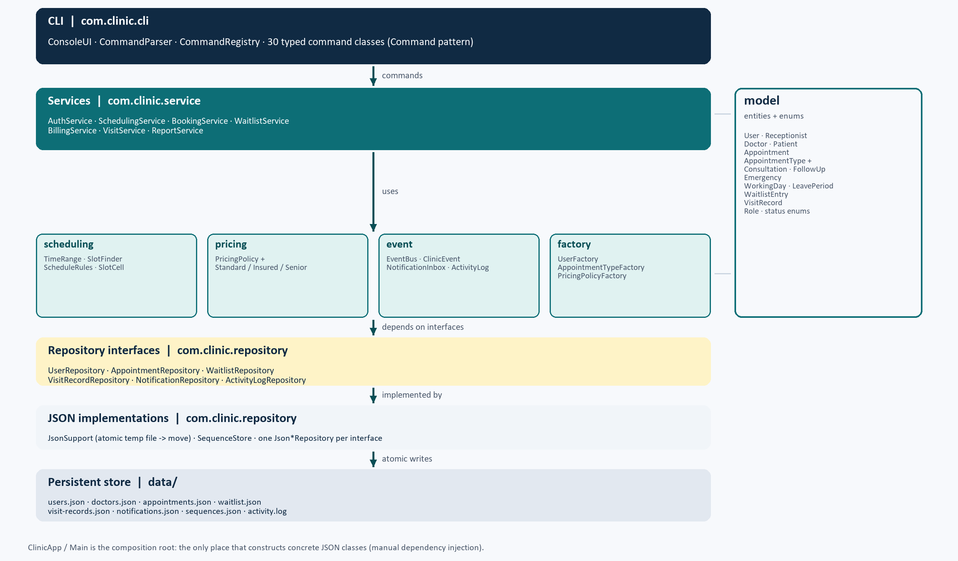
ARCHITECTURE
Layered by design, injected at one place
CLI -> services -> repository interfaces -> JSON; the model is shared by every layer
1
The CLI never touches files
Commands call services only; formatting stays in the CLI.
2
Services depend on interfaces
JSON classes are hidden behind repository interfaces.
3
Clock is injected
No bare LocalDateTime.now(); --now makes the demo repeatable.
4
One composition root
ClinicApp wires every object; nothing else constructs JSON classes.
ClinicApp.open wires repositories, services, listeners and seed data in one place.
Console Clinic Appointment System
05
Notes:
Explain dependency direction: the arrows only point downwards. The most important consequence is testability and replaceability: swapping JSON for SQLite would only touch the repository package. The Clock injection is what makes the reproducible demo possible.

Slide 6
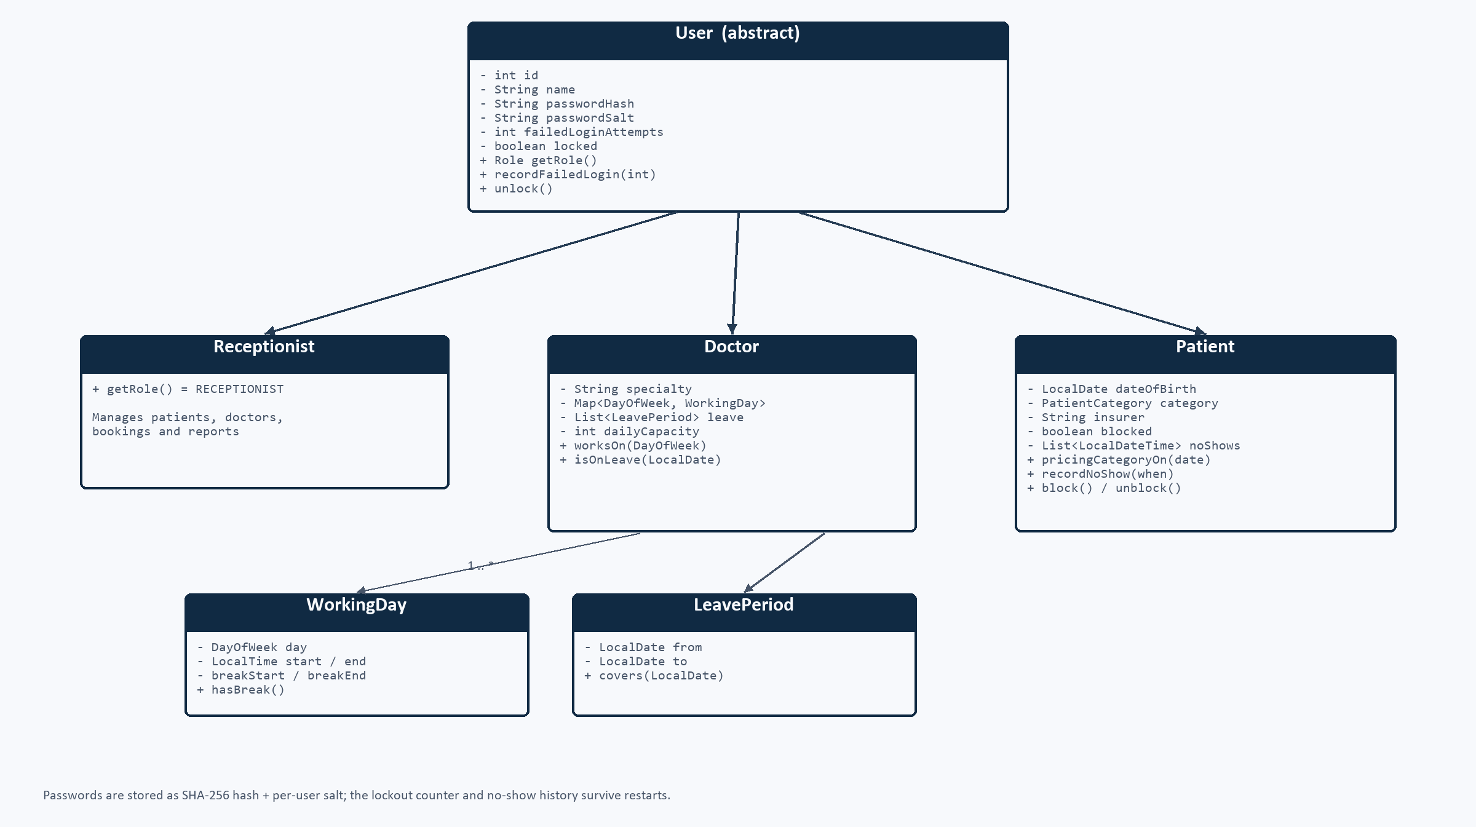
DOMAIN MODEL
Two abstractions carry the clinic's rules
Abstract User (three roles) and abstract AppointmentType (three booking behaviours)
▪ User is abstract: id, salted password hash, failed-login counter, lock flag.
▪ Receptionist, Doctor and Patient add only role-specific data.
▪ AppointmentType owns duration, base fee, break/capacity flags and eligibility.
▪ FollowUp overrides eligibility: completed visit with the same doctor within 14 days.
▪ The lifecycle is validated inside Appointment, not in the services.
One shared model; role-specific data only in the subclasses.
Console Clinic Appointment System
06
Notes:
Two hierarchies, two reasons to change. The user hierarchy keeps identity and security in one place. The appointment-type hierarchy means the booking service never asks 'what type is this?'; it asks the type for its rules. That is the open/closed principle in practice.

Slide 7
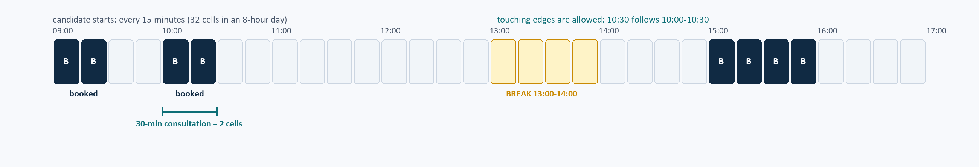
SCHEDULING ENGINE
Time-slot logic, solved once
Half-open intervals, a 15-minute grid, and pure functions that never touch a repository
Half-open overlap
Hours, break, leave
Next free slots
start < other.end &&
other.start < end
WorkingDay + LeavePeriod;
15-minute boundary check
Scan forward up to 60 days;
return the first three
Console Clinic Appointment System
07
Notes:
This is the heart of the project. The overlap rule is a single method in TimeRange, used by breaks, leave, double bookings and slot search. Show the grid: candidate starts every 15 minutes, a 30-minute consultation occupies two cells, touching edges are legal, the break blocks normal types but not emergencies.

Slide 8
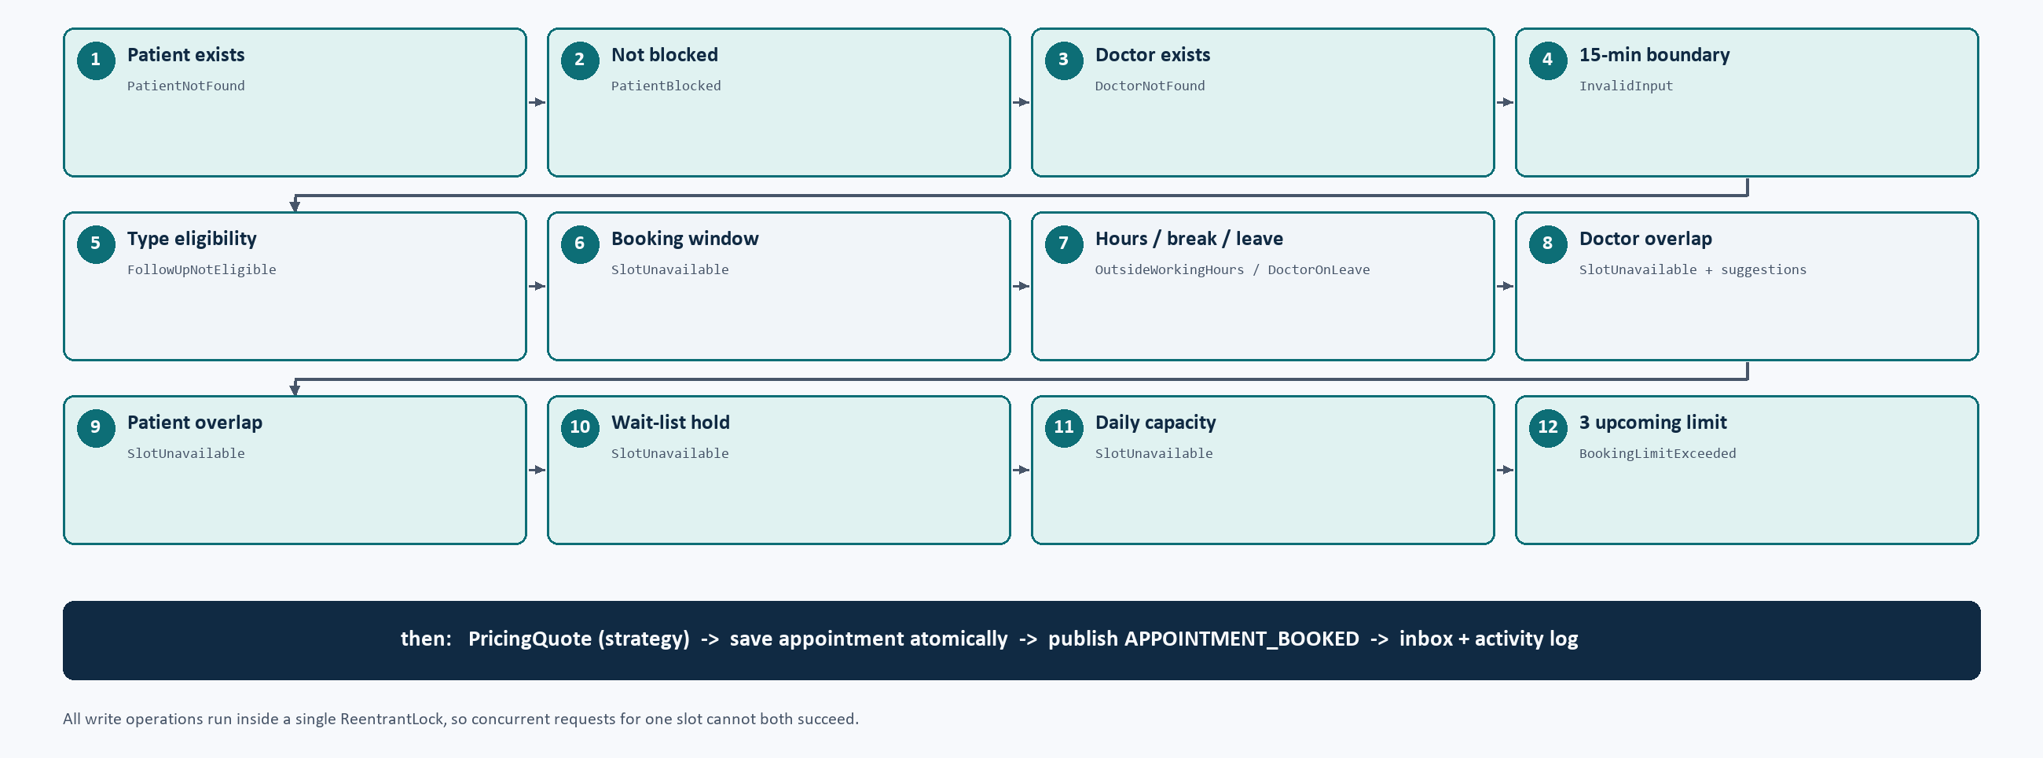
BOOKING RULES
Twelve checks, one specific error each
Nothing is mutated before every check passes; a rejected booking leaves no trace
Every failed check raises its own checked exception; nothing is written before the chain passes.
Console Clinic Appointment System
08
Notes:
Walk the numbered chain quickly, then focus on two: 'hours/break/leave' and 'doctor overlap'. Each rule maps to a checked exception, so the console always tells the user which rule blocked them. The waiting-list hold check (10) is subtle: an active offer reserves the slot even though no provisional appointment is written.

Slide 9
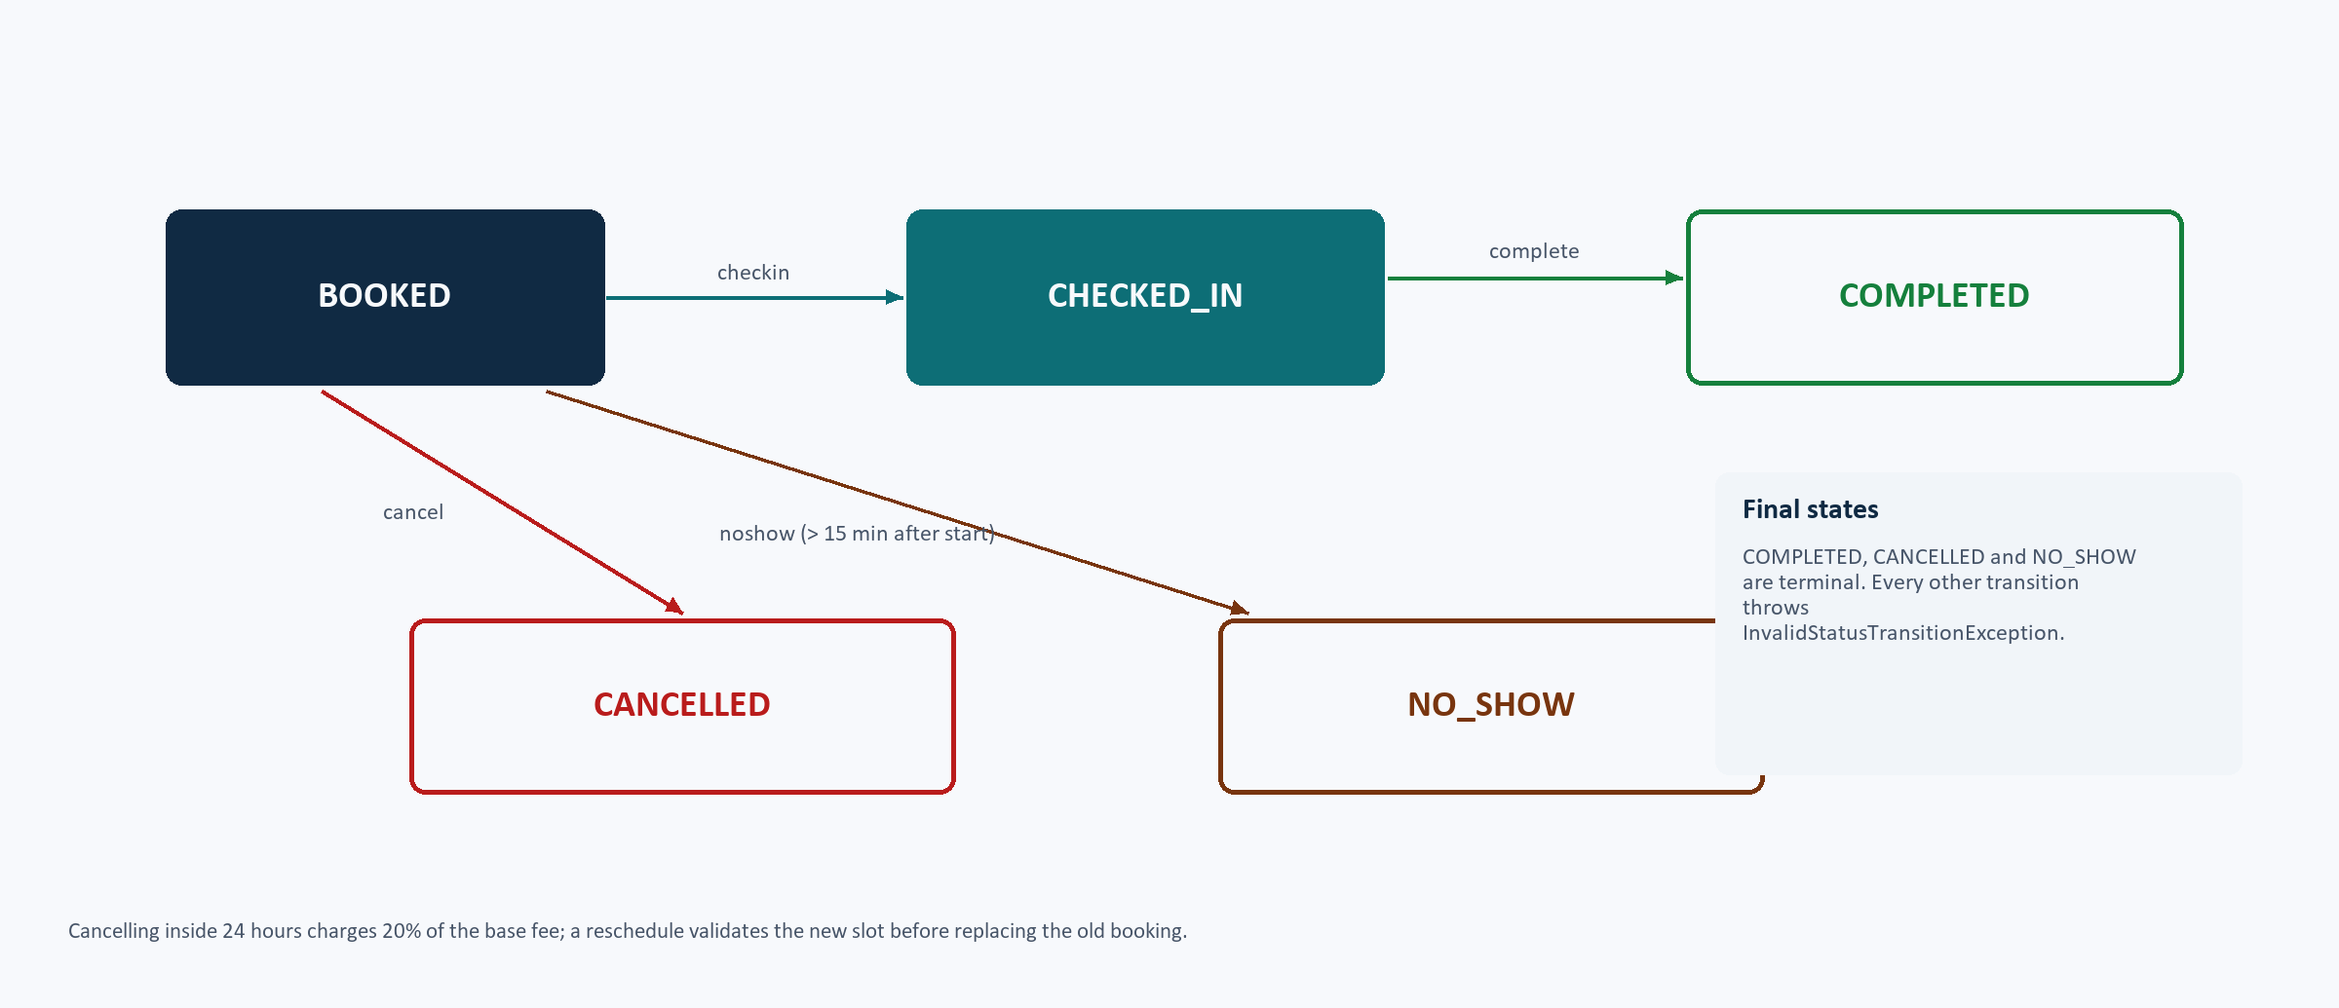
LIFECYCLE
A small state machine, enforced in one place
BOOKED -> CHECKED_IN -> COMPLETED; cancellation and no-show leave from BOOKED only
Late fee
Cancel inside 24h: 20% of the base fee (1,000 on a 5,000 consultation).
Atomic reschedule
New slot validated first; failure leaves the original untouched.
No-show block
Transitions are validated inside Appointment.transitionTo(...).
3 no-shows in 90 days -> blocked until a receptionist unblocks.
Console Clinic Appointment System
09
Notes:
The lifecycle lives in Appointment.transitionTo, so no service can create an inconsistent state. Point out the three consequences on the right: the late fee, atomic rescheduling and the no-show block, which is lifted by the receptionist but keeps the history.

Slide 10
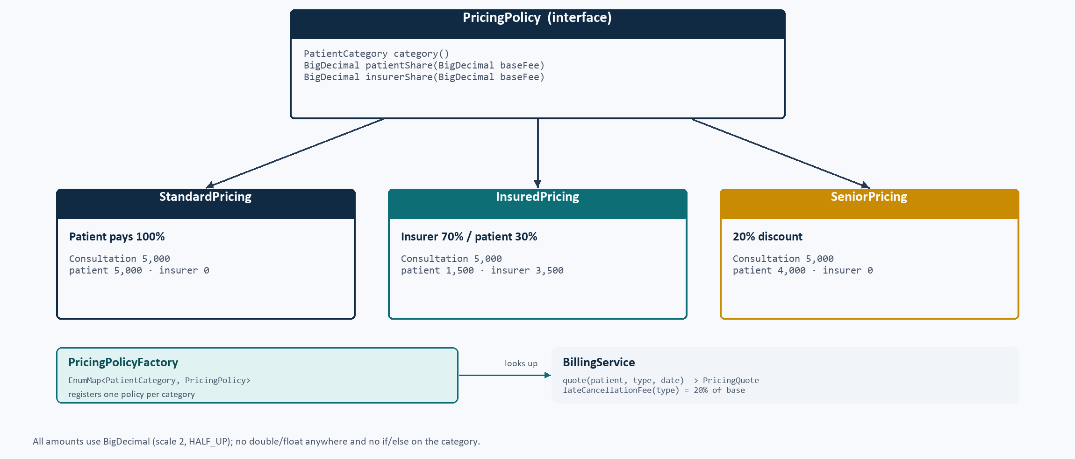
PRICING
Strategy pattern, no if/else on the category
One policy per category, looked up in an EnumMap; BigDecimal only
Worked example
INSURED · Consultation 5,000
patient 1,500
insurer 3,500
insurer covers 70%, patient 30%
SENIOR · Consultation 5,000
patient 4,000
20% discount; insurer pays 0
Adding a category means adding a policy and one factory entry - no billing change.
Late cancellation = 20% of the base fee. Money is stored as strings, split with HALF_UP, and always sums back to the base fee.
Console Clinic Appointment System
10
Notes:
The key design point: BillingService asks the factory for a policy and calls patientShare / insurerShare. There is no if/else on the category. The senior category is derived from the date of birth at pricing time and takes precedence over insurance - call this out as a documented interpretation.

Slide 11
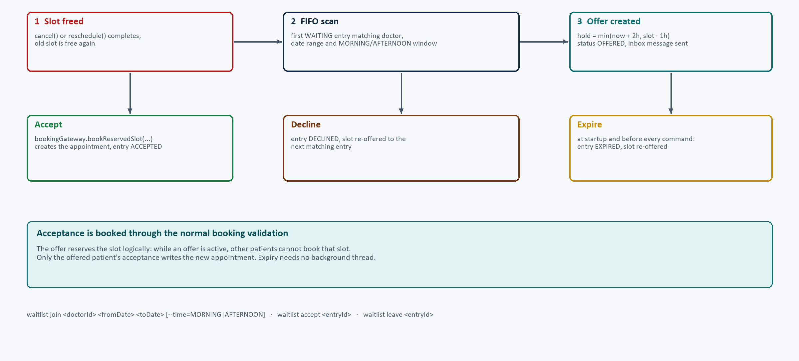
WAITING LIST
Cancelled slots do not stay empty
FIFO offers with a 2-hour hold, capped at one hour before the slot; expiry needs no threads
▪ Join with a doctor, a date range and a MORNING/AFTERNOON window.
▪ The first matching entry gets the slot; while offered, nobody else can book it.
▪ Hold = min(offer time + 2h, slot start - 1h).
▪ Accept books through the normal validation; decline or expiry offers it to the next entry.
▪ Expiry runs at startup and before every command, so no background thread is needed.
Accept, decline and expiry all funnel through the same offer lifecycle.
Console Clinic Appointment System
11
Notes:
Explain the offer window formula with a concrete case: slot at 15:30, offer at 08:00, hold until 10:00. If the slot is only 30 minutes away, the cut-off is already in the past, so the entry is skipped. The lazy expiry keeps the design simple and deterministic.

Slide 12
DATA & CONCURRENCY
Crash-safe JSON and exactly one winner
Temp file -> atomic move; one ReentrantLock around every booking mutation
Persistence
Concurrency
▪ users.json, doctors.json, appointments.json, waitlist.json
▪ visit-records.json, notifications.json, sequences.json, activity.log
▪ ISO-8601 dates, money as strings, type discriminators
▪ Id sequences continue after a restart
▪ Corrupt file -> clear message and exit code 1 (no partial load)
Two threads, one slot, one success
PASS concurrency: exactly one of two
simultaneous bookings succeeds
PASS restart: ids continue after the
last saved value
SelfTest finished: 40 passed, 0 failed.
▪ One ReentrantLock serialises booking writes.
▪ Repositories synchronise their own saves.
Files.writeString(tmp) -> Files.move(tmp, target, ATOMIC_MOVE)
Console Clinic Appointment System
12
Notes:
Two guarantees worth emphasising: a crash cannot leave half a JSON file because writes are temp-file-then-atomic-move; and two receptionists cannot both book the same slot because all write operations take one lock. The self-test proves the second with two real threads.

Slide 13
VERIFICATION
Evidence, not claims
A self-test harness, three scripted demo sessions and a clean Maven build
40 / 40
110
9,216
31
self-test checks pass
Java source files
lines of Java
console commands
Covered by SelfTest
Demo and failure checks
▪ Overlap, break, leave, notice, horizon, capacity, limits, blocked patient
▪ Pricing splits for all three categories
▪ Late fee, atomic reschedule, follow-up eligibility
▪ Waiting-list offer and acceptance
▪ No-show block and receptionist unblock
▪ Password hashing, concurrency, restart persistence and ids
▪ demo/run-demos.ps1: 3 JVMs, one data folder
▪ Overlap -> suggestions, late fee, offer accepted
▪ No-show block -> unblock -> book again
▪ Check-in, note, complete, follow-up
▪ Restart loads 17 -> 19 -> 20 -> 21 appointments
▪ Corrupt JSON -> clear message, exit code 1
Console Clinic Appointment System
13
Notes:
Be precise about what was verified and how: 40 programmatic checks, run against the real repositories with a fixed clock; three scripted sessions as separate processes (which proves persistence); and negative tests for corrupt data. Mention that JUnit was deliberately not added because the brief allows Gson only.

Slide 14
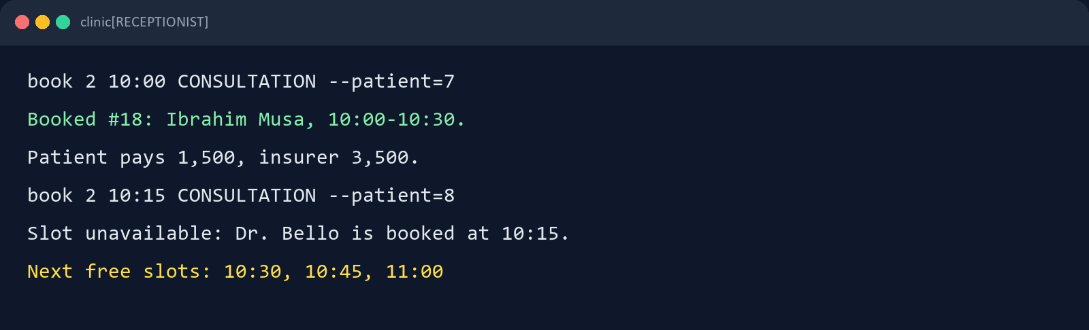
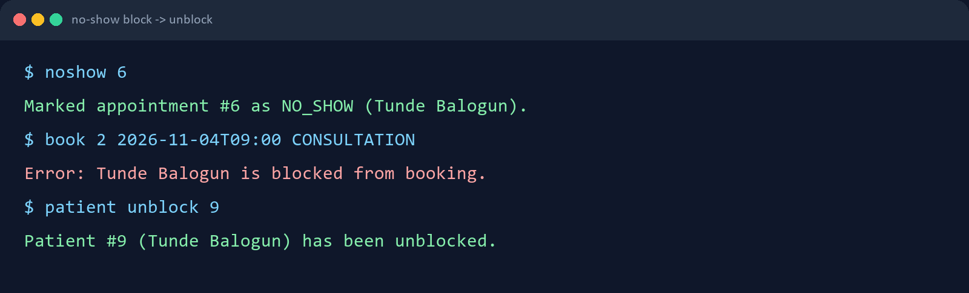
DEMO
Three rules in action
Reproducible because the clock is pinned to Monday 2 November 2026, 08:00
1
Overlap rejected
Suggestions come from the same SlotFinder that powers the slots command.
2
Waiting-list offer
A cancellation offers the slot; accepting books it for the waiting patient.
3
No-show block
The third no-show blocks; the receptionist unblocks; history stays.
Console Clinic Appointment System
14
Notes:
Run the demo if time allows, otherwise narrate these two transcripts. Point out the fee split on the first booking, the three suggestions on the conflict, and the block/unblock pair. Mention the clock flag so the audience knows the result is repeatable.

Slide 15
REFLECTION
What went well, what stays rough, what comes next
What went well
Trade-offs
Next steps
▪ TimeRange first: one overlap rule for everything
▪ Clock injection -> deterministic tests and demo
▪ Lifecycle inside Appointment.remove inconsistent states
▪ Strategy + Factory kept booking/billing closed to change
▪ Self-test harness compensated for no JUnit
▪ One coarse booking lock, simple but serialising
▪ Whole-file JSON rewrites; fine for one clinic
▪ No password change / password policy
▪ Senior pricing overrides INSURED (documented)
▪ Console layout assumes a monospaced terminal
▪ Recurring appointments and week view
▪ Automatic doctor assignment by specialty
▪ History export to JSON/PDF; login reminders
▪ SQLite behind the same repository interfaces
▪ JUnit + CI running the self-test suite
Console Clinic Appointment System
15
Notes:
Keep this honest. The strongest points are TimeRange, Clock injection and polymorphic rules. The limitations are acceptable for the brief's single-clinic scale, and the future work shows awareness of how the design would evolve (repository swap, CI, recurring appointments).

Slide 16
Thank you
Questions?
The project is in clinical_java_project: source, README, UML diagrams, demo scripts and this deck.
Onah Debeiwu Chrysanctus — Student1639236
Okeke Chiemerie Miracle — Student1647235
Okonkwo Samuel chiemerie — Student1627019
Console Clinic Appointment System
16
Notes:
End with the takeaway: a small console application that still does the hard parts properly - time arithmetic, rule enforcement, pricing strategies, waiting lists, data integrity and concurrency. Invite questions.

