Slide 1

ECE 281
Lesson 10
1

Slide 2
Lesson 10 Outline
Do Time Logs!
Lab 1 In-class

Slide 3
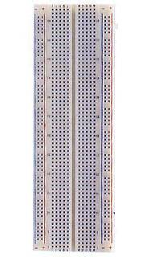
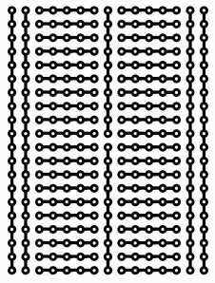
Breadboards 101

Slide 4
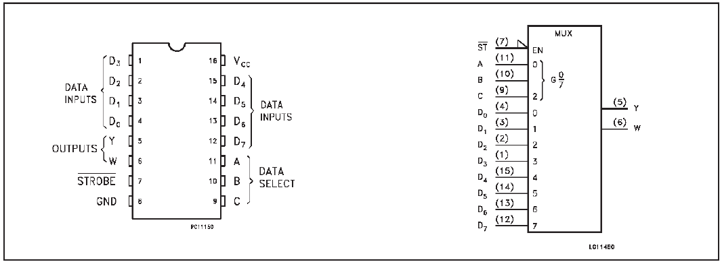
8:1 Multiplexer (PN 74151)
K:\DF\DFEC\ECE281\Datasheets\74x151.pdf

Slide 5
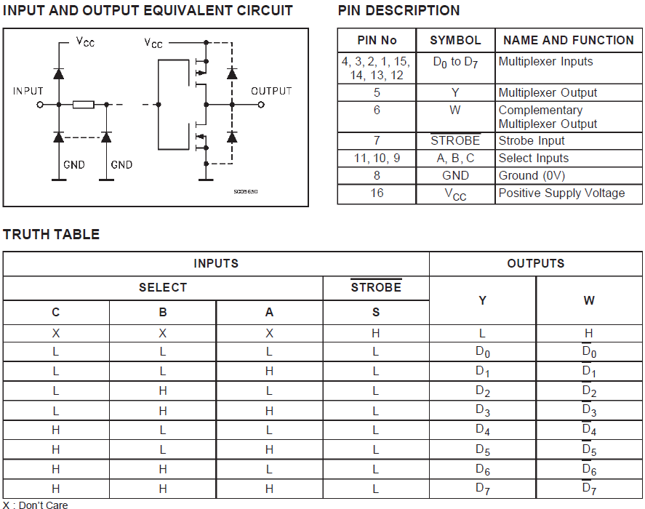
8:1 Multiplexer (PN 74151)
K:\DF\DFEC\ECE281\Datasheets\74x151.pdf

Slide 6
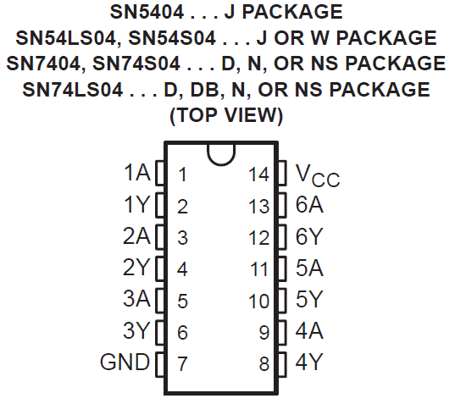

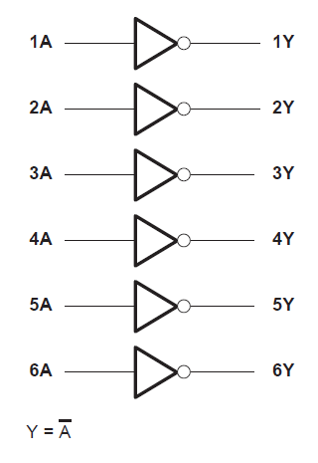
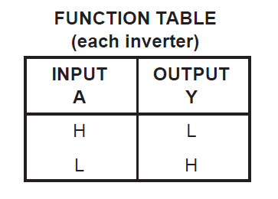
Hex NOT (PN 7404)
K:\DF\DFEC\ECE281\Datasheets\sn74ls04.pdf

Slide 7
Tips
Test as you go
  Connect ground and power first
  Test one chip at a time
  Then connect chips together
Keep wires as flat and straight as possible
Do not cross wires if you can avoid it

Slide 8

8

