Slide 1
GLaM + Mixtral of Experts
AI - Lecture
Florian Kaiser, Jannis Nau 29.06.2026
Notes:
Both papers: same problem, scaling without cost explosion
GLaM (Google) first, Mixtral as outlook

Slide 2
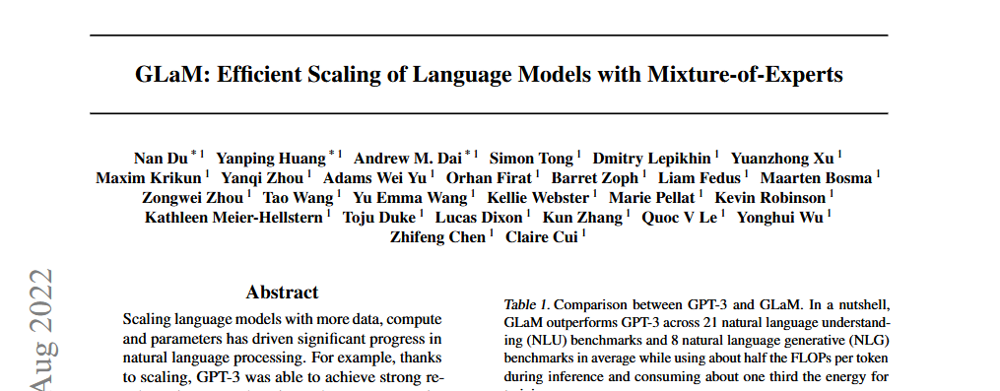
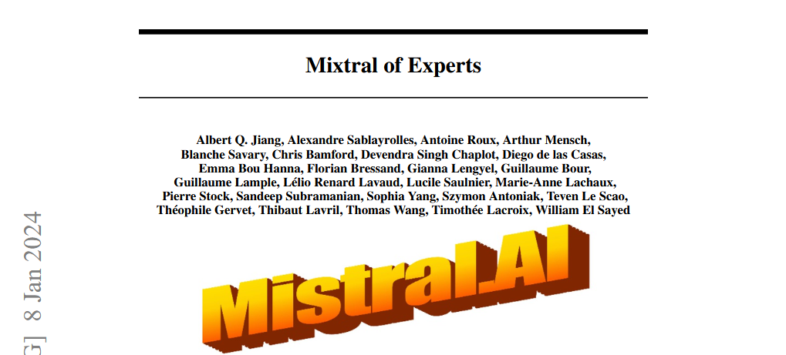
Agenda
GLaM (Du et al., 2022)
Motivation
Core Idea
Results
Mixtral of Experts (Jiang et al., 2024)
Intro
Architecture
What do “Experts” actually learn
Key Takeaways
[1]
[2]

Slide 3
Motivation - Dense Models don’t scale well
In a classic dense transformer, every single parameter is active for every token.
More capability means more parameters.
Computational costs and energy consumption grow linearly with model size.
Outcome
Scaling quickly becomes prohibitively expensive.
GPT-3 consumed ~1,287 MWh during training alone.
Notes:
Dense transformer: every parameter active for every token
More capacity = more parameters = more compute, linearly
GPT-3 training: ~1,287 MWh (~120 German households/year)
Question: increase capacity, keep compute constant?

Slide 4
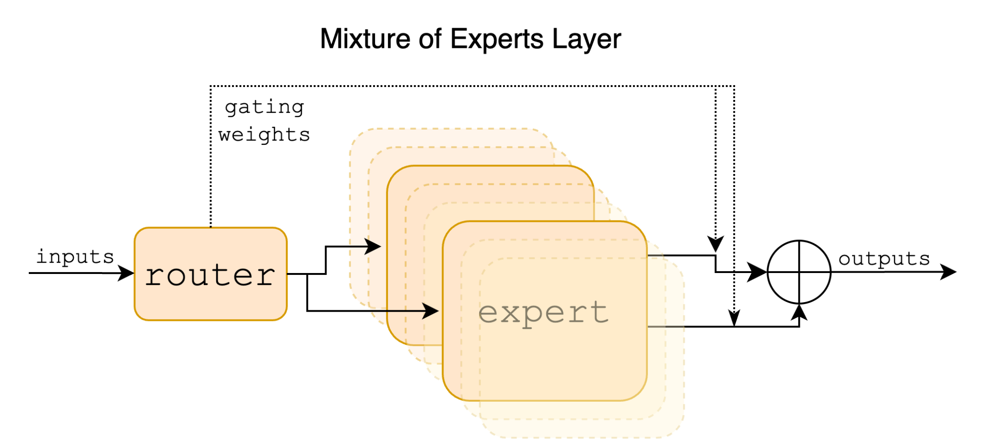
Core idea - A Mixture-of-Experts
Big total capacity, small active compute
Only the selected experts run, so parameter count grows without growing per-token FLOPs.
Softmax gating over experts
The gate uses a softmax to model how well each expert fits the token. Outputs are a weighted sum.
Top-2 routing
Each token is processed by its 2 best experts, a balance of quality and efficiency.
[2]
G(x) = Softmax(TopK(x · Wg))
Notes:
Instead of 1 large FFN: many small experts
Learned router picks the best 2 experts per token
Only selected experts run, rest stay idle
Parameter count grows with number of experts, compute per token stays constant
Formula: x · Wg → TopK → Softmax → weights for selected experts
Output = weighted sum of expert outputs

Slide 5
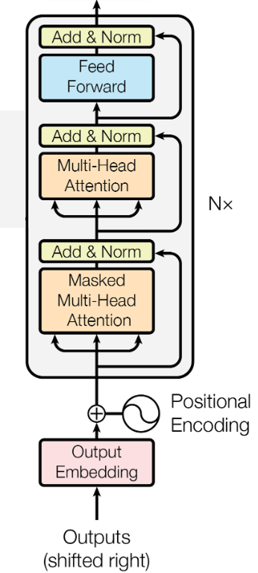
Core idea - Transformer Decoder-only
[3]
Notes:
Classic block: Input + Positional Encoding → Self-Attention → Add&Norm → FFN → Add&Norm

Slide 6
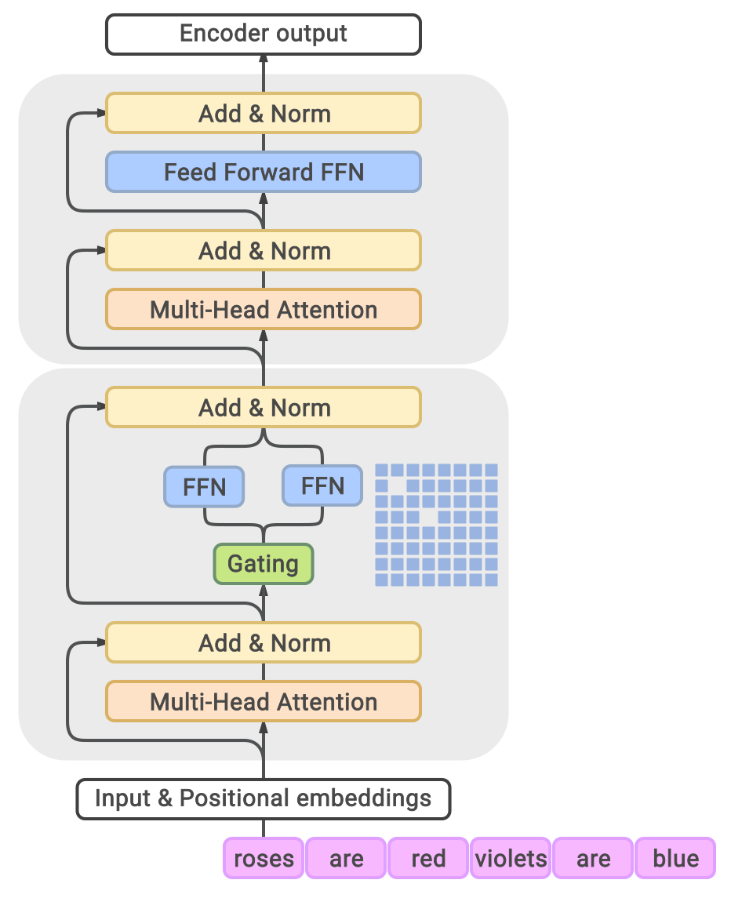
Core idea - Architecture
Decoder-only
Generalist LM, evaluated zero/one/few-shot
64 experts / MoE layer
Gating selects the top 2 per token
MoE every other layer
Interleaved with standard Transformer layers
1.2T total params
but only ~96.6B (8%) active per token
Every other layer is an MoE layer
[1]
↑ input tokens
Notes:
Two block types alternating
MoE layer (bottom): 64 experts instead of 1 FFN, gating picks top-2
Regular layer (top): 1 FFN
Every other layer = MoE layer
1.2T total parameters, ~96.6B (8%) active per token
Notation 64B/64E: 64B base model, 64 experts/layer → adds up to 1.2T total

Slide 7
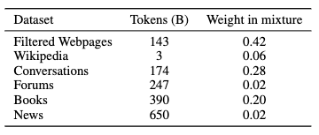
Training data
1.6 trillion tokens
A broad corpus of web pages, books, Wikipedia, forums, news and public conversations.
A learned quality filter
A feature-hash linear classifier scores web pages against curated text. Pareto sampling still keeps some low-quality pages to avoid bias.
Quality beats quantity
Filtered data consistently outperforms unfiltered, with the largest gains on text generation (NLG).
[1]
Notes:
1.6T tokens: web pages, books, Wikipedia, forums, news, conversations
Learned linear quality classifier (feature hashing)
Pareto sampling: deliberately keeps some low-quality pages too (avoids bias)
Filtered data > unfiltered, biggest gains on NLG

Slide 8
Evaluation - in-context, no fine-tuning
Zero- / one- / few-shot only
Tasks are solved purely from a few in-context examples (like GPT-3)
29 tasks across 7 categories
21 language-understanding (NLU) and 8 generation (NLG) benchmarks.
Understanding tasks
Pick the option with the highest length-normalised log-likelihood.
Generation tasks
Beam search (width 4), scored by exact-match / F1.
Notes:
Beam search is an algorithm used in many NLP and speech recognition models as a final decision making layer to choose the best output given target variables.
In-context, no fine-tuning (like GPT-3) (General-purpose LLMs)
29 tasks, 7 categories (21 NLU, 8 NLG)
Understanding: highest length-normalized log-likelihood
Generation: beam search (width 4), exact-match/F1

Slide 9
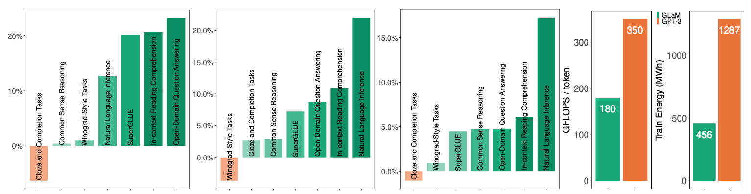
GLaM - Results
[1]
(a)–(c) per-category % change of GLaM (64B/64E) vs GPT-3 across 7 categories, (d) inference FLOPs / token and training energy. [1]
Bars above zero mean GLaM beats GPT-3. It does so in almost every category, in all three settings.
And it gets there with ca. half the FLOPs / token (180 vs 350) and about third of the training energy (456 vs 1,287 MWh).
Notes:
Bars above 0 = GLaM beats GPT-3 → almost everywhere, all 3 settings
~half the FLOPs/token (180 vs 350)
~a third of the training energy (456 vs 1,287 MWh)

Slide 10
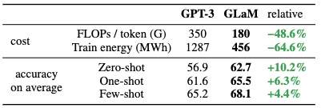
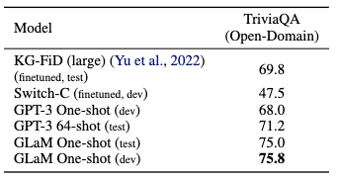
GLaM - Results
Average accuracy across the 29 tasks for:
Zero-shot,
One-shot,
Few-shot
Outperforms SOTA (state-of-the-art) few shot Model (GPT-3) for open domain.
[1]
[1]
Notes:
Avg. accuracy: zero-shot 62.7 vs 56.9 (+10.2%)
One-shot 65.5 vs 61.6 (+6.3%)
Few-shot 68.1 vs 65.2 (+4.4%)
TriviaQA open-domain: GLaM one-shot even beats fine-tuned models (75.8 vs 69.8 KG-FiD)

Slide 11
Mixtral - the same idea, with open weights
Sparse Mixture-of-Experts (SMoE)
Decoder-only, every feed-forward block is replaced by 8 experts. A router picks the top-2 experts.
47B total parameters, only ~13B active
Each token sees just 2 of the 8 experts → 5x fewer active parameters than dense Llama 2 70B, so inference stays cheap.
Trained at 32k context, released open-weight
Base and Instruct models published under Apache 2.0. The first MoE network to reach state-of-the-art among open models.
Matches GPT-3.5 and Llama 2 70B
Equal or better on most benchmarks, and far ahead on mathematics, code generation and multilingual tasks.
Difference from GLaM: experts at every layer (not every other), and 8 experts per layer instead of 64.
Notes:
Open-weight, Apache 2.0, first SOTA MoE among open models
8 experts per layer (not 64), EVERY layer (not every other)
Top-2 routing, like GLaM
47B total, ~13B active (5x fewer than dense Llama 2 70B)
Matches/beats Llama 2 70B & GPT-3.5, strong on math/code/multilingual

Slide 12
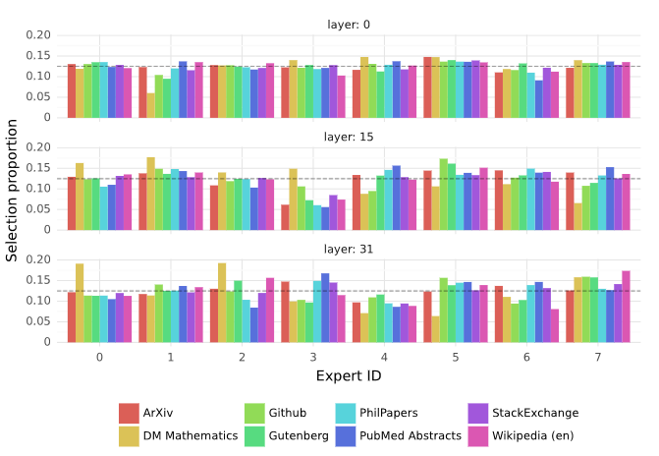
Mixtral - what the experts learn and how it scores
What the experts learn
No topic specialisation: ArXiv, biology and philosophy route almost identically.
Experts track syntax: 'self' in Python or code indentation hit the same expert.
Strong positional locality: consecutive tokens often share an expert (deeper layers), useful for caching.
How it performs
Matches/beats GPT-3.5 & Llama 2 70B with 5 times fewer active params.
[2]
Notes:
No topic specialization (ArXiv, biology, philosophy ~evenly distributed)
Specialization by syntax (e.g. 'self' in Python → same expert)
Positional locality: consecutive tokens often share an expert (deeper layers) → useful for caching

Slide 13
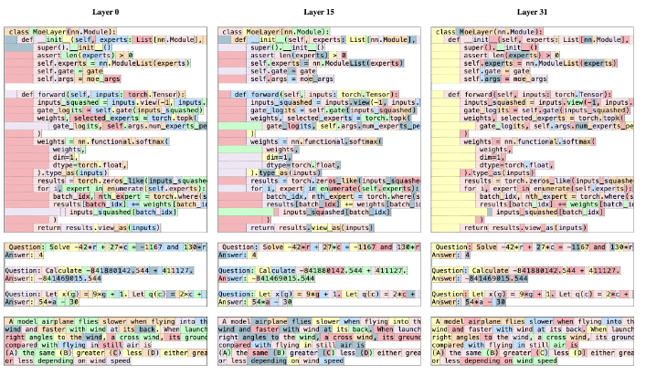
[2]
[2]
Notes:
Left: even domain distribution across experts
Right: syntax specialization, consistent across multiple layers

Slide 14
Key Takeaways
Sparsity scales capacity, not cost
Mixture-of-Experts grows total parameters while keeping the compute per token roughly constant.
A learned router does the work
A softmax top-k gate sends each token to its best few experts, only those experts run.
GLaM - trillion-scale, efficient
1.2T parameters but ~8% active per token: GPT-3-level quality at about half the per-token FLOPs and a third of the training energy.
Mixtral - the same recipe, open-weight
13B active parameters beat dense Llama 2 70B. Experts specialise by syntax rather than topic.
Mixture-of-Experts is now a practical path to bigger, cheaper LLMs.
Notes:
MoE: capacity up, compute per token constant
Router learns expert-token assignment automatically
GLaM: trillion-scale, efficient
Mixtral: same principle, open-weight, fewer experts
Experts specialize by syntax, not topic

Slide 15
Literature + List of Figures
[1] GLaM, Du et al., 2022, https://arxiv.org/pdf/2112.06905
[2] Mixtral of Experts, Jiang et al., 2024, https://arxiv.org/pdf/2401.04088
[3] Attention Is All You Need, Vaswani et al. 2017, https://arxiv.org/abs/1706.03762

