Slide 1

Faculty of Digital Medical Technologies
LLM / Generative AI · Spring 2026
Dominant Psychosocial Response & Distress Classification in Oncology Messages
Updated proposal - a novel, synthetic, label-leakage-controlled NLP benchmark
K.T. | HIT | A.A.
K.T.
1
HIT — Holon Institute of Technology

Slide 2
Faculty of Digital Medical Technologies
LLM / Generative AI · Spring 2026
1
MOTIVATING USE CASE
Reading the emotional state behind oncology messages
● Background: a cancer diagnosis carries a heavy psychosocial burden; supportive-care teams want to triage emotional state from patient-generated text.
● Why it matters: distress drives care needs. Two signals matter - which response dominates, and how intense the distress is.
● Why it is challenging: no public labeled dataset for this framing, and emotional labels are subjective and expensive to annotate.
● How it is solved today: manual screening (e.g. distress thermometers) and generic sentiment tools that miss fine-grained, mixed affect.
Two questions per message
1) Dominant psychosocial response
anxiety, sadness, anger, hope,
guilt, denial, acceptance
2) Distress intensity (ordinal)
low < medium < high
K.T.
2
HIT — Holon Institute of Technology

Slide 3
Faculty of Digital Medical Technologies
LLM / Generative AI · Spring 2026
2
PROJECT TASK
Two labels per message
● Formal task: f(text) -> (response in 7 classes, distress in {low, medium, high}).
● Input: one English oncology-related message. Output: the dominant response and the ordinal distress level (predicted by separate models).
● Novelty: unlike broad sentiment work, we jointly study fine-grained response type and ordinal distress on an attribute-controlled synthetic corpus.
Input -> Output (example)
“Scan is on Thursday. I keep rereading the same line and nothing goes in, and I have
checked my phone for the clinic number ten times tonight.” -> anxiety / medium
K.T.
3
HIT — Holon Institute of Technology

Slide 4
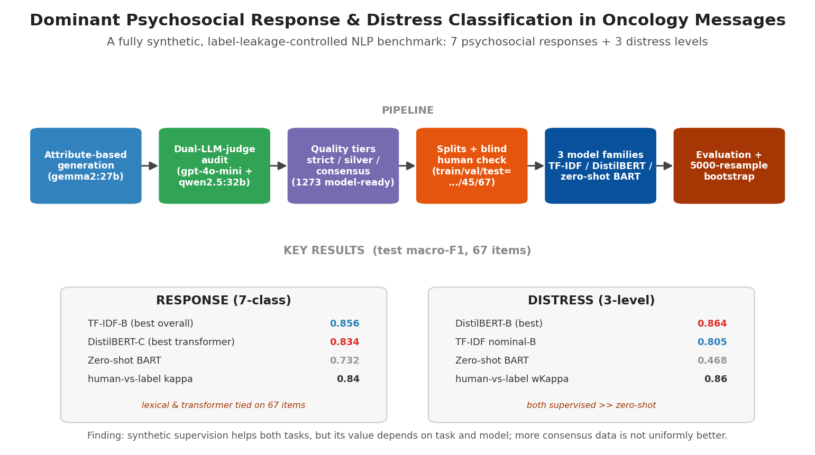
Faculty of Digital Medical Technologies
LLM / Generative AI · Spring 2026
3
MODELS & METHODS
Pipeline and three model families
Generator: gemma2:27b (Ollama). Judges: gpt-4o-mini + qwen2.5:32b. Models compared: TF-IDF + Logistic Regression, fine-tuned DistilBERT, zero-shot BART-MNLI.
Fine-tuning: DistilBERT with class-weighted cross-entropy, separate models for response and distress.
K.T.
4
HIT — Holon Institute of Technology

Slide 5
Faculty of Digital Medical Technologies
LLM / Generative AI · Spring 2026
4
DATA SPECIFICATION & GENERATION
Attribute-based synthetic generation
● Requirements: diverse, realistic, and leakage-free text - the message must never explicitly name the target response label.
● Attribute space: role, cancer stage, cancer type, tone, channel, age group, length, noise - sampled to force coverage.
● Generate: condition the LLM on attributes + an intended label; reject malformed or constraint-violating outputs; retain confident label drift only when both judges agree on a consensus label.
● Label & audit: two blind LLM judges predict the labels; agreement assigns each item to a quality tier.
Tier | Records
strict | 471
silver | 75
consensus | 727
model-ready | 1273
K.T.
5
HIT — Holon Institute of Technology

Slide 6
Faculty of Digital Medical Technologies
LLM / Generative AI · Spring 2026
5
METRICS & KPIs
How we measure success
Primary
macro-F1 (equal weight to all classes)
Response
micro / macro precision, recall, F1 + minority macro-F1
Distress (ordinal)
weighted kappa, MAE, severe (low<->high) rate, per-level
Significance
5000-resample paired bootstrap, 95% CIs
Human check
Cohen / weighted kappa vs. a blind annotator on the test set
Guardrail
test set never used for tuning (validation only)
K.T.
6
HIT — Holon Institute of Technology

