Slide 1

Faculty of Digital Medical Technologies
LLM / Generative AI · Spring 2026
Dominant Psychosocial Response & Distress Classification in Oncology Messages
Interim - dataset, baselines, and plan
K.T. | HIT | A.A.
K.T.
1
HIT — Holon Institute of Technology

Slide 2
Faculty of Digital Medical Technologies
LLM / Generative AI · Spring 2026
1
PROJECT REVIEW
Where the project stands
● Motivation: triage the emotional state behind oncology messages - which response dominates, and how intense the distress.
● Task: 7-class psychosocial response + 3-level ordinal distress, predicted by separate models.
● Changed from the proposal: reframed “emotion” to “dominant psychosocial response”; added dual-LLM-judge auditing, quality tiers, and a strict label-leakage ban.
● Novelty: fine-grained response + ordinal distress on a fully synthetic, attribute-controlled corpus with auditing and blind human validation.
K.T.
2
HIT — Holon Institute of Technology

Slide 3
Faculty of Digital Medical Technologies
LLM / Generative AI · Spring 2026
2
PREVIOUS WORK
Four anchors from recent literature
Work | Focus | Relation to our project
Yu et al. 2023 (NeurIPS) | Attribute-conditioned synthetic generation; diversity vs. bias | Justifies our attribute-based generation (role, stage, type, tone, ...)
Li et al. 2023 (EMNLP) | Synthetic data is weaker for subjective tasks | Justifies our strict audit, quality tiers, and human check
Zheng et al. 2023 (NeurIPS) | LLM judges are scalable but biased (position, verbosity, ...) | Precedent for LLM evaluation; motivates two judges + human validation
Xu et al. 2026 (PLOS Dig. Health) | LLM annotation + emotional-tone classification of cancer posts | Closest domain baseline and the reference point for our novelty
Novelty vs. Xu et al.: 7 response classes (not Neg/Neu/Pos) + a separate ordinal distress task + a synthetic attribute-controlled corpus + dual-judge tiers + human-ambiguity analysis.
K.T.
3
HIT — Holon Institute of Technology

Slide 4
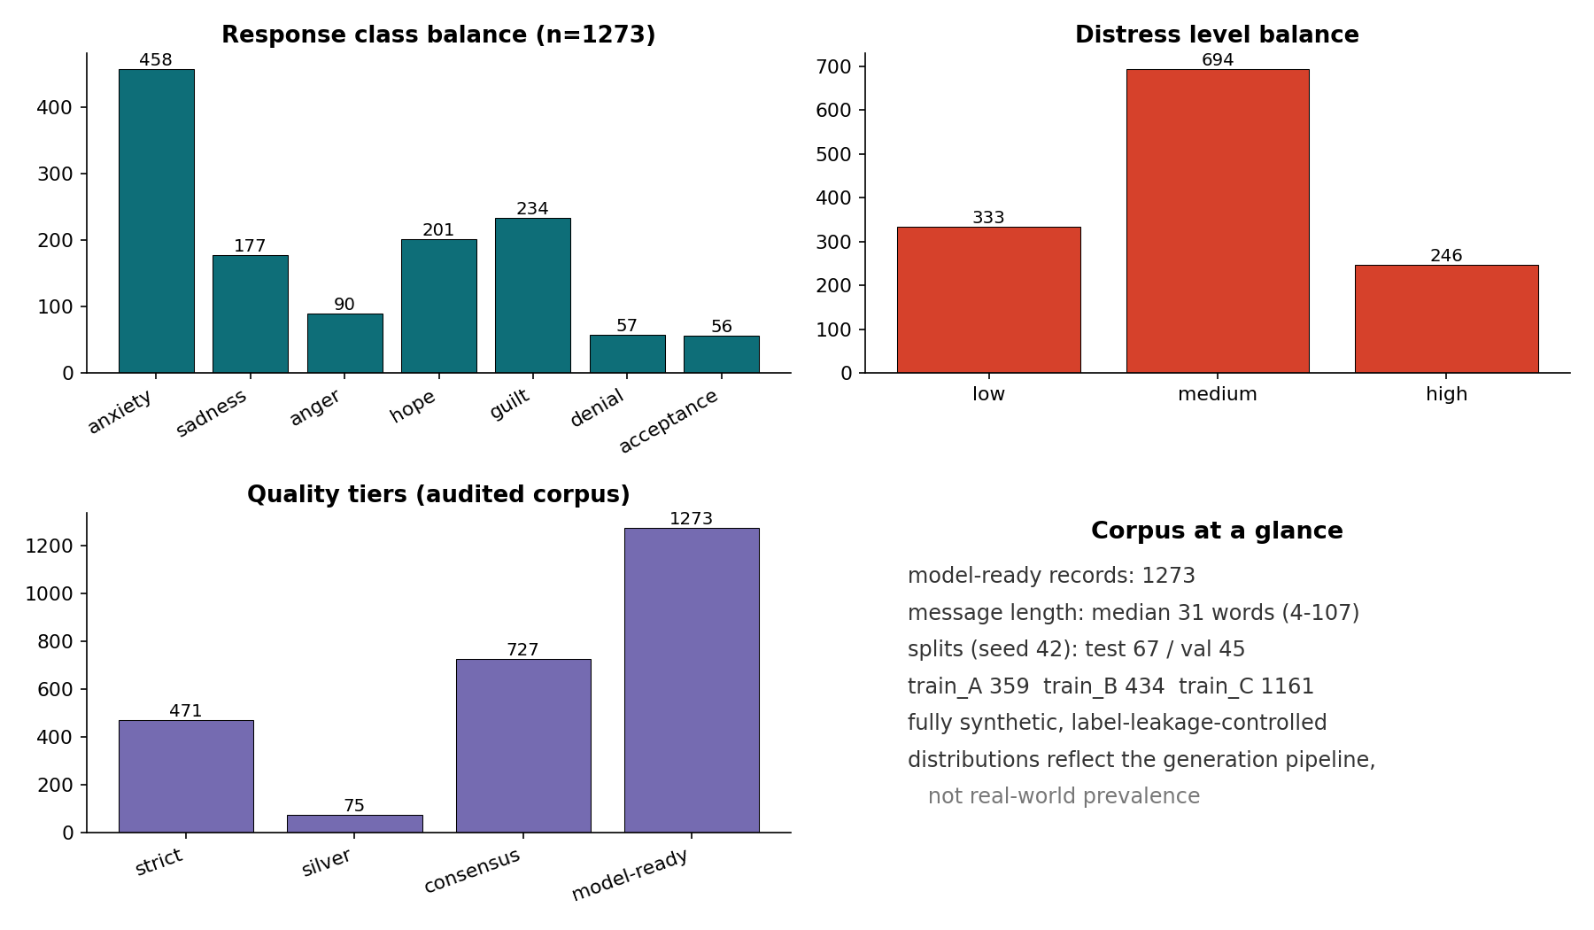
Faculty of Digital Medical Technologies
LLM / Generative AI · Spring 2026
3
DATASET
A synthetic, audited corpus
● Corpus funnel: 2033 generated, 2025 valid audited, 1273 model-ready (used in experiments).
● Generated by attribute-based prompting; labeled by two blind LLM judges into strict / silver / consensus tiers.
● EDA reading: strong class imbalance (anxiety and medium-distress dominate); messages are short (median 31 words).
● Distributions reflect the generation pipeline, not real-world prevalence.
K.T.
4
HIT — Holon Institute of Technology

Slide 5
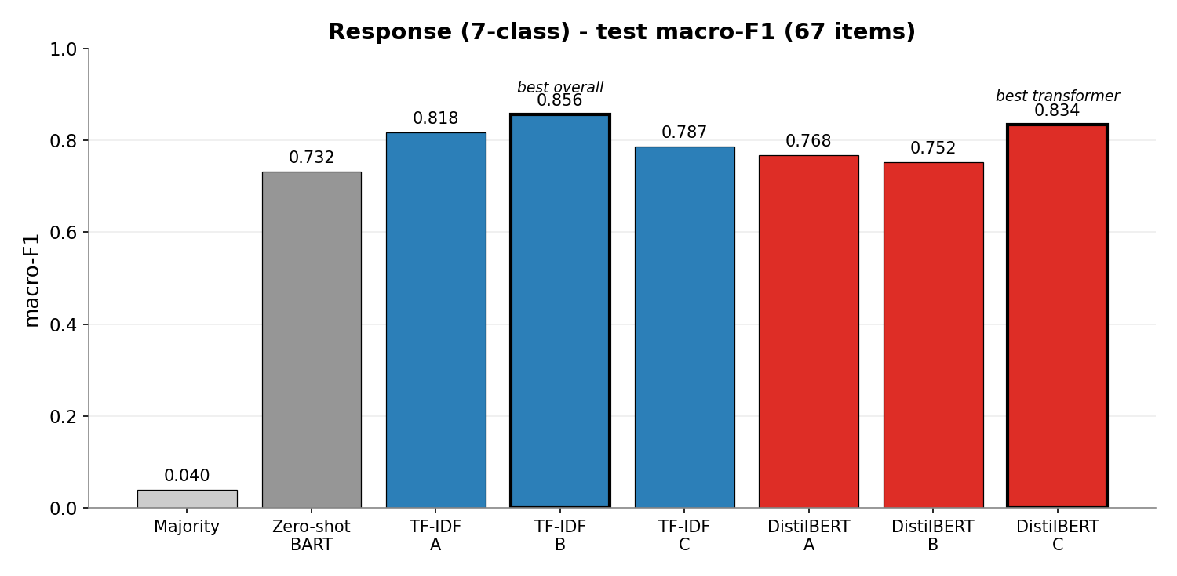
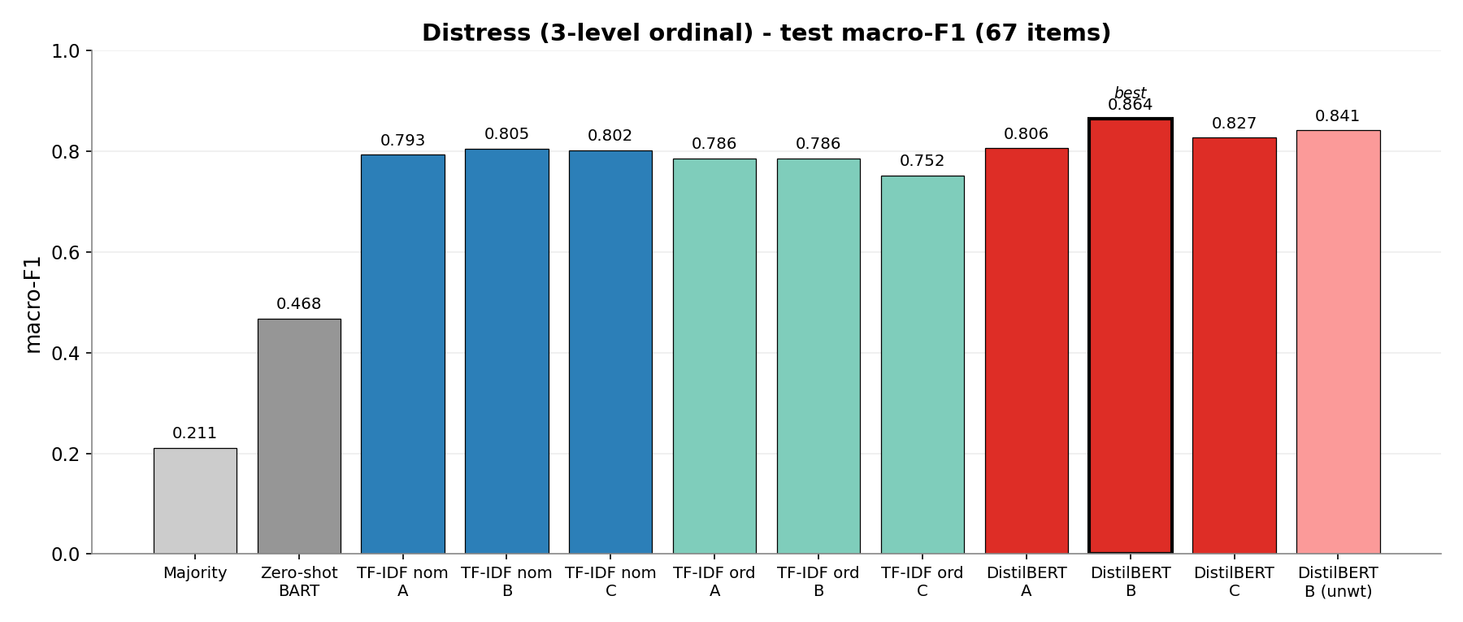
Faculty of Digital Medical Technologies
LLM / Generative AI · Spring 2026
4
BASELINE & RESULTS
Baselines and first results
● Off-the-shelf baseline = zero-shot BART. Both supervised families had higher point estimates than zero-shot; the gap was bootstrap-reliable for both families on distress and for TF-IDF-B on response.
● Error inspection: response shows an anger artifact (the model appears more closely aligned with the dual-judge policy than with the independent annotator's reading); distress error concentrates at the low / medium boundary.
K.T.
5
HIT — Holon Institute of Technology

Slide 6
Faculty of Digital Medical Technologies
LLM / Generative AI · Spring 2026
5
PLAN
Steps, scope and status
Phase | Scope | Status
Data generation | Attribute-based generation + rejection sampling | Done
Auditing & tiers | Dual-LLM-judge audit, strict / silver / consensus | Done
Splits & human check | Train/val/test + blind human annotation of test | Done
Modelling | TF-IDF, DistilBERT (A/B/C, 5 seeds), zero-shot | Done
Evaluation | Bootstrap CIs, error analysis, human reference | Done
Final presentation | Assemble repo, slides, visual abstract | In progress
K.T.
6
HIT — Holon Institute of Technology

