Slide 1

Faculty of Digital Medical Technologies
LLM / Generative AI · Spring 2026
Dominant Psychosocial Response & Distress Classification in Oncology Messages
Final - methodology, results, and conclusions
K.T. | HIT | A.A.
K.T.
1
HIT — Holon Institute of Technology

Slide 2
Faculty of Digital Medical Technologies
LLM / Generative AI · Spring 2026
1
PROJECT DEFINITION
Task, recap and refinement
● Goal: from one oncology message, predict the dominant psychosocial response (7 classes) and the ordinal distress level (low / medium / high).
● Data: 2,033 generated messages, 2,025 valid audited, and 1,273 model-ready items across quality tiers - no real patient data, no label leakage.
● Methods & metrics: three model families compared with macro-F1, ordinal weighted kappa / MAE, and 5000-resample bootstrap, validated by a blind human reading.
Refinement since proposal: “emotion” -> “dominant psychosocial response”; added dual-judge auditing,
quality tiers, the leakage ban, and ordinal-aware distress metrics.
K.T.
2
HIT — Holon Institute of Technology

Slide 3
Faculty of Digital Medical Technologies
LLM / Generative AI · Spring 2026
2
ACHIEVEMENTS & NOVELTY
What we built and what is new
● Built and audited a 2,025-message synthetic corpus (2,033 generated); 1,273 items retained as model-ready, in strict / silver / consensus tiers.
● Compared three model families on both tasks; DistilBERT was evaluated over five random seeds, while TF-IDF and zero-shot baselines were deterministic; with bootstrap significance testing and a blind human validation.
● Delivered a consolidated error analysis (anger artifact, anxiety over-prediction, low / medium distress boundary).
Novelty
We jointly study fine-grained psychosocial response type and ordinal distress intensity using an attribute-controlled synthetic corpus, dual-LLM auditing, quality tiers, and blind human validation.
K.T.
3
HIT — Holon Institute of Technology

Slide 4
Faculty of Digital Medical Technologies
LLM / Generative AI · Spring 2026
3
METHODOLOGY
End-to-end methodology
Attribute-based
generation
(gemma2:27b)
Dual-LLM-judge
audit
(gpt-4o-mini +
qwen2.5:32b)
Quality tiers
strict / silver /
consensus
(1273 ready)
Frozen splits +
blind human
check
TF-IDF /
DistilBERT /
zero-shot
Bootstrap
evaluation +
95% CIs
Effort for quality: five random seeds per DistilBERT configuration (report mean +/- std); TF-IDF and zero-shot baselines are deterministic. Plus a class-weighting control, 5000-resample bootstrap CIs, and a blind 67-item human check.
Human check: response kappa 0.84; distress weighted kappa 0.80 linear / 0.86 quadratic.
K.T.
4
HIT — Holon Institute of Technology

Slide 5
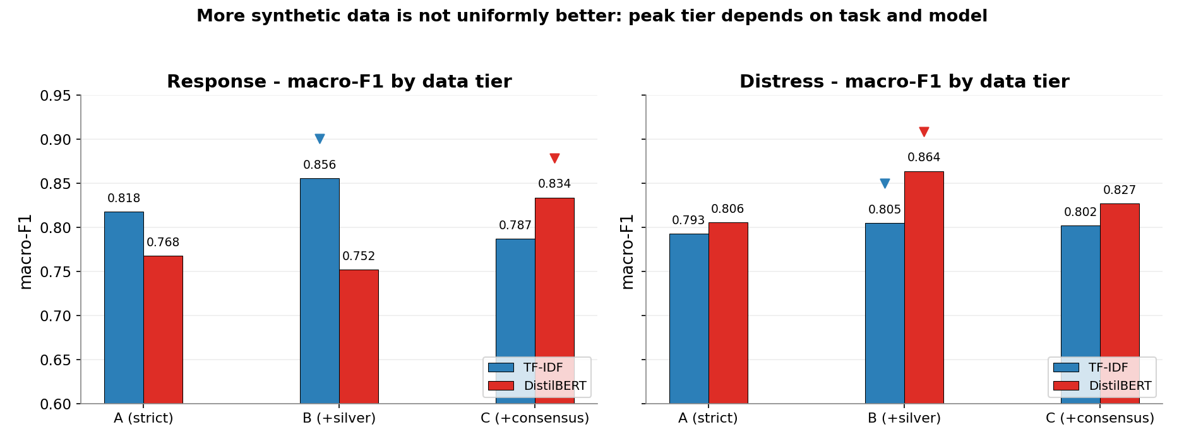
Faculty of Digital Medical Technologies
LLM / Generative AI · Spring 2026
4
RESULTS
Cross-task results
Task | Best lexical | Best transf. | Zero-shot
Response | TF-IDF-B 0.856 | DistilBERT-C 0.834 | BART 0.732
Distress | TF-IDF-B 0.805 | DistilBERT-B 0.864 | BART 0.468
Reliable conclusions (bootstrap):
● Supervised > zero-shot descriptively on both tasks; bootstrap-confirmed for TF-IDF-B on response and both models on distress.
● Lexical vs. transformer was NOT separable on 67 items (CIs include 0).
● More synthetic data is not uniformly better: peak tier depends on task and model.
K.T.
5
HIT — Holon Institute of Technology

Slide 6
CONCLUSION
Conclusions and future work
Goals achieved
competitive classifiers for both tasks, with a rigorous, honestly-scoped evaluation.
What we learned
a sparse lexical model is highly competitive for response; the transformer leads distress on the mean but not provably; more consensus data is not always better.
Residual errors
concentrated at semantically ambiguous boundaries (low / medium distress), not extreme low/high errors; high distress was detected reliably on the synthetic test set.
Scope
synthetic-only evaluation, one human annotator, and a 67-item test set.
Future work
a multi-annotator gold standard, a more context-aware distress model, and validation on real (non-synthetic) text.
K.T.
6
HIT — Holon Institute of Technology

