Slide 1

EF-02: Financial News Sentiment Analyser for Economic Forecasting
Group Members:
Kitula, Kitula-Masaganya Abdul (35552/T.2025)
leka, Revocatus Orest (37058/T.2025)
Lyellu, Sabrina Rashid (37463/T.2025)
Ibrahim, Ghadhal Nkrumah (37254/T.2025)
Supervisors:
Dr. Winfrida
Mr. Benitho
July 2, 2026

Slide 2
Methodology (Agile methodology)
 | Specific Objective | Methodology | Tools | Deliverable
1. | To scrape Tanzanian financial news headlines from online sources | Automated web scraping | Python, Requests, BeautifulSoup, CSV | Raw headline datasets per source
2. | To benchmark and select the most suitable NLP model | Multi-model comparative evaluation (Uisng labelled dataset) | Python,TextBlob,VADER, finBERT, Llama 3.3 70B, GPT 4.0 mini, Groq and OpenAi SDK, scikit-learn, Pandas, | Benchmarking results CSV and selected model
3. | To classify headlines by relevance, category, and sentiment | Prompt-based LLM classification | Python, Groq API, Llama 3.3 70B, Pandas | Labelled headlines dataset
4. | To consolidate classified headlines with macroeconomic indicators | Dataset consolidation and monthlu aggregation | Python, Pandas | Merged visualisation dataset
5. | To analyse correlation between news sentiment and economic indicators | Pearson correlation analysis | Python, Matplotlib, Seaborn, SciPy | Correlation charts and findings

Slide 3
USERS OF THE SYSTEM
Policymakers and economists monitoring currency pressure and inflation mood from local media
Investors tracking sector trends (banking, trade, agriculture, forex) before official statistics
Researchers studying African financial NLP and sentiment relationships
Data scientists extend or adapt the pipeline for other NLP or macroeconomic correlation tasks

Slide 4
System Functionalities
Data collection: scraping, pagination of headlines
Data cleaning: merging, removing duplicates, date normalisation of scraped headlines
Model benchmarking: multi-model evaluation and accuracy comparison
Classification: relevance filtering, category tagging, sentiment labelling on scrapped headlines
Data consolidation: merging headlines with CPI and FX data at monthly level
Visualisation and analysis: charts, correlation matrix, Pearson r and p-value outputs

Slide 5
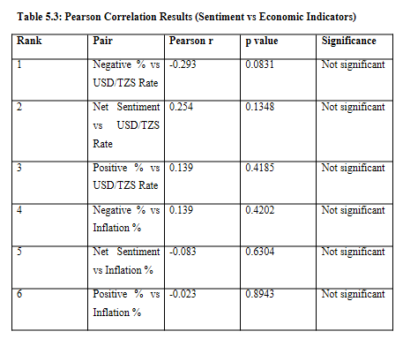

Slide 6
System Demonstration
GitHub repository:
K2Debug/Financial-News-Sentiment-Analyzer-for-Economic-Forecasting at refactor/colab-local-runtime-cache
Clone Repository :
!git clone https://github.com/K2Debug/Financial-News-Sentiment-Analyzer-for-Economic-Forecasting.git

Slide 7
THANK YOU

