Slide 1
NiosⅡ自定义指令
——一种硬件加速的图像卷积系统
徐铭君

Slide 2
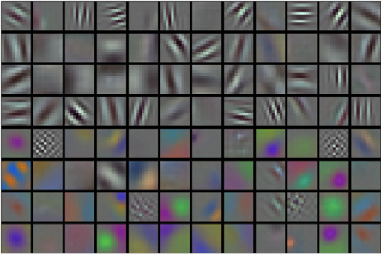
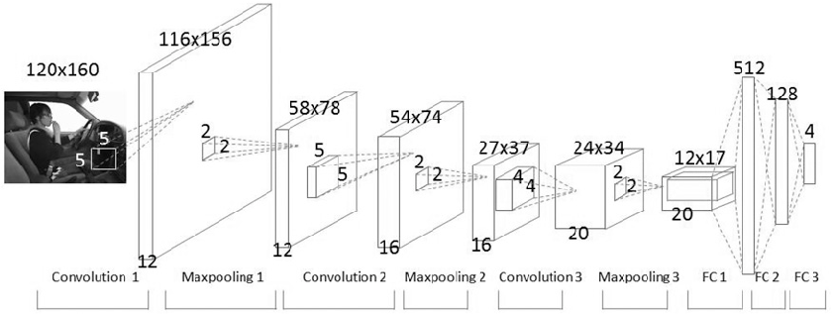
图像的卷积
用于滤波
用于提取图像特征

Slide 3
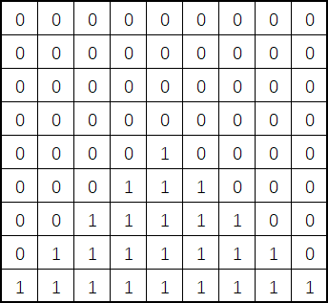
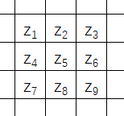
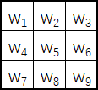
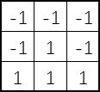
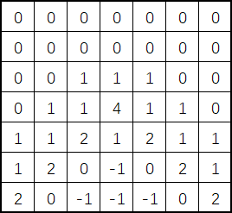

图像的卷积
$$Y=\sum_{i=1}^{9}{w_{i}z_{i}}$$

Slide 4
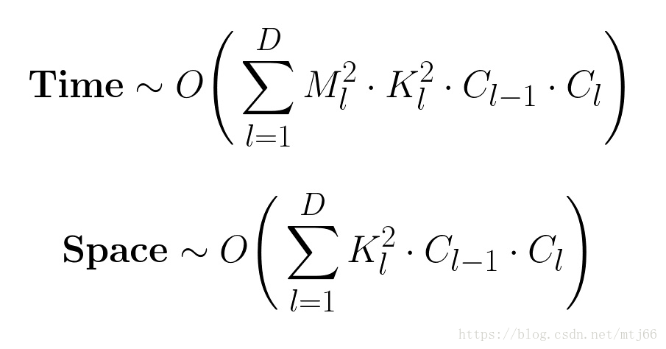
存在问题
M：输出特征图的边长
K：卷积核的边长
Cl-1：卷积核的通道数
Cl：输入图像的通道数
重复性的计算比较多，计算量比较大

Slide 5
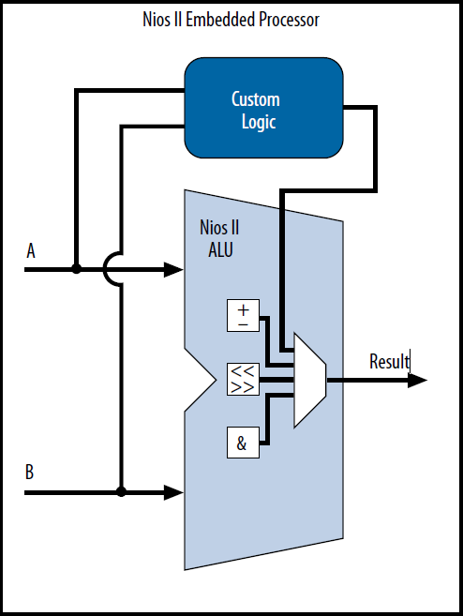
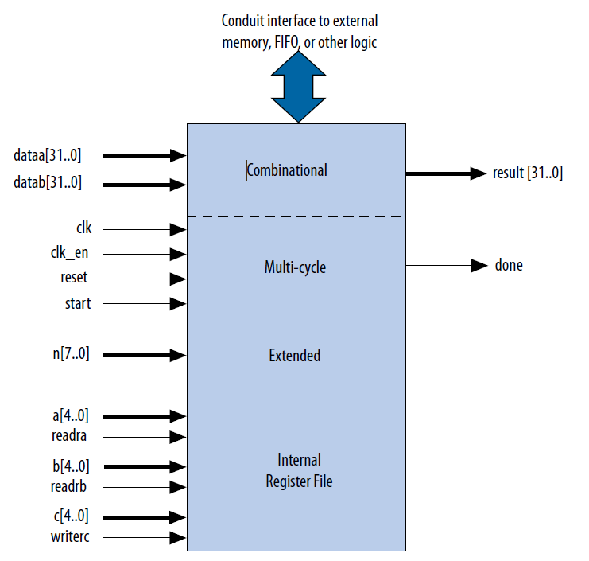
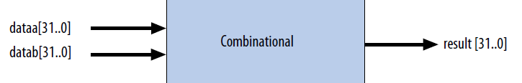
解决方法
自定义指令
定制Nios II处理器
ALU上挂载自定义逻辑块

Slide 6
系统构建
Nios
SOPC
软件
VHDL卷积
软件接口调用

Slide 7


VHDL卷积
系统构建
entity self_convolution is
port( dataa,datab:in std_logic_vector(31 downto 0);
result :out std_logic_vector(31 downto 0));
end entity;
只有两个32位的输入
dataa
datab
char[0]
char[1]
char[2]
char[3]
kernel[0]
kernel[1]
kernel[2]
kernel[3]
$$⊗$$
$$=$$
Result[16..0]

Slide 8
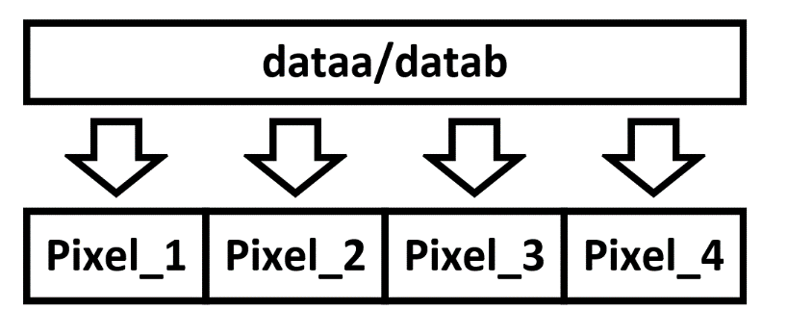
系统构建
VHDL卷积
architecture behave of self_convolution is
signal temp1,temp2,temp3,temp4:signed(16 downto 0);
signal temp_t:std_logic_vector(16 downto 0);
begin
process(dataa,datab)
begin
temp1 <= (unsigned(dataa(7 downto 0))*signed(datab(7 downto 0)));
temp2 <= (unsigned(dataa(15 downto 8))*signed(datab(15 downto 8)));
temp3 <= (unsigned(dataa(23 downto 16))*signed(datab(23 downto 16)));
temp4 <= (unsigned(dataa(31 downto 24))*signed(datab(31 downto 24)));
result(16 downto 0) <= temp1+temp2+temp3+temp4;
temp_t(16 downto 0) <= temp1+temp2+temp3+temp4;
if temp_t > 65535 then
result(31 downto 17) <= "111111111111111";
else
result(31 downto 17) <= "000000000000000";
end if;
end process;
end behave;
符号位的扩展

Slide 9
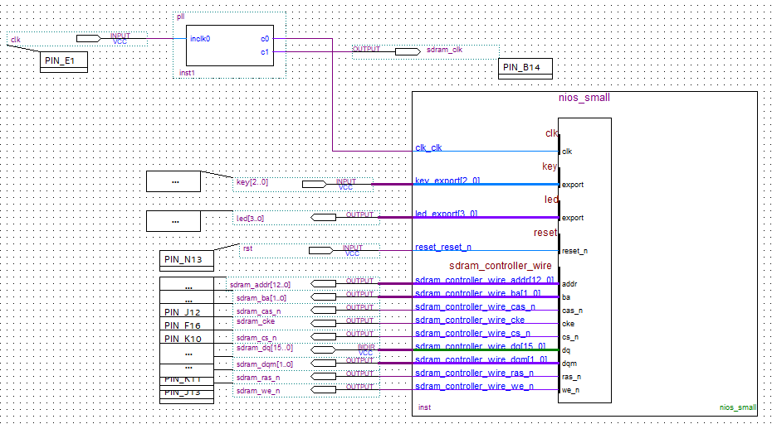
SOPC
系统构建
SDRAM:32MB
PLL:50MHz

Slide 10
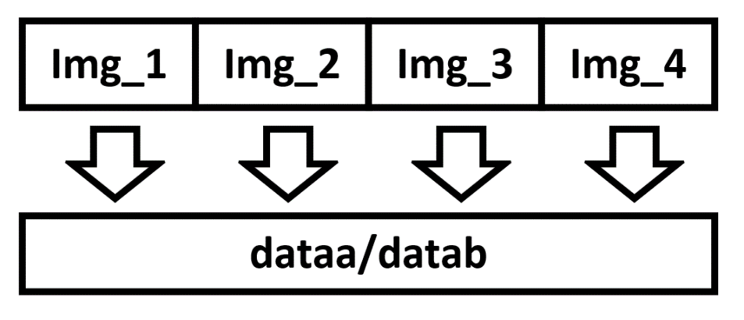
软件设计
系统构建
B1 = (*(int*)(*(kernel_r)));
B2 = (*(int*)(*(kernel_r)+3));
B3 = (*(int*)(*(kernel_r)+6));
for(i=0;i<78;i++)
{
for(j=0;j<78;j++)
{
A1=0;A2=0;A3=0;
A1 = (img[i][j]|(img[i][j+1]<<8)|(img[i][j+2]<<16));
A2 = (img[i+1][j]|(img[i+1][j+1]<<8)|(img[i+1][j+2]<<16));
A3 = (img[i+2][j]|(img[i+2][j+1]<<8)|(img[i+2][j+2]<<16));
Y1 = (int)ALT_CI_CONVOLUTION_0(A1,B1);
Y2 = (int)ALT_CI_CONVOLUTION_0(A2,B2);
Y3 = (int)ALT_CI_CONVOLUTION_0(A3,B3);
Y = Y1+Y2+Y3;
if(Y < 0)
Y = 0;
else if(Y > 255)
Y = 255;
img_out[i][j] = Y;
}
}

Slide 11


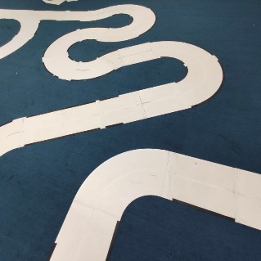





效果检测
结果测试

Slide 12
用时检测
结果测试
if (alt_timestamp_start() < 0)
{
printf("Can't Start Timestamp...\n");
}
time1 = alt_timestamp();
//C语言软件处理
time2 = alt_timestamp();
//VHDL自定义指令
time3 = alt_timestamp();
printf("func1 needs %u\n",(unsigned int)(time2-time1));
printf("func2 needs %u\n",(unsigned int)(time3-time2));
func1 needs 108397813
func2 needs 62150273
加速了70%

Slide 13
谢谢大家

