Slide 1
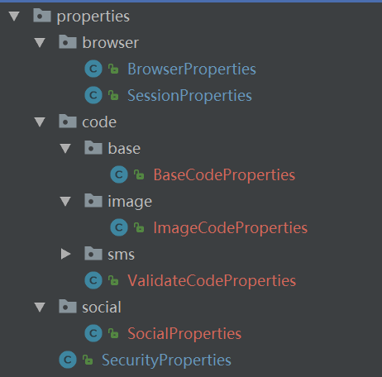
SecurityProperties
SocialProperties
BrowserProperties
ValiateCodeProperties
ImageCodeProperties
SmsCodeProperties
BaseCodeProperties

