Slide 1
FPS Game Demo
Kendall Fischer

Slide 2
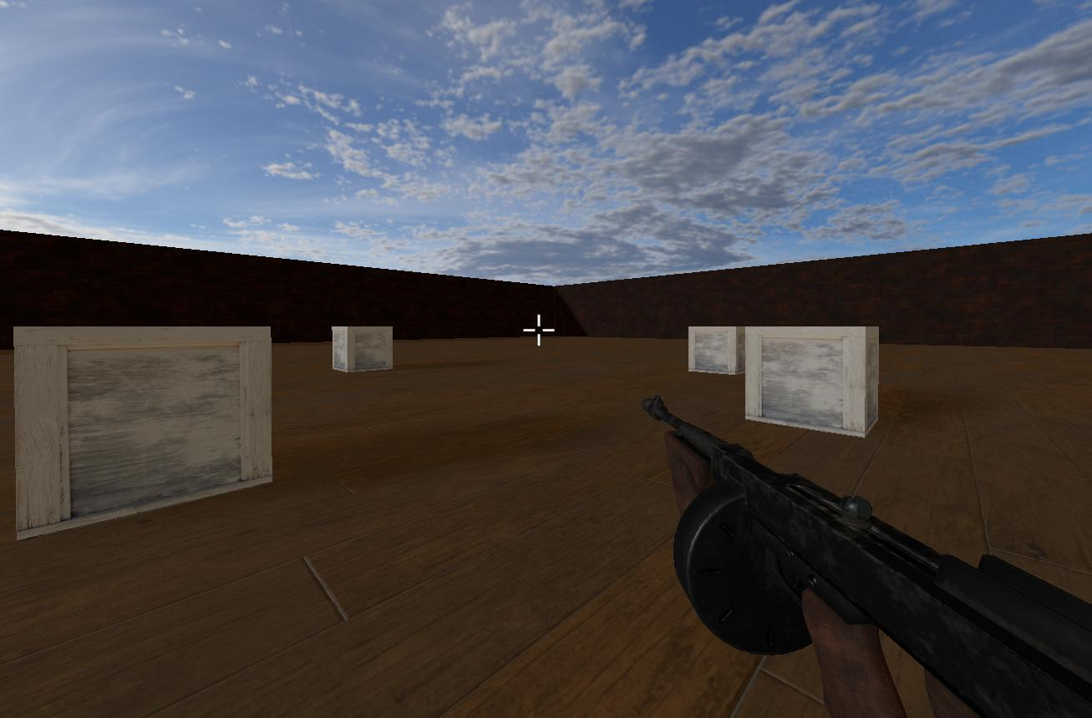
Goals for the project
Create a first person camera view similar to that of a first person shooter
Have a gun model follow the camera
Build a basic scene with some objects in it

Slide 3
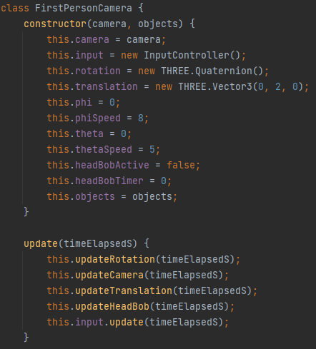
First Person Camera
Controls camera movement
Simulates step motion using sin()
Does intersection tests with objects in the scene and does a lookAt()

Slide 4
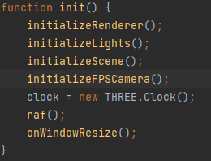
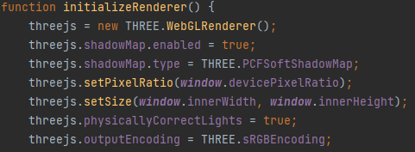
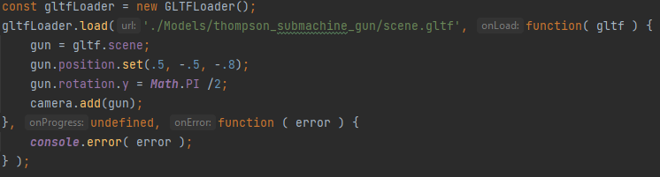
The Scene
Initialization broken up into separate functions
Enabled physically based rendering
Attached gun to the camera

Slide 5
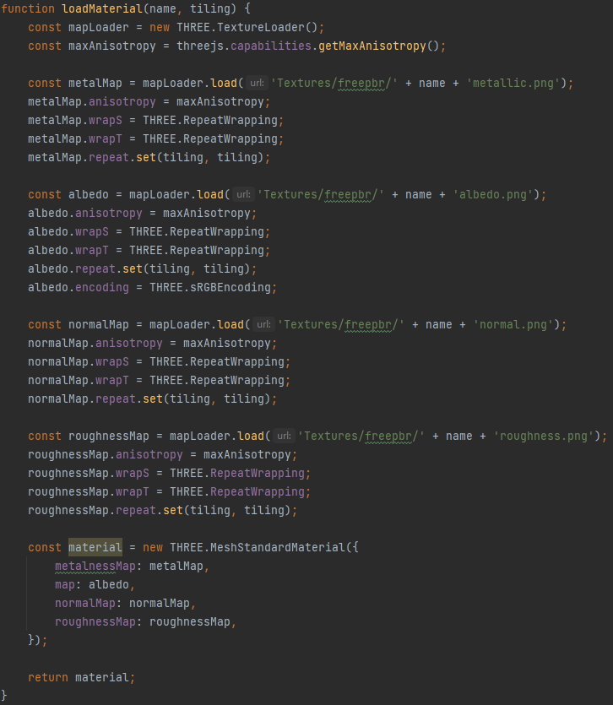
Textures
From freepbr.com
loadMaterial function loads each part of the texture into a material

Slide 6
Demo

