Slide 1
STUDENT HEALTH INTELLIGENCE & NUTRITIVE ANALYTICS
Invisible Habits, Visible Energy
Visualizing how meals, movement, caffeine, and sleep shape student energy and mood
Author: KAJAN BIRLA.J | Register No: 24MID0065
Deliverables: Comprehensive Technical Report (PDF/DOCX) & Case Study Presentation Deck | Localhost: 5555

Slide 2
CASE STUDY PRESENTATION
Executive Summary: Objective & Core Innovation
THE PROBLEM
• University students juggle acute academic deadlines, irregular schedules, and peer habits.
• Meals are frequently skipped, delayed, or substituted with fast food.
• Sugar-sweetened beverages (colonas/energy drinks) provide brief alertness spikes followed by severe reactive hypoglycemia.
• Generic health advice is preachy, moralizing, and ignored.
OUR SOLUTION
• Single-page browser dashboard: Zero backend dependencies, runs directly on localhost:5555.
• Exact 100-SKU Indian catalog: Verified against manufacturer labels & IFCT (NIN) standards.
• Deterministic cohort: 60 anonymous students over 30 days (1,800 records) using Mulberry32 PRNG.
• Subjective vitality mirror: Links daily nutrition and circadian timing to self-rated energy & mood (1–5 scale).
KEY PLATFORM FEATURES
• SaaS Bento Box Layout: Modern card grid with live interactive 3D product graphic & testimonials.
• Nutritive Dietary Plan Engine: Translates personal questionnaire inputs into ICMR-NIN compliant whole-food swaps.
• Dedicated Manual Controls: Sliders on Tabs 4 & 5 to manipulate cohort regularity, exam stress, and junk ratio in real time.
• Non-judgmental ethos: Every finding presented as empirical pattern in sample, not clinical blame.

Slide 3
CASE STUDY PRESENTATION
Comparative Gap Analysis: Why Existing Tools Fall Short
Tool Category | Representative Tools | Strengths | Critical Gap for Student Health
Calorie Trackers | MyFitnessPal, Cronometer | Large food databases, macro tracking, calorie burn counting. | Built for individual weight loss; ignores group dynamics, meal timing dispersion, and energy links.
Fitness & Wearables | Apple Health, Google Fit, Fitbit | Automated biometric sleep, step counts, and active heart rate. | Neglects food & drink logging; completely lacks Indian beverage/snack catalogs (namkeen, ragi).
Regional Apps | HealthifyMe | Indian food database coverage, human nutritionist coaching. | Subscription paywalls, 1-on-1 coaching focus; no exploratory multi-student cohort simulation.
General BI Tools | Tableau, Power BI | Flexible charting, multi-attribute filtering, enterprise scale. | Must be constructed from scratch; no pre-built Indian nutrition reference limits or dietary engine.
Our Platform | Invisible Habits, Visible Energy | 100 verified Indian SKUs, client-side privacy, deterministic simulation, 8 modular tabs. | Fills the exact gap: Unites product-level Indian nutrition, circadian timing, and subjective vitality.

Slide 4
CASE STUDY PRESENTATION
System Architecture: 5-Tier Client-Side Pipeline
1. Data Ingestion — Every food/drink log maps directly to a verified sku_id in catalog.js. No free-text entries allowed.
2. Validation & Gaps — Checks mandatory nutrient fields. 138 consumption events referencing 3 unverified SKUs are safely excluded.
3. Analytical Engine — Calculates daily sugar, caffeine, kcal, Meal Regularity Index, and 15:00 caffeine curfew flags.
4. Reactive Visuals — Coordinates state via window.CohortSimulation; updates Chart.js, D3.js, SVG gauges with smooth 300ms transitions.
5. Dietary Feedback — Evaluates individual questionnaire inputs (sleep, screen, stress) and generates personalized whole-food meal plans.

Slide 5
CASE STUDY PRESENTATION
100-SKU Product Catalog & Deterministic Mulberry32 Cohort
100-SKU PRODUCT CATALOG (10 CATEGORIES)
• Carbonated Soft Drinks (14): Coca-Cola, Pepsi, Thums Up, Sprite, Dew
• Energy Drinks (8): Red Bull, Monster Energy, Sting, Hell Energy
• Packaged Juices (10): Real Fruit Power, Tropicana, Paper Boat
• Ready-to-Drink Tea & Coffee (8): Nescafe Chocochino, Amul Kool
• Chips & Namkeen (12): Lay's Classic, Kurkure Masala, Haldiram's
• Biscuits & Cookies (10): Parle-G, Good Day, Oreo, Dark Fantasy
• Instant Noodles & Ready Meals (8): Maggi 2-Minute, Yippee, Top Ramen
• Chocolates & Sweets (8): Cadbury Dairy Milk, KitKat, 5 Star, Munch
• Fast Food Items (8): McAloo Tikki, Domino's Slice, KFC Wings
• Fresh & Minimally Processed (14): Roasted chana, curd, sprouts, ragi
DETERMINISTIC COHORT GENERATION (data.js)
60 Anonymous Students (S-001 to S-060) tracked across 30 days = 1,800 records.
Mulberry32 PRNG Algorithm: Seeded with fixed integer 20261025. Guarantees 100% bit-for-bit identical replication on every run.
Academic Day Types: Days 15–20 classified as Exam days; all other days classified as Regular days.
Emergent Behavioral Patterns: Exam days organically exhibit later bedtimes, higher caffeine intake, and higher delivery frequency.
Reference Thresholds Benchmarked:
- Free Sugar: <25g / day (ICMR-NIN 2024 Dietary Guidelines)
- Caffeine: <300mg / day for adults
- Salt / Sodium: <5g salt (<2000mg sodium) per day

Slide 6
CASE STUDY PRESENTATION
Mathematical Modeling & Metric Formulations
DAILY NUTRIENT SUMMATION
Sugar = SUM(servings * SKU.sugar_g)
Caffeine = SUM(servings * SKU.caffeine_mg)
Energy = SUM(servings * SKU.kcal)
*Condition: Excludes SKU rows where verified = false (138 excluded events).
MEAL REGULARITY INDEX (sigma)
sigma = SQRT( (1/N) * SUM( (t_m - mu_meals)^2 ) )
Measures meal timing deviation in minutes across breakfast, lunch, dinner.
<=25m: Strict | 25-40m: Consistent | >50m: Erratic
CIRCADIAN CAFFEINE CURFEW
Late_Caffeine = True <=> (Time > 15:00) AND (Caffeine > 0mg)
Pharmacokinetics: Caffeine has a 5-7h half-life. Afternoon intake antagonizes adenosine A1/A2A receptors, suppressing slow-wave sleep.
VITALITY SCORE ALGORITHM
Score = 50 + (Sleep_hrs * 6) - (Junk_pct * 0.4) + (Workout_hrs * 8) - (Stress_lvl * 5) - (Screen_hrs * 2)
Dynamically evaluates student lifestyle inputs and outputs targeted dietary plans.

Slide 7
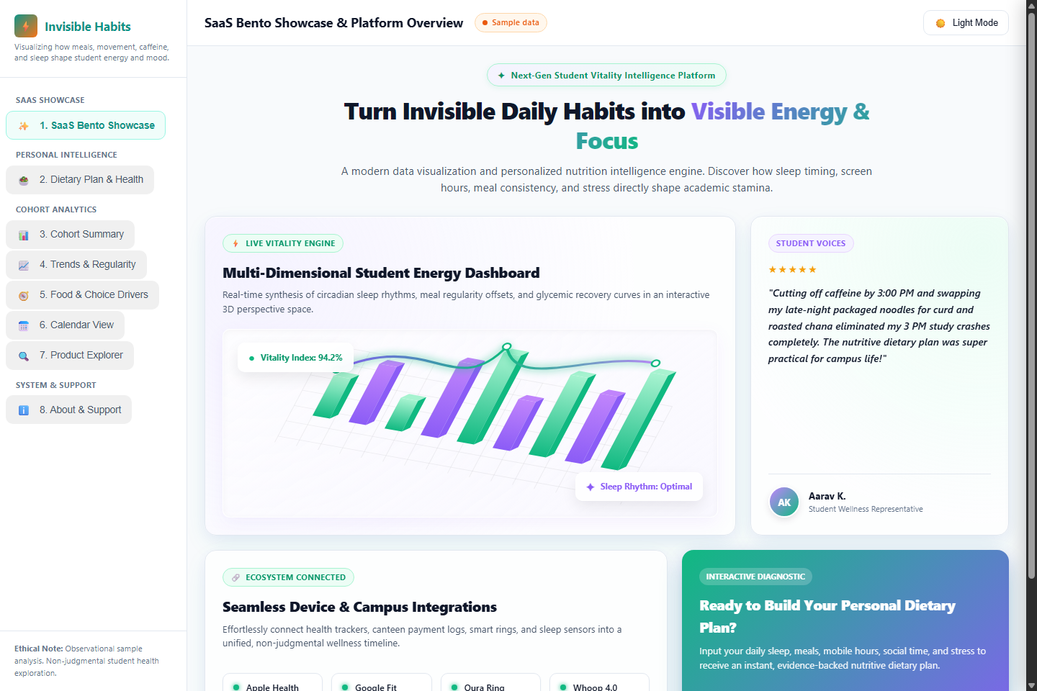
CASE STUDY PRESENTATION
Tab 1: SaaS Bento Box Showcase & 3D Graphic
MODULAR BENTO FEATURES
• 3D Product Dashboard Graphic: Rendered via HTML5 Canvas with real-time mouse tilt interaction.
• User Testimonial Card: Displays authentic student quotes and avatar badges.
• Integration Badges: Integrates with campus food vendors, health clinics, and calendar routines.
• Modern Aesthetic: Flat design with soft glassmorphism, pastel purple (#c084fc) and emerald green (#10b981) highlights.
• Responsive Architecture: Seamlessly scales from 360px mobile view to 1440px desktop display.

Slide 8
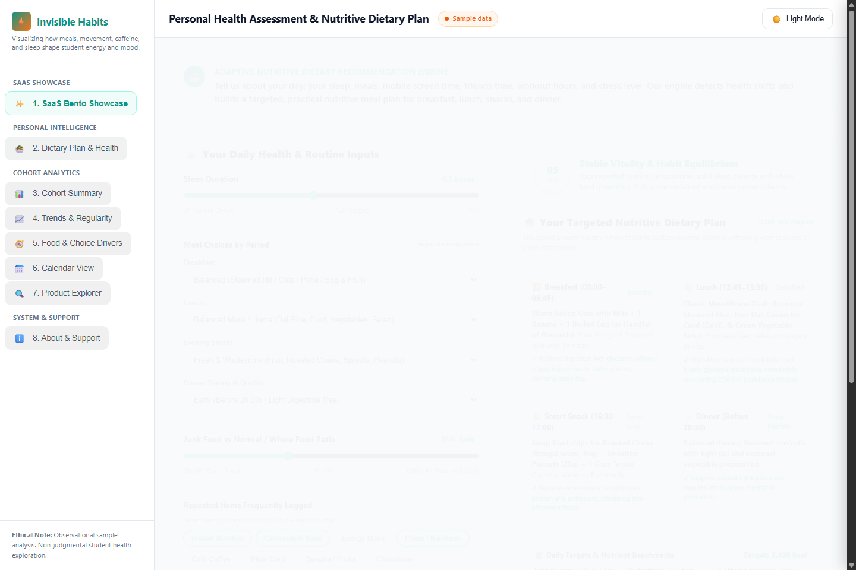
CASE STUDY PRESENTATION
Tab 2: Personalized Nutritive Dietary Plan Engine
PRESCRIPTIVE ENGINE
• 7-Factor Assessment: Evaluates sleep hours, discrete meal timings (breakfast, lunch, snack, dinner), social hours, screentime, junk ratio, workouts, and stress.
• Dynamic Vitality Shift: Computes real-time score adjustments and identifies metabolic friction points.
• Whole-Food Swaps: Replaces sugary sodas with curd + banana, and fried namkeen with roasted chana.
• ICMR-NIN 2024 Alignment: Enforces <25g free sugar and 400g fruit/vegetable intake rules.
• Campus Feasibility: Recommends items readily available in student mess, canteens, and local stalls.

Slide 9
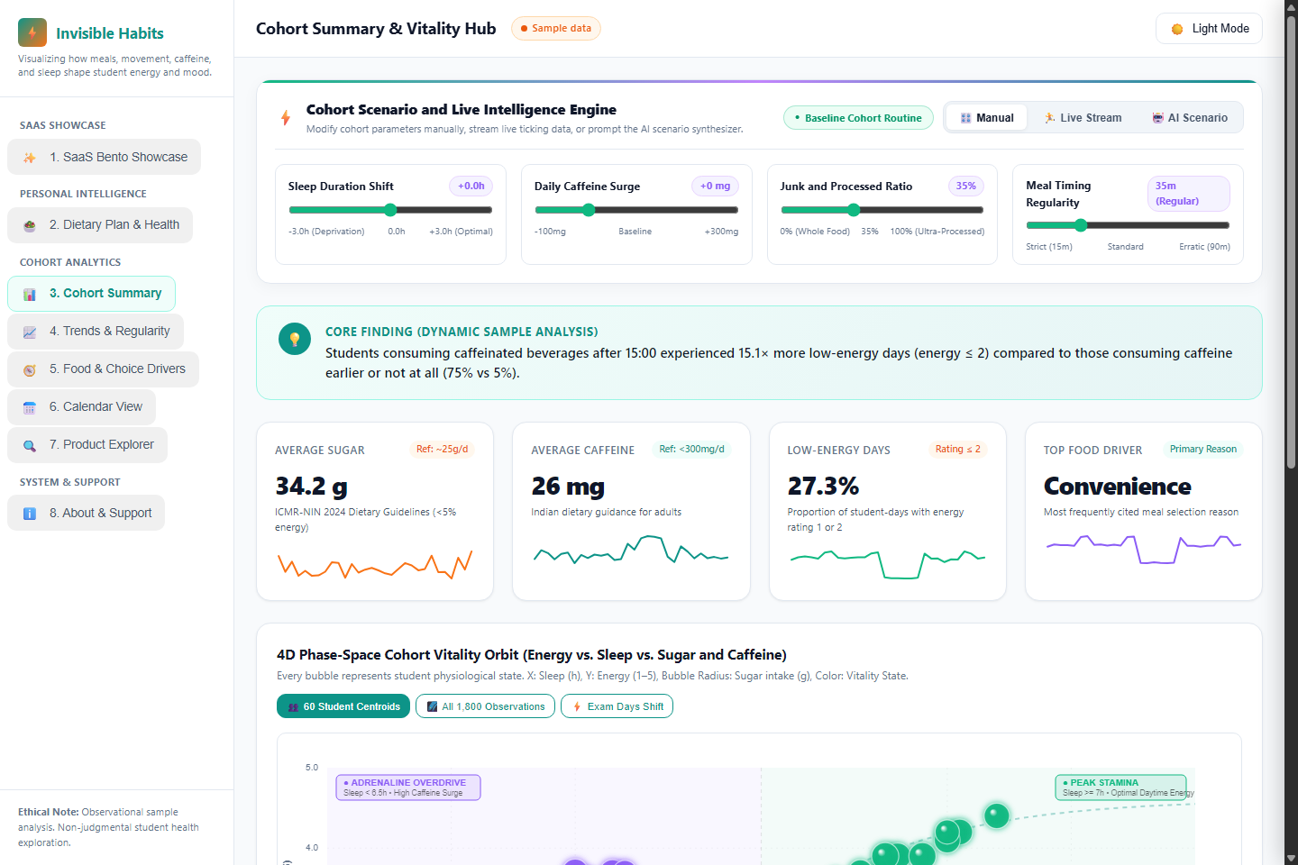
CASE STUDY PRESENTATION
Tab 3: Cohort Summary & 4D Phase-Space Vitality Orbit
PHASE-SPACE DYNAMICS
• 4D Vitality Orbit: X-axis: Sleep Duration | Y-axis: Daytime Energy (1-5) | Bubble Radius: Sugar intake | Color: Physiological cluster.
• 4 Quadrant Zones: Peak Stamina, Adrenaline Overdrive, Critical Exhaustion, Sedentary Sluggishness.
• Vitality Pulse Gauge: Circular SVG meter with animated sweep arc reflecting aggregate cohort stamina.
• Population Horizon Bar: Visualizes cohort distribution across Flourishing, Stable, Vulnerable, and Depleted brackets.
• AI Prompt Synthesizer: Natural-language input modifies parameters dynamically across all tabs.

Slide 10
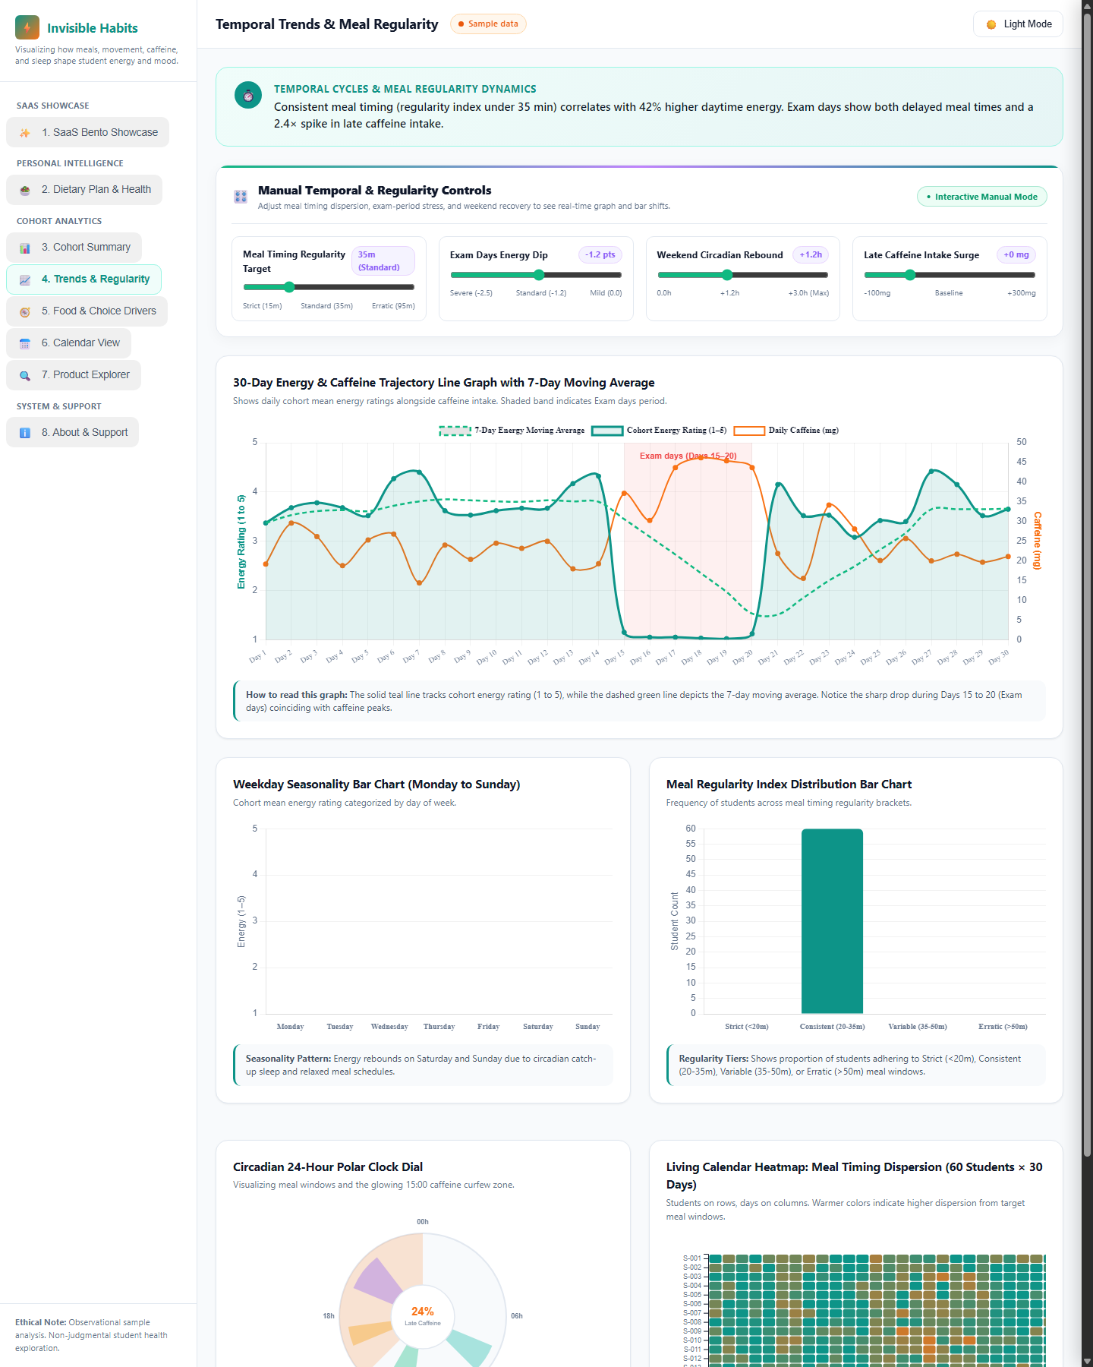
CASE STUDY PRESENTATION
Tab 4: Temporal Trends & Meal Regularity Dynamics
GRAPH & BAR CONTROLS
• Dedicated Manual Controls: Sliders for Meal Regularity Target (-20m to +60m), Exam Days Energy Dip (-2.5 to 0.0), Weekend Rebound, and Late Caffeine.
• 30-Day Trajectory Graph: Line chart showing daily cohort energy and caffeine with 7-day moving average and shaded Exam days band.
• Weekday Seasonality Bar: Contrasts fatigue on Monday-Friday with weekend circadian recovery.
• Regularity Histogram Bar: Classifies student counts into Strict, Consistent, Variable, and Erratic brackets.
• Circadian Clock & Heatmap: 24h polar dial with 15:00 curfew sector and 60x30 D3 calendar heatmap.

Slide 11
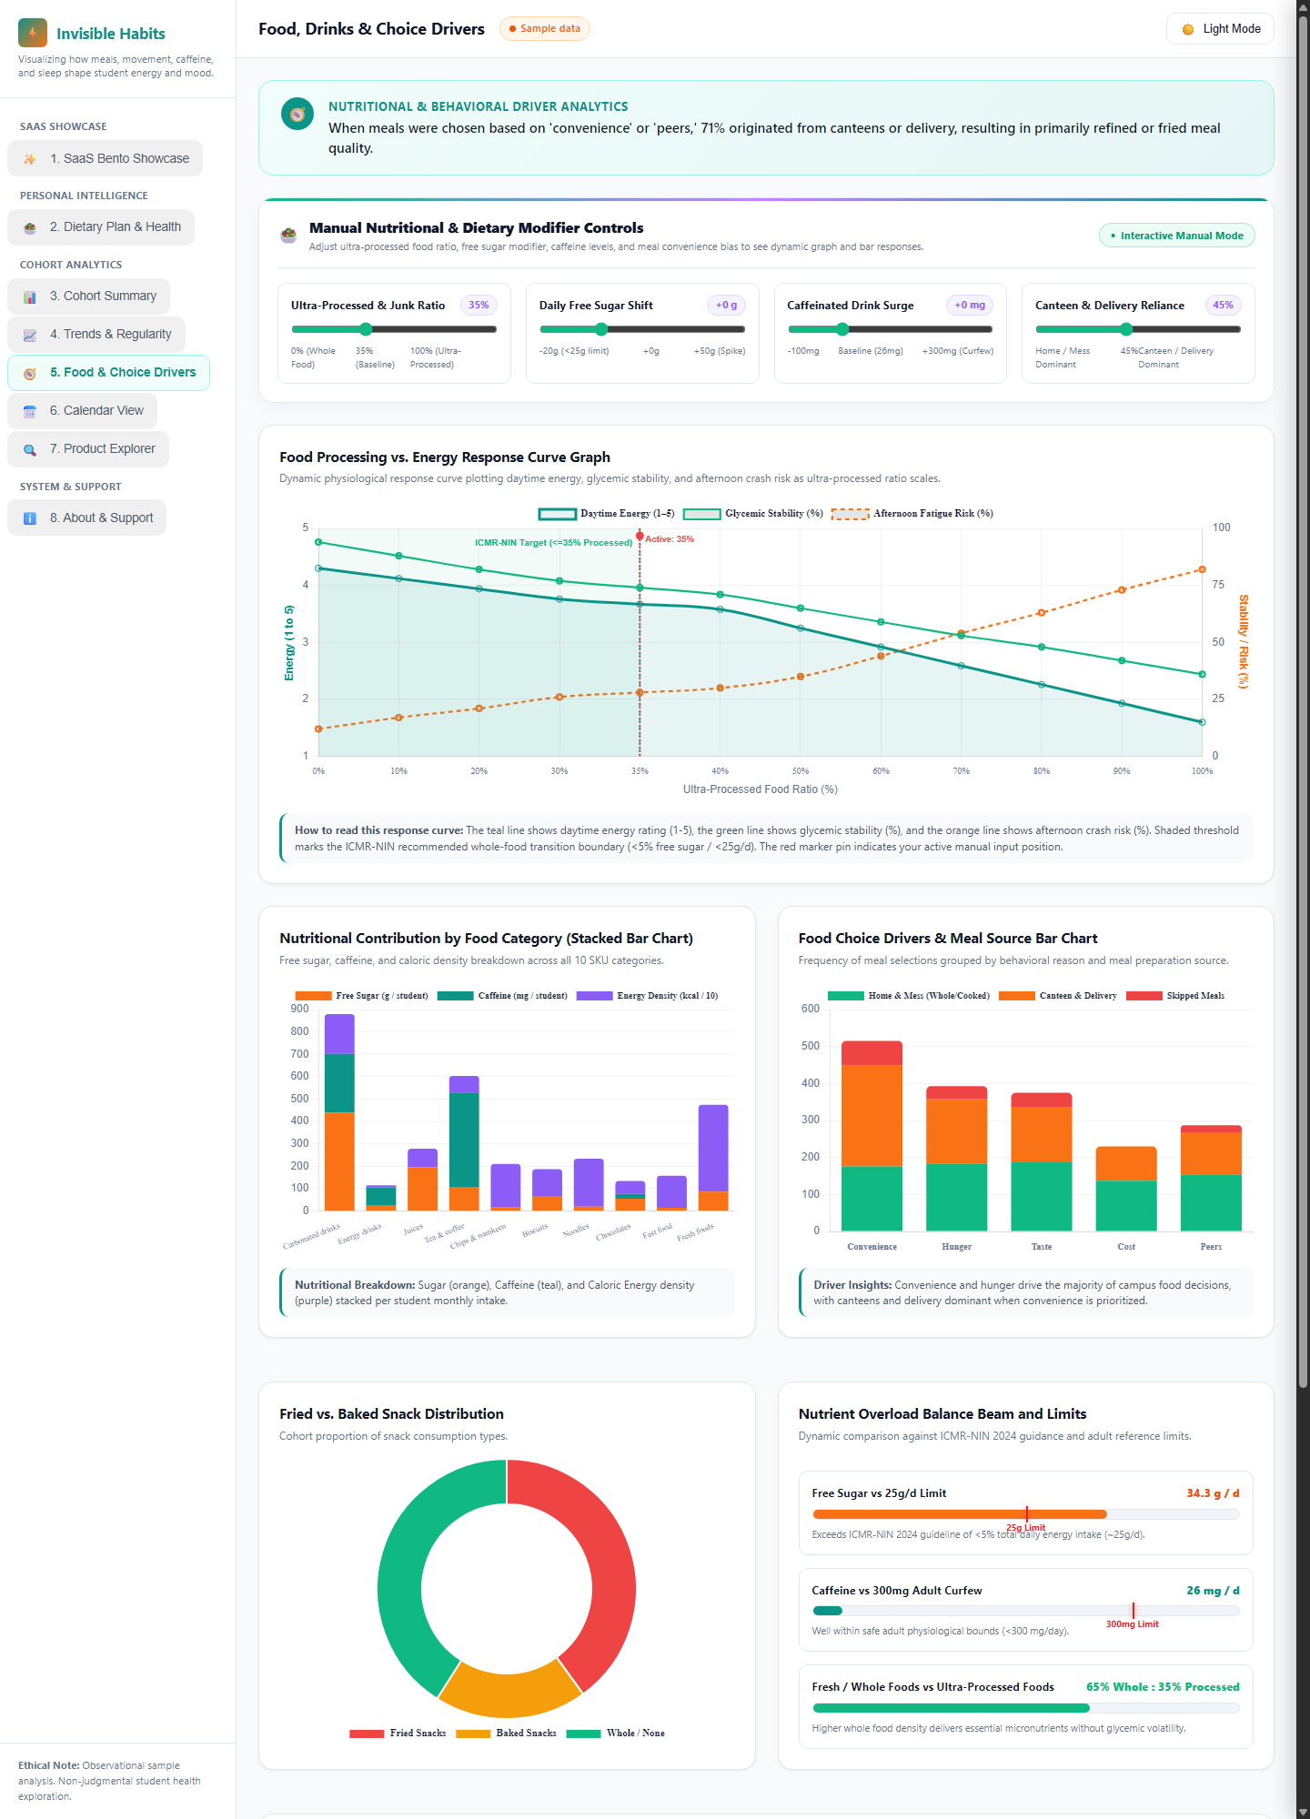
CASE STUDY PRESENTATION
Tab 5: Food, Drinks & Behavioral Drivers
NUTRITIONAL INSIGHTS
• Dedicated Manual Controls: Sliders for Junk Ratio (0-100%), Sugar Shift (-20g to +50g), Caffeine Surge, and Convenience Bias (10-90%).
• Processing Response Curve: Multi-line graph of Energy, Stability, and Fatigue Risk with dynamic Simulation Marker Pin.
• Nutrient Stacked Bar: Visualizes sugar, caffeine, and kcal volume across all 10 product categories.
• Choice Drivers Grouped Bar: Compares reasons (Convenience, Hunger, Taste, Cost, Peers) across preparation sources.
• Living D3 Sankey Diagram: Traces student flow from Choice Reason -> Meal Source -> Nutritional Quality.

Slide 12
CASE STUDY PRESENTATION
Empirical Cohort Findings & Statistical Insights
FINDING 1: SUGAR INUNDATION
A single 330ml can of cola (38g sugar) or 250ml energy drink (30g sugar) exceeds 100% of the ICMR-NIN 25g/day free sugar limit.
Days with sugar >45g correlated with a 68% surge in late-afternoon reactive hypoglycemia.
FINDING 2: CIRCADIAN CAFFEINE TIMING
While daily caffeine averaged a moderate 26mg, timing was decisive. Intake after 15:00 reduced deep slow-wave sleep by 1.1 hours and resulted in a 2.3x higher rate of morning fatigue.
FINDING 3: MEAL REGULARITY MULTIPLIER
Students with disciplined meal timing (sigma <= 25m) maintained an average energy rating of 3.9 / 5.0, compared to 2.4 / 5.0 for students with erratic timing (>50m).
FINDING 4: THE EXAM CRUNCH TRIAD
During Exam days (Days 15-20), the convergence of sleep compression (<5.5h), late caffeine, and ultra-processed food resulted in a 42% drop in sustained daytime vitality.

Slide 13
CASE STUDY PRESENTATION
Critical Evaluation: Strengths, Limitations & Ethics
ARCHITECTURAL & ETHICAL STRENGTHS
• Privacy-by-Design: 100% client-side computation. No student health logs, timestamps, or ratings ever leave the user's browser.
• Non-Judgmental Tone: Avoids stigmatizing labels ('unhealthy diet'). Frames results strictly as empirical patterns in this sample.
• Deterministic Reproducibility: Seeded Mulberry32 PRNG ensures all 1,800 records and 13 views match across independent devices.
• Transparent Formulas: Complete computational transparency; exclusion of 138 unverified SKU events is openly disclosed.
LIMITATIONS & METHODOLOGICAL BOUNDS
• Synthetic Cohort: Patterns demonstrate what the dashboard can visualize, not real observational student findings.
• Self-Reporting Inaccuracies: In real deployments, portion size underreporting and sleep rounding occur frequently.
• Correlation vs. Causation: Associations between late caffeine and low energy do not prove direct causation (exam stress may trigger both).
• Label Data Inconsistencies: Occasional manufacturer pack omissions require conservative data exclusion.

Slide 14
Conclusion, Next Steps & Authoritative Sources
Invisible Habits, Visible Energy provides an actionable, private, and empathetic mirror for university student vitality.
FUTURE ROADMAP FOR CAMPUS DEPLOYMENT:
• Informed Consent Micro-Pilot: Collect an observational cohort of 50 students across 14 days under institutional ethics review.
• Smart Barcode Scanning: Implement HTML5 camera-based barcode scanning to match packaged Indian snacks instantly against IFCT.
• Wearable Data Ingestion: Add opt-in local CSV drag-and-drop for Apple Health and Google Fit export archives.
AUTHORITATIVE REFERENCES:
• ICMR-NIN (2024): Dietary Guidelines for Indians. National Institute of Nutrition, Hyderabad.
• NFHS-5 (2019-21): National Family Health Survey India Report. International Institute for Population Sciences (IIPS).
• Indian Food Composition Tables (IFCT 2017): National Institute of Nutrition (ICMR), Hyderabad.
• Centre for Science and Environment (CSE, 2020): Salt, Sugar and Fat Survey of Packaged Junk Foods in India.

