Slide 1
Meta-Analysis

Slide 2
Brenton Wiernik
Personality and work psychologist
Conducted meta-analyses on
Personality traits
Career attitudes
Hurricane evacuation behaviors
Vaccine uptake
Music intonation therapy for stroke patients
…

Slide 3
Overview of Course
Day 1:
Meta-analytic thinking and basic meta-analytic models
Day 2:
Moderator analyses, heterogeneity, artefact corrections
Day 3:
Diagnostics, publication bias
Day 4:
Systematic reviews, advanced topics, other R topics

Slide 4
Evidence synthesis & systematic reviews
Systematic review: Research synthesis as a scientific process
Emphasis on transparent, replicable, and systematic methods to “limit bias in the assembly, critical appraisal, and synthesis of all relevant studies on a specific topic” (Last, 2001)
Transparency and clarity is key
Synthesis can use qualitative and/or quantitative methods
For some history, see Chalmers et al. (2002, https://doi.org/bvwspb)

Slide 5
What is meta-analysis?
Quantitative combination of statistical information from multiple empirical studies to produce an overall estimate of a particular relationship
Approach: Quantify the size, direction, and precision of the effect or association in each study and use this as primary data in further analyses

Slide 6
Questions Meta-Analysis Can Address
Meta-analysis examines whether an effect varies and, if so, how and why
What is the overall (average) size and direction of the effect or association?
How much do effects or associations vary across studies?
Does the effect or association depend on characteristics of the studies?

Slide 7
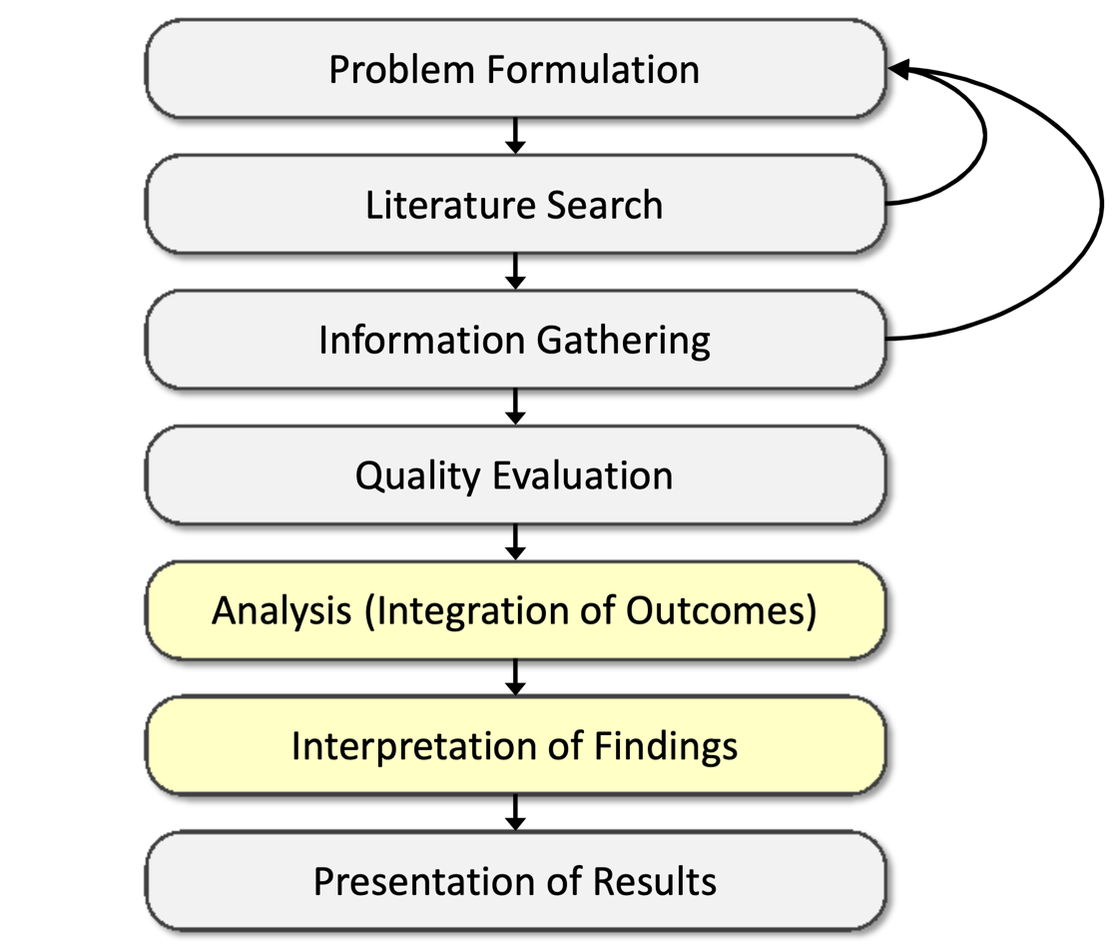
Meta-analysis in the SR process
Cooper (2016)
ISBN: 9781483331157

Slide 8
Logic of Meta-Analysis
Traditional narrative reviews are biased
Cannot be comprehensive
Often reflects reviewer bias
Typical focus on statistical significance testing
Significance testing misleads scientific inquiry
Highly dependent on sample size
Highly dependent on size of population effect
Null findings not given the same “weight” as significant findings
Meta-analysis changes the focus to the direction and magnitude of the effects across studies
Direction and magnitude represented by the effect size

Slide 9
Applications of meta-analysis
Meta-analytic reviews
Meta-analyses with primary data
Multi-site studies
E.g., multiple clinics, multiple organizations, multiple schools
Multiple group/moderator analyses
Different job families, different patient populations, different countries or cultures

Slide 10
Meta-analytic reviews
Meta-analysis is most frequently applied when conducting a review of a research literature
As an alternative to narrative reviews
A meta-analytic review is only useful if the review is carefully conducted and comprehensive
Medical meta-analyses are highly concerned with the quality of the review
Many psychology meta-analyses are rather sloppy with their review methods
This has been improving in recent years

Slide 11
When Can You Do Meta-analysis?
Meta-analysis is applicable to research studies that
Are empirical
Produce quantitative results
Examine the same constructs/variables and relationships
Have findings that can be expressed in a comparable statistical form (i.e., effect sizes: mean differences, correlation coefficients, odds-ratios, proportions, etc.)
Are substantively “comparable” given the question at hand

Slide 12
When Can You Do Meta-analysis?
How many studies do you need to do a meta-analysis?
Two
Continuously cumulating meta-analysis (Braver et al., 2014, https://doi.org/10/5k2)
Meta-analyses of different sizes let you draw different kinds of conclusions
Preliminary findings
Robust estimates
Moderator effects

Slide 13
The Replication Continuum
Pure
Replications
Conceptual
Replications
Studies included in a meta-analysis should examine the same relationship
What is the same relationship?
Similar constructs, same constructs, or same measures?
“Apples and oranges”
The purer a replication, the easier it is to defend the comparability of studies

Slide 14
Strengths of Meta-analysis
Imposes rigor on the process of summing up research findings
Represents findings in a more differentiated and sophisticated manner than conventional reviews
Capable of finding relationships across studies that are obscured in other approaches
Protects against over-interpreting differences across studies
Can handle a large numbers of studies (this would overwhelm narrative approaches to review)

Slide 15
Weaknesses of Meta-analysis
Requires a lot of effort (blood, sweat, and tears)
Easy to do a very bad meta-analysis
“Apples and oranges” criticism
Statistical analyses may gloss over more qualitative distinctions between studies
But this is an empirical questions
Most meta-analyses include “blemished” studies to one degree or another
e.g., a randomized design with attrition
Meta-analysis is limited by the data available for input
Can’t turn observational studies into experiments using meta-analysis

Slide 16
Weaknesses of Meta-analysis
Study selection (availability, publication) bias poses a continual threat
Negative and null finding studies that you were unable to find
Outcomes for which there were negative or null findings that were not reported
Analysis of between-study differences is fundamentally correlational

Slide 17
Sampling Error and Significance Testing

Slide 18
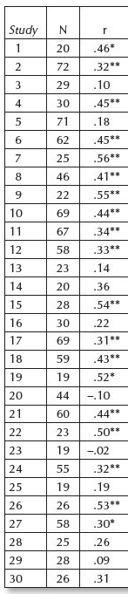
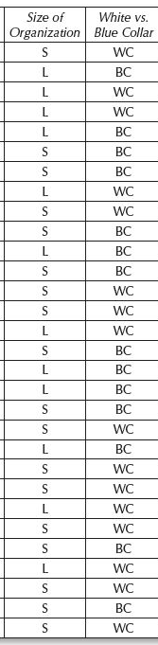
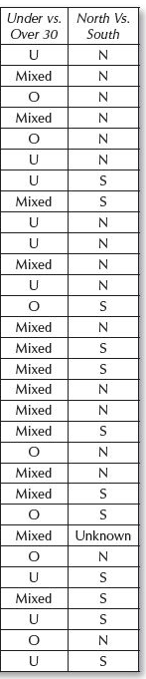
Example:
30 studies of job satisfaction and organizational commitment
(S-H2014: 5)
19 significant

Slide 19
Conclusions based on example
Job satisfaction and organizational commitment are sometimes correlated, sometimes not
Results support a model where commitment grows over time, then asymptotes
Correlation more likely among younger samples, trade workers, and in the North
The problem?

Slide 20
Conclusions based on example
Every one of the correlations was randomly drawn from the same sample
Population r = .33 in all samples
Sample r’s ranged from -.10 to .56
The null hypothesis was never true!
In all samples, the true r = .33
The significance test found no relationship 11 times
11 / 30 = Error rate of 37%
Not an error rate of 5%!

Slide 21
The problem with p values
Significance tests test the hypothesis that the population value precisely equals a null value (usually 0)
This is virtually never true
Significance tests are highly dependent on sample size
With small N, virtually nothing is significant
With large N, most everything is significant At N = 153,629, r = .01 is significant at p < .05 (Notice how most SEM studies ignore the χ² test)

Slide 22
The problem with p values
Most importantly, p values tell us nothing about
The size of the effect
The precision of our estimate of the effect
Whether the result is likely to replicate in new samples
What tells us more information?
N = 200, r = .21: p = .003 or
(95% CI .08, .34)
N = 50, r = .20: p = .162 or
(95% CI -.08, .45)
Notes:
Population for both rs = .30

Slide 23
Dance of the p-values
Demonstration: http://psychologicalscience.org/index.php/members/new-statistics#p1
Conclusions:
p values are extraordinarily variable across samples unless N and/or the effect size are large
Confidence intervals are more stable (they generally overlap and, by definition, cover the population value 95% of the time)
p values tell us nothing about the distribution of samples; CIs tell us quite a lot
CIs tell us everything p values do and more

Slide 24
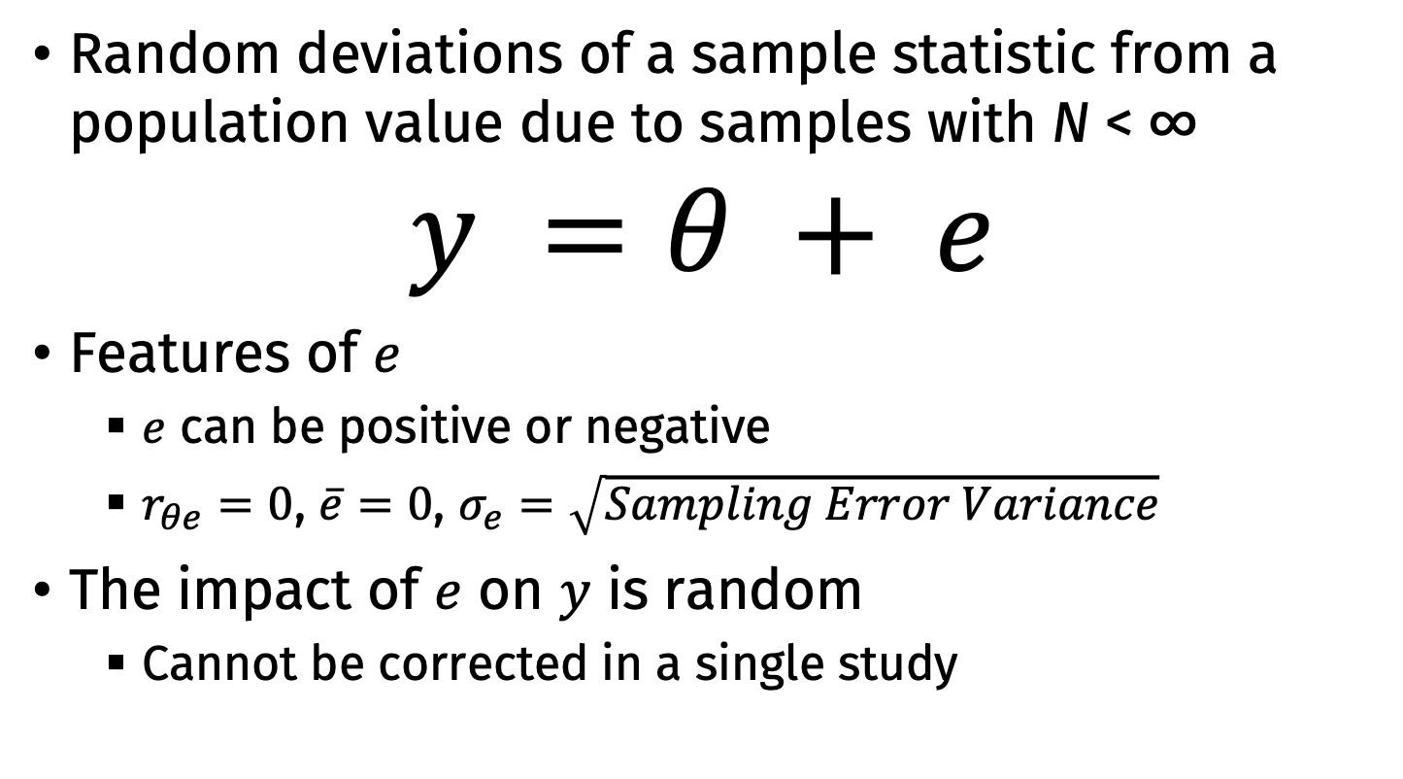
Sampling error
Random deviations of a sample statistic from a population value due to samples with N < ∞
$$y =θ + e$$
Features of $e$
$e$ can be positive or negative
$r_{θe}=0$, $\overline{e}=0$, $σ_{e}=\sqrt{Sampling Error Variance}$
The impact of $e$ on $y$ is random
Cannot be corrected in a single study

Slide 25
Sampling Distribution
The distribution of the sampling errors for a particular statistic
Developing a sampling distribution:
Take a sample of size N
Compute statistic (mean, variance, correlation, etc.)
Do it again (infinitely)
The array of values is the sampling distribution
Many common statistics have known asymptotic distributions

Slide 26
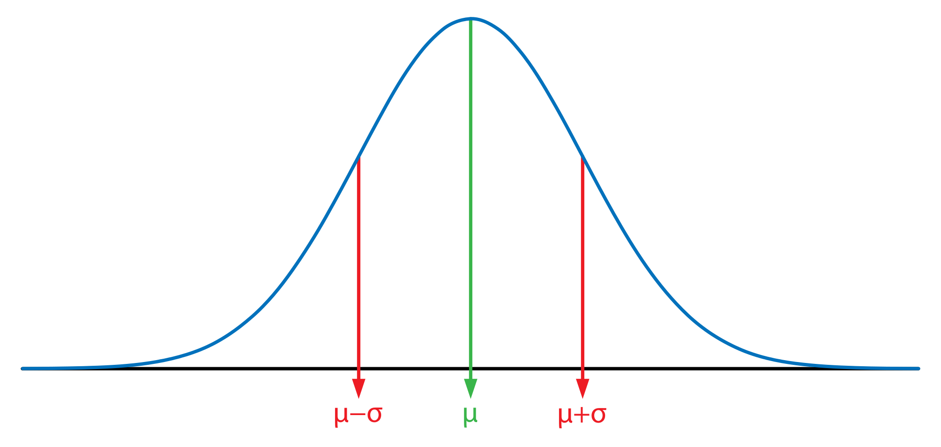

Sampling Distribution: Sample Mean
$\overline{e}=0$
$σ_{e}^{2}=\frac{σ_{x}^{2}}{N}$
$σ_{e}=\frac{σ_{x}}{\sqrt{N}}$

Slide 27

Sampling Distributions and Confidence Intervals
We can use the standard deviation of the sampling distribution (the standard error) to construct confidence intervals around sample effect size estimates
For normally-distributed statistics:
$95\% CI=ES ±1.96×SE$
Sample mean:
$95\% CI_{μ}=\overline{x}±1.96×\frac{SD_{x}}{\sqrt{N}}$

Slide 28
Effect Sizes and Confidence Intervals

Slide 29
Effect Size Measures for Meta-Analysis
Effect size: A measure that quantifies the phenomenon of interest so that it is comparable across studies
Not conflated with sample size/precision
Some commonly used metrics
raw or standardized mean differences
risk differences, log risk ratios, log odds ratios
raw or r-to-z transformed correlation coefficients
raw means, proportions, Cronbach’s alpha values
regression coefficients, (semi)partial correlations
standard deviations, coefficients of variation, standard deviation ratios
...

Slide 30
Terminology
We use ‘effect size’ to refer to any quantitative measure of the size of some phenomenon of interest
Even for measures that reflect the association between variables or some property of individual groups
Effect size ≠ standardized mean difference
Effect size ≠ any standardized measure in general
e.g., the raw mean difference is an effect size measure, a regression coefficient is an effect size measure, ...

Slide 31
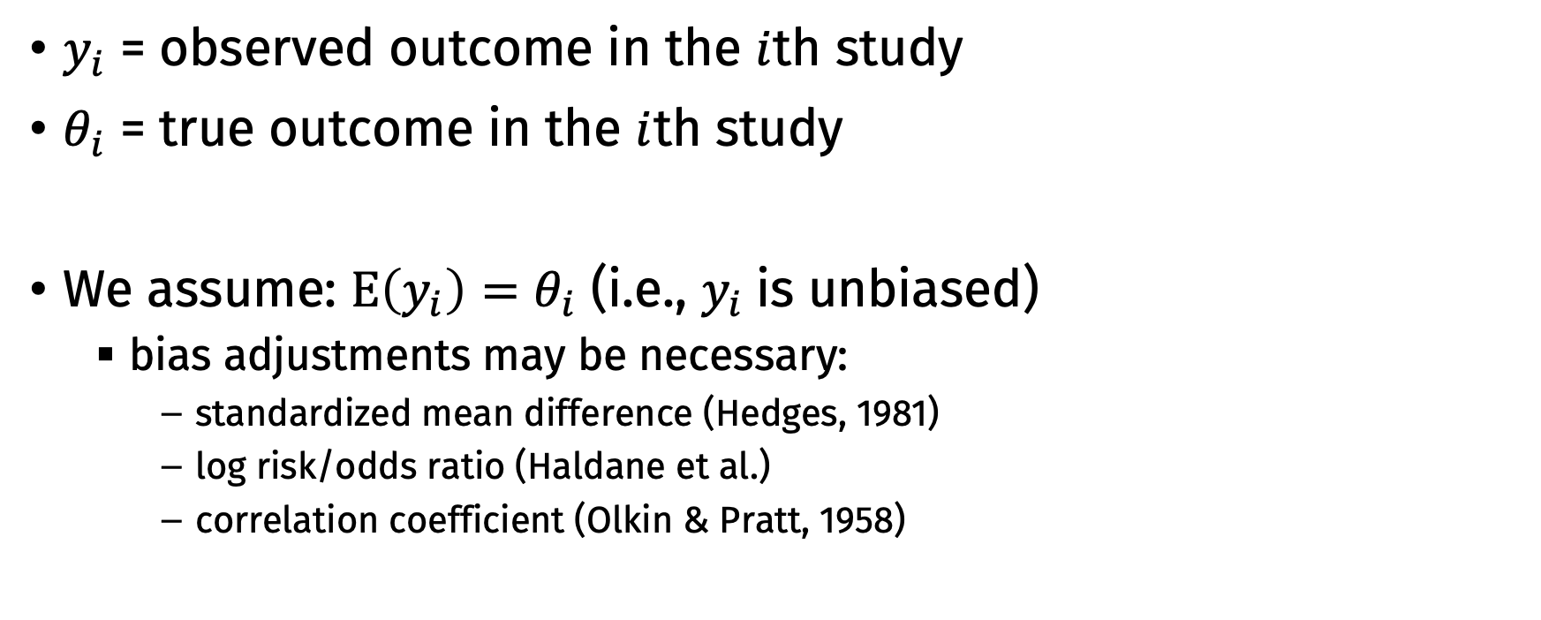
Observed/Estimated vs. True Outcomes
$y_{i}$ = observed outcome in the $i$th study
$θ_{i}$ = true outcome in the $i$th study
We assume: $E\left(y_{i}\right)=θ_{i}$ (i.e., $y_{i}$is unbiased)
bias adjustments may be necessary:
standardized mean difference (Hedges, 1981)
log risk/odds ratio (Haldane et al.)
correlation coefficient (Olkin & Pratt, 1958)

Slide 32
Common assumptions for effect sizes in meta-analysis
Effect size has a normal sampling distribution
Becomes basis for constructing confidence intervals on mean ES
Often only true asymptotically
Might need a variance-stabilizing transformation
Known sampling error variance
Often based on asymptotic assumptions
Often need to substitute observed values into the equation, so we only get an estimate

Slide 33
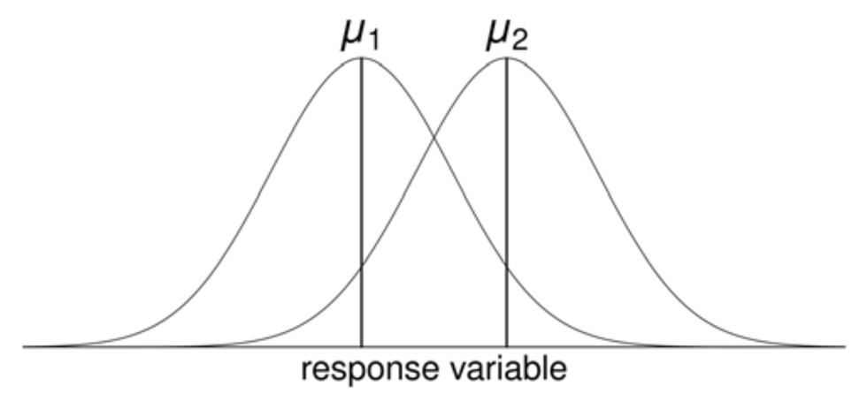
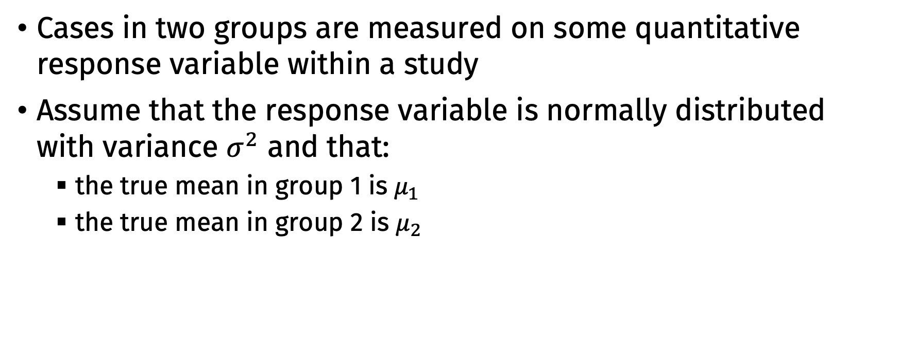
2 Groups + Quantitative Variables
Cases in two groups are measured on some quantitative response variable within a study
Assume that the response variable is normally distributed with variance $σ^{2}$ and that:
the true mean in group 1 is $μ_{1}$
the true mean in group 2 is $μ_{2}$

Slide 34

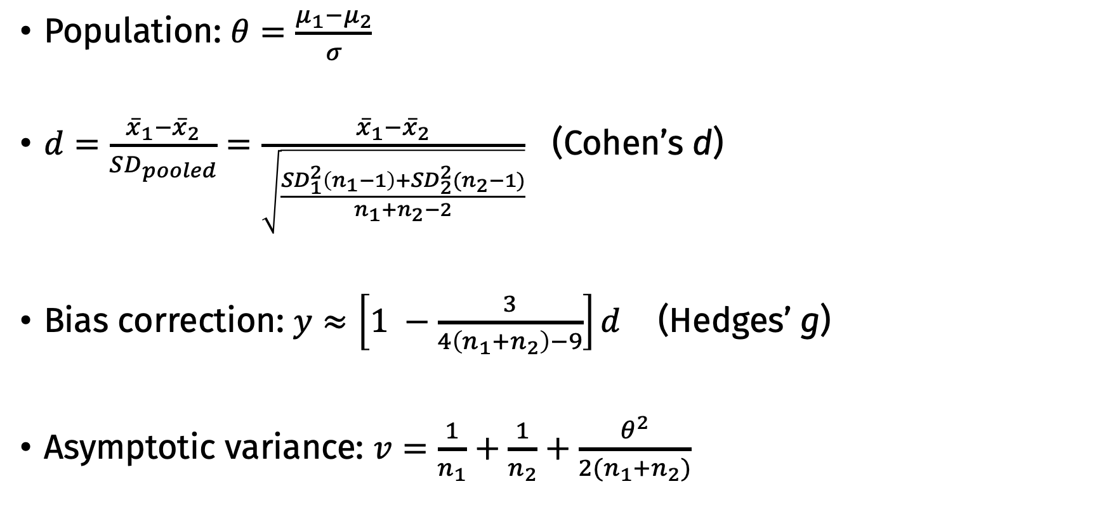
Standardized Mean Difference
Population: $θ=\frac{μ_{1}−μ_{2}}{σ}$
$d=\frac{{\overline{x}}_{1}−{\overline{x}}_{2}}{SD_{pooled}}=\frac{{\overline{x}}_{1}−{\overline{x}}_{2}}{\sqrt{\frac{SD_{1}^{2}\left(n_{1}−1\right)+SD_{2}^{2}(n_{2}−1)}{n_{1}+n_{2}−2}}}$ (Cohen’s d)
Bias correction: $y≈\left[1 −\frac{3}{4\left(n_{1}+n_{2}\right)−9}\right]d$ (Hedges’ g)
Asymptotic variance: $v=\frac{1}{n_{1}}+\frac{1}{n_{2}}+\frac{θ^{2}}{2(n_{1}+n_{2})}$
Sample:
$$\frac{1}{n_{1}}+\frac{1}{n_{2}}+\frac{y^{2}}{2(n_{1}+n_{2})}$$

Slide 35
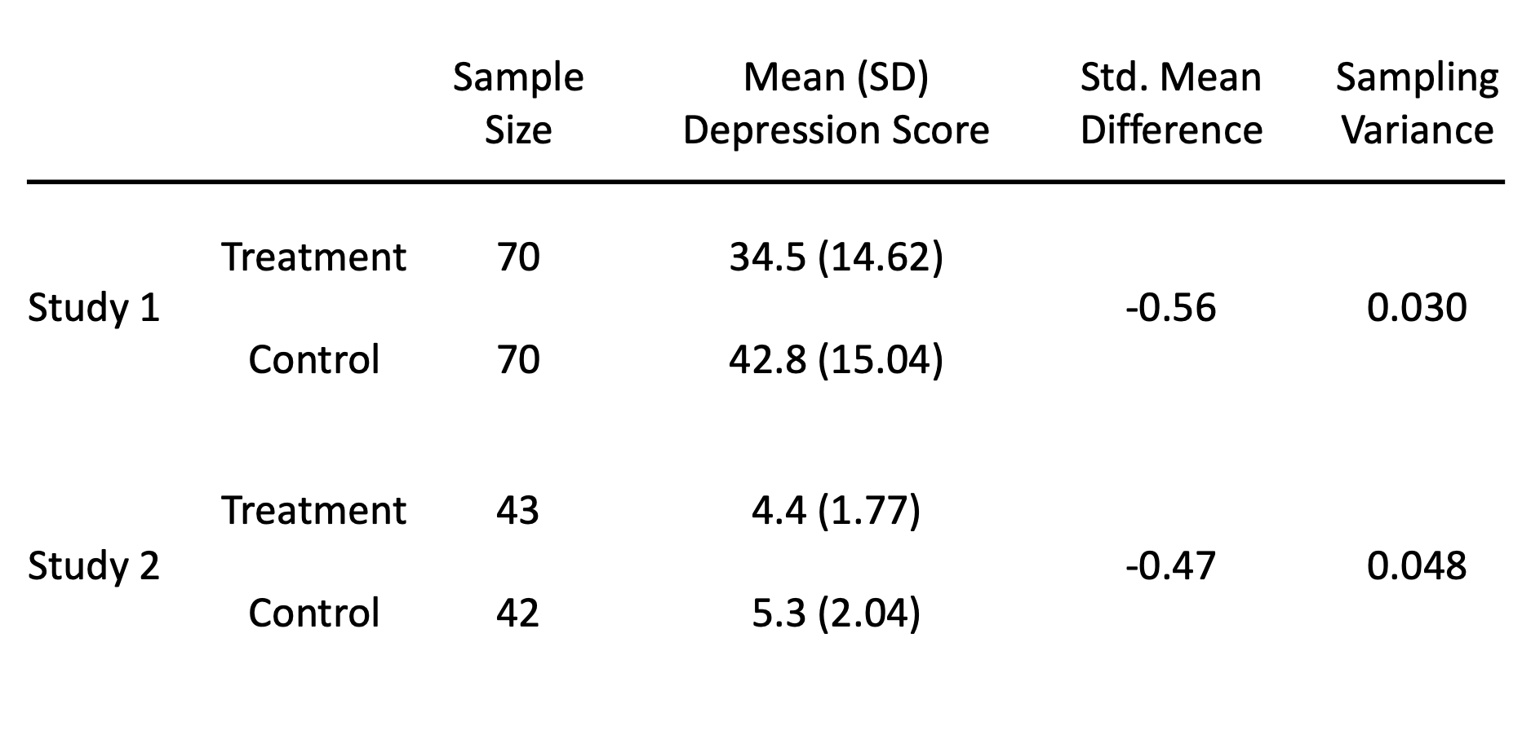

Slide 36
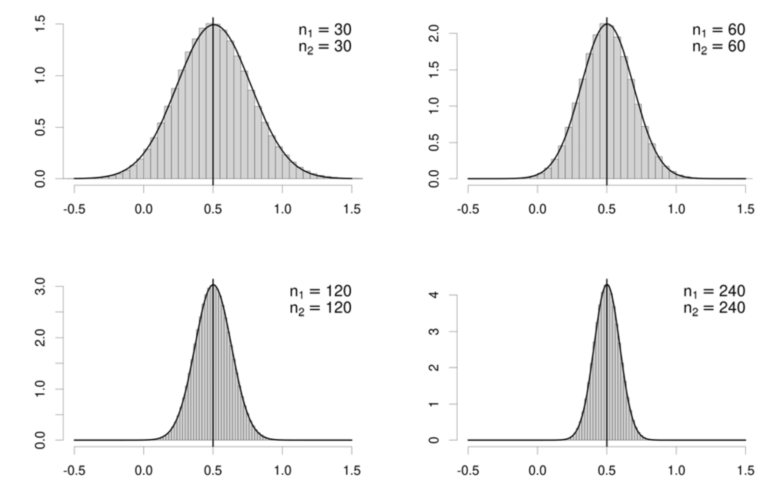

Slide 37
Interpreting SMDs
Oft cited: 0.2/0.5/0.8 = S/M/L (Cohen, 1988)
Rather arbitrary; too large for most social science effects
Better: Use empirical distribution of effects in a field
e.g., for psychology, 0.2/0.4/0.6 = 25/50/75%ile = S/M/L
Better: Relate SMD back to a familiar scale with known SD
e.g., cognitive functions in children is harmed by lead exposure (d = −0.20)
SD of IQ scores ≈ 15
Hence, implies a −0.20 × 15 = −3 point difference in IQ scores (on average)

Slide 38
Empirical ES Benchmarks
https://gist.github.com/bwiernik/903e49e6d59671623a7c44683b3028f4
Gignac, G. E., & Szodorai, E. T. (2016). Effect size guidelines for individual differences researchers. Personality and Individual Differences, 102, 74–78. https://doi.org/10.1016/j.paid.2016.06.069
Paterson, T. A., Harms, P. D., Steel, P., & Credé, M. (2016). An assessment of the magnitude of effect sizes: Evidence from 30 years of meta-analysis in management. Journal of Leadership & Organizational Studies, 23(1), 66–81. https://doi.org/10.1177/1548051815614321

Slide 39
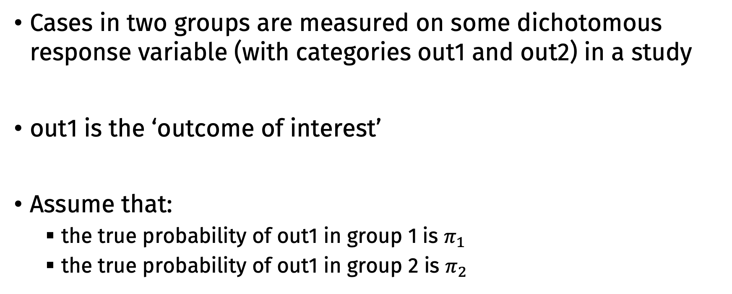
2 Groups + Dichotomous Variable
Cases in two groups are measured on some dichotomous response variable (with categories out1 and out2) in a study
out1 is the ‘outcome of interest’
Assume that:
the true probability of out1 in group 1 is $π_{1}$
the true probability of out1 in group 2 is $π_{2}$

Slide 40
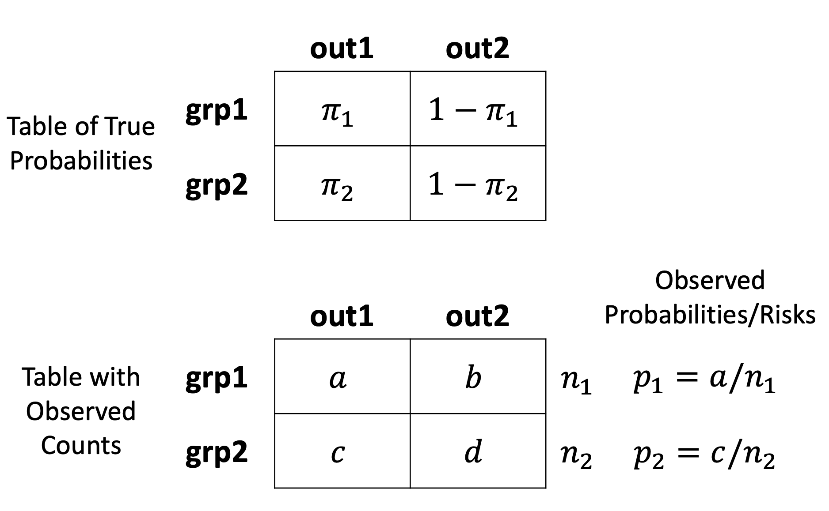

Slide 41
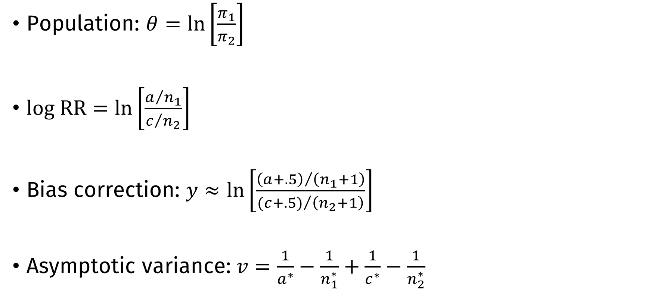
Log Risk Ratio (Log Relative Risk)
Population: $θ=ln\left[\frac{π_{1}}{π_{2}}\right]$
$log RR=ln\left[\frac{a/{n_{1}}}{c/{n_{2}}}\right]$
Bias correction: $y≈ln\left[\frac{{\left(a+.5\right)}/{\left(n_{1}+1\right)}}{({c+.5)}/{\left(n_{2}+1\right)}}\right]$
Asymptotic variance: $v=\frac{1}{a^{∗}}−\frac{1}{n_{1}^{∗}}+\frac{1}{c^{∗}}−\frac{1}{n_{2}^{∗}}$
(often only applied when one of the 2x2 table cells is a 0; several variations are also used)

Slide 42
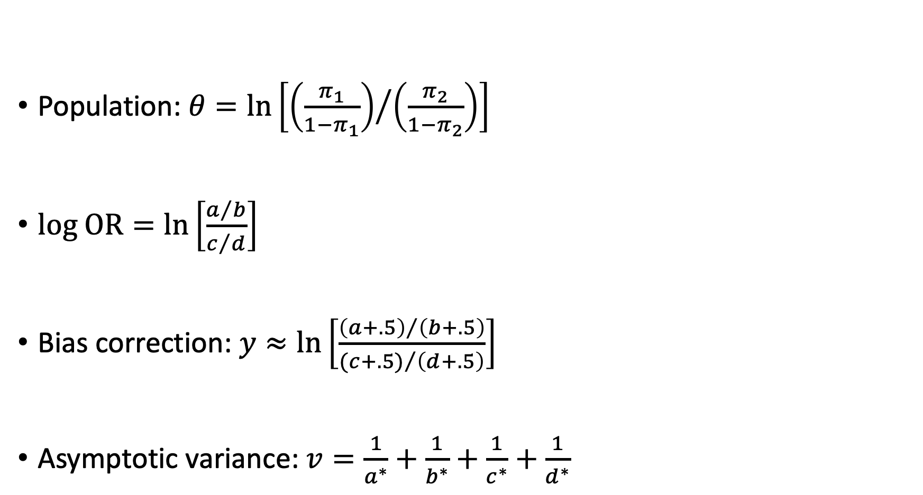
Log Odds Ratio
Population: $θ=ln\left[{\left(\frac{π_{1}}{1−π_{1}}\right)}/{\left(\frac{π_{2}}{1−π_{2}}\right)}\right]$
$log OR=ln\left[\frac{a/b}{c/d}\right]$
Bias correction: $y≈ln\left[\frac{{\left(a+.5\right)}/{\left(b+.5\right)}}{({c+.5)}/{\left(d+.5\right)}}\right]$
Asymptotic variance: $v=\frac{1}{a^{∗}}+\frac{1}{b^{∗}}+\frac{1}{c^{∗}}+\frac{1}{d^{∗}}$
(often only applied when one of the 2x2 table cells is a 0; several variations are also used)

Slide 43
OR vs RR
Risk ratios may be preferred over odds ratios for interpretability
Odds are odd
But caution!
Doi et al. (2020, https://doi.org/ghmndx; 2022, https://doi.org/gmg6fg)
RR are sensitive to baseline risk; OR are not
Best practice: Estimate models using OR, convert to RR for interpretation

Slide 44
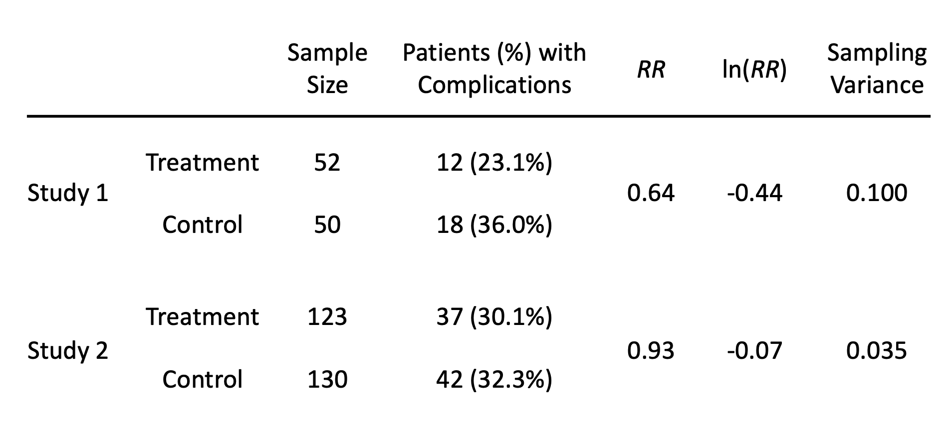

Slide 45
Interpreting RR
RR = 0.64 for complications in the treatment versus the control group
“The risk of complications in the treatment group is .64 times (or 64% of) the risk of complications in the control group”
“The risk of complications is 36% (1 − .64 = .36) lower in the treatment group compared to the control group”
“The risk of complications is 1.56 (1/.64 ≈ 1.56) times higher (= 56% higher) in the control group compared to the treatment group”

Slide 46
Interpreting log RR/OR
Log OR can be interpreted using a logistic distribution
Log odds:
0 = even, 50% probability
1 = 75% probability
2 = 88% probability
3 = 95% probability
4 = always, 98% probability
Comparison with Cohen’s d
See https://doi.org/cxshr5
When base rate is 1%, OR (log OR):
< 1.7 (.53) ∼ d ≲ .20 (“negligible”)
= 1.7 (.53) ∼ d ≈ .20 (“small”)
= 2.8 (1.0) ∼ d ≈ .40 (“medium”)
= 4.4 (1.5) ∼ d ≈ .60 (“large”)
= 6.7 (1.9) ∼ d ≈ .80 (“very large”)
Simple rules of thumb:
OR < 1.5 (small)
OR > 5 (large)

Slide 47
Why the log RR/OR?
To get a symmetrical measure:
study1: p₁ = .50 and p₂ = .25 → RR = 2.0
study2: p₁ = .25 and p₂ = .50 → RR = 0.5
Mean of the two RR is 1.25
The ln[RR] values are .6932 and −.6932
Mean of the two ln[RR] is 0
Back-transformation: e⁰ = 1
To get approximate normality

Slide 48
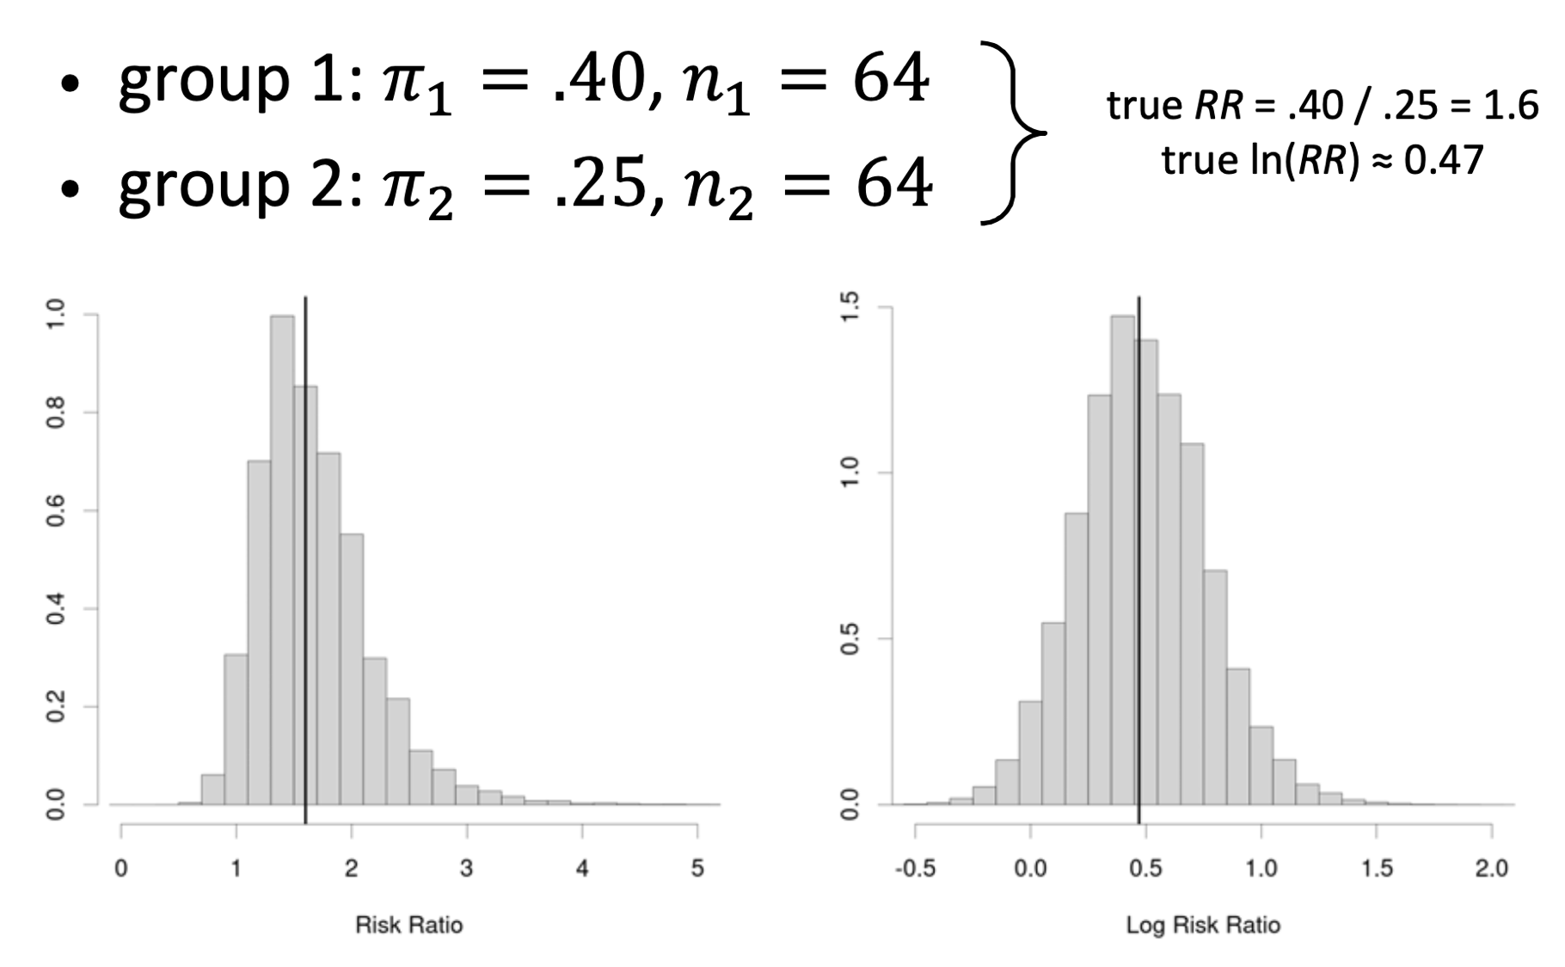

Slide 49
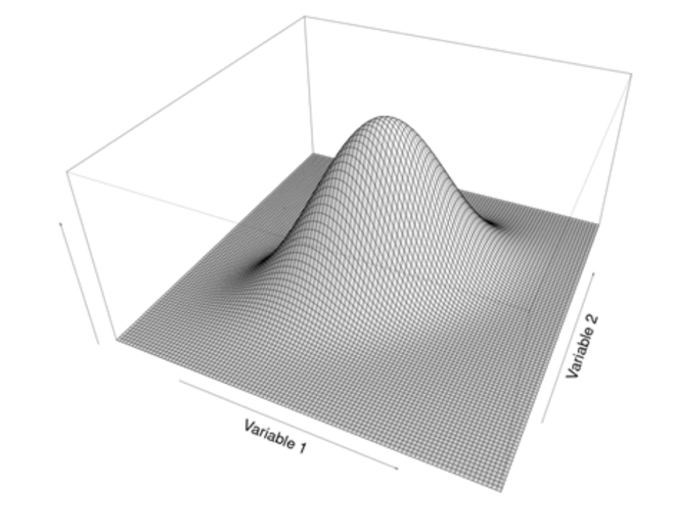

Association of 2 Quantitative Variables
Two quantitative variables are measured in a single group of cases
Assume the variables have a bivariate normal distribution with true correlation $ρ$

Slide 50
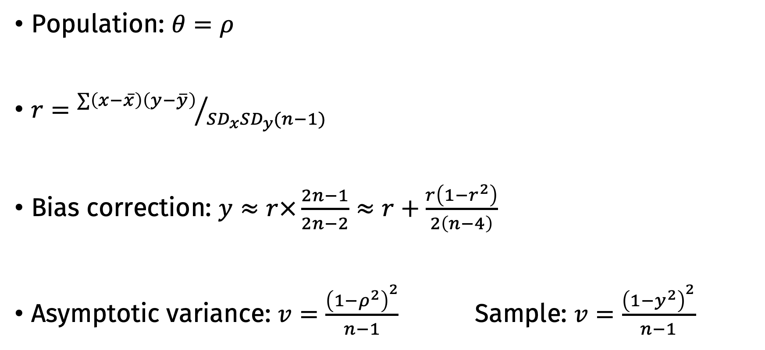
Pearson correlation coefficient
Population: $θ=ρ$
$r={∑\left(x−\overline{x}\right)\left(y−\overline{y}\right)}/{SD_{x}SD_{y}(n−1)}$
Bias correction: $y≈r×\frac{2n−1}{2n−2}≈r+\frac{r\left(1−r^{2}\right)}{2\left(n−4\right)}$
Asymptotic variance: $v=\frac{{\left(1−ρ^{2}\right)}^{2}}{n−1}$ Sample: $v=\frac{{\left(1−y^{2}\right)}^{2}}{n−1}$

Slide 51
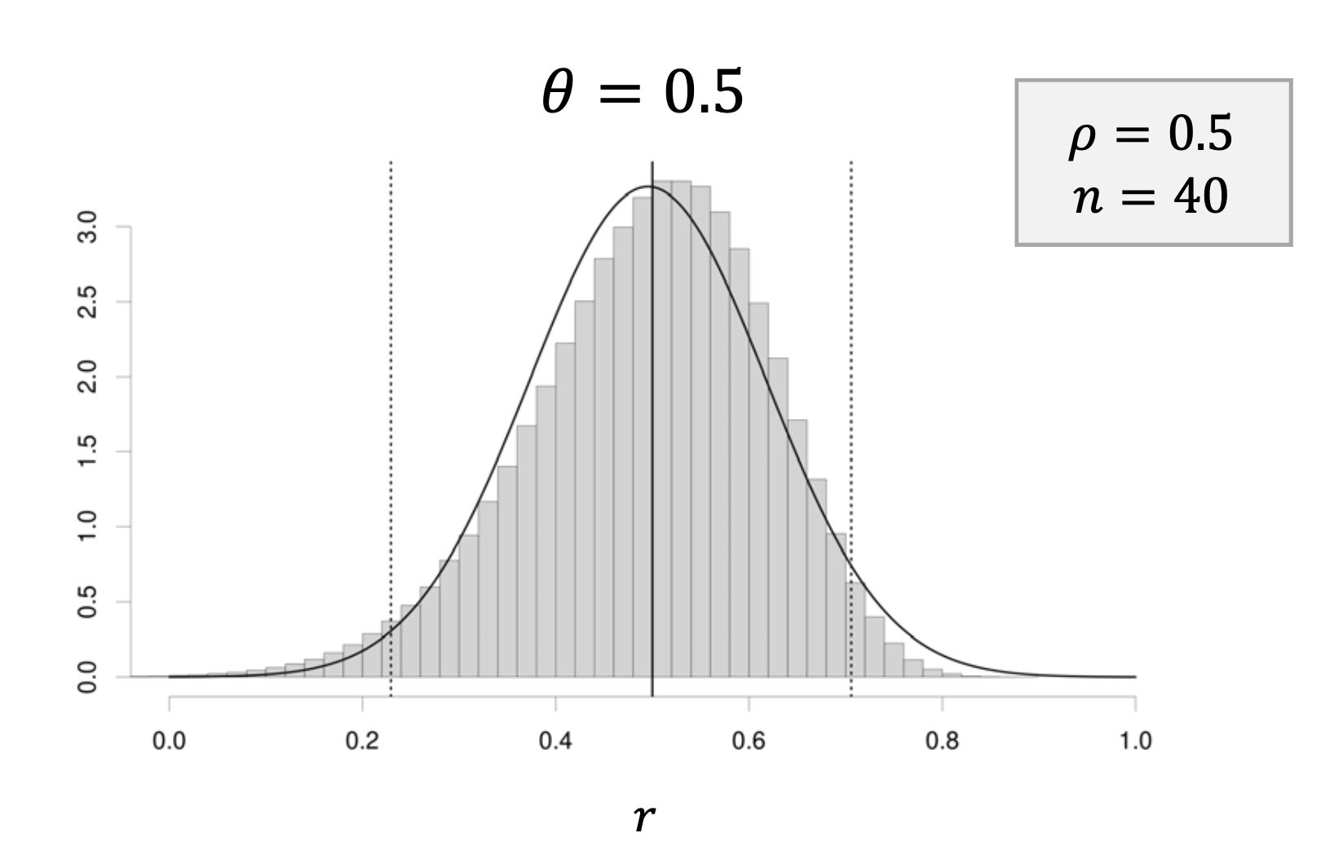

Slide 52
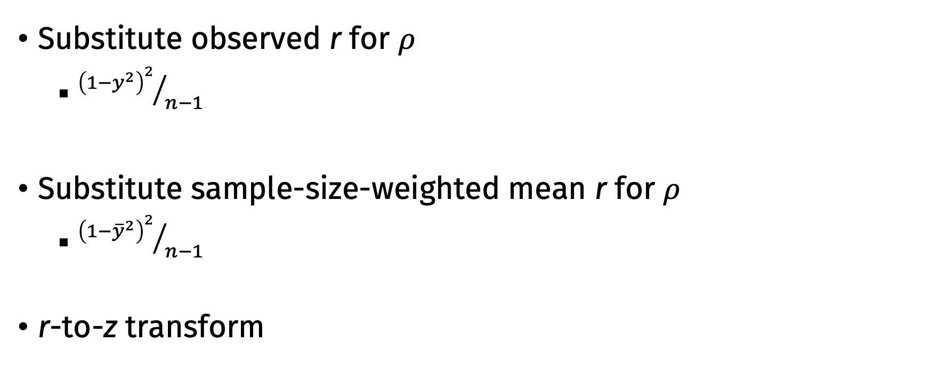
Computing the sample variance for r
Substitute observed r for $ρ$
${{\left(1−y^{2}\right)}^{2}}/{n−1}$
Substitute sample-size-weighted mean r for $ρ$
${{\left(1−{\overline{y}}^{2}\right)}^{2}}/{n−1}$
r-to-z transform

Slide 53
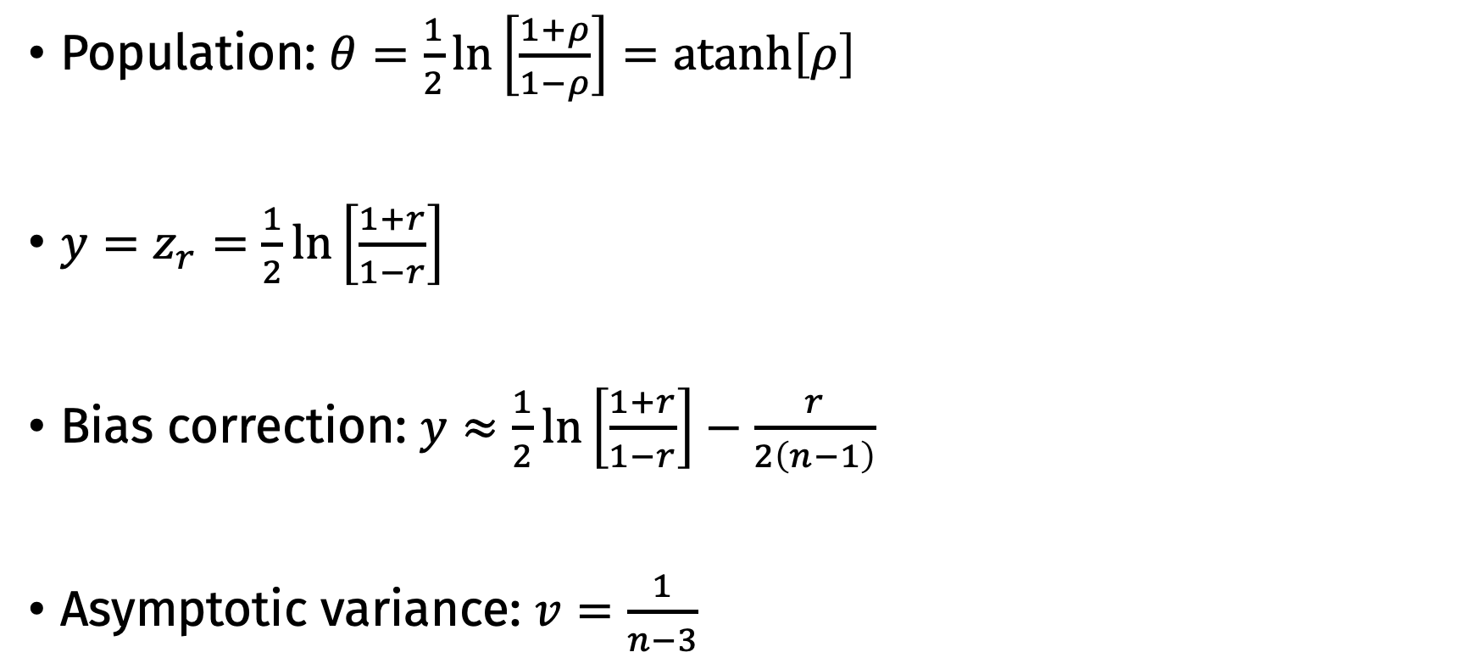
r-to-z transformed correlation
Population: $θ=\frac{1}{2}\ln\left[\frac{1+ρ}{1−ρ}\right]=atanh\left[ρ\right]$
$y=z_{r}=\frac{1}{2}\ln\left[\frac{1+r}{1−r}\right]$
Bias correction: $y≈\frac{1}{2}\ln\left[\frac{1+r}{1−r}\right]−\frac{r}{2\left(n−1\right)}$
Asymptotic variance: $v=\frac{1}{n−3}$
(this correction is rarely applied)

Slide 54
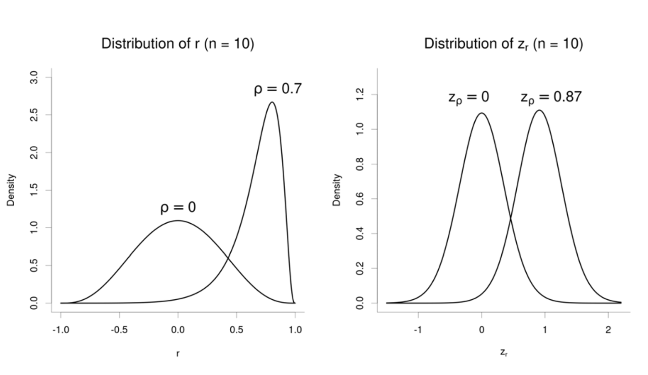
Why z transform?

Slide 55
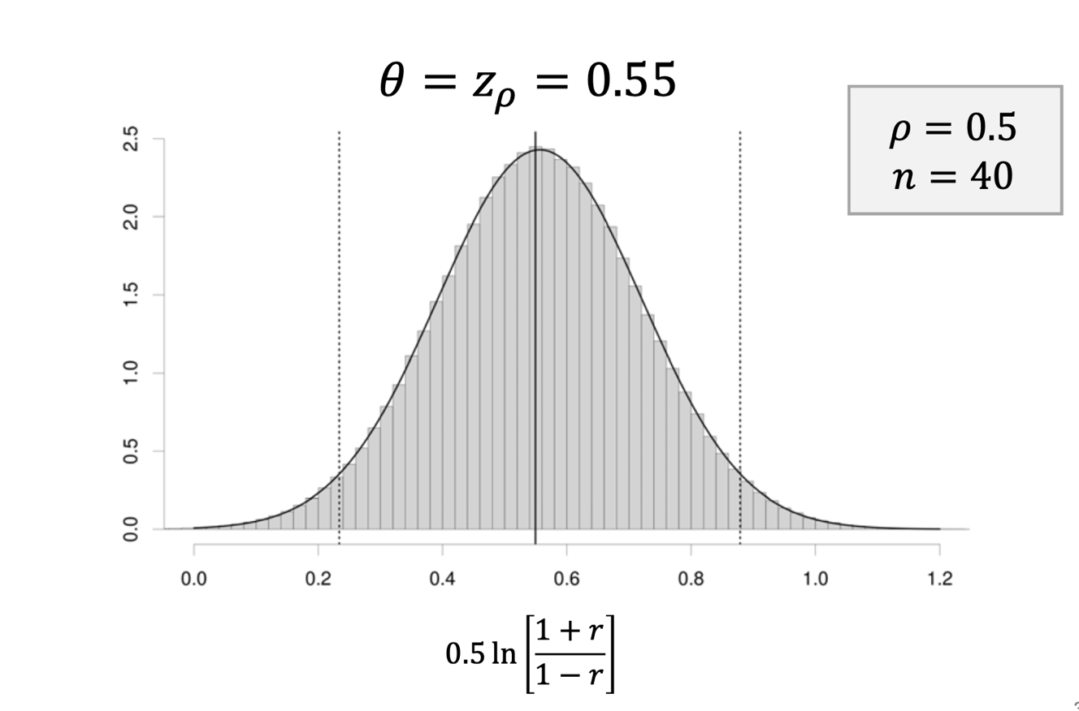
Why z transform?

Slide 56
Interpreting correlations
Oft cited: 0.1/0.3/0.5 = S/M/L (Cohen, 1988)
Rather arbitrary; too large for most social science effects
Inconsistent with d benchmarks (cf. d = .20/.63/1.15)
Better: Use empirical distribution of effects in a field
e.g., for psychology, 0.1/0.2/0.3 = 25/50/75%ile = S/M/L
Better: Relate r back to a familiar scale with known SD
e.g., study hours in college associated higher grades (r = 0.20)
SD of hours ≈ 5; SD of grades ≈ 1.1
Hence, implies 5 more hours is associated with an expected difference of 0.20 × 5 / 1.1 = .91 grade points

Slide 57
Caution: Other correlations
Other types of correlations
ICC
Phi
Point-biserial, biserial
Tetrachoric, polychoric
Different sampling error variances
Constraints on possible values; increased uncertainty due to adjustments
Affected by uneven group splits
Correct to even splits or for artificial dichotomization
See Pustejovsky (2014; https://doi.org/f5z2tp)

Slide 58
Correlations with Binary Variables
Binary with continuous
E.g., gender and job satisfaction
“Point-biserial” correlation
Binary with binary
E.g., training/no training with turnover
“Phi correlation”
Both are affected by uneven group splits
Correct to even splits or for artificial dichotomization
Avoid computation of tetrachoric/biserial correlations

Slide 59
Working with transformations
If we conduct a meta-analysis in a transformed metric, we back-transform results for presentation
lnRR / lnOR → exp()
z-correlation → transf.ztor()
lnOR → transf.logortorr()

Slide 60
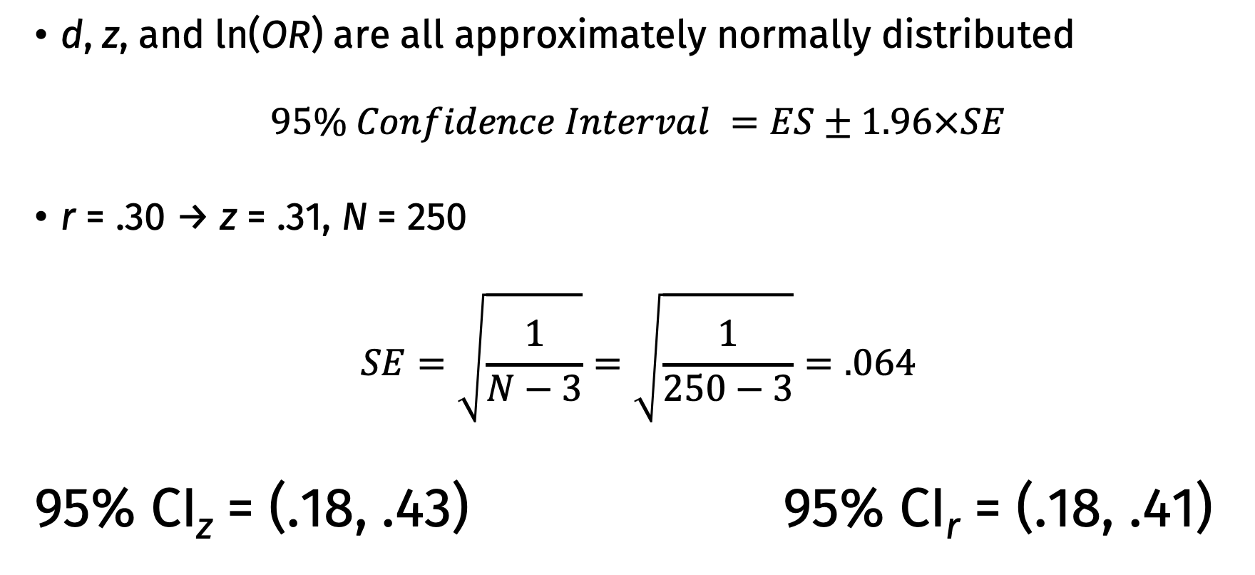
Confidence Intervals
d, z, and ln(OR) are all approximately normally distributed
$$95\% Confidence Interval =ES±1.96×SE$$
r = .30 → z = .31, N = 250
$$SE=\sqrt{\frac{1}{N−3}}=\sqrt{\frac{1}{250−3}}=.064$$
95% CI_{z} = (.18, .43) 95% CI_{r} = (.18, .41)

Slide 61
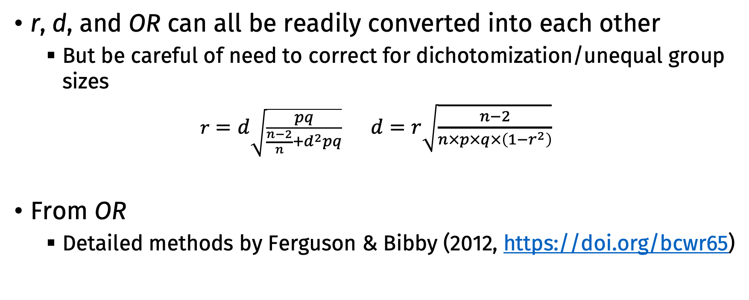
Converting Between Effect Sizes
r, d, and OR can all be readily converted into each other
But be careful of need to correct for dichotomization/unequal group sizes
$r=d\sqrt{\frac{pq}{\frac{n−2}{n}+d^{2}pq}}$ $d=r\sqrt{\frac{n−2}{n×p×q×\left(1−r^{2}\right)}}$
From OR
Detailed methods by Ferguson & Bibby (2012, https://doi.org/bcwr65)

Slide 62
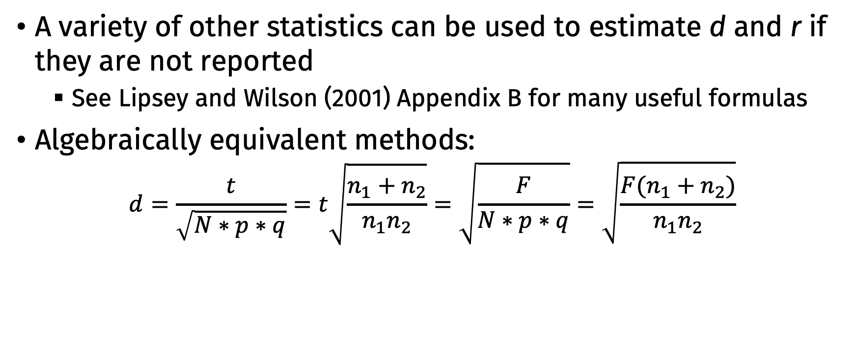
Estimating Effect Sizes from Other Statistics
A variety of other statistics can be used to estimate d and r if they are not reported
See Lipsey and Wilson (2001) Appendix B for many useful formulas
Algebraically equivalent methods:
$$d=\frac{t}{\sqrt{N∗p∗q}}=t\sqrt{\frac{n_{1}+n_{2}}{n_{1}n_{2}}}=\sqrt{\frac{F}{N∗p∗q}}=\sqrt{\frac{F(n_{1}+n_{2})}{n_{1}n_{2}}}$$
Independent t-test
Two-group one-way ANOVA
* Note: Can only use these formulas with F tests with two groups

Slide 63
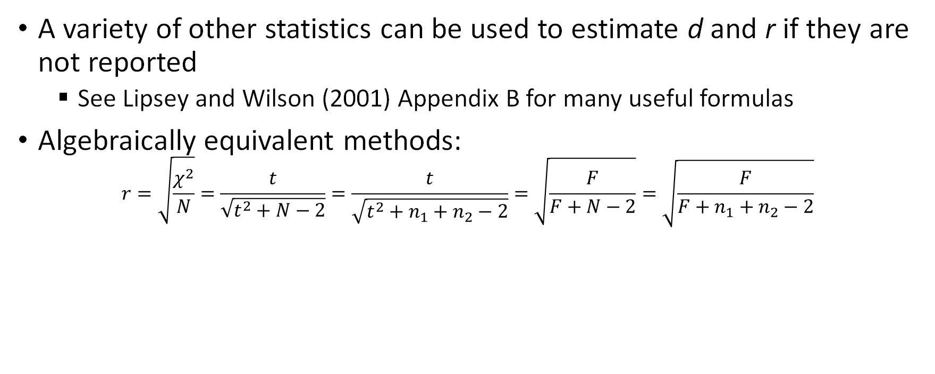
Estimating Effect Sizes from Other Statistics
A variety of other statistics can be used to estimate d and r if they are not reported
See Lipsey and Wilson (2001) Appendix B for many useful formulas
Algebraically equivalent methods:
$$r=\sqrt{\frac{χ^{2}}{N}}=\frac{t}{\sqrt{t^{2}+N−2}}=\frac{t}{\sqrt{t^{2}+n_{1}+n_{2}−2}}=\sqrt{\frac{F}{F+N−2}}=\sqrt{\frac{F}{F+n_{1}+n_{2}−2}}$$
Chi
Square
Test
Two-group one-way ANOVA
Independent t-test
* Note: Can only use these formulas with F and χ² tests with two groups

Slide 64
Degrees of Approximation to the d Value Depending of Method of Computation
Direct calculation based on means and standard deviations
Algebraically equivalent formulas (t-test)
Exact probability value for a t-test
Compute from correlation coefficient
Numerator: Estimates of the mean difference (adjusted means, unstandardized regression weight, gain score means)
Denominator: Estimates of the pooled standard deviation (gain score standard deviation, one-way ANOVA with 3 or more groups, ANCOVA)
Approximations based on dichotomous data
Excellent
Good
Poor

Slide 65
Estimating Effect Sizes from Other Statistics
The formulas for F-ratios and χ² described above should only be used for two-group comparisons (i.e., df = 1)
More complex formulas are needed when more than two groups are present
Lipsey & Wilson (2001)
Rosnow et al. (2000, 10/dppjh5)

Slide 66
Effect Size Calculators
David Wilson’s ES calculator
http://cebcp.org/practical-meta-analysis-effect-size-calculator/
Practical meta-analysis
metafor::escalc() in R
psychmeta::convert_es() in R
effectsize package in R

