Slide 1
Publication Bias

Slide 2
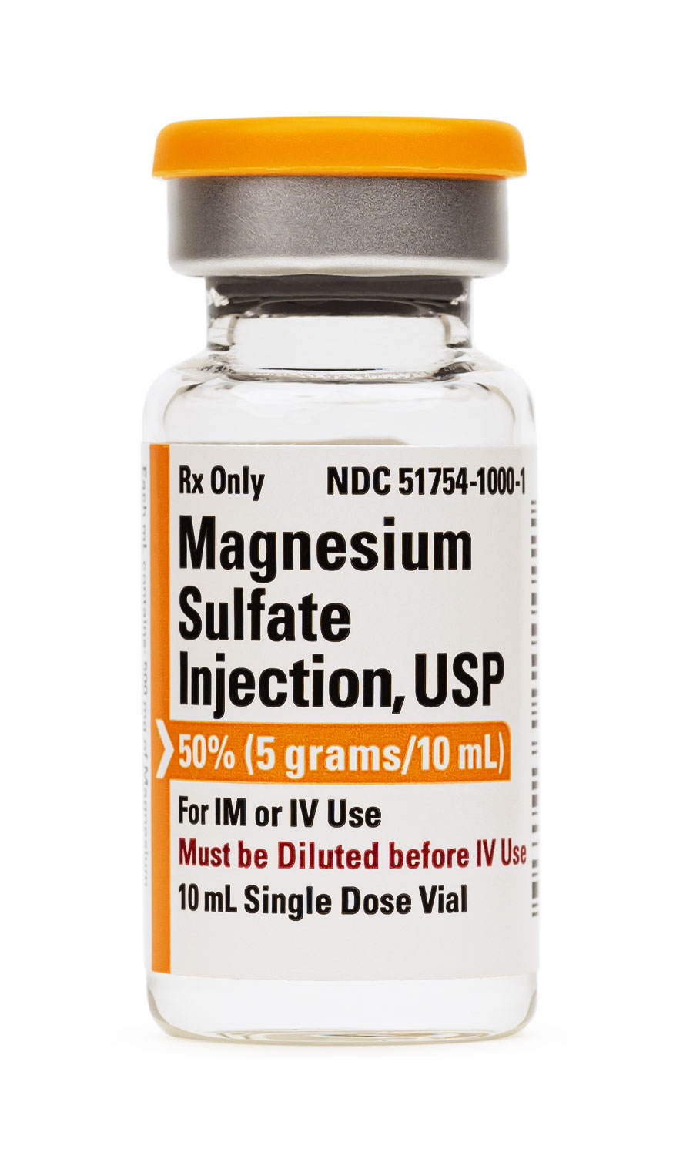
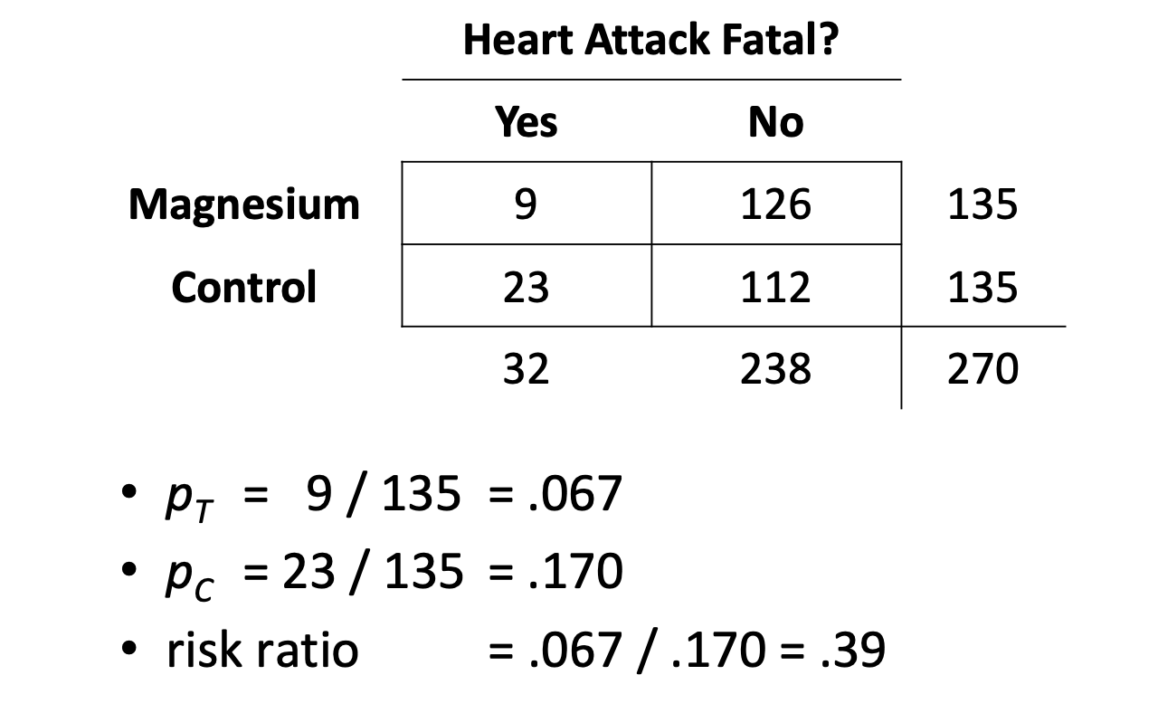
Example: Magnesium treatment
Meta-analysis on the effectiveness of intravenous magnesium treatment in acute myocardial infarction for reducing the risk of mortality and arrhythmias

Slide 3
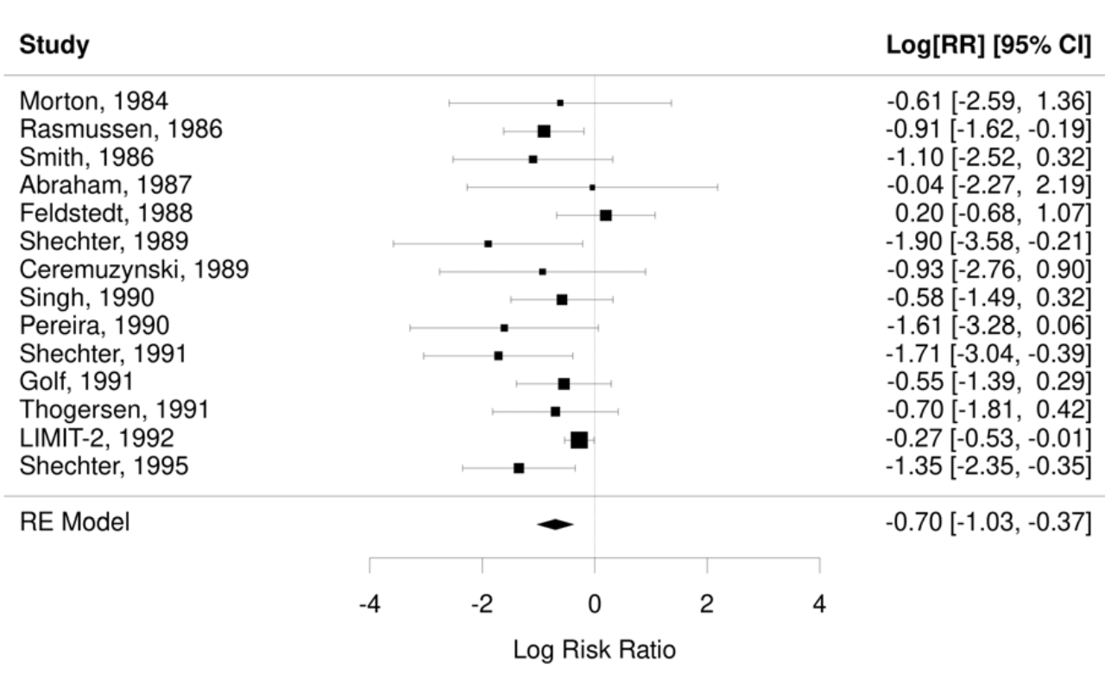
Example: Magnesium treatment

Slide 4
Example: Magnesium treatment
“intravenous magnesium is a safe, effective, widely practicable, and inexpensive intervention”

Slide 5
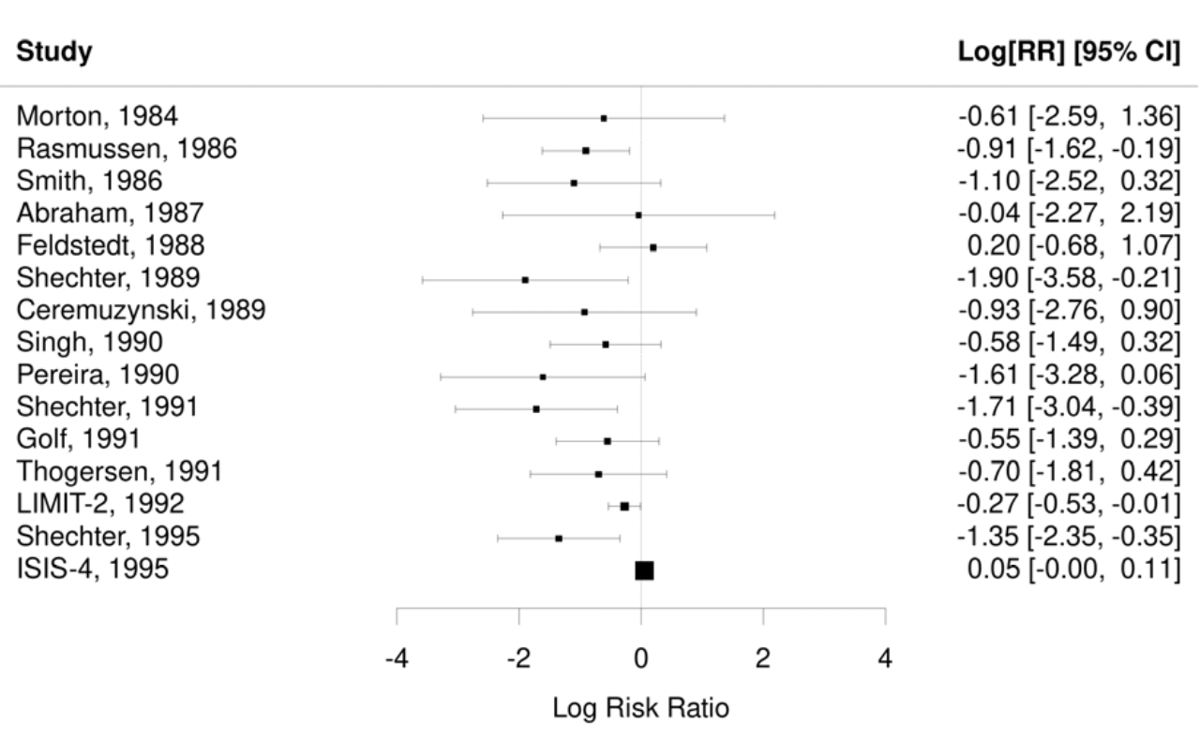
Example: Magnesium treatment

Slide 6
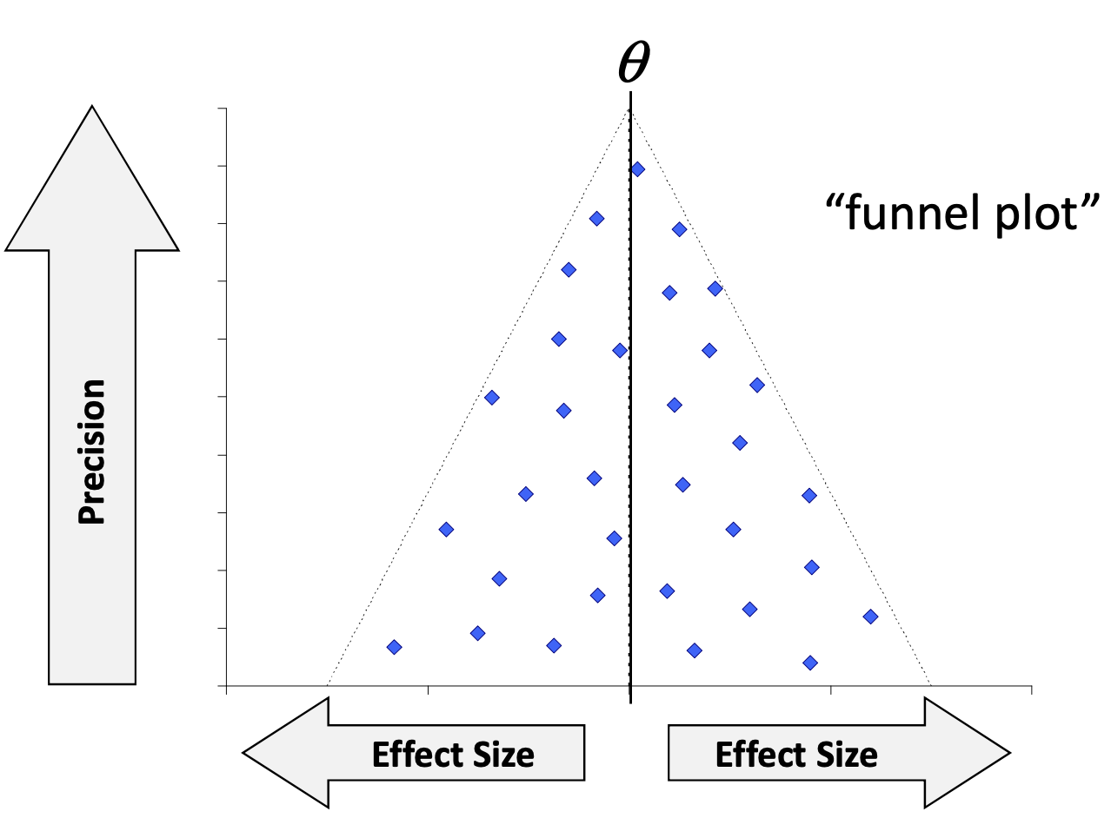

Slide 7
Effect size
Standard error

Slide 8
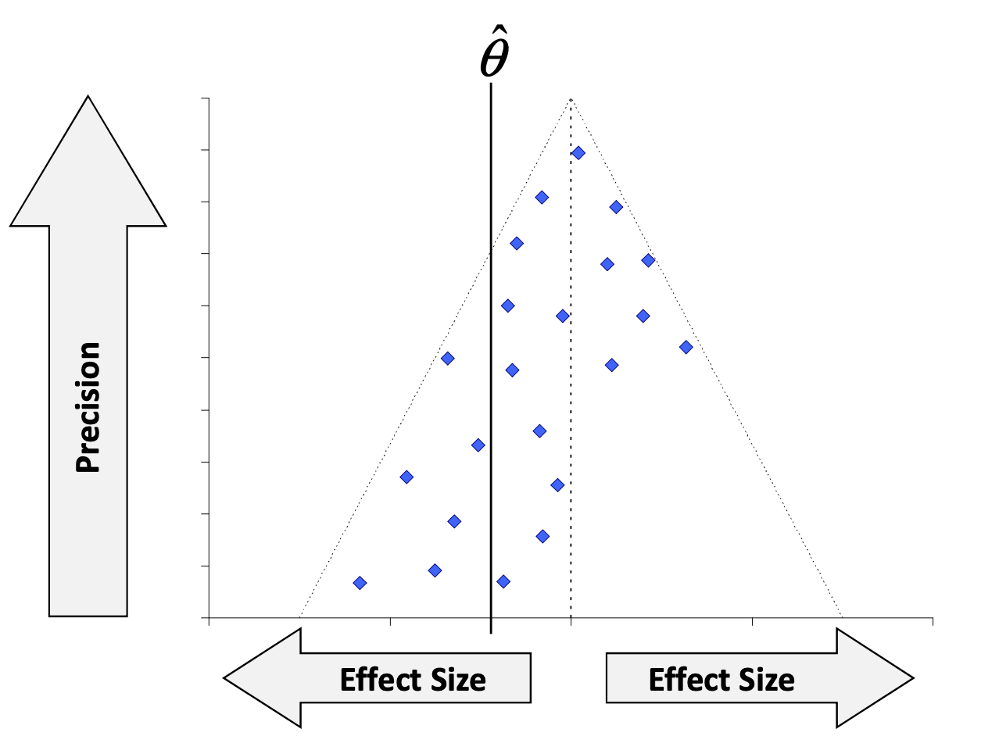

Slide 9
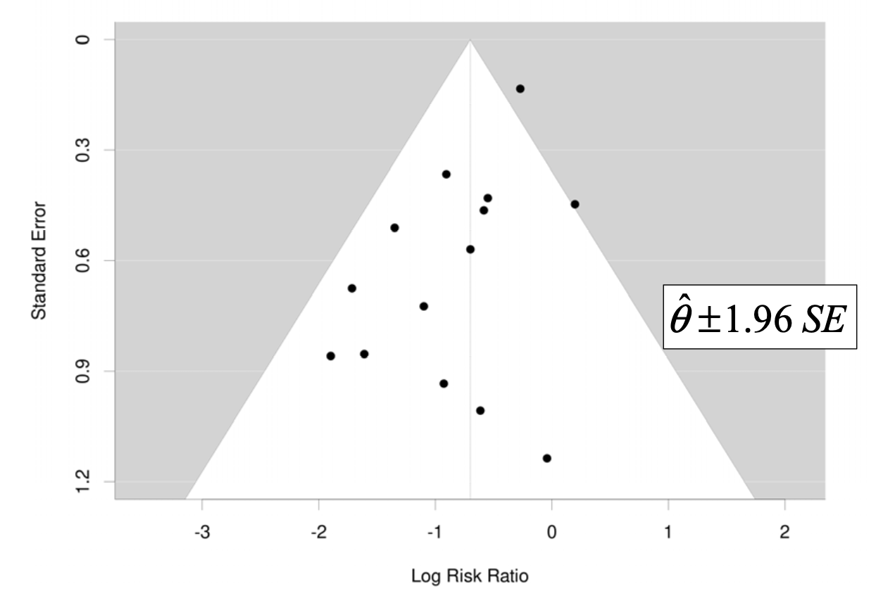
Example: Magnesium Treatment

Slide 10
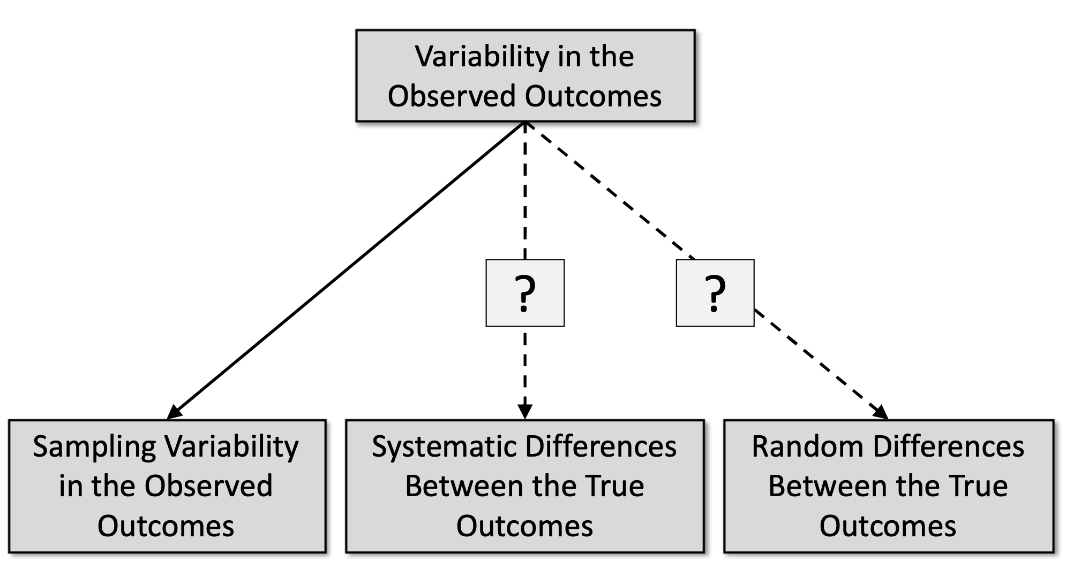
Sources of Variability in Outcomes

Slide 11
Publication bias and questionable research practices
Statistically significant findings are:
more likely to be published
more likely to be published quicker
more likely to be cited in English journals
more likely to be published more than once
more likely to be cited by others
…
To get statistically significant results, researchers are likely to:
try out several analyses
selectively drop “outliers” or other cases
drop measures or conditions that “didn’t work”
round numbers selectively
…

Slide 12


Slide 13
Does your literature have publication bias?
tl;dr : Yes

Slide 14
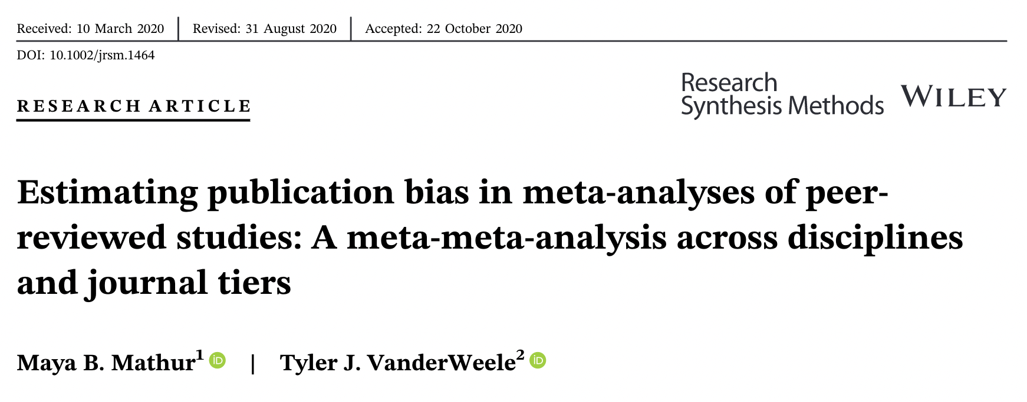
Does your literature have publication bias?
More nuanced: It depends. Probably.
Less likely:
Meta-analyses of registered studies
Meta-analyses of “non-headline” results
(Mathur & VanderWeele, 2021, https://doi.org/gmdbxw)

Slide 15
Dealing with Publication Bias
Visualizing the meta-analytic data
Funnel plot
Funnel plot asymmetry (are small studies different from large studies)
Regression tests (“Egger”, PET–PEESE)
Trim and fill
Cumulative meta-analysis (does adding small studies change result)

Slide 16
Dealing with Publication Bias
“Robustness” (how many null studies would we need to cancel results)
Failsafe N / File drawer analysis
p value distribution (do p values resemble a reliable literature)
Contour-enhanced funnel plot
p curve
p uniform
Modeling the publication process (why do we think things are published vs not)
Selection models
Agent based models

Slide 17
Funnel plot asymmetry
Logic: Do large and small studies get systematically different results?
Larger studies are less “swingy” — less opportunity to censor
Larger studies more likely to have p < .05 regardless of ES
Tested by examining whether the funnel plot is asymmetrical
Does the precision/standard error predict the observed effect size?

Slide 18
Regression test

Slide 19
Regression test
Effect size
Standard error

Slide 20
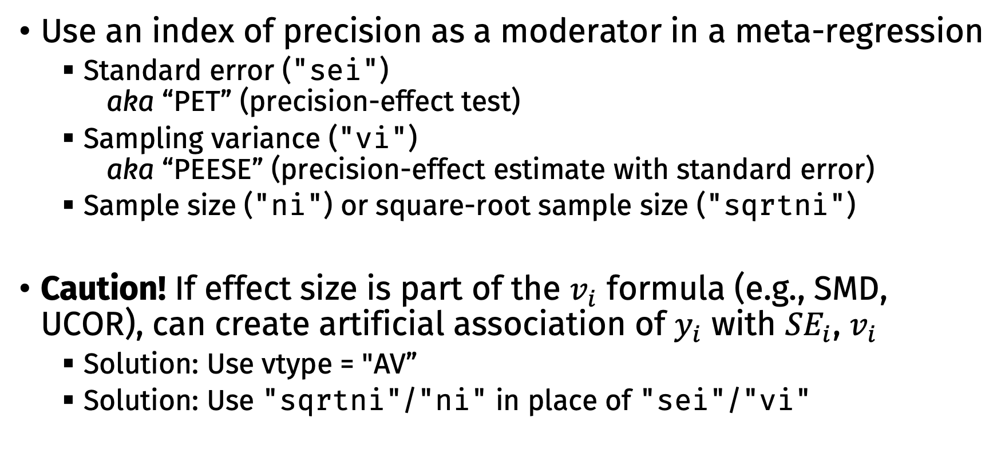
Regression test
Use an index of precision as a moderator in a meta-regression
Standard error ("sei") aka “PET” (precision-effect test)
Sampling variance ("vi") aka “PEESE” (precision-effect estimate with standard error)
Sample size ("ni") or square-root sample size ("sqrtni")
Caution! If effect size is part of the $v_{i}$ formula (e.g., SMD, UCOR), can create artificial association of $y_{i}$ with ${SE}_{i}$, $v_{i}$
Solution: Use vtype = "AV”
Solution: Use "sqrtni"/"ni" in place of "sei"/"vi"

Slide 21
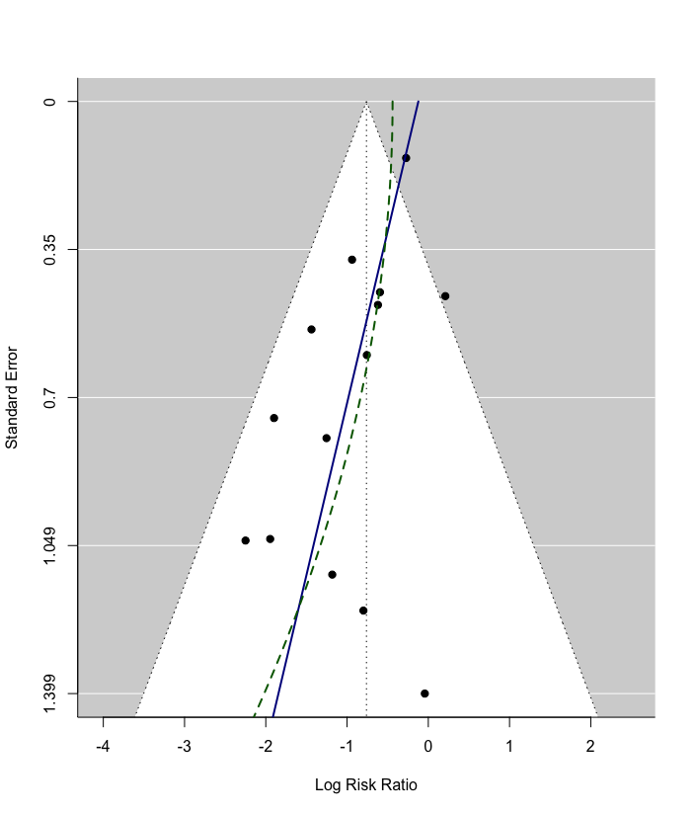
Regression Test
PET (sei)
t = -3.1486, df = 12, p = 0.0084
Limit Estimate (as sei -> 0): b = -0.1222 (CI: -0.46, 0.21)
PEESE (vi)
t = -2.0103, df = 12, p = 0.0674
Limit Estimate (as vi -> 0): b = -0.4396 (CI: -0.82, -0.05)

Slide 22
PET–PEESE
PET is more accurate when there is no true effect
PEESE is more accurate when there is a true effect
PET–PEESE balances the two
If PET “Limit” CI includes 0, keep the PET estimate
Otherwise, keep the PEESE estimate
My recommendation: Report both; the best estimate lies somewhere in between

Slide 23
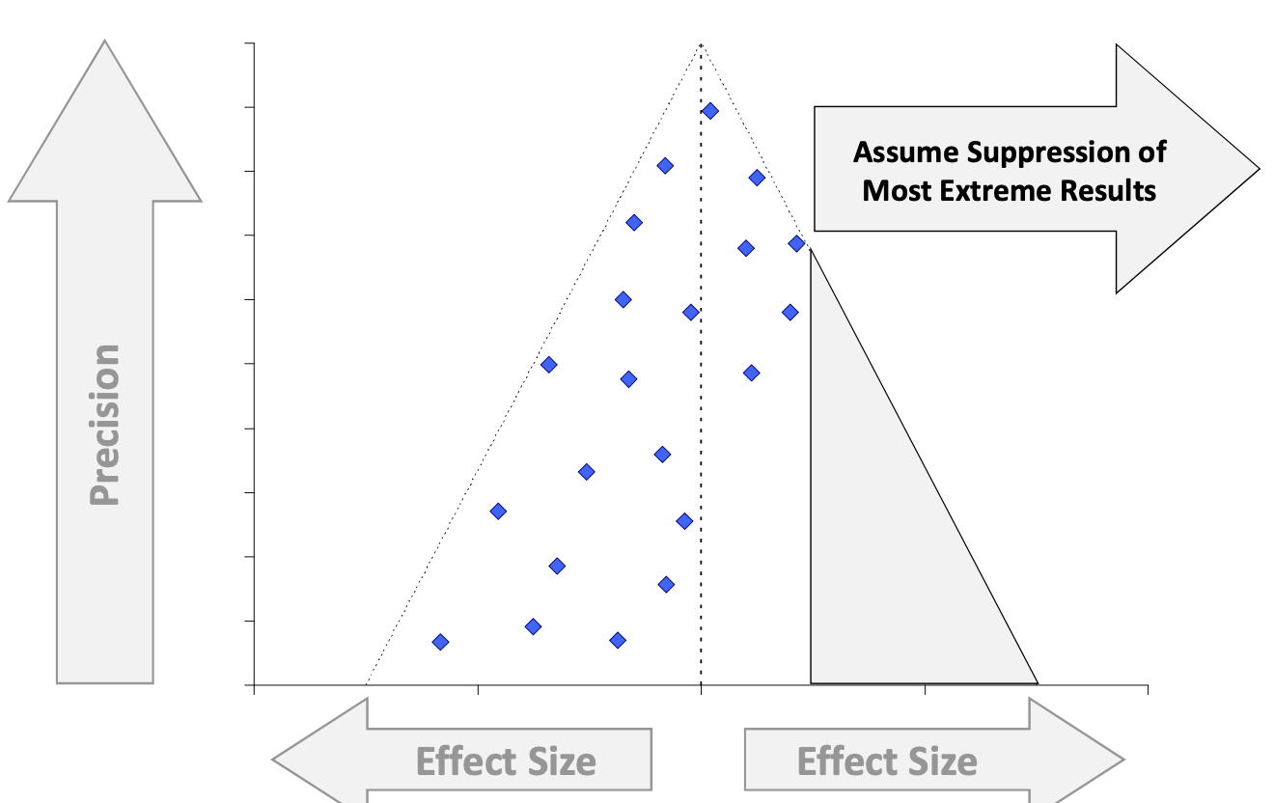
Trim and Fill

Slide 24
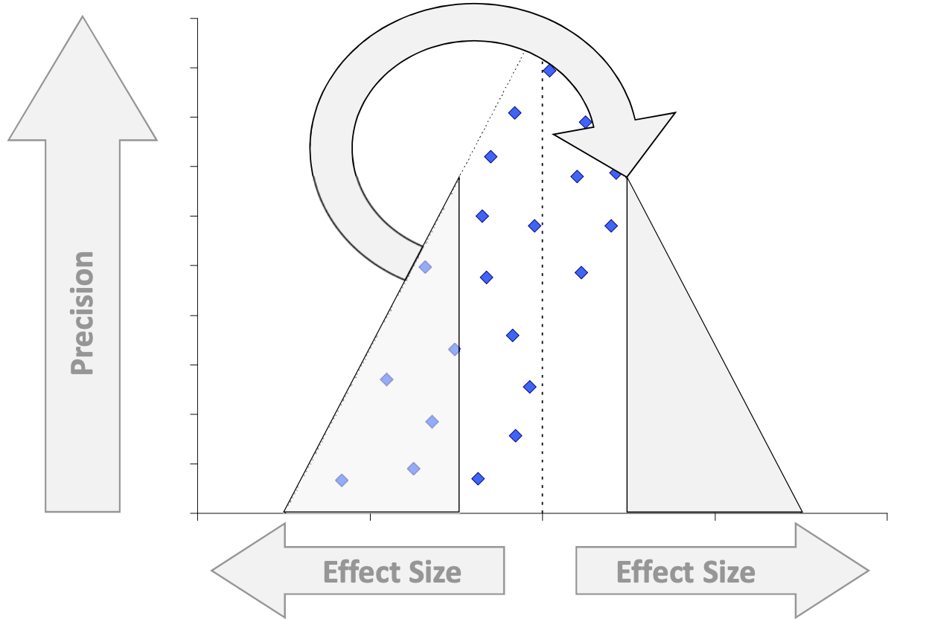
Trim and Fill

Slide 25
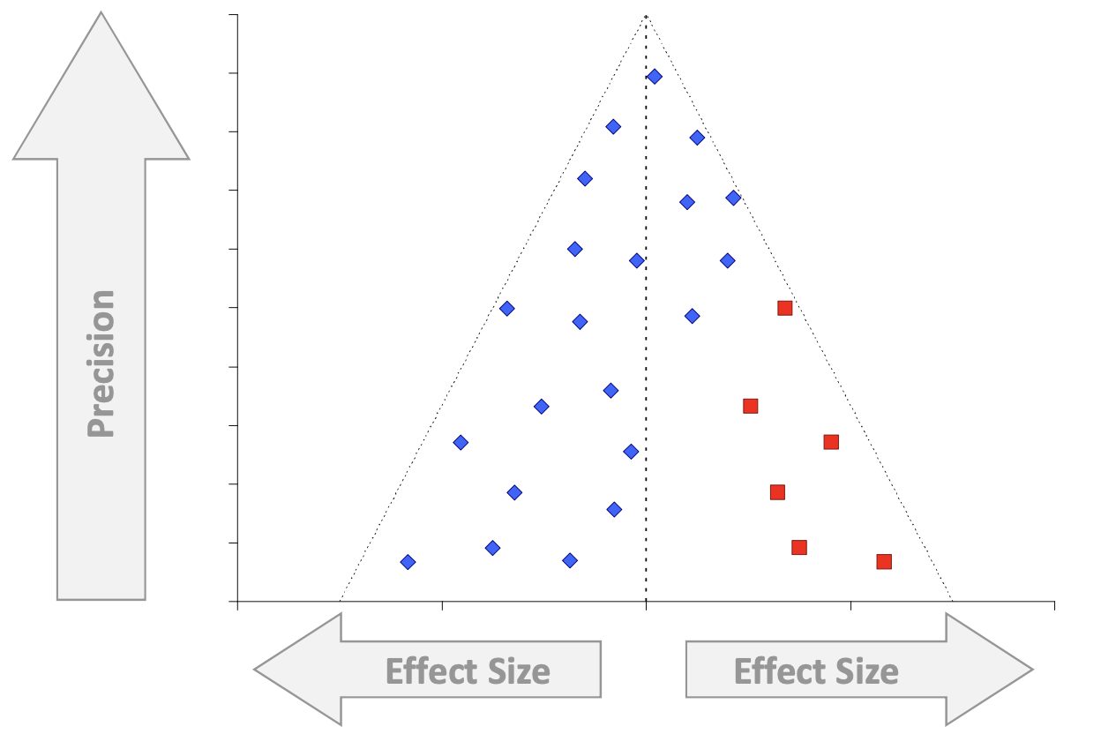
Trim and Fill

Slide 26
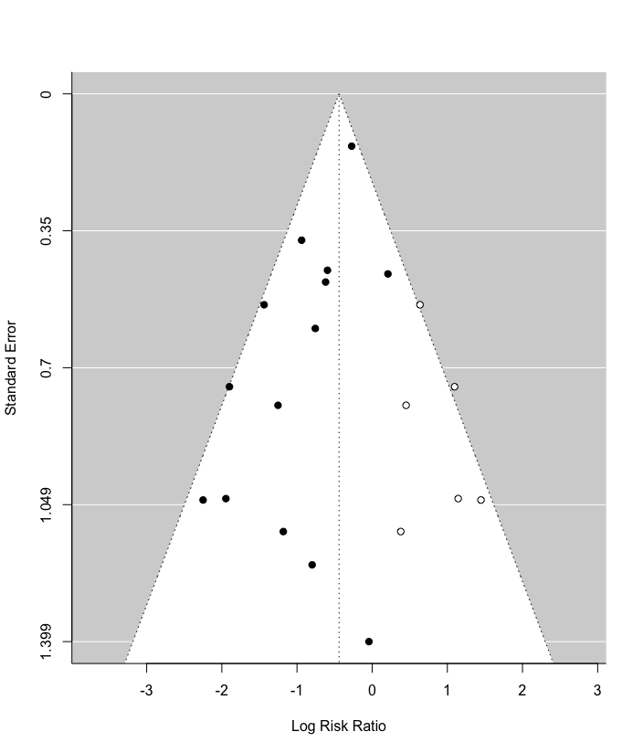
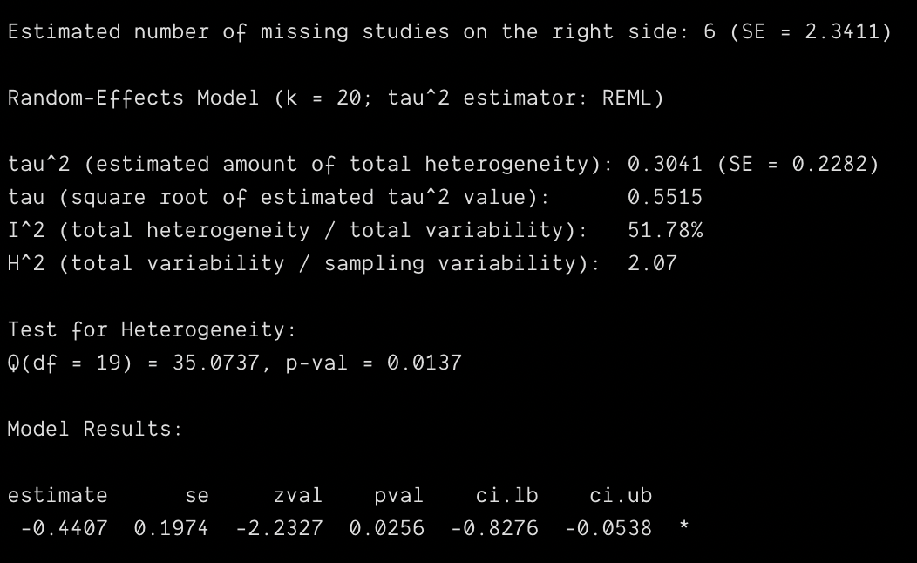
Trim and Fill

Slide 27
Trim and Fill
Problem: No real reason to expect exact symmetry of the funnel plot
Problem: Forcing asymmetry into specific discrete studies is inflexible
Regression tests like PET–PEESE have the same logic, but model the asymmetry more flexibly
Problem: Trim-and-fill tends to undercorrect

Slide 28
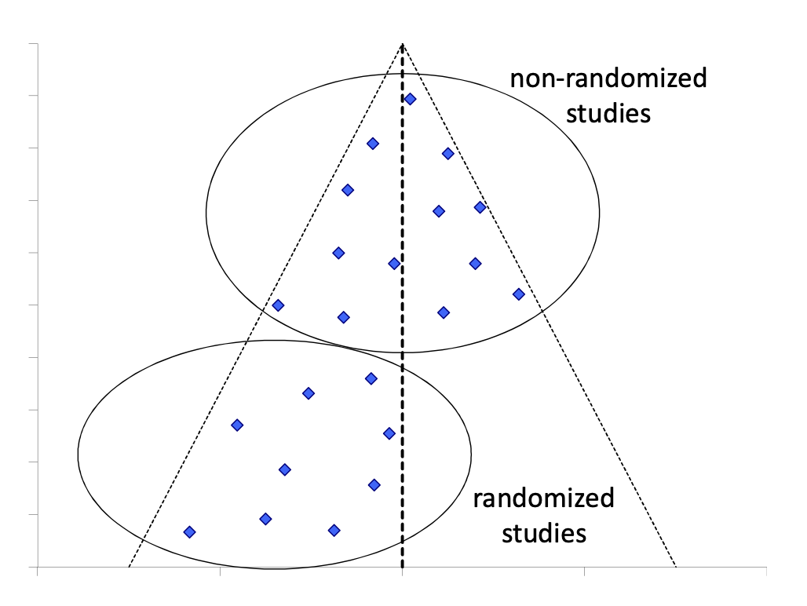
Caution: Asymmetry due to moderators
Asymmetry doesn’t always mean publication bias!
Legitimate reasons for asymmetry
Moderators: Smaller studies are more robust
Artefacts: Smaller studies used better measurement
Remedies
Include moderators/corrections and conduct tests on residuals
Be cautious

Slide 29
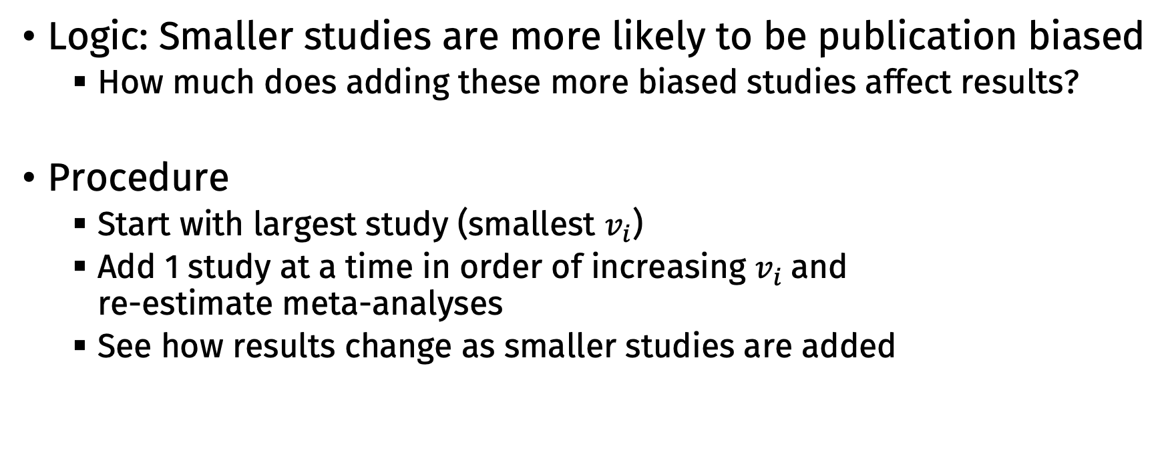
Cumulative meta-analysis
Logic: Smaller studies are more likely to be publication biased
How much does adding these more biased studies affect results?
Procedure
Start with largest study (smallest $v_{i}$)
Add 1 study at a time in order of increasing $v_{i}$and re-estimate meta-analyses
See how results change as smaller studies are added

Slide 30
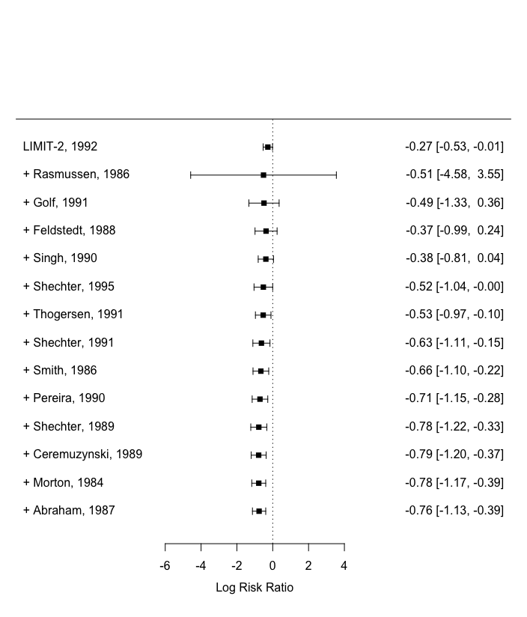
Cumulative meta-analysis

Slide 31
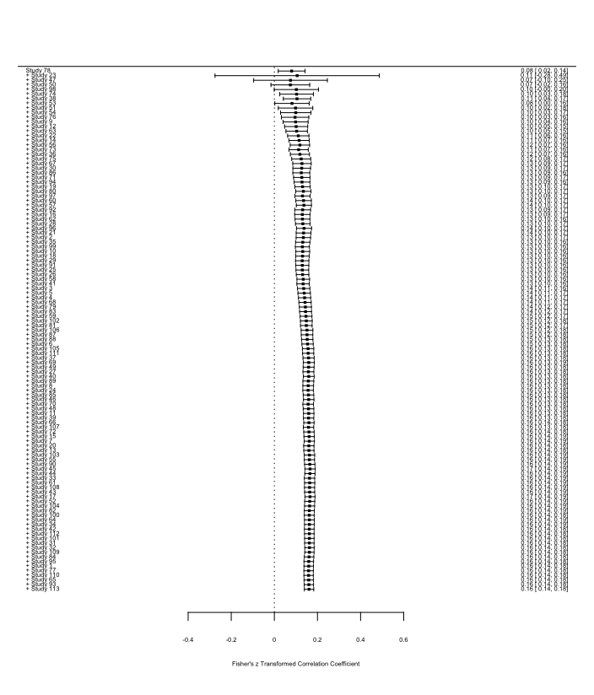
Cumulative meta-analysis

Slide 32
WAAP: Weighted average of adequately powered studies

Slide 33
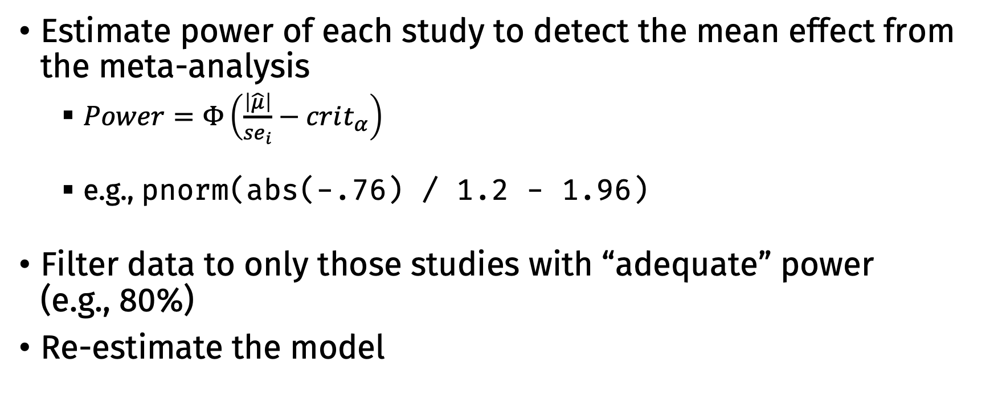
WAAP: Weighted average of adequately powered studies
Estimate power of each study to detect the mean effect from the meta-analysis
$Power=Φ\left(\frac{\left|\hat{μ}\right|}{se_{i}}−crit_{α}\right)$
e.g., pnorm(abs(-.76) / 1.2 - 1.96)
Filter data to only those studies with “adequate” power (e.g., 80%)
Re-estimate the model

Slide 34
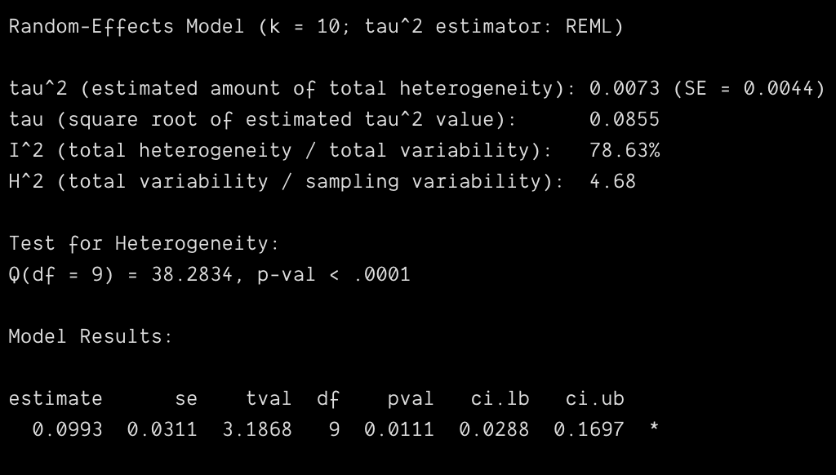
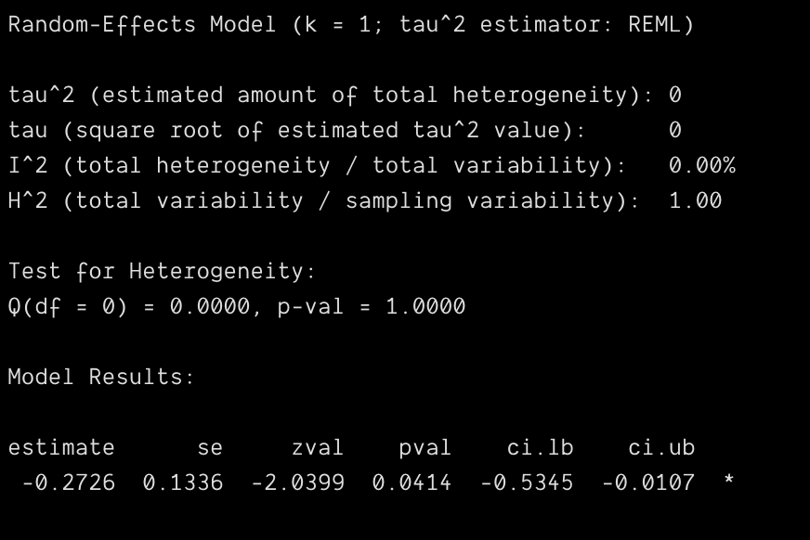
WAAP
Conscientiousness
Magnesium

Slide 35
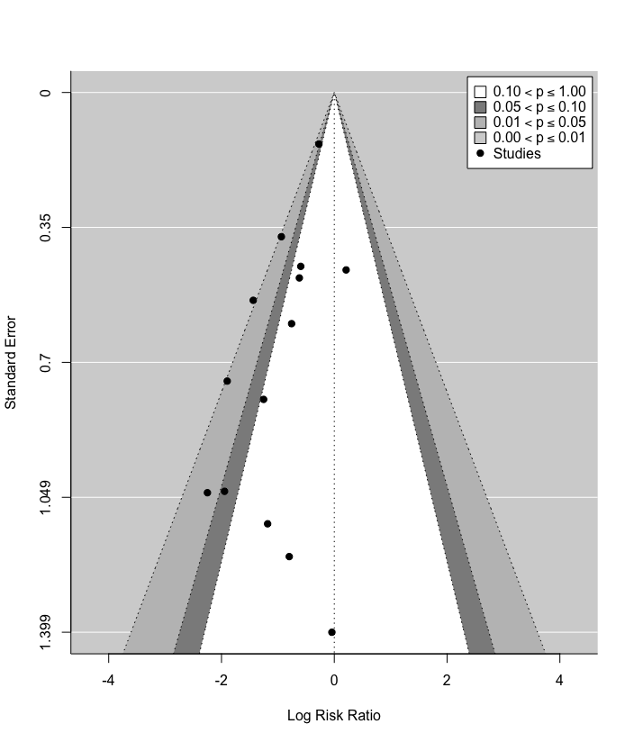
p-value based methods
Contour-enhanced funnel plots
Center funnel plot around 0
Add confidence regions > 0.05; .05 to .01, < .01
Are effect sizes clustered in the “danger zone” between p = .05 and .01?

Slide 36
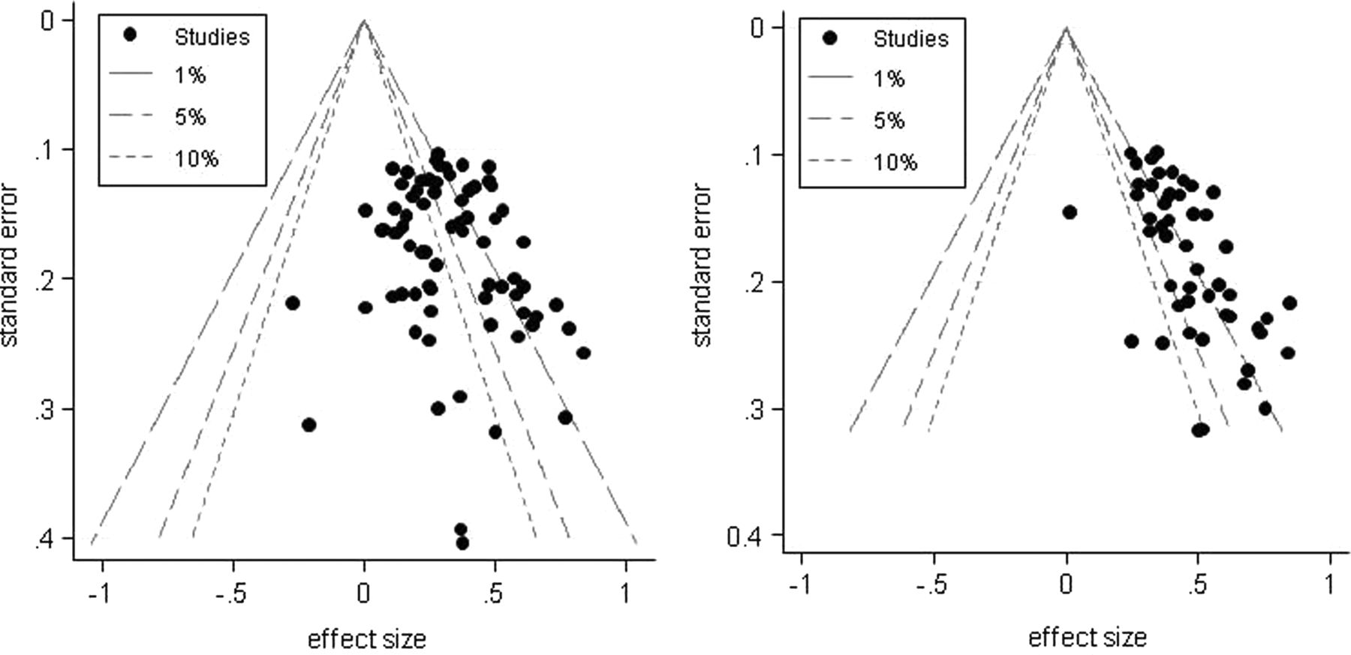
Contour-Enhanced Funnel Plot
FDA registered trials database
Published studies

Slide 37
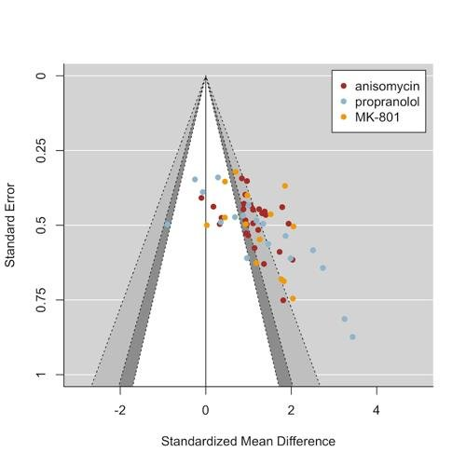
Contour-Enhanced Funnel Plot

Slide 38
p-value based methods
p-curve
If the effect is non-null, p values against 0 should be right-skewed (lots of very small, few close to .05 or larger)
Compare distribution of significant p values to expected patterns
Right skewed: Evidence for a real effect
Flat/uniform: Evidence for a null effect
Left skewed (stacked near .05): Evidence for “p-hacking”
Problem: Only uses significant studies
Problem: Performs poorly when there is heterogeneity

Slide 39
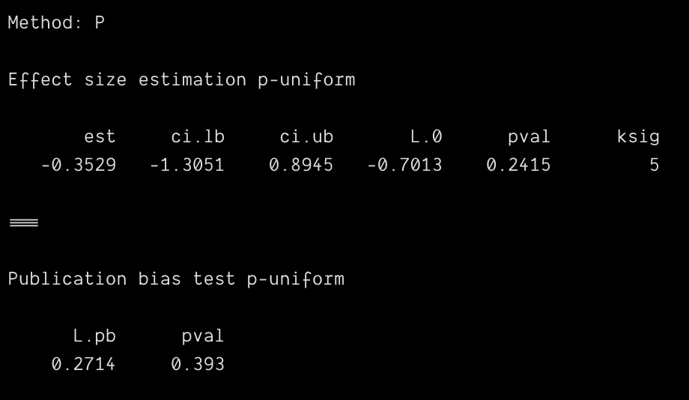
p-value based methods
p-uniform
p values tested against the true parameter value (i.e., not against 0) are uniformly (flat) distributed
Find the effect size that makes the distribution of p values as close to uniform as possible
Problem: Performs poorly when there is heterogeneity

Slide 40
Modeling the publication process
Logic: Rather than heuristics like asymmetry or p distributions, let’s examine publication bias by actually modeling how we think the publication process works
Examples:
Selection model: Let’s model whether a study was published or not based on its p value or other features (e.g., preregistered, topic)
Agent based model: Let’s simulate literatures with different processes and see which our data resemble

Slide 41
Selection model
Logic: Assume an inverse relationship between the p value against 0 and the probability of publication
This induces bias in meta-analytic findings
With enough studies, we can estimate this relationship and and remove the bias from the meta-analytic findings
Difficult to use in practice (k must be large)
Two flavors:
Logistic regression — smaller k okay, but less connected with process
Step function — more like real publication process, but need large k

Slide 42
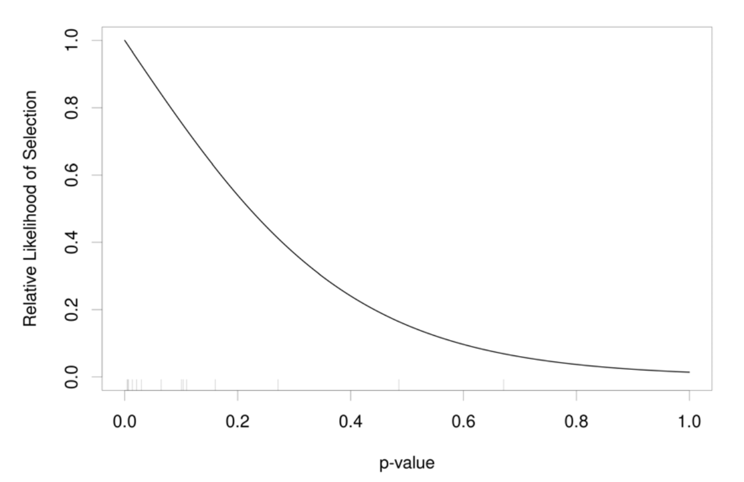
Selection models: Magnesium

Slide 43
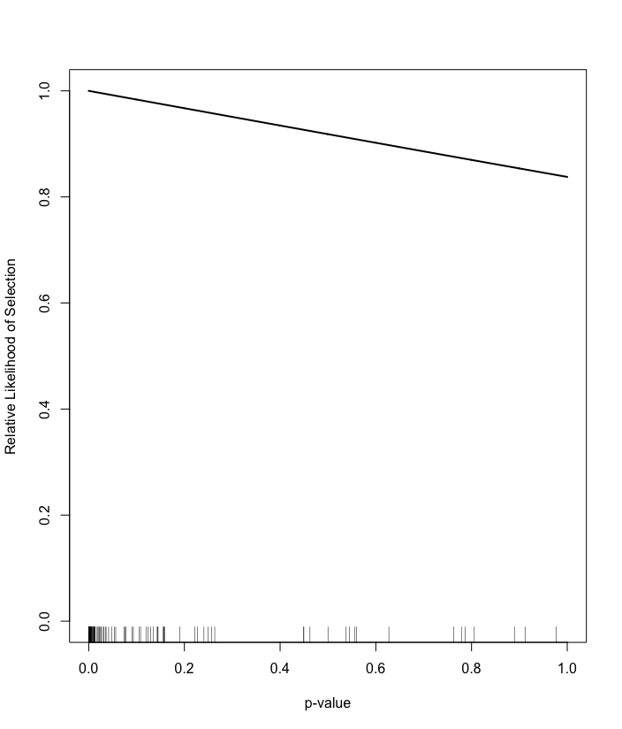
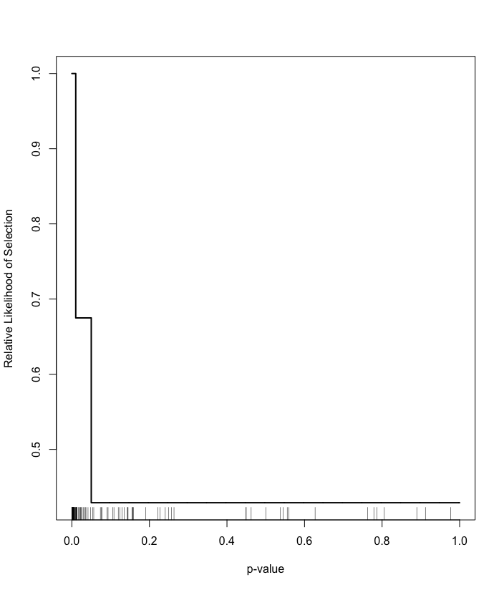
Selection models: Conscientiousness

Slide 44
“Robustness” methods
Logic: If a large number of null studies would be needed to cancel the effect, the result is robust to publication bias
Approaches:
Rosenberg: How many studies needed to raise p for a FE model above .05?
Orwin: How many studies needed to reduce weighted mean ES below minimally relevant threshold?
e.g., Magnesium
Rosenberg N: 66 studies
Orwin N [log(.90)]: 52 studies

Slide 45
“Robustness” methods
Problem: Failsafe N is basically just a transformation of the p value
Problem: More bias in the literature → more “robust” results!
Problem: Big Failsafe N
e.g., “ego depletion” meta-analysis reported FSN > 50,000!
Regression tests and subsequent replications found ES = 0
See: https://crystalprisonzone.blogspot.com/2016/07/the-failure-of-fail-safe-n.html

Slide 46
Resources
Overview of publication bias methods with 5 practical recommendations
Carter et al. (2019). Correcting for bias in psychology: A comparison of meta-analytic methods. https://doi.org/10/gf3vww
Evidence for reduced publication bias with “non-headline” results
Mathur, M. B., & VanderWeele, T. J. (2021). Estimating publication bias in meta-analyses of peer-reviewed studies: A meta-meta-analysis across disciplines and journal tiers. https://doi.org/10.1002/jrsm.1464
Nice short demonstration of various methods
Zigerell, L. J. (2017). Potential publication bias in the stereotype threat literature: Comment on Nguyen and Ryan (2008). https://doi.org/10.1037/apl0000188

