Slide 1
Modeling Statistical Artefacts in Meta-Analysis
Brenton M. Wiernik

Slide 2
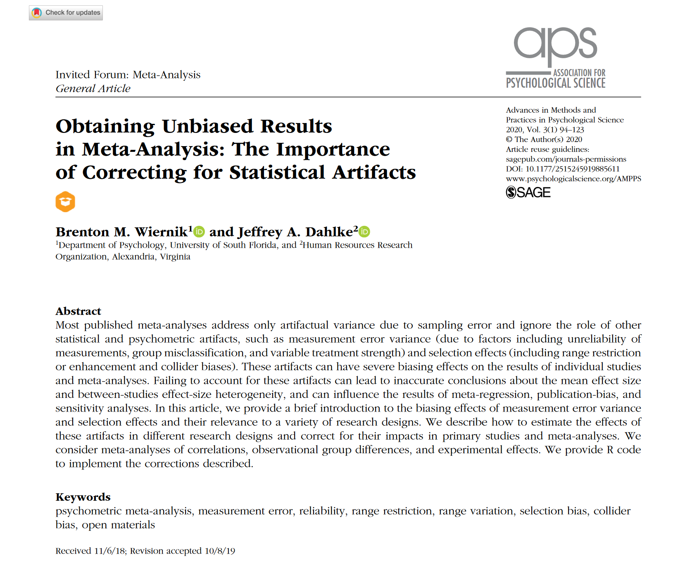
https://psyarxiv.com/9mpbn/

Slide 3
What’s the purpose of meta-analysis?

Slide 4
What’s the purpose of meta-analysis?
Widespread perspective: To summarize and critique a body of studies

Slide 5
What’s the purpose of meta-analysis?
Alternative perspective: To enhance studies
To facilitate the best possible inferences about their research questions
To identify and correct sources of bias

Slide 6
Factors that obscure study results
Sampling error
Artificial variability and inconsistency across studies
Confounding
Poor measurement
Measurement error, measure contamination
Biased sampling
Attenuated effects, collider bias

Slide 7
Statistical Artefacts in Meta-Analysis
In recent years, a lot of attention has been paid to addressing confounding, collider bias, selection bias, measurement error in primary studies
Meta-analysis can also be leveraged to estimate the impacts of these sources of bias
How much might effects have been biased by poor measurement?
How might biased sampling have impacted effects?
Can we pull information from other samples to remove confounding?

Slide 8
Meta-analysis as bias correction has a long history

Slide 9
Connection with risk of bias assessment
Methods for assessing risk of bias in studies have become routine
Especially outside of psychology
Common sources of bias include
Lack of control groups, randomization
Lack of control for confounding factors
Poor quality measurement
Restricted sampling
Many of these sources have estimable impacts on results and can be statistically adjusted

Slide 10
Connection with causal inference
Causal modeling approaches are increasingly have spread widely to other social and biomedical sciences
Causal models, directed acyclic graphs (DAGs), generative models
Common practices from epidemiology and econometrics
There are deep connections between causal models and, eg, corrections for measurement error and collider bias

Slide 11
Connection with model-based meta-analysis
Model-based meta-analysis (Becker 2009, HRSMA)
Meta-analytic structural equations modeling (Cheung, )
Approaches to meta-analysis aimed at estimating full statistical models, rather than single parameters
Adjust for confounding
Might include measurement models
Statistical adjustments to effect sizes use similar ideas, drawing on information from individual studies

Slide 12
Measurement error
Artefact that causes observed (i.e., measured) values to deviate from the “true” values of underlying latent variables
Also called
Unreliability
Observational error
Information bias
Low precision
Misclassification
Examples
Fluctuations in scale responses
Treatment non-compliance
Rater idiosyncrasies
Instrument idiosyncrasies

Slide 13
Types of measurement error
Source | Description
Random response error | Truly random error specific to each item/response; unique to each measurement
Transient error | Error due the specific period or environment in which data are gathered; shared by measures completed within a meaningfully short time span
Content sampling / instrument error | Error due to specific content or features of the measure/instrument used; shared by measures with the same or highly similar content or features
Rater sampling / source error | Error due to the specific raters or sources used to gather data; shared by measures with the same rater

Slide 14
Systematic and random measurement error
Systematic error (bias) affects each score in the same manner (e.g., consistent underestimates)
Mean error across persons
Random error affects each score differently and refers to the variance of the errors across persons.
Typically, only the error variance affects standardized effect sizes such as correlations and Hedges’s g
Differential bias across groups or score ranges could also impact correlations or g values

Slide 15
Quantifying measurement error
For any single measurement, we don’t know the direction or size of measurement error
But across many measurements, we can quantify how measurement error affects variability
We can conduct reliability studies to estimate the magnitude of measurement error variance
e.g., how consistent are measurements over time, across raters, across items in a scale?

Slide 16
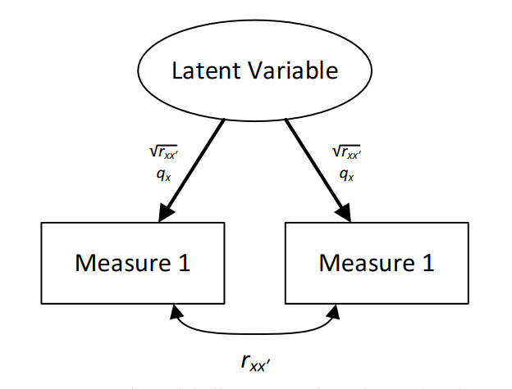
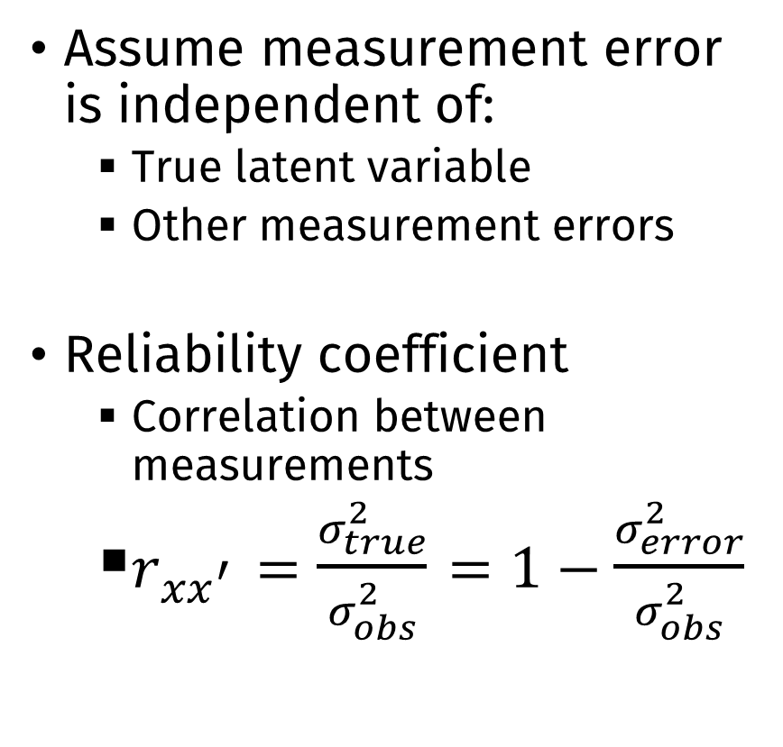
Quantifying measurement error
Assume measurement error is independent of:
True latent variable
Other measurement errors
Reliability coefficient
Correlation between measurements
$r_{xx^{′}}=\frac{σ_{true}^{2}}{σ_{obs}^{2}}=1−\frac{σ_{error}^{2}}{σ_{obs}^{2}}$

Slide 17
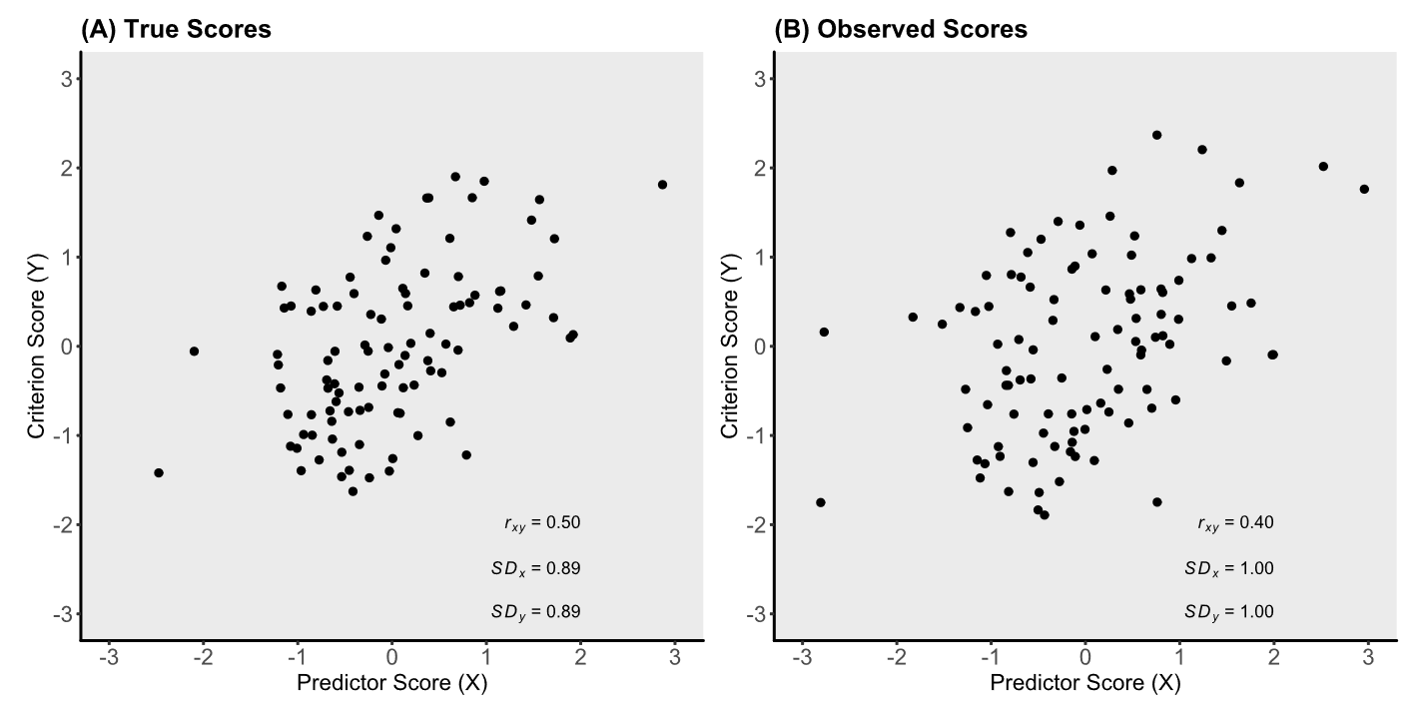
Effect of measurement error on results

Slide 18
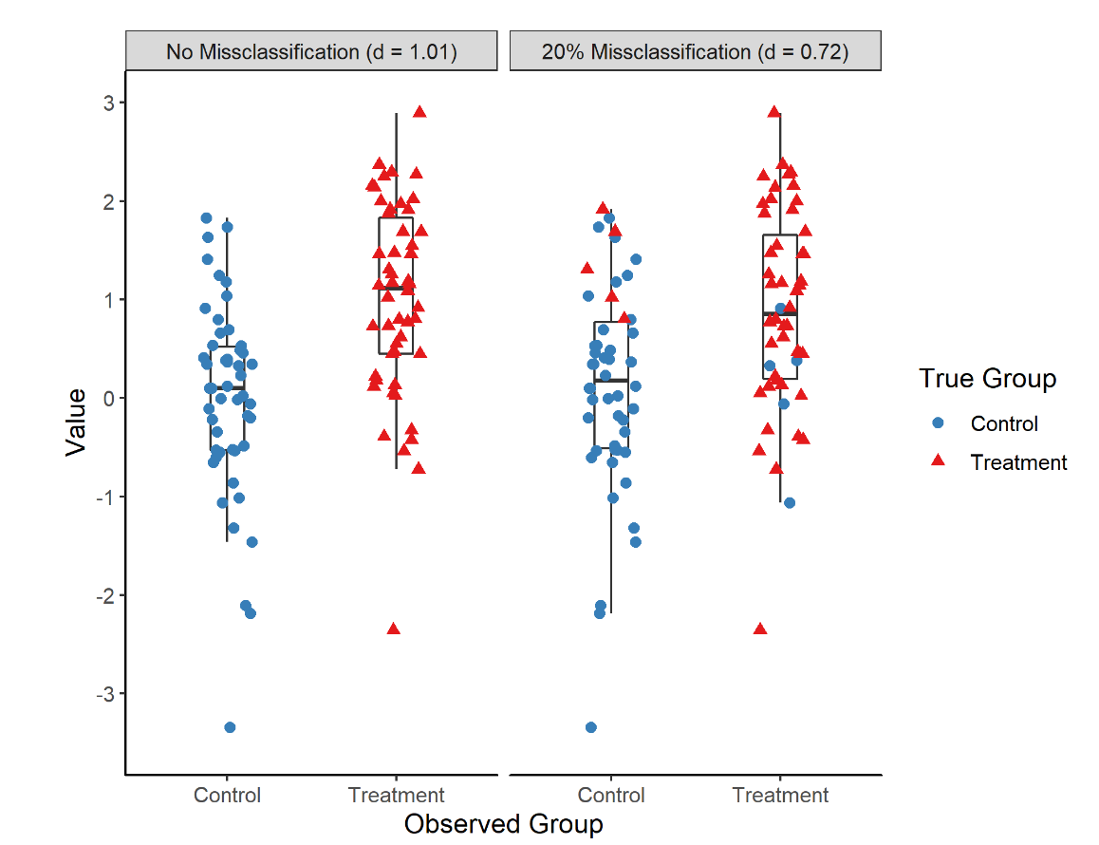
Effect of measurement error on results

Slide 19

Measurement error and meta-analysis
Mean effect size
Generally, systematic null-bias
$${\overline{r}}_{xy}=\overline{ρ}×\overline{\sqrt{r_{xx^{′}}}}×\overline{\sqrt{r_{yy^{′}}}}=−.32×.89×.84=−.24$$

Slide 20
Measurement error and meta-analysis
Heterogeneity and moderator analysis
Ignoring measurement error = overestimate heterogeneity τ
Differential measurement error can bias moderator analyses
e.g., Comparing cognitive behavioral therapy (CBT) and mindfulness therapy for PTSD
Therapies are really equally effective (δ̅ = .40)
CBT studies measure PTSD more reliably (r̅_{yy′} = .90) than mindfulness studies (r̅_{yy′} = .60)
Observed effect sizes suggest moderation (d̅_{CBT} = .38 vs d̅_{Mind} = .31)

Slide 21
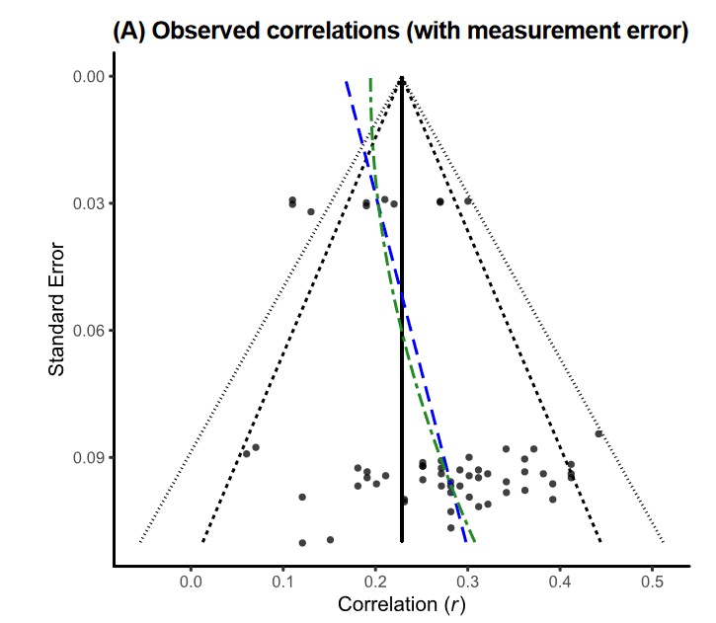
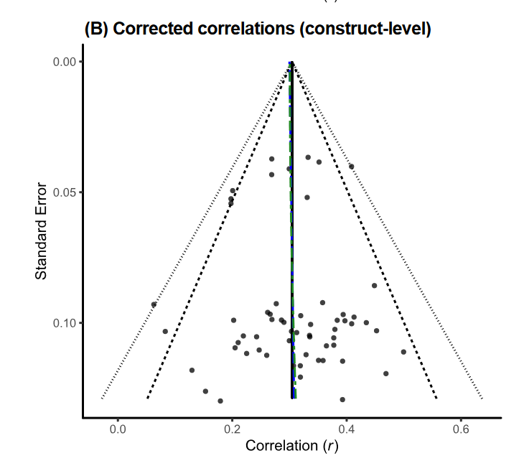
Measurement error and meta-analysis
Publication bias

Slide 22


Correcting for measurement error in measured variables
$$r_{c}=\frac{r_{obs}}{\sqrt{r_{xx^{′} ̧}}\sqrt{r_{yy^{′}}}}$$
$${SE}_{r_{c}}^{2}={SE}_{r_{obs}}^{2}×{\left({r_{c}}/{r_{obs}}\right)}^{2}$$
$$d_{c}={d_{obs}}/{\sqrt{r_{yy_{pooled}^{′}}}}$$
$${SE}_{d_{c}}^{2}={SE}_{d_{obs}}^{2}×{\left({d_{c}}/{d_{obs}}\right)}^{2}$$

Slide 23
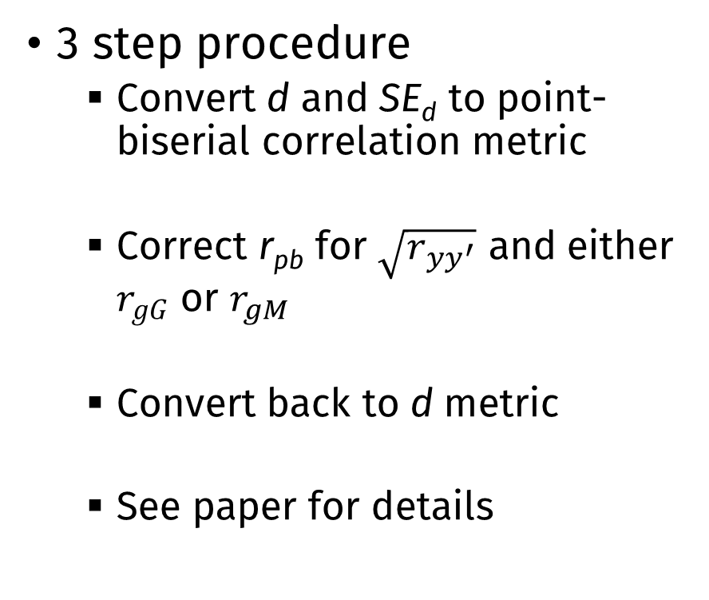
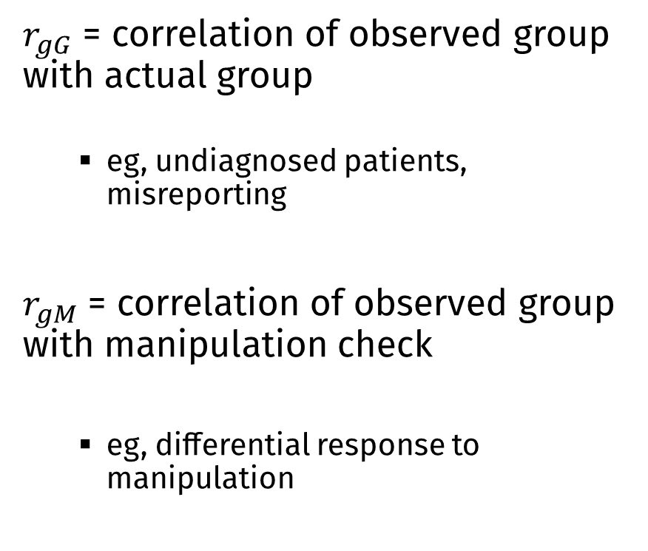
Correcting for measurement error (group misclassification)
$r_{gG}$ = correlation of observed group with actual group
eg, undiagnosed patients, misreporting
$r_{gM}$ = correlation of observed group with manipulation check
eg, differential response to manipulation
3 step procedure
Convert d and SE_{d} to point-biserial correlation metric
Correct r_{pb} for $\sqrt{r_{yy^{′}}}$ and either $r_{gG}$ or $r_{gM}$
Convert back to d metric
See paper for details

Slide 24
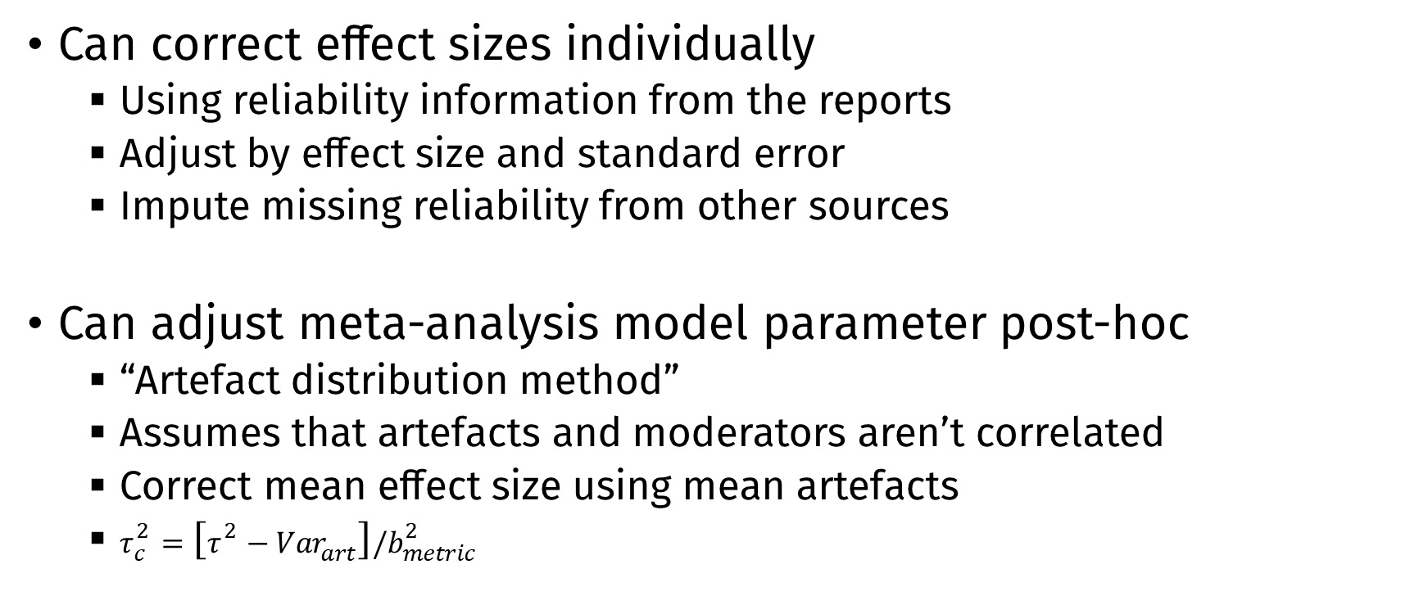
Correcting for measurement error in meta-analysis
Can correct effect sizes individually
Using reliability information from the reports
Adjust by effect size and standard error
Impute missing reliability from other sources
Can adjust meta-analysis model parameter post-hoc
“Artefact distribution method”
Assumes that artefacts and moderators aren’t correlated
Correct mean effect size using mean artefacts
$τ_{c}^{2}=\left[τ^{2}−Var_{art}\right]/b_{metric}^{2}$

Slide 25
When should you correct for measurement error?
When you choose a reliability estimator that captures the important sources of error for a variable
When measurement model assumptions are reasonable
Errors are uncorrelated with each other and true scores
When measurement models are complex, more sophisticated corrections could be applied

Slide 26
Selection effects
When the sample where the effect size is computed does not reflect the population to which it should be generalized
Due to selection or conditioning on some variable
e.g., range restriction, selection bias, collider bias

Slide 27
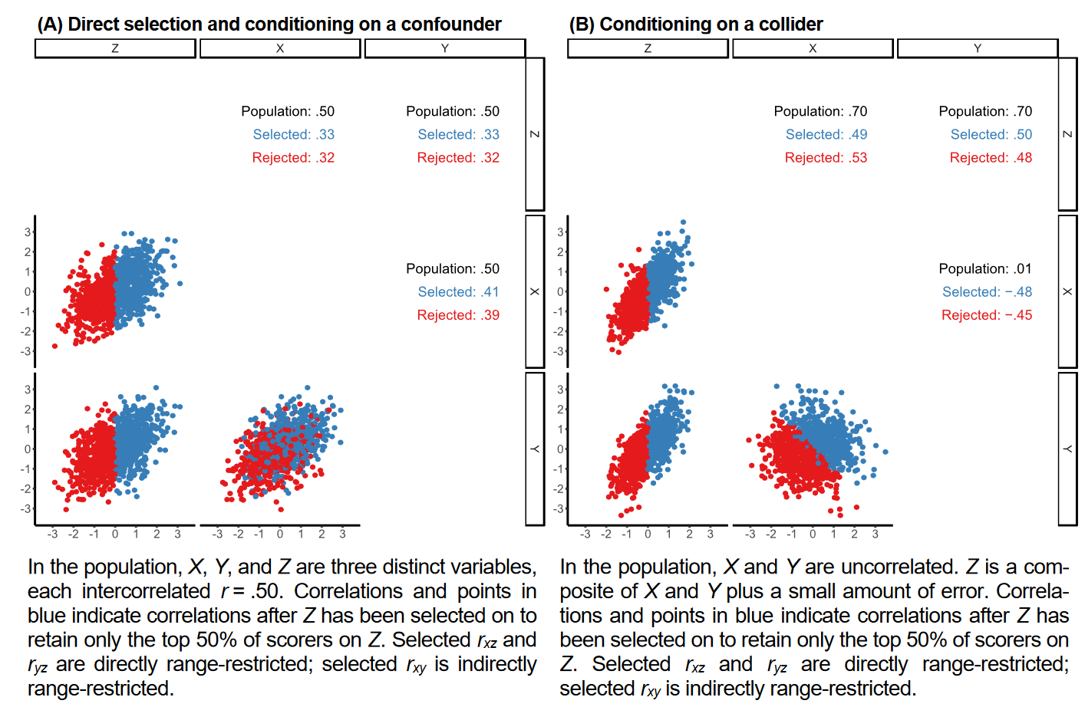
Impact of selection effects

Slide 28
Selection effects are ubiquitous!
How much the sampling process condition on important covariates or other variables?
These factors are present in most studies across many fields
Researchers should always consider how results might be affected by biased sampling

Slide 29
Selection effects and meta-analysis
Selection effects can bias all 3 categories of results described above
Mean effect size
Heterogeneity and moderators
Publication bias

Slide 30
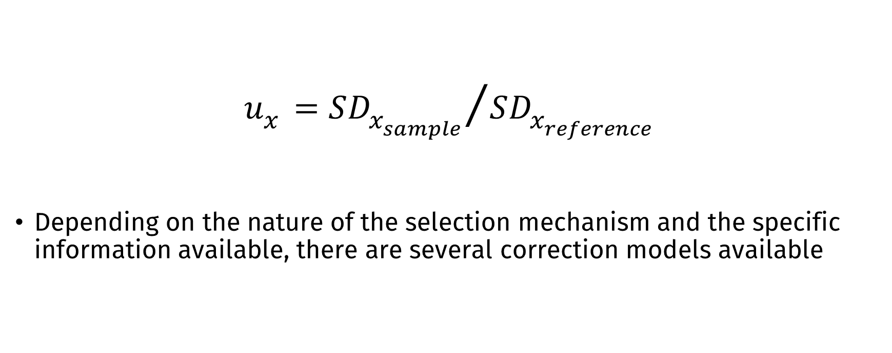
Quantifying and correcting selection bias
$$u_{x}={SD_{x_{sample}}}/{SD_{x_{reference}}}$$
Depending on the nature of the selection mechanism and the specific information available, there are several correction models available

Slide 31
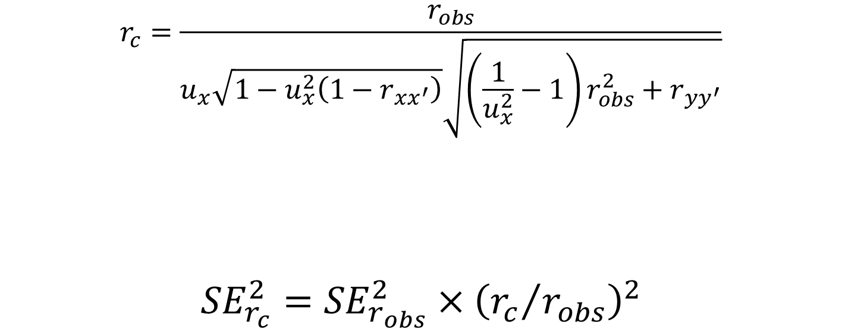
Example: Direct range restriction on X
$$r_{c}=\frac{r_{obs}}{u_{x}\sqrt{1−u_{x}^{2}\left(1−r_{xx^{′}}\right)}\sqrt{\left(\frac{1}{u_{x}^{2}}−1\right)r_{obs}^{2}+r_{yy^{′}}}}$$ $${SE}_{r_{c}}^{2}={SE}_{r_{obs}}^{2}×{\left({r_{c}}/{r_{obs}}\right)}^{2}$$

Slide 32
When should you correct for selection effects?
Should always be considered and discussed
Common selection effect corrections in psychmeta require
Linear relationships between predictor and outcome
Residual variances are equal in the selected sample and target population

Slide 33
Applying statistical corrections in R
library(psychmeta)
correct_r(
correction = "bvirr",
rxyi = .40, n = 150,
rxx = .80, ryy = .80,
ux = .90, uy = .80
)

Slide 34
Applying statistical corrections in R
correct_d(
correction = "uvirr_y",
d = .40, n1 = 75, n2 = 75,
rGg = .80, ryy = .80, uy = .80
)

Slide 35
Applying statistical corrections in R
ma_results_r <- ma_r(ma_method = "ic",
rxyi = rxyi, n = n,
rxx = rxxi, ryy = ryyi,
ux = ux, uy = uy,
data = data_r_bvirr
)
ma_results_d <- ma_d(ma_method = "ic",
d = d, n1 = n1, n2 = n2, ryy = ryyi, construct_y = construct, data = data_d_meas_multi)

Slide 36
Applying statistical corrections in R
es_data <- get_metafor(ma_results_d,
analyses = list(construct_y = "Y"),
ma_method = "ic",
correction_type = "ts"
)

Slide 37
Applying statistical corrections in R
ma_results_r <- ma_r(ma_method = "ad",
rxyi = rxyi, n = n,
rxx = rxxi, ryy = ryyi,
ux = ux, uy = uy, data = data_r_bvirr
)

Slide 38
Conclusions
Measurement error and selection effects are pervasive
Detrimental impacts of these artefacts on the validity of research conclusions have been widely documented
By applying carefully justified artefact corrections, our meta-analyses can better fulfill their research aims
Meta-analyses should routinely present observed results and results adjusted for plausible measurement and sampling artefacts

