Slide 1
Reporting Guidelines

Slide 2
Guidelines
APA Style JARS Table 9: Quantitative meta-analysis article reporting standards. American Psychological Association. https://apastyle.apa.org/jars/quant-table-9.pdf
The PRISMA 2020 statement: An updated guideline for reporting systematic reviews. BMJ, n71. https://doi.org/10/gjkq9b
PRISMA 2020 explanation and elaboration: Updated guidance and exemplars for reporting systematic reviews. BMJ, n160. https://doi.org/10/gjkrwz
PRISMA Group. (n.d.). PRISMA 2020 checklist. https://doi.org/10.1136/bmj.n71
PRISMA-S: An extension to the PRISMA Statement for Reporting Literature Searches in Systematic Reviews. Systematic Reviews, 10(1), 39. https://doi.org/10/gh2z2k

Slide 3
Conducting and Reporting a Systematic Review
Literature searches in systematic reviews and meta-analyses: A review, evaluation, and recommendations. Journal of Vocational Behavior, 118, 103377. https://doi.org/10/ggh2bx
How to do a systematic review: A best practice guide for conducting and reporting narrative reviews, meta-analyses, and meta-syntheses. Annual Review of Psychology, 70(1), 747–770. https://doi.org/10/gftjxg

Slide 4
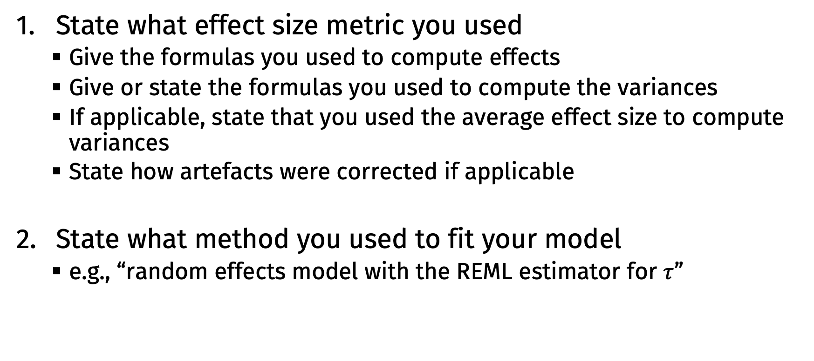
Reporting your model
State what effect size metric you used
Give the formulas you used to compute effects
Give or state the formulas you used to compute the variances
If applicable, state that you used the average effect size to compute variances
State how artefacts were corrected if applicable
State what method you used to fit your model
e.g., “random effects model with the REML estimator for $τ$”

Slide 5
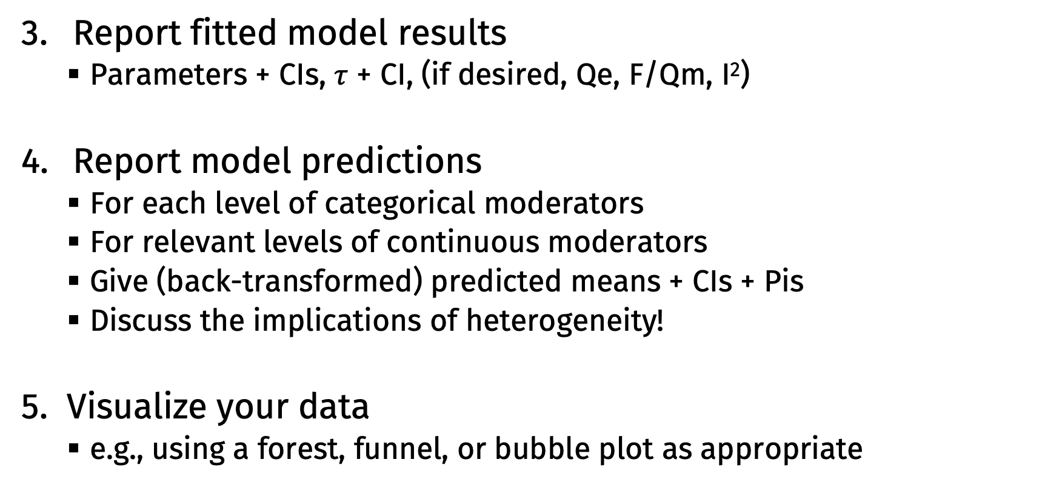
Reporting your model
Report fitted model results
Parameters + CIs, $τ$ + CI, (if desired, Qe, F/Qm, I²)
Report model predictions
For each level of categorical moderators
For relevant levels of continuous moderators
Give (back-transformed) predicted means + CIs + Pis
Discuss the implications of heterogeneity!
Visualize your data
e.g., using a forest, funnel, or bubble plot as appropriate

Slide 6
Reporting your model
Discuss publication bias
Is it a concern?
Report funnel plots, regression tests, cumulative meta-analysis/WAAP
Consider other publication bias models as well
Discuss limitations of generalizability
Study populations, settings, etc.
Overall quality / threats to validity of the included studies
Share your data and analysis script in a public repository
e.g., https://osf.io

