Slide 1
Dependent Effects
Multilevel, Multivariate, and Robust Meta-Analysis

Slide 2
Dependency
Most meta-analyses include studies that report multiple outcomes
Multiple outcomes for same group
e.g., infection, severe disease, death
e.g., Extraversion, Conscientiousness, Agreeableness
Shared samples
e.g., multiple time points or publications
e.g., common control group
Overlapping influences
e.g., Overlapping geographic locations
e.g., Same lab or research group

Slide 3
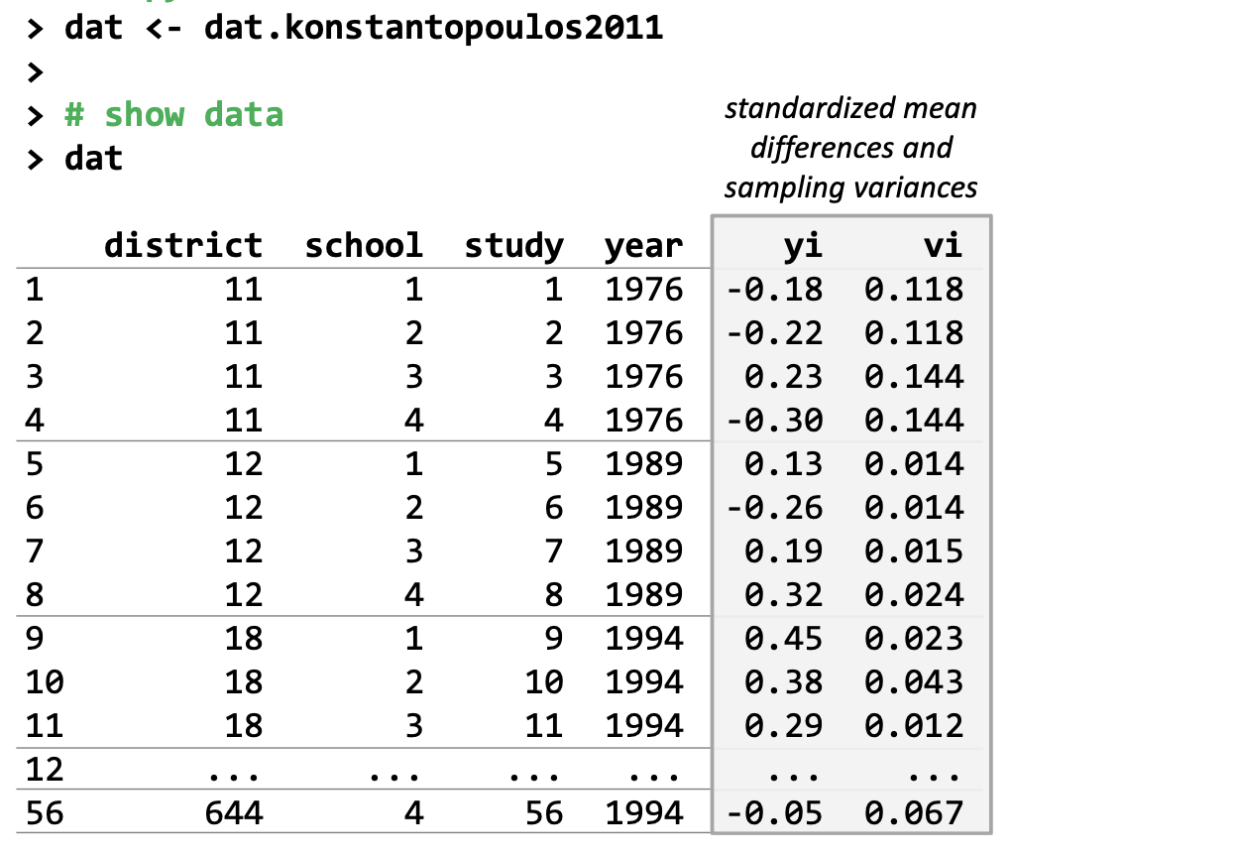
Example: Multilevel structure

Slide 4
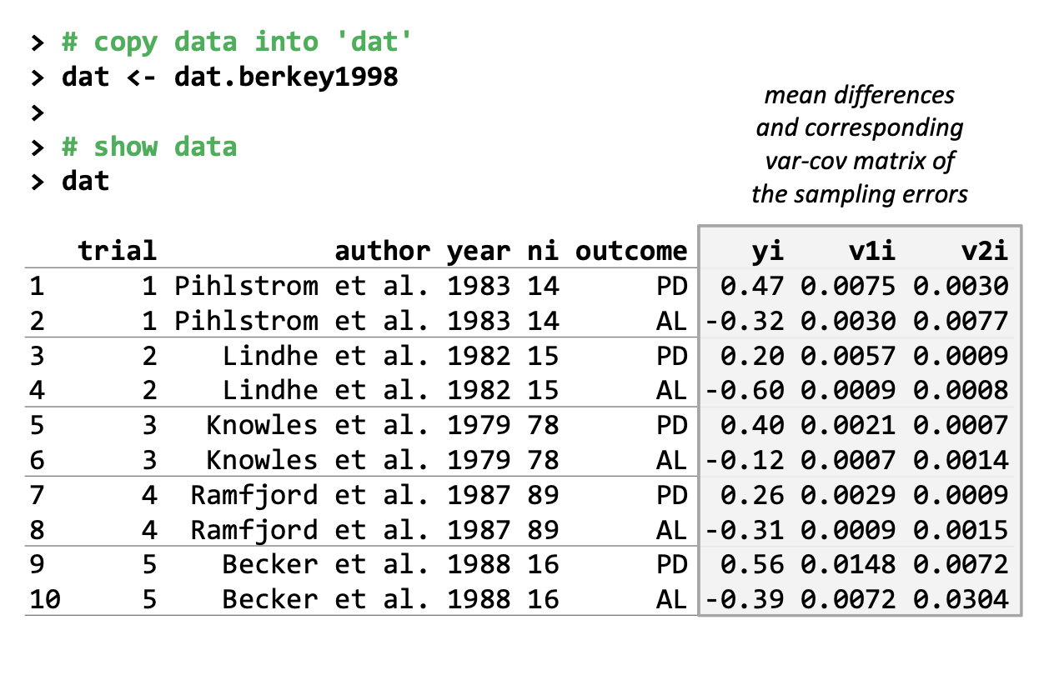
Example: Multiple outcomes

Slide 5
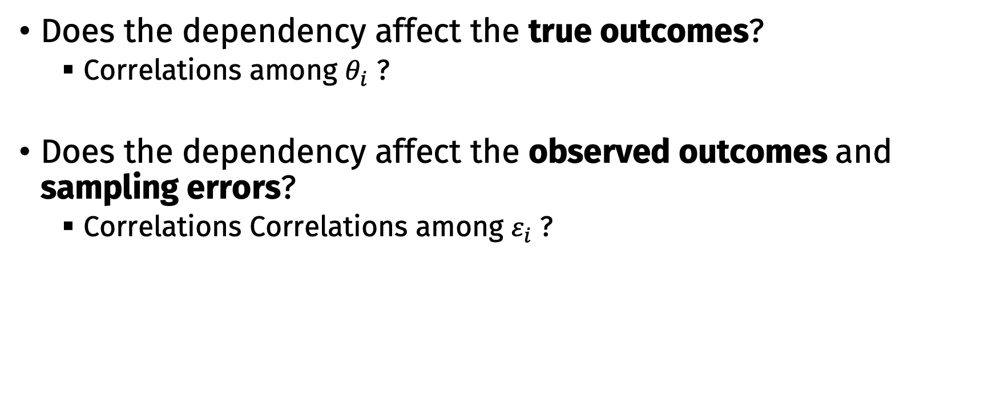
Key question about dependency
Does the dependency affect the true outcomes?
Correlations among $θ_{i}$ ?
Does the dependency affect the observed outcomes and sampling errors?
Correlations Correlations among $ε_{i}$ ?

Slide 6
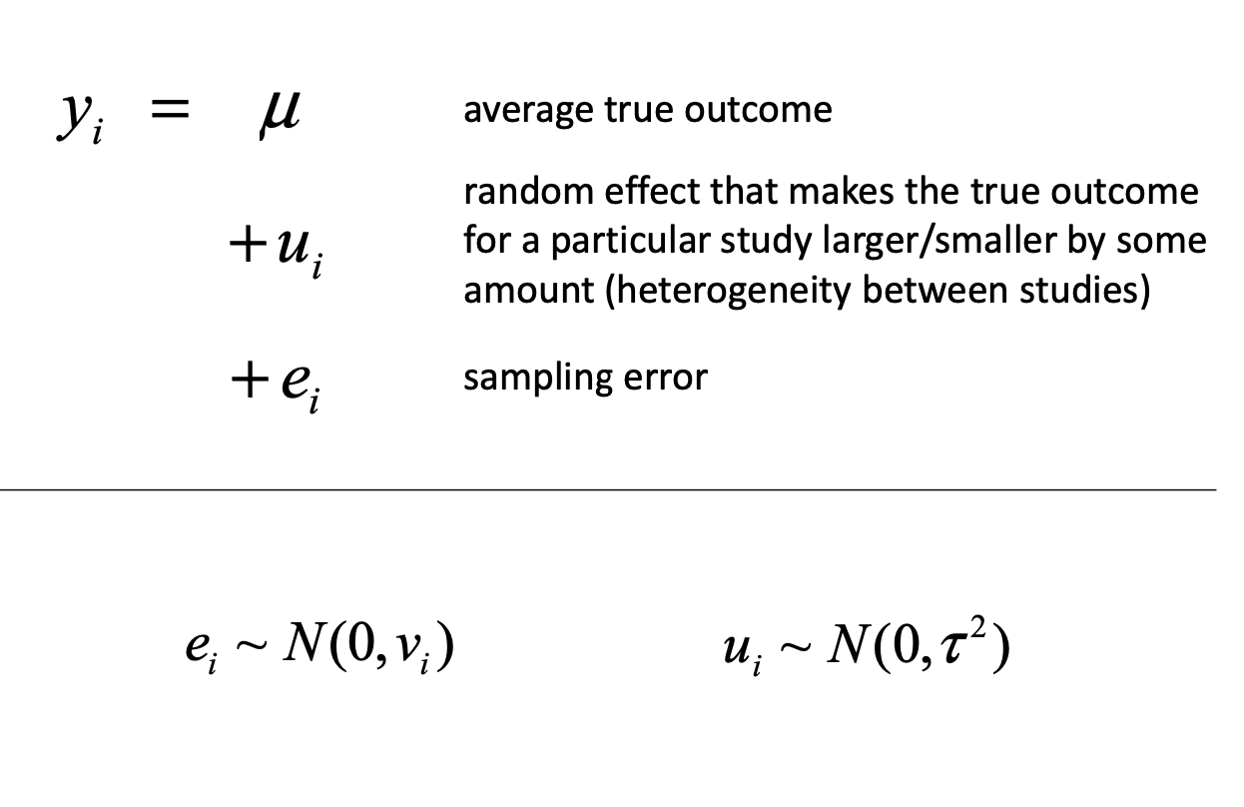
Standard random effects model

Slide 7
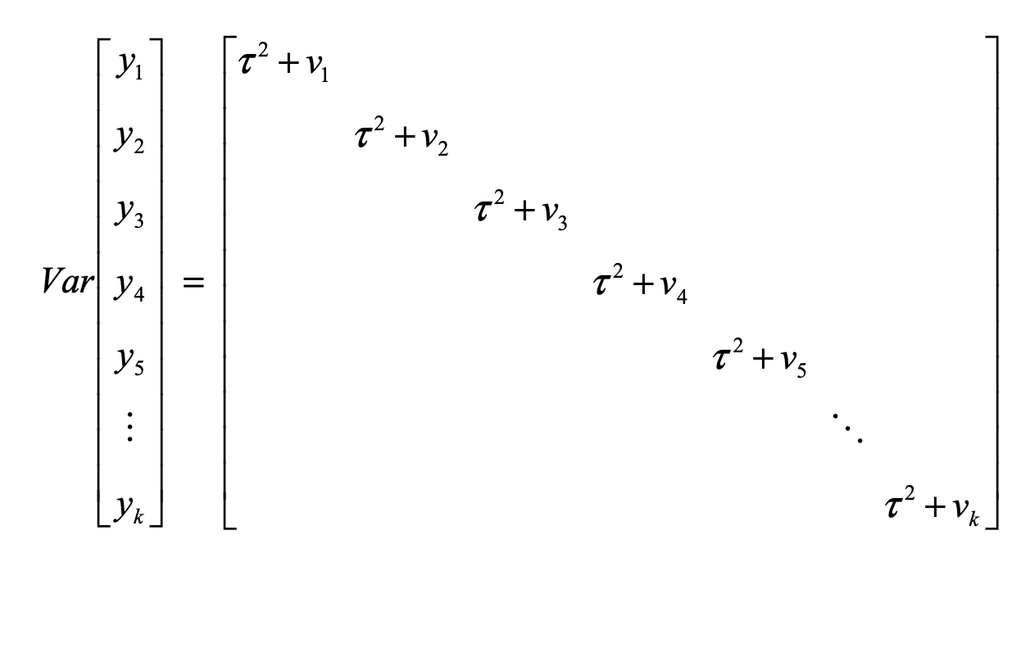
Implied marginal variance-covariance matrix

Slide 8
rma.mv() vs rma()
The rma.mv() function is similar to rma() [or rma.uni()]
More flexible, can handle complex random effects and correlated errors
Need to specify the random effects structure specifically
rma(yi = yi ~ 1, vi = vi,
method = "REML", data = dat)
rma.mv(yi = yi ~ 1, vi = vi,
random = ~ 1 | study,
method = "REML", data = dat)

Slide 9
Handling dependency
Data reduction
Select one effect size
Compute average effect size
Compute composite effect size
Robust variance estimation
Modeling dependency structure

Slide 10
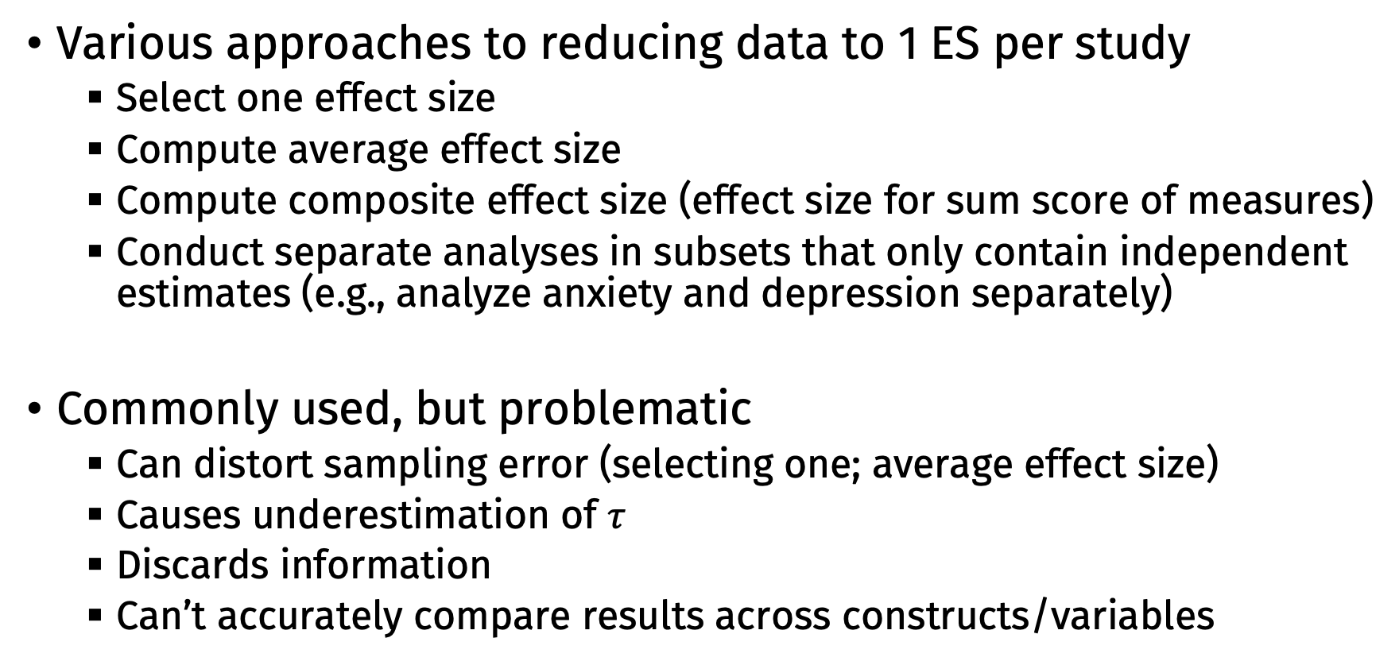
Data reduction
Various approaches to reducing data to 1 ES per study
Select one effect size
Compute average effect size
Compute composite effect size (effect size for sum score of measures)
Conduct separate analyses in subsets that only contain independent estimates (e.g., analyze anxiety and depression separately)
Commonly used, but problematic
Can distort sampling error (selecting one; average effect size)
Causes underestimation of $τ$
Discards information
Can’t accurately compare results across constructs/variables

Slide 11
Robust variance estimation
Fit the model as normal, but adjust SEs, p values, CIs to account for dependency (clustering)
Doesn’t adjust parameter estimates for any influences of clustering
Advantages:
Easy to apply
Can yield accurate intervals and tests with just clustering information
Disadvantages:
Doesn’t account for impact of dependency on parameter estimates
Can be inefficient

Slide 12
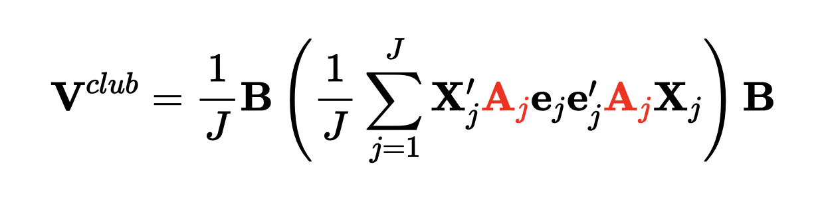
Robust variance estimation
For more details: https://www.jepusto.com/files/clubsandwich

Slide 13
R Code

Slide 14
RVE + Multilevel/Multivariate Models
You can combine robust estimation with multilevel/multivariate estimation to handle potential misspecifications in the structure

Slide 15
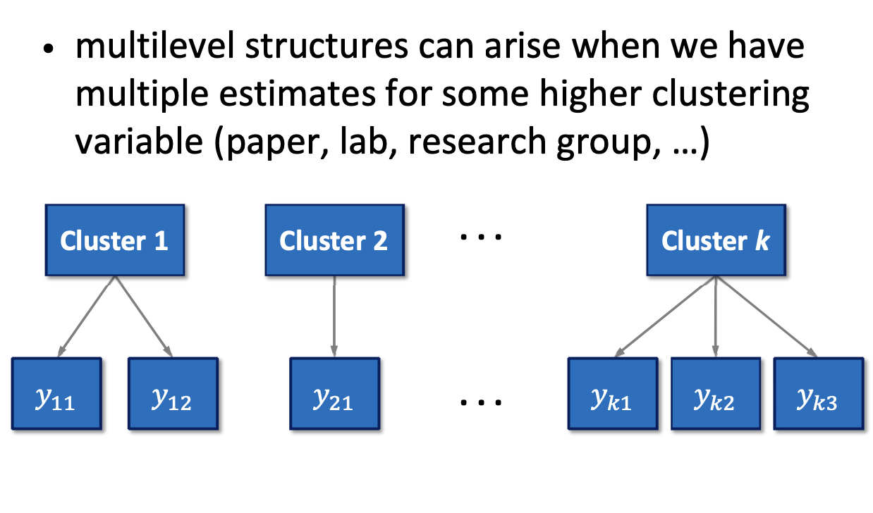
Multilevel meta-analysis

Slide 16
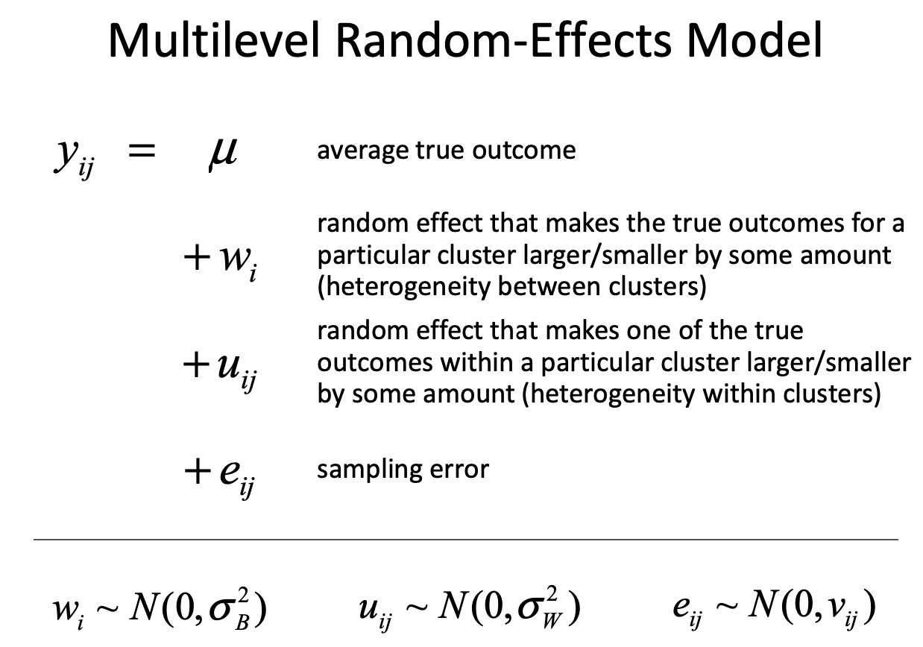

Slide 17
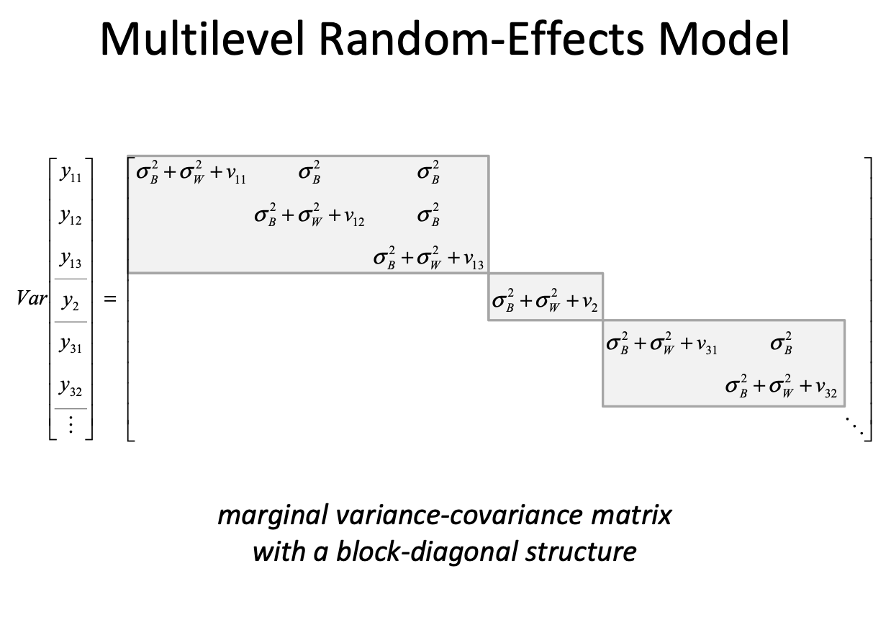

Slide 18
Specifying a multilevel model
In rma.mv(), specify nested random effects:
random = ~ 1 | var1 / var2 adds a random effect for each level of var1 and a random effect for each level of var2 within each level of var1

Slide 19
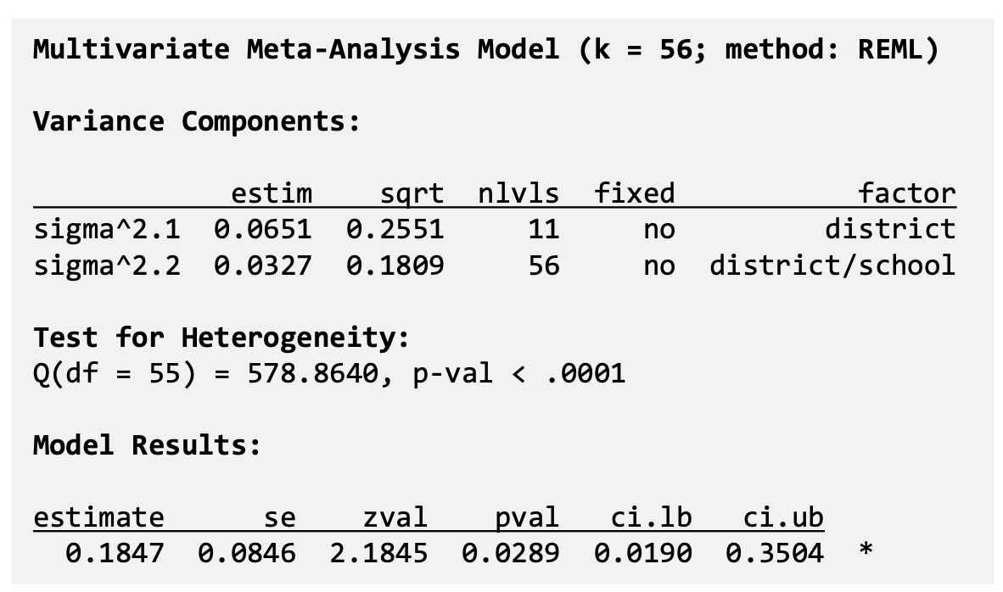
Specifying a multilevel model

Slide 20
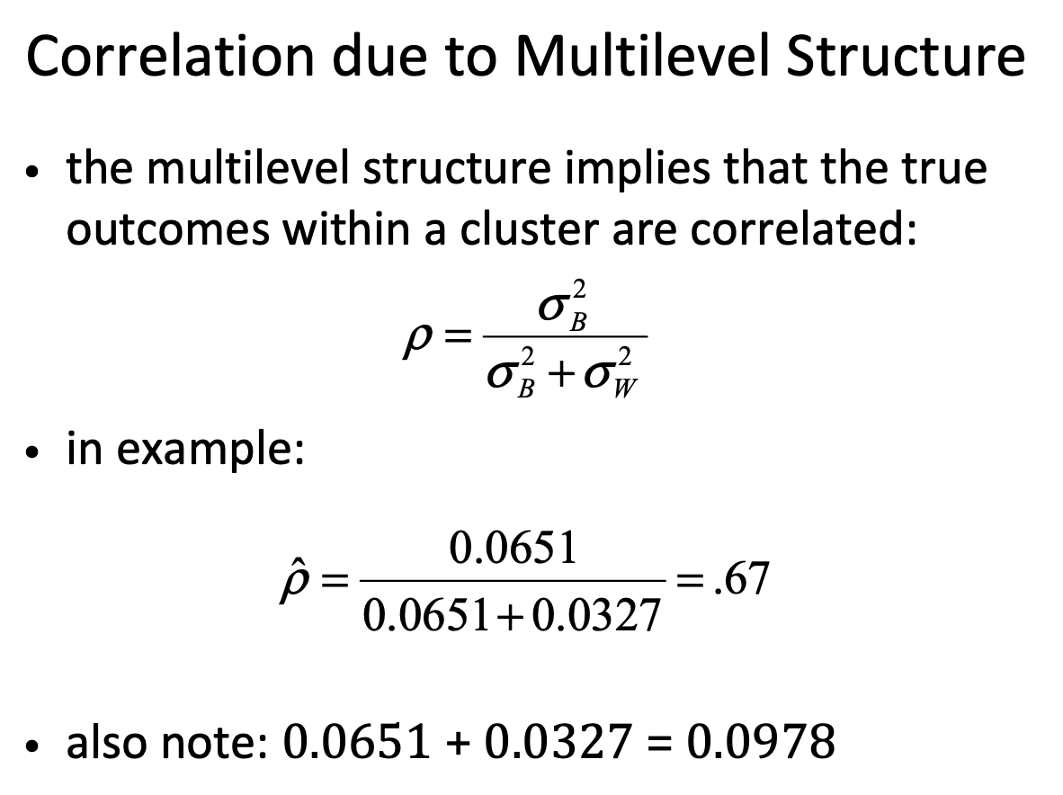

Slide 21
Note
The random effect at the level of the clustering variable does not replace the random effect at the observation/estimate level!
We add the clustering level random effect to the standard random/mixed-effects model
(Otherwise you assume that there is no heterogeneity within clusters = assuming that the within-cluster correlation is 1)

Slide 22
Note
This model only considers correlations among the true outcomes (random effects)
It assumes independent sampling errors within clusters
This is sensible if no overlap in the data/subjects used to compute outcomes
Examples:
multiple independent studies reported in paper
multiple papers published by the same group
results reported for different subgroups

Slide 23
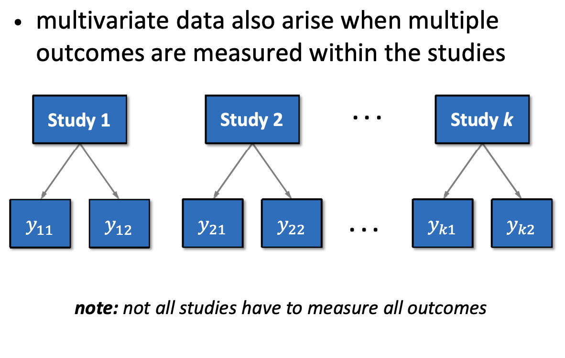
Multivariate (correlated outcomes) meta-analysis

Slide 24
Multiple correlated outcomes
Since the outcomes are measured in the same subjects, the sampling errors are correlated
True outcomes may also be correlated
Equations for the covariance between the sampling errors of various outcome measures can be found in Gleser & Olkin (2009), Wei & Higgins (2013), Steiger (1980), …
Common problem: information needed to compute covariances not available

Slide 25
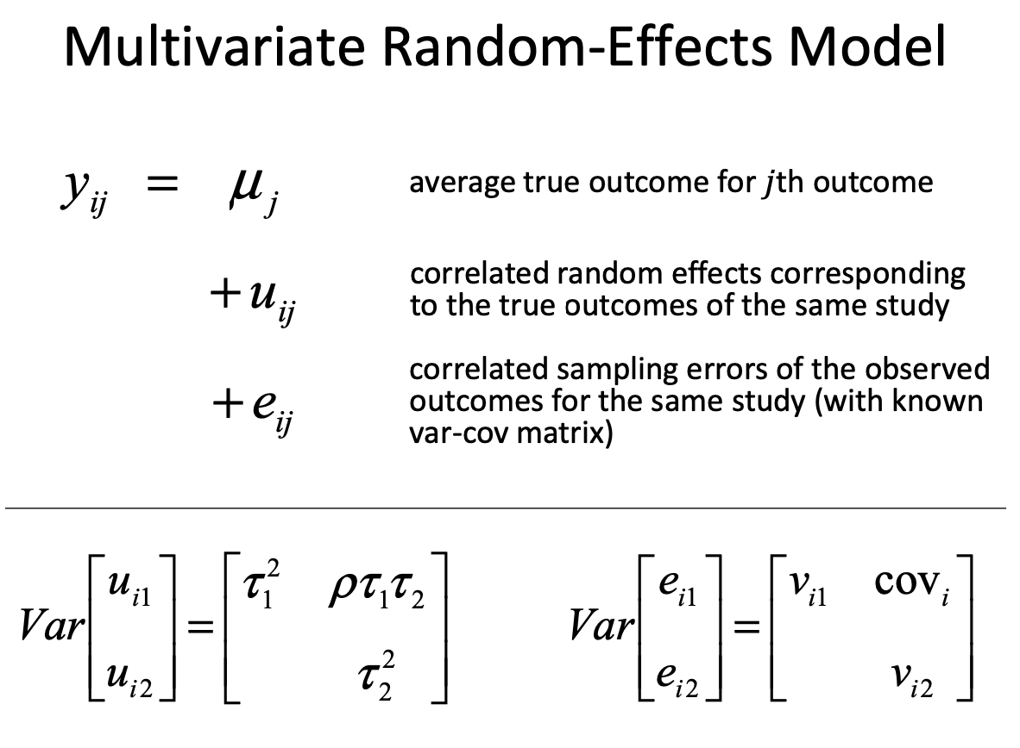

Slide 26
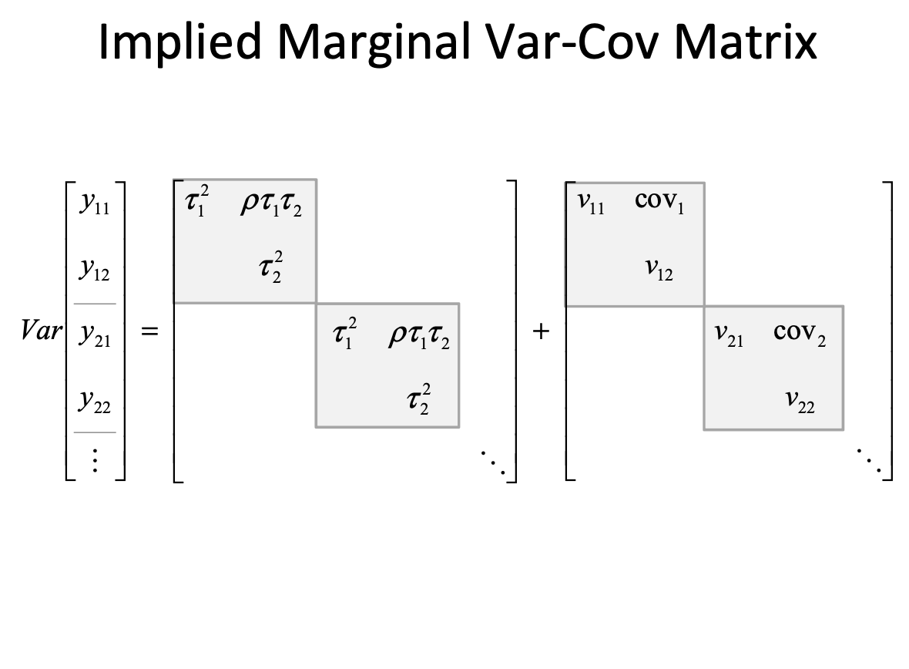

Slide 27
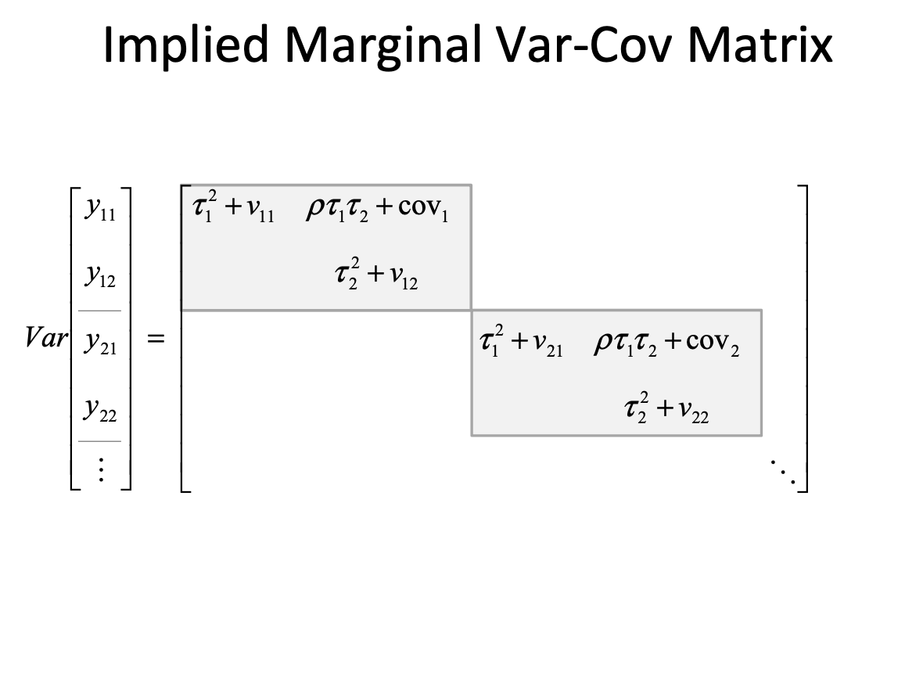

Slide 28
Periodontal disease data

Slide 29
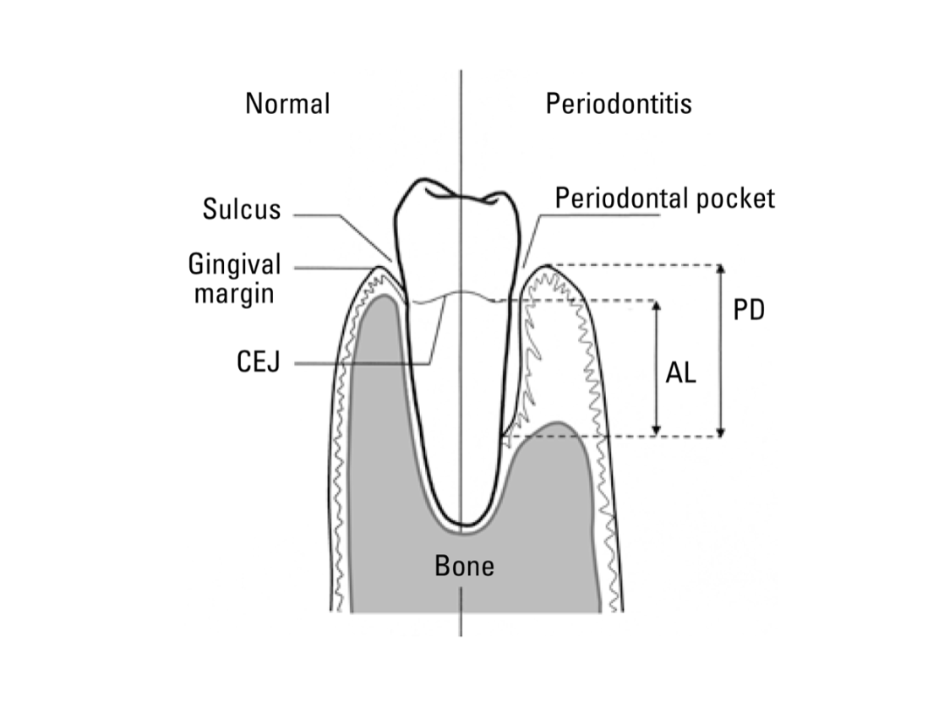

Slide 30
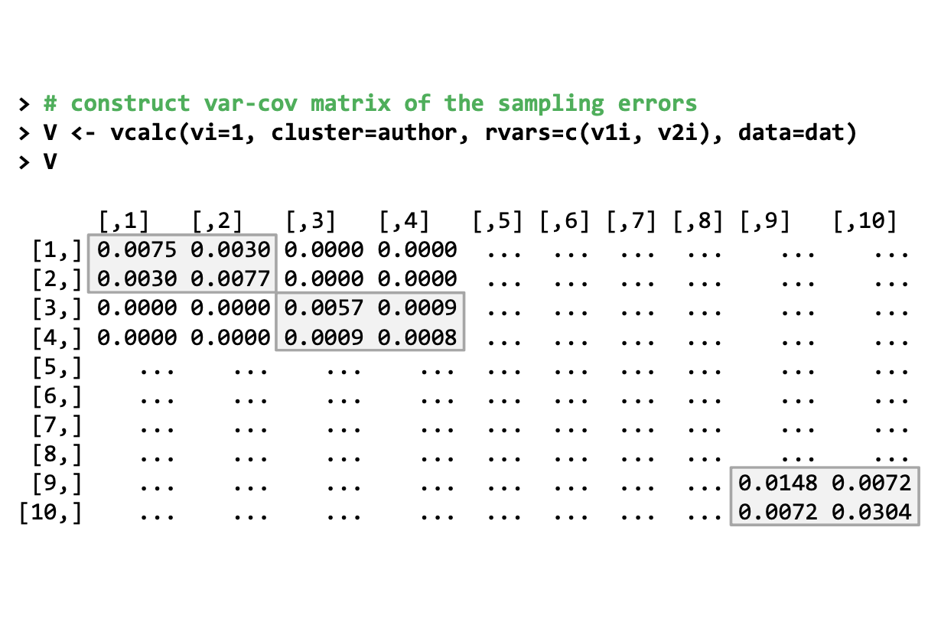
Constructing a within-sample covariance matrix (V)

Slide 31
Options for constructing V
Ideal: Use rvars and give the whole matrix for each study
Realistic: Make some assumptions (“guesstimates”)
obs = column indicating the measure used for different measures of the same concept
type = column indicating the construct/concept being measured
rho = assumed correlation(s) for outcomes measured at the same time
rho can be a single number or a matrix giving values for each pair
If both obs and type are specified, rho should be a list() giving the information for each

Slide 32
Options for constructing V
Realistic: Make some assumptions (“guesstimates”)
time1 = column indicating the time a measure was taken
phi = assumed correlation(s) for outcomes measured at the same time
grp1,grp2 = column indicating the time a measure was taken
phi = assumed correlation(s) for outcomes measured at the same time
The various arguments an be combined depending on the complexity of your study

Slide 33
Options for constructing V
For correlations, if you have multiple constructs/concepts (type)
Use rcalc() instead of vcalc() to construct V
This function can appropriately handle correlations with some overlapping variables versus not

Slide 34
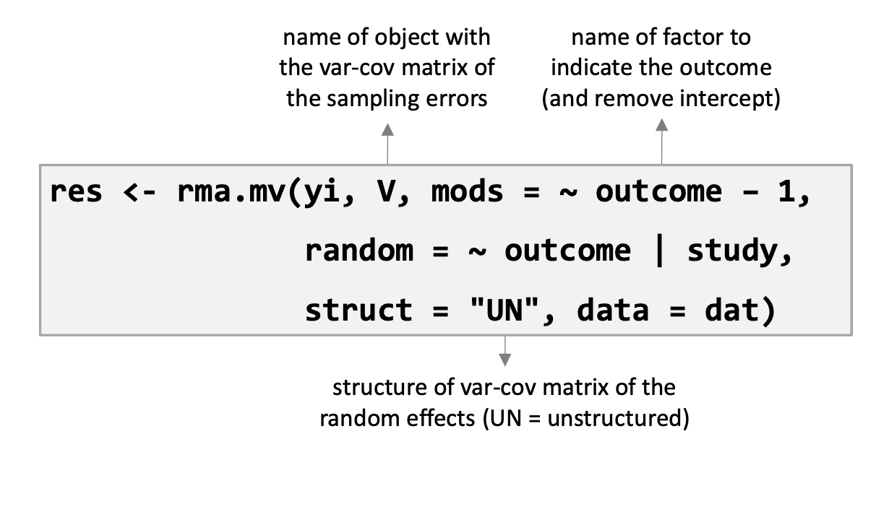

rma.mv()
+ 0

Slide 35
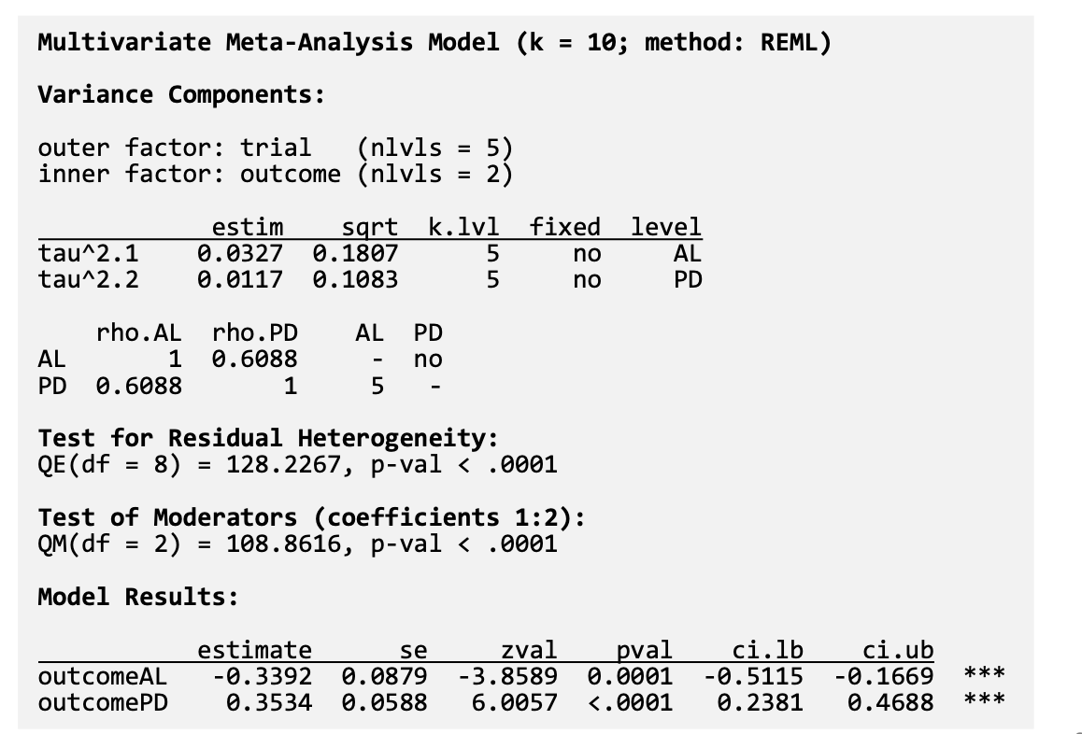

Slide 36
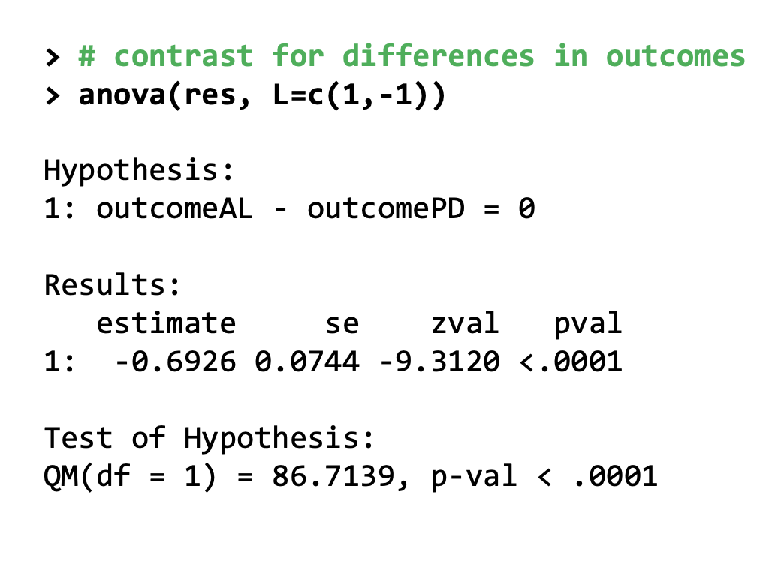

Slide 37
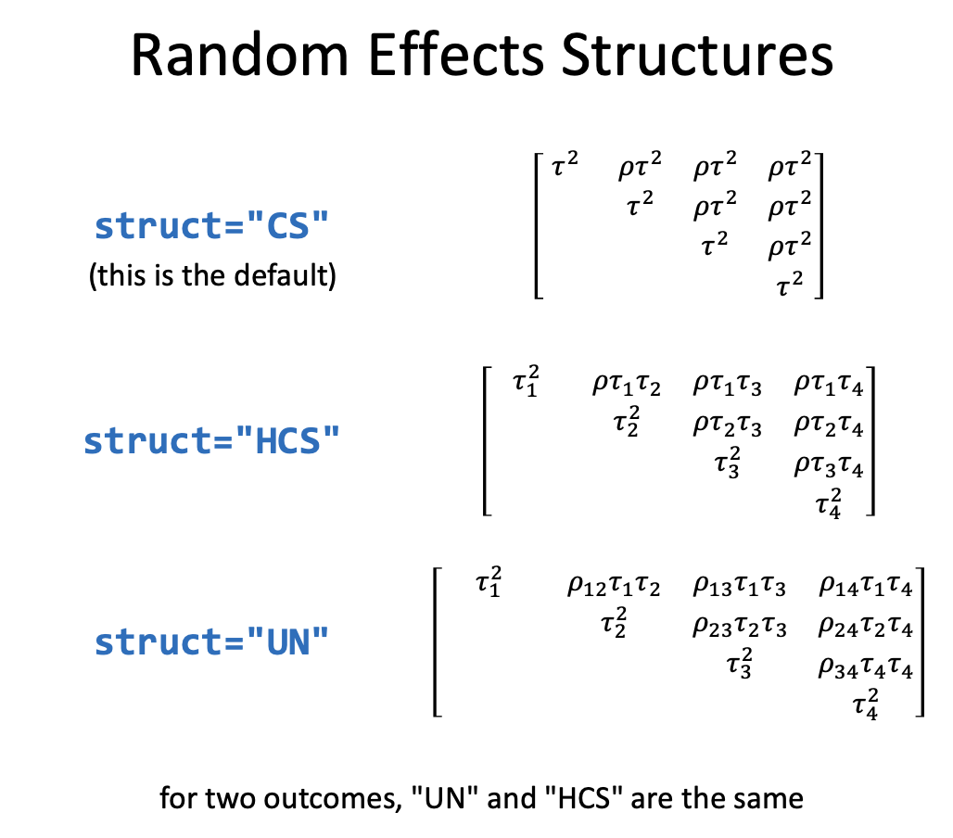

Slide 38
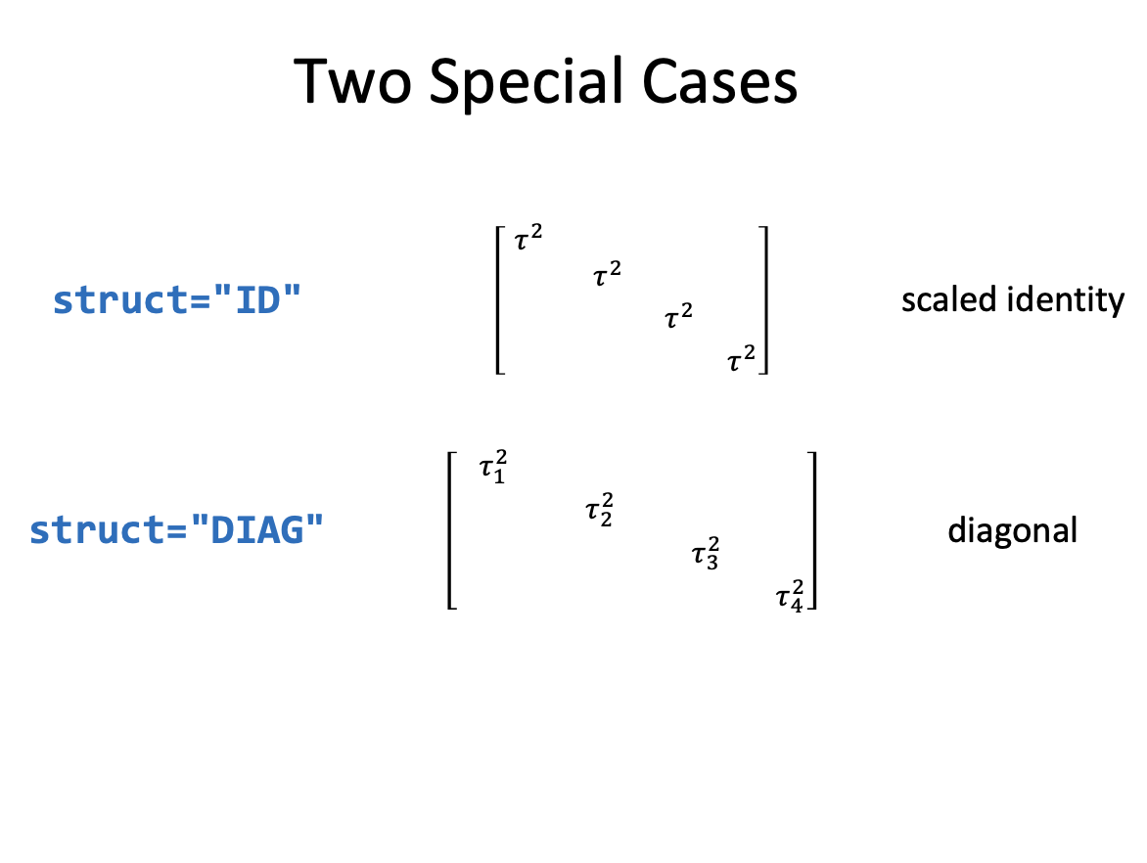

Slide 39
Additional cases
Multiple Time Points
Use autoregressive structure in V (time1 in vcalc()) and for the random effects (struct = "AR" or struct = "HAR")
Spatial data
Incorporate spatial correlation into random effects (e.g., struct = "SPEXP" or struct = ”SPGAU")
Common control group
Incorporate shared groups into V (grp1 and grp2 in vcalc())

