Slide 1
Sensitivity Analyses and Assumption Checks

Slide 2
Meta-Regression Assumptions
No outliers: Results are not overly influenced by 1 or 2 studies
Linearity : Correct functional form between continuous predictors and response (e.g., linear, could also be polynomial, splines, etc.)
Independence : Data points are independent of each other
Homogeneity of variance : Variance of residuals and τ is constant across groups/predictor levels
Normality of random effects : Residuals and u_{i} are normally distributed

Slide 3
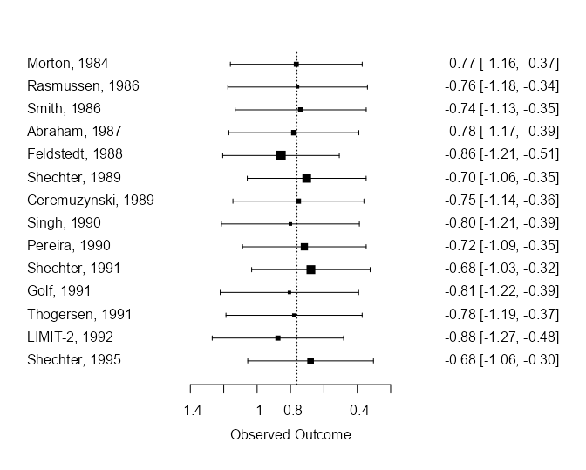
Detecting Influential Points: Leave-1-Out Analysis
Re-run the analyses, leaving out 1 study each time
Examine how model results change each time
mod_loo <- leave1out(mod_mg)
> range(mod_loo$estimate)
[1] -0.8753711 -0.6776824
> range(sqrt(mod_loo$tau2))
[1] 0.2792188 0.4334259

Slide 4
Influence diagnostics
Weight
Do 1 or 2 studies have much larger weight than others?
Do these essentially determine the whole result?
weights(mod); rma(weights = wt)
Cook’s Distance
Measure of “leverage”
How much do predicted values change if a case is excluded?
Values bigger than qchisq(.50, p) can be interpreted as substantial leverage

Slide 5
Influence diagnostics
rstudent dffits cook.d cov.r tau2.del QE.del hat weight dfbs inf
Morton, 1984 -0.0275 0.0233 0.0006 1.1151 0.1522 19.6249 0.0220 2.2042 0.0230
Rasmussen, 1986 -0.3294 -0.0220 0.0005 1.2505 0.1763 18.1350 0.1235 12.3523 -0.0221
Smith, 1986 -0.6068 -0.1256 0.0165 1.1026 0.1461 18.7570 0.0451 4.5142 -0.1254
Abraham, 1987 0.5400 0.1073 0.0120 1.0845 0.1543 19.5877 0.0167 1.6691 0.1059
Feldstedt, 1988 2.0850 0.6278 0.3114 0.8717 0.1308 17.2443 0.0986 9.8595 0.6293
Shechter, 1989 -1.5573 -0.3505 0.1151 0.9068 0.1205 16.7874 0.0287 2.8741 -0.3611
Ceremuzynski, 1989 -0.3799 -0.0485 0.0025 1.1016 0.1479 19.3051 0.0252 2.5163 -0.0483
Singh, 1990 0.2941 0.2208 0.0532 1.2217 0.1850 19.6156 0.0935 9.3470 0.2193
Pereira, 1990 -1.2075 -0.2590 0.0663 0.9810 0.1293 17.6889 0.0289 2.8919 -0.2637
Shechter, 1991 -1.6114 -0.5052 0.2364 0.9012 0.1073 16.0787 0.0498 4.9841 -0.5244
Golf, 1991 0.3549 0.2518 0.0697 1.2291 0.1879 19.6348 0.1010 10.0989 0.2511
Thogersen, 1991 0.0314 0.0986 0.0104 1.1905 0.1721 19.4877 0.0697 6.9694 0.0972
LIMIT-2, 1992 1.7747 0.8538 0.4433 1.1081 0.0780 12.7145 0.2164 21.6445 0.7469 *
Shechter, 1995 -1.2264 -0.4836 0.2259 1.0143 0.1129 16.4793 0.0807 8.0746 -0.4915

Slide 6
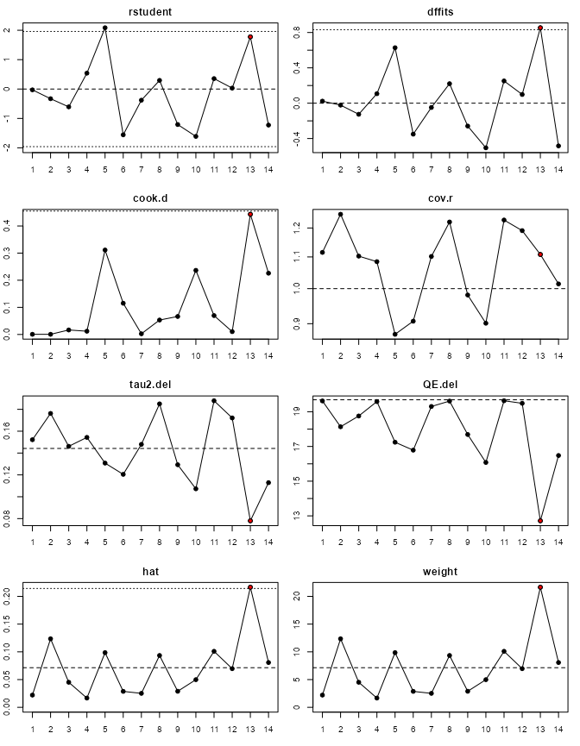
Influence diagnostics
If you have highly influential studies, consider reporting results with and without the study
But be cautious! Remember the LIMIT-2 study here was the best guess!

Slide 7
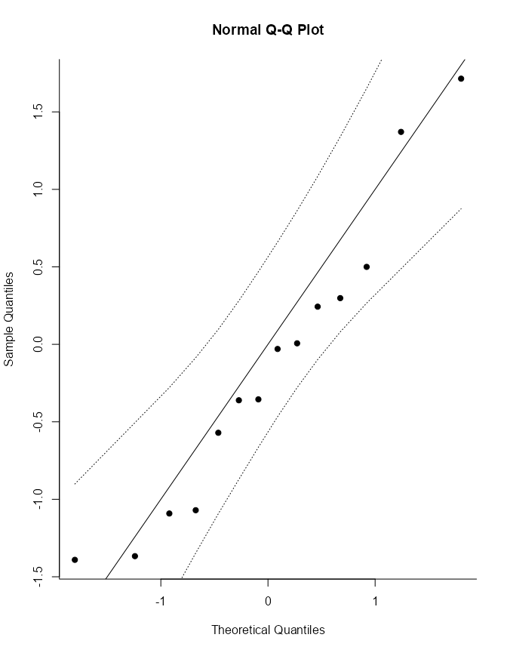
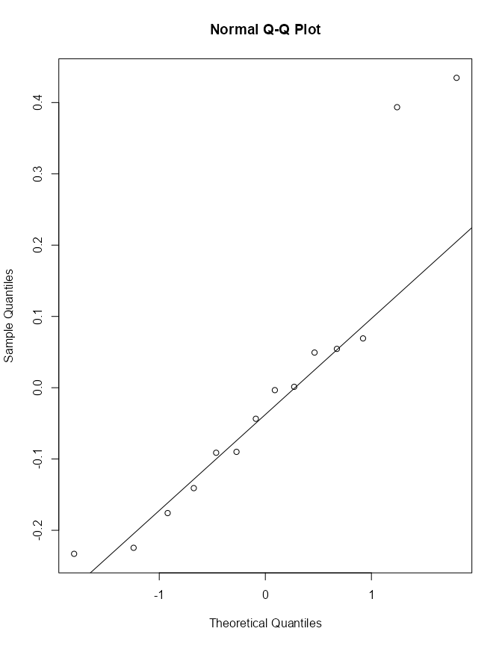
Assessing normality assumptions
Residuals
Random effects

Slide 8
Addressing non-normality
Consider dropping studies well outside the assumed normal distribution
Interpret prediction intervals with caution – they will generally be too wide
Consider focusing on BLUP estimates for the more typical studies rather than the full prediction interval

Slide 9
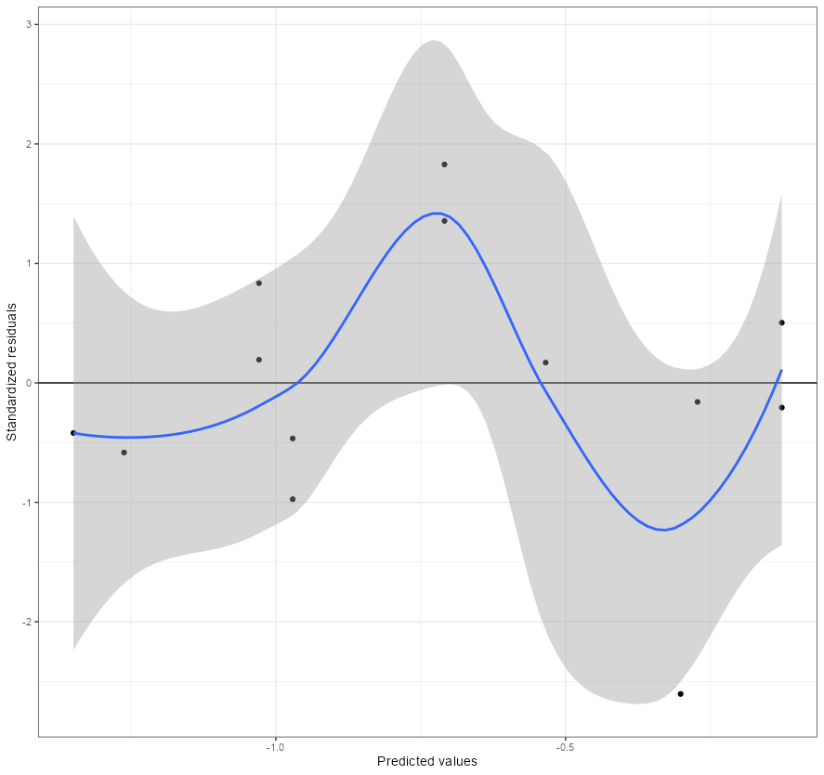
Meta-Regression: Linearity
Plot predicted values against standardized residuals
A clear nonlinear trend would suggest nonlinearity in the predictor–outcome relationship or a missing moderator
Explore other relationships or moderators

Slide 10
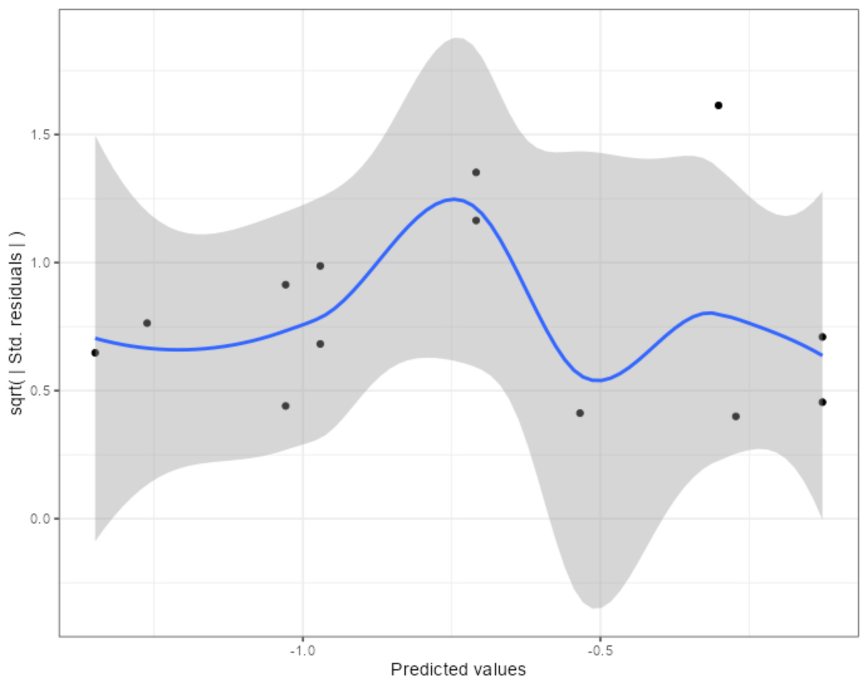
Meta-Regression: Homogeneity of residual variance
Plot predicted values against square-root absolute standardized residuals
A clear nonlinear trend would suggest uneven heterogeneity of residual variance
Usually means a missing moderator
Or use a better transformation of the outcome (e.g., ZCOR instead of UCOR)

Slide 11
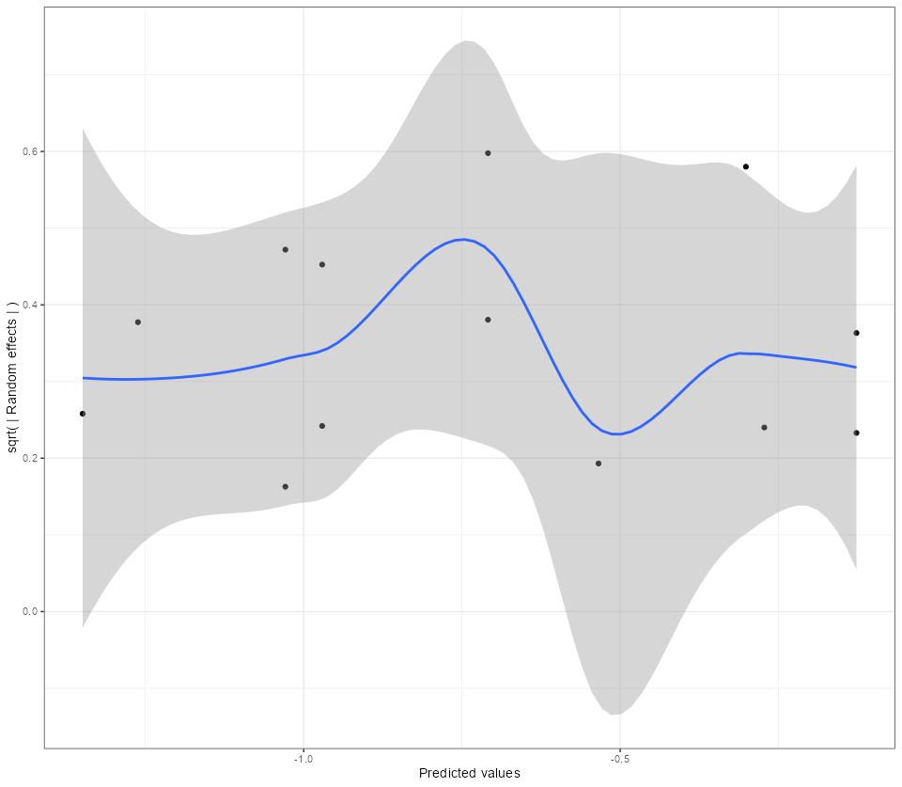
Meta-Regression: Homogeneity of random effects
Plot predicted values against square-root absolute random effects estimates
A clear nonlinear trend would suggest uneven heterogeneity of true outcome variance
Usually means a missing moderator

