Slide 1
Moderator Analysis
Meta-Regression
Subgroup Analysis

Slide 2
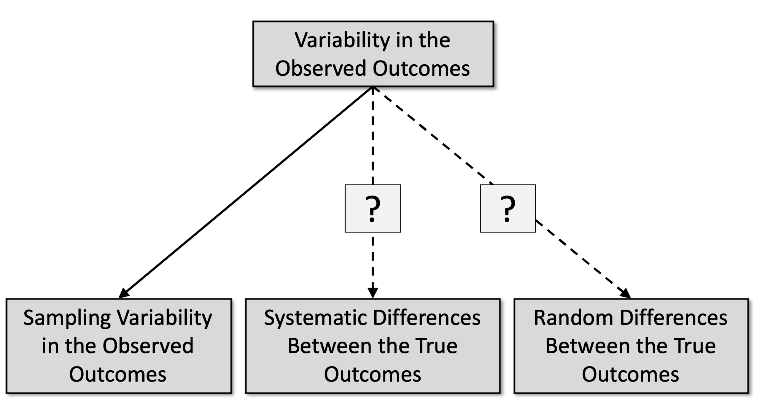
Sources of Variability in Outcomes

Slide 3
Moderator variables
Study-level variables that may be associated with the size of the outcomes
Individual participant data (IPD) meta-analysis can handle individual-level moderators
Types of moderators
substantive variables (features of the treatment, context, participants, etc.)
methodological variables (e.g., randomized versus non-randomized study, cross-sectional vs predictive)
“extrinsic” variables (e.g., publication year, published/unpublished)

Slide 4
Example: BCG vaccine
Nonpathogenic environmental bacteria
May provide a natural immunity against TB
Are more prevalent closer to the equator
Thus, BCG vaccine may appear to be less effective when closer to the equator
Absolute latitude of study site may thus be a moderator of BCG vaccine efficacy

Slide 5
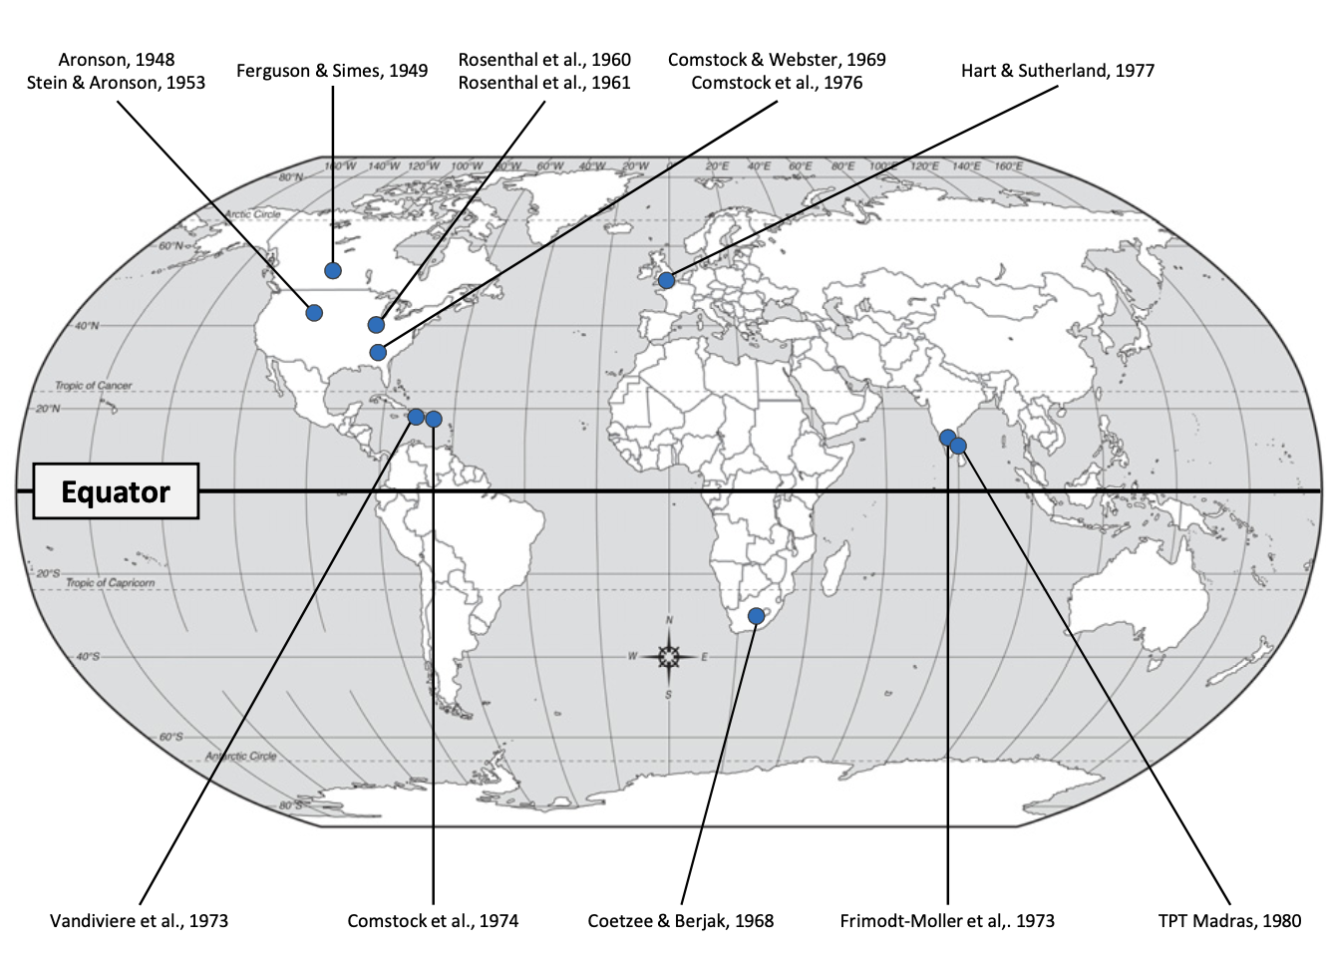

Slide 6
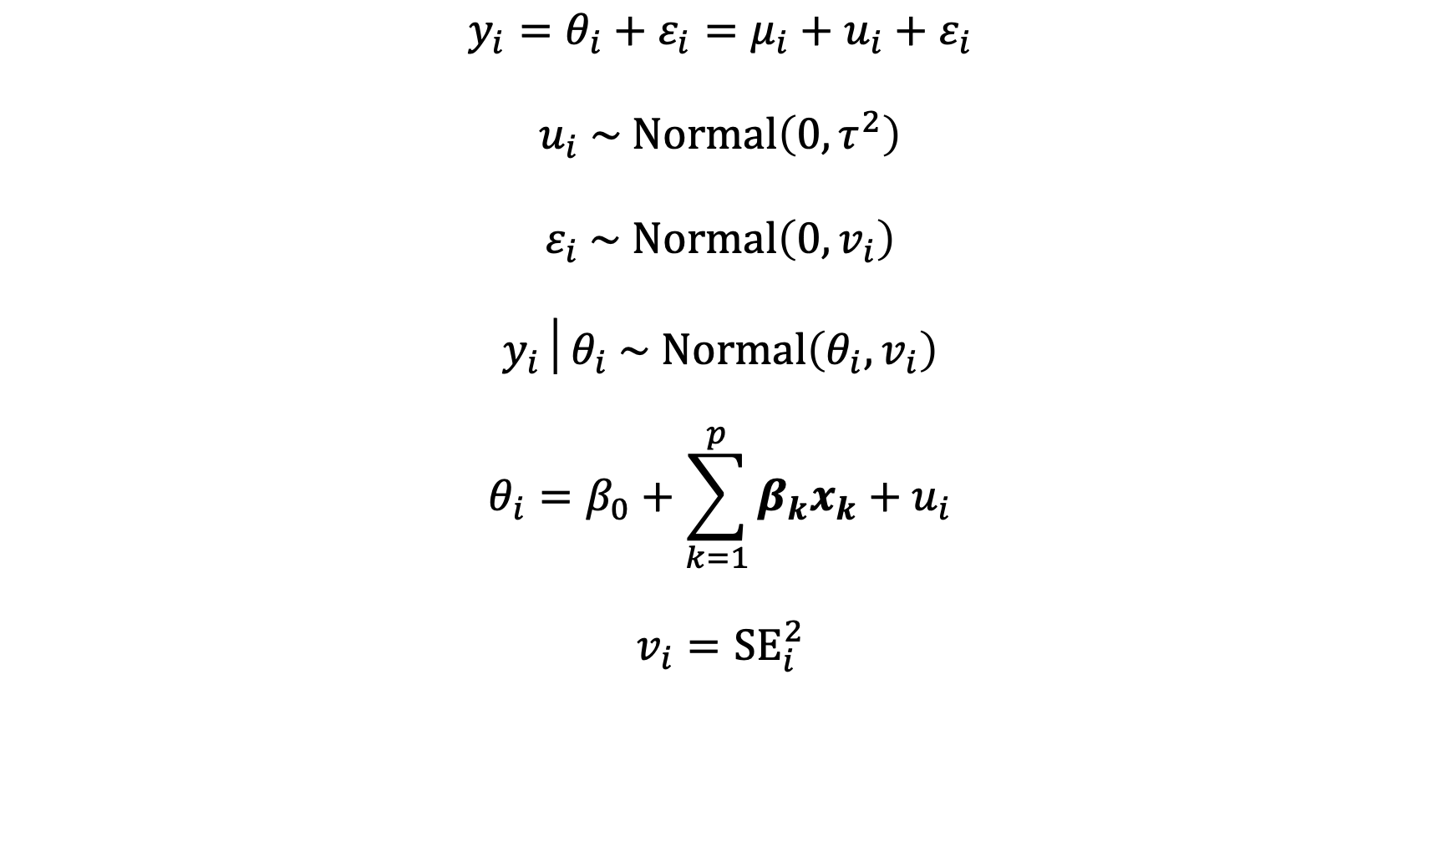
Adding predictors to a meta-analysis model
$$y_{i}=θ_{i}+ε_{i}=μ_{i}+u_{i}+ε_{i}$$
$$u_{i} \sim Normal\left(0,τ^{2}\right)$$
$$ε_{i} \sim Normal\left(0,v_{i}\right)$$
$$y_{i}│θ_{i} \sim Normal\left(θ_{i},v_{i}\right)$$
$$θ_{i}=β_{0}+\sum_{k=1}^{p}{β_{k}x_{k}}+u_{i}$$
$$v_{i}={SE}_{i}^{2}$$

Slide 7
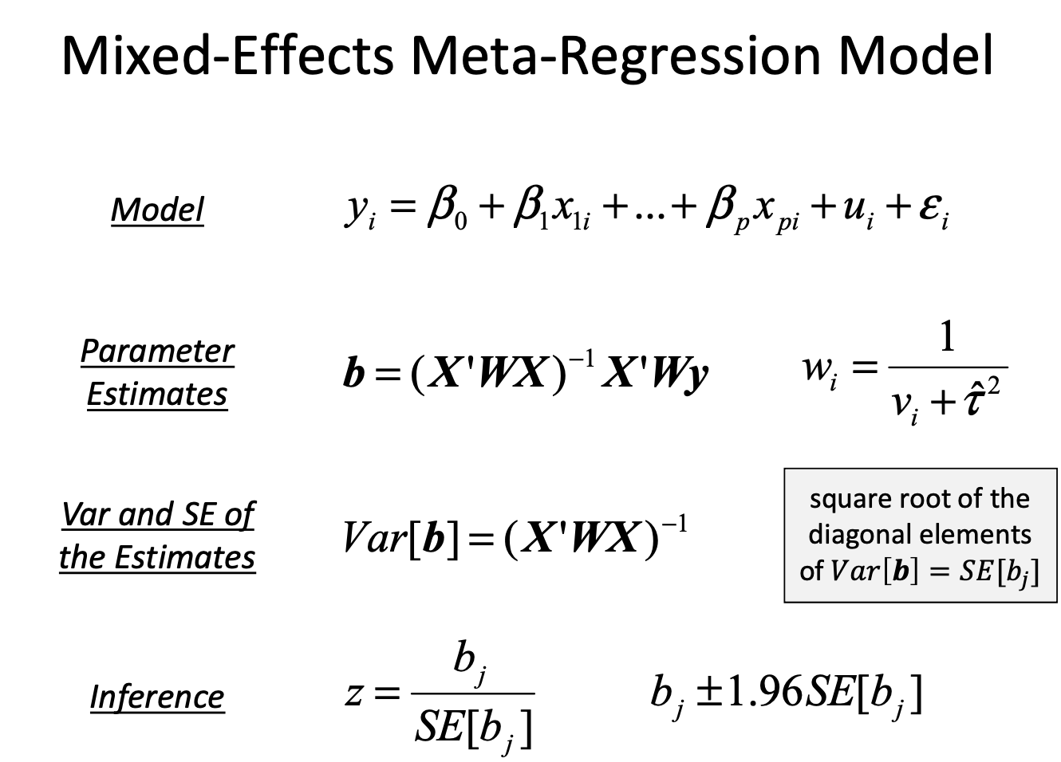

Slide 8
Meta-regression is just regression!
A meta-regression is just a regression model!
Response (outcome) variable: observed effect size y_{i}
Predictors: study/group-level moderators

Slide 9
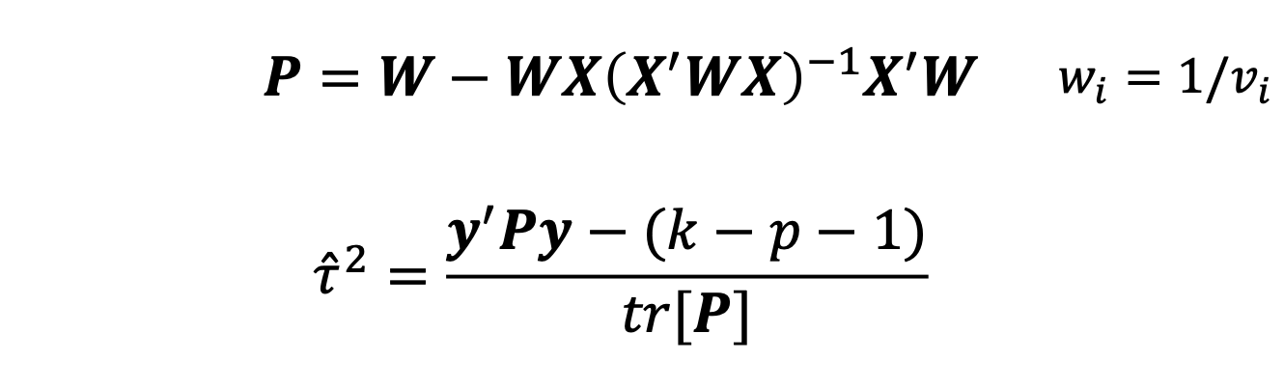


Estimating $τ^{2}$ in a mixed effects model
Variance accounted for the predictors is subtracted out from $τ^{2}$
e.g., the DL estimator:

Slide 10
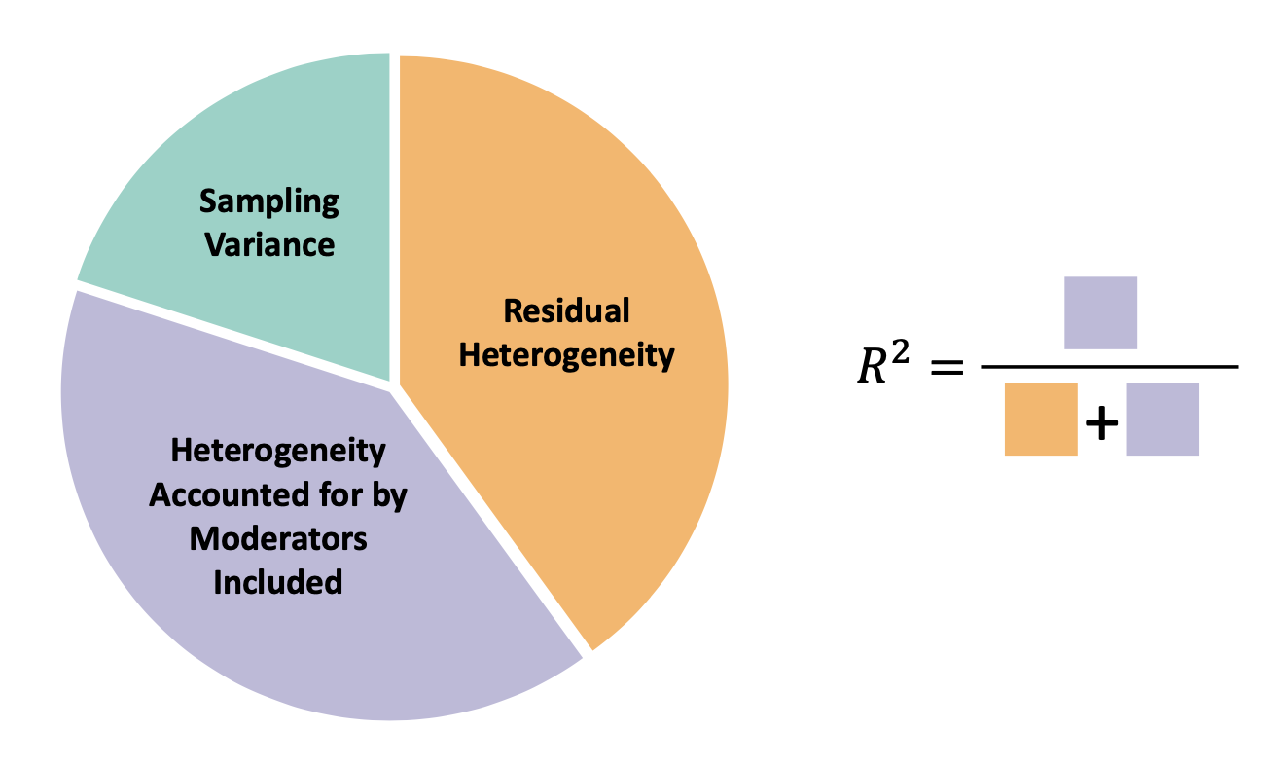
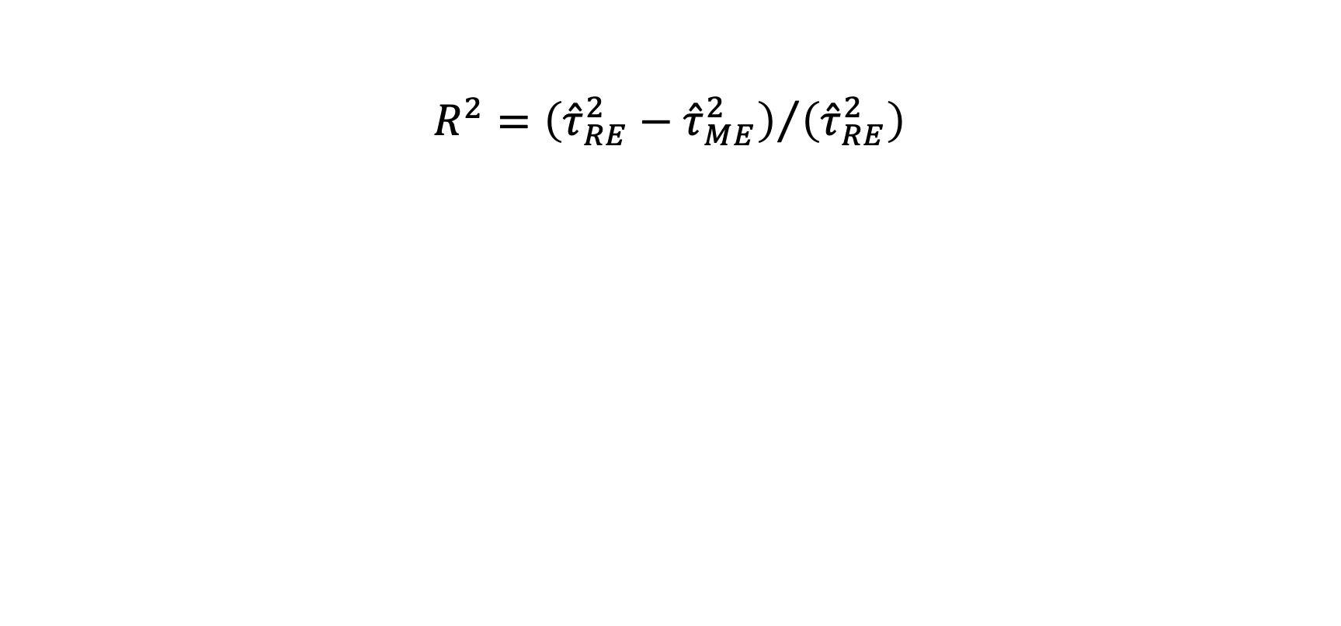
Pseudo-R² value
$$R^{2}={\left({\hat{τ}}_{RE}^{2}−{\hat{τ}}_{ME}^{2}\right)}/{\left({\hat{τ}}_{RE}^{2}\right)}$$

Slide 11
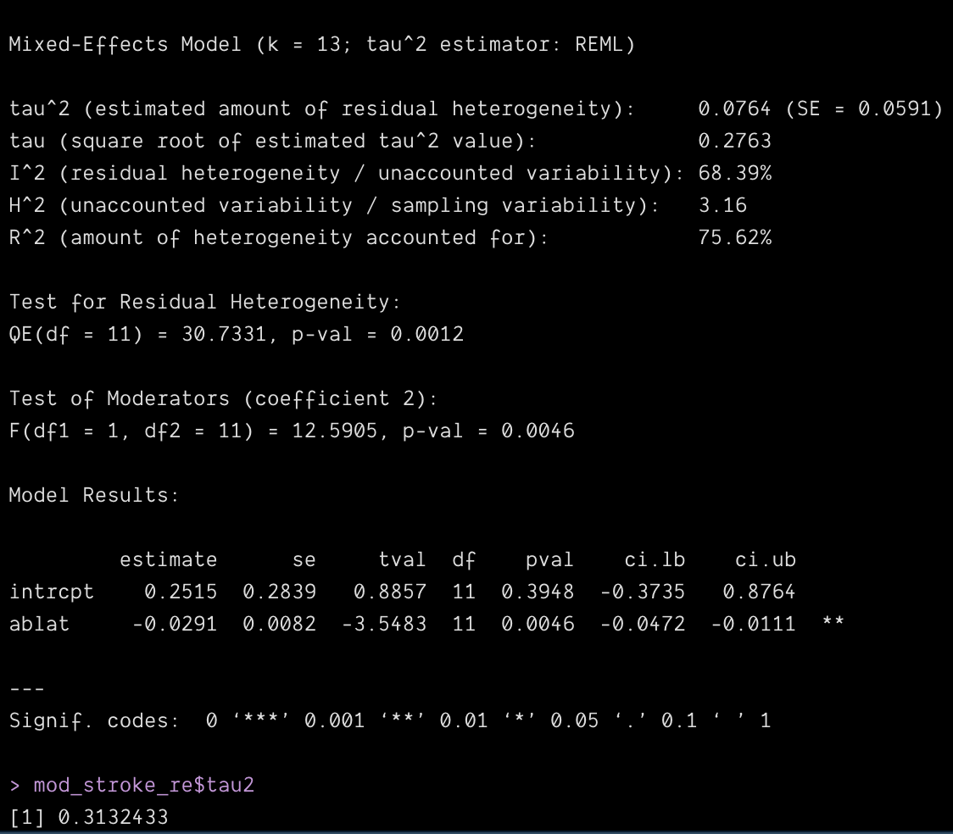

Slide 12

Predicted values in a meta-regression
$${\hat{μ}}_{i}=β_{0}+β_{1}x_{1i}+β_{2}x_{2i}+…+β_{p}x_{pi}$$
$$Var\left[{\hat{μ}}_{i}\right]=x_{i}Var\left[β\right]x_{i}^{′}$$
$$95\% CI={\hat{μ}}_{i}±1.96 × \sqrt{Var\left[{\hat{μ}}_{i}\right]}$$

Slide 13
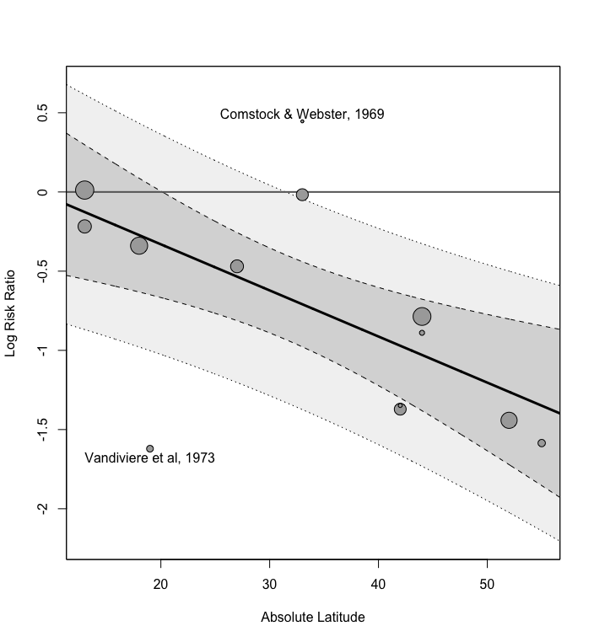
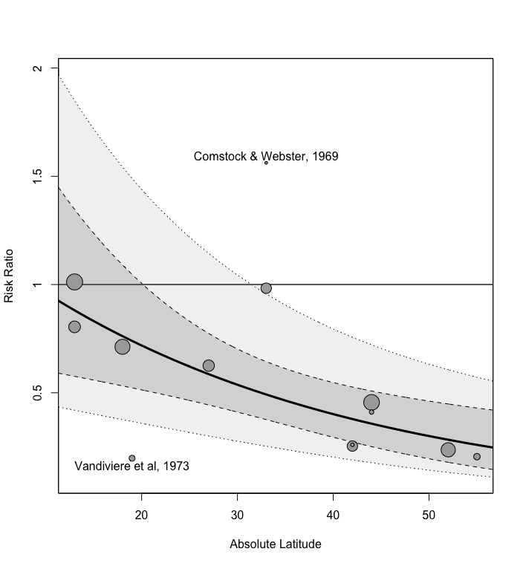

Slide 14
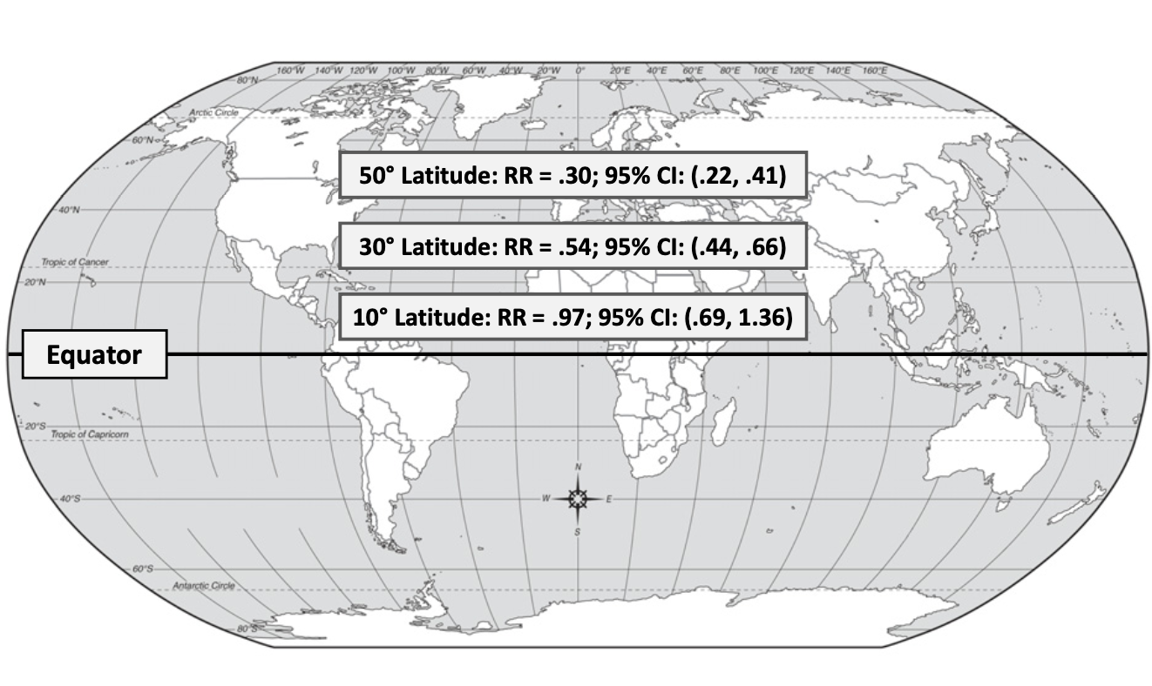

Slide 15
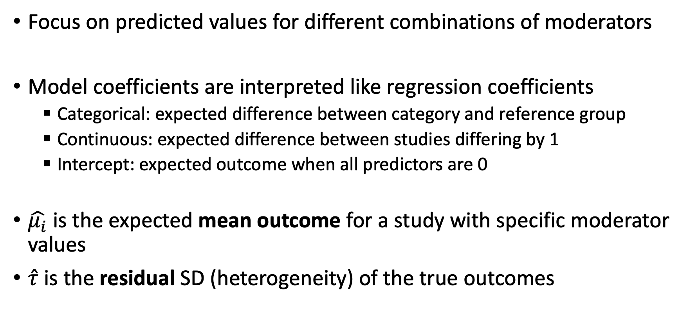
Interpreting a mixed effects model
Focus on predicted values for different combinations of moderators
Model coefficients are interpreted like regression coefficients
Categorical: expected difference between category and reference group
Continuous: expected difference between studies differing by 1
Intercept: expected outcome when all predictors are 0
$\hat{μ_{i}}$ is the expected mean outcome for a study with specific moderator values
$\hat{τ}$ is the residual SD (heterogeneity) of the true outcomes

Slide 16
Specifying a mixed effects model
Add to the yi formula
yi = yi ~ 1 + mod1 + mod2
Moderators can be categorical
Automatically contrast (dummy) coded
To treat numerical variables as categorical: factor(mod2)
Can also include interactions (mod1 * mod2), polynomials, splines, etc.

Slide 17
R code

Slide 18
Caution with meta-regression!
Meta-regression makes similar assumptions as any other regression model
Linearity : Correct functional form between continuous predictors and response (e.g., linear, could also be polynomial, splines, etc.)
Independence : Data points are independent of each other
Homogeneity of variance : τ is constant across groups/predictor levels
Normality of random effects : u_{i} are normally distributed

Slide 19
Caution with meta-regression!
The relevant sample size in a meta-regression is the number of studies/effect sizes
What will happen if you have k = 20 studies and you fit a meta-regression with p = 8 moderators?

Slide 20
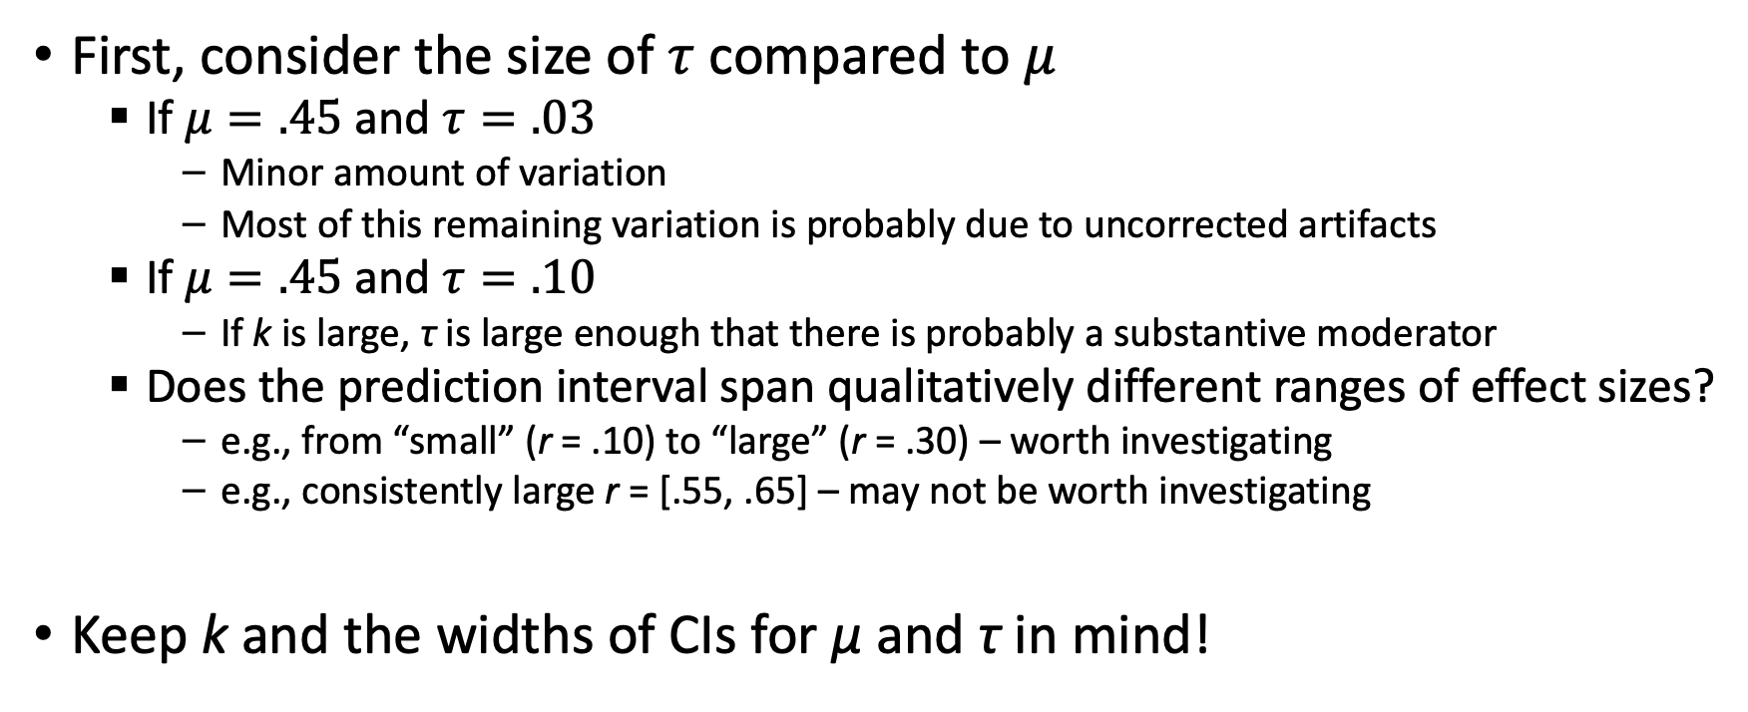
When to Search for Moderators
First, consider the size of $τ$ compared to $μ$
If $μ=.45$ and $τ=.03$
Minor amount of variation
Most of this remaining variation is probably due to uncorrected artifacts
If $μ=.45$ and $τ=.10$
If k is large, τ is large enough that there is probably a substantive moderator
Does the prediction interval span qualitatively different ranges of effect sizes?
e.g., from “small” (r = .10) to “large” (r = .30) – worth investigating
e.g., consistently large r = [.55, .65] – may not be worth investigating
Keep k and the widths of CIs for μ and τ in mind!

Slide 21
How to Search for Moderators
Consider relevant moderators before doing analyses
What moderators are theoretically or methodologically predicted?
Self- versus supervisor-ratings of job performance
One behavioral checklist versus another
Different stress-management interventions
Time spent training
Post-hoc searches for moderators (“fishing”) are likely to capitalize on chance
If a moderator is found post-hoc, additional primary studies are needed to confirm it

Slide 22
Testing Moderators
Compared to primary studies, meta-analysis can have much more power to find moderators
A primary study comparing training conducted by experts versus by managers might have N = 40 in each condition
A meta-analysis comparing studies of training by experts, managers, or a mix might have total Ns > 1000 in each subgroup
But that doesn’t mean that meta-analysis is all-powerful!

Slide 23
Power to Detect Moderators
The effective sample size for examining moderators in the number of studies (k)!
Frequently, researchers try to examine ≈40 moderators with a sample of ≈50 studies
There is a strong possibility that any correlation between moderators and effect sizes is chance
The potential influence of moderators is also limited by the real variation in effects
If 80% of the variance in effects is due to artifacts, the “reliability” of the observed r’s is .20!
Check out the metapower package: https://cran.r-project.org/package=metapower

Slide 24
Two Approaches to Moderator Analysis
Meta-regression
Add predictors to your meta-regression model
Work with the model same as other regression models
Omnibus tests, R², model coefficients + CIs, predictions and prediction intervals, etc.
Visualizations, diagnostics, overfitting, etc.
Subgroup analysis
Split the data into groups by moderator levels
Fit intercept-only meta-analyses in each group

Slide 25
Pros and Cons: Meta-regression
Pros
Strong statistical foundations
Formal tests
Can handle continuous predictors well
Can model complex functional forms
Can model multiple moderators, interactions
Cons
Easy to overfit
Need to take additional steps to get predicted levels, intervals for different levels
Sometimes, small k for predictor combinations isn’t obvious
Generally, assume constant τ across groups/levels

Slide 26
Pros and Cons: Subgroup analysis
Pros
Fast and intuitive
Clear when k is small or zero for some predictor combinations
Cons
Need to polytomize continuous moderators
Formal omnibus tests and tests of differences between groups less well-developed

Slide 27
Interpreting meta-regression
Coefficients + CIs
Differences in ES between categorical groups
Differences in ES associated with 1-unit continuous variable difference
All interpretative rules for regression apply
I recommend focusing on estimated mean ES, CI, PI for studies with different predicted levels
Visualize relationships of moderators with ES!

Slide 28
Interpreting subgroup analysis
Compare predicted μ, τ, CIs, PIs across groups
If the moderator has an effect, there will be two observable results
Differences in μ across subsets
Reduction of τ within subsets
If examining multiple moderators, be careful of correlated moderators
Conduct hierarchical moderator analysis

Slide 29
Hierarchical Moderator Analysis
Overall Meta-analysis
Integrity Tests and Supervisor-Rated Performance
k = 153, ρ = .35, SD_{ρ} = .13
Applicants
k = 25, ρ = .42, SD_{ρ} = .05
Incumbents
k = 90, ρ = .33, SD_{ρ} = .18
Concurrent
k = 1
ρ = .48
Predictive
k = 23
ρ = .41
SD_{ρ} = .00
Concurrent
k = 63
ρ = .37
SD_{ρ} = .14
Predictive
k = 20
ρ = .26
SD_{ρ} = .21
Concurrent
k = 88, ρ = .39, SD_{ρ} = .11
Predictive
k = 57, ρ = .32, SD_{ρ} = .13
From Ones et al. (1993)

Slide 30
Moderators and “Overall” effects
If there is a strong moderator effect, don’t interpret the overall effect and deemphasize it in your presentation
Consider omitting the overall results or moving them to a later table, appendix, or online supplement
Readers will often just take the overall result and ignore the nuance of the moderation

