Slide 1
Heterogeneity
Observed, expected, and residual variability
Estimators for random effects variance

Slide 2

Random effects model
$$y_{i}=θ_{i}+ε_{i}=μ+u_{i}+ε_{i}$$
$$u_{i} \sim Normal\left(0,τ^{2}\right)$$
$$ε_{i} \sim Normal\left(0,v_{i}\right)$$
$$y_{i}│θ_{i} \sim Normal\left(θ_{i},v_{i}\right)$$
$$θ_{i}=β_{0}+u_{i}=μ+u_{i}$$
$$v_{i}={SE}_{i}^{2}$$

Slide 3
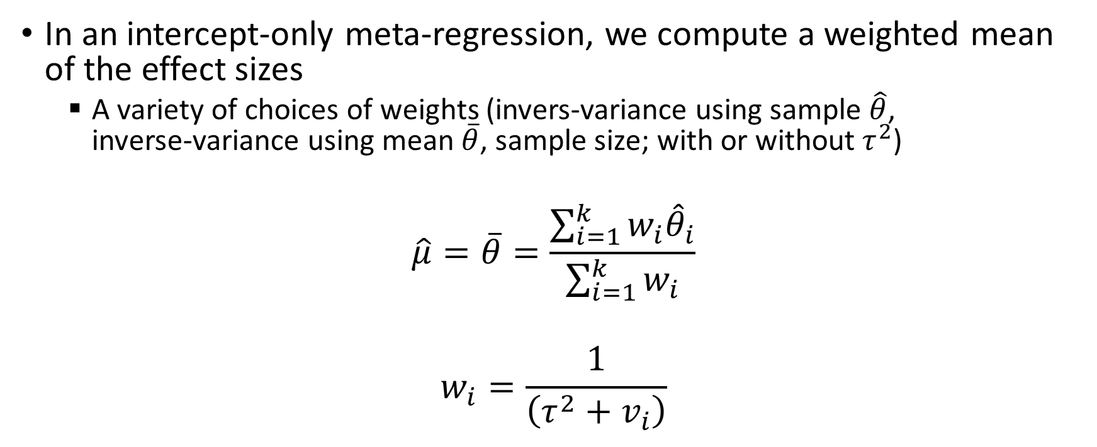
Estimating the mean effect size
In an intercept-only meta-regression, we compute a weighted mean of the effect sizes
A variety of choices of weights (invers-variance using sample $\hat{θ}$, inverse-variance using mean $\overline{θ}$, sample size; with or without $τ^{2}$)
$$\hat{μ}=\overline{θ}=\frac{\sum_{i=1}^{k}{w_{i}{\hat{θ}}_{i}}}{\sum_{i=1}^{k}{w_{i}}}$$
$$w_{i}=\frac{1}{\left({τ^{2}+v}_{i}\right)}$$

Slide 4
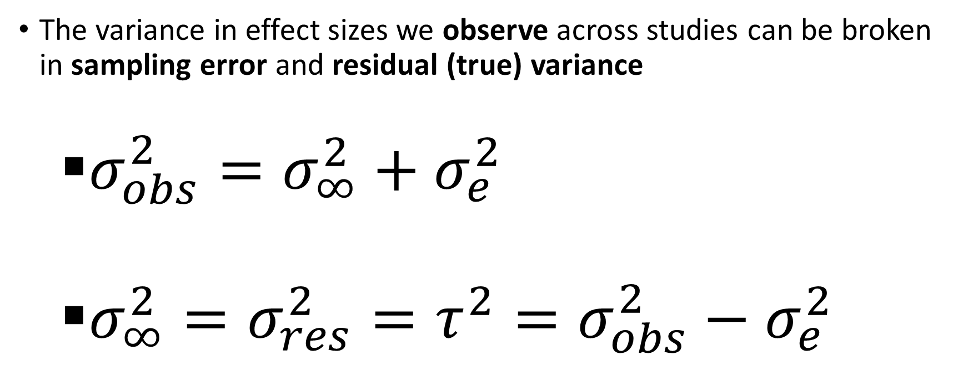
Estimating random effects variance
The variance in effect sizes we observe across studies can be broken in sampling error and residual (true) variance
$σ_{obs}^{2}=σ_{∞}^{2}+σ_{e}^{2}$
$σ_{∞}^{2}=σ_{res}^{2}=τ^{2}=σ_{obs}^{2}−σ_{e}^{2}$

Slide 5

Observed Variance
Observed variance:
Weighted variance of effect sizes
$$σ_{obs}^{2}=σ_{\hat{θ}}^{2}={∑\left[w_{i}{\left({\hat{θ}}_{i}−\overline{θ}\right)}^{2}\right]}/{∑w_{i}}$$

Slide 6
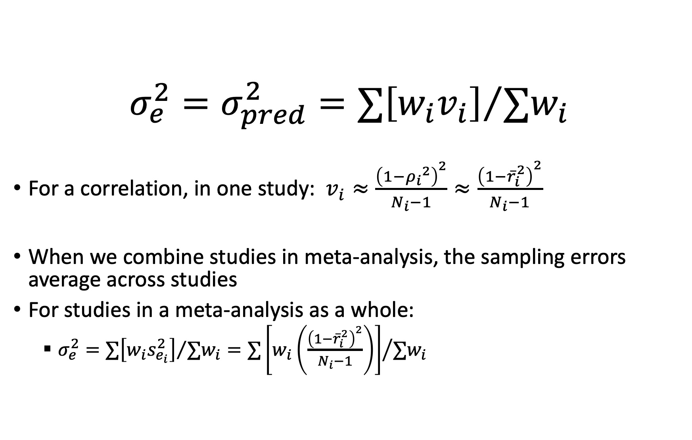
Expected/Predicted Variance (Sampling Error)
$$σ_{e}^{2}=σ_{pred}^{2}={∑\left[w_{i}v_{i}\right]}/{∑w_{i}}$$
For a correlation, in one study: $v_{i}≈\frac{{\left(1−{ρ_{i}}^{2}\right)}^{2}}{N_{i}−1}≈\frac{{\left(1−{\overline{r}}_{i}^{2}\right)}^{2}}{N_{i}−1}$
When we combine studies in meta-analysis, the sampling errors average across studies
For studies in a meta-analysis as a whole:
$σ_{e}^{2}={∑\left[w_{i}s_{e_{i}}^{2}\right]}/{∑w_{i}}={∑\left[w_{i}\left(\frac{{\left(1−{\overline{r}}_{i}^{2}\right)}^{2}}{N_{i}−1}\right)\right]}/{∑w_{i}}$

Slide 7

Estimating τ² (Residual, True, Random Effects) Variance
Conceptually
$σ_{res}^{2}=τ^{2}=σ_{\hat{θ}}^{2}−σ_{pred}^{2}=σ_{\hat{θ}}^{2}−σ_{e}^{2}$
There are a variety of estimators of $τ^{2}$

Slide 8
Estimators for τ²
Hunter-Schmidt estimator
k-corrected Hunter-Schmidt estimator
DerSimonian-Laird estimator
Hedges estimator
Sidik-Jonkman estimator
Maximum likelihood estimator
Restricted maximum likelihood estimator***
Empirical Bayes / Paule-Mandel estimator
…

Slide 9
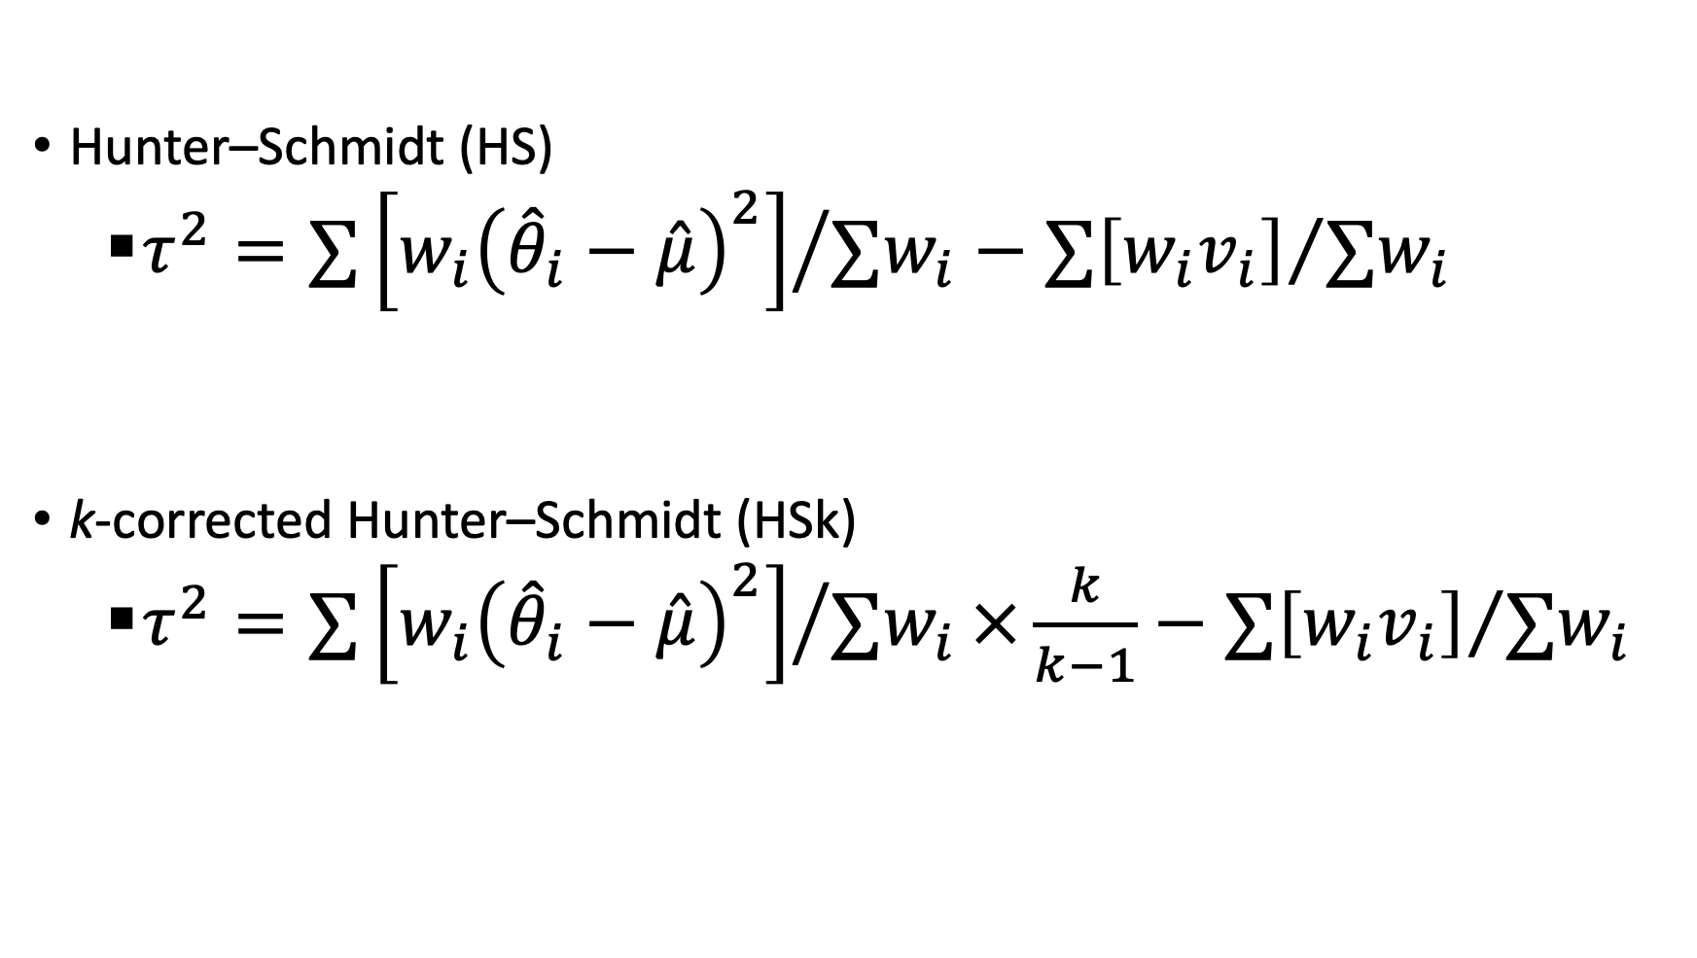
Estimators for τ²
Hunter–Schmidt (HS)
$τ^{2}={∑\left[w_{i}{\left({\hat{θ}}_{i}−\hat{μ}\right)}^{2}\right]}/{∑w_{i}}−$ ${∑\left[w_{i}v_{i}\right]}/{∑w_{i}}$
k-corrected Hunter–Schmidt (HSk)
$τ^{2}={∑\left[w_{i}{\left({\hat{θ}}_{i}−\hat{μ}\right)}^{2}\right]}/{∑w_{i}}×\frac{k}{k−1}−$ ${∑\left[w_{i}v_{i}\right]}/{∑w_{i}}$

Slide 10
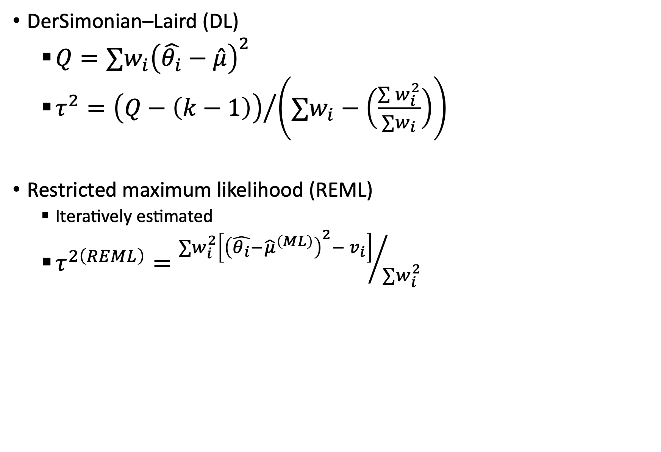
Estimators for τ²
DerSimonian–Laird (DL)
$Q=∑w_{i}{\left(\hat{θ_{i}}−\hat{μ}\right)}^{2}$
$τ^{2}={\left(Q−\left(k−1\right)\right)}/{\left(∑w_{i}−\left(\frac{\sum{w_{i}^{2}}}{∑w_{i}}\right)\right)}$
Restricted maximum likelihood (REML)
Iteratively estimated
$τ^{2\left(REML\right)}={∑w_{i}^{2}\left[{\left(\hat{θ_{i}}−{\hat{μ}}^{\left(ML\right)}\right)}^{2}− v_{i}\right]}/{∑w_{i}^{2}}$

Slide 11
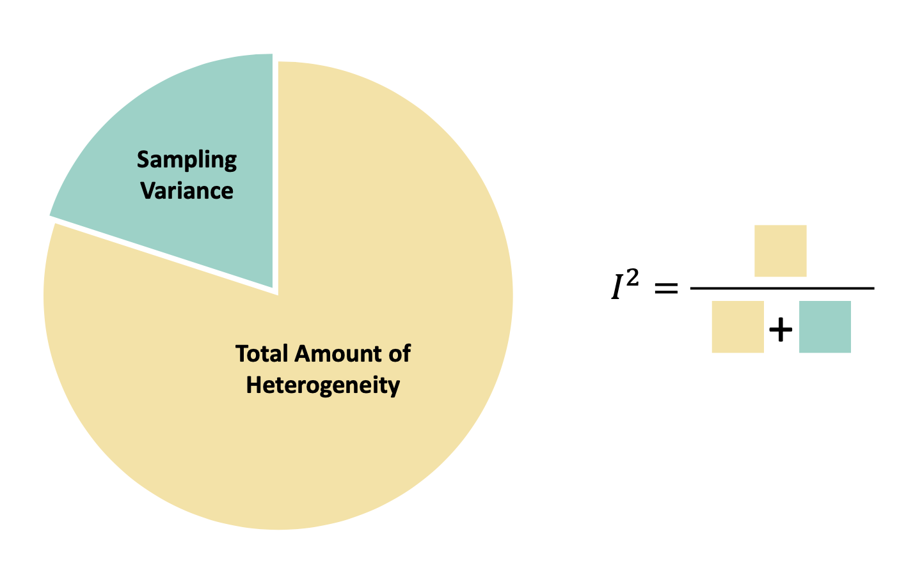
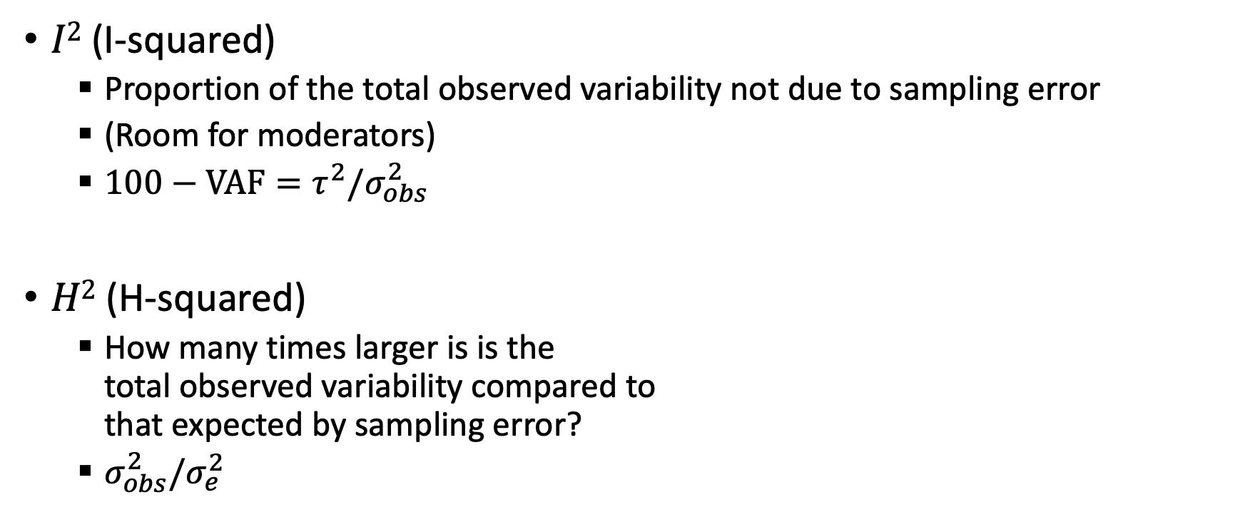
Related statistics
$I2$ (I-squared)
Proportion of the total observed variability not due to sampling error
(Room for moderators)
$100−VAF=τ^{2}/σ_{obs}^{2}$
$H2$ (H-squared)
How many times larger is is the total observed variability compared to that expected by sampling error?
$σ_{obs}^{2}/σ_{e}^{2}$

Slide 12
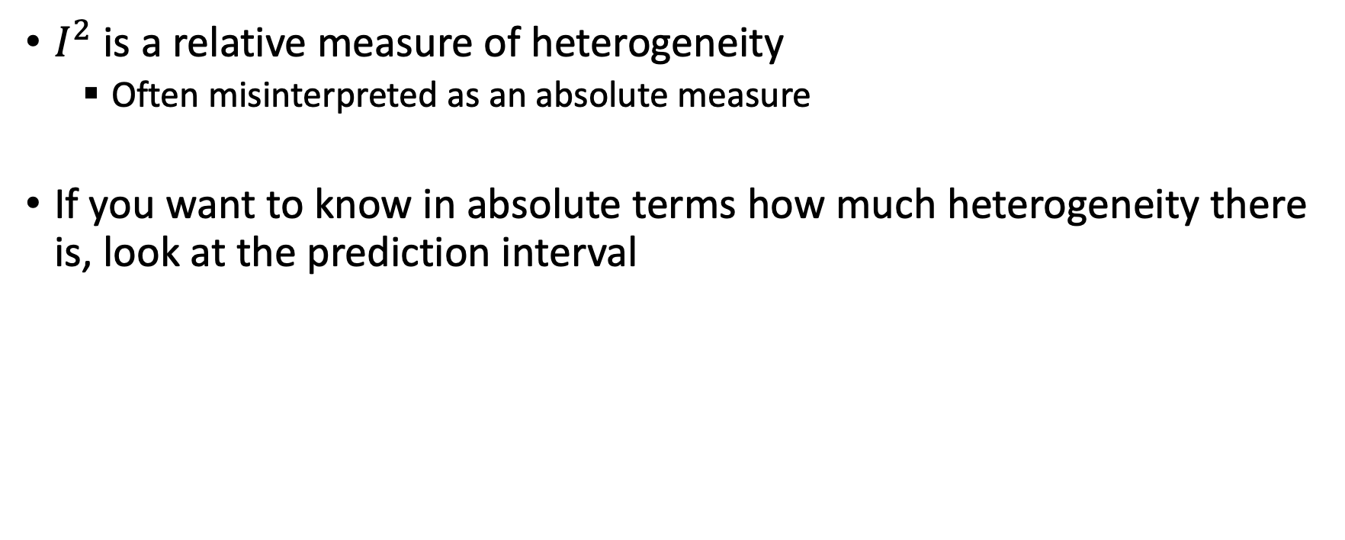
Relative vs. Absolute Heterogeneity
$I^{2}$ is a relative measure of heterogeneity
Often misinterpreted as an absolute measure
If you want to know in absolute terms how much heterogeneity there is, look at the prediction interval

Slide 13
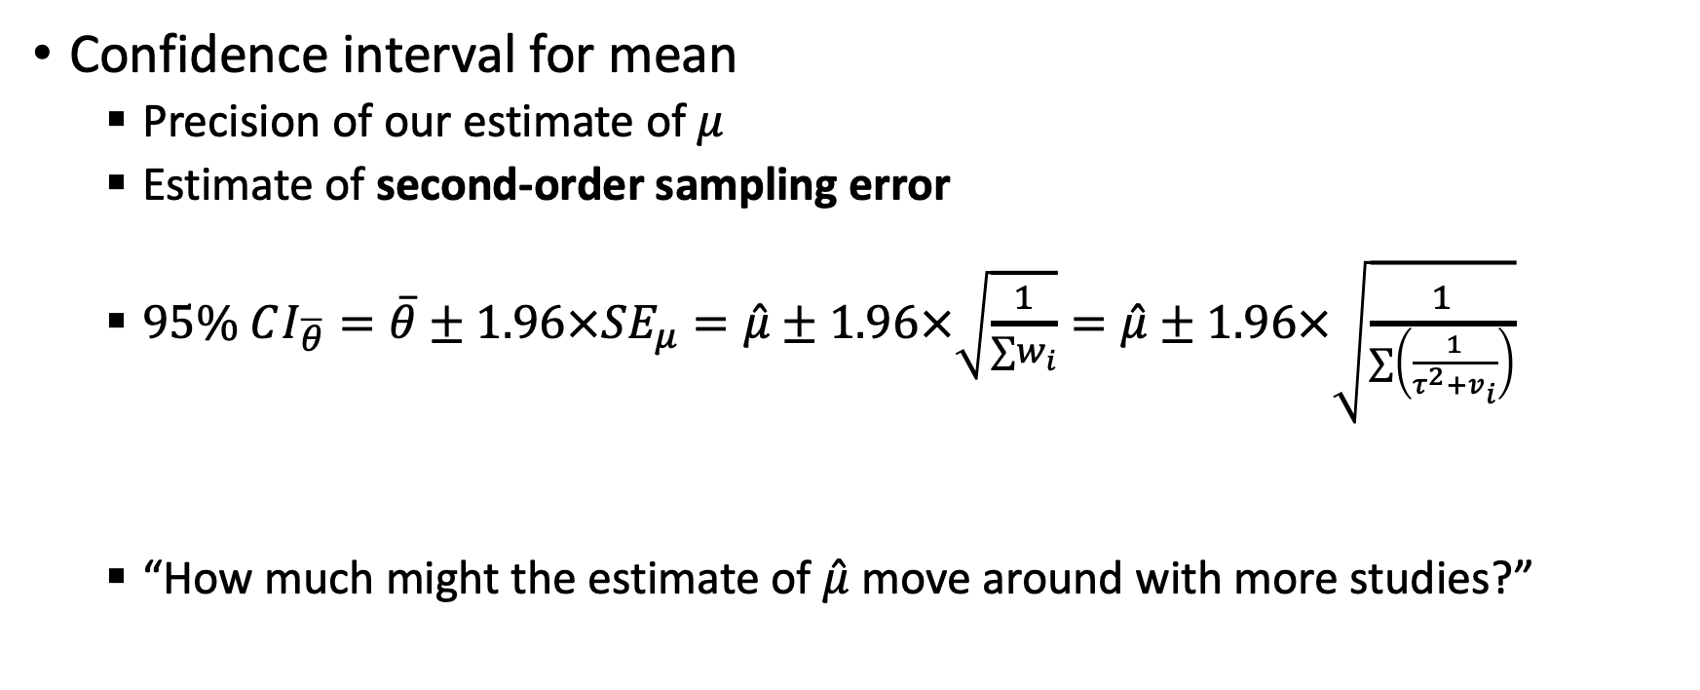
Intervals: Confidence interval for mean
Confidence interval for mean
Precision of our estimate of $μ$
Estimate of second-order sampling error
$95\% CI_{\overline{θ}}=\overline{θ}±1.96×SE_{μ}=\hat{μ}±1.96×\sqrt{\frac{1}{∑w_{i}}}=\hat{μ}±1.96×\sqrt{\frac{1}{∑\left(\frac{1}{τ^{2}+v_{i}}\right)}}$
“How much might the estimate of $\hat{μ}$ move around with more studies?”

Slide 14

Intervals: Prediction interval
Prediction interval
Where might the true effects be?
$95\% PI_{θ}=\hat{μ}±1.96×\sqrt{SE_{\hat{μ}}^{2}+τ^{2}}$
“Where do I expect 95% of real effects to be?”

Slide 15
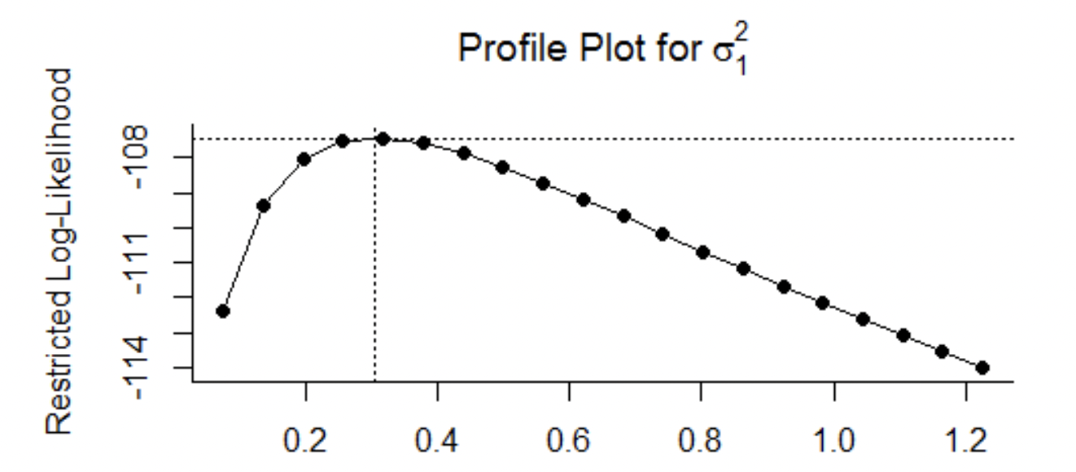
Intervals: Confidence interval for τ
Confidence interval for τ
Constructed using profile likelihood – change τ²
“How confident are we in our estimate of the heterogeneity?”
“How much stock should we place in the prediction intervals?”
τ²

Slide 16
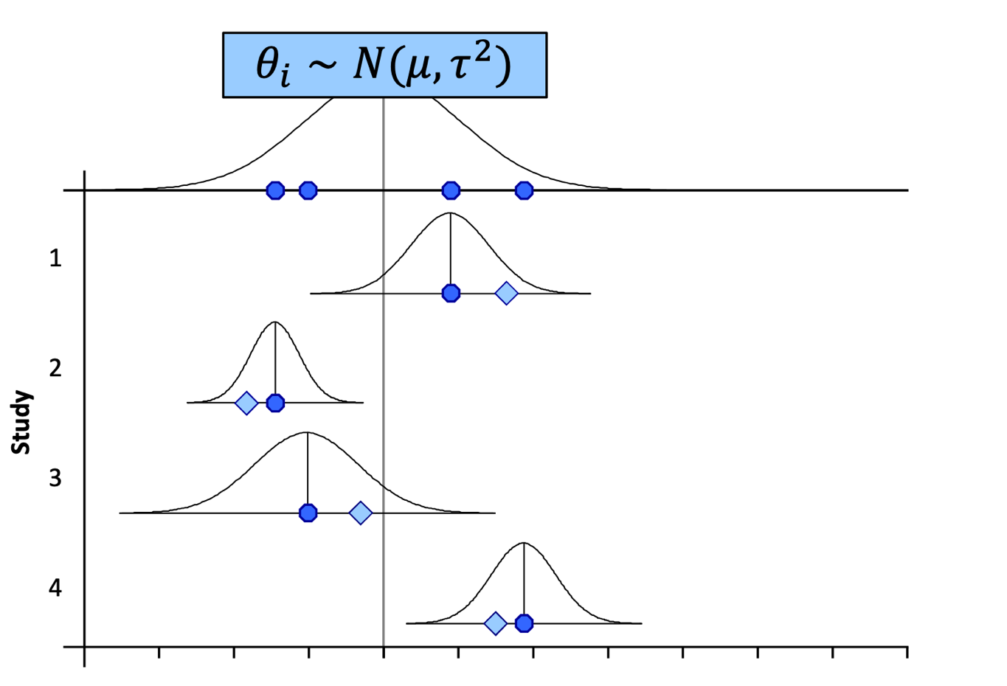
Best linear unbiased predictions (BLUPs)

Slide 17
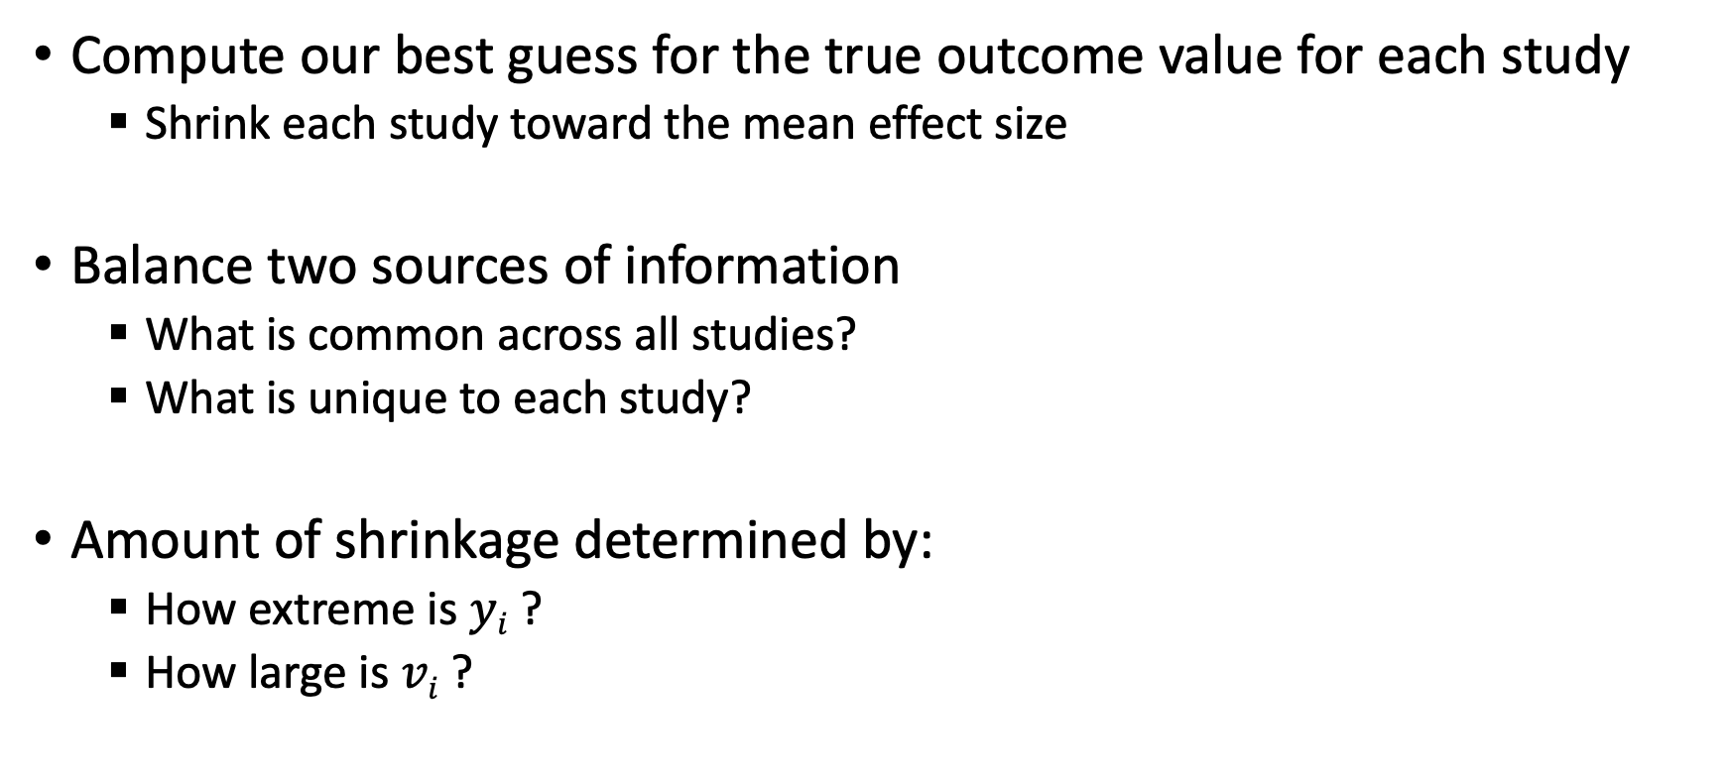
Best linear unbiased predictions (BLUPs)
Compute our best guess for the true outcome value for each study
Shrink each study toward the mean effect size
Balance two sources of information
What is common across all studies?
What is unique to each study?
Amount of shrinkage determined by:
How extreme is $yi$ ?
How large is $vi$ ?

Slide 18

Best linear unbiased predictions (BLUPs)
$$Rel_{i}=\frac{{\hat{τ}}^{2}}{{\hat{τ}}^{2}+v_{i}}$$
$$BLUP\left(θ_{i} | y_{i},v_{i},\hat{μ},\hat{τ}\right)=\left(1−Rel_{i}\right)\hat{μ}+\left(Rel_{i}\right)y_{i}$$

Slide 19
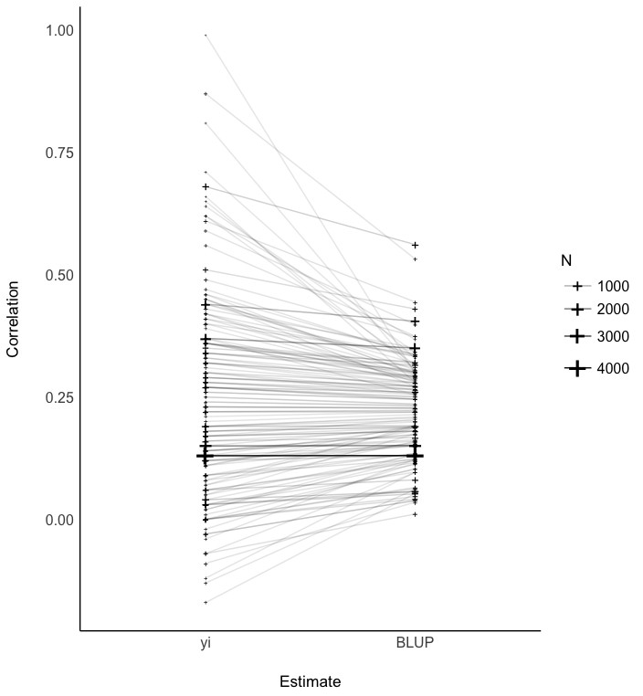
Best linear unbiased predictions (BLUPs)

Slide 20
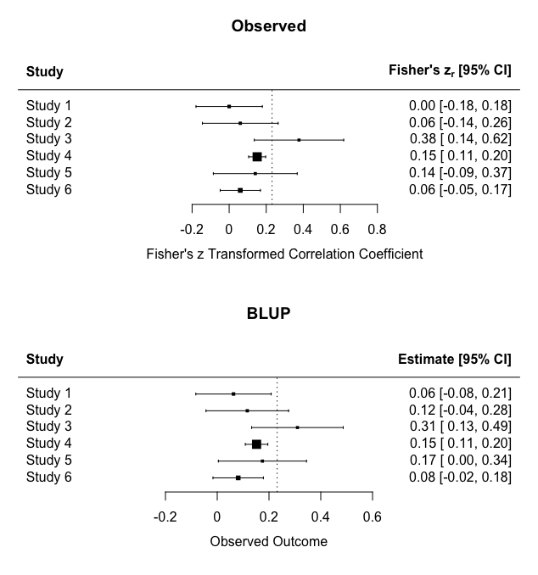
Best linear unbiased predictions (BLUPs)

Slide 21
R Code

