Slide 1
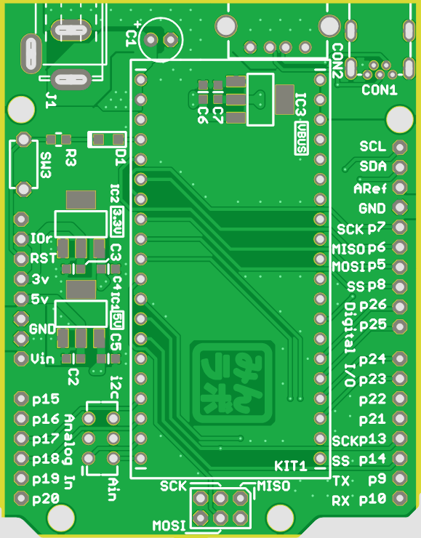
6-9V in
USB Host/Device(exclusive)
p27/SCL
SCL
SDA
Reset
p28/SDA
Aref
GND
p7/D13
SCK
MISO
MOSI
IOref
p6/D12
Reset
p5/D11
3.3V out
p8/D10
5V out
p26/D9
PwmOut
GND
p25/D8
GND
Vin
p24/D7
p23/D6
AnalogIn
p15/A1
p22/D5
p16/A2
p21/D4
p17/A3
p13/D3
p12/MISO
AnalogOut
p18/A4
p13/SCK
p14/D2
p19/A5
p9/D1
TX
RX
p20/A6
p10/D0
p11/MOSI

