Slide 1
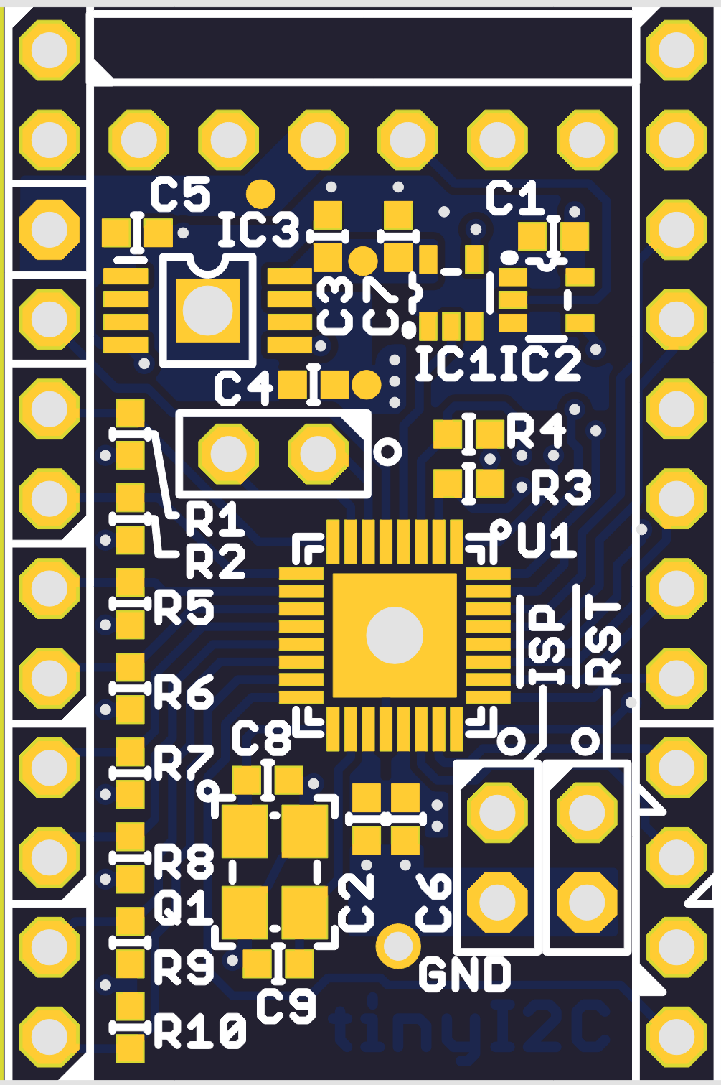
(BK) ----- FTDI Serial ----- (GRN)
or compatible
1.8V Output
GPIO 00
GND
GPIO 01
5.0V Output
GPIO 02
GPIO 16
GPIO 03
GPIO 0
SDA0 (2-800KHz)
GPIO 04
I2C0
SCL0 (2-800KHz)
GPIO 05
SDA1(1-400KHz)
GPIO 06
I2C1
SCL1(1-400KHz)
GPIO 07
SDA2(1-400KHz)
MOSI
I2C2
SCL2(1-400KHz)
MISO
SPI(1/2/4/8MHz)
SDA3(1-400KHz)
SCK
I2C3
SCL3(1-400KHz)
CS

