Slide 1
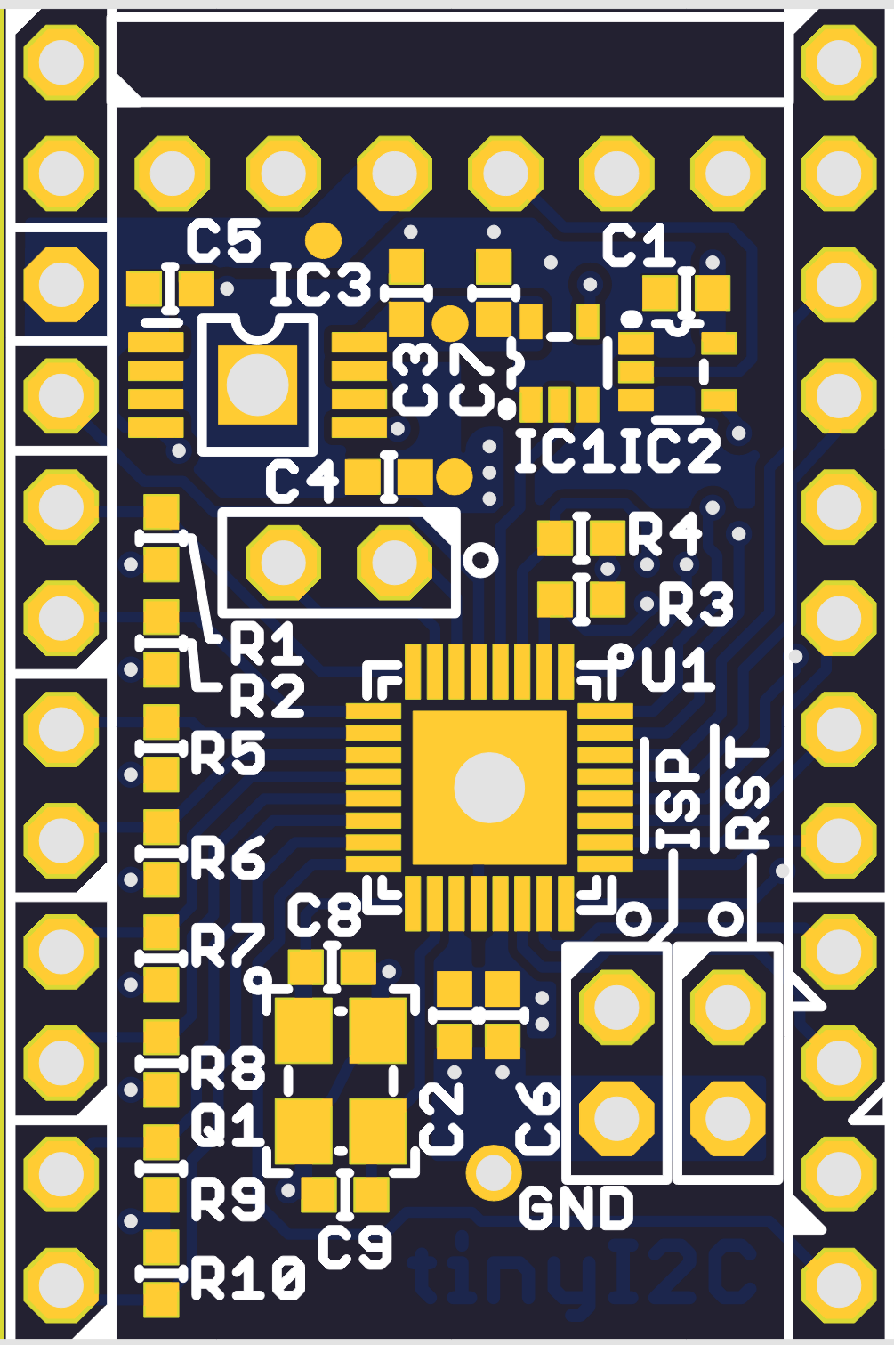
(BK) ----- FTDI Serial ----- (GRN)
or compatible
1.8V Output
GPIO 00
GND
GPIO 01
5.0V Output
GPIO 02
GPIO 16
GPIO 03
GPIO 0
SDA0 (2-800KHz)
GPIO 04
I2C0
SCL0 (2-800KHz)
GPIO 05
SDA1(1-400KHz)
GPIO 06
I2C1
SCL1(1-400KHz)
GPIO 07
SDA2(1-400KHz)
MOSI
I2C2
SCL2(1-400KHz)
MISO
SPI(1/2/4/8MHz)
SDA3(1-400KHz)
SCK
I2C3
SCL3(1-400KHz)
CS

Slide 2
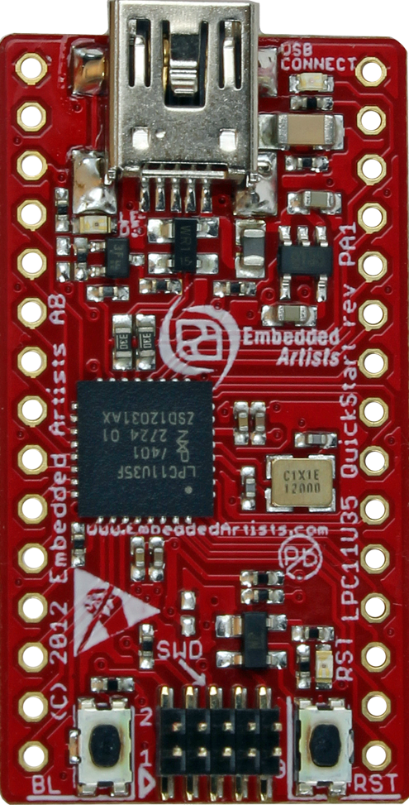
GND
GND
VBUS 5.0V
3.3V Output
CS
MISO
GPIO 17
SPI(1/2/4/8MHz)
MOSI
SDA0 (2-800KHz)
I2C0
SCK
SCL0 (2-800KHz)
GPIO 00
GPIO 01
GPIO 16
GPIO 02
GPIO 15
GPIO 03
GPIO 1
GPIO 0
GPIO 04
GPIO 14
GPIO 05
GPIO 06
GPIO 13
GPIO 07
GPIO 12
GPIO 10
GPIO 11
GPIO 1
GPIO 1
Image from http://www.embeddedartists.com/sites/default/files/styles/ea_photos_list/public/image/product/qsb_lpc11u35.png

