Slide 1


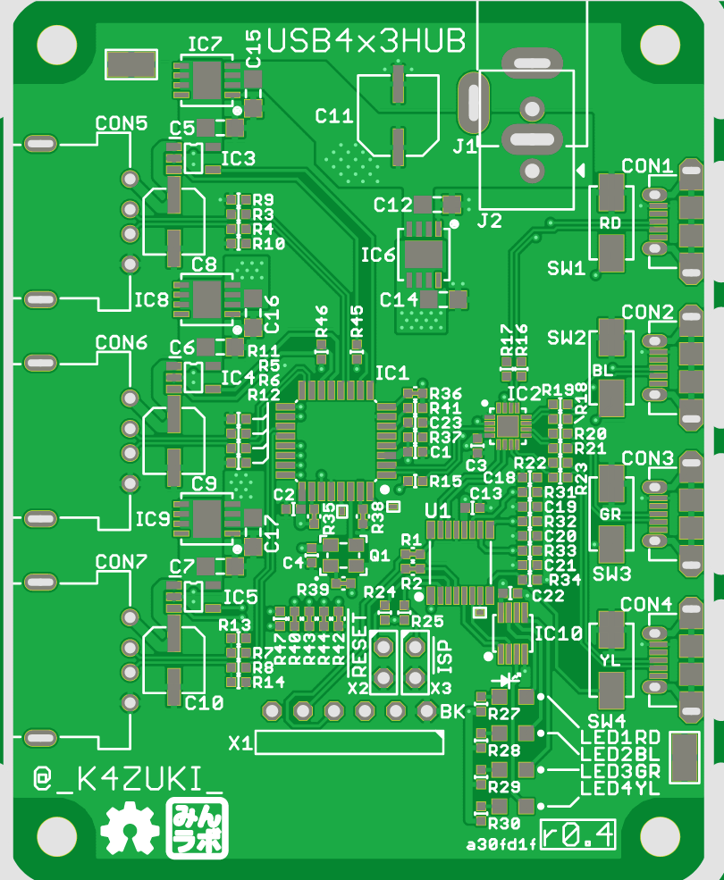


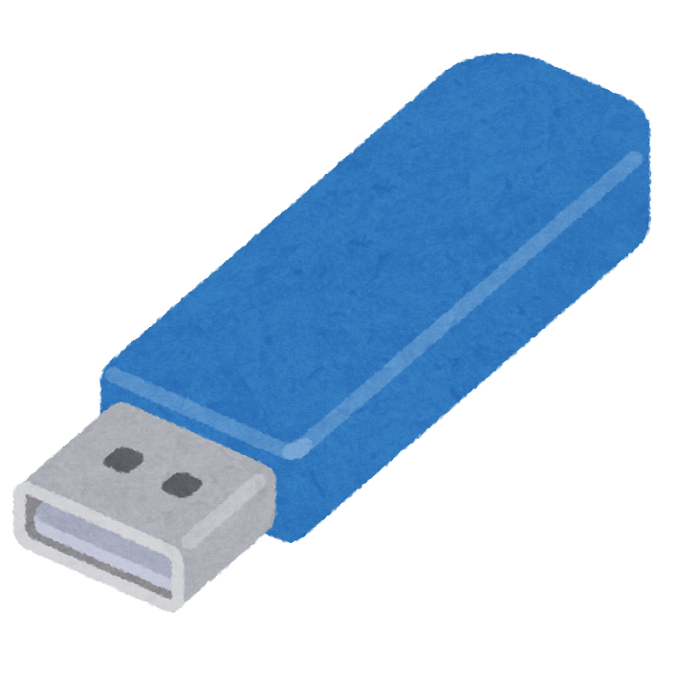
PC
4 USB hosts
x
3-Port USB hub
Mac
XBOX
PS4?

