Slide 1
My Exploration of Unicorn Companies Using Python
Done by: Kabir Sinha
CMP 262

Slide 2
What is a Unicorn Company??
Startup company
Privately owned
Worth at least $1,000,000,000
Approximately 1,230 Unicorns in the world

Slide 3
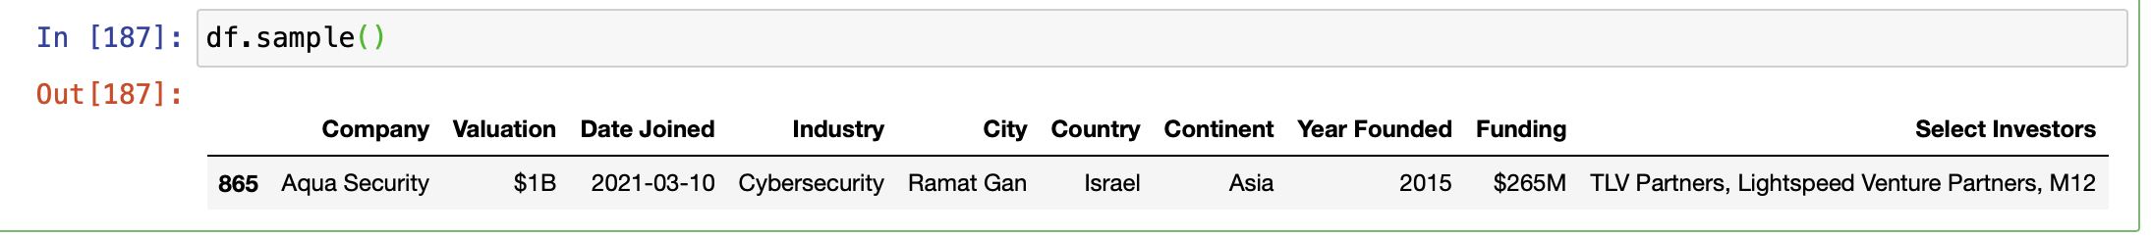
The dataset
A csv file from mavenanalytics.io
Contains the top 1073 Unicorn companies
Sample:

Slide 4
For each company, we know:
Company Name
Estimated Valuation (approx. a year behind)
Date of Unicorn status
Industry of service
City/Country/Continent of operation
Founding year
Estimated investment funding
Select investor groups

Slide 5
Other Requirements
For analysis, uploaded dataset (from mavenanalytics.io) into pandas data frame in a Jupyter notebook
Imported matplotlib/seaborn for visuals/showing data relationships
Imported datetime/numpy for converting values and performing calculations

Slide 6
Purpose of my Analysis
Answer questions regarding certain statistics on these companies
Influence future investing for wealthy clients, assuming more of these companies went public

Slide 7


What I Want to Know
Companies with the best/worst Profits
Investor groups with the highest/lowest ROI’s
Industries that is most lucrative
City most popular for Unicorn startups
Companies with the best/worst average annual revenue (in case they’re different from the first point)

Slide 8
Began with
Standard exploratory analysis:
Df.describe
Df.columns
Df.dtypes (all object except Year Founded [int64])
Df.shape (1074 x 10)
Df.head()
Df.tail()
Df.sample()
Df.info()

Slide 9
For My Own Analysis
Dropped bottom 471 – only analyzing companies worth $2B+
Renamed columns
Dropped rows with missing data
Formatted columns with currency to full string values
($2B → 2.000x10e9)

Slide 10
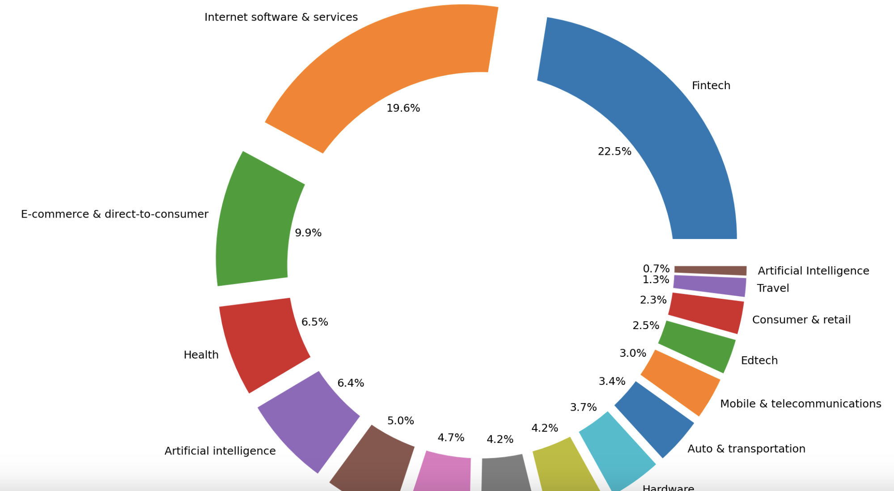
Finding the Biggest Industry
Printed a df.groupby() with counts of industries included in my data frame
Created a donut chart with separated sections
Fintech is the most popular industry
AI is the least popular

Slide 11
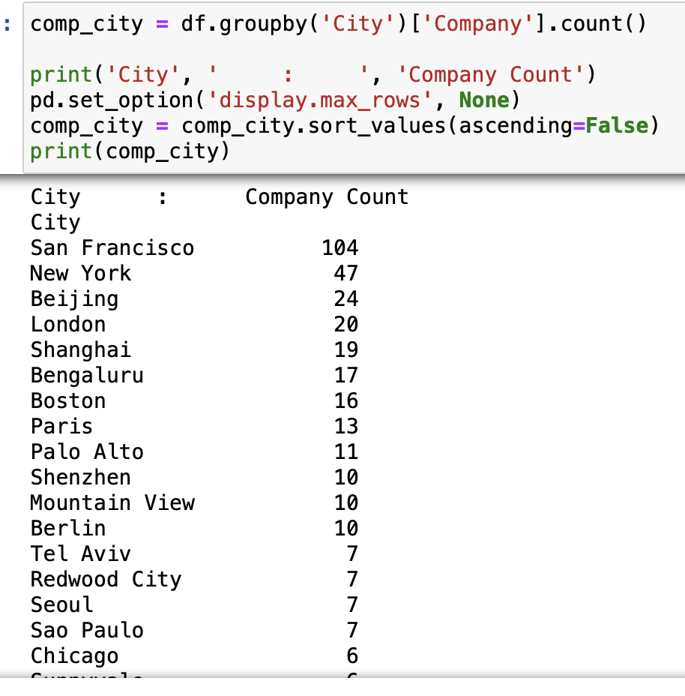
Most Popular Unicorn City
df.groupby() of cities with companies as the count
San Francisco hosts the most Unicorn companies

Slide 12
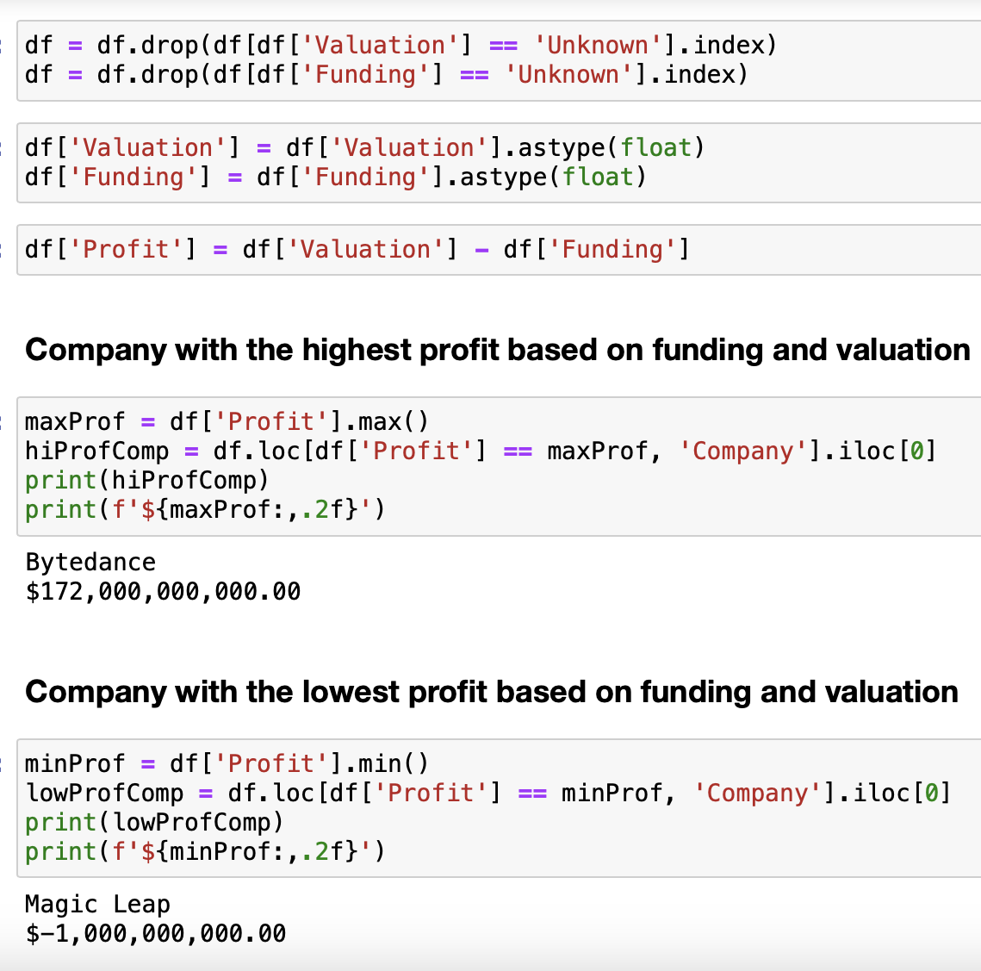
Most/least Profits
Created column calculating each company’s profit
Created groupby()’s showing the min/max profits

Slide 13
Most/Least profitable Investor Groups
Wanted to find the investor groups that made the best and worst investments
Created df.sort()’s [one ascending, one descending]
Graphed top and bottom 12 investment groups based on their company’s profit value

Slide 14
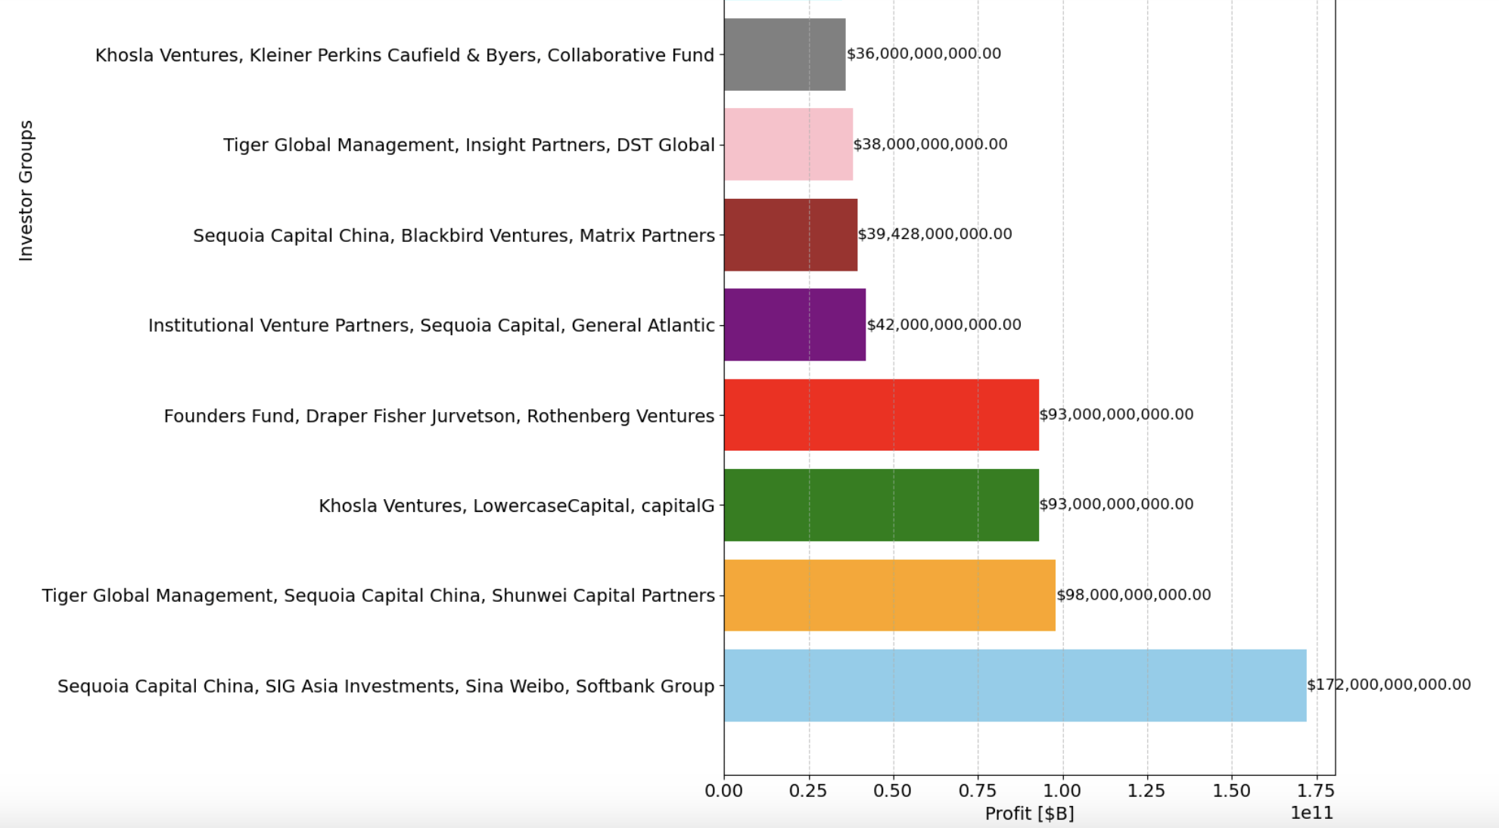
8 Most Profitable Investor Groups

Slide 15
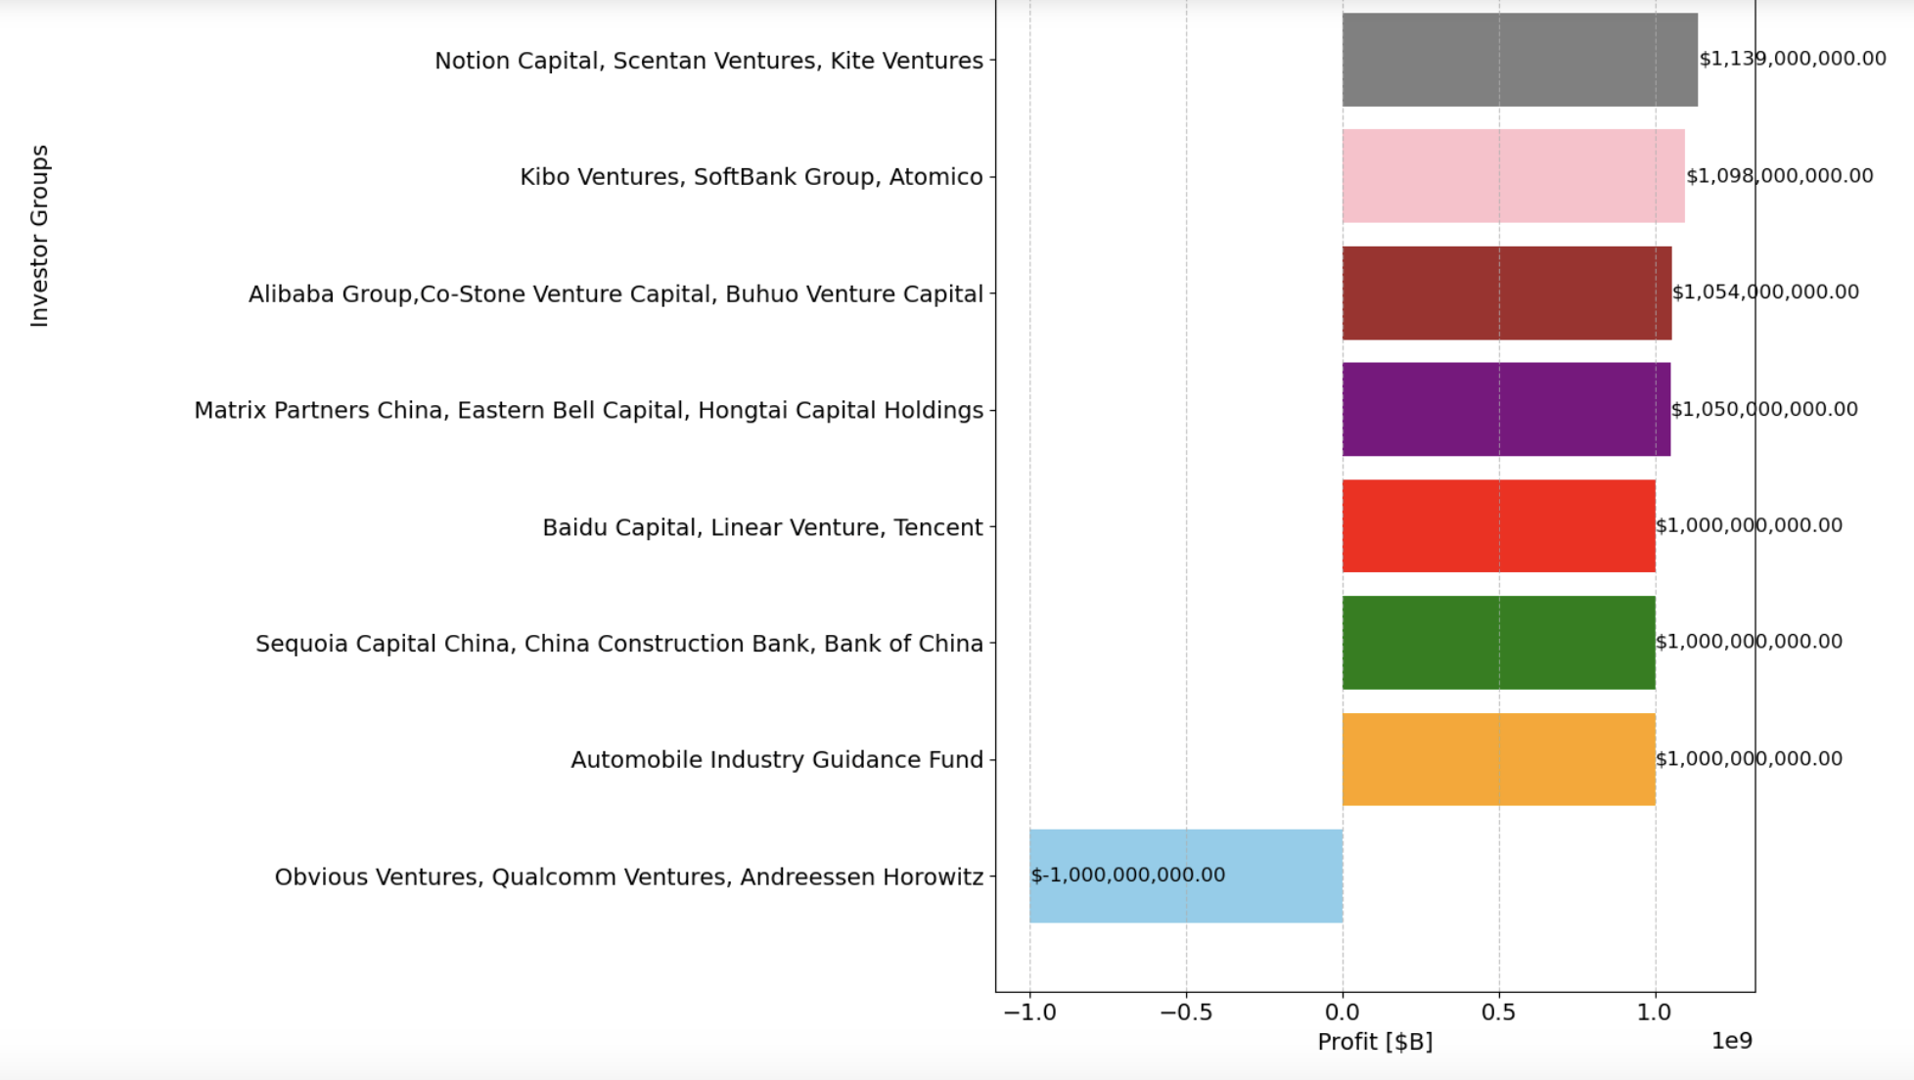
8 Least Profitable Investor Groups

Slide 16
Most/Least Avg Revenue
Created new data frame column called Avg_yrly_prof by dividing Profit/years since company founding
Performed df.loc[] method to find min/max values from Avg_yrly_prof and returned values w/ their companies

Slide 17
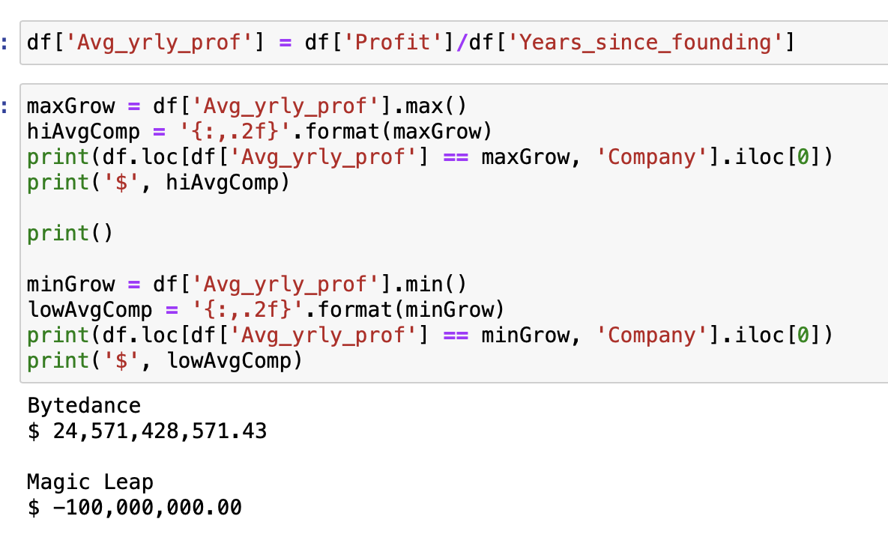
Avg_yrly_prof min/max

Slide 18
Insights
Was able to programmatically answer each of my data questions
Only 603 companies (56.20% of dataset) valued at >$1B
Only 128 (11.93%) values >$5B
An investor doesn’t always have best/worst ROI based on company performance
Don’t follow Magic Leap investment trends

Slide 19

For the Future
Want to find out which investors had the best/worst ROI’s individually
Recalculate certain data with most recent profit values for companies
Find out which industry generated the most money based on company profits

