Slide 1
Cyber Security: Tackling Malware
Keshavan Seshadri - Team K7

Slide 2
Defining the Problem Statement
To build a malware detection software having the following features :
Ability to take submission from different channels
Handle Exceptions
Role based access
Dashboards for all users
Reports for all users

Slide 3
Overview of the Solution
To build a wrapper around an existing sandbox such as Cuckoo
Cuckoo provides a simple and lightweight REST api server.
This means, the web-app can use the POST method to send the file for scanning.
The malware software, Cuckoo sitting at the back-end shall analyze and create a report for potential malware.
This report can be shown to the user by a GET request.
The wrapper shall have secure authentication through softwares like Auth0 and shall have admins who have special privileges to add/ delete users and view the reports of all users.
Handling exceptions are done at every request. For example, if the sandbox cannot detect for malware in .bin files then an error would be sent as the result of the POST request. This would be displayed to the users as “ .bin files are not allowed ”.

Slide 4
More on Cuckoo
Cuckoo acts like a black-box ie, given an input it gives an output, analyzing whether malware exists or not.
It employs machine learning algorithms to improvise on scanning for malware.
Can be deployed on the web.
Online: http://cuckoo.cert.ee/

Slide 5
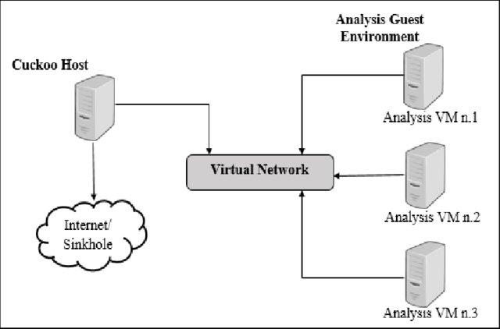

Slide 6
Types of Solution
Web-based Platform
Local Platform
Windows
Linux
MacOs
Android

Slide 7
Web Based Platform
Advantages
Easily accessible on a browser
Supports different types of files
And is not indigenous to one particular operating system
Disadvantages
Requires stable Internet Connection
Typically slower than offline Platform
Can’t process large number of files

Slide 8
Offline Platform
Advantages
Relatively faster than web based platform.
Can process large number of files in the same system
Disadvantages
Different for Different operating systems
Needs to be “installed” thereby taking a toll on the user’s computer.
Generally proprietary

Slide 9
Definitely, Web-Based platforms are preferable for a “single user” and local platforms are preferable for large companies.

Slide 10
Starting with the web-app
Important components:
Languages Used
Security, Vulnerability
Scalability
Maintainability
Speed and Efficiency
Portability

Slide 11
Need for latest technology
The web-application should be built with the latest technology available to enhance its features.
Old technologies fade out if they are not continuously developed.

Slide 12
Auth0 for Login and Sign-up
Since, this web-application addresses ensuring cyber security as the larger problem, there needs to be a secure and efficient login and sign-up otherwise it would be vulnerable to cyber-attacks.
This is much better than the conventional method of storing the user information into databases.
It also helps in distributing the functionality to softwares that are specialized in that particular area

Slide 13
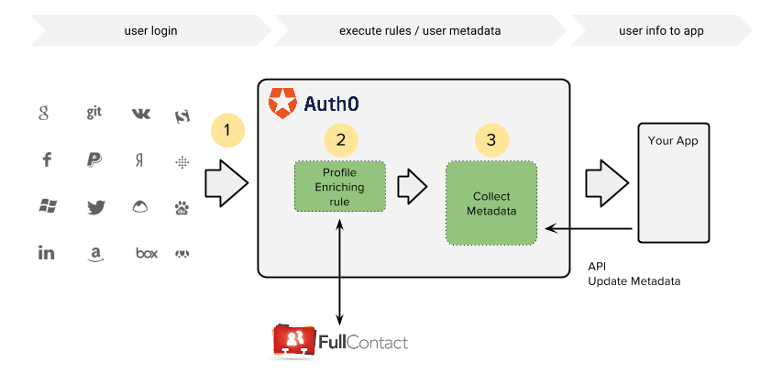

Slide 14
More Features of Auth0
Cross-platform login and sign-up.
Ability to link to social media.
Free for small-scale users.
High security
Distributable code
Supports wide range of languages.
JSON file output as user profile.

Slide 15
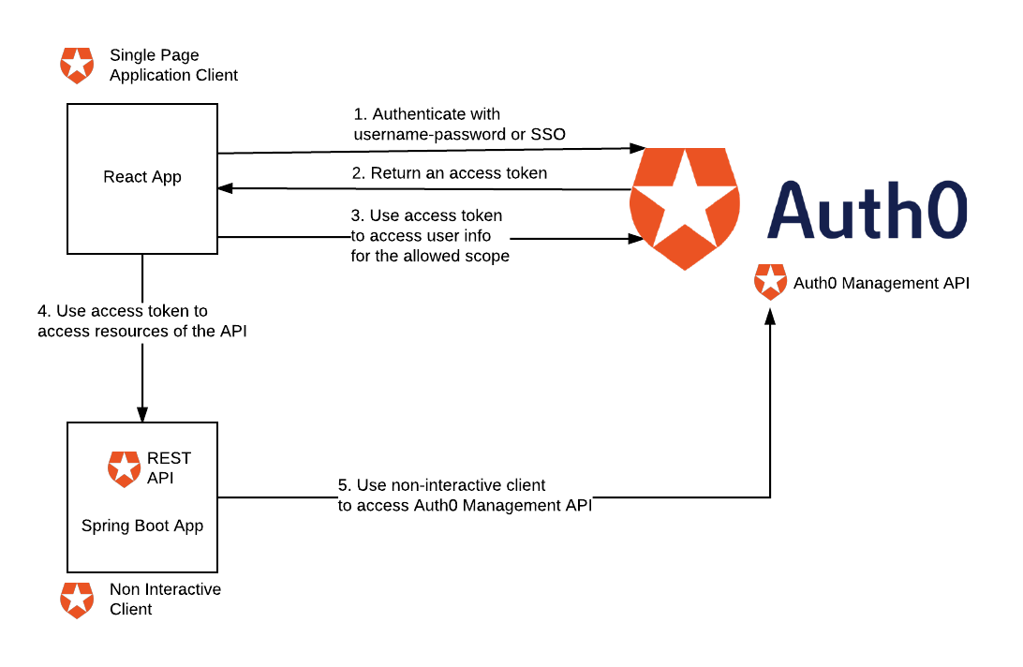

Slide 16
Usage of Auth0 in the web-app
Auth0 gives a JSON file of the user info which shall have the details of his name, e-mail ID which shall be first retrieved by a GET request at manage.auth0.com
This data is stored at the backend with the help of a database software like SQL, MongoDB using the POST method.
When the user dashboard or any of his/her information is needed a GET request is sent to the back-end server to retrieve the necessary information.
Multiple login and signup from social media can be brought in by integrating the web-app with the social media in the Auth0 dashboard.

Slide 17
Go-lang : For Backend
Go generates binaries for your applications with all the dependencies built-in.
Language Design
Power Standard Library
Package Management
Static Typing
Concurrency Support
Testing Support

Slide 18
ReactJs : For Frontend
Creates Interactive and dynamic UI for website and mobile applications
Virtual DOM
Event Handling
JSX = JavaScript + XML
High Performance
React Native
Component - Based

Slide 19
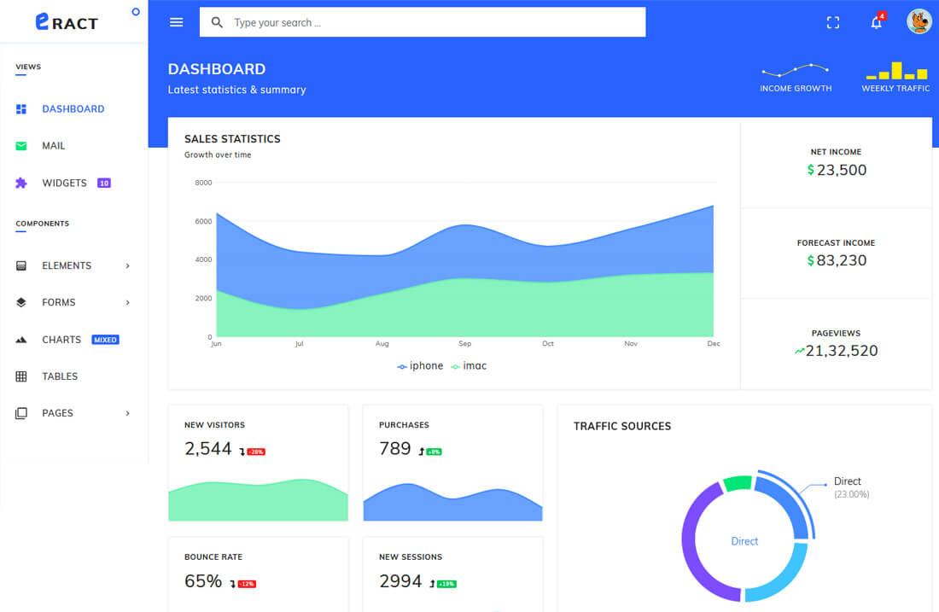

Slide 20
Features of User
Sign-up and Login with social media accounts.
POST file/files of different types and scan for malware.
GET analyzed report in PDF format.
View all pending tasks.
View all completed tasks and their reports and sort them based on date/relevance.
Search by task ID.
Delete a task.
Reboot a task.

Slide 21
Features of admin
View Dashboard of all users
Add/ Delete/ Modify users and/or their tasks.
Block users
View all reports of user tasks

Slide 22
File submission Methods
Display which files are not allowed
Accept through URL/ Hashes
Upload by Drag-Drop
Upload by curl / python and similar scripts
Upload by browsing the file through GUI

Slide 23
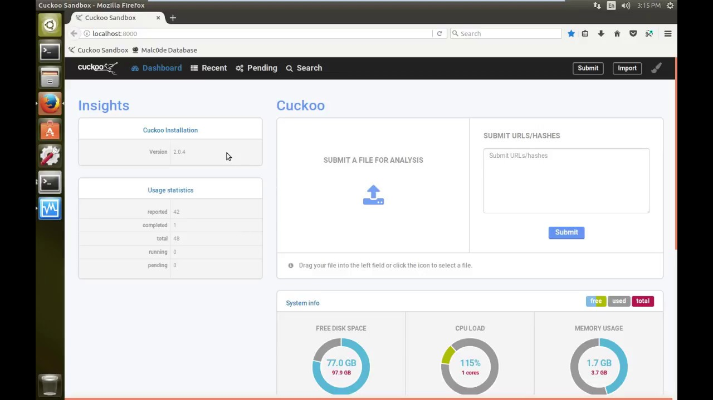

Slide 24
Handling Exception : In detail
Errors in compatibility of the files accepted by malware detection software and the files provided by the user shall be raised as the result of the POST request.
Errors due to large file size (BAD Request 400) can be raised by writing a simple Vanilla JavaScript function to calculate the size of the file before uploading. URL: https://stackoverflow.com/questions/7497404/get-file-size-before-uploading
Errors due to “file not found” (404) also can be raised when the POST request is sent by the user.
Error due to proxy shall also be displayed when a GET or POST request is made.
Error due to unauthorized access can be dealt by forcing the user to log in.
Error due to TimeOut can be dealt by checking the user’s network connectivity or otherwise display that there are too many requests to the server.

Slide 25
References
https://docs.cuckoosandbox.org/en/latest/faq/
https://en.wikipedia.org/wiki/List_of_HTTP_status_codes
https://www.angularminds.com/blog/article/7-top-reactjs-features-which-makes-it-best-for-development.html
https://auth0.com/about
https://cuckoo.sh/docs/usage/api.html#resources
https://megathon.in/

