Slide 1
PPT模板下载：www.1ppt.com/moban/ 行业PPT模板：www.1ppt.com/hangye/
节日PPT模板：www.1ppt.com/jieri/ PPT素材下载：www.1ppt.com/sucai/
PPT背景图片：www.1ppt.com/beijing/ PPT图表下载：www.1ppt.com/tubiao/
优秀PPT下载：www.1ppt.com/xiazai/ PPT教程： www.1ppt.com/powerpoint/
Word教程： www.1ppt.com/word/ Excel教程：www.1ppt.com/excel/
资料下载：www.1ppt.com/ziliao/ PPT课件下载：www.1ppt.com/kejian/
范文下载：www.1ppt.com/fanwen/ 试卷下载：www.1ppt.com/shiti/
教案下载：www.1ppt.com/jiaoan/ PPT论坛：www.1ppt.cn
b
-Megastore-
Providing Scalable, Highly Available, Storage for Interactive Services
Lin Jinting, Chen Dian, Zhang Weiming, Liang Jiahui

Slide 2
INDEX
01
INTRODUCTION
02
AVAILABILITY AND SCALE
03
MEGASTORE
04
CORE: REPLICATION
05
CONCLUSION

Slide 3
1
INTRODUCTION

Slide 4
Today`s Interactive Online Services
Numerous Users
Highly Scalable
Competition
Rapid Development
Responsive
Low Latency
Invaluable Info
High Available

Slide 5
Everybody`s Requirement
Scalable
Admin
Automatic
Management
Developers
Easy Deployment
Wide-area Replication
ACID
Transactions
High-Available,
Policy
Read, Modify, Write
Users
High-Available,
Low Latency
Good Experience

Slide 6
Scalable
Admin
Automatic
Management
Developers
Easy Deployment
Eventual
Consistency
Bigtable
Clustering
MySQL Failover
MySQL
Wide-area Replication
ACID
Transactions
High-Available,
Policy
Read, Modify, Write
Quorum
Voting
Users
High-Available,
Low Latency
Good Experience

Slide 7
Our Solution
Scalable
Eventual
Consistency
Clustering
Bigtable
MySQL Failover
MySQL
Wide-area Replication
ACID
Transactions
Quorum
Voting

Slide 8
2
AVAILABILITY AND SCALE

Slide 9
Overview
1
2
For Availability
For Scale
A Synchronous, Fault-tolerant log replicator. (i.e., by Chubby.)
NoSQL data storage with its own replicated log. (i.e. by Bigtable.)

Slide 10
Common Replication Strategies And Paxos
Asynchronous Master / Slave Mode
Master maintains the writes ahead log. If there are appends to the replication log, master will be acknowledged in parallel with slave through Message Queue(MQ).
Weakness: But if the target slave is down, data loss will occur. Therefore needs a consensus protocol.
Synchronous Master / Slave Mode
Master inform its slaves after the changes are applied.
Weakness: Needs a external system to keep the time.
Optimistic Replication
Mutations are propagate through the gourp asynchronous.
Because the order of propagation is unpredictable, it is impossible to implement transaction with such algorithm.
Paxos
No distinguished master and slave. Use vote and catch up to keep data consensus.

Slide 11
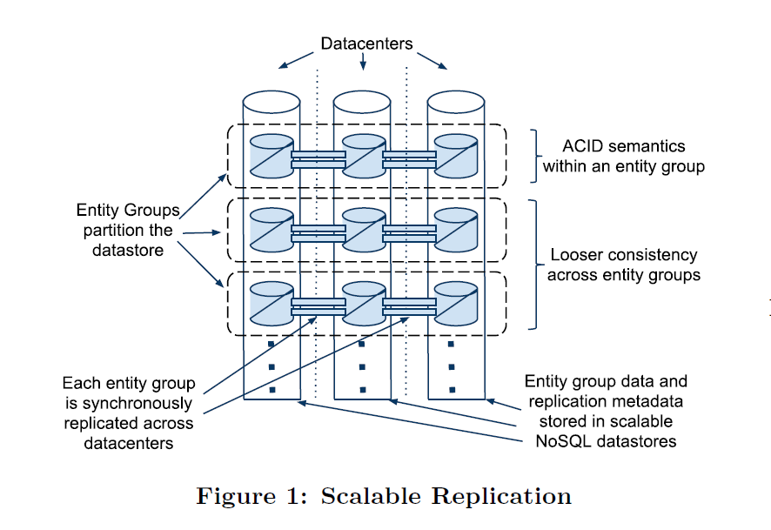
Entity Groups

Slide 12
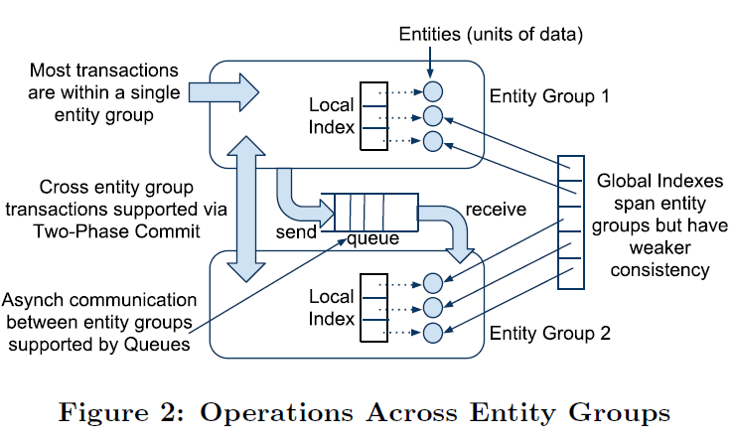
Operations Across Entity Groups

Slide 13
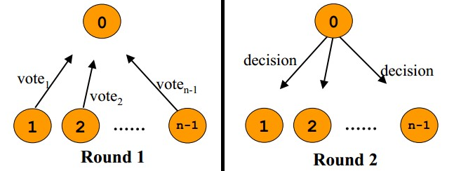
Two-Phase Commit(2PC)
Commit-request phase, so called voting phase
In this phase, coordinator(coord.) will inform all partcipants that whether they can cmmit or not, and all partcipants respond their status and make preparation if agree.
Commit phase
If all vote yes, than this transaction will be committed in all partcipants. If some of them vote no, this transaction will be abort and all partcipant will rollback previous actions.

Slide 14
How to define the boundary of a entity group?
Email
Each email account is able to form a entity group. And A sends an email to B will be regards as an across-group transaction.
Blogs
The profile for each user will be formed a entity group naturally.
Posts and metadata will be formed another entity group.
A third entity group will be used to describes the blog titles.
Transactions are rely on asynchronous message queue.
Maps
Not such modle is suitable for describing gergraphic data. We usually divide the map into several non-overlapping patches, in order to form a entity group for a single patch.

Slide 15
3
MEGASTORE

Slide 16
Assumptions And Philosophy For API Design

Slide 17
What Is Hierarchical Layout?

Slide 18
Sample Data Schema
CREATE SCHEMA PhotoApp;
CREATE TABLE User {
required int64 user_id;
required string name;
} PRIMARY KEY(user_id), ENTITY GROUP ROOT;
CREATE TABLE Photo {
required int64 user_id;
required int32 photo_id;
required int64 time;
required string full_url;
optional string thumbnail_url;
repeated string tag;
} PRIMARY KEY(user_id, photo_id),
IN TABLE User,
ENTITY GROUP KEY(user_id) REFERENCES User;
CREATE LOCAL INDEX PhotosByTime ON Photo(user_id, time);
CREATE GLOBAL INDEX PhotosByTag ON Photo(tag) STORING (thumbnail_url);

Slide 19
Data Stored In Bigtable – User Table
CREATE TABLE User {
required int64 user_id;
required string name;
} PRIMARY KEY(user_id), ENTITY GROUP ROOT;
Row Key | User.name
101 | John
102 | Mary
103 | Jane

Slide 20
Data Stored In Bigtable – Photo Table
CREATE TABLE Photo {
required int64 user_id;
required int32 photo_id;
required int64 time;
required string full_url;
optional string thumbnail_url;
repeated string tag;
} PRIMARY KEY(user_id, photo_id),
IN TABLE User,
ENTITY GROUP KEY(user_id) REFERENCES User;
Row Key | Photo.name | Photo.tag | Photo._url
101, 500 | 12:30:01 | Dinner, Paris | …
101, 502 | 12:15:22 | Dinner, Paris | …
103, 19 | 08:32:11 | Office | …

Slide 21
Data Stored In Bigtable – Foreign key
Entity Group root
CREATE TABLE User {
required int64 user_id;
required string name;
} PRIMARY KEY(user_id), ENTITY GROUP ROOT;
1.Stored in User table
CREATE TABLE Photo {
required int64 user_id;
required int32 photo_id;
required int64 time;
required string full_url;
optional string thumbnail_url;
repeated string tag;
} PRIMARY KEY(user_id, photo_id),
IN TABLE User,
ENTITY GROUP KEY(user_id) REFERENCES User;
2.Child table refers to User

Slide 22
Data Stored In Bigtable – Actual Bigtable
Row key | User.name | Photo.time | Photo.tag | Photo._url | ···
101 | John
101, 500 |  | 12:31:01 | Dinner, Paris | ··· | ···
101, 502 |  | 12:15:22 | Betty, Paris | ··· | ···
102 | Mary
103 | Jane
103, 19 |  | 08:32:11 | Office | ··· | ···
Primary Key
Table User
Table Photo

Slide 23
Data Stored In Bigtable – Entity Groups
Row key | User.name | Photo.time | Photo.tag | Photo._url | ···
101 | John
101, 500 |  | 12:31:01 | Dinner, Paris | ··· | ···
101, 502 |  | 12:15:22 | Betty, Paris | ··· | ···
102 | Mary
103 | Jane
103, 19 |  | 08:32:11 | Office | ··· | ···
EG - John
EG - Mary
EG – Jane
Primary Key
Table User
Table Photo
Entity Groups: Users and his Photos
1. Root Entity: User
2. Child Entity: Photo

Slide 24
Data Stored In Bigtable – Data Partitions

Slide 25
Data Stored In Bigtable – Data Partitions
Row key | User.name | Photo.time | Photo.tag | Photo._url | ···
101 | John
101, 500 |  | 12:31:01 | Dinner, Paris | ··· | ···
101, 502 |  | 12:15:22 | Betty, Paris | ··· | ···
102 | Mary
103 | Jane
103, 19 |  | 08:32:11 | Office | ··· | ···

Slide 26
Data Stored In Bigtable – Index Features
Storing Clause
Storing additional info for retrieval. It will make search for specific entity spend less communication rounds.
If you want to get the thumbnail_url without this index, it will take at least 2 rounds communications. But with this, it takes 1 round minimum.
Repeated Indexed
Each repeated tag has its own index entry.
Inline Indexes
Extracting slices of info from child entities and storing it in the parent for fast access.
CREATE GLOBAL INDEX PhotosByTag ON Photo(tag) STORING (thumbnail_url);
CREATE GLOBAL INDEX PhotosByTag ON Photo(tag) STORING (thumbnail_url);
CREATE LOCAL INDEX PhotosByTime ON Photo(user_id, time);

Slide 27
Data Stored In Bigtable – Local And Global Index
CREATE LOCAL INDEX PhotosByTime ON Photo(user_id, time);
CREATE GLOBAL INDEX PhotosByTag ON Photo(tag) STORING (thumbnail_url);
User._id | time | Row key
John | 12:31:01 | 101, 500
John | 12:15:22 | 101, 502
James | 12:12:00 | 108, 501
Local Index:
Used to find entities within an EG.
Photo.tag | Thumbnail_url | Row key
Dinner | ··· | 101, 500
Paris | ··· | 101, 500
Betty | ··· | 108, 501
Global Index:
Used to find entities across an EG.

Slide 28
Within EG - ACID Semantics And MVCC
Write Ahead Log
Write it before apply the changes. It can be used for fail recovery or transaction rollback.
MultiVersion Concurrency Control (MVCC)
Different values can be stored in a single Bigtable cell, with their timestamps attached.
Reader uses timestamps to identify the
latest value for target property in a fully
updated transaction.
At the same time, reads and writes are
isolated, as there are multiply versions. If a writer is appending the latest value to
bigtable, reads will fetch the one version older value. But still the latest value until the writer finishes.
Photo.tag
[(Dinner, Paris), 12:30:01], [(Father, Mother), 12:31:01]
[(Betty, Paris), 12:15:22], [(Betty), 12:16:22]

Slide 29
Read – Current, Snapshot And Inconsistent Read
Current Read
Always done within a single EG. Read info before confirming all previous transactions are applied.
Snapshot Read
Picks up the latest known fully applied version, though there may be some transactions waiting for applied, for example, transactions delayed in Asynchronous Message Queue for network problems.
3. Inconsistent Read
Reads the value in Bigtable directly regards the log status.
See the differences between them from table below:
Type | Data Consensus | Latency
Current Read | High | High
Snapshot Read | Medium | Medium
Inconsistent Read | Low | Low

Slide 30
Write – Complete Transaction Lifecycle
Current Read
Uses a current read to determine the next available log position.
Application Logic
Prepare the data to be written together, and designate it a latest log position. Also, batching writes to a front-end server can reduce the possibility of contention.
Commit
Client submit mutations and the server will use Paxos to vote a consensus value across all replicas.
Apply
Write mutations that win the Paxos procedure into the Bigtable, with its own timesamp attached.
Clean UP
Clean all unnecessary values. For example, older version of a updated value.

Slide 31
4
CORE: REPLICATION

Slide 32
Original Paxos With Sample I
A way to reach consensus among a distributed system on a given value by winning more than half votes. There are 2 phases: (1)Prepare and (2)Accept.
But it is ill-suited for high letency network.
Suppose 25 travellers need to reach a consensus about where to go with 5 additional leaders.
Leaders will only reply the latest message he receives.
With at least half of the leaders` accept(i.e., 3 leaders), this traveler can enter the Accept phase.

Slide 33
Original Paxos With Sample II
There are 2 possible situations:
If none of the leaders had made decision. This traveller will send message to all leaders with his proposal.
If more half leaders reach a consensus, this will be the decision.
If it is the other situation, he has to retry from Prepare phase.
At least 1 leader had made decision.
If more half leaders reach a consensus, this will be the decision.
If all leaders had not reached consensus, he will supports the latest decison.

Slide 34
Megastore`s Approach – Fast Read And Write
Fast Read
Local reads
“Write usually succeed on all replicas.” Therefore, allowing local reads with lower latercies and better utilization is reasonable.
Coordinator
“A coordinator is a server tracks a set of entity groups for withc its replica has observed all Paxos writes.”
Fast Write
Implied prepare message
Each successful write implied a prepare message for next log position it needs to perform next write. So, 1 round for each subsequent writes is saved.
2. “Use the closest replica”
Select the replica with most submitting in this region.

Slide 35
Megastore`s Approach – Replica Types
There are 3 different types of replicas in Megastore:
Full Replica
Witness Replica
Read-only Rreplica
See the differences from table below.
 | Full Replica | Witness Replica | Read-only replica
Current Read | Yes | No | No
Log and Data Storage | All | Not-applied log, No data and indexes | Full data snapshot
Vote | Yes | Yes | No
Usage | All | Tie breakers, Voting | Dissemination - CDN

Slide 36
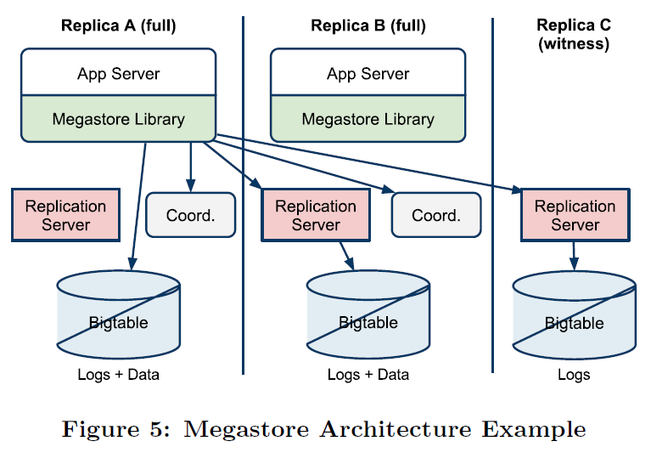
Architecture Example

Slide 37
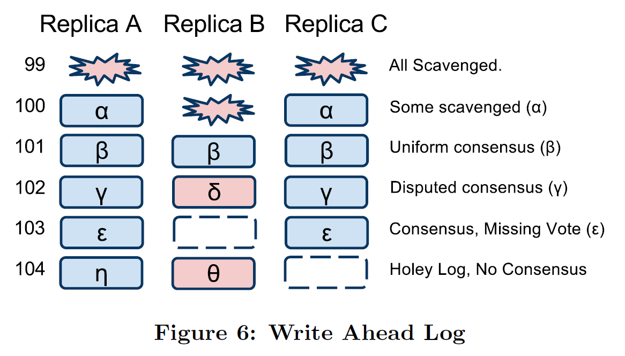
Replicated Logs

Slide 38
Reads
There are 5 steps for read algorithm in Megastore:
Query Local
“Determine if the entity group is up-to-date locally.”
Find Position
Get the highest log position, and select the corresponding replica.
1. Local read. Get the log position and timestamp locally.
2. Majority read.
Catchup
Get unknow value from other replica; run Paxos for any unconsensus.
Apply all consensus value, and push the state up-to-date.
Validate
Send its coordinator a message asserting itself up-to-date.
Query Data

Slide 39
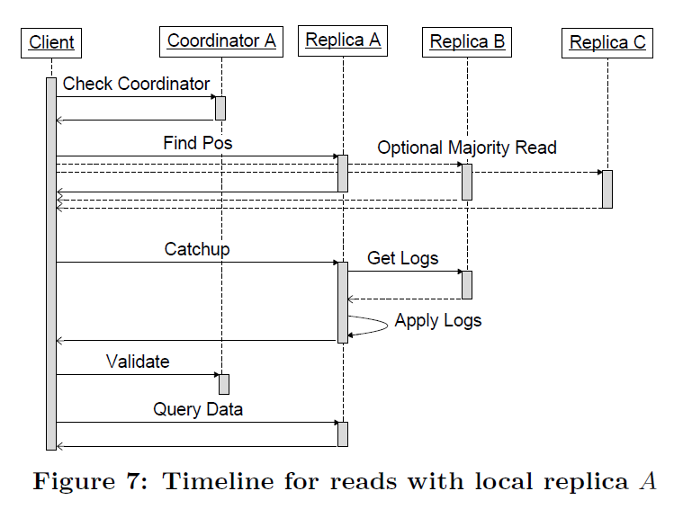
Read Example Timeline

Slide 40
Writes
There are 5 steps for write algorithm in Megastore:
Accept Leader
“Ask the leader to accept the value as proposal number zero.”
Prepare
“Run Paxos Prepare phase at all replicas.”
Accept
Ask the rest of replicas to accept the proposal, as the Accept Phase in Paxos.
Invalidate
If a full replica does`n accept this value, invalidate its coordinator.
Apply

Slide 41
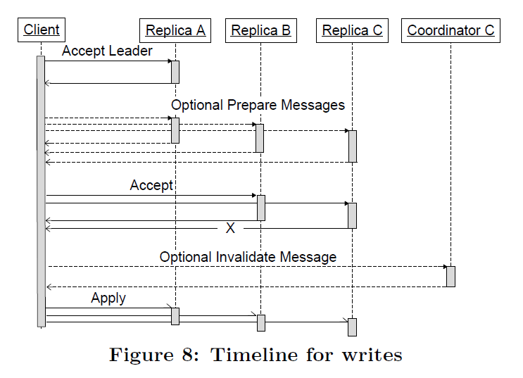
Write Example Timeline

Slide 42
Coordinator Availability
Coordinator is a simpler process than Bigtable with much more stability. But it still has the risk to crash or other situations that cause its unabaliable.
Reader
“To precess a request, a coordinator must hold a majority of its locks.”
Writer
Test the coordinator whether it still has locks.
If a live coordinator suddenly lost network connection, writers has to wait for the lock expired or a maunal repair.

Slide 43
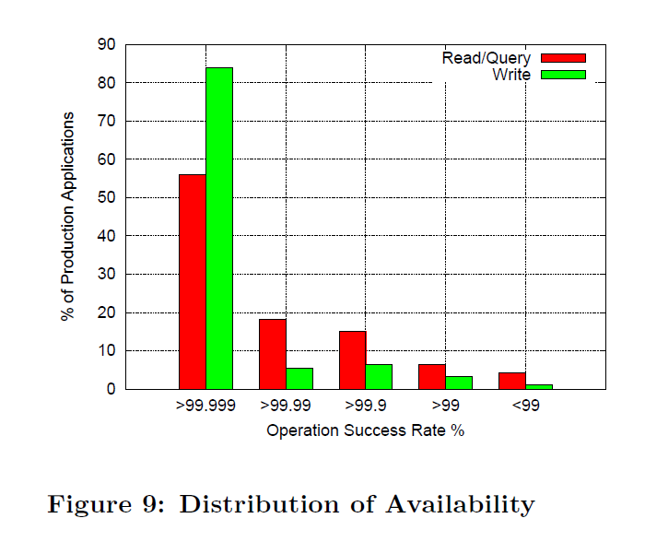
Distribution of Availability

Slide 44
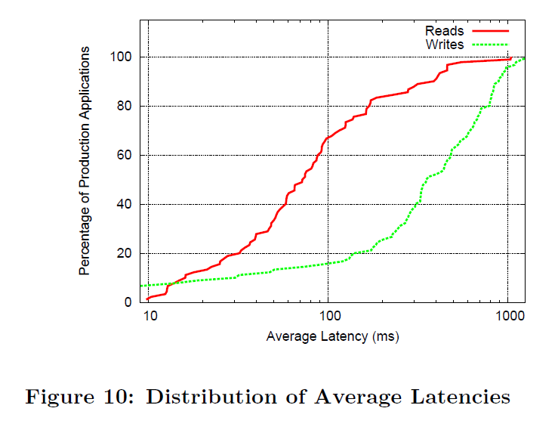
Latency

Slide 45
5
CONCLUSION

Slide 46
Conclusion
In this presentation, we make introduction for the following concepts:
Entity Groups;
Data Model and MVCC;
Paxos in Megastore;
Replication algorithm.
Since Megastore is the origin of many distributed systems, we truely hope our audience can fully understand the revolutional concept and theory that Megastore brings to us.
One step further, keep the motivation for learing and innovating is the fundamental motive power towards truth.
「Stay Hungry, Stay Foolish.」
By Steve Jobs

