Slide 1

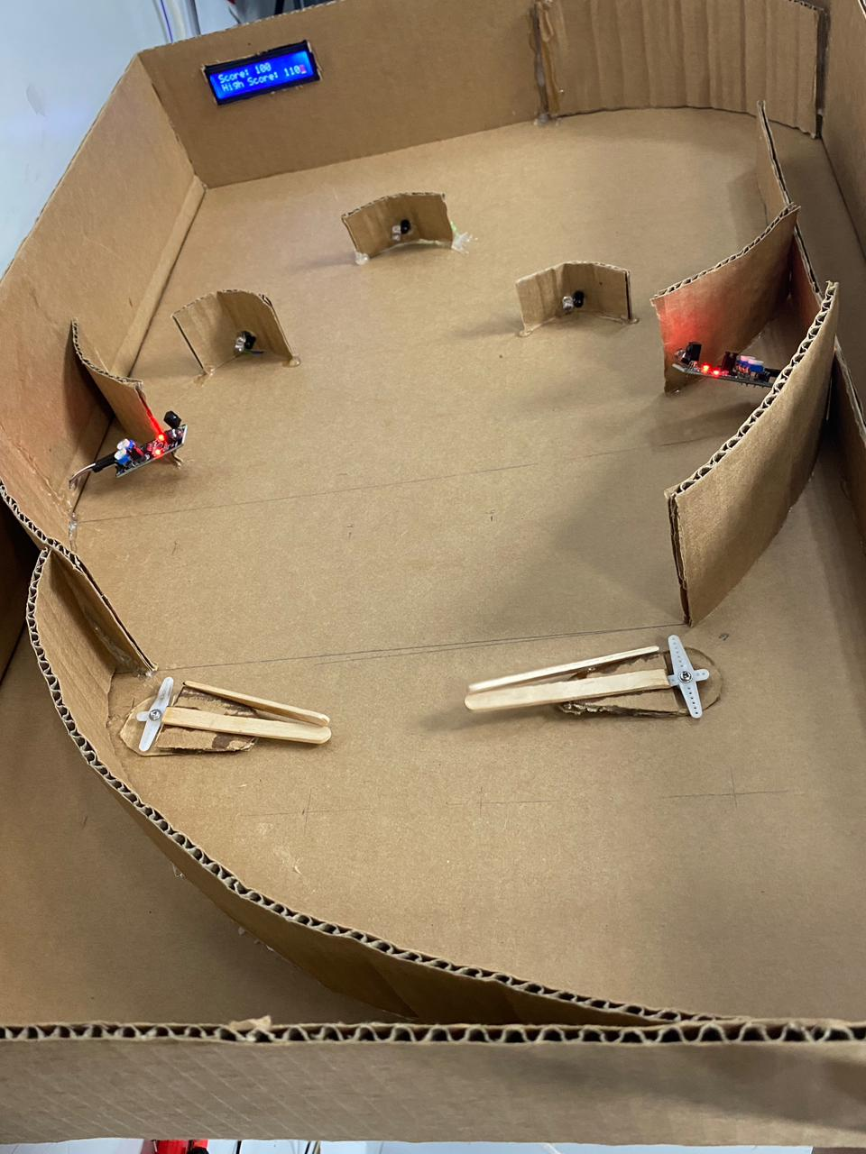
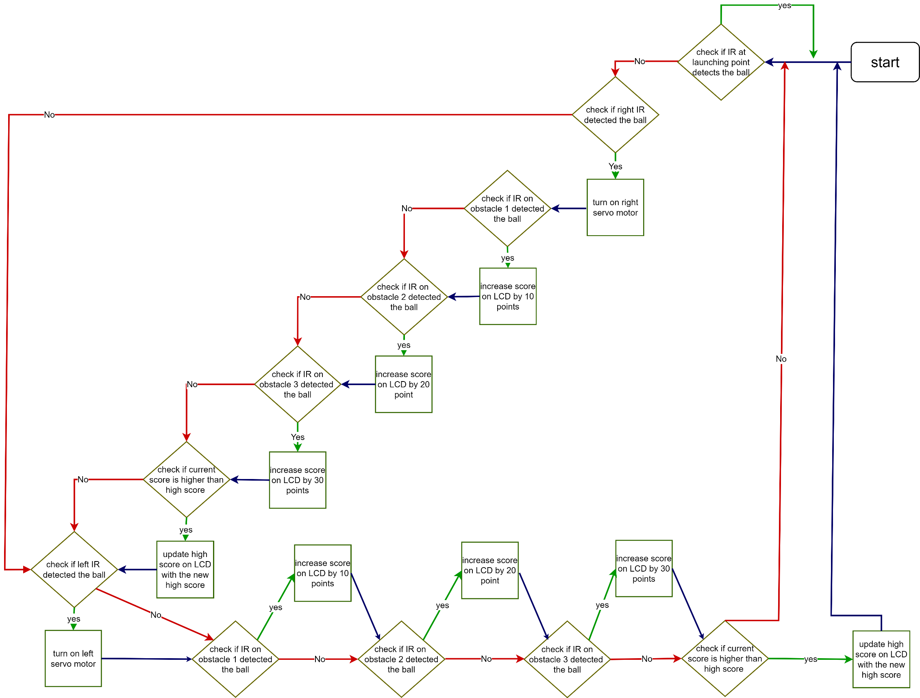
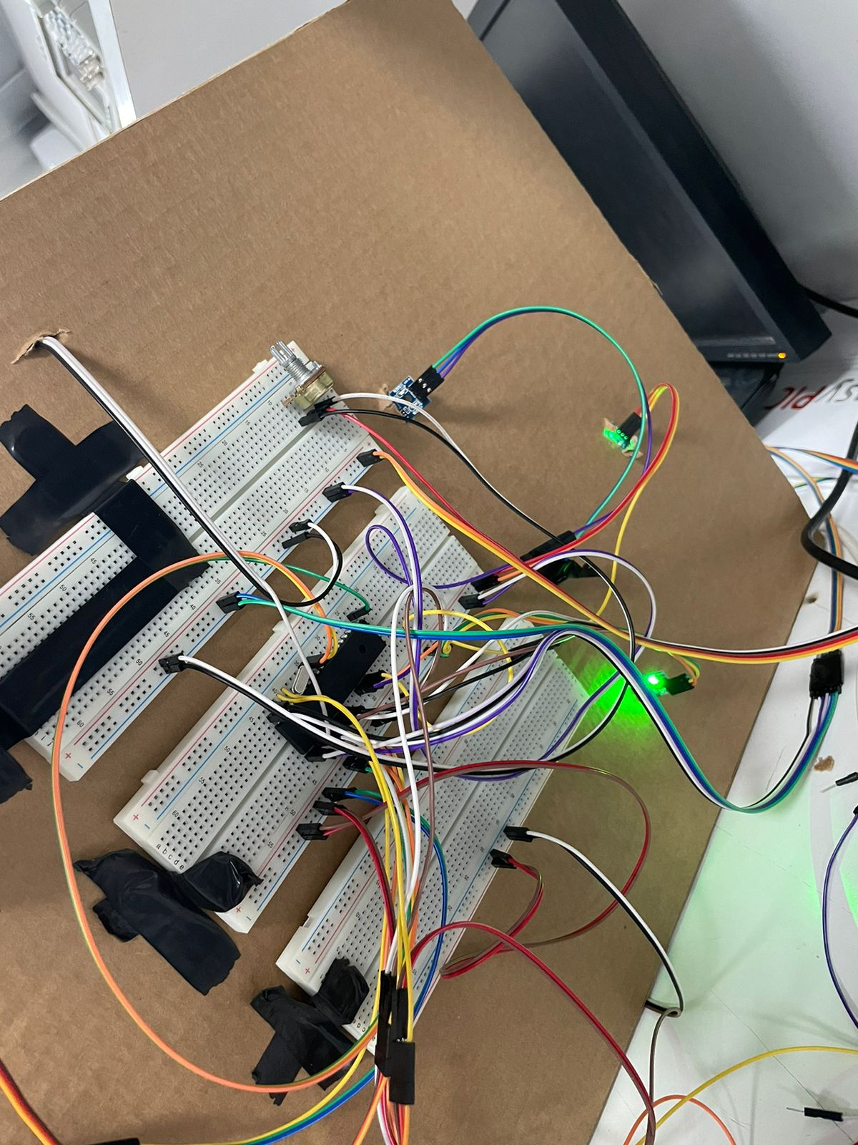
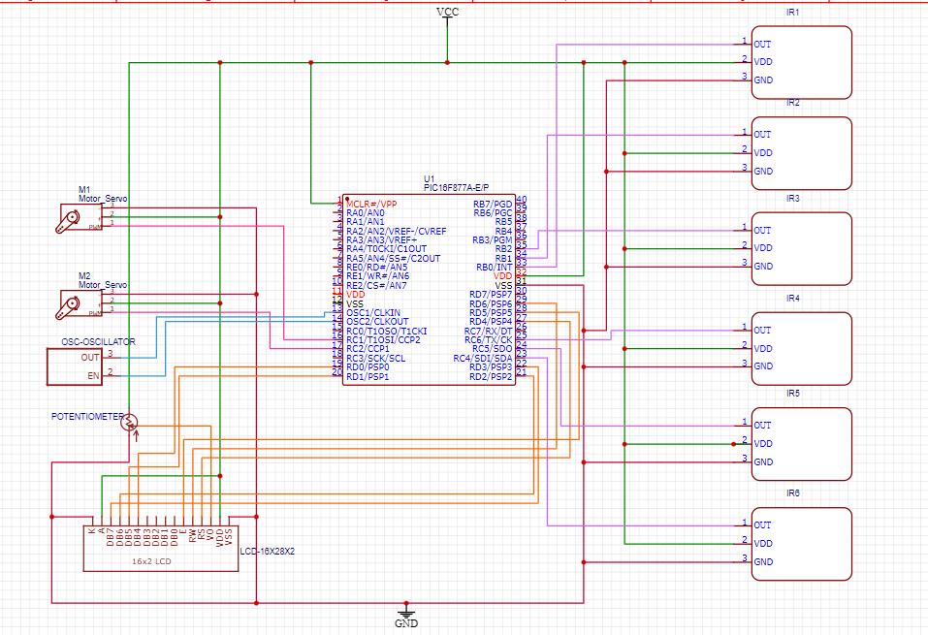
Autonomous Pinball Machine
S. Huneidi, N. Darwazeh, M. Alsaadi
Supervisor: Dr. Belal Sababha
Embedded Systems Final Design Project, Spring 2023
King Abdullah II School of Engineering
Princess Sumaya University for Technology
Introduction
The aim of this project is to design an autonomous pinball machine using 16F877A microcontroller. Two IR sensors are used to detect the running ball in case of moving towards the handlers, which are provided with two servo motors to lead their movement. Three obstacles are put in different locations of the model, each of which is supplied with an IR. The job of the IR sensor here, is to detect the ball whenever it hits the obstacle, and hence, sends a signal to the LCD screen to display the increased score. Overall, this project combines embedded systems with sensors technology to construct a modern, autonomous pinball machine.
Results
The following figures depict the final results after connecting the circuits and designing the Pinball Machine.
figure 1: top view of the prototype
Figure 2: circuit connections for the machine
The proposed idea was to automate the arcade game “Pinball” and design it in a more modern, technological form, which was achieved through using IR sensors to detect the moving ball, servo motor to move the handlers of the machine, and an LCD screen that displays the current score and the highest score of all time.
Ramps of different sizes where added in some parts of the body to facilitate the movement of the ball.
A spring was chosen as a simple launching mechanism for the ball at the beginning of the game.
Design
In the following, the flowchart of this project that demonstrates how our autonomous pinball machine works according to our code flow:
Figure 1: Autonomous Pinball Machine flow chart
What follows, is the designed circuit of the system we are seeking to construct:
Figure 2: schematic design
Conclusion
This project proved how different technologies work together. The embedded systems, alongside with sensors technology are capable of creating different autonomous machines that can perform multiple different tasks.
In our case, synchronizing between the IR sensors and the servo motors - achieved through code -, helped achieving a meaningful functionality and movement of the machine handlers, changing the score and displaying it on the LCD screen accordingly depending on the IR sensors. Overall, the project proved that sensors technology, combined with embedded systems are capable of applying any desired function.

