Slide 1

Customer Buying Behavior Prediction
Objective: To identify the primary factors influencing flight booking completion
Analyst: Abdiaziz Ibrahim Kar
Date: 01/09/2025

Slide 2
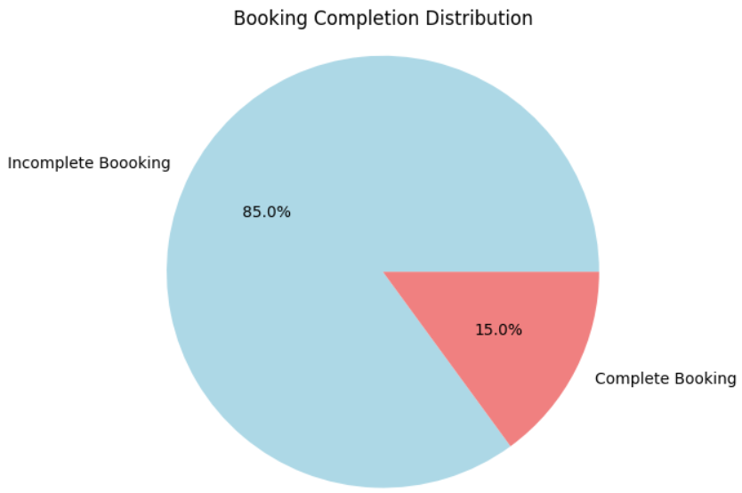
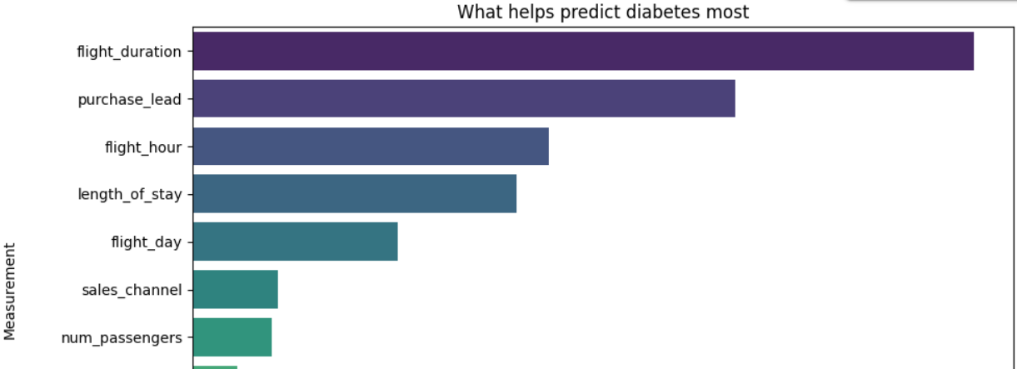
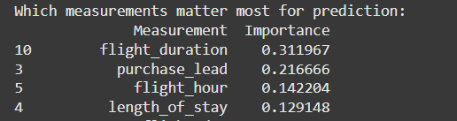
Key Findings
Only 15% of initiated bookings are completed.
Complete Bookings: 7,478
Incomplete Bookings: 42,522
The most important features:
flight_duration
purchase_lead
length_of_stay
flight_hour

