Slide 1
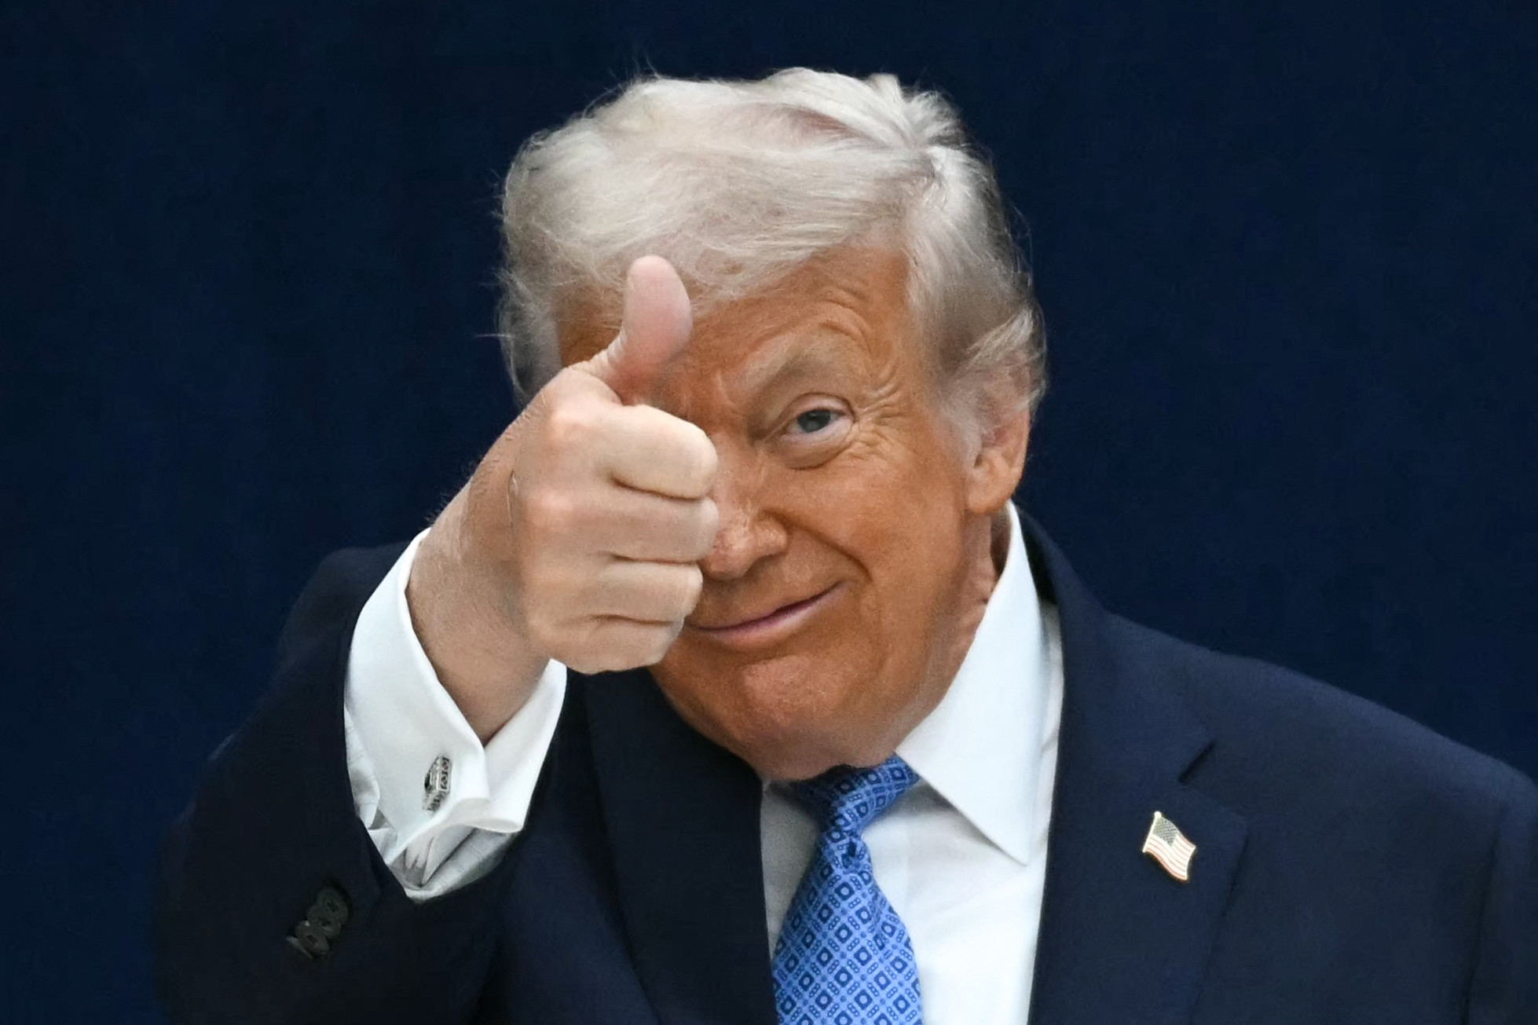
Donald TRUMP the goat
USA 45th president
Make America great again !
God bless America (sigma)

Slide 2
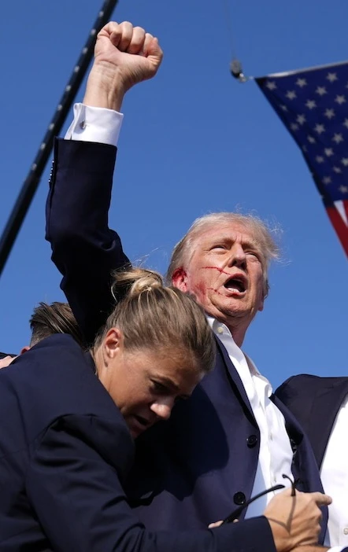
Sigma projects
WW3
Trump coin
Dodged a bullet
Drink bleach for eternal life

Slide 3
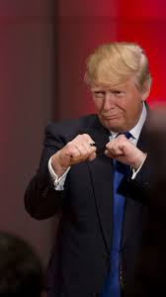

The US army

Slide 4
His glory
He kidnapped a random dude from another country that starts with the letter V so try to guess what it is
Like and sub
best stuff out there

Slide 5
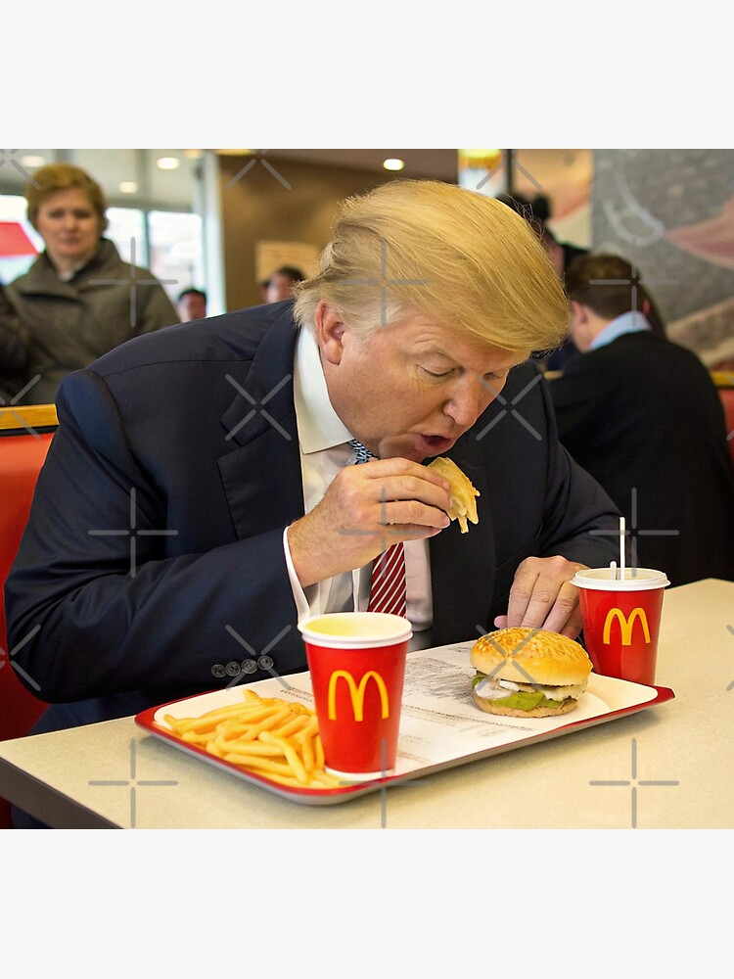
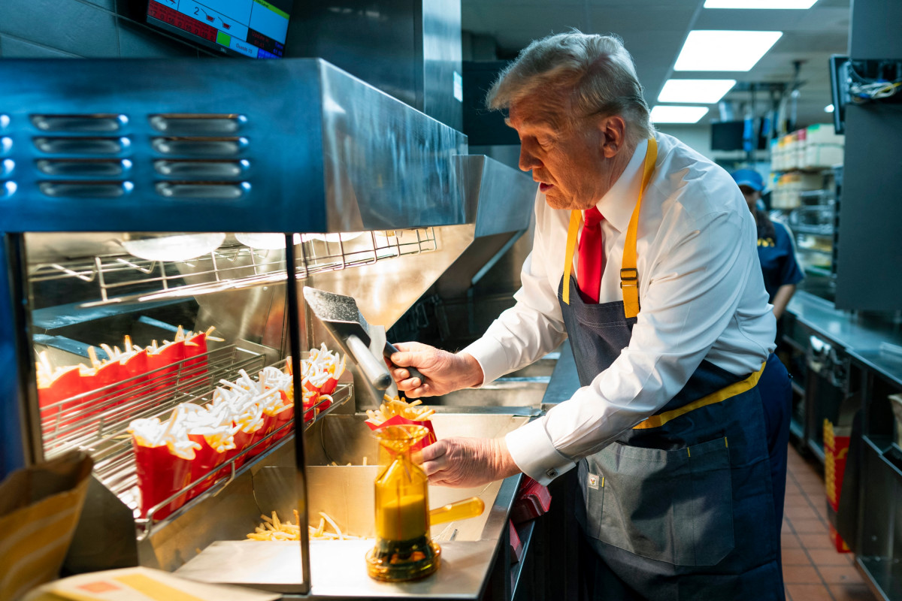
His struggles
Worked at mc donalds
Didn’t graduate
No dad
No mom
No uncle
No aunt
No grandma
No grandpa
order here

