Slide 2
Machine Learning Track
Work Plan
Analytics Institute
April 2023
Notes:
Background
Thank you for your time to attend this call. I know everyone is busy with their work and that we have some deadlines to meet. But perhaps, this could be a good time to just set aside everything first and reflect on our growth potential as data scientists.
What we have this afternoon for you is an opportunity to grow and learn an exciting part of being a data scientist. At work, we’re all doing what we are tasked to do to help the business grow and to make our customers happy. But what if, we could also allocate some time on giving our personal careers a bit of attention, in the hopes of finding fulfillment as employees of this company.
I know that some, if not all of you are dying to learn what you might have neglected the skills required to be a well-rounded data scientist and machine learning professional. What we are offering to you today is a chance to bring us back to the forgotten track of being a machine learning practitioner. So, we urge everyone to give this chance a try as we all learn and master the skills required for being a machine learning specialist.
A bit of a background on how all of this started. Back in 2019, the HR development team rolled out a hiring program wherein vetted fresh graduates were to be exposed in different departments of the company and were to be mentored and coached by chosen leads within the teams they had been assigned to be a part of. During that time, the advanced analytics team, headed by Charles and with the support of HR was given the opportunity to develop and support some of the junior associates. Given the success of the program, the analytics team was inspired to create a special training program aimed for budding analytics specialists and data scientists. In early 2022, the Analytics Institute was born and had rolled out its first training program.
[can skip this] The first training program was mainly focused on CX analytics. We asked different CX teams to participate in the training and mentoring program. There were about 10-15 people who joined and who got assigned to work on analytics initiatives proposed by their respective teams. There were regular mentoring sessions to guide and coach the participants in their projects. There were training sessions as well on Python, data visualizations and data analysis. Though the program was fruitful, there were some areas that could still be improved. We realized that initiative and commitment were key to learning. We also thought that a seasoned expert as a mentor and coach was also very important.
Today, as part of the program, we are starting a new track, which is the ML track. You have been nominated by your respective leads to participate in this track. I hope all of you are as excited as I am in going through this learning journey.

Slide 3
Learning Objectives & Goals
To familiarize with machine learning concepts, development, deployment and MLOps, and expose students to a live ML implementation
To implement ML models and deploy them in production, ensuring alignment with CVM business objectives, campaign operations and CVM frameworks (i.e. Grid)
To undergo hands-on training in model development by assigning real-world exercises and applied use-case projects
To immerse in the model and pipeline building by assigning tasks to help improve and extend the current ML implementation
To give guidance and support in the learning activities thru instruction, shadowing and mentoring to maintain continuity from concepts to application

Slide 4
Approach
Learning by doing
3-month, 4-stage training program
5-10 hrs a week of training and practice
1-3 hrs a week of mentoring
bi-weekly 15-min update meetings
Assigned tasks & projects are implementable in production
Each activity has a specific deliverable
Online video course and reading assignments
Participants will be assigned to a use case project
Commitment Level to allocate time varies for Learner and Internship

Slide 5
4 Stages of Training, 2 Commitment Levels
Highly encourage for Participants go through the whole Learner to Internship journey of the Program

Slide 6
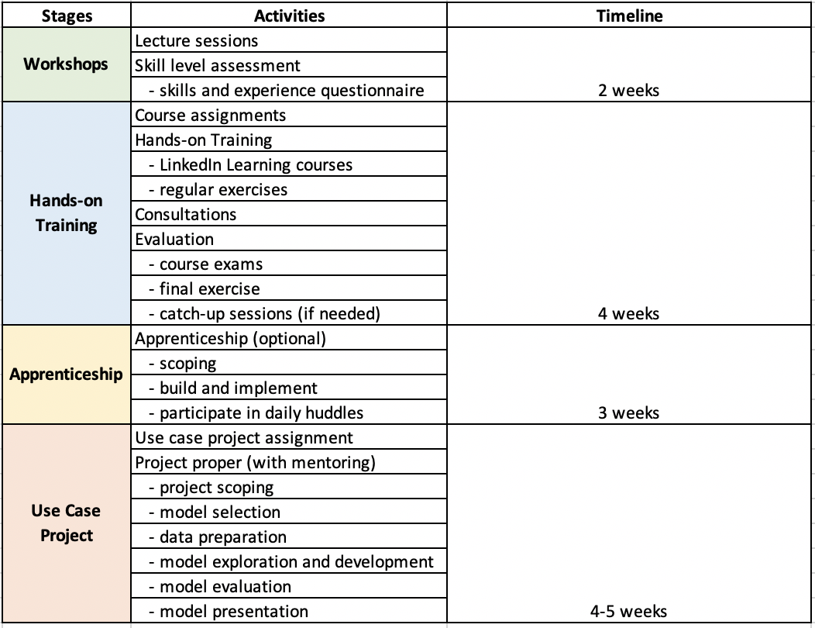
4 Stages of Training & Activities
Notes:
Workshops
• business overview – campaign metrics, campaign grids, GCG, ML offers
• ML overview – ML foundations, general concepts and algorithms
• ML development – data and feature engineering, model building and evaluation
• MLOps – model deployment, retraining, code versioning and maintenance
Skill level assessment
• handing out questionnaires to probe skill level on important areas of ML, like Python coding, modelling and model measurement
• this will be the basis of the courses they will be assigned to take
Course assignment
• listed down all relevant courses on LinkedIn learning. The students are free to choose which courses they want to take, but there will be prescribed courses that they should complete.
We could also assign courses based on the models they will be building for the use case project they will undergo later on.
• There will be regular exercises to be given as well. These exercises should enhance and solidify the skills they will have acquired from the courses
Consultations
• consultation sessions at least 2-3 hours a week . The students could ask questions and get guidance from these sessions
Evaluation
• There’s an exam at the end of each course. We’ll use the exam results to evaluate what they’ve learned
• There’s also a final exam to test their model building skills
• remedial sessions may be conducted if needed
Apprenticeship
• apprenticeship will be catered to WS3 members only. In this stage, certain tasks will be assigned to students to help build and improve Polaris Alpha

Slide 7
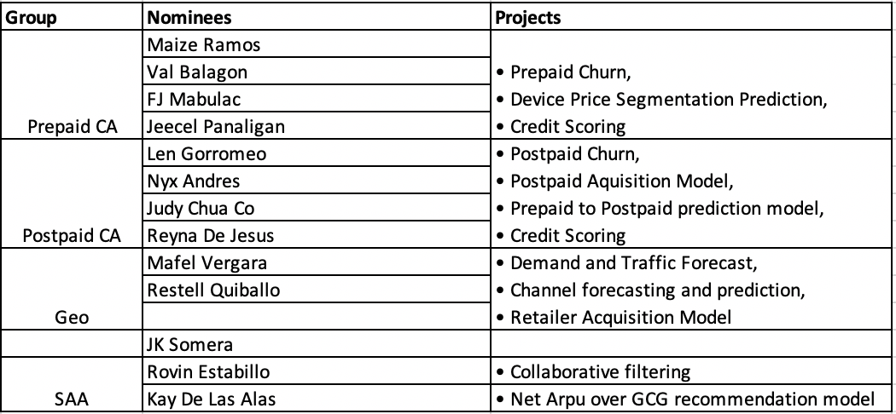
Project Assignment

Slide 8
ML Project Lifecycle
1. Goal definition (from a business problem)
How to think strategically
How to master your executive presence
Atomic habits
Designing a presentation
2. Data collection & preparation
Data engineering foundations
Data science foundations: data engineering
Level up: Python data acquisition, prep and EDA
3. Feature engineering
Advanced Pandas
Applied Machine learning: feature engineering
4. Model training
Introduction to machine learning
Applied machine learning: foundations
Machine learning with Python: Foundations
Machine learning with Python: logistic regression (course)
Machine learning with Scikit-Learn
Supervised learning essential training (course)
Applied machine learning: Algorithms
Hands-on PyTorch Machine Learning (course)
Machine learning and AI Foundations: classification modeling (course)
Machine learning and AI Foundations: prediction, causation and statistical inference
Mistakes to avoid in machine learning
Deep learning: getting started (course)
Deep learning: model optimization and tuning
5. Model evaluation
Level up: python data modeling and model evaluation metrics
6. Model deployment
MLOps essentials: model development and integration
7. Model serving
8. Model monitoring
MLOps essentials: model deployment and monitoring
9. Model maintenance
Others:
Hands-on Introduction: Python
Advanced Python: Working with data
Level up: advanced python
Data science foundations: Python scientific stack
Python design patterns
Building tools with Python
Python: programming efficiently
Python: Decorators
learning git and GitHub
Pair programming with AI
Machine learning foundations: linear algebra
Overfitting and underfitting (video)
Upskilling and respelling your workforce
the data science of experimental design

Slide 9
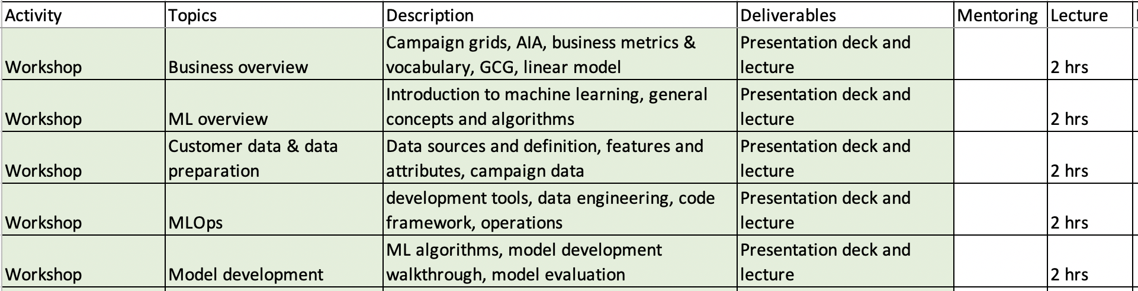
Workshops
• A series of lectures will be given to the participants explaining the whole ML lifecycle, from business goals to model development and deployment
• The focus of the workshops is the ML lifecycle process implemented in production and the different tools and artifacts used to perform ML
• 5 2-hr workshop sessions to be conducted within 2 weeks
Learner

Slide 10
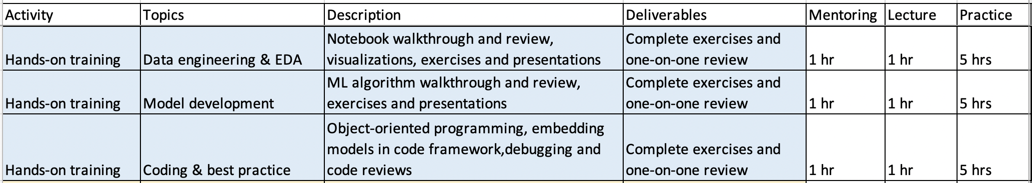
Hands-On Training
• delves deeper into the details of the current implementation by
• sharing the notebooks used to build and develop the models,
• demonstrating each step of the ML building process
• assigning work exercises
• mentoring starts
• a student will be paired with a mentor
• assess the skill level, interest and background of the student
• give reading assignments and exercises with intention of filling skill gaps
• 3 weeks to train and prepare for the upcoming activities
• Post-review and evaluation
Learner

Slide 11
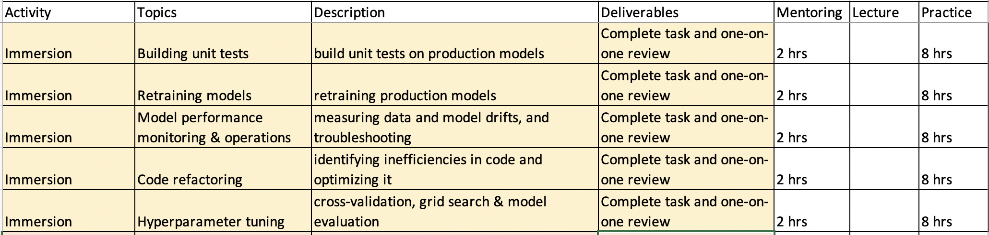
Apprenticeship
• assign an auxiliary task to each student
• mentors to guide students in the tasks
• 8 hrs a week for 2 weeks to complete the tasks
Internship

Slide 12
CVM critical models
Prepaid churn (wrt SWR)
Postpaid churn (payment (IDPD) propensity)
Home churn
Device price segment prediction
Postpaid acquisition model
Credit scoring for postpaid & prepaid
Demand forecast (how big is the market for postpaid and Home)
Traffic forecast
Robust topup forecasting model
Retailer acquisition model
Channel forecasting
Channel prediction (how are likely to convert to digital channels)
Prepaid to postpaid prediction model
CX complaints – sentiment analysis

Slide 13
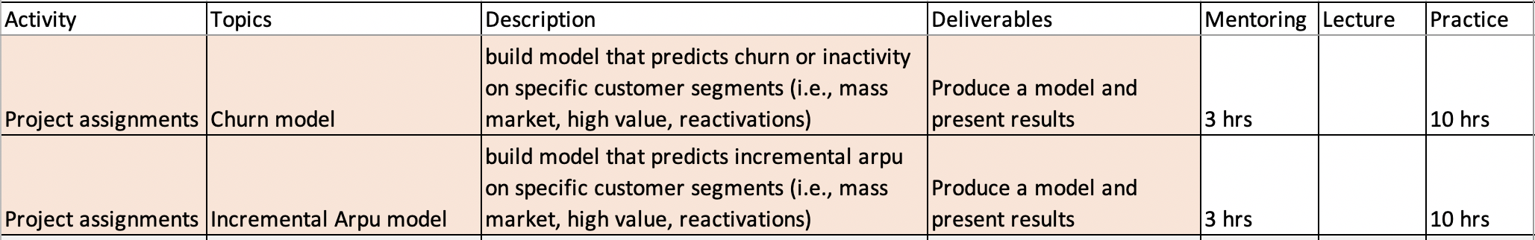
Project Assignments (Directed)
• Assign a project to each student
• The project can either be churn or arpu model. Alternatively, a student can propose a model of interest
• 10 hrs a week for 4-6 weeks of model building.
• The project must touch different components of the ML process:
• feature engineering & selection
• feature analysis
• model development & evaluation
Apprenticeship
Directed
Co-Development
Internship

Slide 14
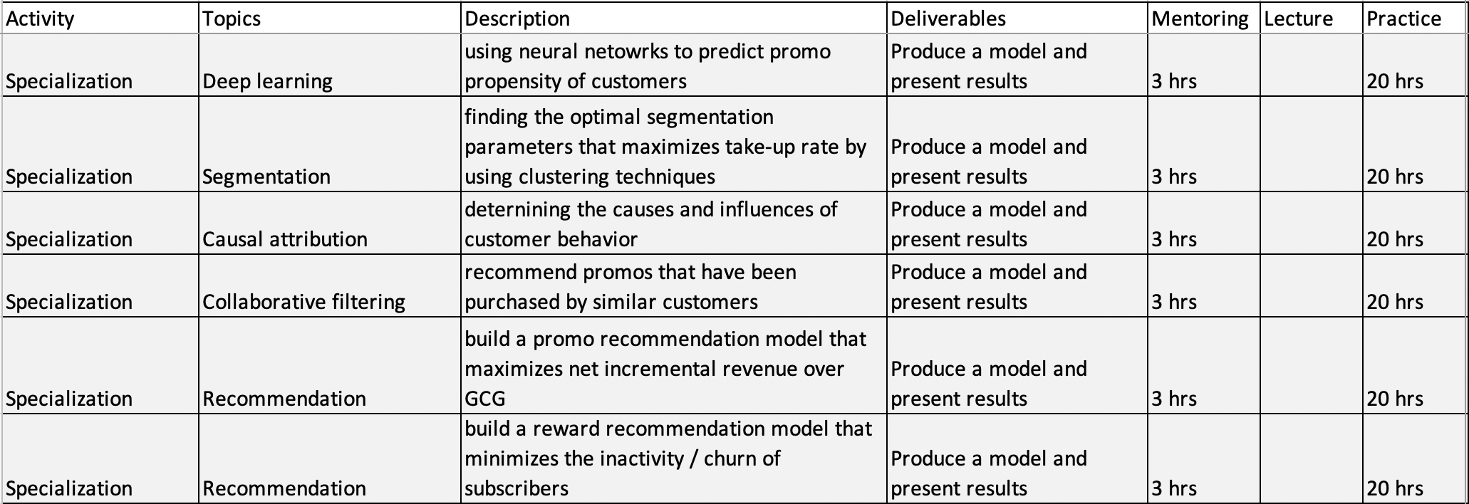
Projects (Co-Development) (6 weeks)
Internship

Slide 15
Timeline
Initial Cascade Apr 17
Request for participation from Leads Apr 18
Invitation to participate Apr 20
Program Kick-off Apr 28
Start of Workshop May 4
Start of Internship Jun 2023
Presentation of ML Project Aug 2023
Program Completion Aug 2023

Slide 16
List of Nominees
 | Nominees | Assigned Project | Assigned Mentor?
1 | Maize Ramos
2 | FJ Mabulac
3 | Jeecel Panaligan
4 | Val Balagon
5 | Len Gorromeo
6 | Nyx Andres
7 | Judy Chua Co
8 | Reyna De Jesus
9 | Mafel Vergara
10 | Restell Quiballo
11 | JK Somera
12 | Rovin Estabillo
13 | Kay De Las Alas

Slide 17
END

Slide 18
Learning Objectives & Goals
To familiarize with the CVM objectives, campaign operations and current ML pipeline implementation
To undergo hands-on training in model development by assigning real-world exercises and applied use-case projects
To immerse in the model and pipeline building by assigning tasks to help improve and extend the current ML implementation
To give guidance and support in the learning activities thru instruction, shadowing and mentoring

Slide 19
Prerequisite
Python – Intermediate
Basic SQL
Basic SKLearn and Pandas (Course available)
Jupyter Notebook
Kick-off : April 18
NLP
Observer
3 Courses (for Observer) (6 hours) (High Level)
April 17 – Language Model
Next Month : May – Text Classification
Next – Named Entity
Paper
Contributor
Python – Intermediate
Pytorch or Tensorflow : Experience developing
Neural Network
Huggingface
Completed course CS224N or Equivalent

Slide 20
Approach
Learning by doing
10-week training program
5-10 hrs a week of training and practice
1-3 hrs a week of mentoring
bi-weekly 15-min update meetings
Assigned tasks & projects are implementable in production
Each activity has a specific deliverable
Online video course and reading assignments
Participants get to choose a full-time specialization project for implementation post-apprenticeship

Slide 21
4 Stages of Training, 2 Commitment Levels
Learner
Internship
Workshops
• A series of lectures explaining the whole ML lifecycle
• 5 2-hr workshop sessions to be conducted in a span of 2 weeks
Hands-on Training
• Deep dive into the details of the current ML implementation
• Assigned readings, courses and exercises
• Health check on Python and data engineering skills
Apprenticeship (Immersion)
• Assign an auxiliary, ML-related tasks, output of which will be deployed in production
• Evaluate readiness to proceed to next stage
• 50% commitment
Use Case Project
• Build a model that can be applied to a real use case
• Agreed milestone between AADS and immediate supervisor
• Present model results to CVMA
2 weeks
4 weeks
3 weeks
4+ weeks

