Slide 1
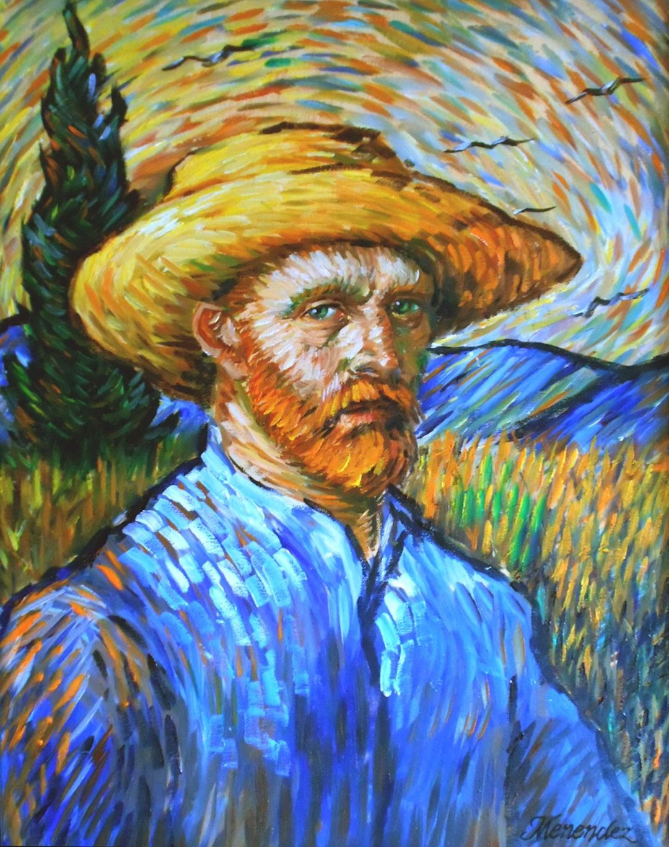
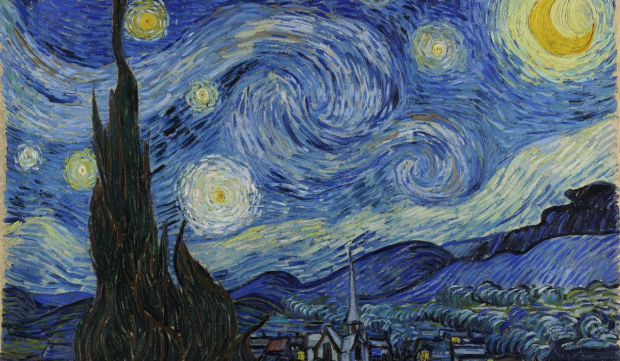
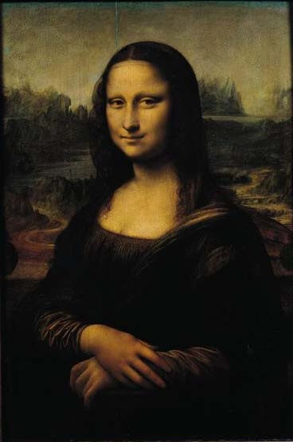
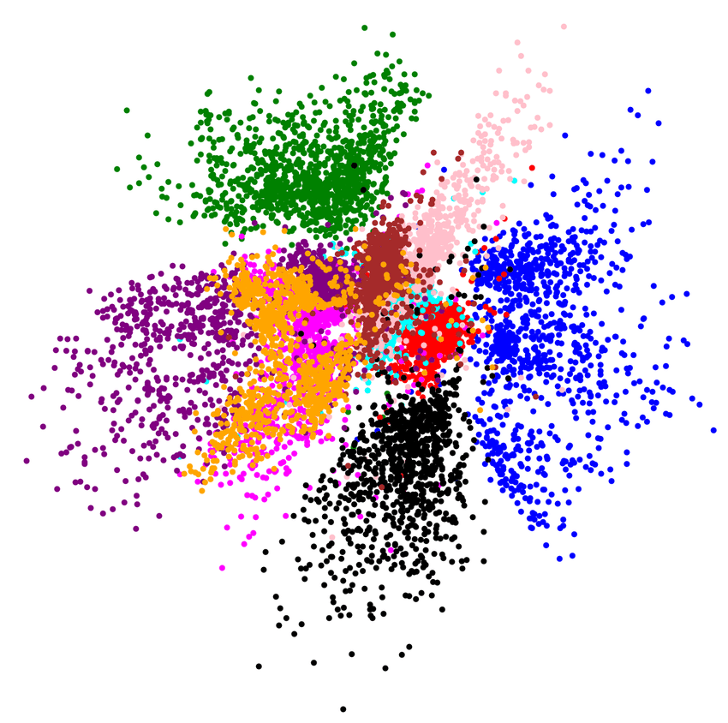
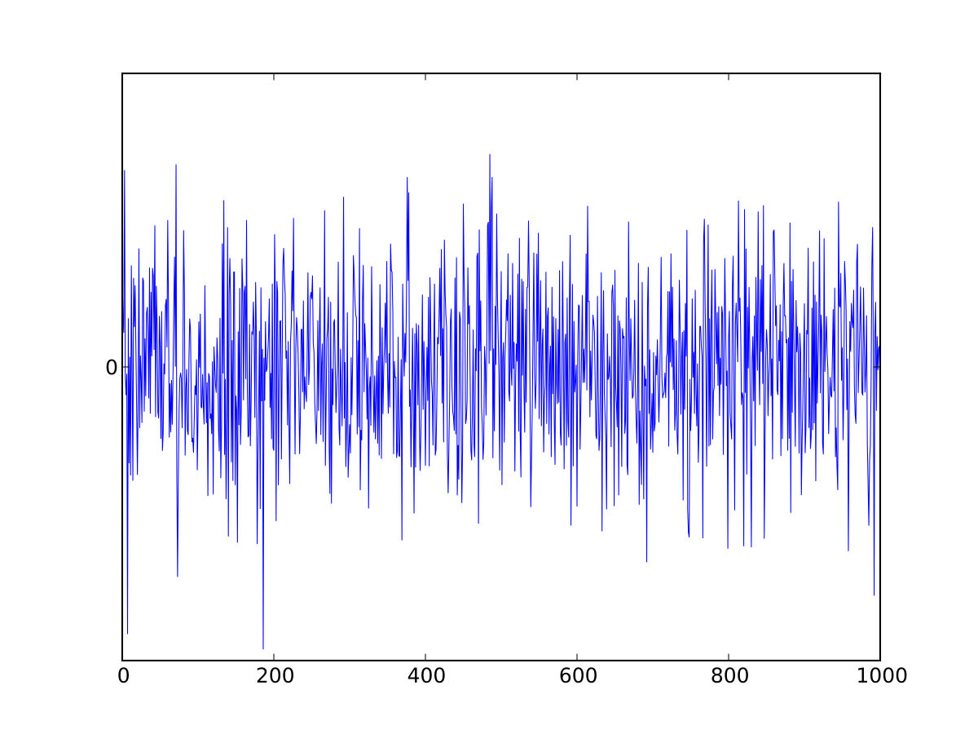
Real Samples
Discriminator
(D)
Is D correct?
Latent Space
Fake Samples
Generator
(G)
Update parameters
Latent space image source: Davidson, Tim R., et al. "Hyperspherical variational auto-encoders." arXiv preprint arXiv:1804.00891 (2018).
This Photo by Unknown Author is licensed under CC BY-SA

