Slide 1
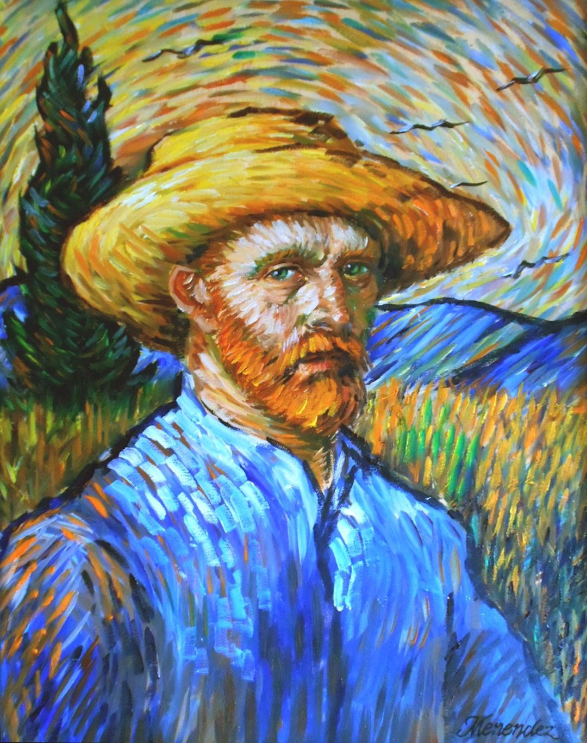
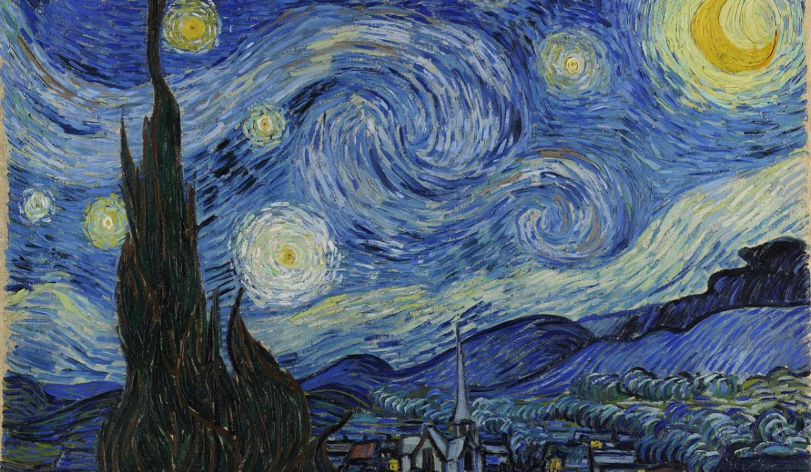
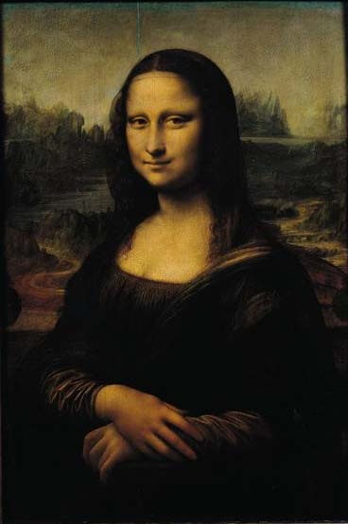

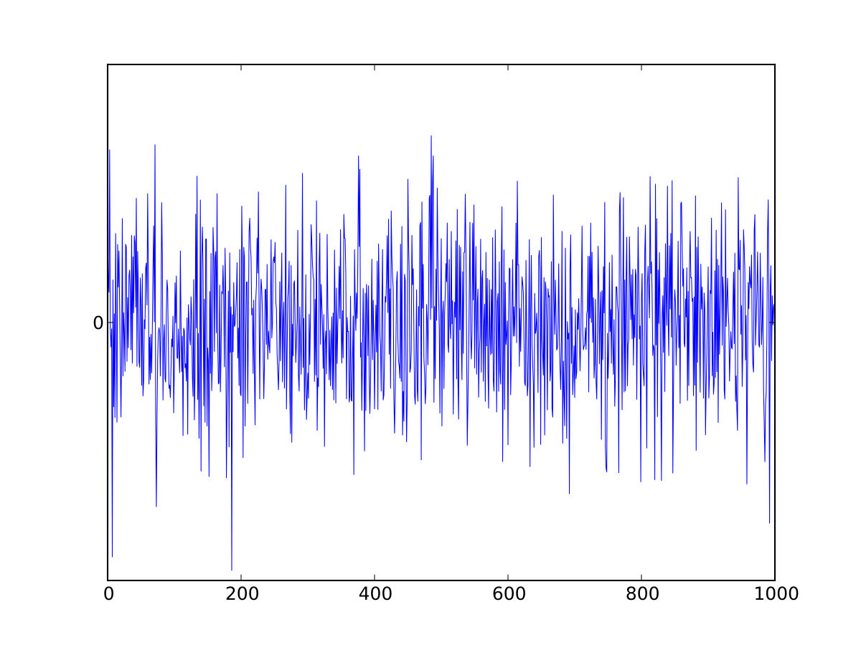
Real Samples
Discriminator
(D)
Is D correct?
Fake Samples
Generator
(G)
Update parameters
This Photo by Unknown Author is licensed under CC BY-SA

