Slide 1

GenAI Buildathon
Problem Statement Title: NAARI – The Web Application
Theme: Women Empowerment & Digital Transformation
PS Category: Software
Team Name: GeekGenesis
Team Members: 1. MD Shehzad- Team Leader, AIML & Backend Developer
2. Syed Rahman- Frontend DEVELOPER
3. MOHD KAIF- DEPLOYMENT ENGINEER
UID: f38fa611-0972-4df3-b445-5f2ebca22e21

Slide 2
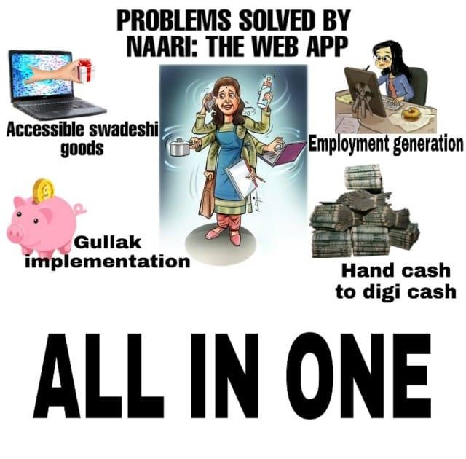
NAARI – The Web Application

Slide 3
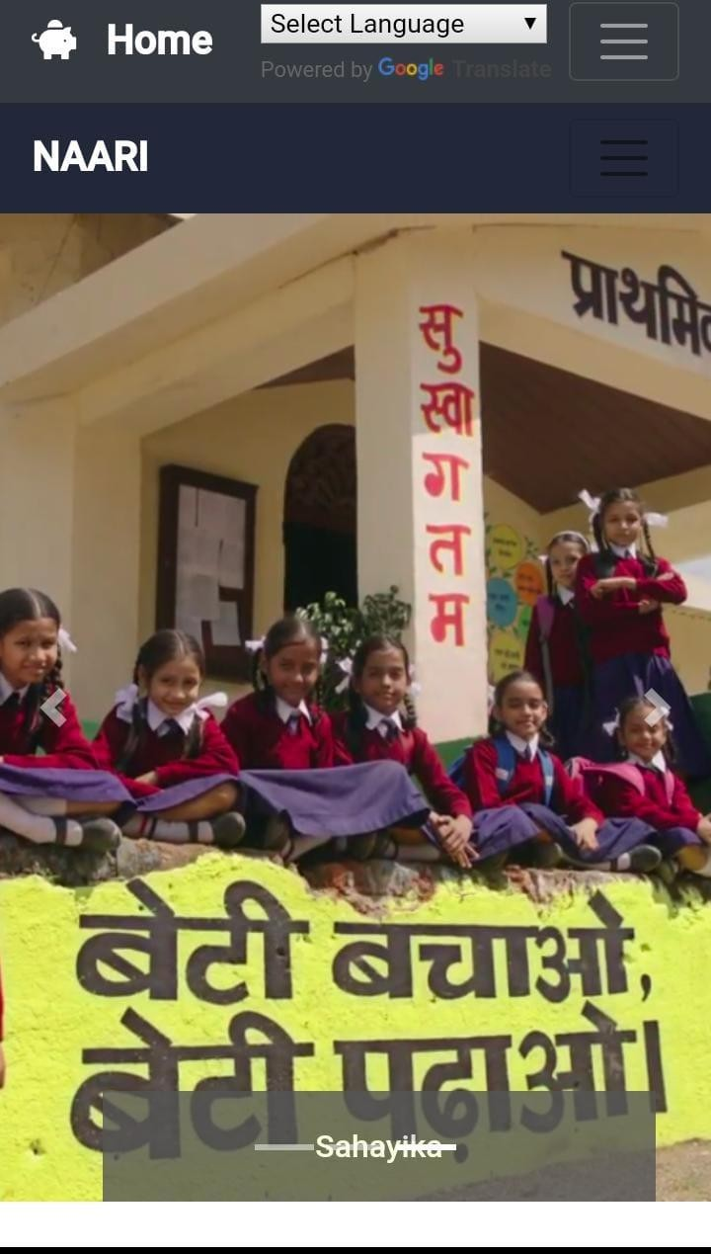
Technology Stack Used
HTML,CSS,JQuery
Bootstrap , JavaScript
Frontend
Backend ML Models APIs
Cloud Sever
NodeJS v14.3.0
database PostgreSQL -12
Chat Bot- Dialog Flow
Deep learning keras (ResNet-50)
Government- Digilocker API , Aadhar Verification
Google -Geo Location API, Translator API
AWS (Amazon Web Service)
Digital Ocean
For Transaction
Paytm API

Slide 4
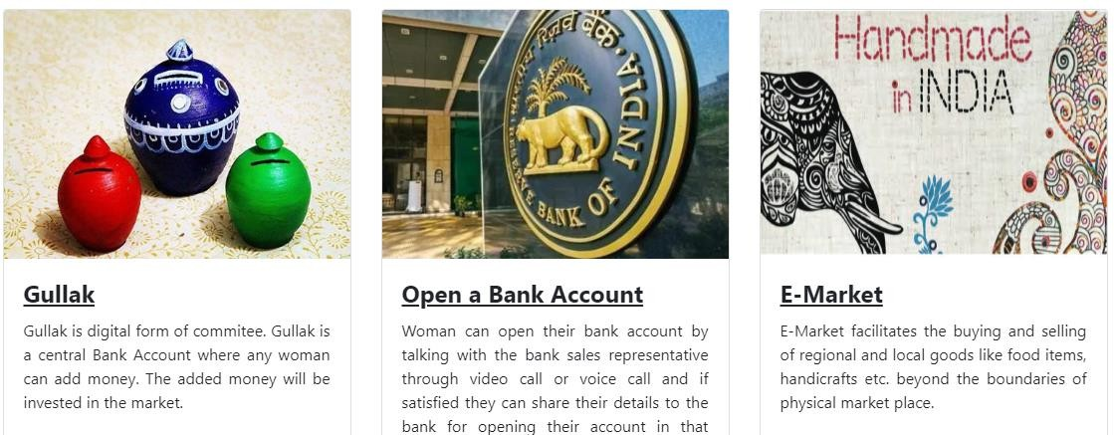
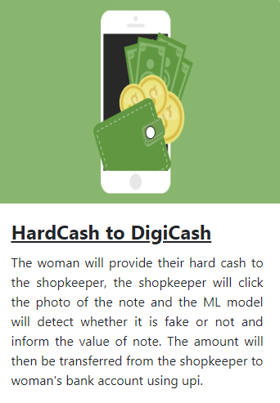

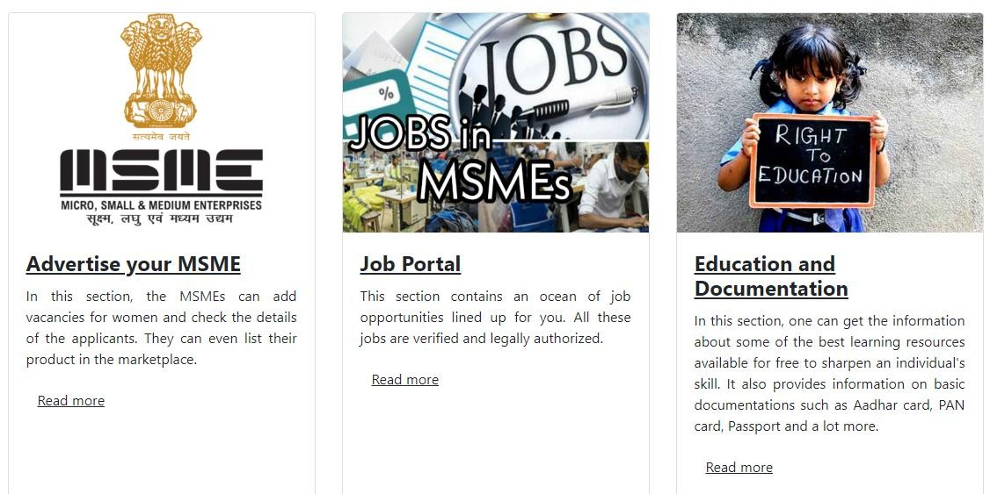
Services provided by NAARI

Slide 5
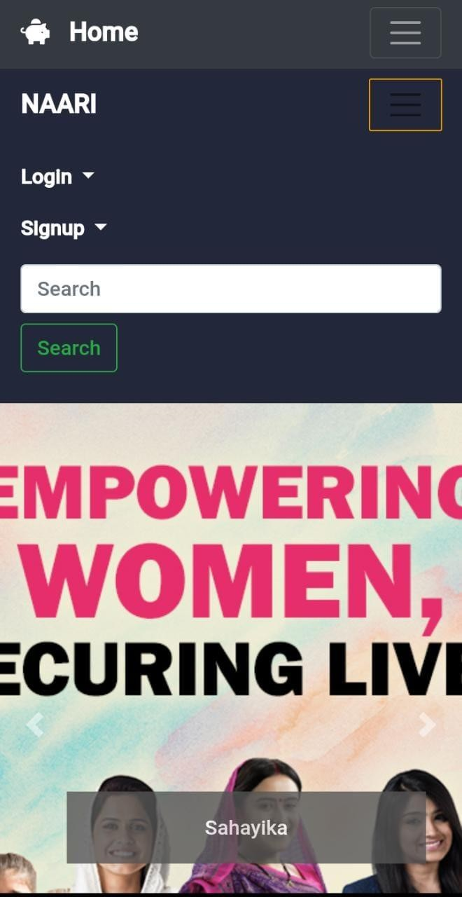
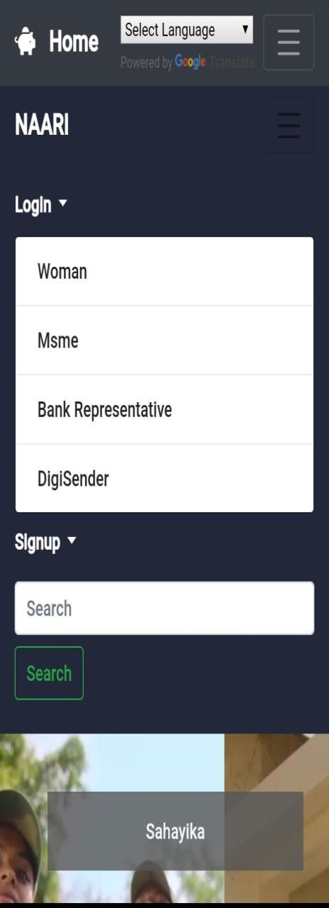
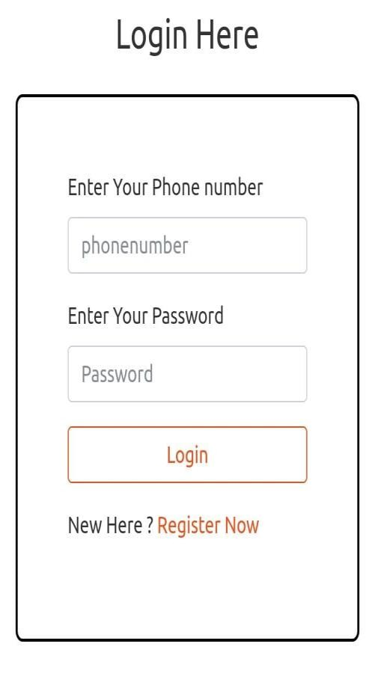
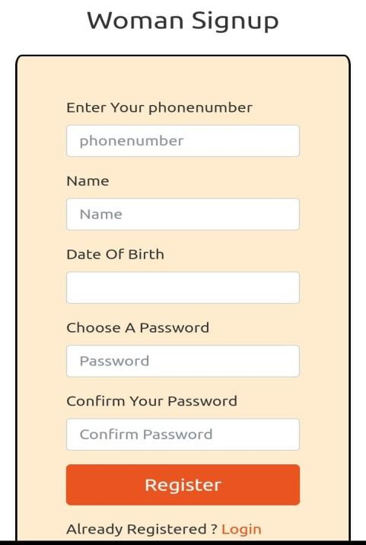
Working of NAARI
Language Select
Is member
No
Yes
Chat Bot

Slide 6
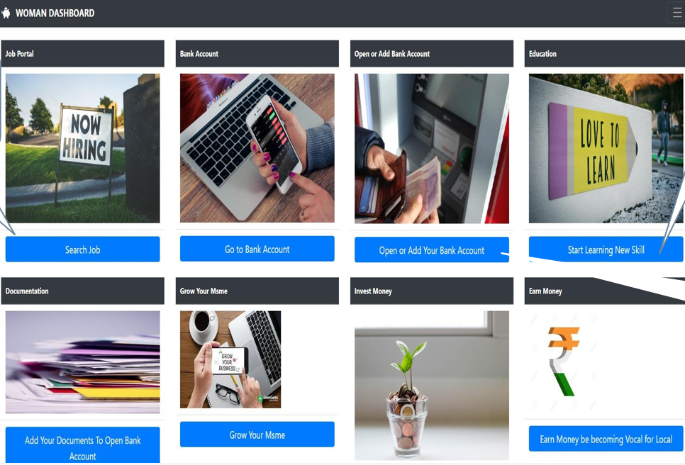
After Login Signup Women Dashboard will appear
Webpage of Various Courses of education Opens
Webpage opens with various types of jobs and qualification in it
Webpage opens that will help to open ur bank account

Slide 7
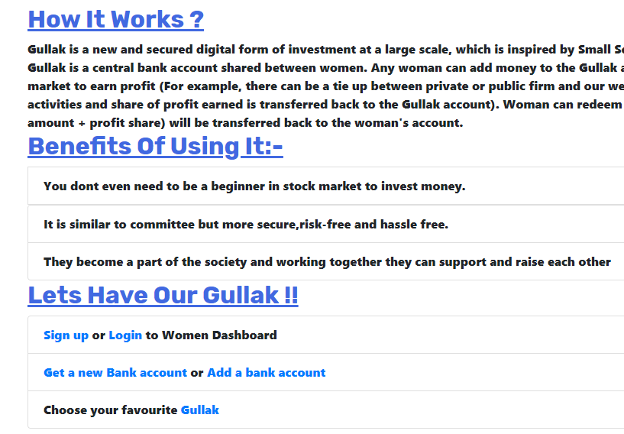
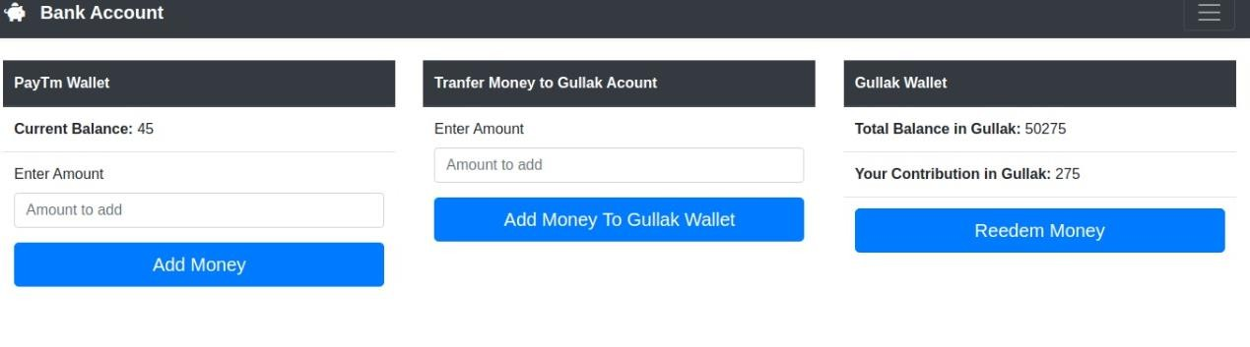
Gullak
Webpage appear to add or transfer money

Slide 8
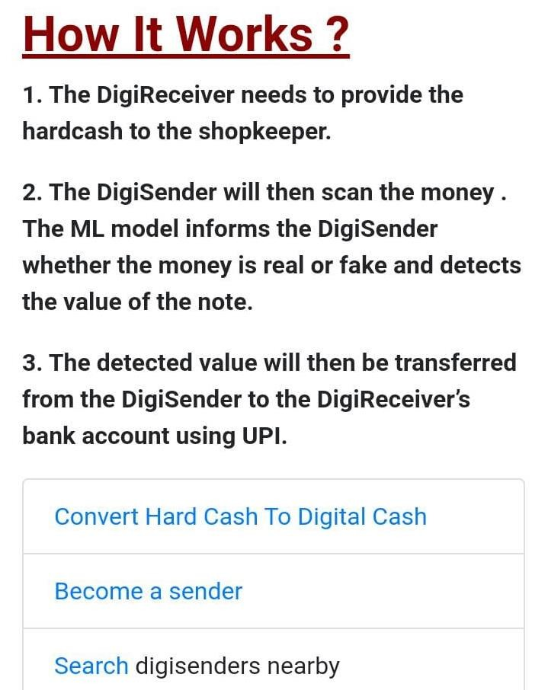
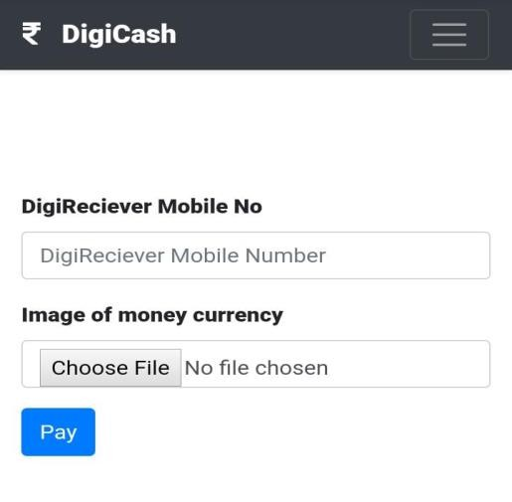
Hand Cash to Digi Cash
The DIGI Cash dialog box appears
R->S
If you want to become a sender login to page and start the process.
Shopkeeper will
Search Digi Senders nearby our place

Slide 9
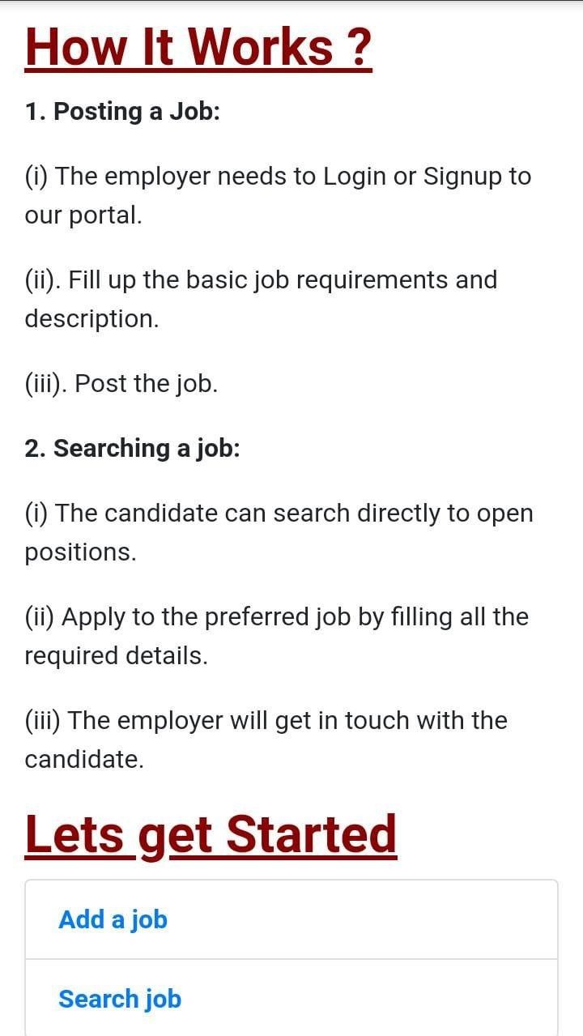
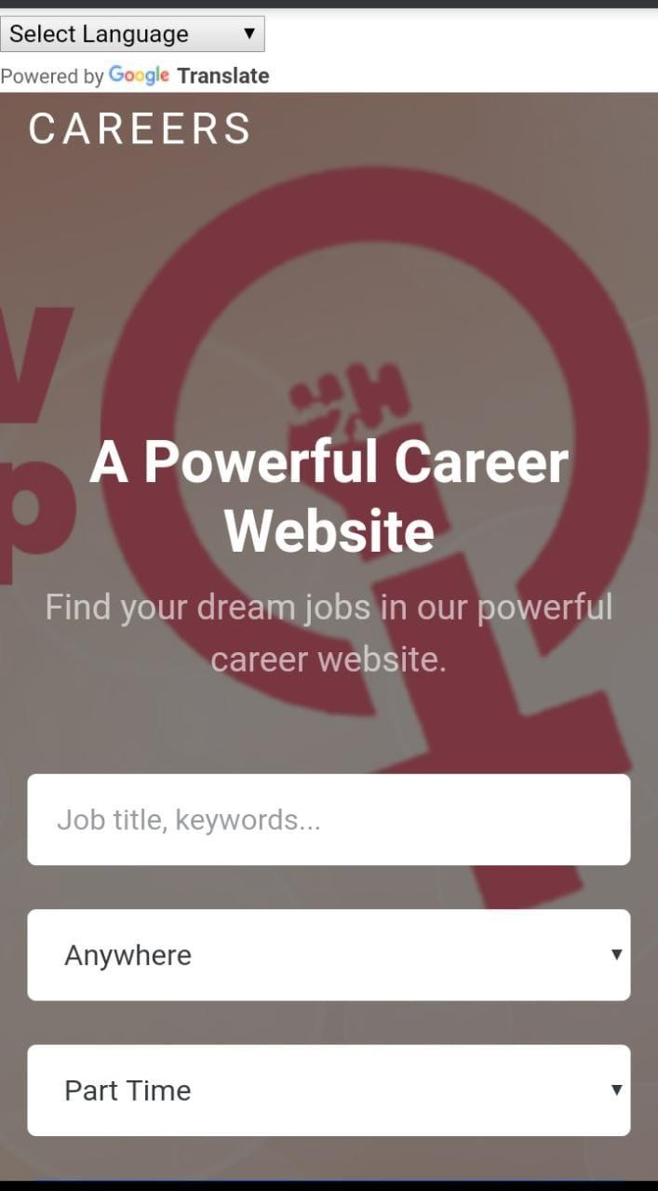
Job Portal
Webpage appear for Adding a job and he must be registered
Job Search site opens

Slide 10
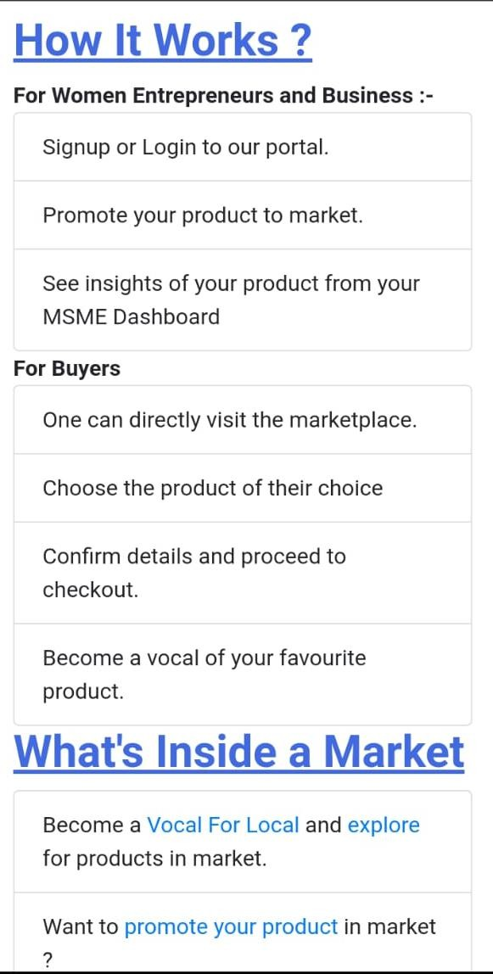
Vocal for local
Web page for Vocal
Appears
You can see the new Products which are being advertised.
Webpage appear for
promoting your Products

Slide 11
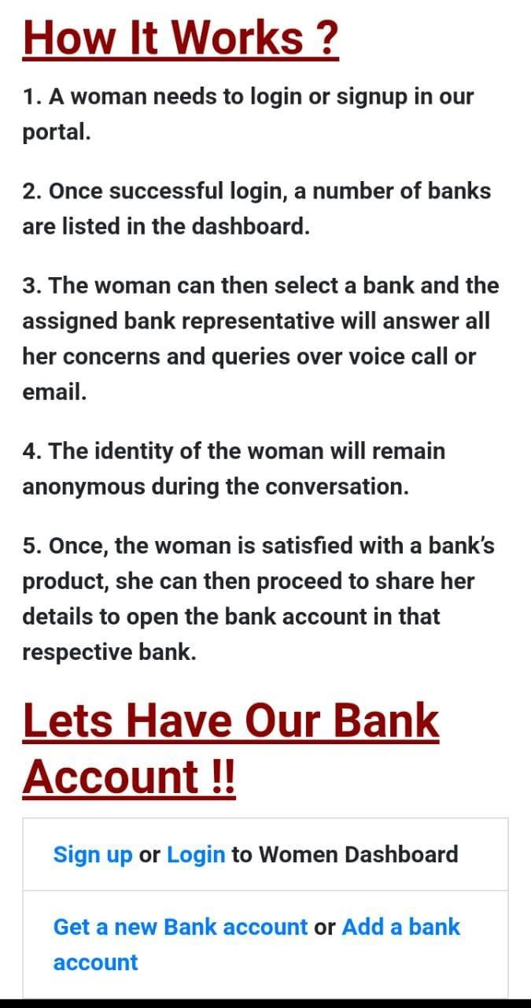
Opening a Bank Account
Webpage appears in which bank she wants to add her account and can call or videocall them
Login page appears and women dashboard appears

Slide 12

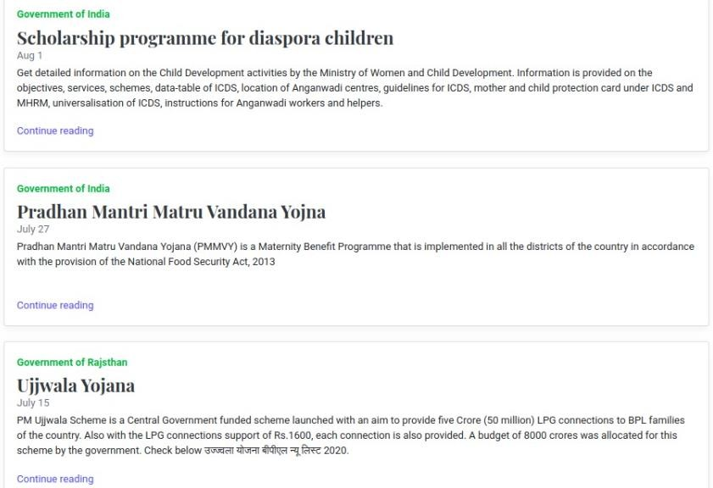
Latest Schemes and Policies
This Webpage Helps you find the latest Schemes and Policies Provided by the government and how to use them and how to register for them

Slide 13
REFERENCES
Bootstrap — https://getbootstrap.com/docsgetbootstrap
jQuery — https://api.jquery.comgetbootstrap
Node.js v14.3.0 — https://nodejs.org/download/release/v14.3.0/docs/api/nodejs
PostgreSQL 12 — https://www.postgresql.org/files/documentation/pdf/12/postgresql-12-A4.pdfpostgresql
Dialogflow (ES/CX) — https://cloud.google.com/dialogflow/docsgetbootstrap
ResNet-50 (CVPR 2016) — https://arxiv.org/abs/1512.03385getbootstrap
Keras — https://keras.iogetbootstrap
DigiLocker (Partners) — https://www.digilocker.gov.in/web/partners/issuersdigilocker
Aadhaar Auth API v2.5 — https://uidai.gov.in/images/resource/Aadhaar_Authentication_API-2.5_Revision-1_of_January_2022.pdfuidai
Geolocation API — https://developers.google.com/maps/documentation/geolocation/overviewdevelopers.google
Translation API — https://cloud.google.com/translate/docscloud.google
AWS Docs — https://docs.aws.amazon.comgetbootstrap
DigitalOcean Docs — https://docs.digitalocean.comdigitalocean
Schemes (National Portal) — https://www.india.gov.in/my-government/schemesdigilocker
PMJDY — https://pmjdy.gov.in

