Slide 1

PYPI
Kaipa subhash reddy

Slide 2
INDEX
Pypi
Contribution library to pypi.
Commands in commandprompt.
Package Creation.
Link of Created package.
Reference
Conclusion.

Slide 3
PYPI
Python Package Index.
It is a repository.
Able to install package and libraries.
https://pypi.org/ to access to pypi package.

Slide 4
CONTRIBUTION TO PYPI
Create account in pypi.org.
Create a library or package.
By using command prompt we can able to upload your package to pypi.

Slide 5
COMMANDS IN POWERSHELL
pip install setuptools twine
python3 setup.py sdist
twine upload –repository-url https://upload.pypi.org/legacy/ dist/*
After it will ask user name and password then after it will able to upload your package to pypi.
It generates URL for the uploaded package where any one can able to access and install this package.

Slide 6
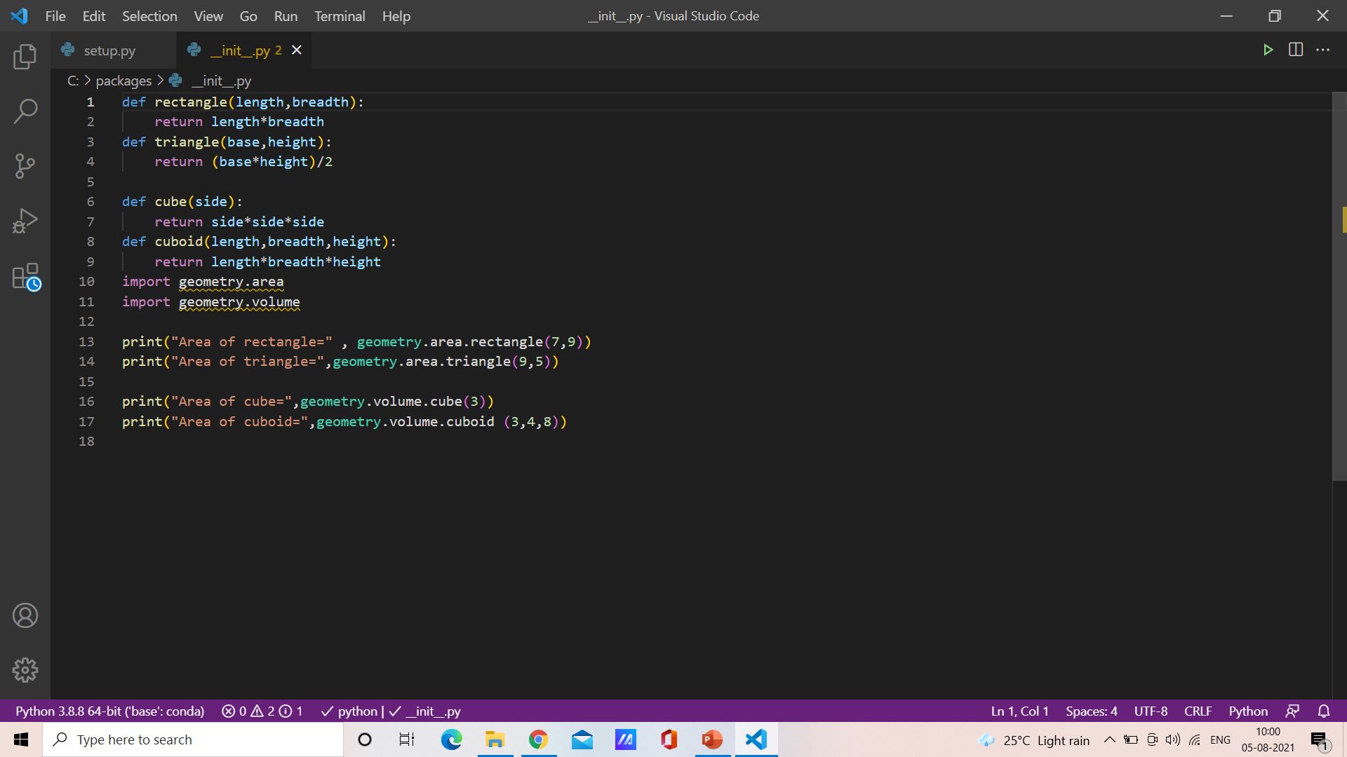
PACKAGE CREATION
__init__.py:

Slide 7
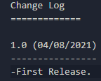
PACKAGE CREATION
CHANGELOG.txt:

Slide 8
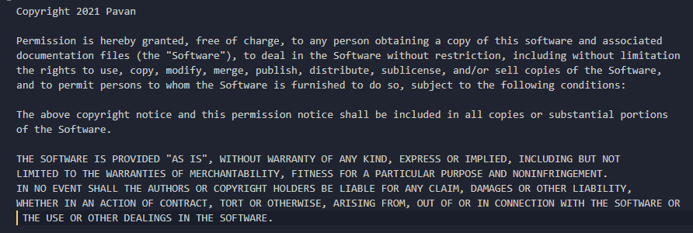
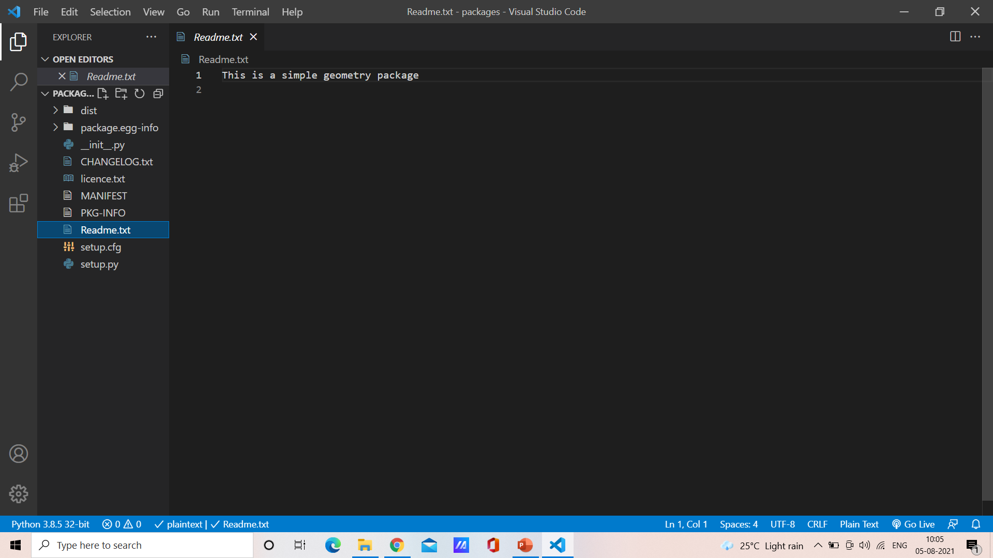
LICENCE.txt:
README.txt:

Slide 9
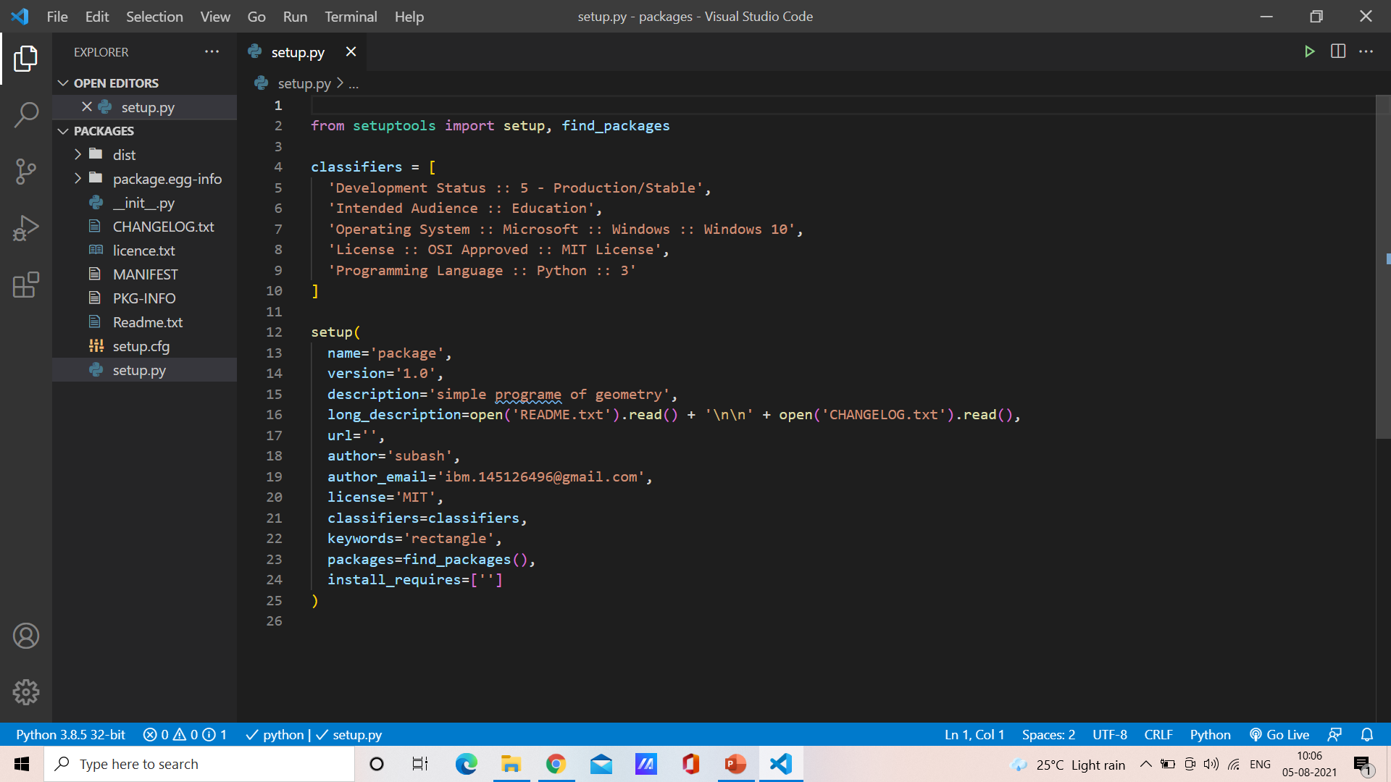
setup.py:

Slide 10
REFERENCE
https://www.youtube.com/watch?v=zhpI6Yhz9_4&t=4s
https://www.wyre-it.co.uk/blog/creating-a-python-package/

Slide 11
CONCLUSION
Able to upload package/Library in pypi..org
Understand how to create package and upload to pypi.

Slide 12


