Slide 1
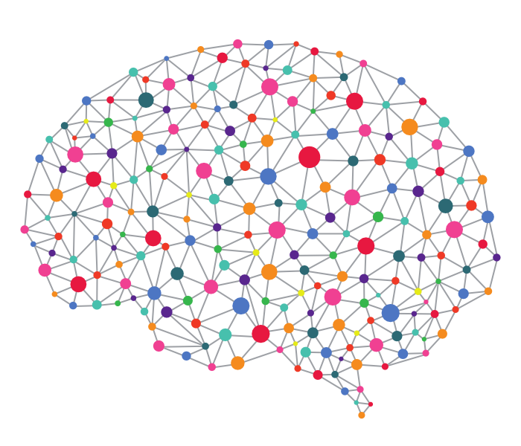
LG-KAIST AI [ Deep Reinforcement Learning 실습 ]
TA: Haanvid Lee, HyeongJoo Hwang, Shinhyung Kim
Advisor: Kee-Eung Kim
KAIST AIPR Lab
[ Contact Info. ]
Haanvid Lee: hvlee@ai.kaist.ac.kr HyeongJoo Hwang: hjhwang@ai.kaist.ac.kr
Shinhyung Kim: shkim@ai.kaist.ac.kr
KeeEung Kim: kekim@cs.kaist.ac.kr

Slide 2
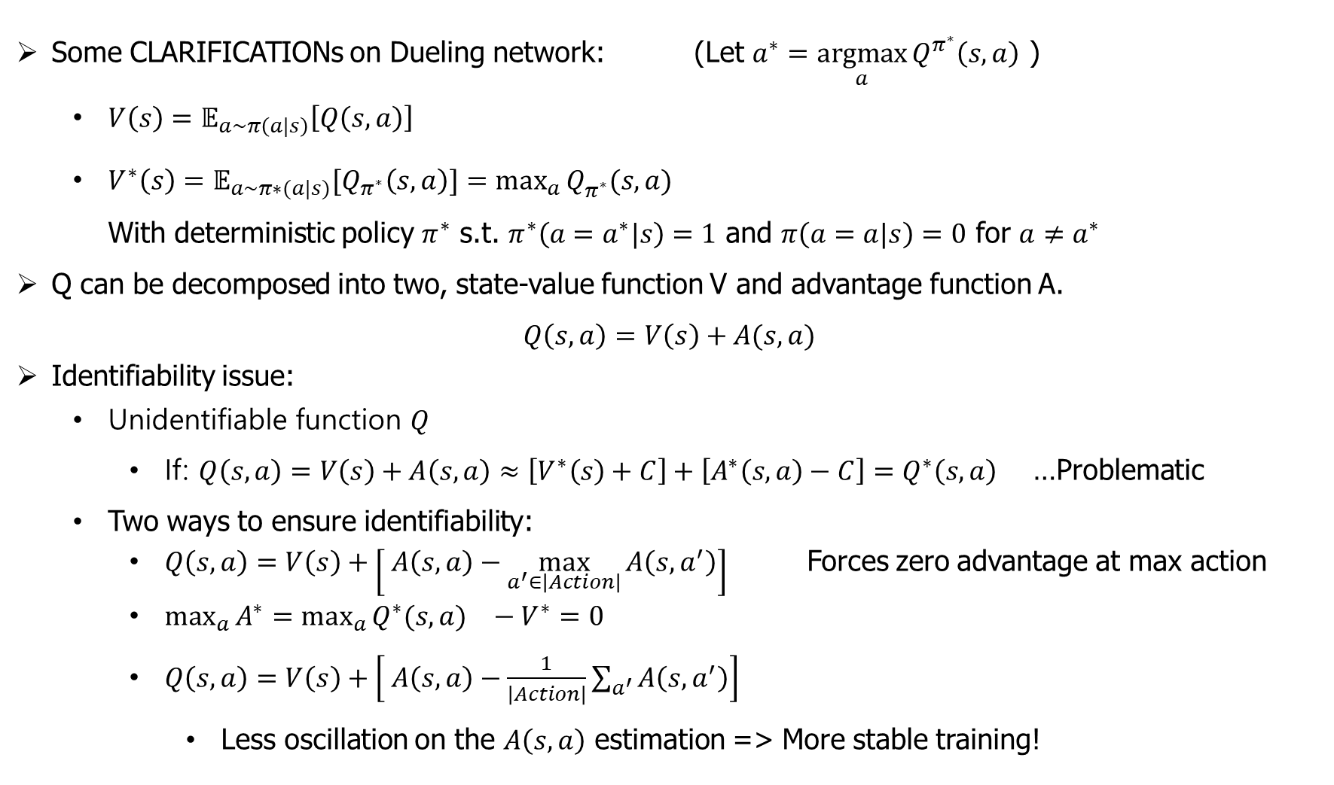
Dueling DQN (DQN++)
Wang et al. (2015). “Dueling Network Architectures for Deep Reinforcement Learning”
Some CLARIFICATIONs on Dueling network: (Let $a^{∗}=\underset{a}{argmax}{Q^{π^{∗}}\left(s,a\right)}$ )
${V\left(s\right)=𝔼}_{a\sim π\left(a|s\right)}\left[Q\left(s,a\right)\right]$
$V^{∗}\left(s\right)={𝔼_{a\sim π∗(a|s)}[Q}_{π^{∗}}\left(s,a\right)]=\max_{a}{Q_{π^{∗}}^{}(s,a)}$ With deterministic policy $π^{∗}$ s.t. $π^{∗}\left({a=a}^{∗}|s\right)=1$ and $π\left(a=a|s\right)=0$ for $a≠a^{∗}$
Q can be decomposed into two, state-value function V and advantage function A.
$$Q\left(s,a\right)=V\left(s\right)+A(s,a)$$
Identifiability issue:
Unidentifiable function $Q$
If: $Q\left(s,a\right)=V\left(s\right)+A\left(s,a\right)≈\left[V^{∗}\left(s\right)+C\right]+\left[A^{∗}\left(s,a\right)−C\right]=Q^{∗}\left(s,a\right)$ …Problematic
Two ways to ensure identifiability:
$Q\left(s,a\right)=V\left(s\right)+\left[ A\left(s,a\right)−\max_{a^{′}∈\left|Action\right|}{A\left(s,a^{′}\right)}\right]$ Forces zero advantage at max action
$\max_{a}{A^{∗}}={\max_{a}{Q^{∗}(s,a)}}^{}−V^{∗}=0$
$Q\left(s,a\right)=V\left(s\right)+\left[ A\left(s,a\right)−\frac{1}{\left|Action\right|}\sum_{a^{′}}{A\left(s,a^{′}\right)}\right]$
Less oscillation on the $A\left(s,a\right)$ estimation => More stable training!

Slide 3
Tutorial Guidelines
Experiment 1:
Vanilla Policy Gradient (VPG)
REINFORCE
Variance reduction with baseline
Experiment 2:
Deep Deterministic Policy Gradient (DDPG)
Deterministic policy vs stochastic policy
Relation to DQN

Slide 4
Experiment #1:
Lunar lander control with VPG

Slide 5
VPG
VPG directly optimize the policy from the expected return.
Model-free: Not required to know the environment dynamics
Discrete or continuous action output
Discrete: softmax output
Continuous: Gaussian output
On-policy
Algorithms
REINFORCE
Baseline
Notes:
On-policy: 다른 policy에서 sampl된 trajectory 또는 episode들을 사용할 수 없다.

Slide 6
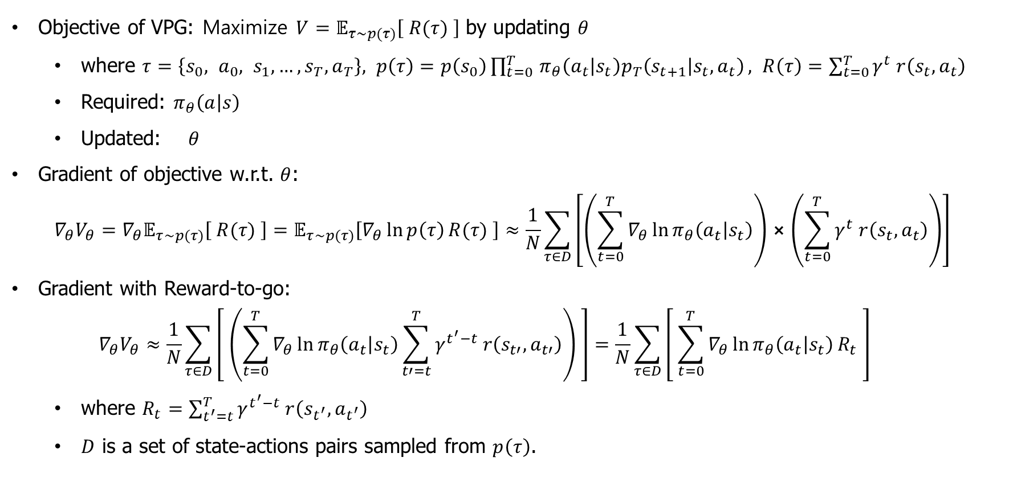
REINFORCE
Objective of VPG: Maximize $V=𝔼_{τ\sim p(τ)}\left[ R(τ) \right]$ by updating $θ$
where $τ=\left\{s_{0}, a_{0}, s_{1},…, s_{T}, a_{T}\right\}, p\left(τ\right)=p\left(s_{0}\right)\prod_{t=0 }^{T}{π_{θ}\left(a_{t} | s_{t}\right)p_{T}\left(s_{t+1} | s_{t},a_{t}\right)}, R\left(τ\right)=\sum_{t=0}^{T}{γ^{t} r\left(s_{t},a_{t}\right)}$
Required: $π_{θ}\left(a | s\right)$
Updated: $θ$
Gradient of objective w.r.t. $θ$:
$$∇_{θ}V_{θ}=∇_{θ}𝔼_{τ\sim p(τ)}\left[ R(τ) \right]=𝔼_{τ\sim p(τ)}\left[∇_{θ}\ln{p\left(τ\right)}R(τ) \right]≈\frac{1}{N}\sum_{τ∈D}{\left[\left(\sum_{t=0}^{T}{∇_{θ}\ln{π_{θ}\left(a_{t} | s_{t}\right)}}\right)⨯\left(\sum_{t=0}^{T}{γ^{t} r\left(s_{t},a_{t}\right)}\right)\right]}$$
Gradient with Reward-to-go:
$$∇_{θ}V_{θ}≈\frac{1}{N}\sum_{τ∈D}{\left[ \left(\sum_{t=0}^{T}{∇_{θ}\ln{π_{θ}\left(a_{t} | s_{t}\right)}}\sum_{t′=t}^{T}{γ^{t^{′}−t} r\left(s_{t′},a_{t′}\right)}\right) \right]}=\frac{1}{N}\sum_{τ∈D}{\left[ \sum_{t=0}^{T}{∇_{θ}\ln{π_{θ}\left(a_{t} | s_{t}\right)}R_{t}} \right]}$$
where $R_{t}=\sum_{t^{′}=t}^{T}{γ^{t^{′}−t} r\left(s_{t^{′}},a_{t^{′}}\right)}$
$D$ is a set of state-actions pairs sampled from $p\left(τ\right)$.
Notes:
On-policy: 다른 policy에서 sampl된 trajectory 또는 episode들을 사용할 수 없다.

Slide 7
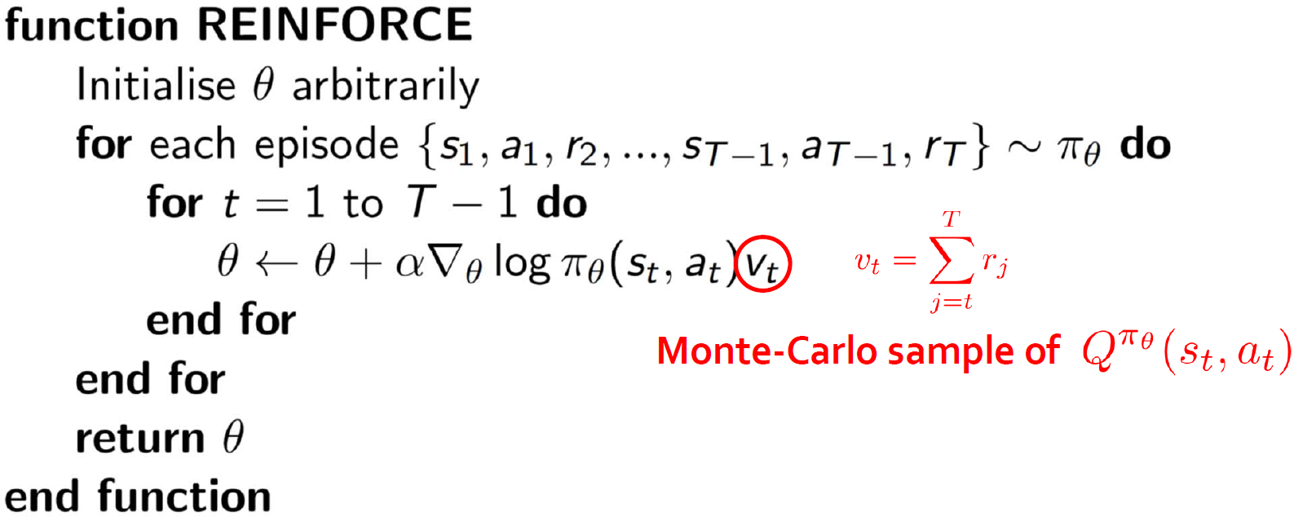
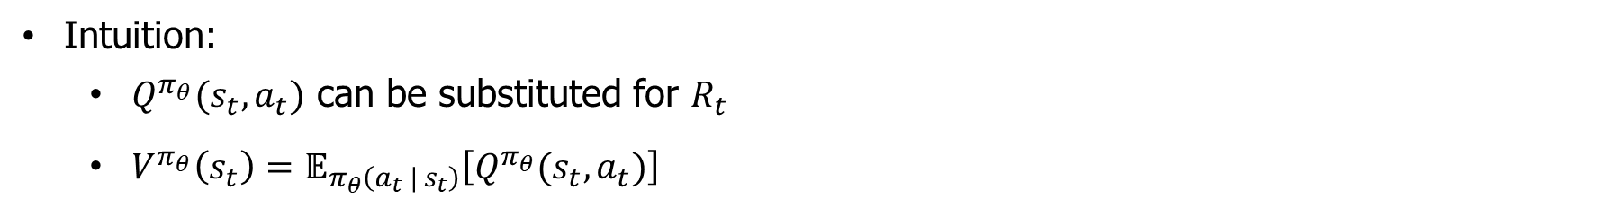
REINFORCE
Intuition:
$Q^{π_{θ}}(s_{t},a_{t})$ can be substituted for $R_{t}$
$V^{π_{θ}}\left(s_{t}\right)=𝔼_{π_{θ}\left(a_{t} | s_{t}\right)}\left[Q^{π_{θ}}(s_{t},a_{t})\right]$
Notes:
On-policy: 다른 policy에서 sampl된 trajectory 또는 episode들을 사용할 수 없다.

Slide 8
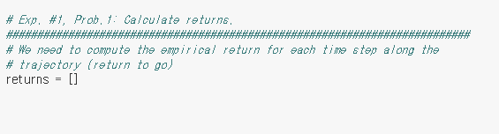
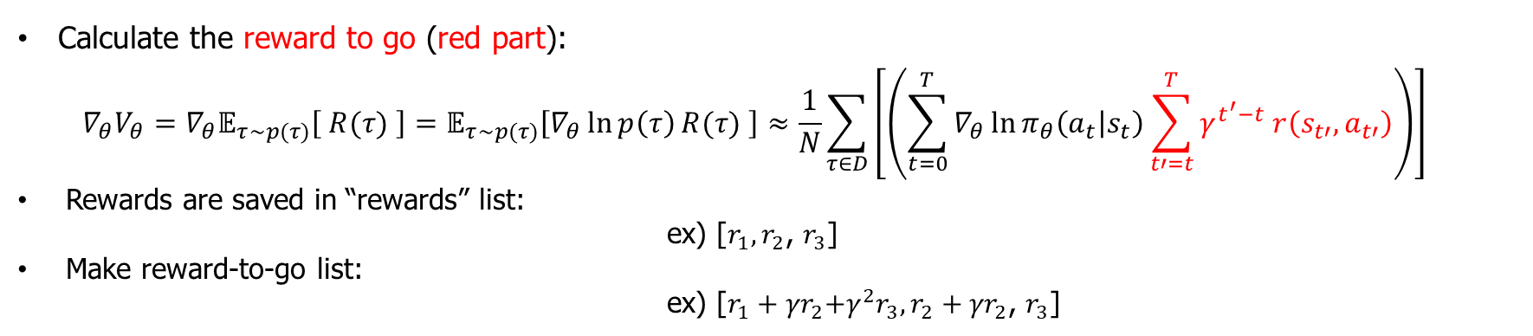
REINFORCE (problem 1/2)
Calculate the reward to go (red part):
$$∇_{θ}V_{θ}=∇_{θ}𝔼_{τ\sim p(τ)}\left[ R(τ) \right]=𝔼_{τ\sim p(τ)}\left[∇_{θ}\ln{p\left(τ\right)}R(τ) \right]≈\frac{1}{N}\sum_{τ∈D}{\left[\left(\sum_{t=0}^{T}{∇_{θ}\ln{π_{θ}\left(a_{t} | s_{t}\right)}}\sum_{t′=t}^{T}{γ^{t^{′}−t} r\left(s_{t′},a_{t′}\right)}\right)\right]}$$
Rewards are saved in “rewards” list: ex) [$r_{1},r_{2}$, $r_{3}$]
Make reward-to-go list: ex) [$r_{1}+{γr}_{2}\text{+}γ^{2}r_{3},r_{2}+{γr}_{2}$, $r_{3}$]
Notes:
On-policy: 다른 policy에서 sampl된 trajectory 또는 episode들을 사용할 수 없다.

Slide 9
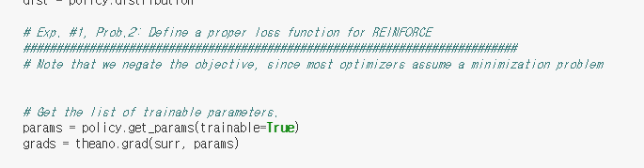
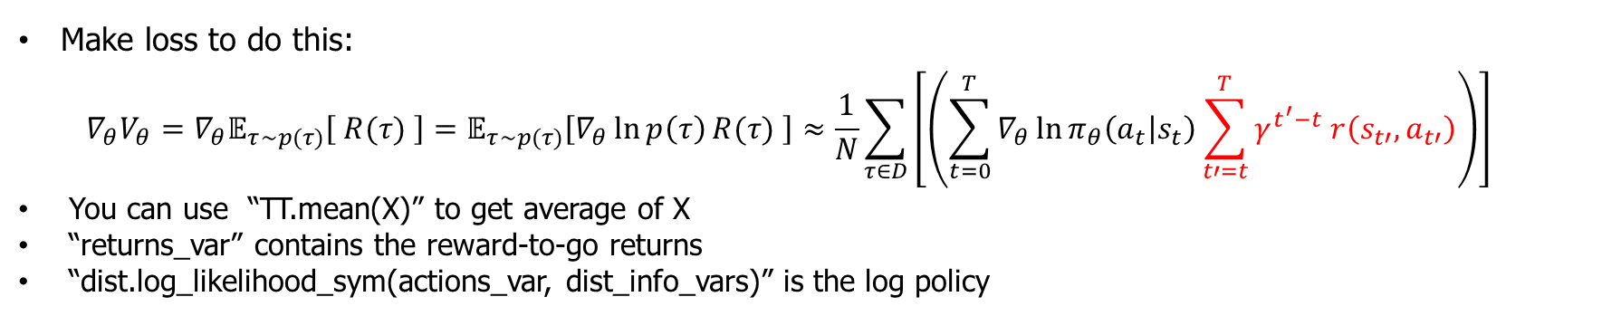
REINFORCE (problem 2/2)
Make loss to do this:
$$∇_{θ}V_{θ}=∇_{θ}𝔼_{τ\sim p(τ)}\left[ R(τ) \right]=𝔼_{τ\sim p(τ)}\left[∇_{θ}\ln{p\left(τ\right)}R(τ) \right]≈\frac{1}{N}\sum_{τ∈D}{\left[\left(\sum_{t=0}^{T}{∇_{θ}\ln{π_{θ}\left(a_{t} | s_{t}\right)}}\sum_{t′=t}^{T}{γ^{t^{′}−t} r\left(s_{t′},a_{t′}\right)}\right)\right]}$$
You can use “TT.mean(X)” to get average of X
“returns_var” contains the reward-to-go returns
“dist.log_likelihood_sym(actions_var, dist_info_vars)” is the log policy
Notes:
On-policy: 다른 policy에서 sampl된 trajectory 또는 episode들을 사용할 수 없다.

Slide 10
Control lunar lander with VPG
Environment: OpenAI gym lunar lander continuous action environment ( ‘LunarLanderContinuous-v2’)
Used libraries: rllab, OpenAI Gym, etc…
Practice:
Try to fill in the blanks of “Day2_REINFORCE_LunarLander_v2.ipynb” and train the agent in the lunar lander environment.
Check average returns along training epochs.
Evaluate the trained agent.
Notes:
Plot mse of Q function?

Slide 11
LunarLanderContinuous-v2 Environment
State
Fire left orientation engine
-1 to -0.5
Fire right orientation engine
+0.5 to +1.0
Num | Observation
0 | X coordinate of Lander
1 | Y coordinate of Lander
2 | X velocity of Lander
3 | Y velocity of Lander
4 | Angle of Lander
5 | Angular velocity of Lander
6 | Left leg ground contact
7 | Right leg ground contact
(x,y)
Fire main engine
0 to +1
Reward
(0,0)
Reward | Conditions
100 to 140 | Moving from the top of the screen to landing pad and zero speed. If moves away from landing pad, it loses reward back
-100 | If the lander crashes
+100 | If the lander comes to rest
+10 | Each leg ground contact
-0.3 | Firing main engine
200 | Solved
Action
Num | Actions | Range
0 | Fire main engine | -1 to 1
1 | Fire left-right engines | -1 to 1

Slide 12
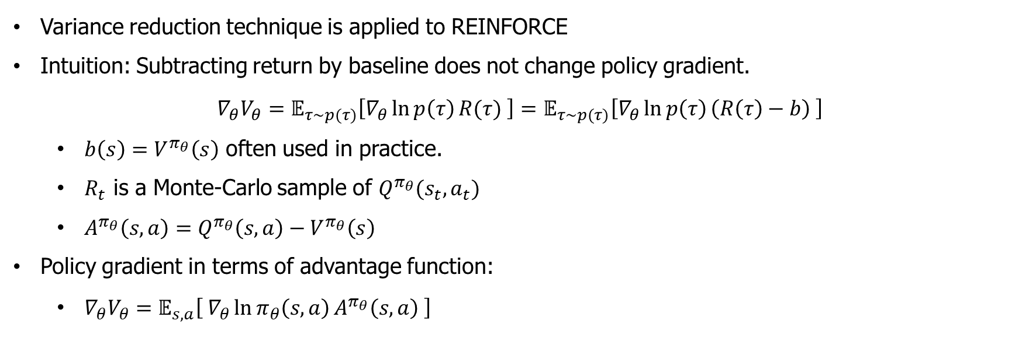
Baseline (HW)
Variance reduction technique is applied to REINFORCE
Intuition: Subtracting return by baseline does not change policy gradient.
$$∇_{θ}V_{θ}=𝔼_{τ\sim p(τ)}\left[∇_{θ}\ln{p\left(τ\right)}R(τ) \right]=𝔼_{τ\sim p(τ)}\left[∇_{θ}\ln{p\left(τ\right)}\left(R\left(τ\right)−b\right) \right]$$
$b\left(s\right)=V^{π_{θ}}\left(s\right)$ often used in practice.
$R_{t}$ is a Monte-Carlo sample of $Q^{π_{θ}}(s_{t},a_{t})$
$A^{π_{θ}}\left(s,a\right)=Q^{π_{θ}}\left(s,a\right)−V^{π_{θ}}\left(s\right)$
Policy gradient in terms of advantage function:
$∇_{θ}V_{θ}=𝔼_{s,a}\left[ ∇_{θ}\ln{π_{θ}\left(s,a\right)}A^{π_{θ}}\left(s,a\right) \right]$
Notes:
On-policy: 다른 policy에서 sampl된 trajectory 또는 episode들을 사용할 수 없다.

Slide 13
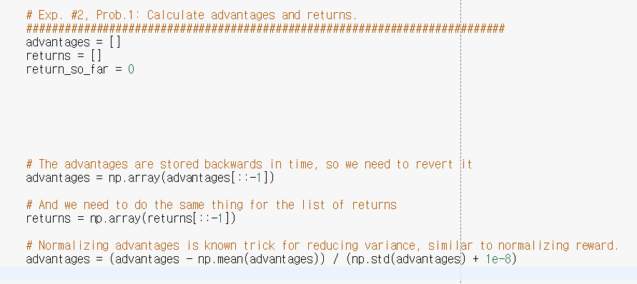
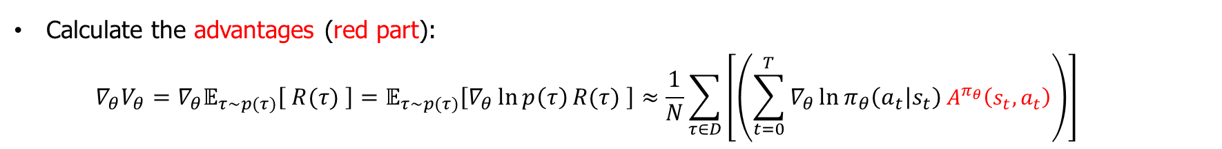
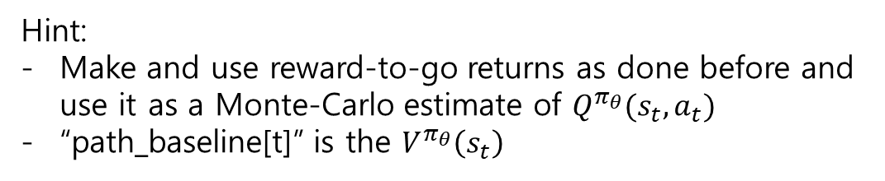
VPG: policy gradient with baseline (problem 1/2)
Calculate the advantages (red part):
$$∇_{θ}V_{θ}=∇_{θ}𝔼_{τ\sim p(τ)}\left[ R(τ) \right]=𝔼_{τ\sim p(τ)}\left[∇_{θ}\ln{p\left(τ\right)}R(τ) \right]≈\frac{1}{N}\sum_{τ∈D}{\left[\left(\sum_{t=0}^{T}{∇_{θ}\ln{π_{θ}\left(a_{t} | s_{t}\right)}}A^{π_{θ}}\left(s_{t},a_{t}\right)\right)\right]}$$
Hint:
Make and use reward-to-go returns as done before and use it as a Monte-Carlo estimate of $Q^{π_{θ}}(s_{t},a_{t})$
“path_baseline[t]” is the $V^{π_{θ}}\left(s_{t}\right)$
Notes:
On-policy: 다른 policy에서 sampl된 trajectory 또는 episode들을 사용할 수 없다.

Slide 14
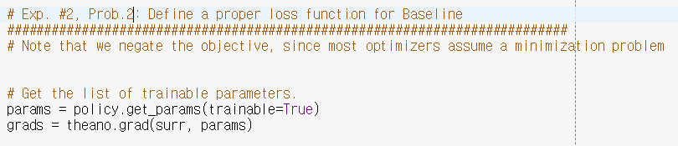
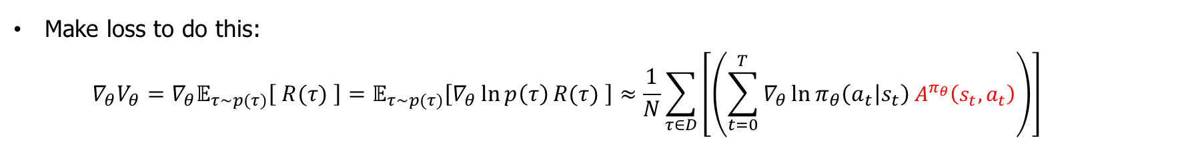
VPG: policy gradient with baseline (problem 2/2)
Make loss to do this:
$$∇_{θ}V_{θ}=∇_{θ}𝔼_{τ\sim p(τ)}\left[ R(τ) \right]=𝔼_{τ\sim p(τ)}\left[∇_{θ}\ln{p\left(τ\right)}R(τ) \right]≈\frac{1}{N}\sum_{τ∈D}{\left[\left(\sum_{t=0}^{T}{∇_{θ}\ln{π_{θ}\left(a_{t} | s_{t}\right)}}A^{π_{θ}}\left(s_{t},a_{t}\right)\right)\right]}$$
You can use “TT.mean(X)” to get average of X
“rewards” contains the rewards in a list.
“dist.log_likelihood_sym(actions_var, dist_info_vars)” is the log policy
Notes:
On-policy: 다른 policy에서 sampl된 trajectory 또는 episode들을 사용할 수 없다.

Slide 15
Experiment #2:
Lunar lander control with DDPG

Slide 16
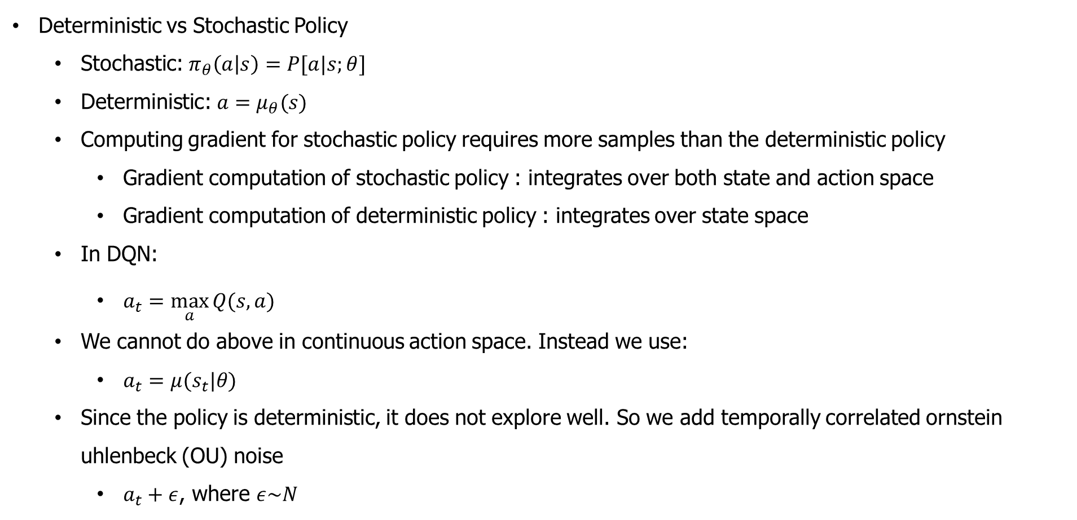
Deep Deterministic Policy Gradient
Deterministic vs Stochastic Policy
Stochastic: $π_{θ}\left(a | s\right)=P[a|s;θ]$
Deterministic: $a=μ_{θ}(s)$
Computing gradient for stochastic policy requires more samples than the deterministic policy
Gradient computation of stochastic policy : integrates over both state and action space
Gradient computation of deterministic policy : integrates over state space
In DQN:
$a_{t}=\max_{a}{Q(s,a)}$
We cannot do above in continuous action space. Instead we use:
$a_{t}=μ(s_{t}|θ)$
Since the policy is deterministic, it does not explore well. So we add temporally correlated ornstein uhlenbeck (OU) noise
$a_{t}+ε$, where $ε\sim N$
Lillicrap et al. ( ICLR 2016). "Continuous control with deep reinforcement learning “
Notes:
On-policy: 다른 policy에서 sampl된 trajectory 또는 episode들을 사용할 수 없다.

Slide 17
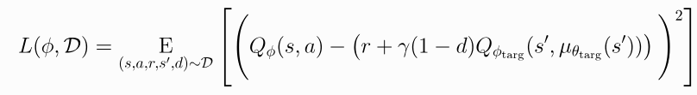




DDPG
Actor-critic algorithm
Learn Q : Minimize (gradient descent) mean square bellman error loss (MSBE)
Target policy network ($μ_{θ_{targ}}$) is used to compute an action which approximately maximizes $Q_{φ_{targ}}$
Polyak averaging:
Learn determinitic policy: Maximize (gradient ascent) expected $Q_{φ}$
Polyak averaging:
Lillicrap et al. ( ICLR 2016). "Continuous control with deep reinforcement learning “
Notes:
On-policy: 다른 policy에서 sampl된 trajectory 또는 episode들을 사용할 수 없다.

Slide 18
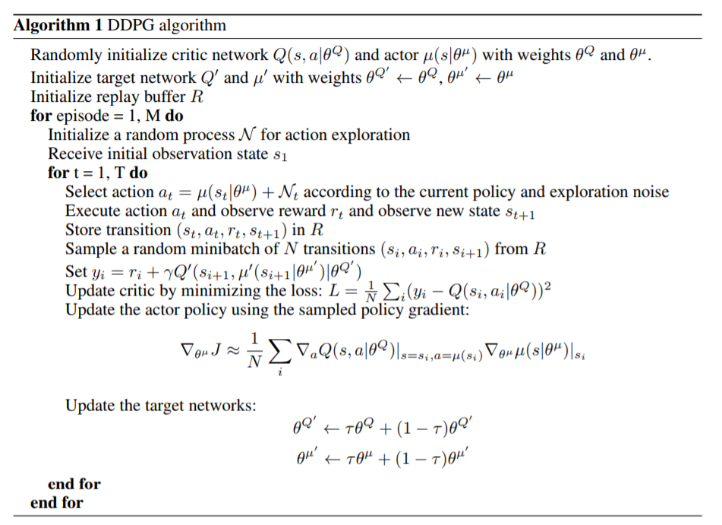
DDPG
Lillicrap et al. ( ICLR 2016). "Continuous control with deep reinforcement learning “
Notes:
On-policy: 다른 policy에서 sampl된 trajectory 또는 episode들을 사용할 수 없다.

